Slide 1
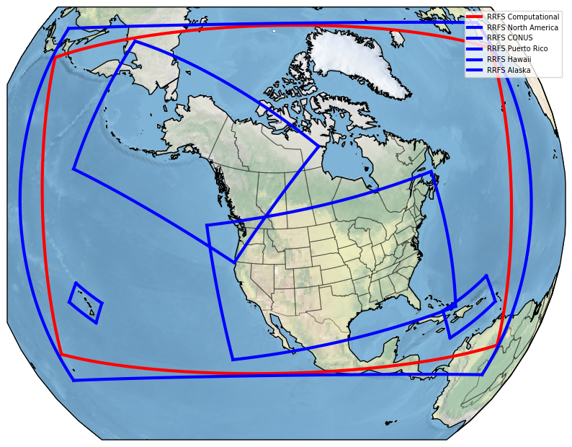
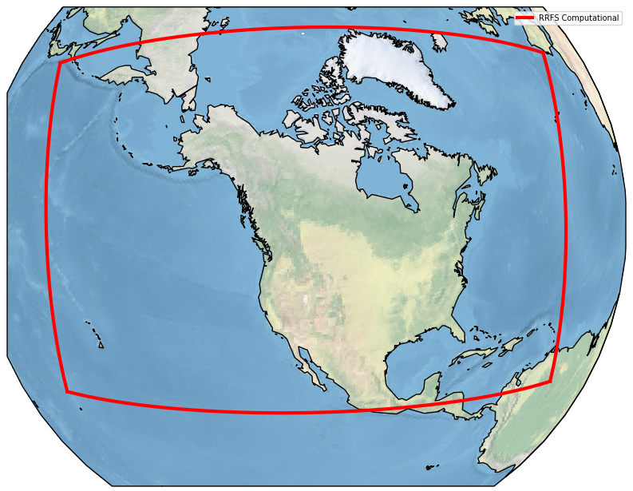
Current Status of the Rapid Refresh Forecast System
Matthew E. Pyle¹, Curtis R. Alexander², Shun Liu¹, Stephen Weygandt²
on behalf of the wider RRFS team
¹NOAA/Environmental Modeling Center, College Park, MD
²NOAA/Global Systems Laboratory, Boulder, CO
RRFS

Slide 2
A potentially large pivot ahead for RRFSv1
The RRFS development team pushed over the last year to optimize overall system performance ahead of a code freeze in late March this year.
RRFS subsequently had issues with missed severe storms during the Hazardous Weather Testbed in May 2024
Subjective and objective skill of RRFS (particularly POD) lagged well behind top performing CAMs.
RRFS was relatively worse this year from SPC perspective than the 2023 version of RRFS.
Recently, decision was made to delay RRFSv1, pulling back from the implementation process to explore alternative options.

Slide 3
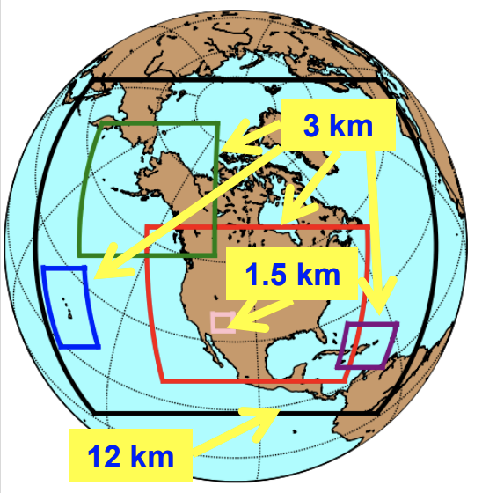
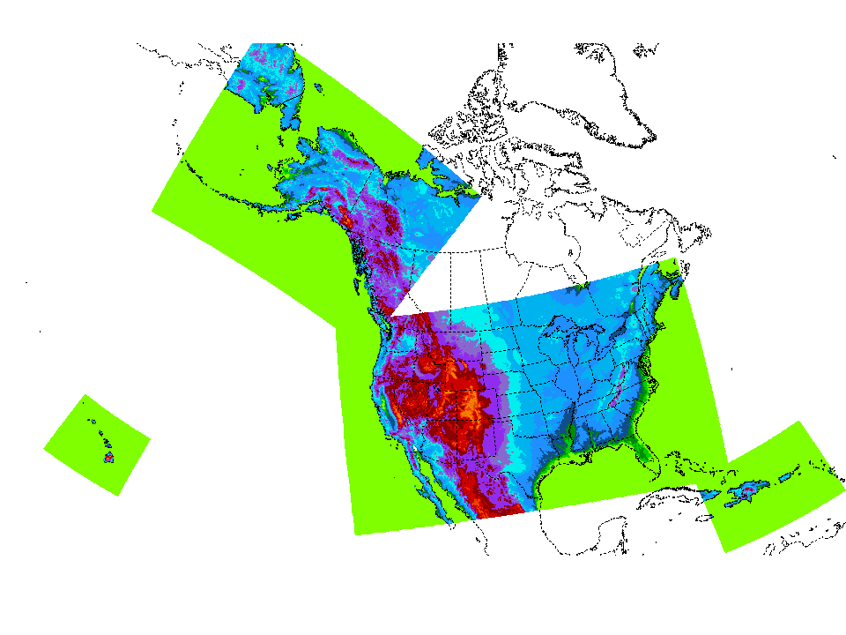
Current Rapid Refresh Forecast System (RRFS)
A UFS Application
3 km grid spacing over North America
FV3 dynamical core
Hourly updated
65 vertical layers
Hybrid 3DEnVar assimilation (30 members)
Includes Smoke & Dust
Det. & Ensemble forecasts to 60 h, every 6 hours
Deterministic forecasts only to 18 h, other cycles
NAM Nests
HiResWs
RRFSv1 Compute Domain (red)

Slide 4
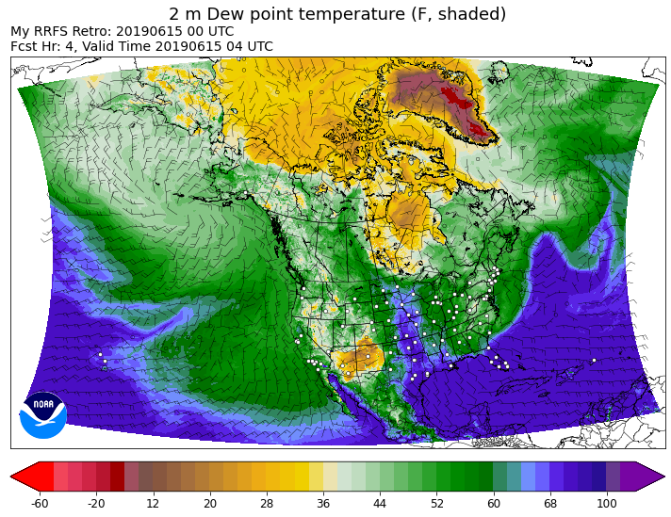
RRFSv1 Data Assimilation
GDAS
GDAS
EnKF
00
03
06
09
12
15
18
21
EnVar
00
03
06
Land
09
12
15
18
Land
21
partial cycle
Land
Atmos
Land
Atmos
03
06
15
18
GFS Atmos
GFS Atmos
Obs Platform | Variables
METAR, Mesonet, Buoy, C-Man, Ship | T, moisture, W, ps, ceiling, vis
Rawinsonde | T, moisture, W
NEXRAD Radar | dBZ, rw, VAD W
Lightning | Flash Extent Density
Aircraft | T, moisture, W
GOES-16/18 | ABI, AMVs, cloud top pres. & T
Polar Orbiters | Radiances (AMSUA, MHS, ATMS, CRIS, IASI, SSMIS)
Two-way interaction between 30 member 3-km DA ensemble ( ) and 3-km deterministic RRFS hybrid 3DEnVar analysis( )
Twice daily, large scale GDAS information is blended into RRFS EnKF system
Partial cycle spin-up of atmosphere from GFS twice per day, land states fully cyc’d

Slide 5
Changes in RRFS parallels since last year’s UIFCW (1/2)
Real time runs shifted to running over full NA domain (late July 2023)
Shift to 32-bit physics (mid Aug 2023)
Inclusion of Grell-Freitas deep convection to help address warm season hyper QPF/convection issues (mid Aug 2023)
Inclusion of CLM (small lakes) (Oct 2023)
Shift from 30h GEFS to 7h GDAS to initialize RDAS-EnKF (Nov 2023)
Shift from a single-physics to multi-physics ensemble (Dec 2023)

Slide 6
Changes in RRFS parallels since last year’s UIFCW (2/2)
Inclusion of scale- and variable-dependent localization (SDL/VDL) (end Jan 2024)
Begin assimilating GOES lightning data (Feb-Mar 2024)
Begin blending of RRFS EnKF and GDAS EnKF (Feb-Mar 2024)
“Streak” fix - reduced strength of 2-dz filtering, but applied over depth of atmosphere (late Mar 2024)
Countless physics bug fixes and tweaks
Considerable output product work, including generation of 15 minute output

Slide 7
The multi-physics ensemble membership
Ensemble forecasts at 00/06/12/18 UTC
Sources of spread:
EnKF ICs,
GEFS LBCs,
multi-physics, stochastic parameter perturbations(*), fixed parameter perturbations (#),
time-lagging
 | MP | PBL | sfc | lsm | Cu | IC/LBC
m1 (ctrl) | Thompson | MYNN | MYNN | RUC | G-F deep | RRFS hybrid/GFS
m2 | Thompson* | TKE-EDMF | GFS | RUC* | G-F dp*+sh | RRFS enkf1/GEFSm1
m3 | Thompson* | MYNN* | MYNN* | RUC* | saSAS deep | RRFS enkf2/GEFSm2
m4 | NSSL# | MYNN* | MYNN* | RUC* | G-F deep* | RRFS enkf3/GEFSm3
m5 | NSSL# | TKE-EDMF | GFS | RUC* | G-F dp*+sh | RRFS enkf4/GEFSm4
m6 | NSSL# | MYNN* | MYNN* | RUC* | saSAS deep | RRFS enkf5/GEFSm5
m7 (m1-6h)
m8 (m2-6h)
m9 (m3-6h)
m10 (m4-6h)
m11 (m5-6h)
m12 (m6-6h)
m13 (HRRR) | Thompson | MYNN | MYNN | RUC | None | HRRRDAS / RAP
m14 (m13-6h)
HRRR used in ensemble product
gen for CONUS/AK
Thanks to Jili Dong for this work

Slide 8
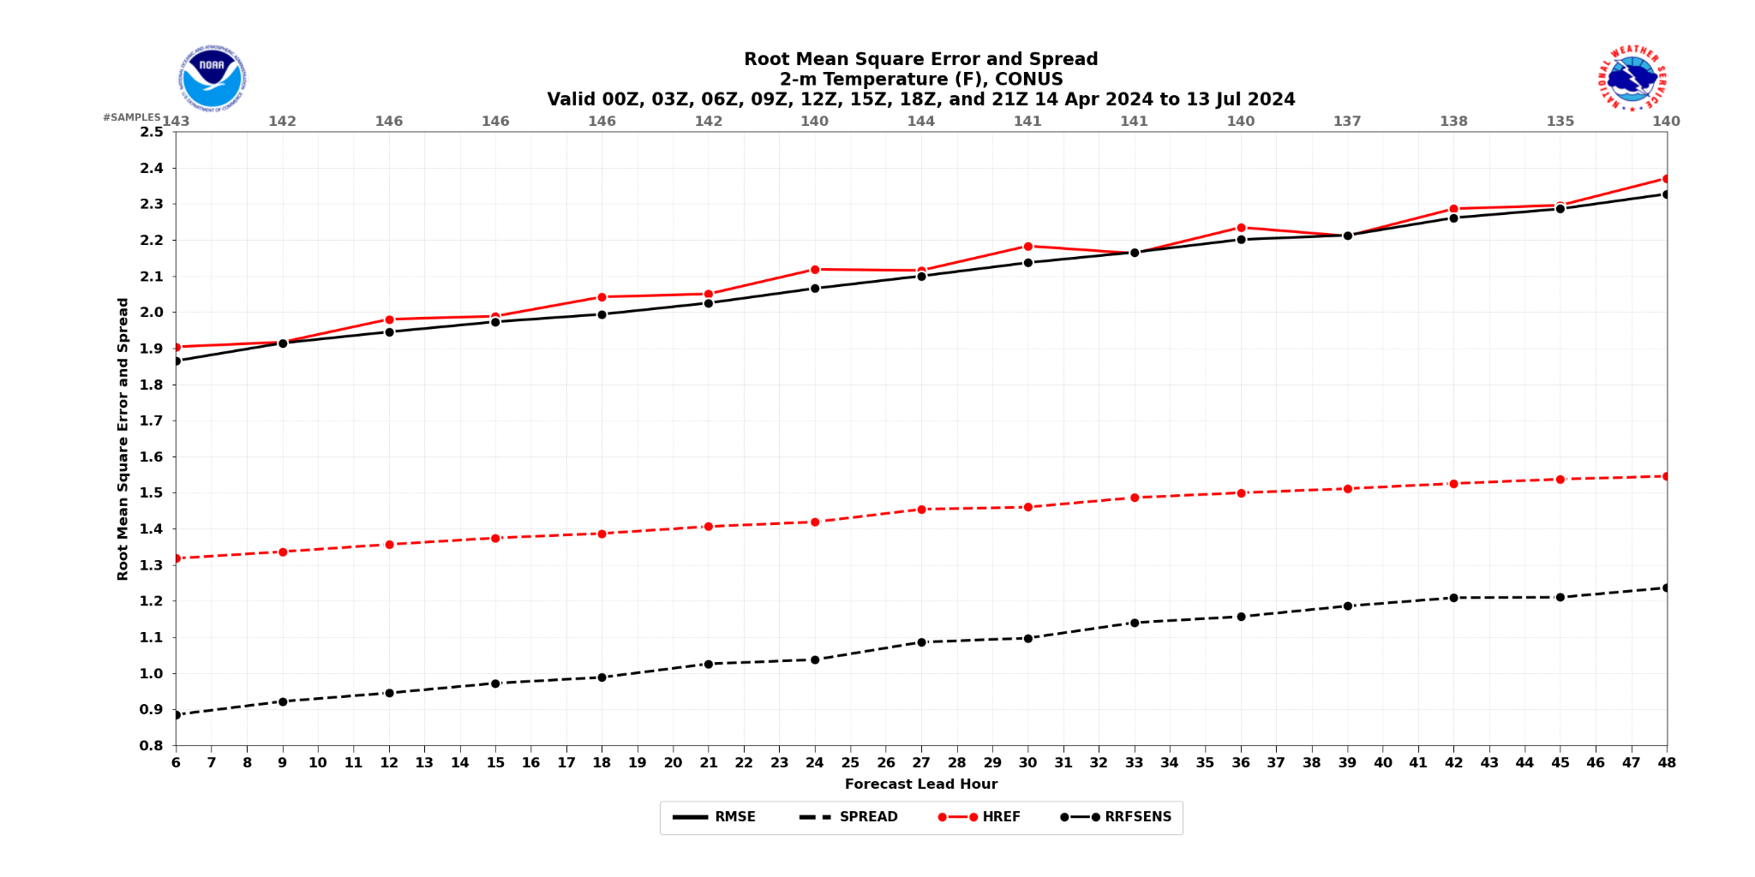
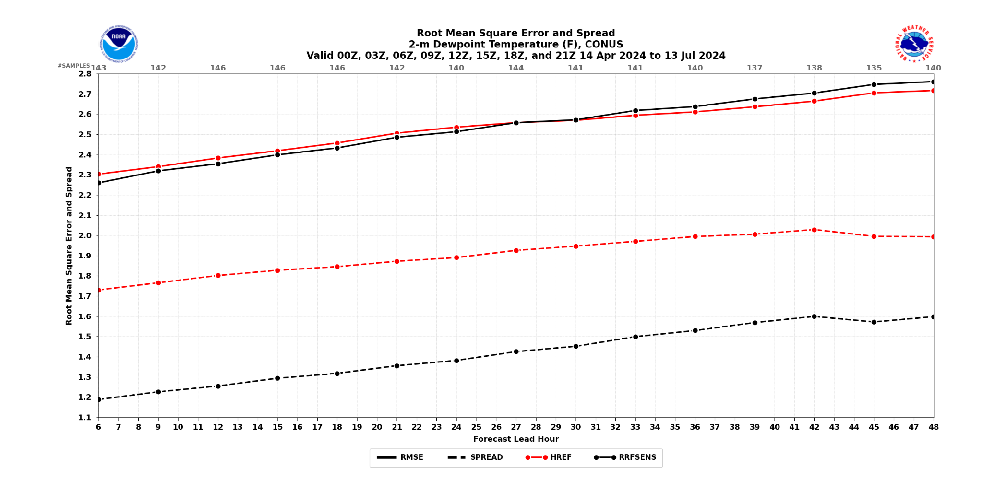
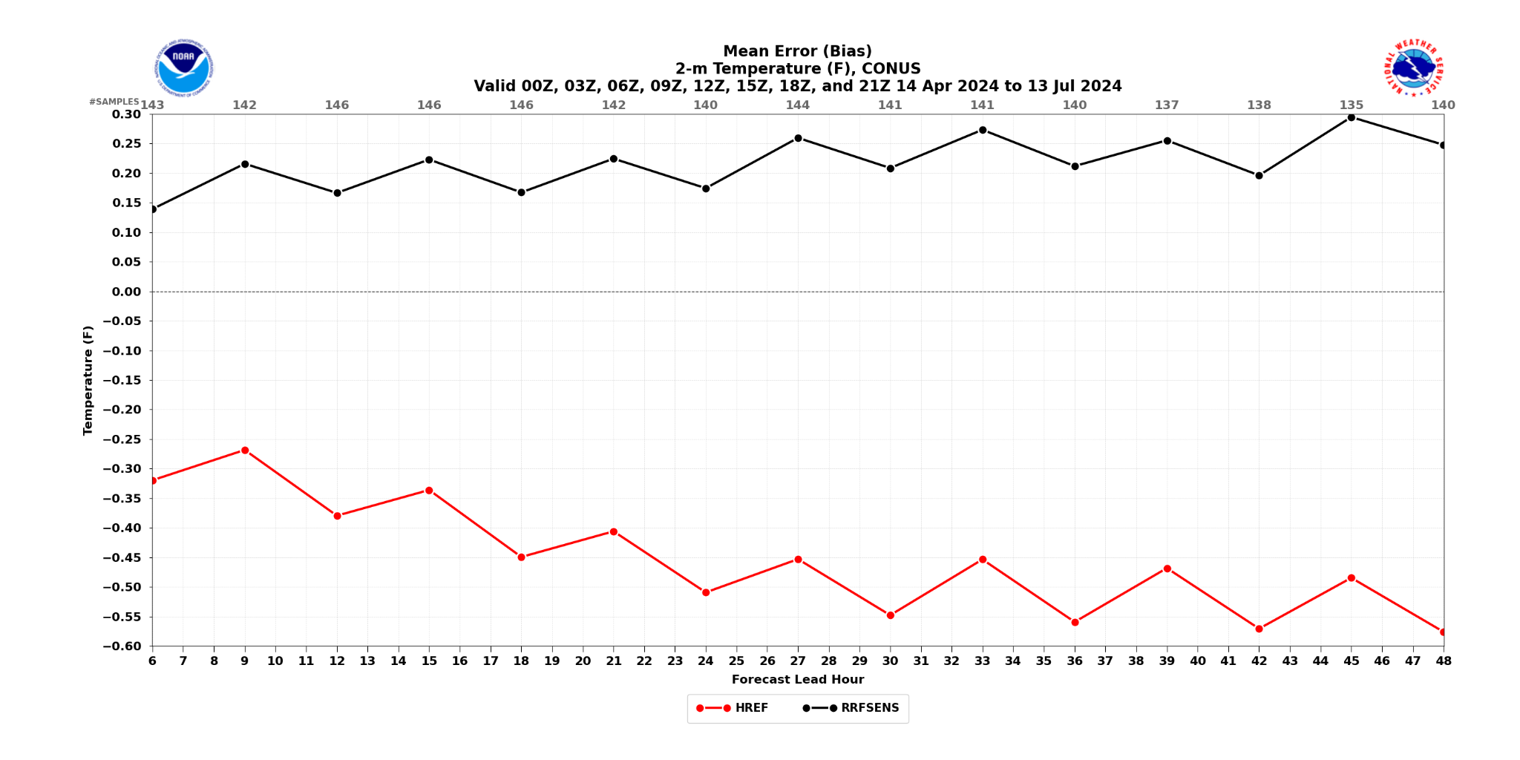
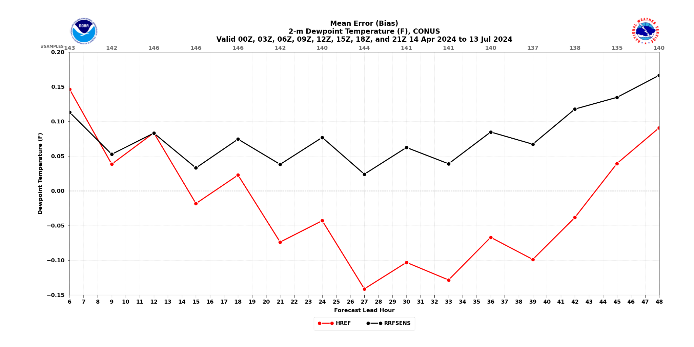
mid-Apr to mid-Jul 2024
ensemble performance
2 m Temp
2 m Td
dramatically better
skill/spread in HREF
RMSE & spread
RMSE & spread
f06
f48
f48
REFS
forecast lead
f06
forecast lead
0.2 F
HREF
bias
bias
bias
-0.6F
-0.15 F

Slide 9
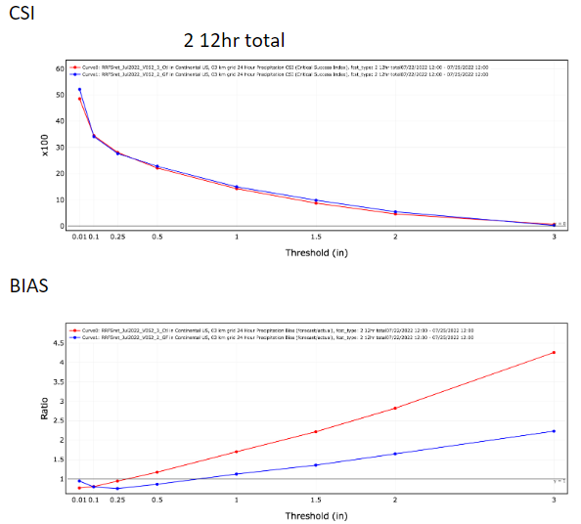
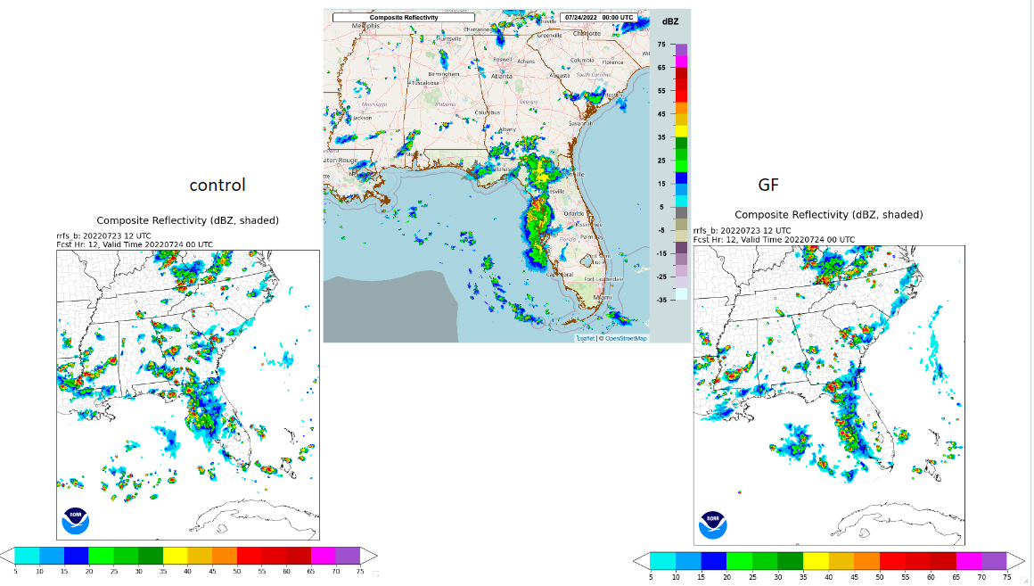
RRFS convective-storm intensity and coverage issue -
testing impact of GF convection
00Z July 20 ~ 23Z July 26, 2022
MRMS
20220724/00Z VT
CTL
Grell-Freitas
CTL
Grell-Freitas
*Thanks to Georg Grell and Haiqin Li for this work

Slide 10
RRFS challenges at HWT experiment
In a tremendously active severe weather season during the 2024 HWT, the deterministic RRFS had numerous struggles in highlighting regions of severe weather.
Several cases were noted with muted convective initiation (CI) or poor retention of strong convection overnight. Use of parameterized convection likely playing a role, but running w/o parameterized Cu proved problematic for FV3 at 3 km spacing.
HRRR
RRFS
MRMS (obs)
9 h forecasts valid 20240507/06Z

Slide 11
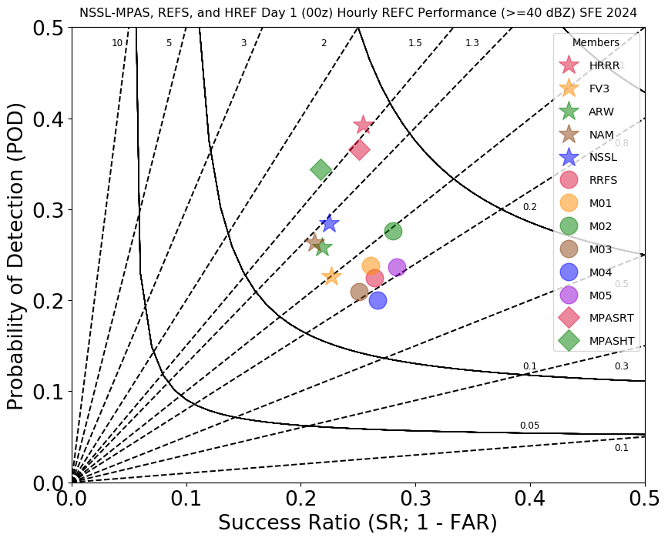
Day 1 00Z Composite Reflectivity (> 40 dBZ )
2024 HWT
HRRR
MPAS runs
MPAS from RRFS ICs
RRFS runs
RRFS ctl
Image courtesy Jake Vancil (OU/CIWRO/SPC)

Slide 12
Repurposed retrospective RRFS tests
Three months (Feb 2022, June & July 2023) of deterministic forecasts over full NA domain, using ICs from full RRFS DA system
Initially slated to be the final RRFS retrospectives for evaluation ahead of an operational implementation
With change in RRFS implementation plans, they are being repurposed to provide a benchmark of current RRFSv1 for comparison against a potential next generation RRFS prototype
We also have RRFS ICs saved from the 2024 HWT period - another period to explore with future retrospectives.

Slide 13
Evolving RRFSv1 plans
Results from the 2024 Hazardous Weather Testbed recently led to a decision to delay the implementation of RRFSv1.
Currently exploring ways forward with NWS leadership, including possibly shifting certain aspects of RRFS to use MPAS.
Take home message: we are unlikely to implement the current RRFS.

Slide 14
Backup Slides

Slide 15
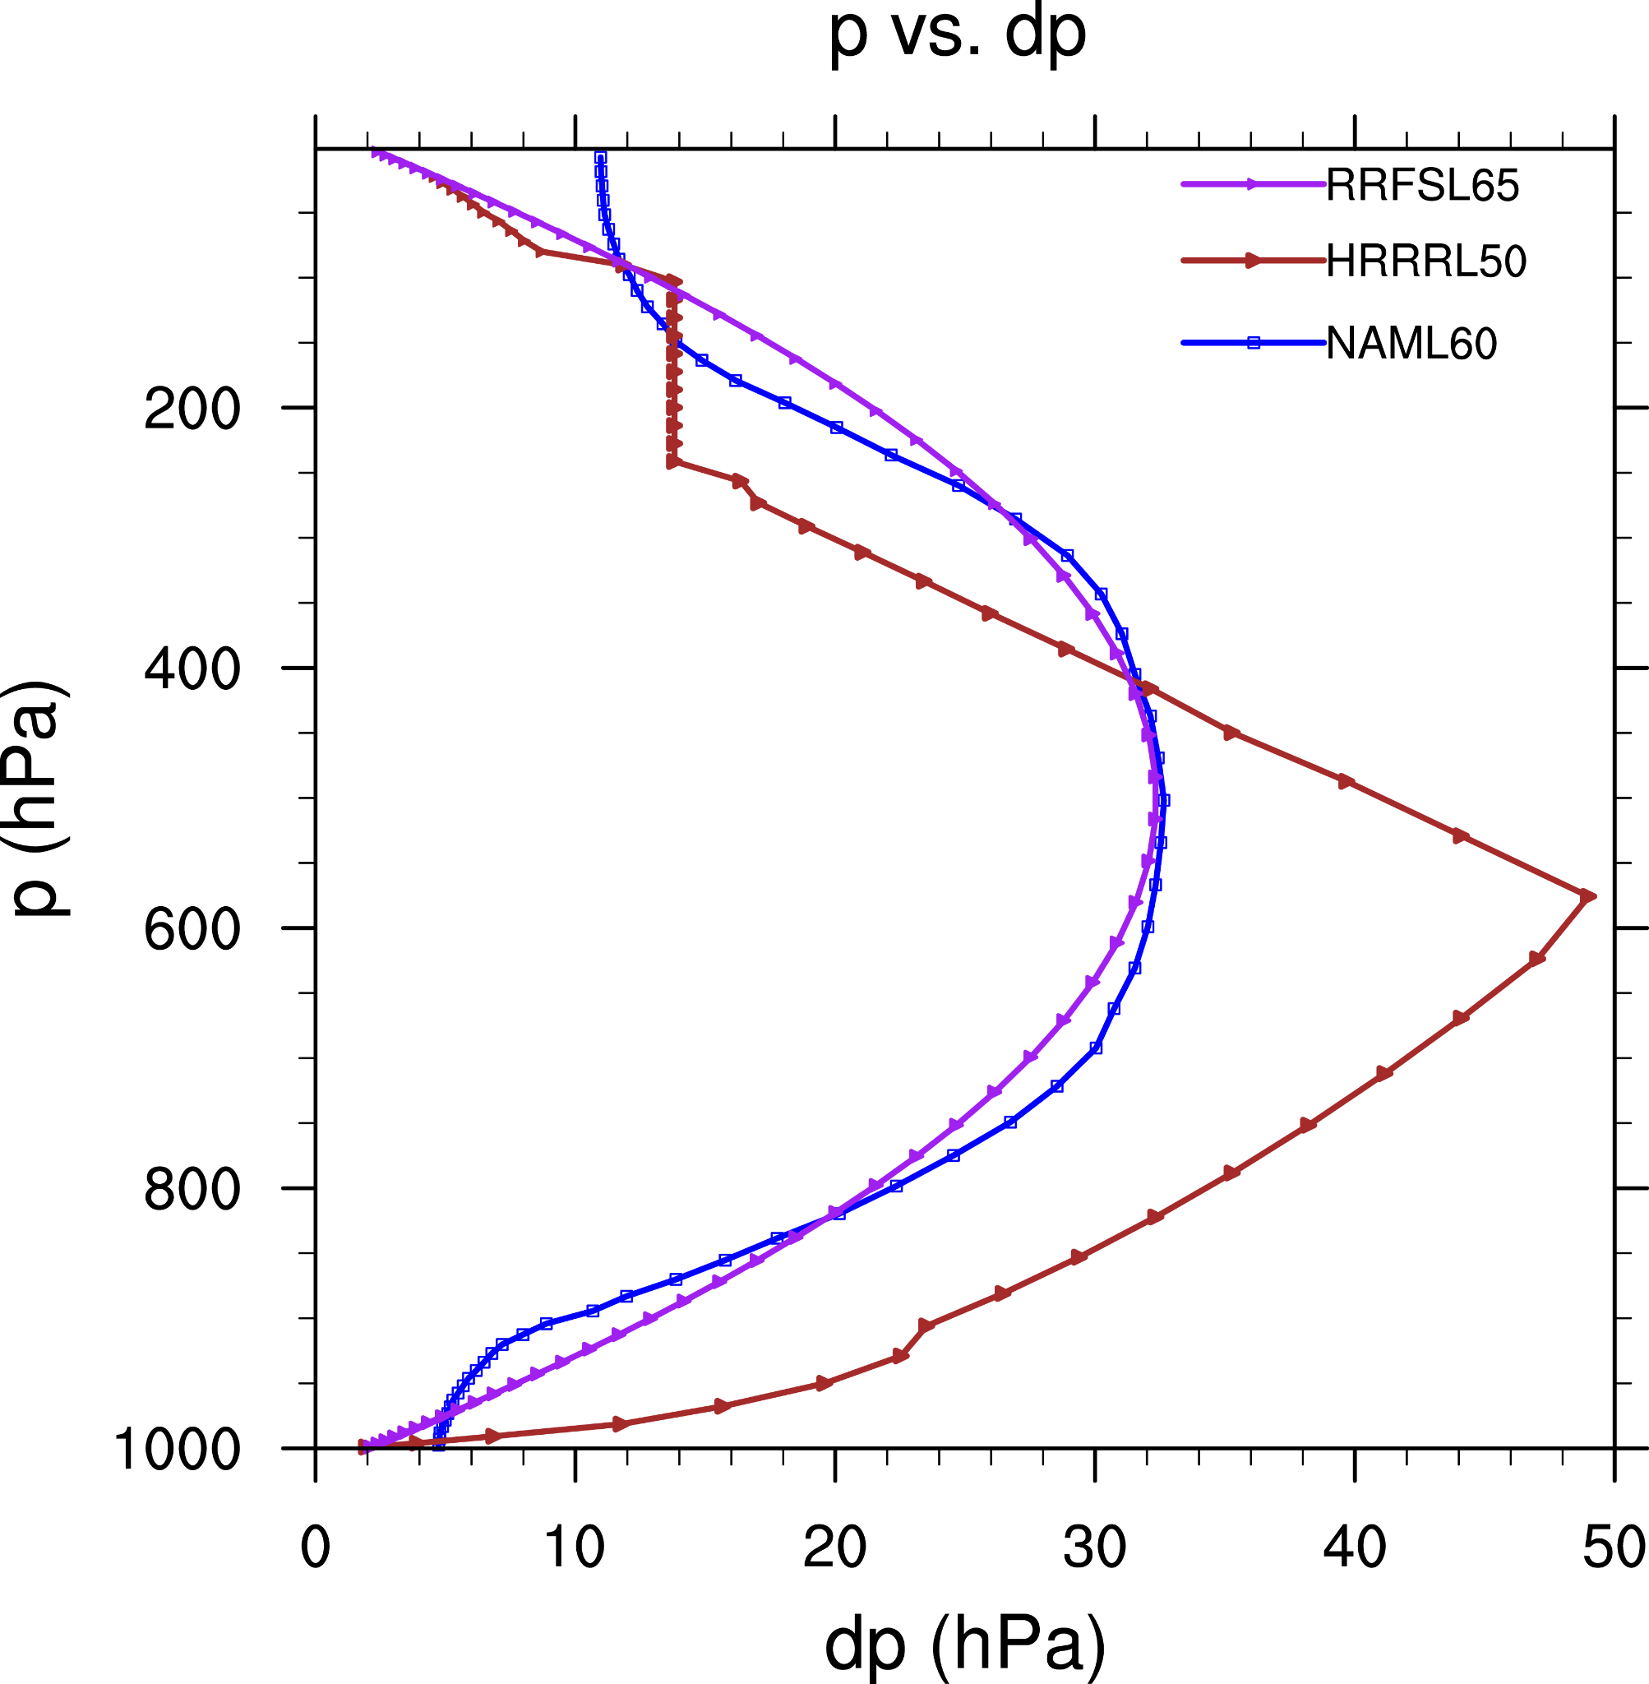
RRFS Physics and Vertical Resolution
Physics | SCHEME | REFERENCE
PBL/Turbulence | MYNN-EDMF | Olson et al. (2019)
Surface Layer | MYNN | Olson et al. (2021)
Microphysics | Thompson-Eidhammer | Thompson and Eidhammer (2014)
Climatological Aerosols | Thompson-Eidhammer | Thompson and Eidhammer (2014)
Smoke and Dust | RAVE fire data, FENGSA scheme for dust | Ahmadov et al., Freitas et al., 2010
Shallow Convection | MYNN-EDMF | Olson et al. (2019) Angevine et al. (2020)
Deep Convection | Grell-Freitas | Grell and Freitas (2014)
Gravity Wave Physics | Small Scale and Turbulent Orographic Gravity-Wave & Form Drag | Beljaars et al. (2004) Tsiringakis et al. (2017) Toy et al. (2021)
Land Model | RUC LSM | Smirnova et al. (1997, 2000, 2016)
Large Lakes | FVCOM | Fujisaki-Manome et al. (2020)
Small Lakes | CLM Lake | Subin et al. (2012), Mallard et al. (2015), Benjamin et al. (2022)
Long and Short Wave Radiation | RRTMG | Iacono et al. (2008), Mlawer (1997)
Parameter | RRFS | HRRRv4 | NAMv4
Number of levels | 65 | 50 | 60
Lowest level (m) | 8 | 8 | 20
Top (hPa) | 2 | 20 | 2

Slide 16
Shift to 32-bit physics
Existing ops NWS models based on the FV3 dycore (e.g., GFS, GEFS, HAFS, ...) use 32-bit dynamics and 64-bit physics
The historical norm for short-range regional forecast systems has been 32-bit physics (NAM, HRRR, ...)
Shifting the RRFS from 64- to 32-bit physics:
reduced total restart file volume by about 1/3 (179 GB to 120.5 GB)
sped up forecasts by ~10-15%
showed minimal forecast impact
Notes:
https://docs.google.com/presentation/d/1m_-7Rc5AjYPE6PnA7VhK2QTIARlKmAEh/edit?usp=sharing&ouid=112238518789832639882&rtpof=true&sd=true

Slide 17
REFS Ensemble product generation
Membership
All REFS domains include 12 RRFS members, CONUS and AK add 2 HRRR members to push to 14 total members
HREF membership sizes: CONUS (10), AK (8), HI/PR (6)
Forecast length and frequency
REFS goes to 60 h, 4x/day for all domains
HREF goes to 48 h, 2x/day most domains
Output grids
REFS uses output grids of RRFS (NAM nest regions) -
3 km CONUS & AK; 2.5 km PR & HI
HREF is processed on 5 km HiresW output grids
RRFSv1 Compute Domain (red)

Slide 18
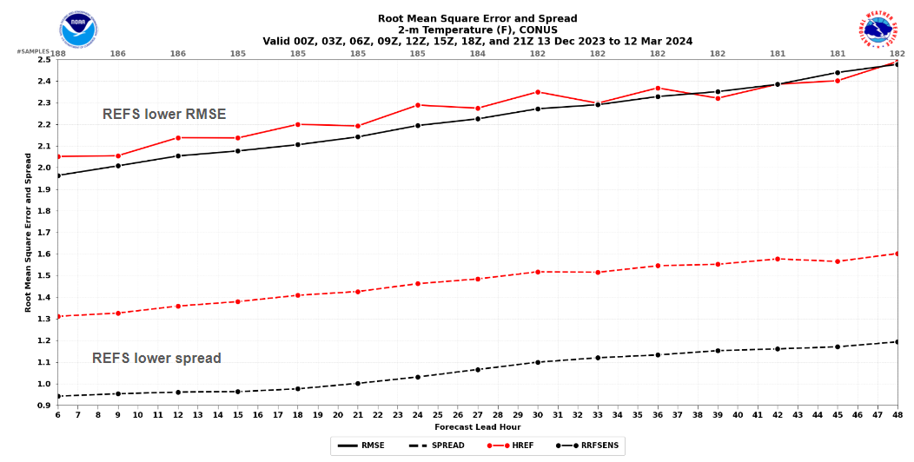
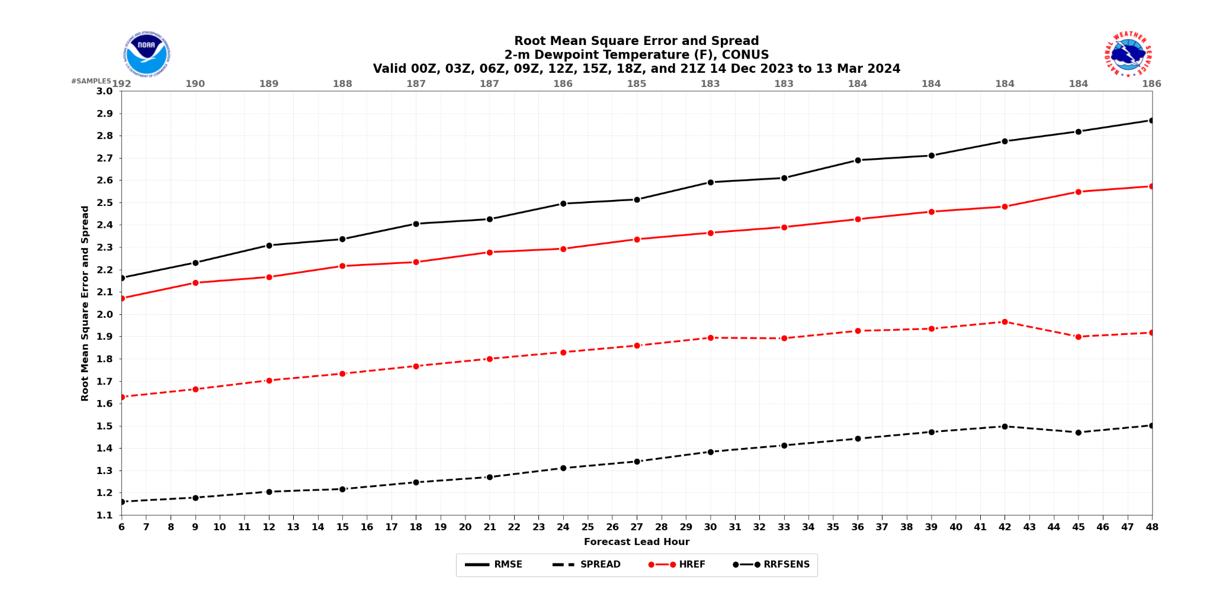
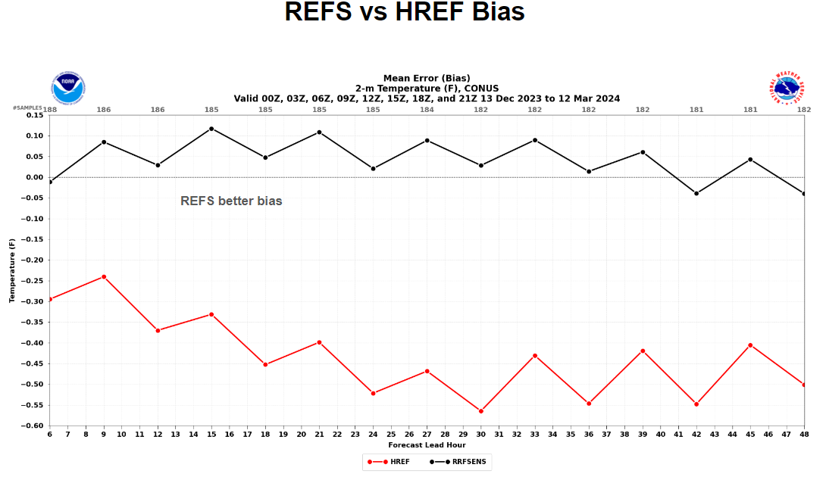
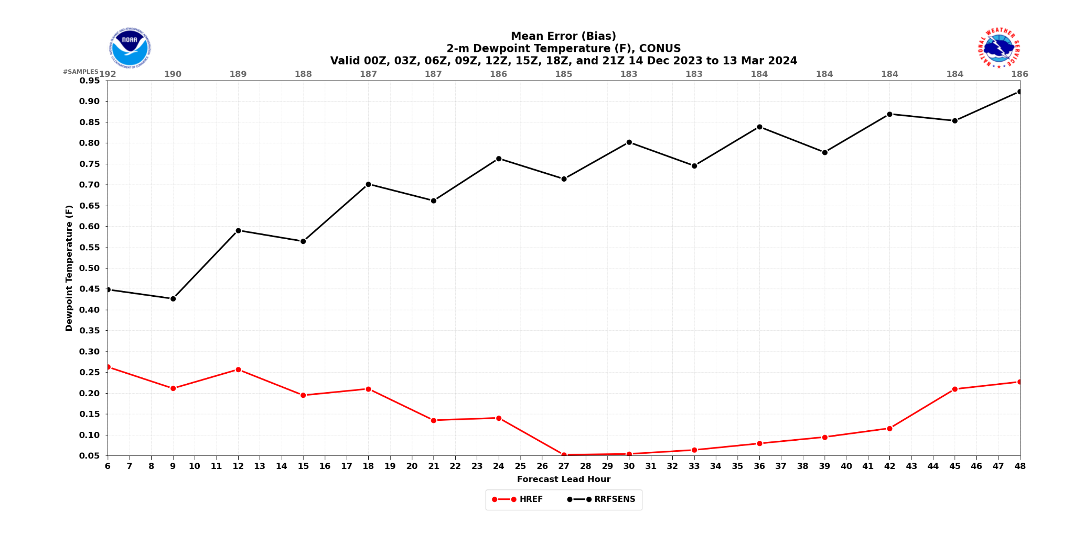
mid-Dec 2023 to mid-Mar 2024
ensemble performance
2 m Temp
2 m Td
RMSE & spread
RMSE & spread
REFS
dramatically better
skill/spread in HREF
HREF
f06
forecast lead
f48
forecast lead
f48
f06
0.95 F
f06
bias
bias
HREF slight cold bias
-0.6F
0.05 F

Slide 19
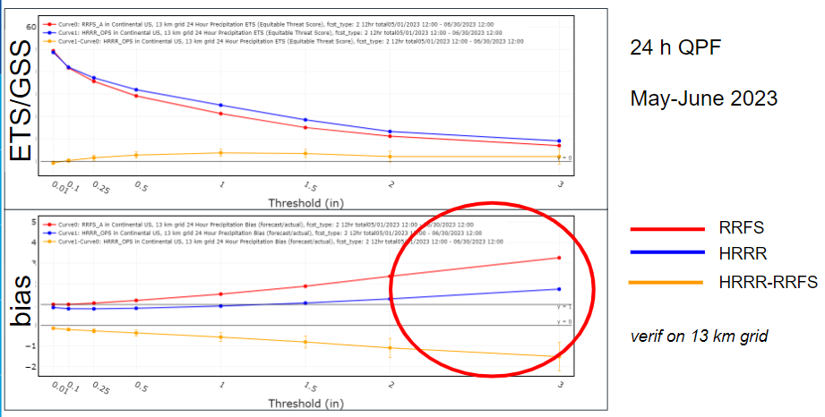
RRFS convective-storm intensity and coverage issue
Testbeds (like FFaIR), and objective verification, have shown that RRFS prototypes have long had a high bias for heavy precipitation in the warm season
Grell-Freitas (GF) parameterized convection was added to RRFS (mid-Aug 2023) to help mitigate this issue, with additional follow on tuning:
GF is not called if the boundary layer scheme’s (MYNN) shallow convection scheme is active
Disabled congestus convection, but slightly decreased the characteristic cloud size for deep convection
Apply scale-aware scaling of GF deep only when the microphysics scheme is not active
Convective cloud condensate from GF is coupled to radiation via subgrid scale cloud fractions
Radar reflectivity from GF is included in the total reflectivity output from the model
*Thanks to Georg Grell and Haiqin Li for this work

Slide 20
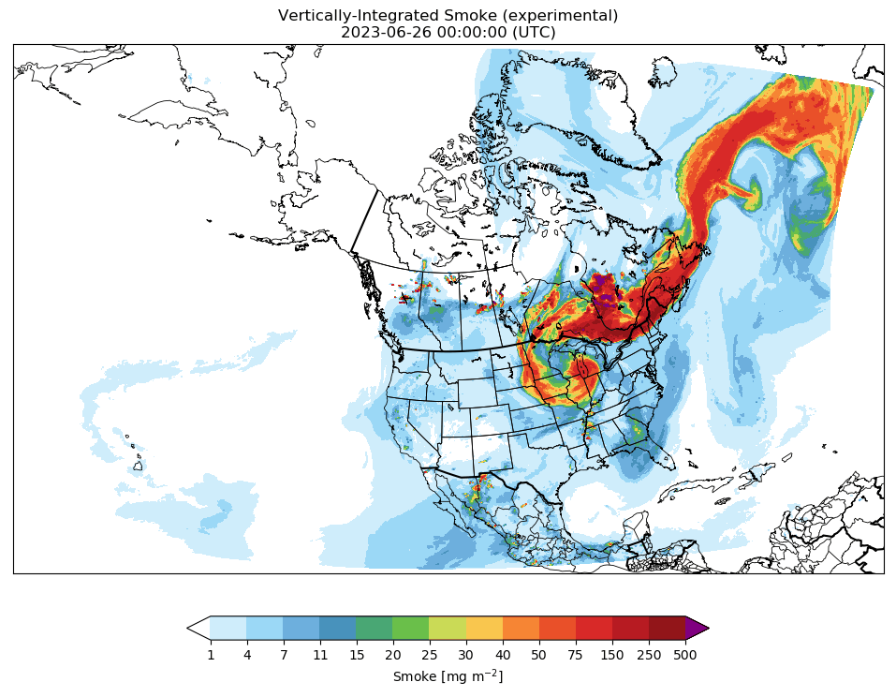
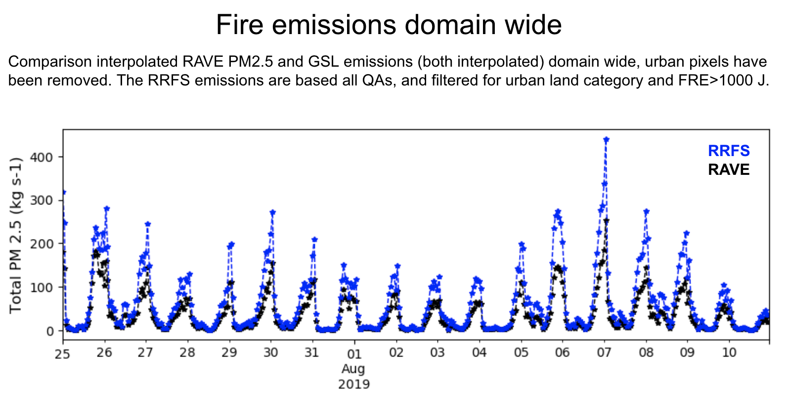
Smoke and Dust
Included in 3-km RRFS over North America
Input data: RAVE Emissions
Fire Radiative Power → plume rise
Fire Radiative Energy → estimate emissions
RAVE → Regional Hourly Advanced Baseline Imager (ABI) and Visible Infrared Imaging Radiometer Suite (VIIRS) Emissions
3 km vertically integrated smoke forecast from 26 June 2023 depicting impact from Canadian wildfires
*Thanks to J. Romero-Alvarez (GSL), R. Ahmadov (GSL), B. Baker (ARL), and P. Bhattacharjee (EMC) for material on this slide

Slide 21
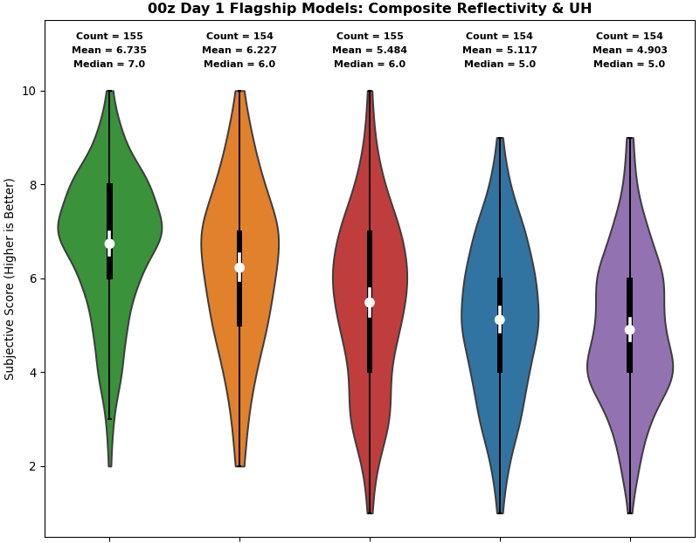
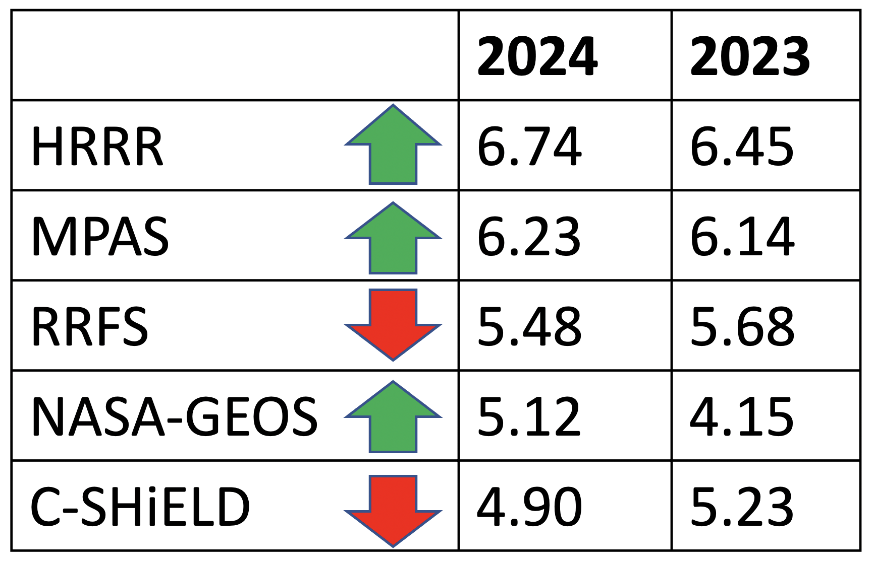
2024 Day 1 Deterministic Flagships: Composite Reflectivity & UH
Change in mean subjective ratings relative to 2023.
HRRRv4 was clear top performer & differences in average ratings were significant (paired student’s t-test).
MPAS RT was clear runner-up & differences w.r.t lower rated models were significant (including RRFS).
Order of ratings was same as last year, except NASA-GEOS and GFDL FV3 (C-SHiELD) have switched places.
HRRR, MPAS, and NASA-GEOS ratings went up this year, while RRFS and C-SHiELD went down.
6.74
6.23
5.48
5.12
4.90
HRRRv4
MPAS RT
RRFS
NASA GEOS
FV3
GFDL FV3
slide courtesy Israel Jirak/Adam Clark

Slide 22
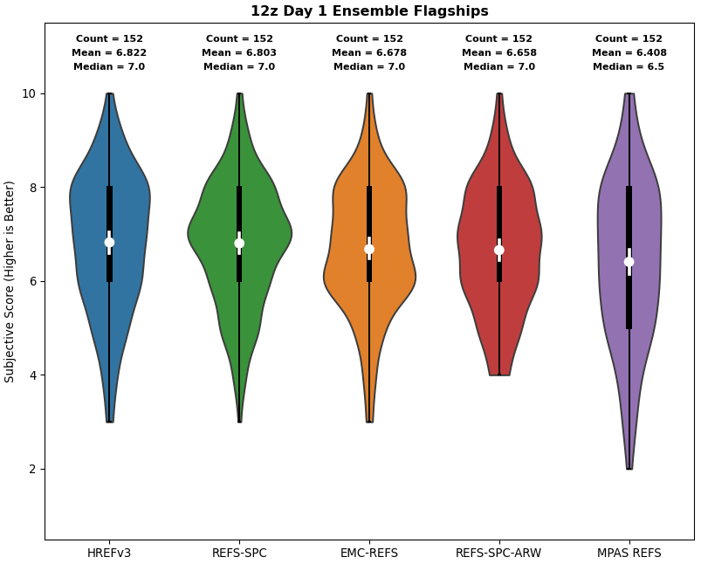
12Z HWT Ensemble Comparison (Day 1): Storm Attributes
Based on subjective evaluations, REFS was fairly competitive with HREF (surprising given deterministic RRFS performance).
REFS best in this comparison for Day 2 (not shown), dramatically different than 2023 HWT where Day 2 REFS performance was a concern.
plot courtesy Israel Jirak/ Adam Clark
HREF - 6.82
REFS - 6.68

Slide 23
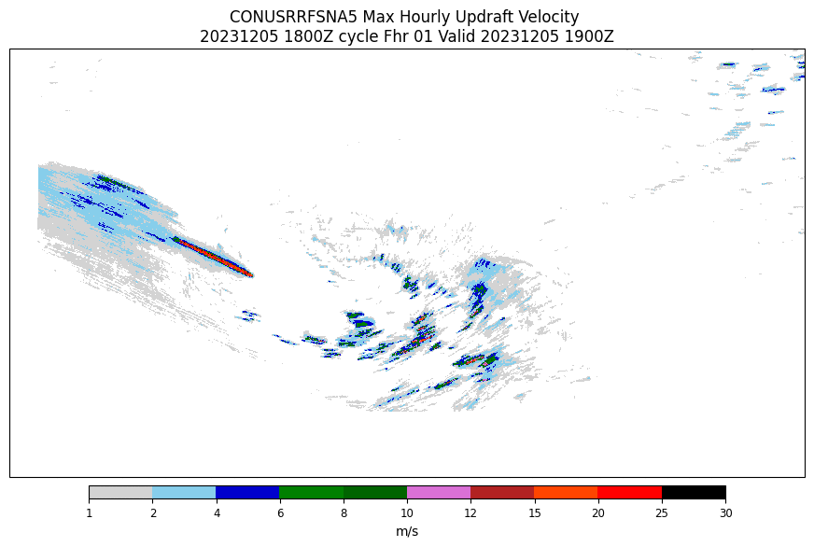
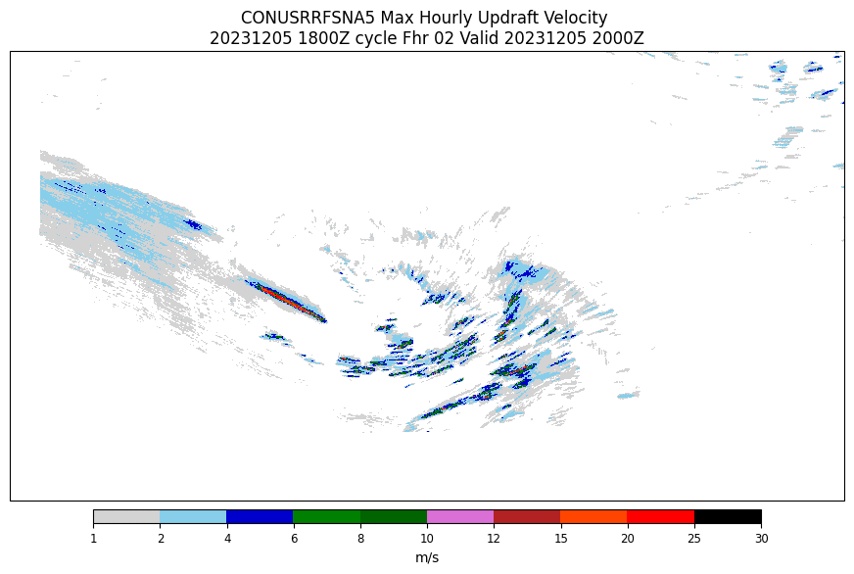
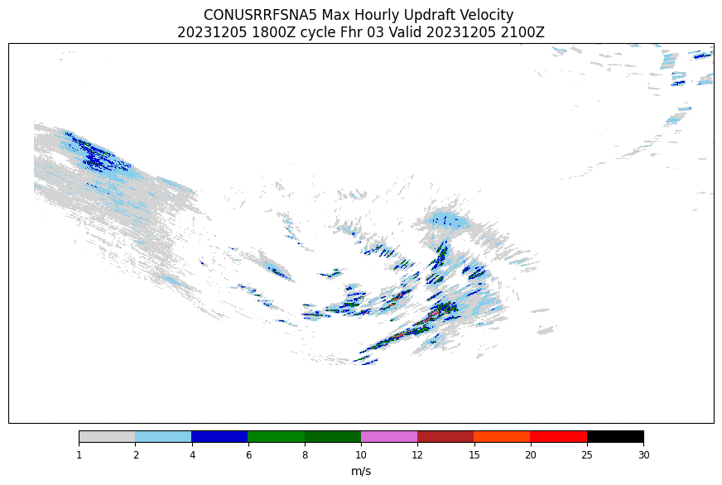
“Streak” case in North Pacific, 20231205/18Z cycle
f01
f02
f03

