Slide 1
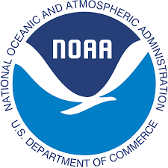
Improving Spatial Resolution in NOAA’s Historical Flood Data with the Coastal Ocean Reanalysis (CORA)
Enhancing Coastal Resilience through Data-Driven Insights
Paola Marie Santini Dosal
Notes:
- Good morning/afternoon, everyone. My name is Paola Santini Dosal, I am an undergrad attending the University of Central Florida, and I am excited to present “Improving Spatial Resolution in NOAA’s Historical Flood Data with the Coastal Ocean Reanalysis (CORA) project”
-This presentation will explore how (CORA) enhances our understanding of flood risks and aids in community education through data-driven insights.

Slide 2
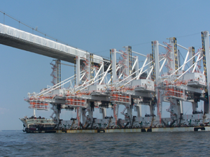
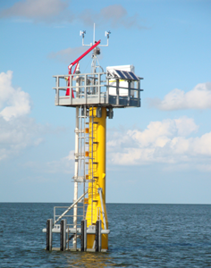
Introduction to CO-OPS
Overview of CO-OPS:
National Ocean Service - NOAA's Center for Operational Oceanographic Products and Services
Part of NOAA focused on monitoring water levels, tides, and currents.
Provides accurate, reliable, and timely data to support safe and efficient maritime navigation, coastal resilience, and informed decision-making.
Mission and Vision:
To be the nation’s trusted source for water level and coastal current information.
Enhance public safety, economic efficiency, and environmental stewardship through superior coastal and oceanographic data and services.
National Water Level Observation Network (NWLON):
A network of long-term, continuously operating water level stations throughout the United States and its territories.
Provides vital data for understanding sea level trends, coastal inundation, and navigation.
< A shipping port that uses data to ensure safe navigation.
<NWLON Sentinel Station SPIP Built to endure Cat-5 hurricanes.
Notes:
-This summer I worked on my internship under the National Ocean Service (NOS) working with NOAA’s Center for Operational Oceanographic Products and Services, also known as CO-OPS, an office integral to NOAA’s mission, providing essential data for maritime and coastal activities.
what do you think of this? I nudged things over so I could include pics - the bottom is a SPIP built to endure Cat-5 hurricanes - they are the sentinels of NWLON. And above is an example of a shipping port that uses our data to ensure safe navigation. Please feel free to use or lose what you'd like. I find adding pics helps people stay engaged.
-Our vision is to ensure public safety and economic efficiency through superior data and services.
-The National Water Level Observation Network, or NWLON, is key to our operations, providing continuous water level data crucial for tracking sea level trends and coastal changes.
-the bottom is a SPIP built to endure Cat-5 hurricanes - they are the sentinels of NWLON. And above is an example of a shipping port that uses our data to ensure safe navigation.
-Ship Transit:
A shipment of cranes going under a bridge. NWLON sensors make such shipments possible by providing real-time water level observations, allowing ship captains to determine when it is safest to transit.
-NWLON Sentinel Station:
Some NWLON stations are specially reinforced to withstand hurricanes and other major storm events. The reinforced stations are better able to keep functioning during these events, providing critical information on water levels and winds that aids emergency response organizations.
Ship Transit:
A shipment of cranes going under a bridge. NWLON sensors make such shipments possible by providing real-time water level observations, allowing ship captains to determine when it is safest to transit.
NWLON Sentinel Station:
Some NWLON stations are specially reinforced to withstand hurricanes and other major storm events. The reinforced stations are better able to keep functioning during these events, providing critical information on water levels and winds that aids emergency response organizations.

Slide 3
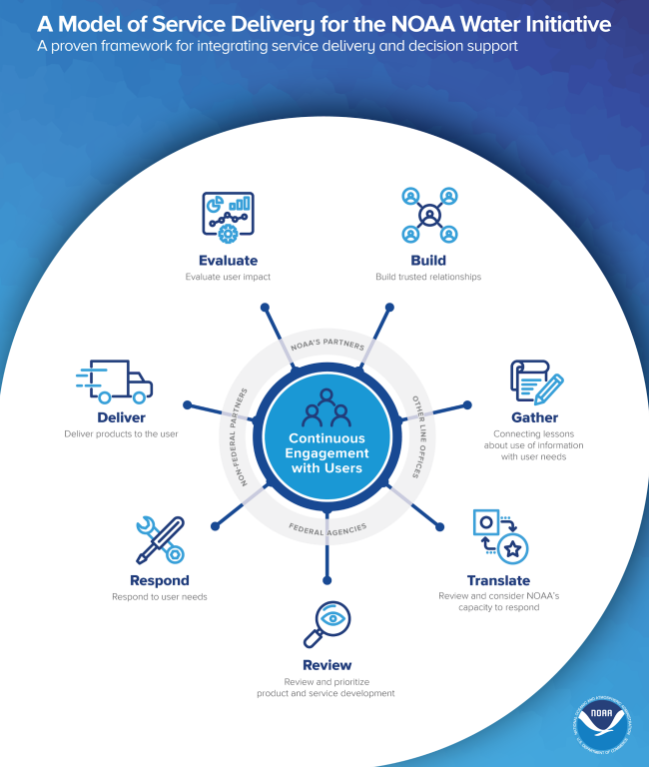
Stakeholder Framework
Stakeholder Engagement:
CO-OPS engages with various stakeholders, including federal, state, and local agencies, academia, private sector, and the public.
Stakeholder input is vital for developing relevant and useful data products and services.
Collaborations:
Partnerships with academic institutions like the University of Hawaii enhance our capabilities.
Collaboration with stakeholders ensures the data meets diverse needs, from scientific research to public safety.
^NOAA’s Service Delivery Framework Model
Notes:
Engaging with stakeholders is a cornerstone of our approach at CO-OPS.
From NOAA's Service Delivery Framework white paper: https://www.noaa.gov/sites/default/files/2022-02/A-Model-of-Service-Delivery-for-the-NOAA-Water-Initiative_FINAL.pdf
We work closely with a wide range of partners, including government agencies, academic institutions, and the private sector, to ensure our data products are relevant and useful.
The input from these stakeholders is crucial in shaping our services, making sure they address real-world needs effectively.

Slide 4
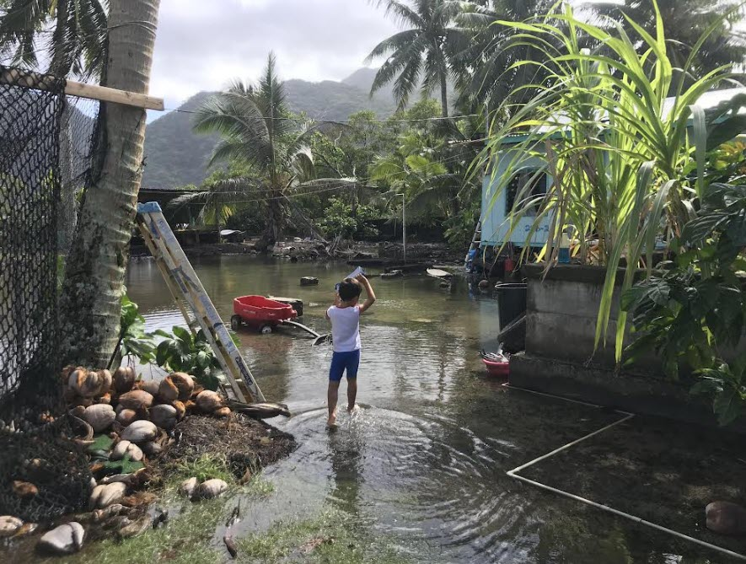
Engagement with Partners - Underserved Communities
University of Hawaii Partnership:
UH researchers contribute to developing and enhancing CO-OPS’ inundation products.
Focus on improving data accuracy and accessibility, particularly for underserved communities.
Supporting Underserved Communities:
Efforts to provide accurate, accessible data to communities most vulnerable to coastal hazards.
Tailored outreach and education initiatives to ensure these communities can use the data effectively.
^Pago Pago, American Samoa.
High Tide Flooding in a local village.
Notes:
Our partnership with the University of Hawaii is particularly impactful.
Pago Pago, American Samoa. High Tide Flooding in a local village.
UH researchers bring valuable expertise that enhances our inundation products.
A key focus of our collaboration is to support underserved communities, ensuring they have access to accurate data and the tools they need to respond to coastal hazards.
By tailoring our outreach and education efforts, we aim to empower these communities to better understand and mitigate flood risks.

Slide 5
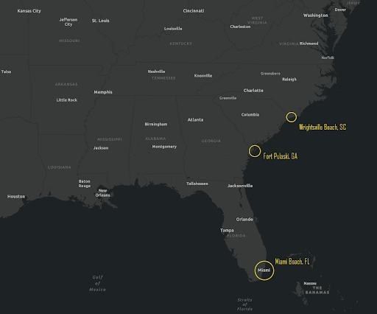
Locations
Highlight Locations:
Miami, FL - Hurricane Irma (2017)
Tybee Island, GA - Flooding (2015)
Wrightsville Beach, SC - Hurricane Floyd (1999)
Notes:
Our study included three key locations: Miami, FL during Hurricane Irma in 2017, Tybee Island, GA in 2015, and Wrightsville Beach, SC during Hurricane Floyd in 1999.
This map highlights these locations, showcasing the diverse range of coastal environments we studied.
Each location provided unique insights into the impact of flooding and the utility of CORA data.

Slide 6
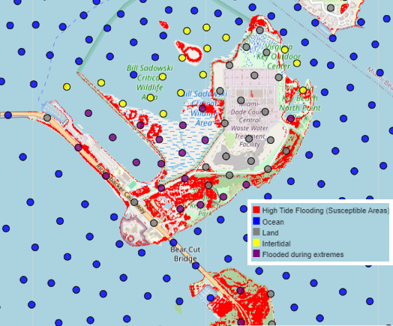
Interview Highlights & Miami Case Study
Interview Highlights:
Linta Rose and Matthew Widlansky from UH provide insights into the importance of accurate inundation data.
Discuss the role of high-resolution data in improving flood risk assessments and community resilience.
Miami Case Study:
Hurricane Irma (2017) demonstrated CORA’s ability to simulate and validate coastal flooding.
Despite making landfall 180 km south, Irma caused significant storm surge in Miami.
^GIS map of Hurricane Irma, 2017 showing extreme flooding and susceptible areas.
Notes:
We interviewed Linta Rose and Matthew Widlansky from UH, who emphasized the critical role of high-resolution inundation data.
Their insights highlight how accurate data improves flood risk assessments and helps build community resilience.
From Climate.Gov - CO-OPS Data support NOAA's Coastal Resilience Toolkit. https://www.climate.gov/news-features/features/interactive-map-how-has-local-sea-level-united-states-changed-over-time
Mean sea level through time from the Virginia Key NWLON station.
Viewers of this file can see comments and suggestions
Thanks
Ok
Added
The Miami Case Study during Hurricane Irma in 2017 is a prime example of CORA’s capabilities.
CORA accurately simulated the significant storm surge in Miami, even though the hurricane made landfall 180 km south.
The maps and charts here illustrate the maximum water levels and the extent of flooding, showcasing CORA's precision.

Slide 7
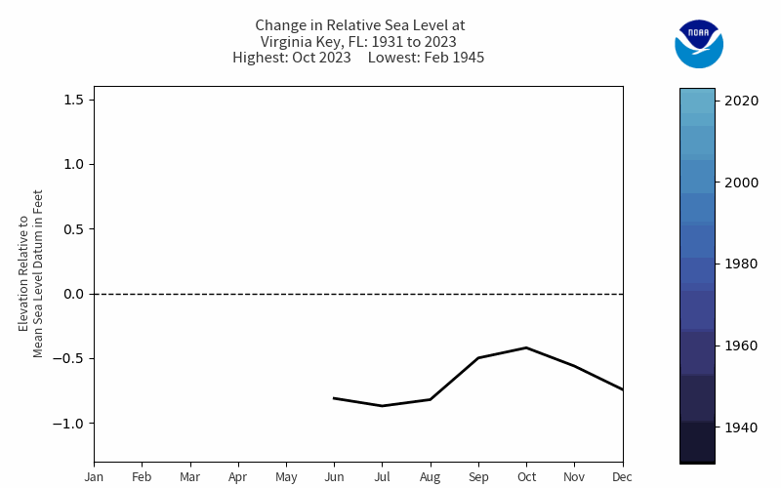
^Mean sea level through time from the Virginia Key NWLON station.

Slide 8
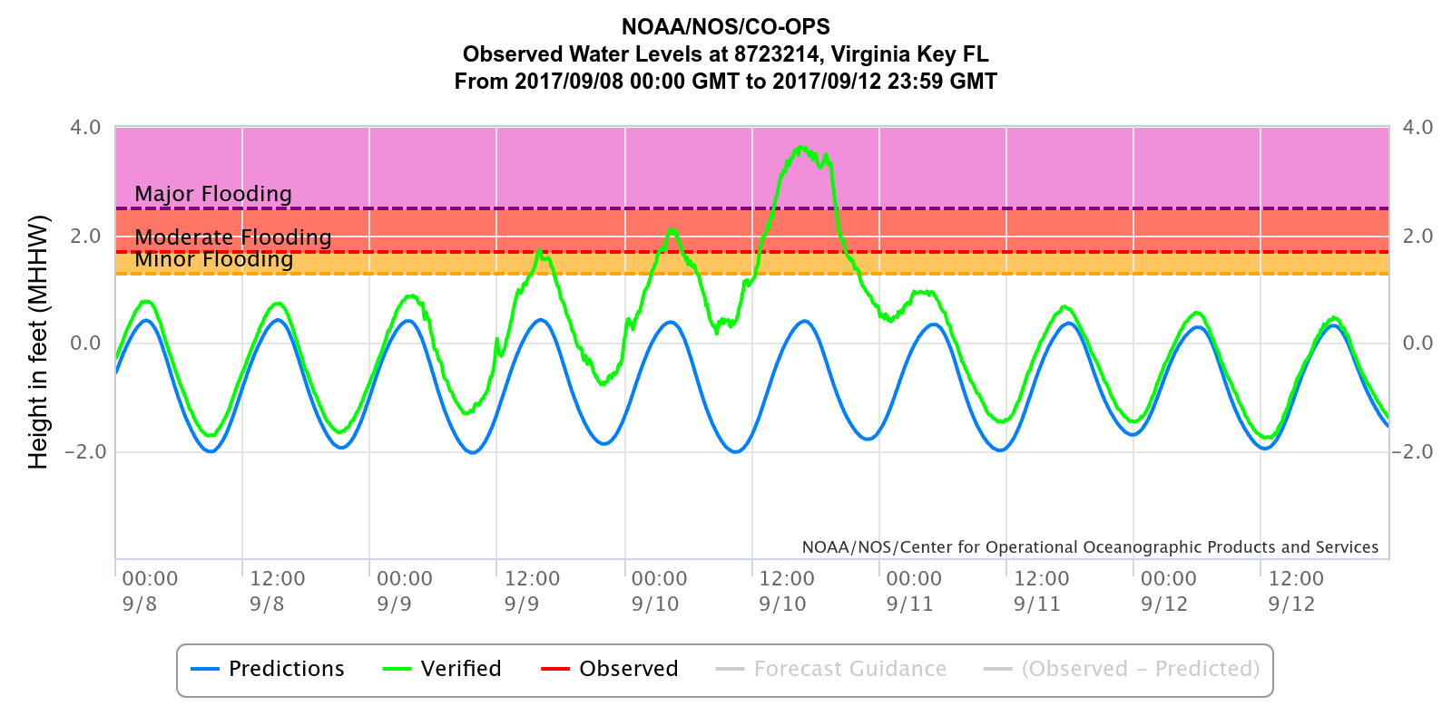
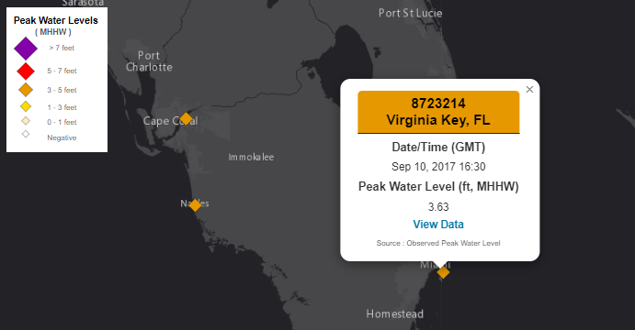
Miami Case Study: CORA
Impact Summary:
Despite Hurricane Irma making landfall 180 km south, Miami experienced a substantial storm surge.
Flooding of roads, buildings, and critical facilities.
Estimated damages in millions of dollars.
Major impacts on transportation and essential services.
Prolonged recovery period due to extensive damage.
^Observed water levels in Miami during Hurricane Irma (2017).
^Map of peak water levels in Miami during Hurricane Irma (2017).

Slide 9
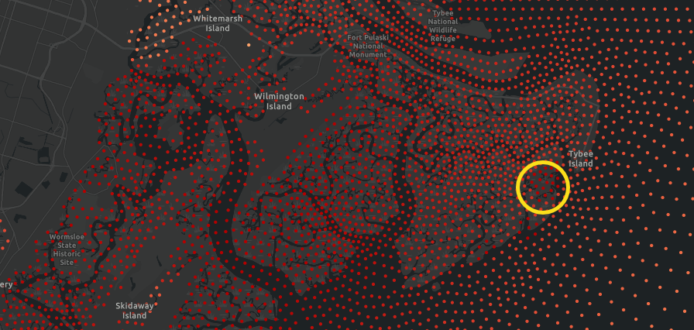
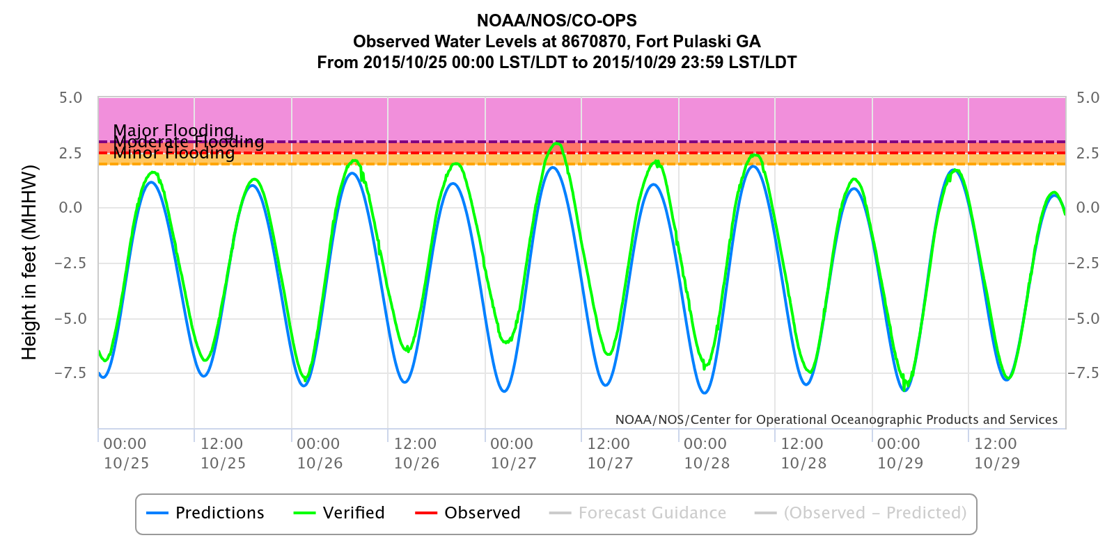
Fort Pulaski, GA Case Study
Event:
Extreme water levels in the wake of Hurricane Oscar, October 2015.
More than 5 ft. above Mean Higher High Water (MHHW), the thresholds for minor high tide flooding.
Analysis:
Examined maximum water level elevations during the flooding event.
Impact assessment on the community, infrastructure, and local environment.
^Maximum water levels (5.09 ft. above MHHW) in CORA data.
^Water level observations from nearby Fort Pulaski NWLON station.
Notes:
In 2015, Tybee Island faced severe flooding, which we analyzed using CORA data.
The linked drone footage provides a striking visual of the flooding's extent and impact.
By studying the maximum water level elevations, we assessed the flood's impact on the community, infrastructure, and local environment.
This analysis helps us understand the vulnerabilities and improve future resilience measures for Tybee Island.
Maximum water levels (5.09 ft. above MHHW) in CORA data.
Water level observations from nearby Fort Pulaski NWLON station.

Slide 10
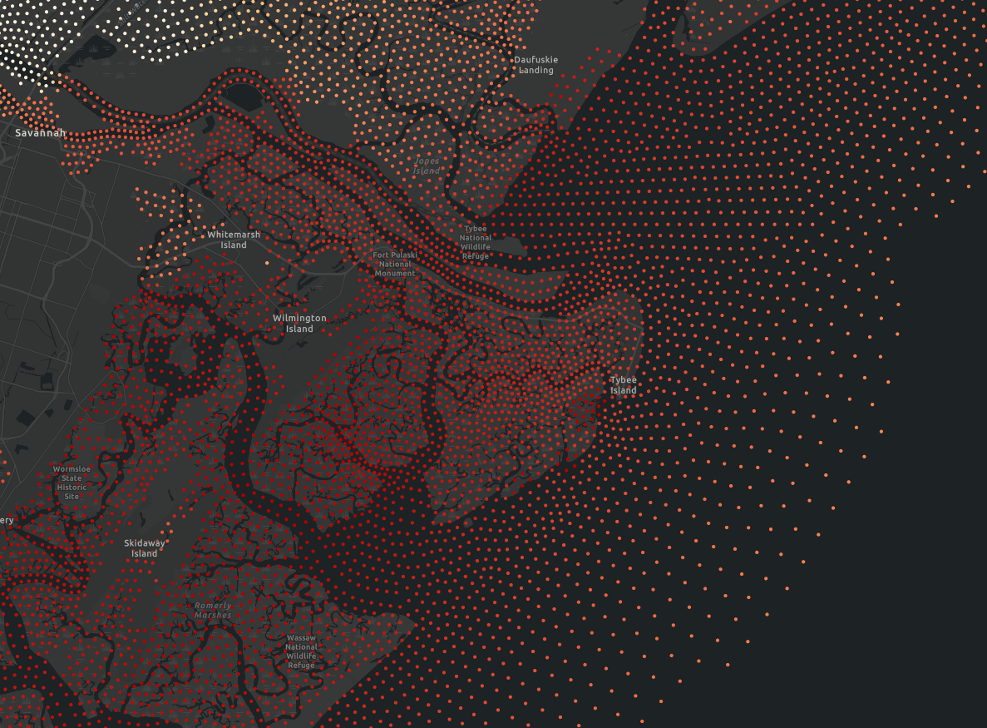
^Fort Pulaski, GA Tybee Island - Max water level with CORA data. Near Fort Pulaski, GA - a NWLON station.
Notes:
^Tybee Island - Max water level with CORA data. Near Fort Pulaski, GA - a NWLON station.

Slide 11
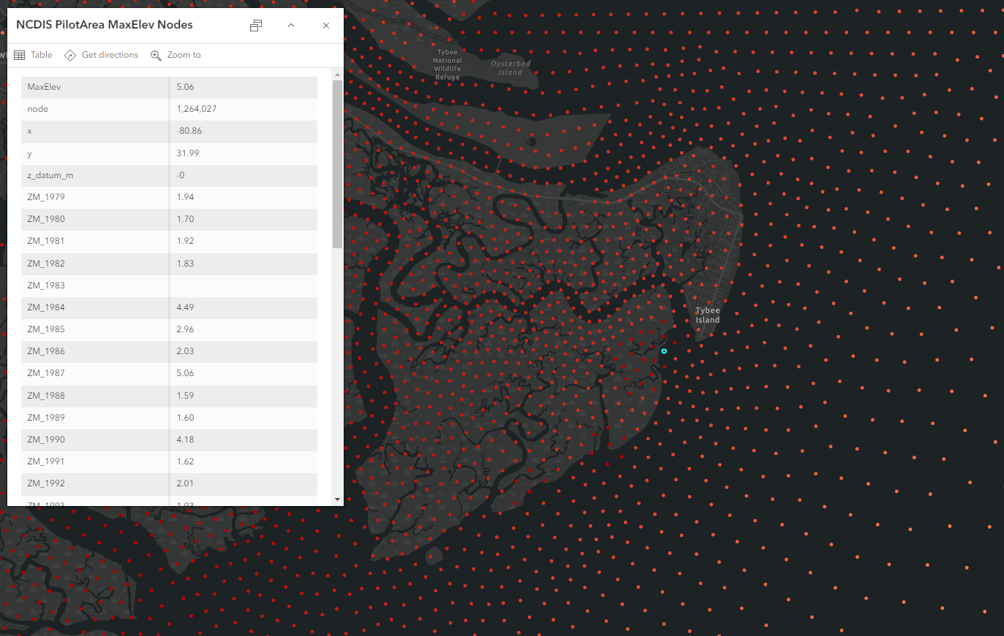
<Flooding at Tybee Island near Fort Pulaski, GA. 5.06 ft. above mean higher high water (aka. minor flooding threshold)
Notes:
Flooding at Tybee Island near Fort Pulaski, GA. 5.06 ft. above mean higher high water (aka. minor flooding threshold)

Slide 12
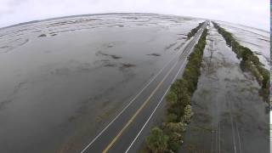
^Drone Footage of flooding in Tybee Island, GA after Hurricane Oscar, October 2015.
Notes:
In 2015, Tybee Island faced severe flooding, which we analyzed using CORA data.
The linked drone footage provides a striking visual of the flooding's extent and impact.
Flooding in the wake of Hurricane Oscar in late October, 2018.
Link to video: https://www.youtube.com/watch?v=RqdvGRBEaqs
By studying the maximum water level elevations, we assessed the flood's impact on the community, infrastructure, and local environment.
This analysis helps us understand the vulnerabilities and improve future resilience measures for Tybee Island.

Slide 13
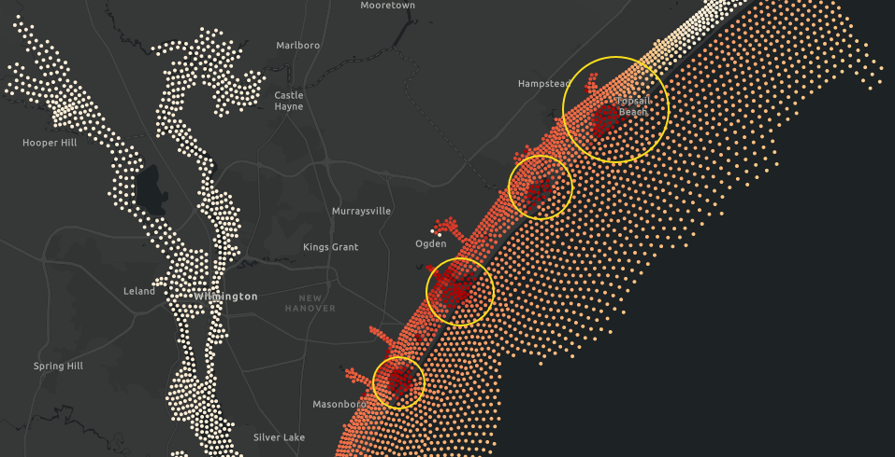
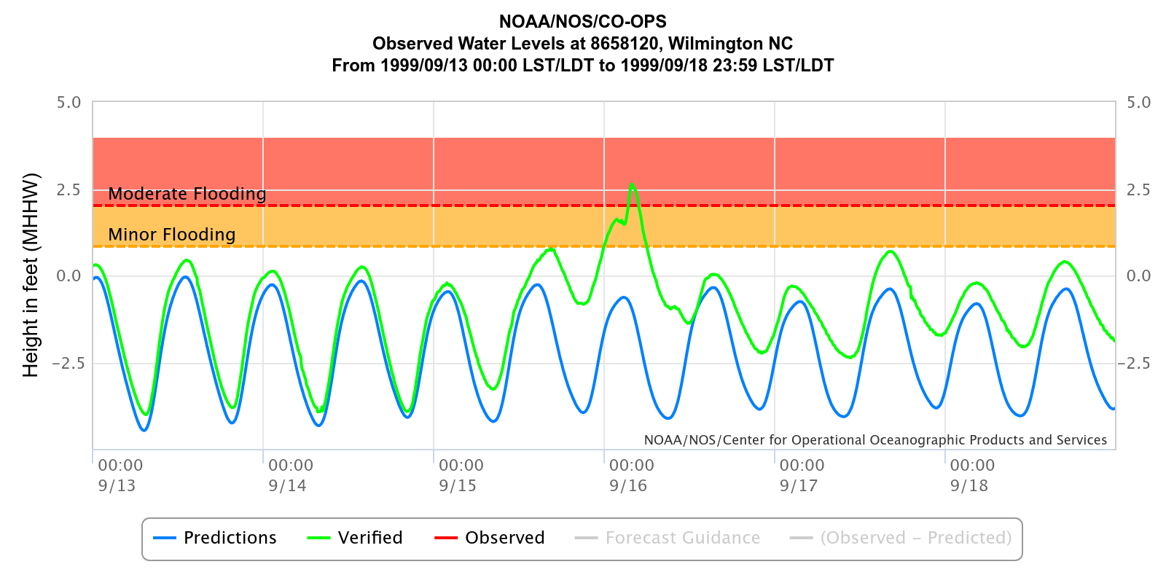
Wrightsville Beach Case Study
Event:
Hurricane Floyd in 1999 caused extensive flooding in Wrightsville Beach, SC.
Discussion:
Detailed flood analysis and impact on the area.
Historical data significance in understanding and preparing for similar events.
Details:
Caused unprecedented flooding across North and South Carolina, and the Mid-Atlantic states.
Flooding resulted in significant damage: ~537,000 homes and businesses lost power in NC.
Total damage was estimated at $6.5 billion, with 57 fatalities across the United States.
Environmental disaster ensued due to hog farm waste, sewage, and chemicals entering rivers.
^Tybee Island - Max water level with CORA data.
Near Wrightsville Beach, SC - a NWLON station.
^Water level observations from nearby Wrightsville Beach NWLON station.
Notes:
Hurricane Floyd in 1999 had a significant impact on Wrightsville Beach.
The National Weather Service provides comprehensive information on this event, which can be accessed through the provided link.
Our analysis focused on the maximum water levels and the overall flood impact.
Understanding historical data like this is crucial for preparing for and mitigating the effects of future hurricanes.

Slide 14
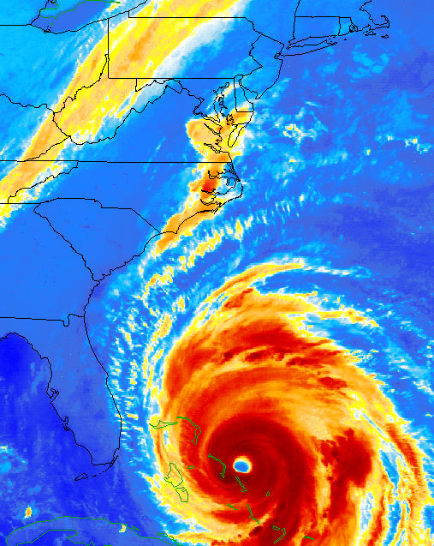
Wrightsville Beach Case Study
<Hurricane Floyd (1999) Impact and flood analysis.

Slide 15
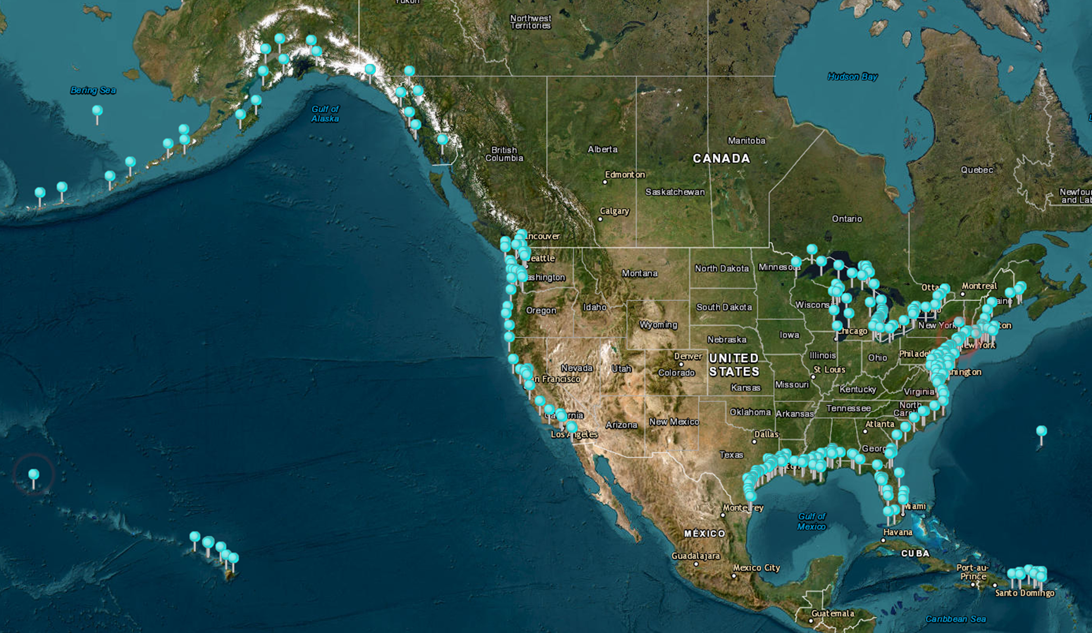
Map Resources
Resources Used:
Maximum water level elevation maps: Provide detailed insights into flood extents and heights.
CORA Grid structure: High-resolution grid that enhances data accuracy.
UH supplementary maps: Additional data layers from the University of Hawaii.
Peak water levels map: Highlights areas most affected by extreme water levels.
^CORA (Coastal Ocean Reanalysis)
Impact Graphics and Coastal Inundation Dashboard.
Notes:
Various map resources were integral to our analysis.
Maximum water level elevation maps show the extent and height of flooding.
The CORA Grid structure provides high-resolution data that enhances the accuracy of our simulations.
UH supplementary maps add valuable additional data layers to our analysis.
The peak water levels map highlights the areas most affected by extreme water levels, aiding in focused resilience planning.

Slide 16
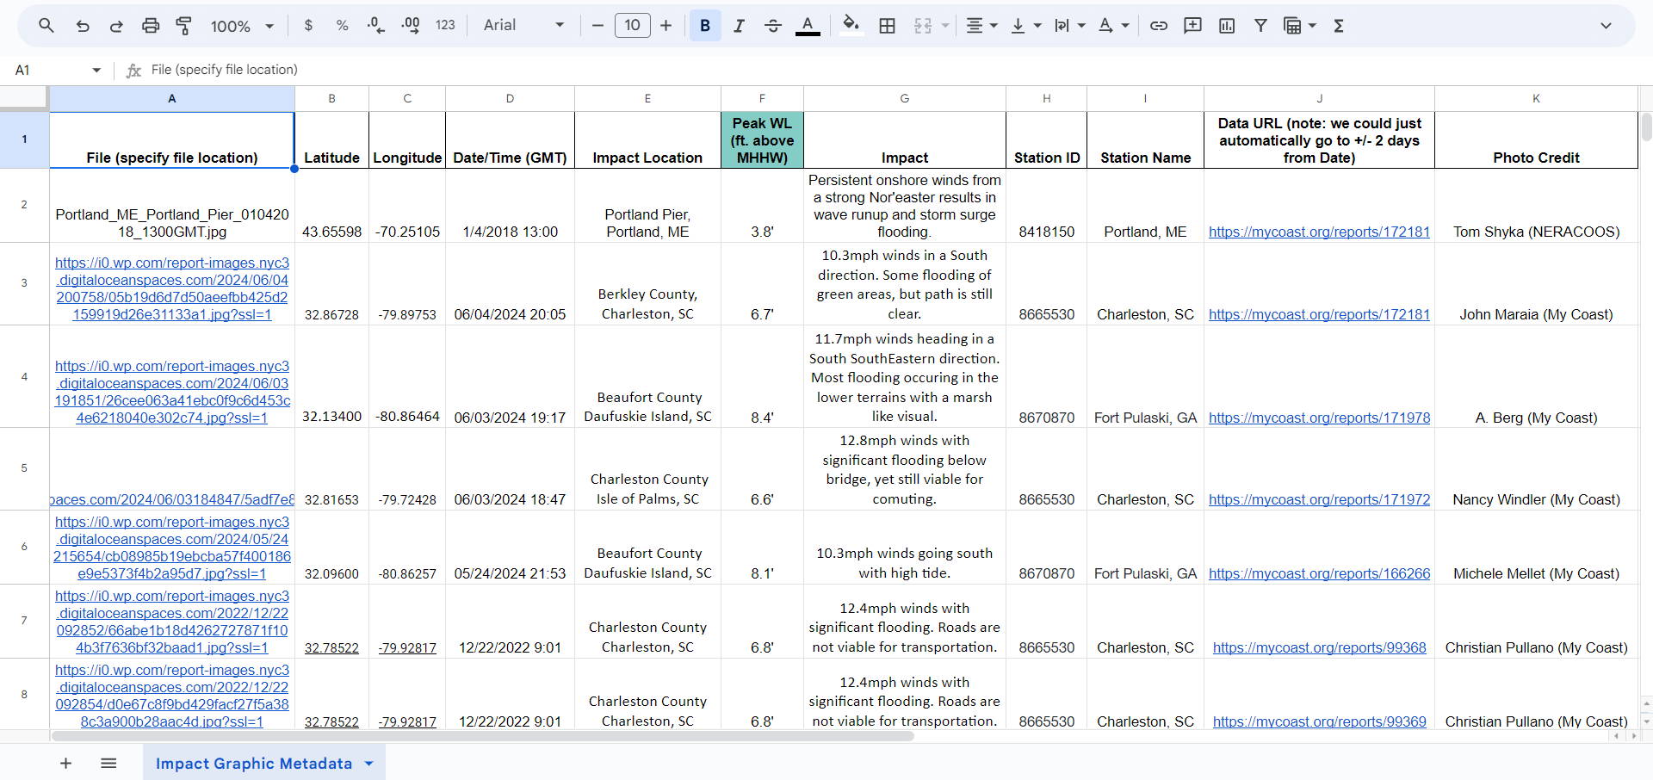
^Impact Graphics metadata chart for future publications.

Slide 17
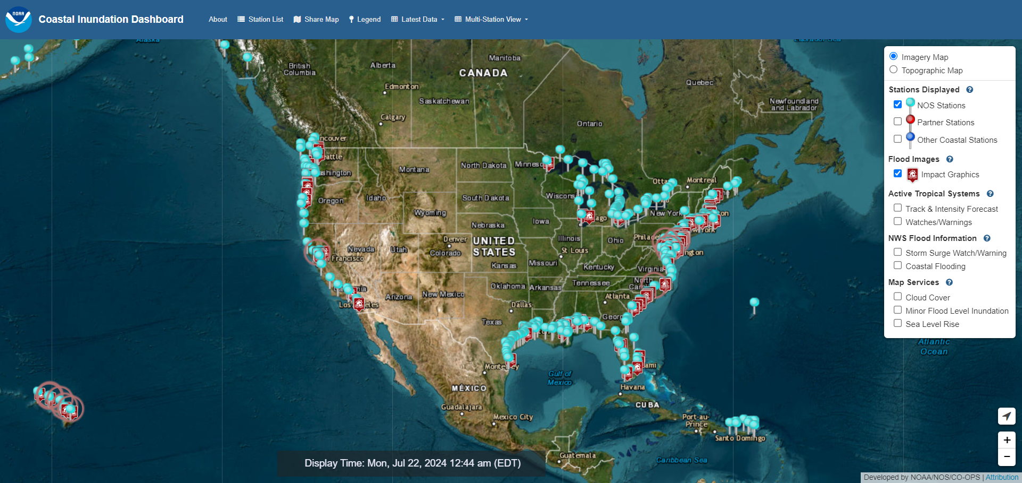

Slide 18
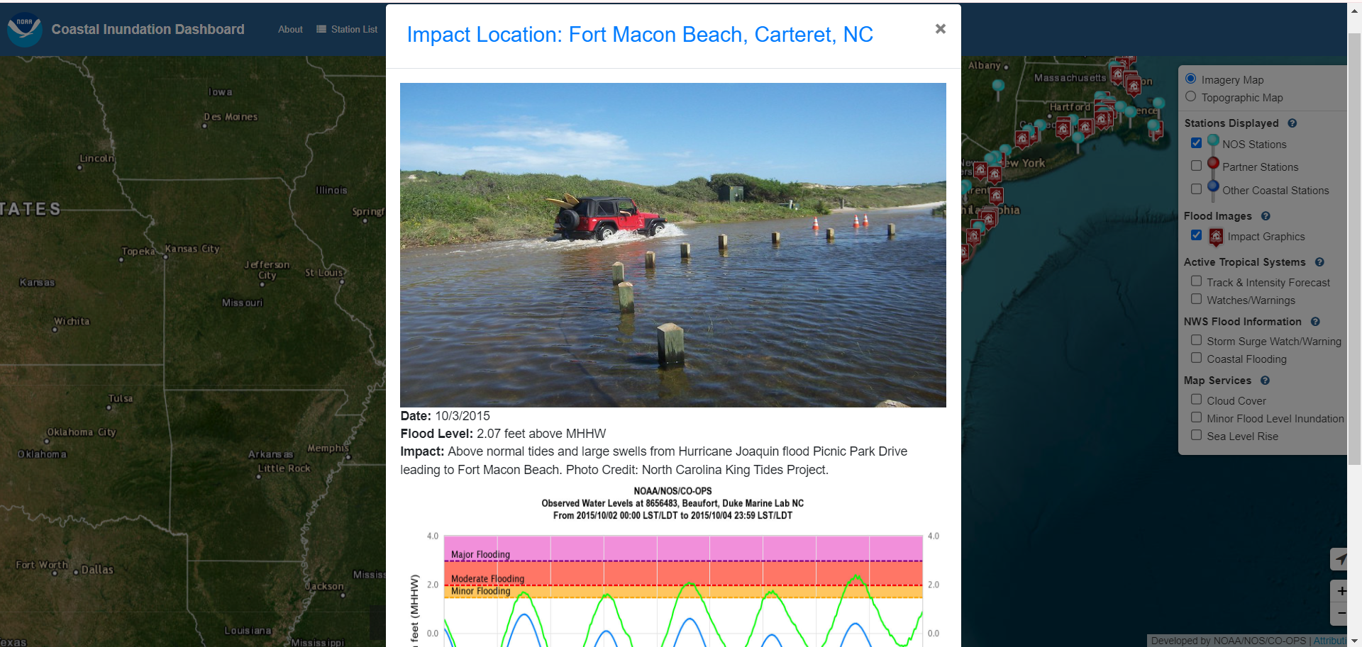

Slide 19
Applications for High-Resolution Historical Data
Benefits:
High-resolution CORA data offers detailed insights into historical sea level changes and extreme weather impacts.
Enhanced accuracy in flood risk assessments and planning.
Applications:
Used in scientific research to study past and predict future coastal changes.
Policymaking: Informs regulations and policies for coastal development and hazard mitigation.
Community planning: Helps local governments and communities prepare for and respond to flood risks.
Examples:
Accurate flood risk assessments lead to improved evacuation planning and infrastructure development.
Historical data aids in understanding long-term trends in sea level rise and extreme weather impacts.
Notes:
High-resolution CORA data provides detailed insights into historical sea level changes and the impacts of extreme weather.
This data is crucial for enhancing the accuracy of flood risk assessments and long-term planning.
Applications of this data range from scientific research to policy making and community planning.
For instance, accurate flood risk assessments help improve evacuation planning and infrastructure development.
Understanding long-term trends in sea level rise and extreme weather impacts allows for better preparation and resilience planning.

Slide 20
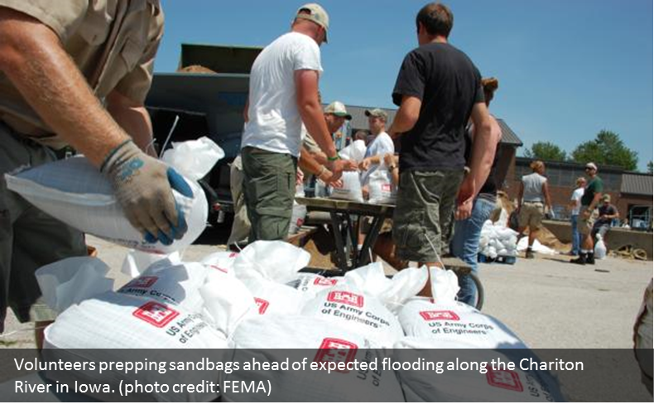
Future: Informed, Equitable Service Delivery
Vision:
Ensuring all communities have access to accurate, high-quality data for informed decision-making.
Continuing to enhance data products and services for better coastal resilience.
Equity:
Providing equitable access to data and services, especially for underserved communities.
Tailoring outreach and education efforts to ensure all communities can use the data.

Slide 21
Conclusion and Q&A
Summary of Key Points:
CORA project provides high-resolution data essential for understanding and mitigating coastal flood risks.
Case studies (Miami, Fort Pulaski, Wrightsville Beach) demonstrate the practical applications and benefits of CORA data.
Stakeholder engagement and partnerships, particularly with the University of Hawaii, are vital to enhancing data accuracy and accessibility.
Commitment to supporting underserved communities and ensuring equitable access to data and services.
Future Directions:
Continuing to refine and enhance data products for improved coastal resilience.
Expanding outreach and educational initiatives to empower all communities.
Leveraging stakeholder feedback for ongoing improvements.
Q&A:
Open floor for questions and discussions.
Notes:
In conclusion, the CORA project is pivotal in providing the high-resolution data necessary for understanding and mitigating coastal flood risks.
Through our case studies in Miami, Tybee Island, and Wrightsville Beach, we've shown how CORA data can be practically applied to enhance community resilience.
Our partnerships, particularly with the University of Hawaii, and our stakeholder engagement efforts are crucial for refining our products and making data accessible to all, especially underserved communities.
Moving forward, we aim to continue improving our data products, expand our outreach efforts, and ensure that all communities can benefit from our work.
I now welcome any questions or comments you may have. Let's discuss how we can further enhance coastal resilience together.

Slide 22
THANK YOU!
CORA
Publication
Contact
Information

