Slide 1
Status of the next version GEFS (v13)
Bing Fu¹, Neil Barton¹, Philip Pegion², Fanglin Yang¹ and Avichal Mehra¹
1. NOAA/NWS/NCEP/EMC
2. NOAA/ESRL/PSL
UIFCW 2024, July 22-26, Jackson, MS
Acknowledgements: Yuejian Zhu*, Eric Sinsky, Hong Guan, Sulagna Ray, Lydia Stefanova, Michael Barlage, Jessica Meixner, Saeideh Banihashemi, Raffaele Montuoro, Barry Baker, Li Pan, Partha Bhattacharjee

Slide 2
Outline
Configurations: GEFSv12 vs GEFSv13
Ensemble prototypes with aerosol (EP4-EP5)
Ensemble prototype (EP5r2) targeting for GEFSv13 reforecast
Summary and future experiments

Slide 3
Model Configurations (GEFSv12 vs GEFSv13)
Components |  | V12 (Sep 23. 2020) | V13 (targeting FY26)
Atmos | Dynamics | FV3 (Finite-Vol Cubed-Sphere) GFSv15 | FV3 (Finite-Vol Cubed-Sphere) GFSv17
 | Physics | saSAS, GFDL-MP, K-EDMF, oroGWD | saSAS, Thompson-MP, sa-TKE-EDMF, uGWD
 | Initial perturbation | EnKF f06 (previous cycle) | EnKF f00 (early cycle)
 | Model uncertainty | 5-scale SPPT and SKEB | 5-scale SPPT, SKEB, SPP, CA
 | Boundary (ocean surface) | NSST + 2-tiered SST | NSST
 | Resolutions | C384L64 (25km) | C384L127 (25km)
Land | Model | NOAH-LSM | NOAH-MP
 | Initial perturbation | N/A | Soil moisture
Ocean | Model | N/A | MOM6 (0.25ºL75)
 | Initial perturbation |  | SOCA-Ens
 | Model uncertainty |  | 5-scale oSPPT and ePBL
Ice | Model |  | CICE6 (0.25º)
 | Initial perturbation |  | SOCA-Ens
Wave | Model | WW3 (1-way) (0.5º) | WW3 (2-way) (0.25º lat/lon grid)
Aerosol | Model | GOCART (1-way) | GOCART (2-way? TBD)

Slide 4
Ensemble prototypes for GEFSv13
Coupled model prototype | Timestamp of the model tag
P5 (EP1) | 09/16/2020
P6 | 02/19/2021
P7 (EP2) | 08/23/2021
P8 (EP3) | 05/31/2022
HR1 (EP4) | 01/30/2023
HR2 | 07/24/2023
HR3 (EP5) | 01/11/2024
6 months
8 months
9 months
8 months
6 months
4 months
It usually takes 8 - 11 months to complete one ensemble prototype

Slide 5
Recent ensemble experiments with aerosol
EP4 | HR1 physics; Climatology aerosol; GFSv15(atm)/ORAS5(ocn)/CPC(ice)/GEFSv12 (wav)
EP4b | HR1 physics; prognostic aerosol with observed emission; GFSv15(atm)/ORAS5(ocn)/CPC(ice)/GEFSv12 (wav)
EP4d (mini) | HR1 physics; prognostic aerosol with blending emission*; GFSv15(atm)/ORAS5(ocn)/CPC(ice)/GEFSv12 (wav)
EP5d (mini) | HR3 physics; prognostic aerosol with blending emission*; GFSv15(atm)/ORAS5(ocn)/CPC(ice)/GEFSv12 (wav)
EP5r2 | HR3 physics; prognostic aerosol with blending emission*; replay IC
Note: | Blending emission: (using observed emission at initial time for the first 5 days (day 1 - day 5), then blending observed emission with climatology for the rest of forecast time (day 6 - day 35/48)

Slide 6
Average AC of 2017-2019
Z500: NH | GEFSv12 | EP4 | EP4b
Week 1 | 0.965 | 0.967 | 0.967
Week 2 | 0.629 | 0.656 | 0.648
Week 3-4 | 0.356 | 0.378 | 0.386
Z500: SH | GEFSv12 | EP4 | EP4b
Week 1 | 0.958 | 0.961 | 0.962
Week 2 | 0.586 | 0.584 | 0.604
Week 3-4 | 0.291 | 0.278 | 0.243
Blue text: higher AC than GEFSv12 (bolded text: significant improvement from GEFSv12 at a 95% confidence interval)
Red text: lower AC than GEFSv12 (bolded text: significant degradation from GEFSv12 at a 95% confidence interval)
Courtesy: Eric Sinsky

Slide 7
EP4b vs EP4d (8 winter cases)
Replacing observed emission with blending emission overall show similar skill scores
Courtesy: Eric Sinsky

Slide 8
EP4b vs EP4d (8 summer cases)
Replacing observed emission with blending emission overall show similar skill scores
Courtesy: Eric Sinsky

Slide 9
Targeting for GEFSv13 reforecast (EP5r2)
The model: EP5r2
HR3 tag + bugfix for tsfc
The experiments:
3 years (Oct 2017 - Sep 2019, Oct 2020 - Sep 2021) experiments + cases from DYNAMO period (Oct 2011 - Jan 2012)
Evaluations: (in progress)
Multiple centers (EMC, CPC, OWP, PSL, WPC etc)
Expected to be completed by Sep 1, 2024

Slide 10
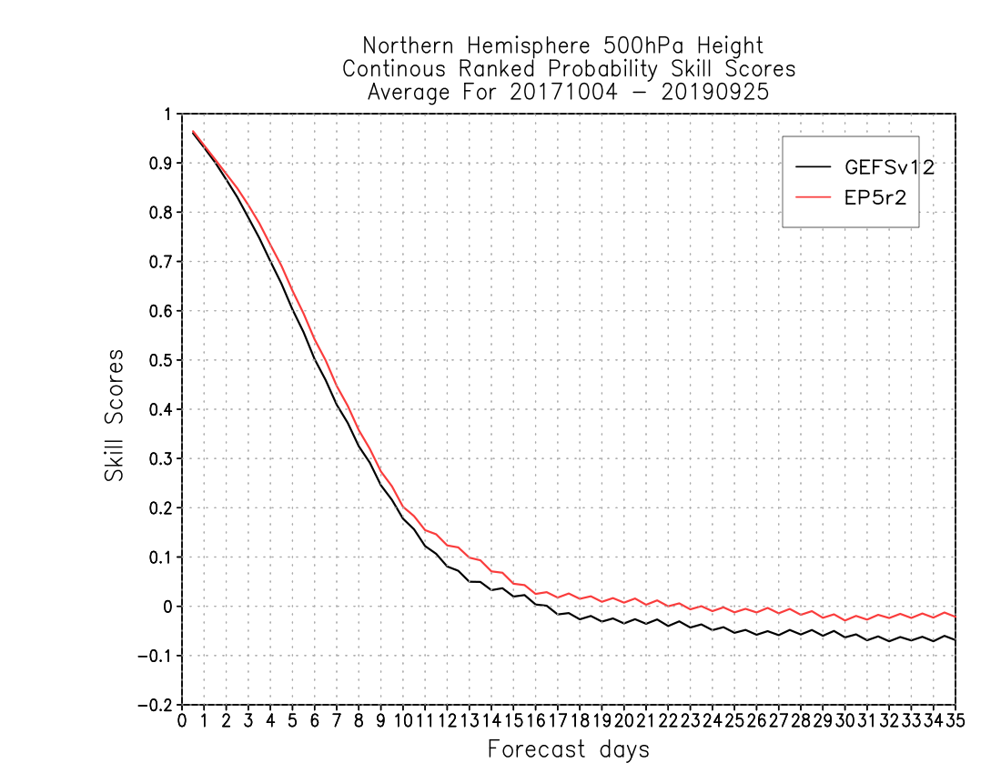
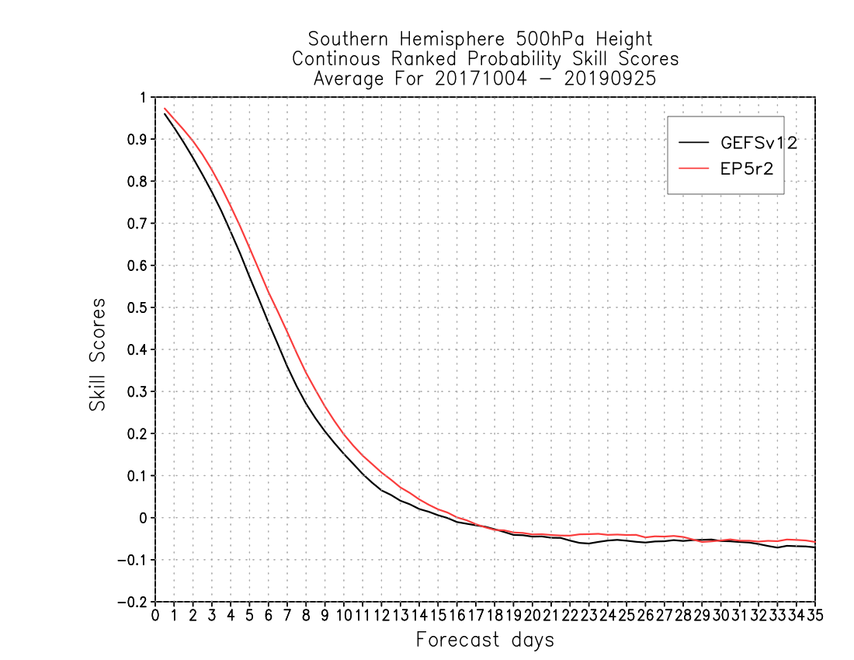
Z500 CRPS
Z500 CRPS
Improved Z500 CRPS for both NH/SH

Slide 11
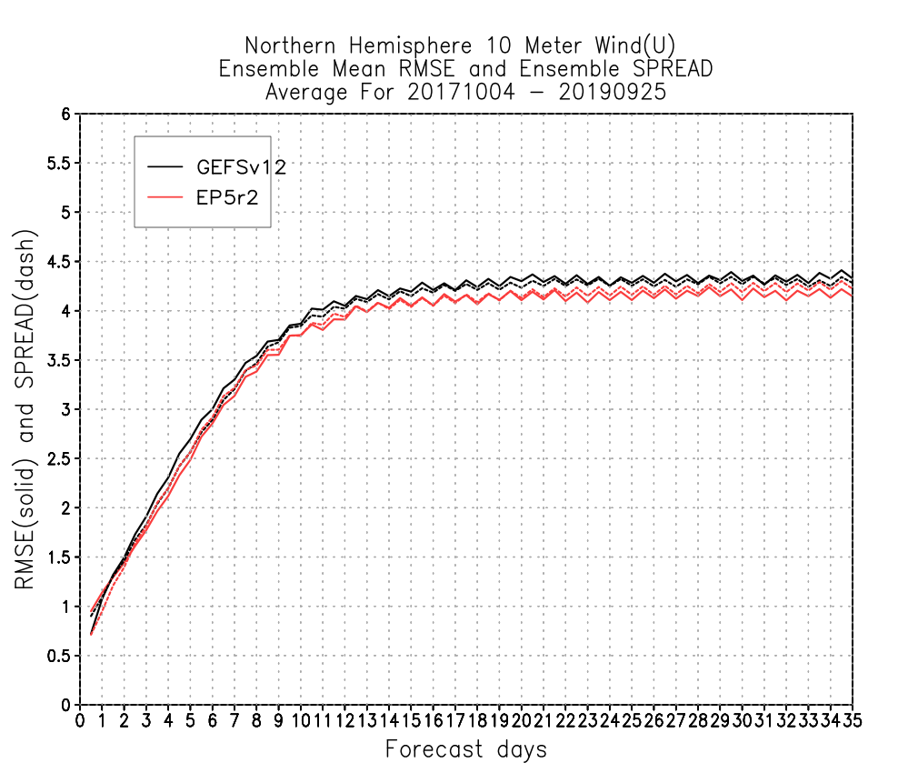
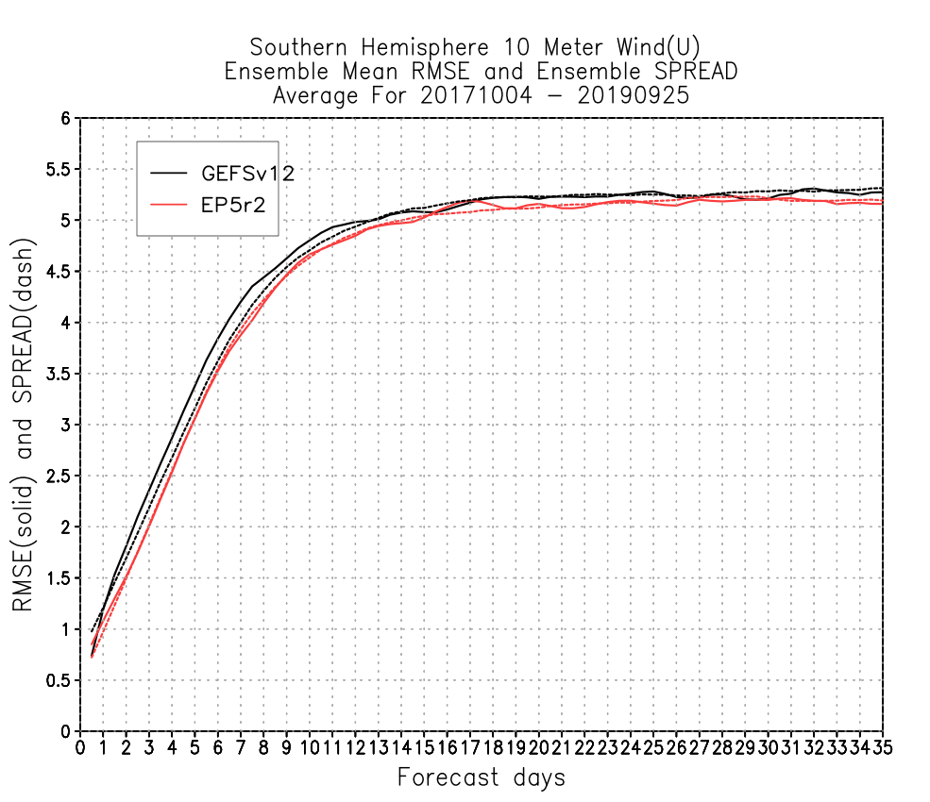
U10M RMSE & SPRD
U10M RMSE & SPRD
Reduced U10M RMSE for both NH/SH
Better RMSE/SPRD relationship

Slide 12
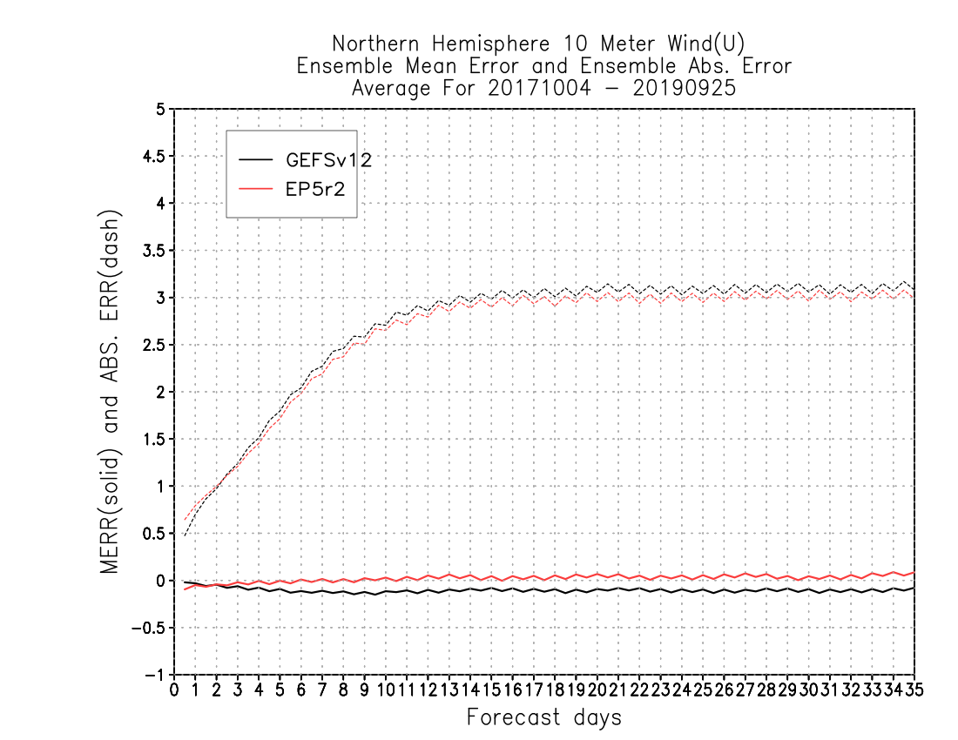
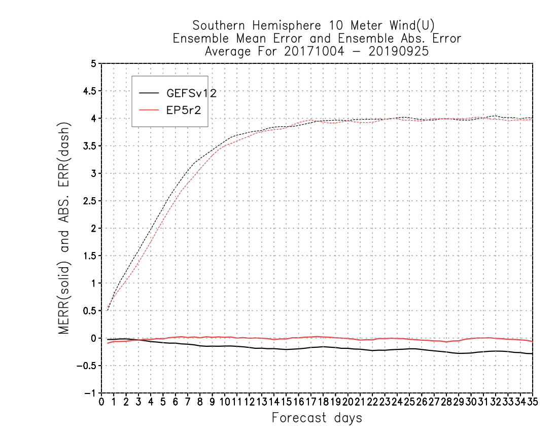
U10M bias
U10M bias
Reduced U10M bias for both NH/SH

Slide 13
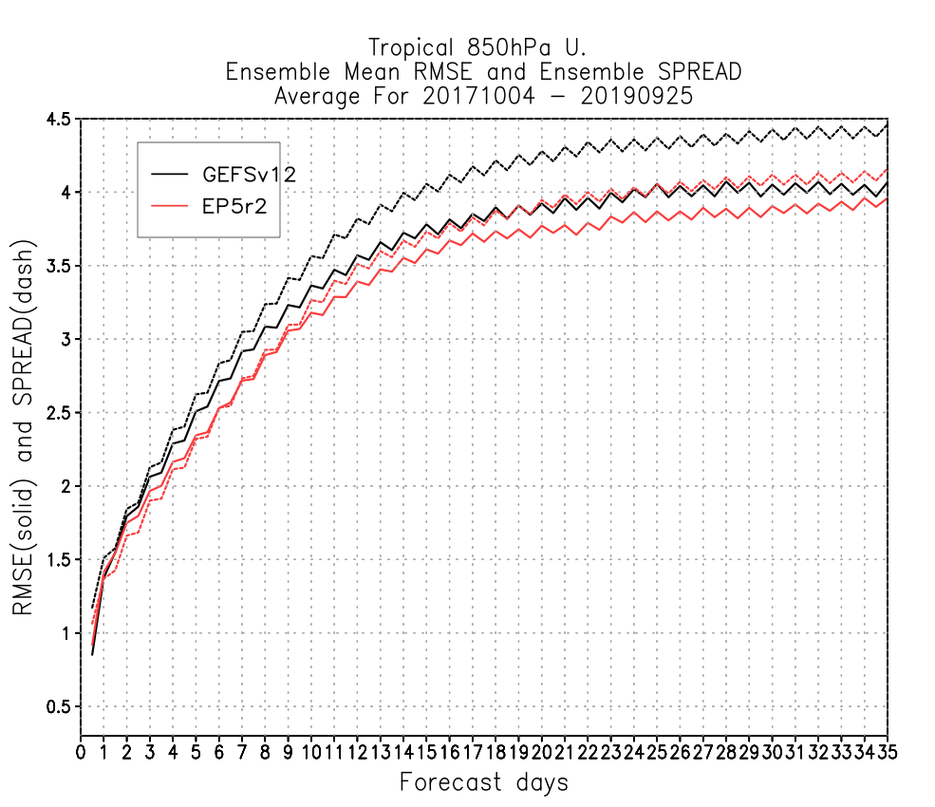
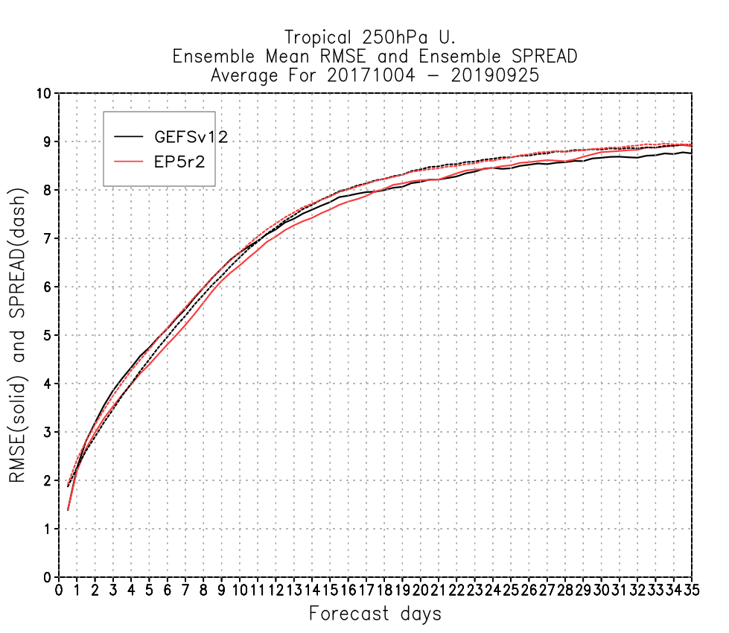
U850/U250 RMSE & SPRD
U850/U250 RMSE & SPRD
Reduced RMSE, reduced overdispersion U850

Slide 14
EP5r2 vs GEFSv12 Scorecard: (Oct 2017 - Sep 2019)
ACC: significantly improved
RMSE: overall improved, except temperature in the tropics
Bias: mixed results, degradation at lower level
Courtesy: Eric Sinsky

Slide 15
Summary
Future experiments
Several ensemble experiments with aerosol have been carried out with the recently updated UFS coupled model
The full set (3+ years) experiments using the latest ensemble prototype has completed, evaluation in progress
Preliminary results show better performance of EP5r2 compared with GEFSv12 in some metrics, some degradations also noticed
Testing HR4 physics (land surface updates, damping parameters, GWD etc) as well as some sensitivity tests of aerosol

