Slide 1
Hurricane Inner-core Data Assimilation Upgrades for HAFSv2 and 2024 Real-Time Parallel Experiments
Xu Lu,¹ Jing Cheng,² Yonghui Weng,¹ Bin Liu,¹ Zhan Zhang,³ Avichal Mehra,³ and Vijay Tallapragada³
¹Lynker at NOAA/NWS/NCEP/EMC; ²Axiom at NOAA/NWS/NCEP/EMC; ³NOAA/NWS/NCEP/EMC
Acknowledgement: Xuguang Wang (MAP/OU)
Unifying Innovations in Forecasting Capabilities Workshop 2024
22-26 July 2024, Jackson, MS

Slide 2
Outline
Data Assimilation (DA) upgrades in the Hurricane Analysis and Forecast System version 2 (HAFSv2).
DA upgrades in the 2024 HAFS-A configuration based real-time parallel experiment.
HAFS-DA JEDI transition.

Slide 3
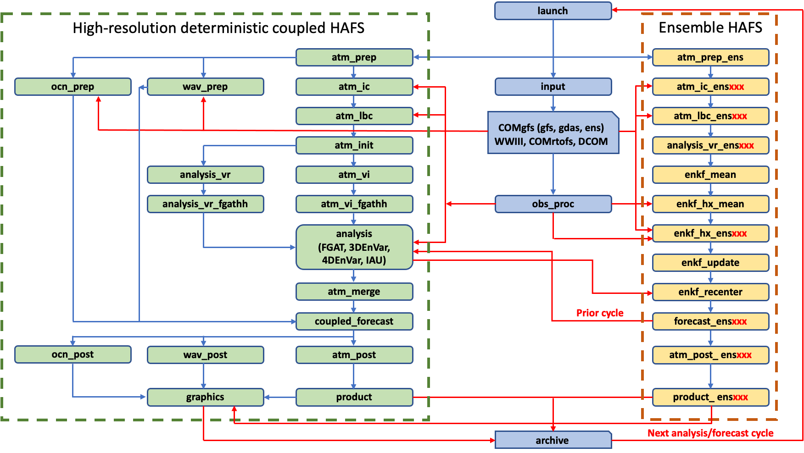
HAFS Workflow and DA Capabilities
DA Options
Vortex Initialization
FGAT
3DVar/3DEnVar/4DEnVar/EnKF
3DEnVar/4DEnVar:
GDAS ensemble
HAFS ensemble
GDAS/HAFS ensemble combined
Options for DA domains
Nest domain only, and use GFS analysis elsewhere
Parent domain only
Self-cycled DA for nest using dual-res. approach, highRes. deterministic and lowRes HAFS EnKF
Self-cycled static DA domain for parent only, beyond IOC
No ocean DA

Slide 4
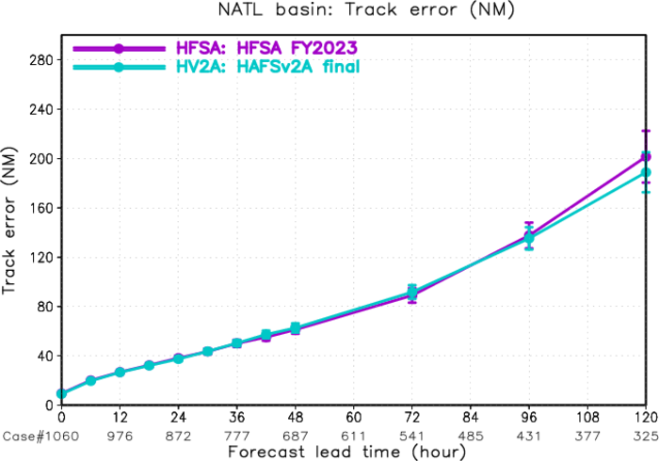
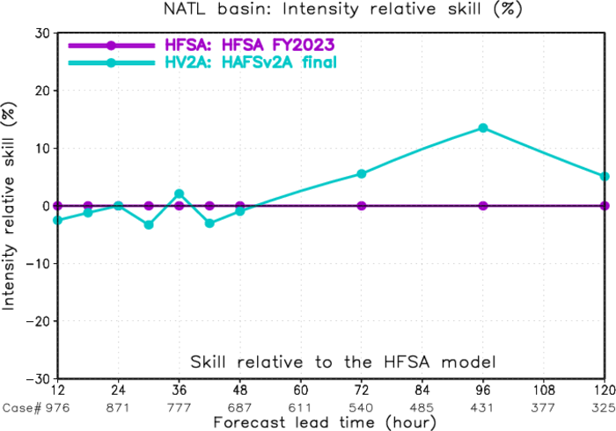
From HAFSv1.1A Real-time Experiment to HAFSv2A Upgrade
The HAFSv2A upgrade is based on the HAFSv1.1A configuration with additional improvements and optimizations in model dynamics, physics, coupling, as well as vortex initialization and data assimilation
Latest HAFS package with updated subcomponents under UFS
Improved DA with Scale-Dependent Localization (SDL)
Alternative horizontal advection scheme for model dynamics
Further optimized model physics in both atmospheric and oceanic components
Unified UFS regional coupling through CMEPS with inline CDEPS and also consider sea surface current coupling
Upgraded GFDL vortex tracker
2021-2023 NATL storms
HFSA: HAFSv1A
HV2A: HAFSv2A
Track Error
Intensity skill

Slide 5
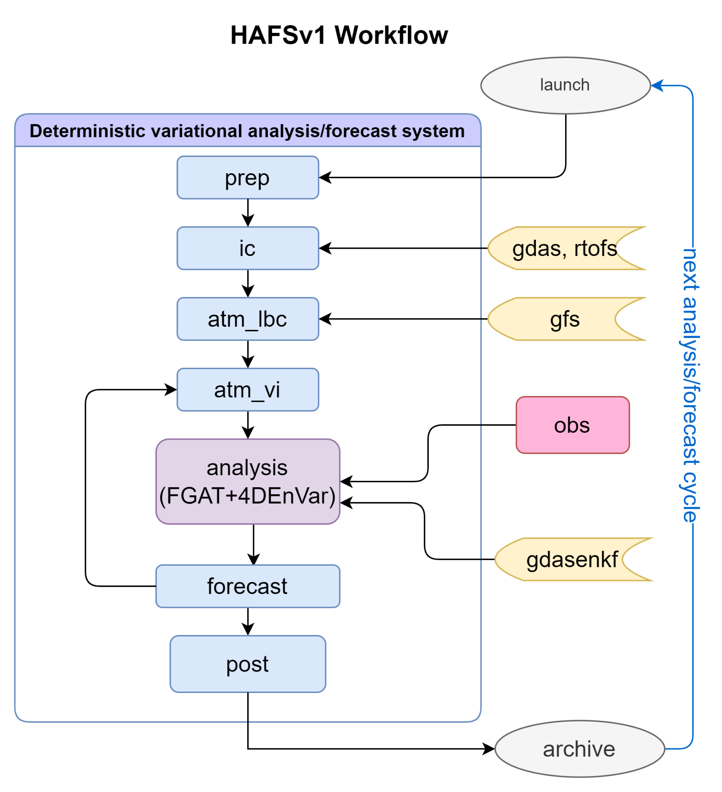
HAFSv2A VI / DA Upgrade
HAFSv1 VI/DA
Vortex Initialization
6-hourly DA cycling in nested domain region, and GFS analysis elsewhere
+/- 3-hour FGAT window
4DEnVar with GDAS ensembles
Leverage obs. used in GFS
Additional meso-scale obs.
New Features in HAFSv2 VI/DA
Hydrometeor and vertical velocity relocation
Ingest high res. meso-sector AMVs
Scale-Dependent Localization (SDL)
Refine DA for the GPS RO (Radio Occultation)
Bug fixes

Slide 6
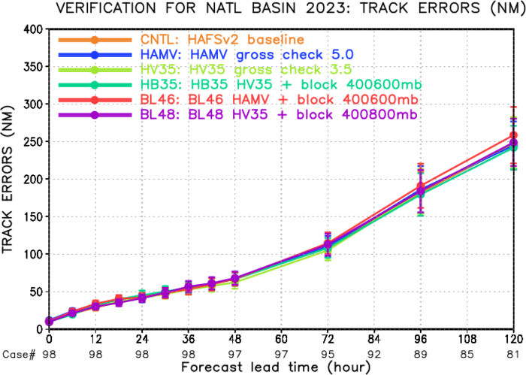
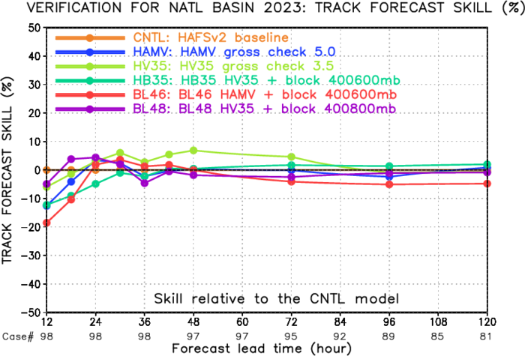
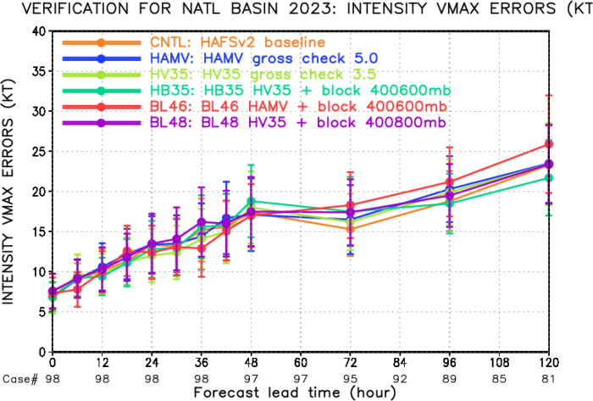
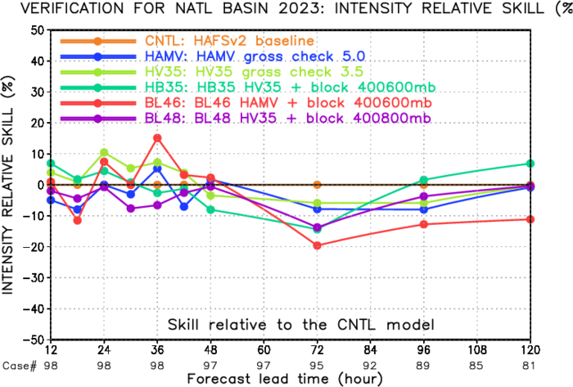
Enhanced AMV Upgrades (Major Atlantic Storms in 2023)
Overall, assimilating enhanced AMV has neutral to positive impact on hurricane forecast, especially on track forecast.
Track Error
Track Skill
Vmax Error
Vmax Skill
Notes:
The enhanced AMV dataset are generated from rapid-scan GOES-16 and GOES-18 imagery.
Moveable “meso sector” , focus on a TC center with 10x10 domain.
This set of data was tested in HWRF for forecasting of Hurricanes (Li et al. 2020, Lewis et al. 2020, Lim et al .2022).

Slide 7
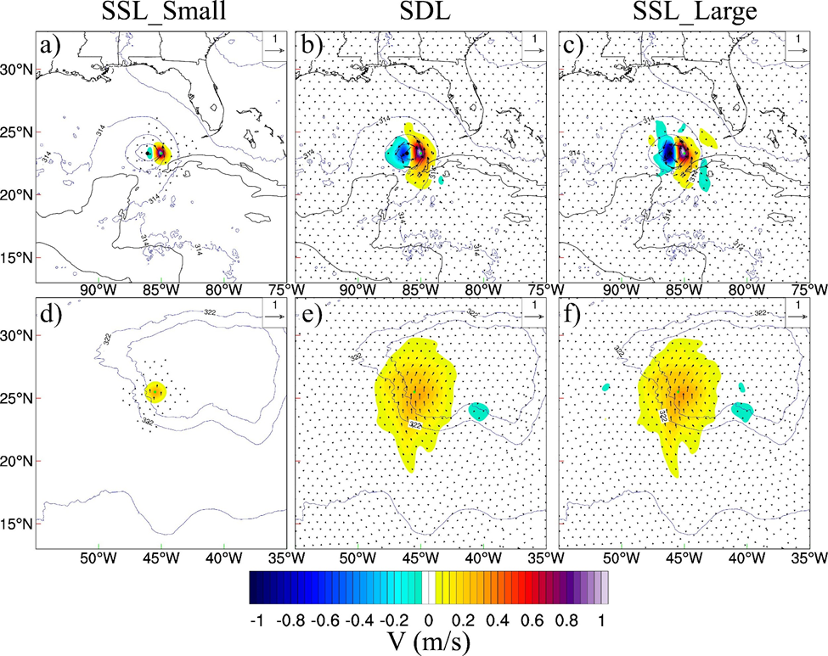
SDL Methodology
~180-km SSL
SDL
~1600-km SSL
MDA with SDL can simultaneously properly correct both the TC and its large-scale steering environment
Near Storm V Inc
1 m/s V innovation
Environmental V Inc
Lu and Wang (2024, JGR-A, accepted)

Slide 8
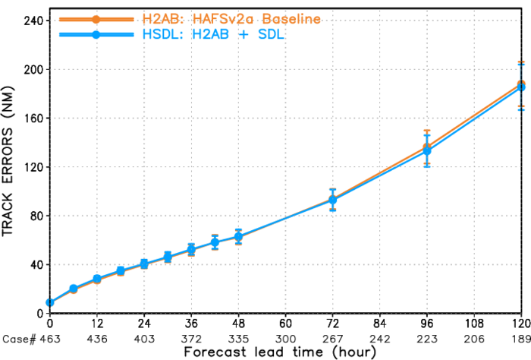
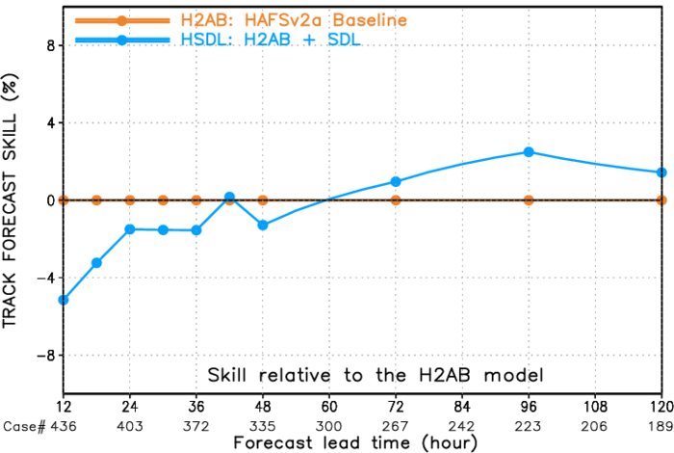
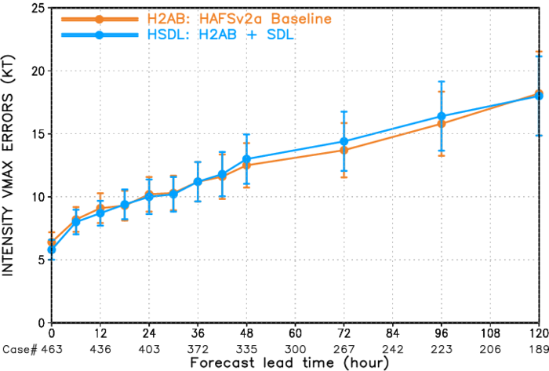
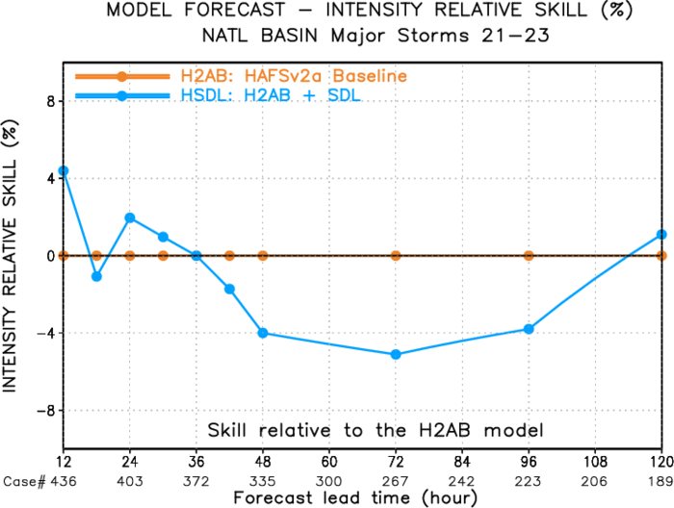
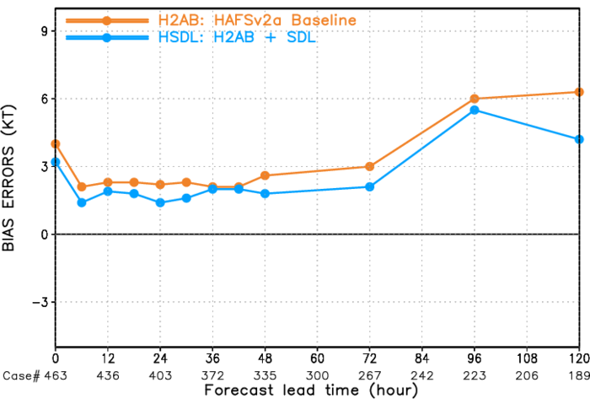
SDL Upgrades (Major Atlantic Storms Between 2021-2023)
HSDL slightly improves long-term track, short-term intensity, and overall intensity bias as compared to H2AB.
Track Error
Track Skill
Vmax Error
Vmax Skill
Vmax Bias

Slide 9
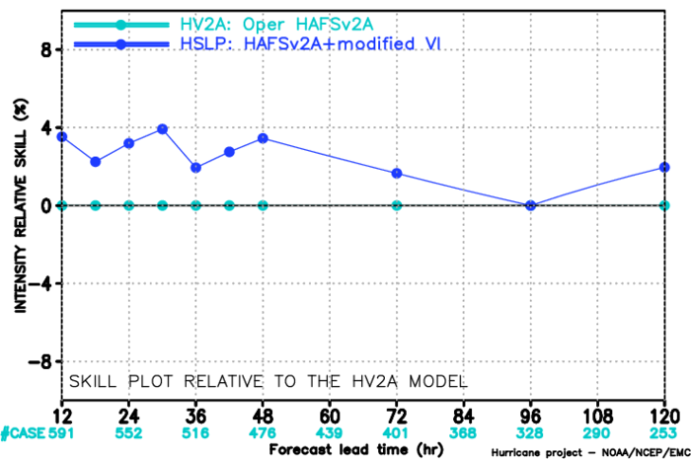
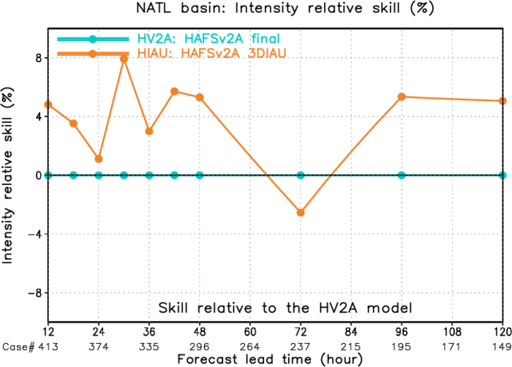
2024 HAFSv2.xA Real-time Parallel Experiment Configurations
Infrastructure
Sync all HAFS submodules/subcomponents with their latest authoritative repositories and branches
Latest HAFS application/workflow
VI and DA
Further improved Vortex Initialization by improving the Pmin enhancement (By JungHoon Shin, Wednesday afternoon)
Apply Storm-Following 3DIAU (Three-Dimensional Incremental Analysis Update) in innercore DA
Assimilate more obs and use new CRTM/2.4.0.1
for selected 2021-2023 NATL storms
The VI improvement resulting in better intensity forecast skills, especially for short forecast lead times
intensity skill
for 2023 NATL storms
The 3DIAU approach reduces intensity errors for almost all forecast lead times
intensity skill

Slide 10
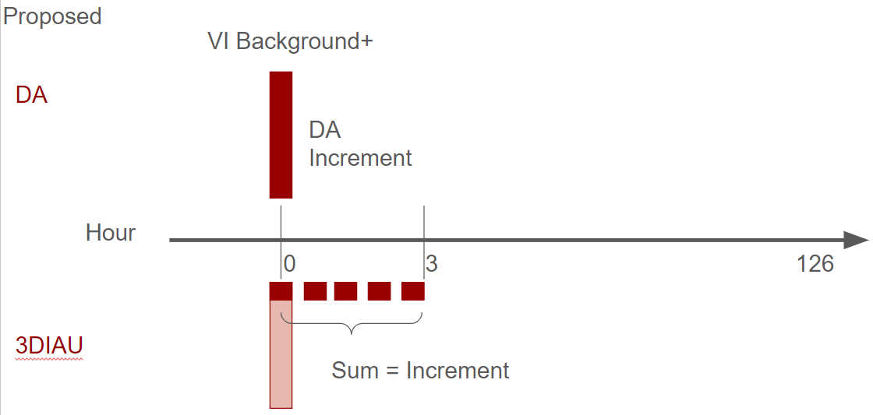
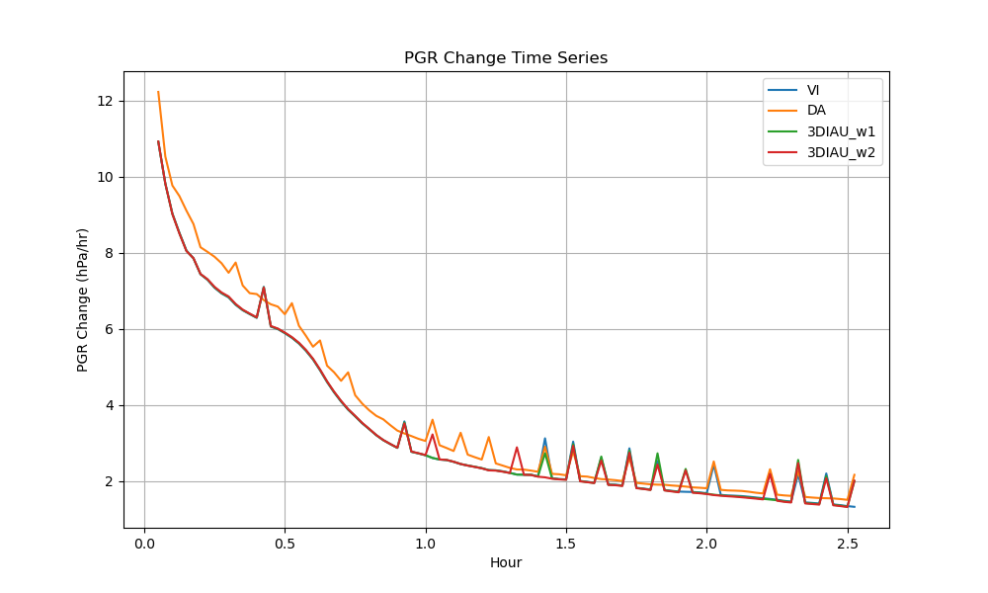
Storm-Following 3DIAU Methodology
The Incremental Analysis Update (IAU) uses the increment as an additional but continuous forcing to the model integration (Bloom et al. 1996).
The continuous but relatively small forcing added to each model integration time step is designed to maximally maintain the dynamical balance of the mass and momentum fields of the model, and therefore reduce the shocks caused by the intermittent DA
Feature-Relative 4DIAU https://doi.org/10.1175/MWR-D-21-0068.1

Slide 11
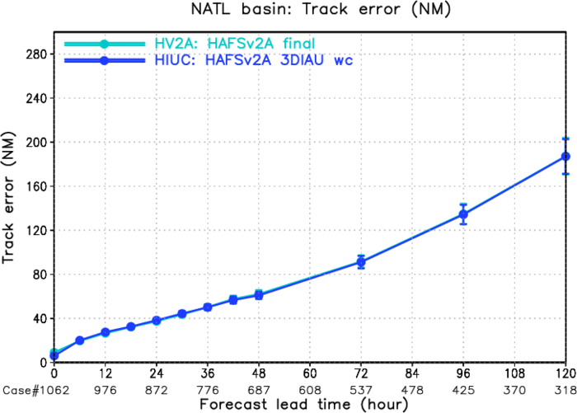
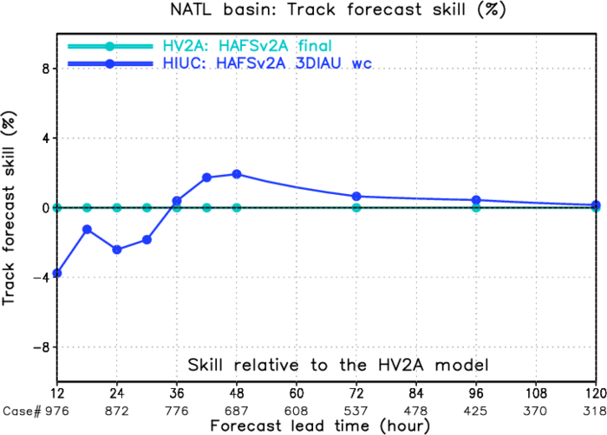
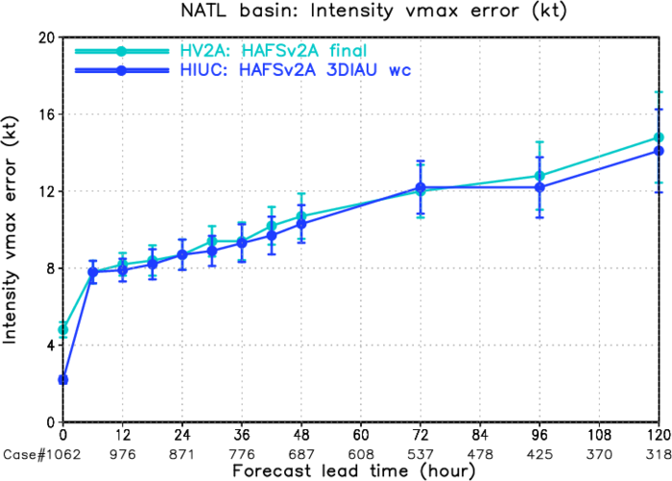
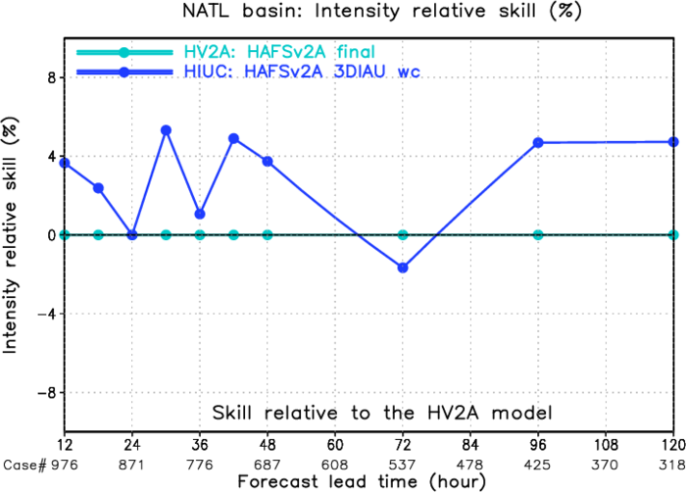
3DIAU Upgrades (Atlantic Storms between 2021-2023)
3DIAU improves track and intensity skills upon the HV2F.
Track Error
Track Skill
Vmax Error
Vmax Skill

Slide 12
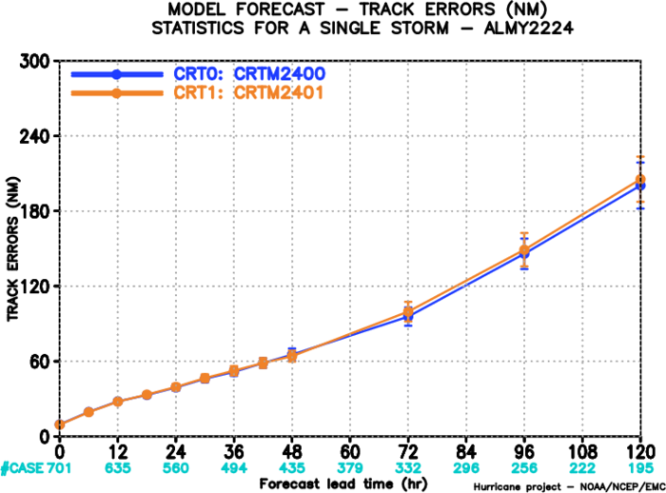
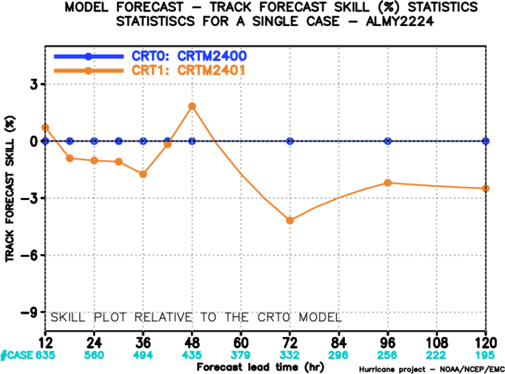
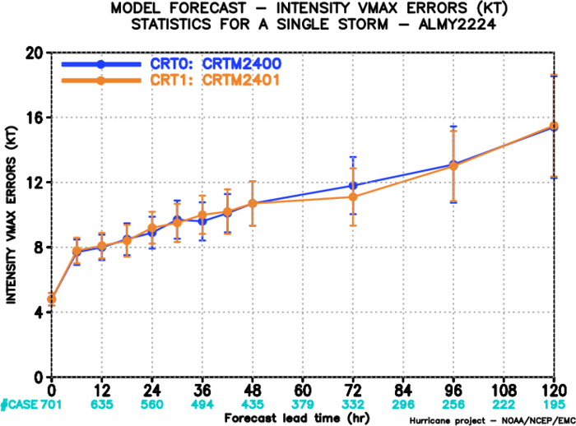
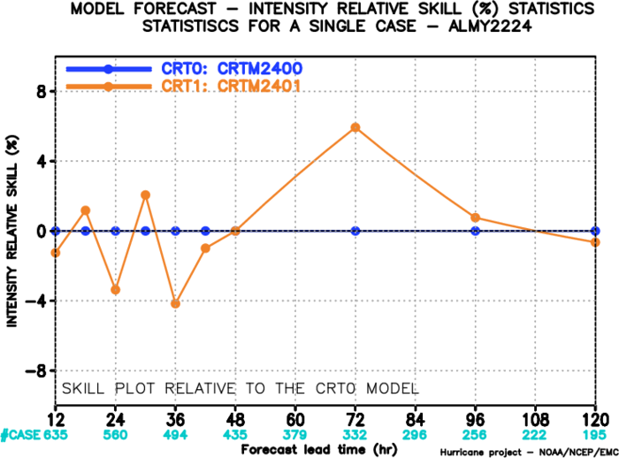
CRTM Upgrades (Atlantic Storms between 2021-2023)
New CRTM (2.4.0.1) with additional observations is overall comparable with the old CRTM (2.4.0).
Slight degradation in track but improvements in intensity.
Track Error
Track Skill
Vmax Error
Vmax Skill

Slide 13
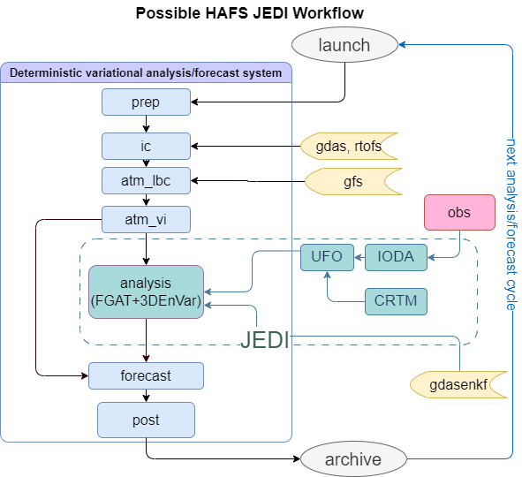
HAFS-DA JEDI transition
Current status of transition from GSI to JEDI
HDASApp: HAFS Data Assimilation System Application
Tested JEDI functions with HAFS model interface:
BUMP, 3DVar, 3DEnVar, 4DEnVar
Observation Operator Validation:
SATWND, SFCSHP, SURFACE, SONDE, MSONET,Dropsonde
ATM, MHS, AMSUA, CRIS, IASI, SSMIS, ABI,
NEXRAD, TDR
Background Covariance choice:
80 members GDAS interpolated onto HAFS GRID

Slide 14
Summary
HAFSv2 DA upgrades:
Enhanced AMV assimilation: produces neutral to positive improvements, especially intrack.
SDL configuration: improves long-term track, short-term intensity, and overall intensity bias
2024 HAFSv2.xA Real-time Parallel Experiment DA upgrades:
Storm-following 3DIAU: improves track and intensity predictions.
CTRM upgrade with additional obs: improves overall intensity predictions.
JEDI based DA in HAFSv3 is planned
References:
Lu, X., X. Wang, M. Tong, and V. Tallapragada, 2017a: GSI-based, Continuously Cycled, Dual-Resolution Hybrid Ensemble-Variational Data Assimilation System for HWRF: System Description and Experiments with. Mon. Wea. Rev., 145, 4877–4898.
——, ——, Y. Li, M. Tong, and X. Ma, 2017b: GSI-based ensemble-variational hybrid data assimilation for HWRF for hurricane initialization and prediction: Impact of various error covariances for airborne radar observation assimilation. Quart. J. Roy. Meteor. Soc., 143, 223–239.
——, ——, 2021. Improving the four-dimensional incremental analysis update (4DIAU) with the HWRF 4DEnVar data assimilation system for rapidly evolving hurricane prediction. Monthly Weather Review, 149(12), pp.4027-4043.
——, ——, 2024: Simultaneous Multiscale 4DEnVar with scale-dependent localization (SDL) in HAFS to improve hurricane predictions. Journal of Geophysical Research: Atmospheres, Accepted.
Wang, X., Chipilski, H.G., Bishop, C.H., Satterfield, E., Baker, N. and Whitaker, J.S., 2021. A multiscale local gain form ensemble transform Kalman filter (MLGETKF). Monthly Weather Review, 149(3), pp.605-622.
Huang, B., Wang, X., Kleist, D. T., and Lei, T. (2021). A Simultaneous Multiscale Data Assimilation Using Scale-Dependent Localization in GSI-Based Hybrid 4DEnVar for NCEP FV3-Based GFS, Mon. Wea. Rev., 149(2), 479-501.
Wang, Y., and X. Wang, 2023. Simultaneous Multiscale Data Assimilation Using Scale‐and Variable‐Dependent Localization in EnVar for Convection Allowing Analyses and Forecasts: Methodology and Experiments for a Tornadic Supercell. Journal of Advances in Modeling Earth Systems, 15(5), p.e2022MS003430.

Slide 15
Thank you!

