Slide 2
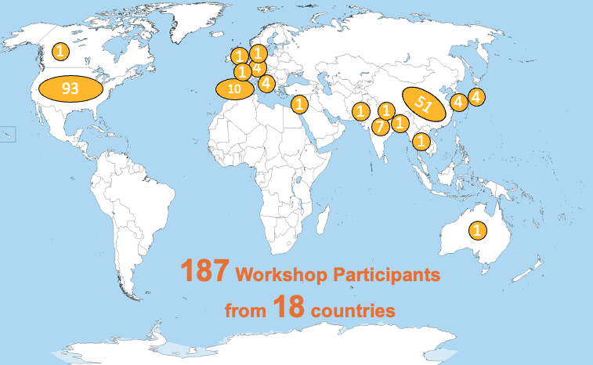
Community Noah-MP land surface model
Noah-MP International Users’ Workshop
(June 3-4, 2024; hybrid)
NWM/
WRF-Hydro
NOAA/UFS
WRF, MPAS
NLDAS
Noah-MP
NASA/LIS
HRLDAS
KIM, GRIST, etc.
UT-Austin
U of Arizona

Slide 3
Snowpack physics improvements in Noah-MP LSM
Improve canopy turbulence scheme above snowpack: Abolafia-Rosenzweig, He, et al. 2021 JAMES
Improve snow compaction/densification: Abolafia-Rosenzweig, He, et al. 2024 JAMES
Improve snow albedo scheme: Lin, He, et al., 2024 JGR-Atmos in review
Improve snow cover parameterization: Abolafia-Rosenzweig, He, et al. 2024 in preparation
Improve canopy snow interception: next-step work

Slide 4
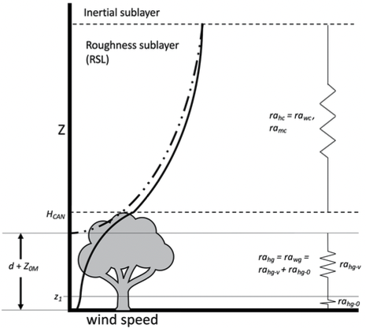
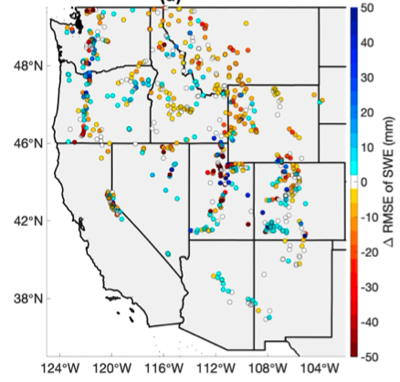
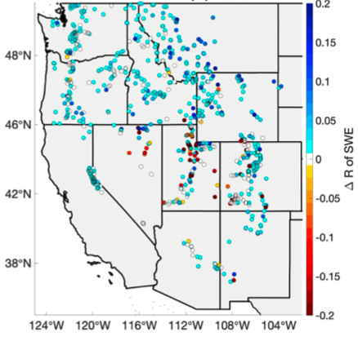
Implementing a Unified Turbulence Parameterization Throughout the Canopy and Roughness Sublayer
Noah-MP uses the Monin-Obukhov (M-O) Similarity Theory (MOST) to calculate land-atmosphere exchanges of fluxes.
The MOST flux-profile relationships are known to fail within and above rough surfaces (particularly in the RSL).
Previous work concluded that simulated SWE is sensitive to different surface turbulence parameterizations.
We integrate a RSL turbulence parameterization (Bonan et al., 2018) within Noah-MP
Reduced RMSE of SWE
Increased Correlation of SWE
Abolafia-Rosenzweig et al. 2021 JAMES

Slide 5
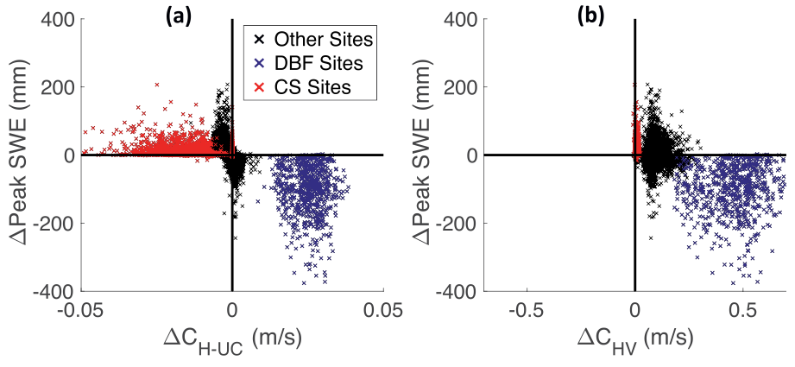
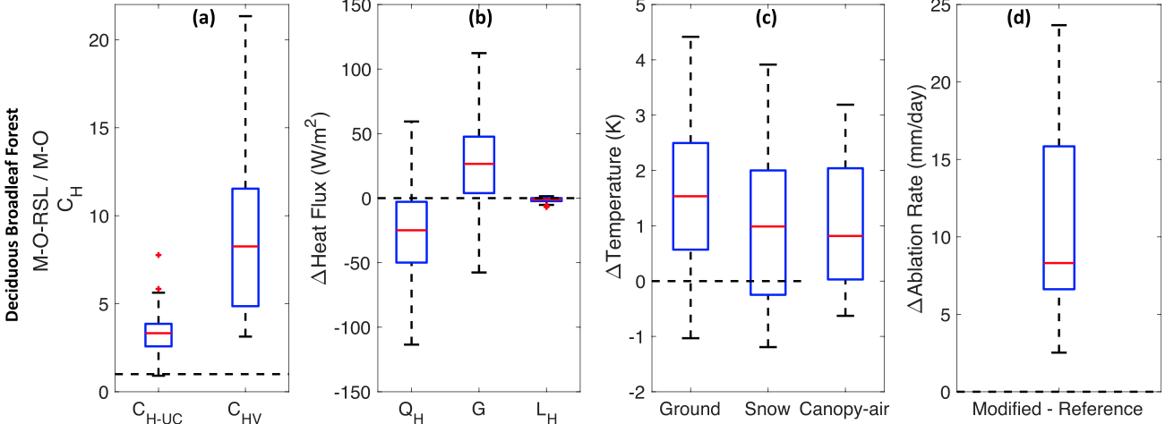
Implementing a Unified Turbulence Parameterization Throughout the Canopy and Roughness Sublayer
Abolafia-Rosenzweig et al. 2021

Slide 6
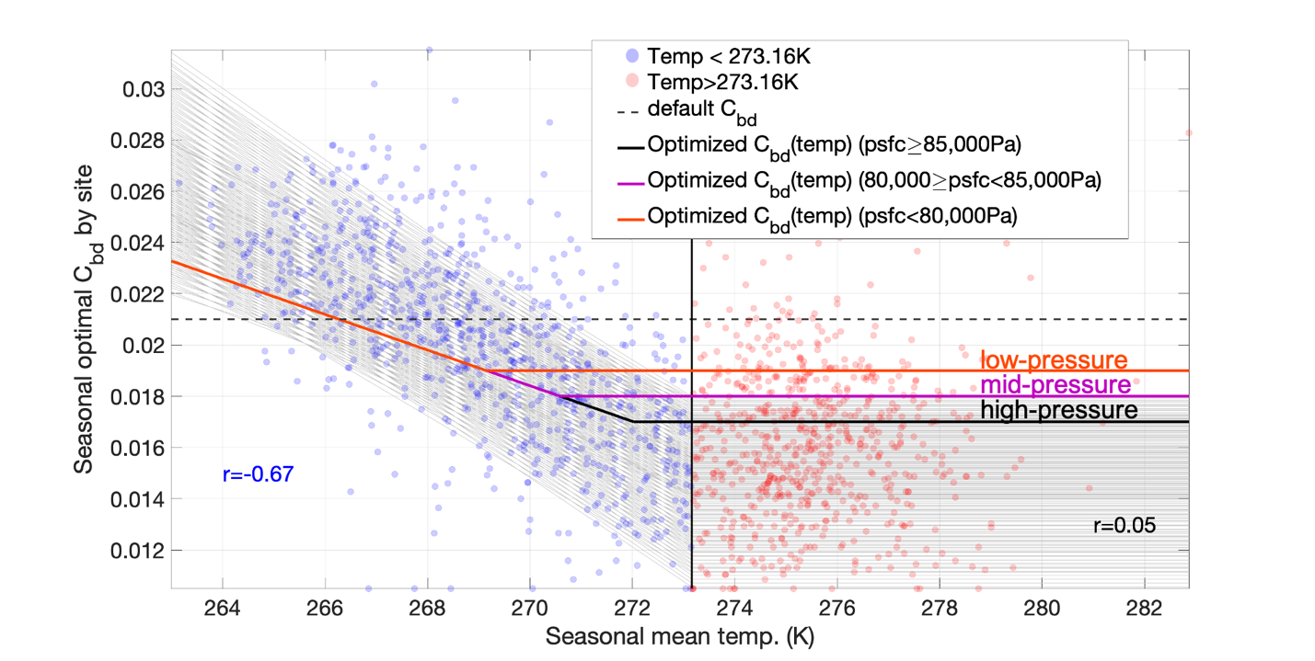
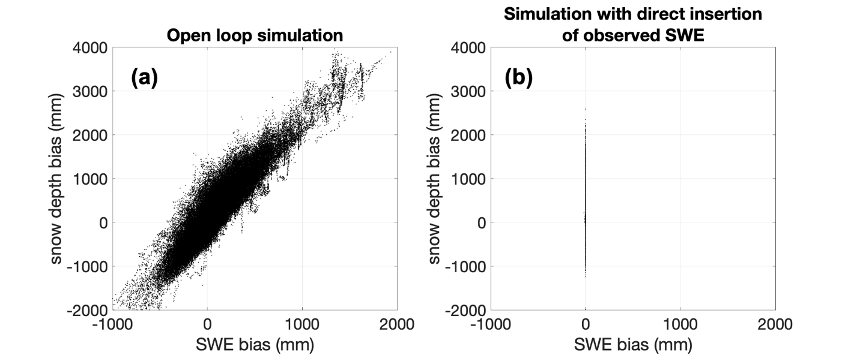
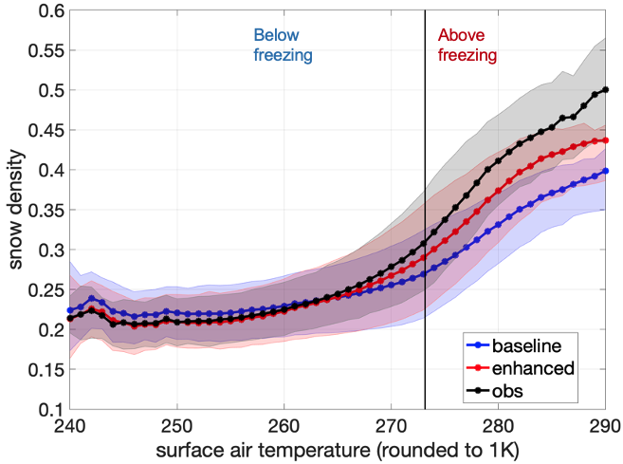
Improved Noah-MP snowpack compaction parameterization constrained by SNOTEL in-situ observations
Noah-MP snow compaction processes:
Destructive metamorphism
Overburden
Melt metamorphism
Abolafia-Rosenzweig et al. 2024a JAMES

Slide 7
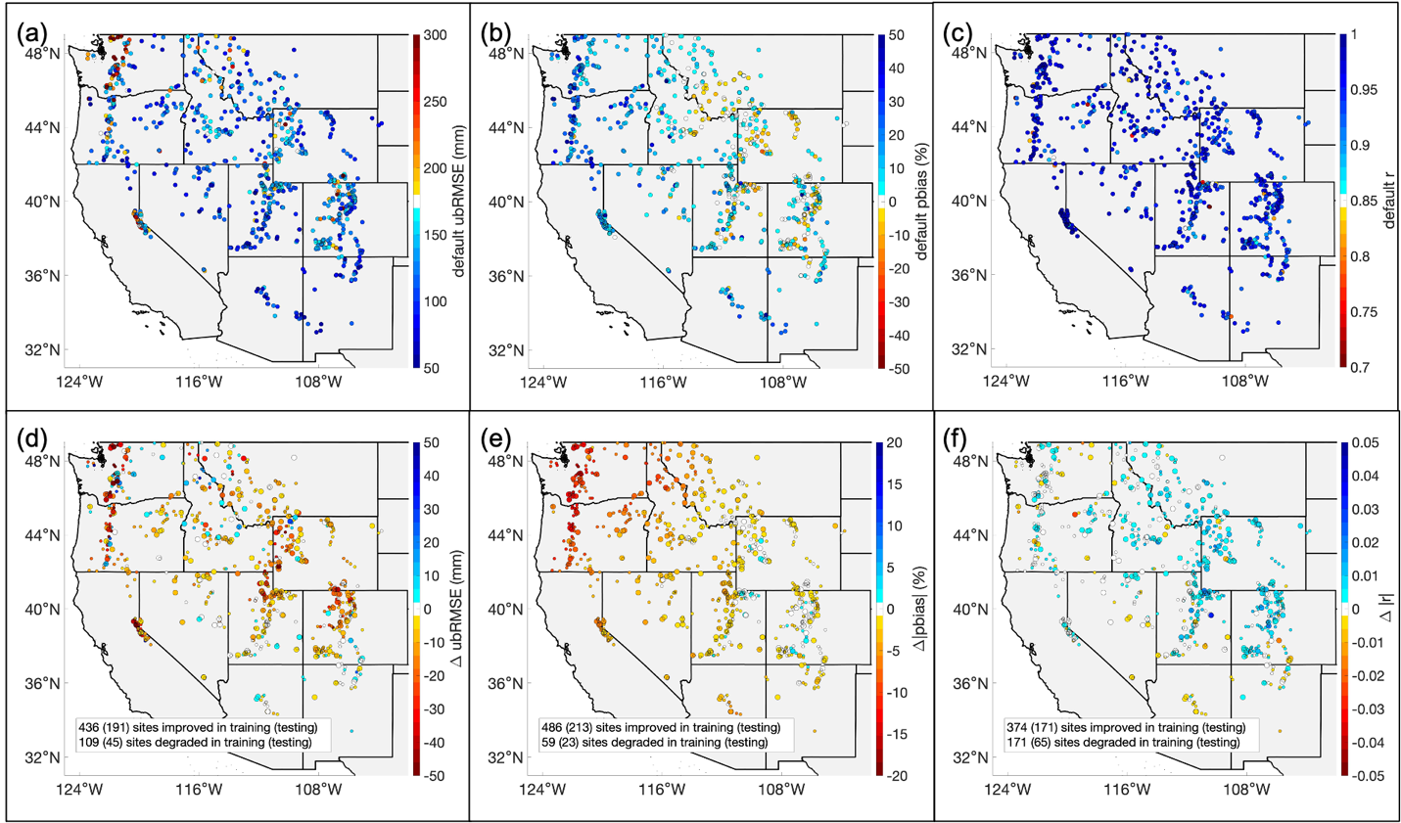
Improved Noah-MP snowpack compaction parameterization constrained by SNOTEL in-situ observations
Abolafia-Rosenzweig et al. 2024a

Slide 8
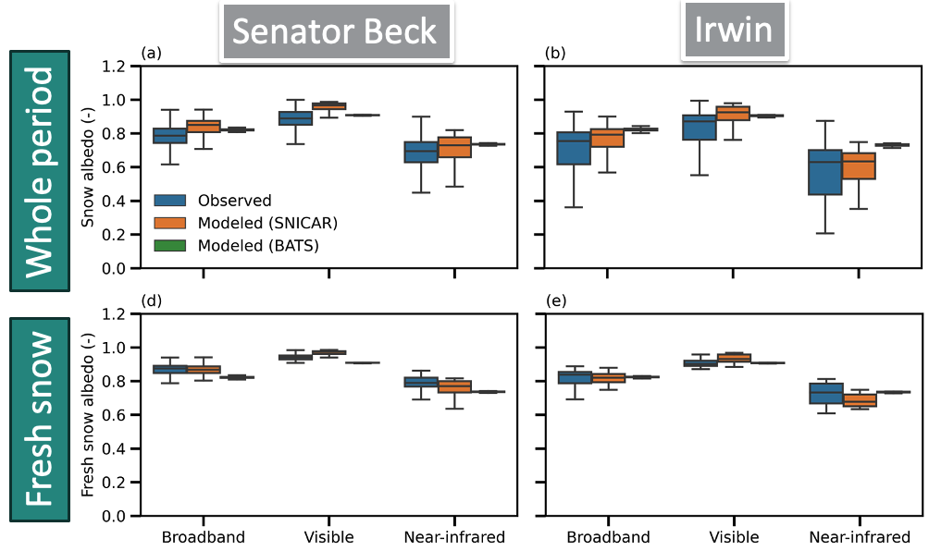
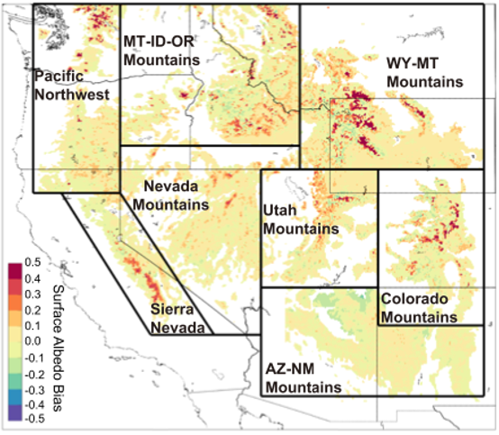
Improved snow albedo modeling in Noah-MP coupled with a physical snowpack radiative transfer scheme
Default Noah-MP snow albedo schemes (e.g., BATS & CLASS) are semi-empirical, showing systematic biases.
SNICAR is a physical radiative transfer model that resolves snow-aerosol-radiation interactions.
NoahMP-SNICAR significantly improves the magnitude and variability of snow albedo modeling.
Snow albedo bias using default Noah-MP snow albedo scheme
NoahMP-SNICAR comparison with in-situ measured snow albedo
He et al., 2019
Lin et al. 2024 in review

Slide 9
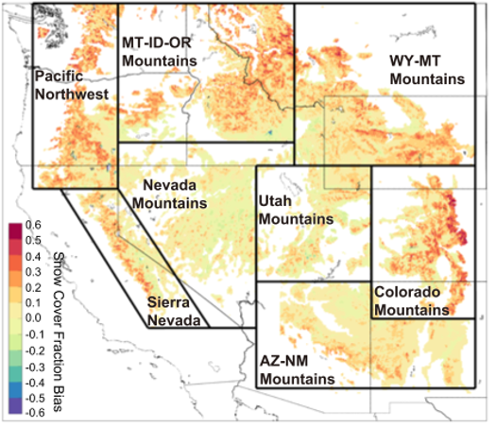
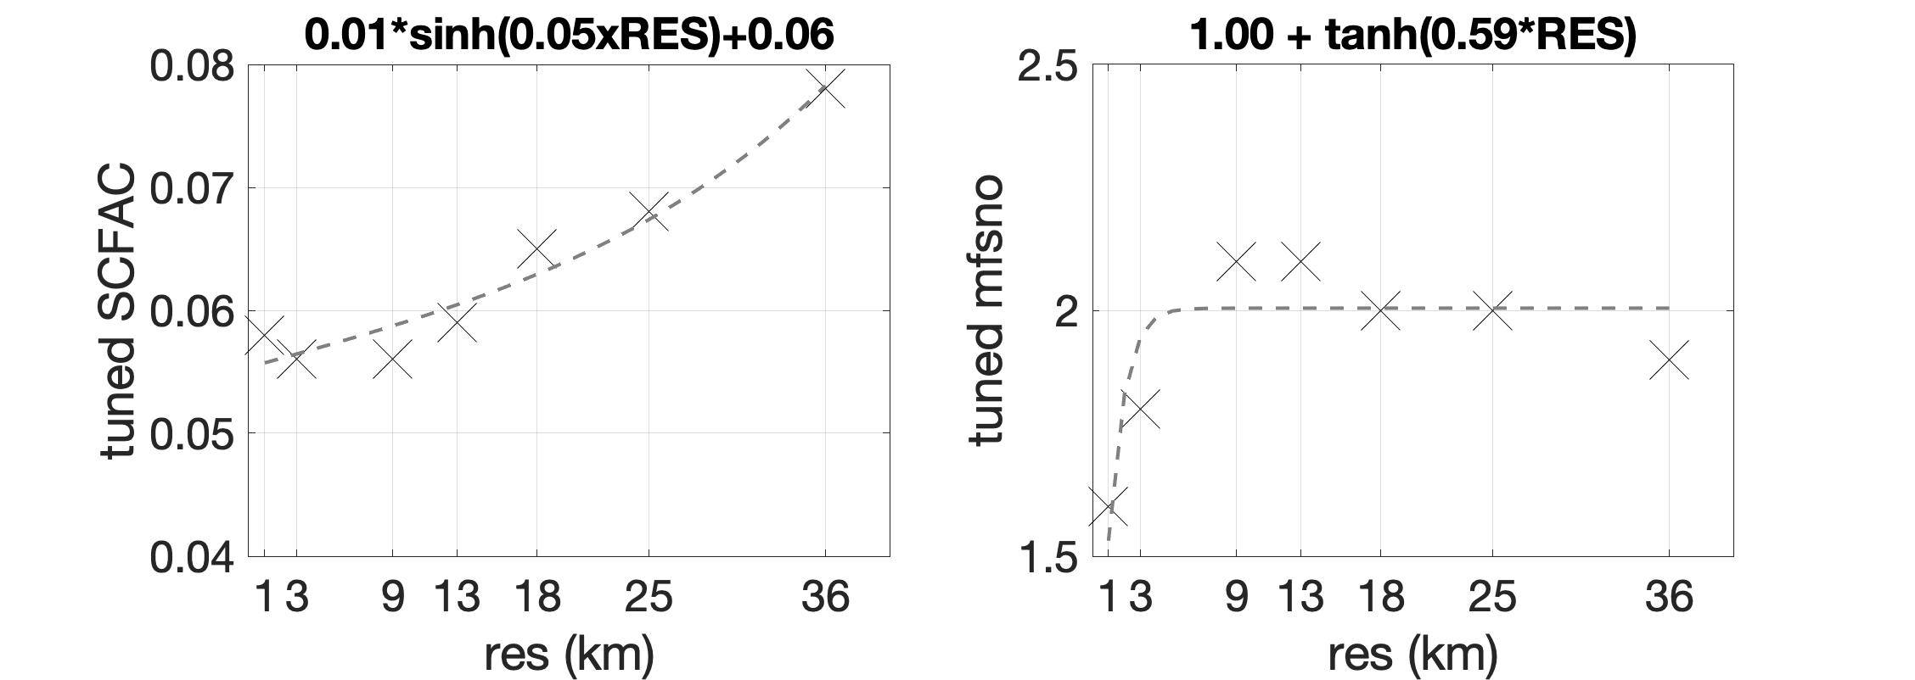
Developing an observation-constrained scale-aware snow cover parameterization in Noah-MP
Default Noah-MP snow cover parameterization tends to systematically overestimate snow cover.
Developing a scale-aware snow cover parameterization using observation-based data (MODSCAG SCF, SNODAS SWE & SD)
Snow cover bias using default Noah-MP
Optimized snow cover parameter vs spatial scale
He et al., 2019
Abolafia-Rosenzweig et al. 2024b in prep

Slide 10
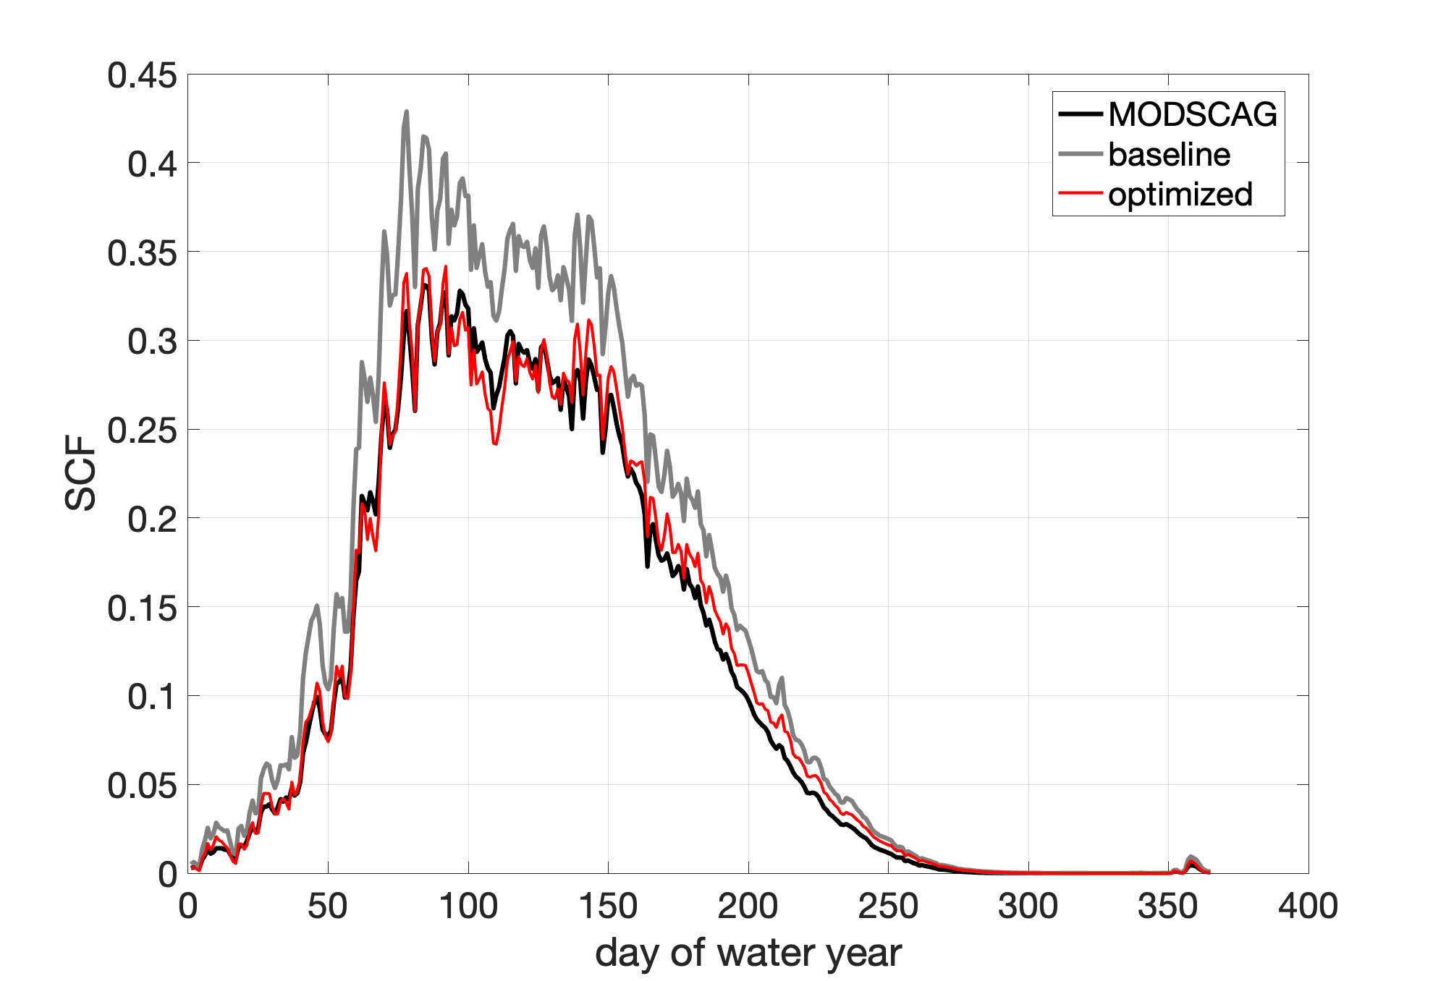
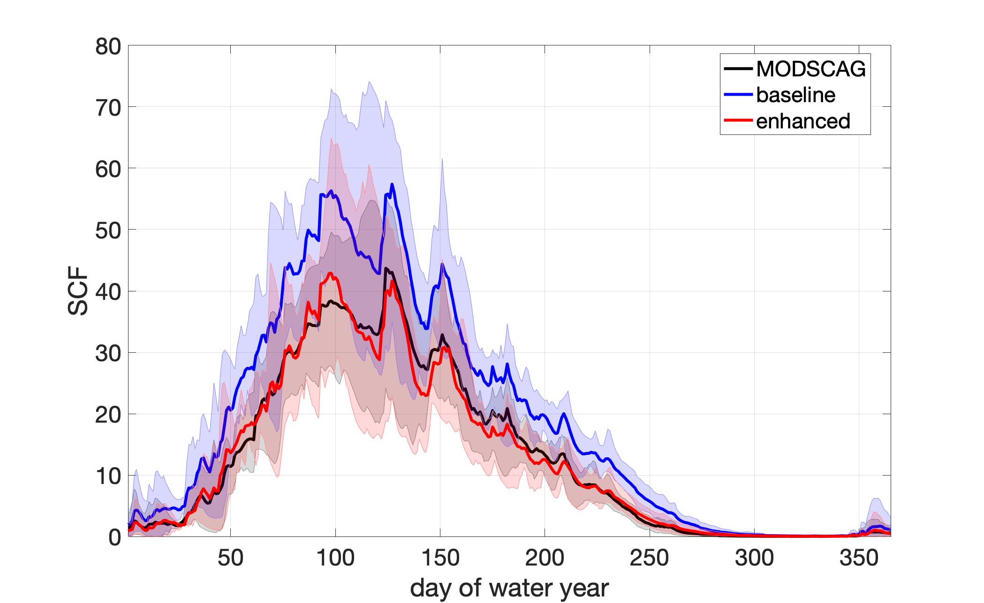
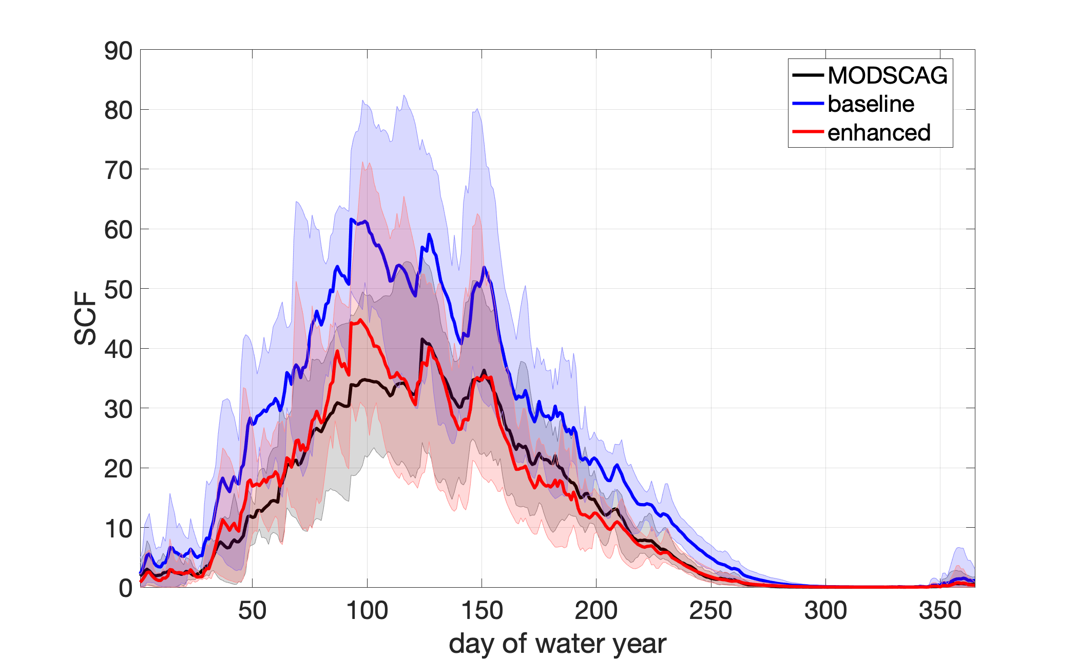
Developing an observation-constrained scale-aware snow cover parameterization in Noah-MP
Snow cover evaluation with MODSCAG observations at UFS-relevant scale
1 km
3 km
13 km
25 km
Abolafia-Rosenzweig et al. 2024b in prep

Slide 11
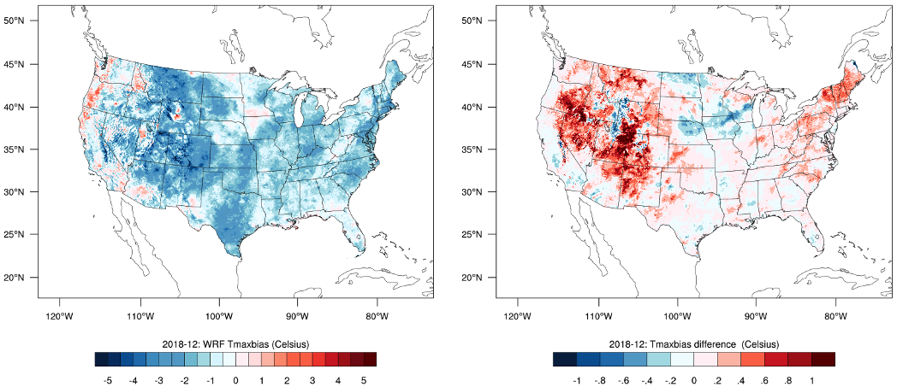
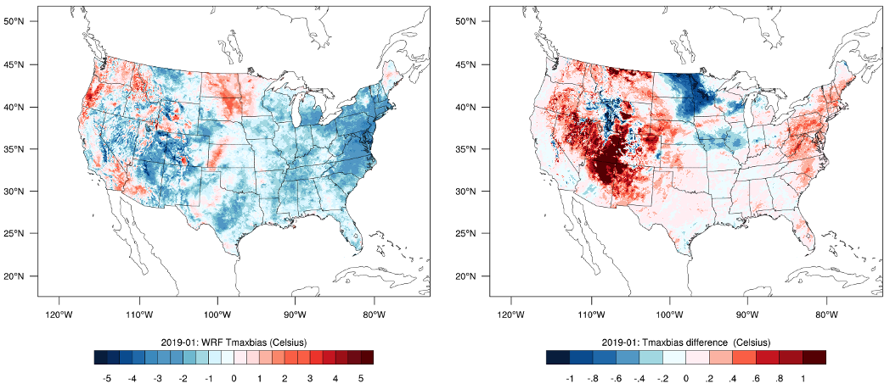
Developing an observation-constrained scale-aware snow cover parameterization in Noah-MP
Default WRF/NoahMP Tmax bias
Difference using new SCF scheme
Couple WRF/Noah-MP 4-km tests using new SCF formulation
2018 Dec
2018 Dec
The new SCF formulation reduces long-standing wintertime Tmax cold bias in WRF/Noah-MP due to reduced SCF.
2019 Jan
2019 Jan
Abolafia-Rosenzweig et al. 2024b in prep

Slide 12
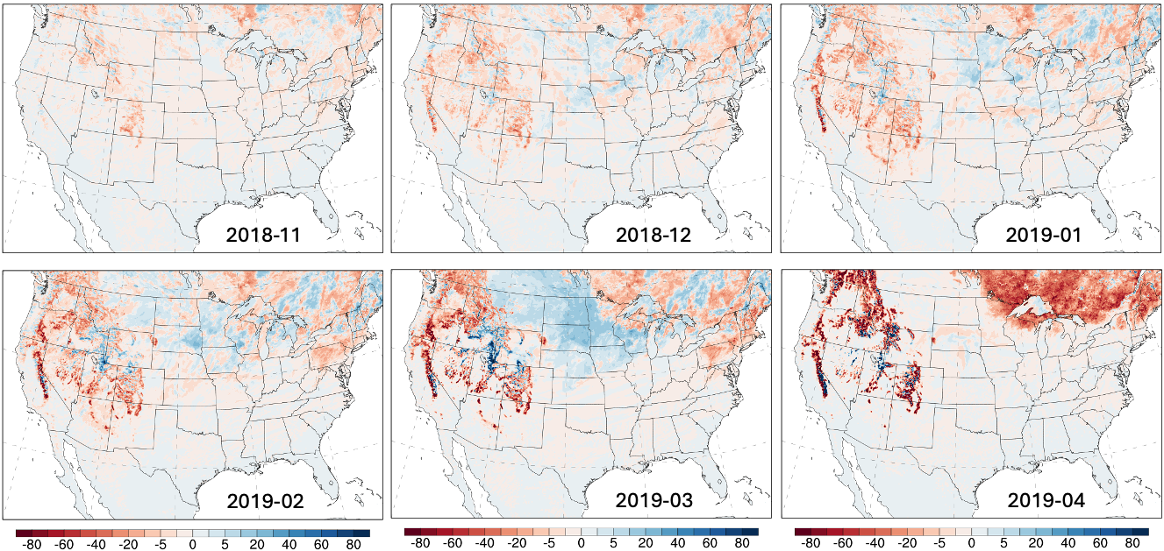
Developing an observation-constrained scale-aware snow cover parameterization in Noah-MP
The new SCF formulation however reduces SWE which tends to be underestimated in WRF/Noah-MP

Slide 13
Thank you! If you are interested in our work, please email me: cenlinhe@ucar.edu

Slide 14
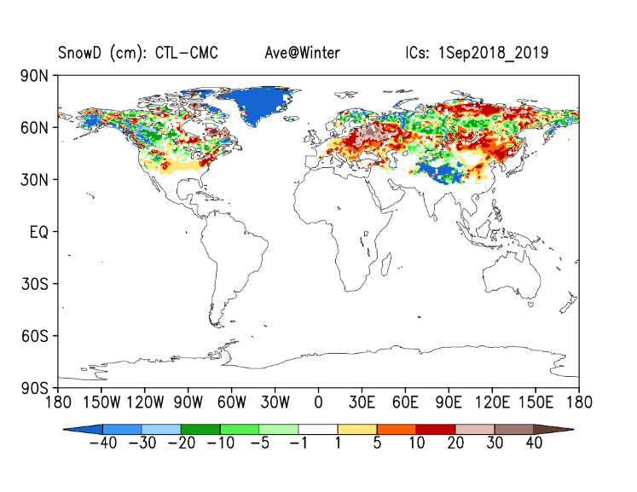
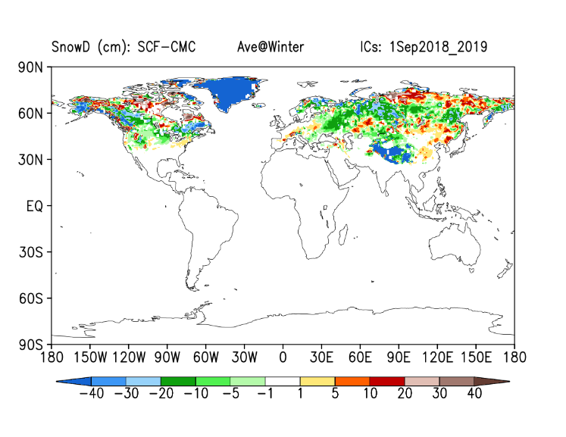
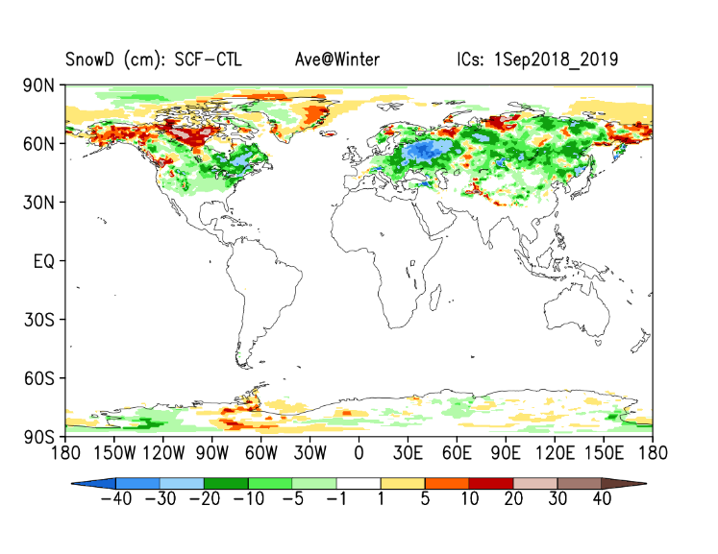
Developing an observation-constrained scale-aware snow cover parameterization in Noah-MP
UFS/Noah-MP coupled test:
● Model: HR3-SFS (C96; atm-only)
● Seasons: One-year simulations; Cold start from GFSv16 outputs; ICs: 1 Sep, 2018-2022 (5 cases)
SFS fcst
Diff Snow: SCF-CTL Ave@Winter
CTL-CMC
SCF-CMC
SCF-CTL
Courtesy of Weizhong Zheng (NOAA)

Slide 15
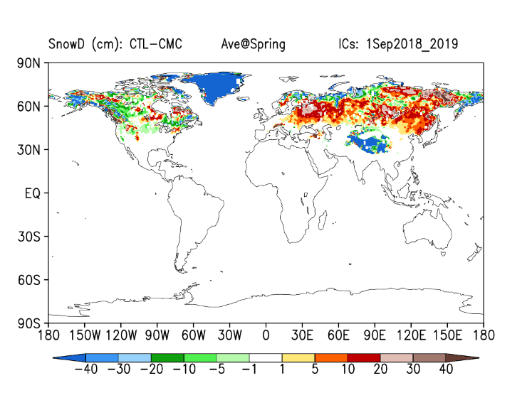
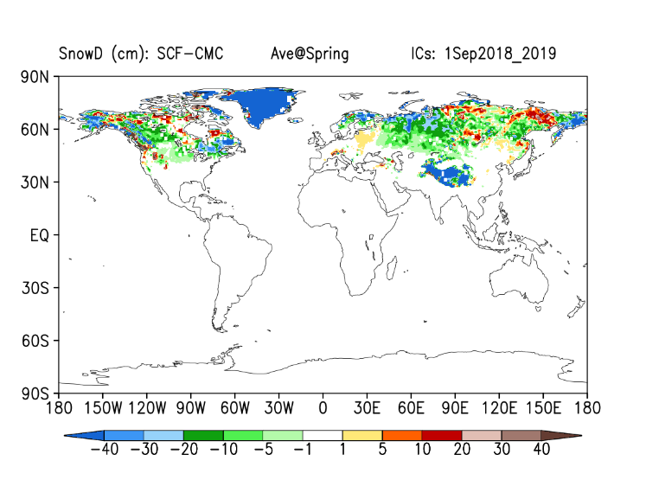
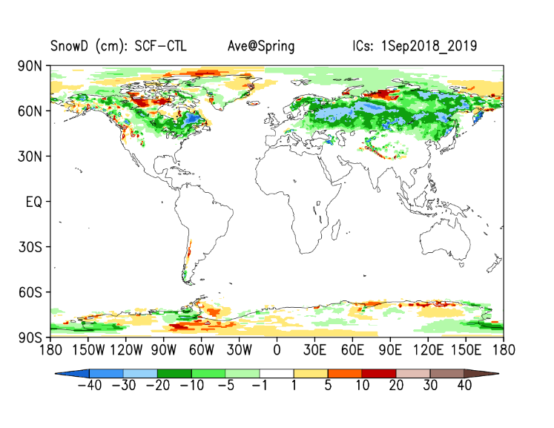
Developing an observation-constrained scale-aware snow cover parameterization in Noah-MP
UFS/Noah-MP coupled test:
● Model: HR3-SFS (C96; atm-only)
● Seasons: One-year simulations; Cold start from GFSv16 outputs; ICs: 1 Sep, 2018-2022 (5 cases)
SFS fcst
Diff Snow: SCF-CTL Ave@Spring
CTL-CMC
SCF-CMC
SCF-CTL
Courtesy of Weizhong Zheng (NOAA)

Slide 16
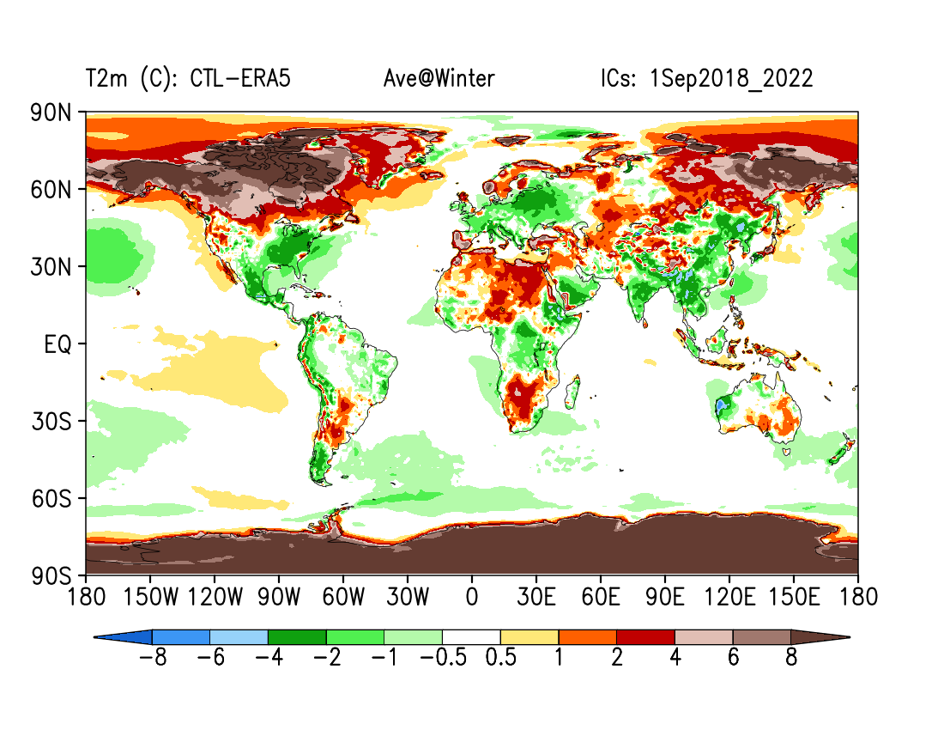
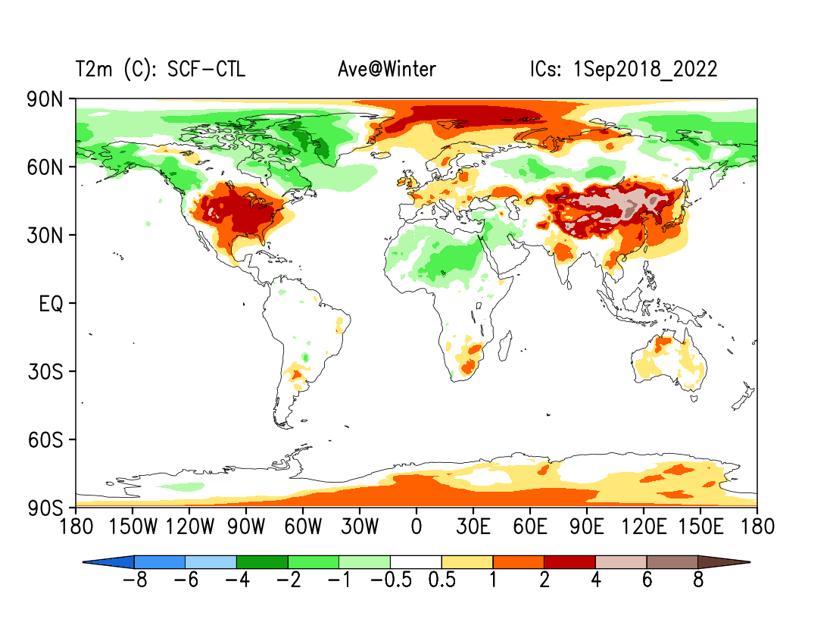
Developing an observation-constrained scale-aware snow cover parameterization in Noah-MP
Diff T2m: SCF-CTL Ave@Winter
SFS fcst
CTL-ERA5
SCF-CTL
Courtesy of Weizhong Zheng (NOAA)
Courtesy of Weizhong Zheng (NOAA)

Slide 17
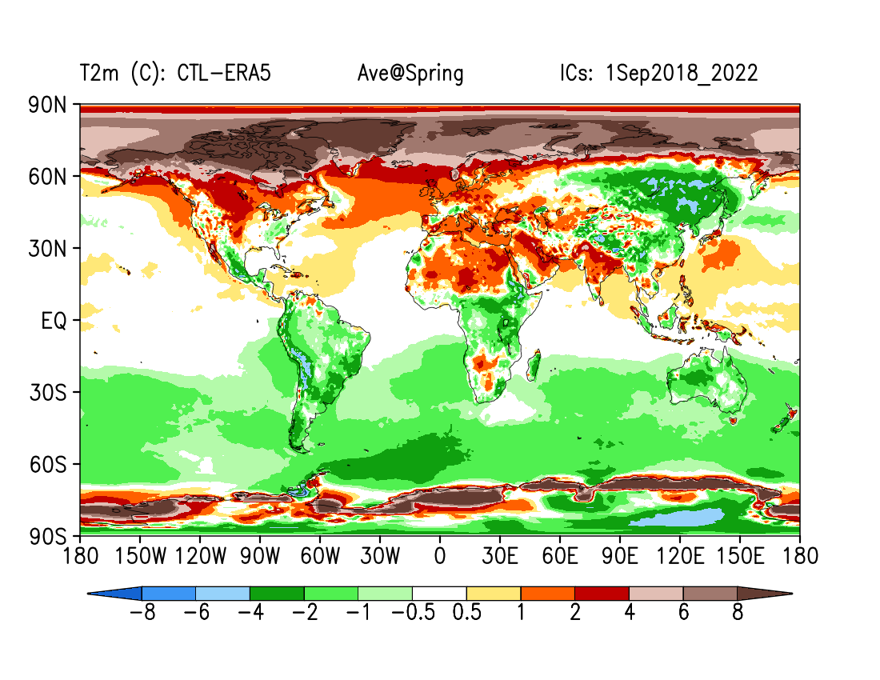
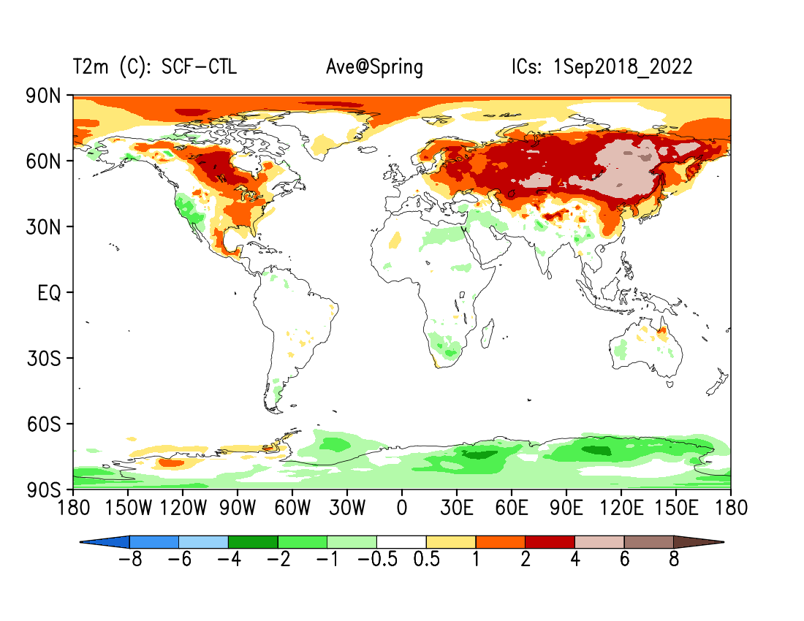
Developing an observation-constrained scale-aware snow cover parameterization in Noah-MP
Diff T2m: SCF-CTL Ave@Spring
SFS fcst
CTL-ERA5
SCF-CTL
Courtesy of Weizhong Zheng (NOAA)

