Slide 1
Updates and evaluation of NOAA’s online-coupled air quality model within the Unified Forecast System
Wei Li^{1,2}, Beiming Tang^{1,2}, Patrick C. Campbell^{1,2}, Youhua Tang^{1,2}, Barry Baker², Zachary Moon^{2,3}, Daniel Tong^{1,2}, Jianping Huang⁴, Kai Wang^{4,5}, Ivanka Stajner⁴, Raffaele Montuoro⁴ and Robert C. Gilliam⁶
¹George Mason University, ²NOAA Air Resources Laboratory, ³Earth Resources Technology, Inc., ⁴NOAA Environmental Monitoring Center , ⁵Lynker Inc., ⁶US EPA
UIFCW24: July 24th, 2024

Slide 2
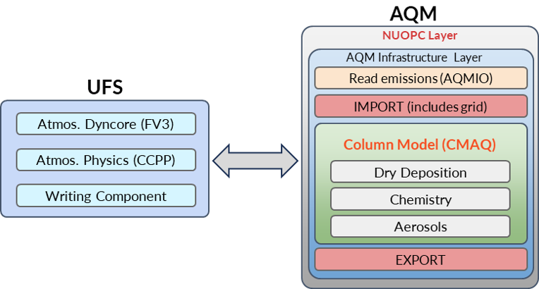
NOAA’s Next-Generation Online-Coupled Air Quality Model
The Unified Forecast System (UFS) is a community-based, coupled, comprehensive Earth modeling system.
FV3 Dynamical Core: engine of atmospheric model by solving equation of air motion.
CCPP: framework for physical parameterization, such as radiation, microphysics, and PBL turbulence.
CMAQ: column model for gas chemistry, aerosol, and dry deposition.
NUOPC layer: ESMF-based layer to communicate between UFS and CMAQ at each time step.
https://github.com/ufs-community
Notes:
You have heard plenty of the UFS-based AQM component, also known as Online-CMAQ platform from our colleagues at EMC already, so I will not repeat, but will emphasize what the current status of AQMv7 is that is slotted to replace the operational model later this year.
This diagram shows the model structure of the online-coupled air quality model. Basically, UFS is coupled with CMAQ through a ESMF NUOPC layer. In this case, in the green box, CMAQ now handles only emission,, chemistry, aerosols, and dry deposition.

Slide 3
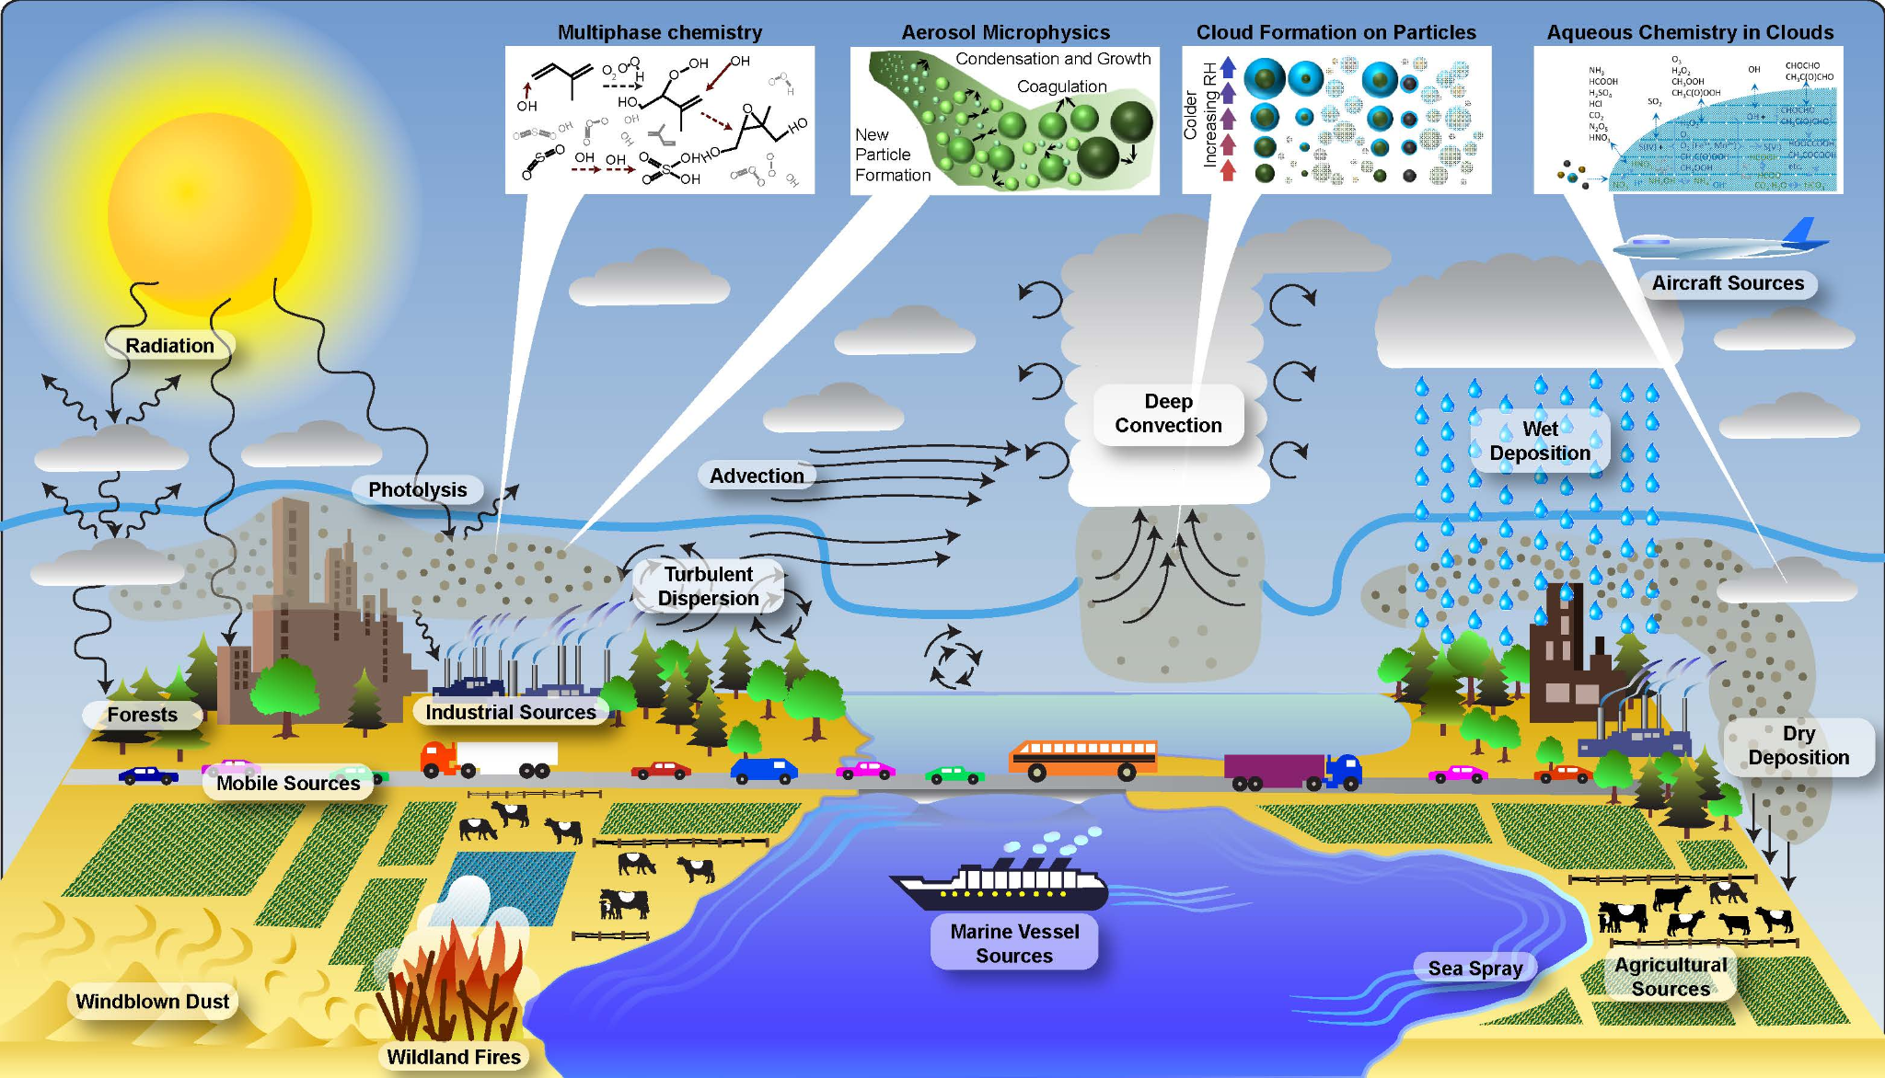
NOAA’s Current UFS Air Quality Model (UFS-AQM)
AQM Version 7 (AQMv7) Chemical Component: Based on the U.S. EPA’s Community Multiscale Air Quality Model (CMAQ) Version 5.2.1. Version released in June 2017.
→ NOAA-ARL has updated the AQM chemical component from CMAQv5.2.1 to CMAQv5.4 (includes interim CMAQv5.3 updates)
→ Major code structure and scientific changes
Notes:
As indicated in the red boxes, other processes, such as vertical mixing, convection, horizontal diffusion, or advection, are more appropriately handled in the FV3 under the UFS Earth System Model Framework.
Focus point in our ARL development work is to advance the processes in the boxes,, including emissions/air-surface exchange and the chemical/aerosol formation processes in the AQM component. The current CMAQ version used in AQM is 5.2.1, released in 2017 and is scientifically outdated. Our job is to update the AQM to be coupled with the latest CMAQ version 5.4, which contains major structural and scientific changes.

Slide 4
Overview of Major Scientific Changes to UFS-AQM
Major science updates from CMAQv5.2.1 → v5.3+ → CMAQv5.4
Updated chemical mechanism (CB6r3 → CB6r5): halogen (bromine and iodine) chemistry, reaction yields, and photolysis rates.
Updated aerosol module (AERO6 → AERO7): changes in organic aerosol formation (anthropogenic and monoterpene SOA yields, adding organic nitrate, IEPOX-SOA consumption of sulfate).
Gas dry deposition: increased O₃ resistance to snow; adding dependence on soil moisture with a general decreased value and increased deposition rate. This change will reduce O₃ NO_{x} and SO₂.
Aerosol dry deposition: adding the dependance on LAI and land use type (forest or grassland), which reduce (enhance) dry deposition velocity of coarse (accumulation) mode.
Summary of impact comparisons for updating from CMAQv5.2.1 to CMAQv5.3+ and CMAQv5.4.
Notes:
So, there is a long list of chemical model changes to CMAQ since version 5.2.1 5 years ago, up until the more current version CMAQv5.4+.
First Bullet: The updated chemical mechanism to the Carbon Bond Version 6, revision 5 includes changes to the photochemistry that largely results in reduced ozone formation, at least compared CB6r3 used in CMAQ.
Second Bullet: The updated aerosol module from AERO6 to AERO7 will change the secondary organic aerosol formation considerably in the model. This will largely be dependent on region considered, and more analyses are needed in the AQMv7/Online-CMAQ system.
Lead to significant changes in predictions of near-surface air quality, such as O₃ and PM_{2.5}

Slide 5
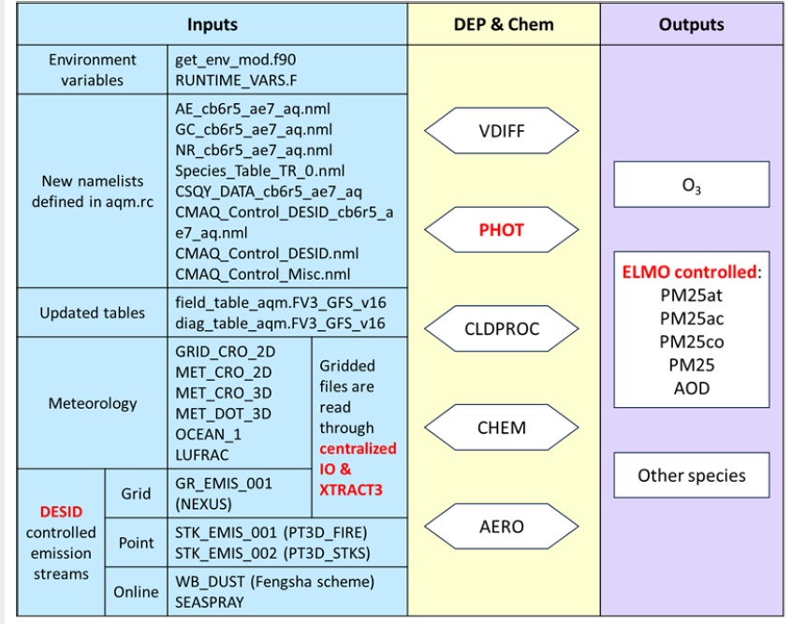
Overview of Major Structural Changes to UFS-AQM
Emission reading, mapping, and scaling are controlled in the Detailed Emissions Scaling, Isolation, and Diagnostic (DESID) module.
Opening, description, extraction, and interpolation of the meteorological and emission variables are encapsulated in the centralized I/O (CIO) module.
Introduction of the Explicit and Lumped air quality Model Output (ELMO) module is included that can synthesize the definition, calculation, and maintenance of individual or aggregate gas and particulate matter online, i.e., simplifies CMAQ output.
Li et al., 2024, GMD, in review.

Slide 6
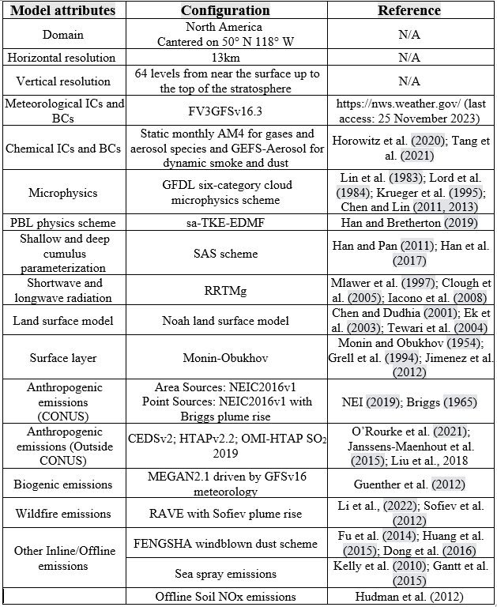
UFS-AQM Model Components and Configurations
Major Configuration, Components, and Inputs
Domain: North America @ 13x13 km horizontal resolution, 64 vertical levels.
CCPP FV3-GFSv16.3 physics.
Anthropogenic Emission: CEDSv2, HTAPv2.2, OMI-HTAP SO2 2019, and NEIC2016v1.
Biogenic Emission: Inline MEGANv2.1
Wildfire Emission: RAVE with Sofiev Plume Rise.
Other Emission: Inline FENGSHA dust and inline sea-spray.
1-month warm start test simulation (August 2023), all conditions same except for CMAQv5.2.1 (AQMv7) vs. CMAQv5.4 update (AQMv7_new).
Notes:
Note again major update to UFS-AQM as presented by Jianping: Regional Hourly Advanced Baseline Imager (ABI) and Visible Infrared Imaging Radiometer Suite (VIIRS) Emissions (RAVE), for calculating fire emissions.

Slide 7
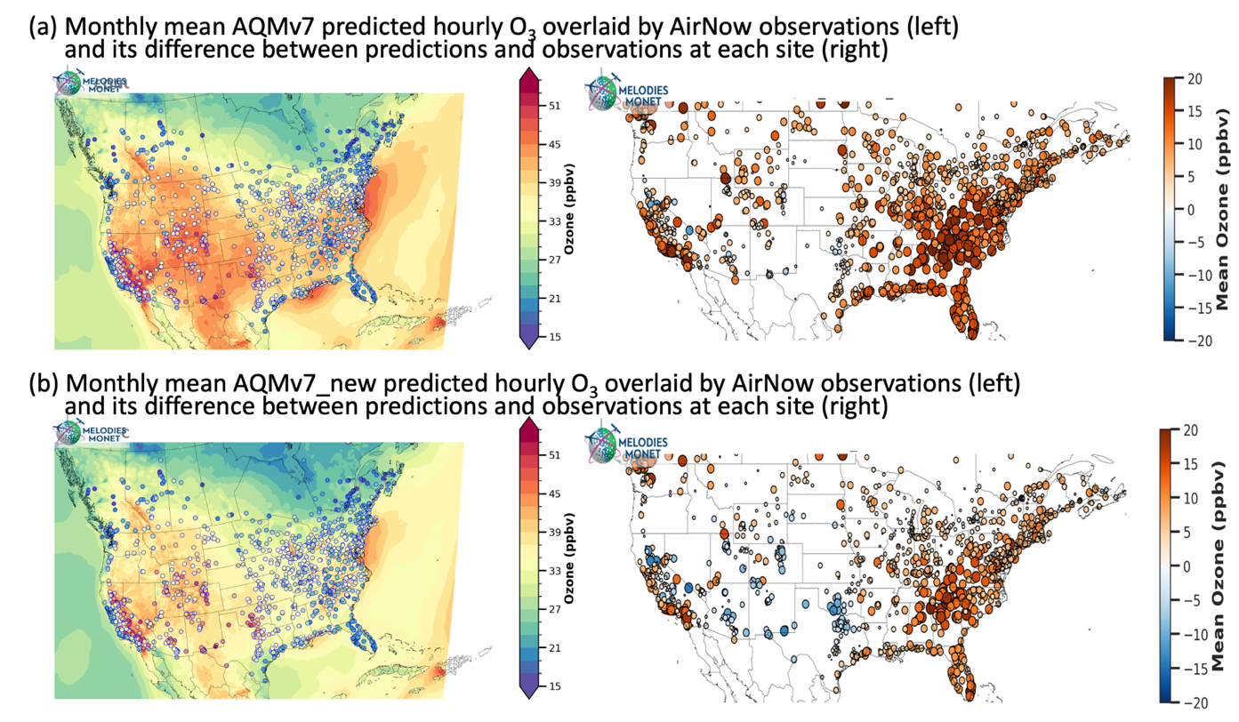
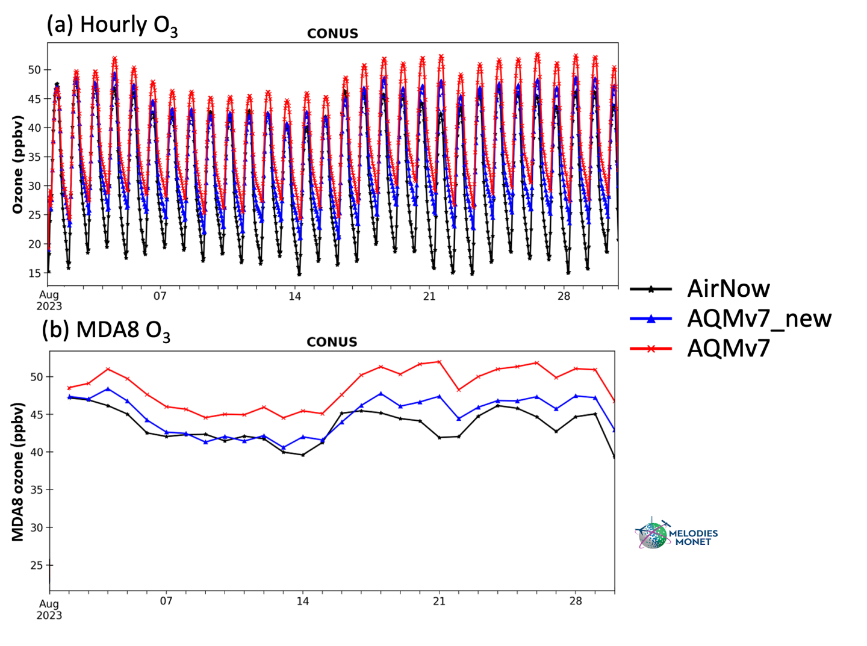
Impact of Updates on Near-Surface Ozone Predictions
August 2023
Mean O₃ for AQMv7 (a) and AQMv7_new (b)
Time series of hourly (a) and MDA8 (b) O₃
Li et al., 2024, GMD, in review.
Notes:
This is the ozone evaluation. For figure on the left, the first column is the average ozone overlaid with AirNow site. If you compare the background color, the new model shows a relatively low ozone almost anywhere, which can reduce positive ozone bias, especially in the eastern and western US, as shown in the second column.
The figure on the right is the CONUS domain average hourly and MDA8 ozone time series. The new model, indicated by blue line, lower the positive bias during both daytime and nighttime, and that will make MDA8 ozone much closer the the observations.

Slide 8
Impact of Updates on Near-Surface Ozone Predictions
August 2023
Region | Model | MB (ppb) | NMB (%) | MdnB (ppb) | NMdnB (%) | R² | RMSE (ppb) | IOA
CONUS | AQMv7 | 7.06 | 22.64 | 6.35 | 21.16 | 0.50 | 13.36 | 0.79
 | AQMv7_new | 3.55 | 11.38 | 2.79 | 9.28 | 0.51 | 11.71 | 0.82
Li et al., 2024, GMD, in review.
Notes:
Statistically as shown in the table, the hourly ozone bias was reduced by about 50% from 7 to 3.5 ppb. And all the other metrics are also improved by the model updates.
In addition, hit rate, false alarm rate, and critical success index (CSI) are also commonly used to evaluate the forecast accuracy and reliability. In general, the updated model shows a higher hit rate and critical success index and a lowe false alarm rate when the threshold is greater than 20 ppb. These indicate the new model can simulate ozone more accurately.

Slide 9
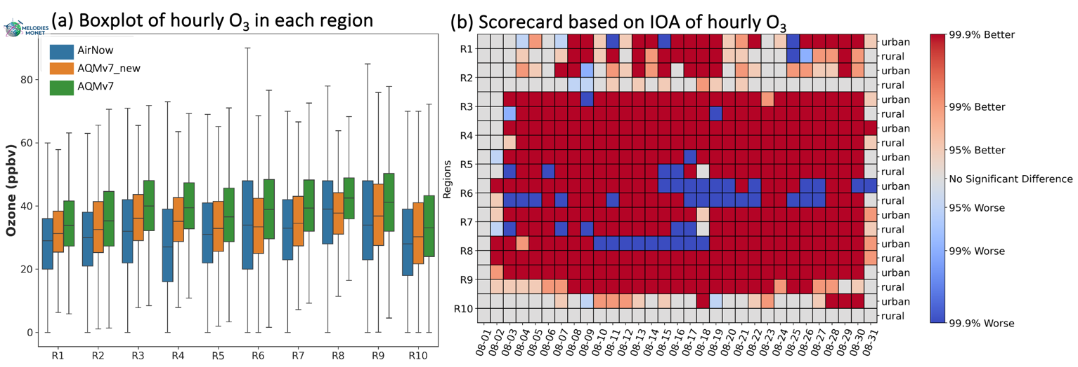
Impact of Updates on Near-Surface Ozone Predictions
August 2023
Mean O₃ for box-whisker (a) and IOA scorecard (b)
Li et al., 2024, GMD, in review.
Notes:
We also assessed the ozone simulations in all the 10 EPA regions. The current model, shown as green boxes, overestimated the observations in blue in all the 10 regions, and the new model in orange color improves the ozone simulation by reducing the bias by 2-5 ppb across the regions.
The scorecard on the right compare the IOA of each region on a daily basis. X axis is dates and y axis is region separated to urban and rural. The red color means the new model perform better and blue color means the opposite. We can see red color is dominant over blue colors, which means the new model performs better on most days across the US.

Slide 10
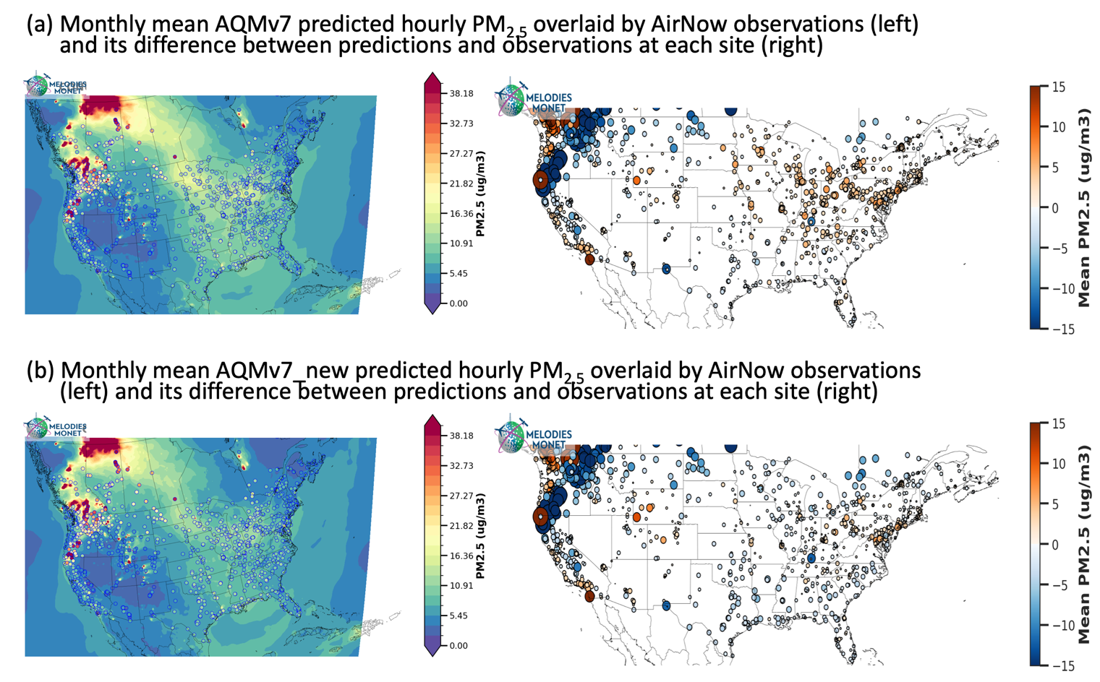
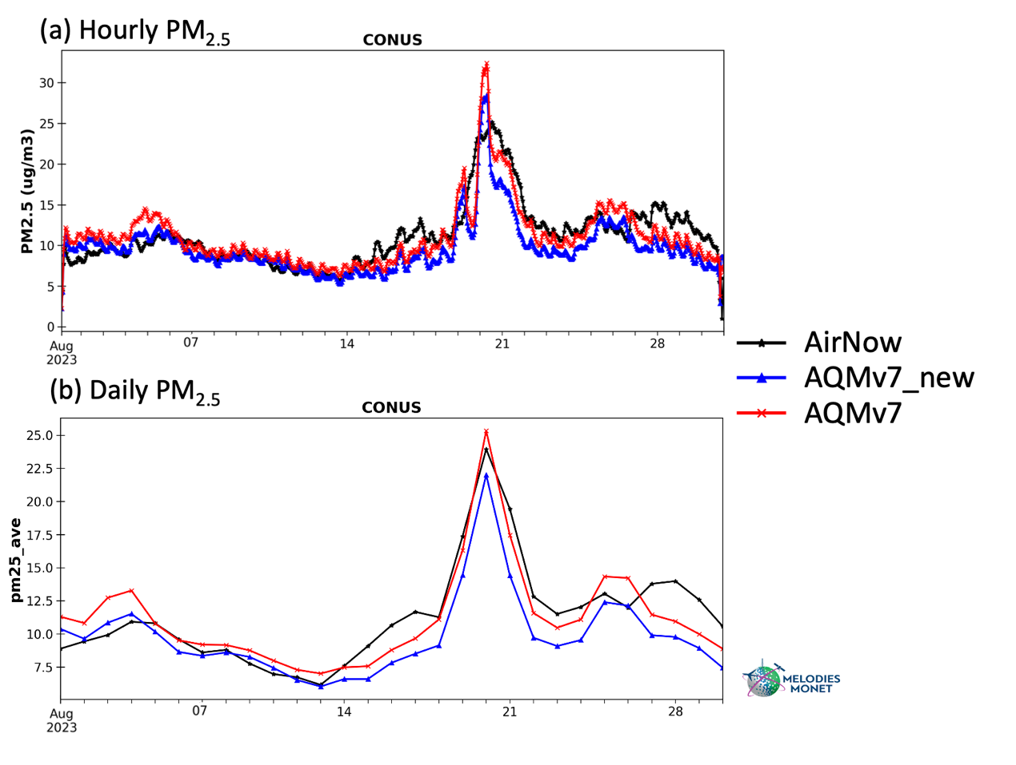
Impact of Updates on Near-Surface PM_{2.5} Predictions
August 2023
Mean PM_{2.5} for AQMv7 (a) and AQMv7_new (b)
Time series of hourly (a) and daily (b) PM_{2.5}
fire
Li et al., 2024, GMD, in review.
Notes:
Jump to PM2.5. The spatial map shows extremely high values over the northwestern US and Canada due to wildfire. The fire plumes can be transported to the northeastern US. The mean bias near the fire locations are very high up to 15 ug/m3, indicating big uncertainties in wildfire emissions, smoke transport, and plume chemistry. Smaller positive bias are found in the northeastern US, which is reduced by the new model.
The hourly and daily time series show both model capture the extreme values around August 20th. And the new model generally has low PM2.5 values on most days.

Slide 11
Impact of Updates on Near-Surface PM_{2.5} Predictions
August 2023
Region | Model | MB (µg/m³) | NMB (%) | MdnB (µg/m³) | NMdnB (%) | R² | RMSE (µg/m³) | IOA
CONUS | AQMv7 | -0.05 | -0.44 | 0.77 | 9.94 | 0.07 | 32.43 | 0.38
 | AQMv7_new | -1.40 | -12.47 | -0.34 | -4.35 | 0.06 | 31.92 | 0.38
Li et al., 2024, GMD, in review.
Notes:
And that makes the mean bias higher in the new model as see in the table, but the median bias and RMSE actually become better. This indicates extreme values from fire lead to the overall high bias. The hit rate and false alarm rate also become higher and lower respectively, although the critical success rate is similar between the two models.

Slide 12
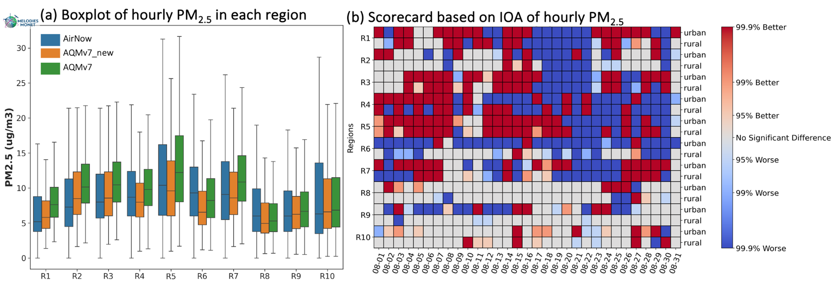
Impact of Updates on Near-Surface PM_{2.5} Predictions
August 2023
Mean PM_{2.5} for box-whisker (a) and IOA scorecard (b)
Better in eastern regions w/o fire
Li et al., 2024, GMD, in review.
Notes:
Look at each region. In the eastern US rom R1 to R5, the current model overestimated PM2.5 while an underestimation is found in the western US from R8 to R10. The new model has a uniformly lower PM2.5 in all regions, which will improve the model performance in the east and make it worse in the west. This can also be seen from the scorecard. Most of the red colors are in the east US before the fire occurs. This implies an underestimation of PM2.5 from wildfire, which can be partly attributed to the fact that VOC emissions from the RAVE inventory are disabled.

Slide 13
Conclusions and Future Plan
The updated model reduces hourly ozone bias by 50%, while only improves PM2.5 simulation in regions less affected by wildfire.
Further evaluate CMAQv5.4 update and tests focusing on AEROMMA field campaign in June-August 2023 → test VOC emissions from fire.
Update and improve diagnostics (e.g. fluxes, dry deposition, process analysis) to better understand AQM scientifically → Comprehensive evaluation paper.
Updating vegetative in-canopy codes and canopy inputs and evaluate impacts.
“Irena Ivanova - Towards Explicit Effects of Forest Canopy Shading and turbulence on Boundary Layer Ozone in UFS SRW Air Quality Model”
Integrate updated anthropogenic emissions and thoroughly test and evaluate impacts for the future of UFS-AQM predictions.
Li, W., Tang, B., Campbell, P. C., Tang, Y., Baker, B., Moon, Z., Tong, D., Huang, J., Wang, K., Stajner, I., Montuoro, R., and Gilliam, R. C.: Updates and evaluation of NOAA’s online-coupled air quality model version 7 (AQMv7) within the Unified Forecast System, Geosci. Model Dev. Discuss. [preprint], https://doi.org/10.5194/gmd-2024-107, in review, 2024.
Notes:
So, in summary on the Progress and Future of the UFS AQM/Online-CMAQ, we at NOAA-ARL and George Mason University are…read bullets.

