Slide 1
Updates on Wave Coupling for the Next Global Forecast System GFSv17
JULY 24, 2024
Jessica Meixner¹ , Matthew Masarik², Saeideh Banihashemi², Ali Salimi-Tarazouj², Ricardo Campos³, Ghazal Mohammadpour², Avichal Mehra¹
¹NOAA/NWS/NCEP/EMC ²Lynker at NOAA/NWS/NCEP/EMC ³CIMAS AA/AOML

Slide 2
Acknowledgements to GFS & UFS Active Developers
Atmospheric Physics NCEP/EMC: Jongil Han, Anning Cheng, Bing Fu, Hong Guan, Zhichang Guo, Sanath Kumar, Xu Li, Wei Li, Qingfu Liu, Eric Sinsky, Ruiyu Sun, Kevin Viner, Helin Wei, Bo Yang, Fanglin Yang, Rongqian Yang, Weizhong Zheng, Xiaqiong Zhou ESRL/GSL: Michael Barlage, Ben Green, Joseph Olson, Tanya Smirnova, Shan Sun, Xia Sun, Michael Toy JCSDA/UCAR:Dom Heinzeller, ESRL/PSL: Lisa Bengtsson, Jian-Wen Bao, Clara Draper, Grant Firl, Songyou Hong, Philip Pegion, Dustin Swales DTC: Ligia Bernardet, Weiwei Li, Man Zhang | Data Assimilation NCEP/EMC: Catherine Thomas, Guillaume Vernieres, Daryl Kleist, Cory Martin, Mindo Choi, Andrew Collard, Jiarui Dong, Andy Eichmann, Travis Elless, Nick Esposito, Iliana Genkova, Azadeh Gholoubi, Tseganeh Gichamo, Brett Hoover, Xin Jin, Emily Liu, Haixia Liu, Hyun-Chul Lee, Xuanli Li, Katie Lukens, Ron McLaren, Dagmar Merkova, Sudhir Nadiga, Shastri Paturi, Ashley Stanfield, Steve Stegall, Andy Tangborn, Russ Treadon, Yaping Wang, Youlong Xia CIRES/GSL: Bo Huang, Mariusz Pagowski PSL: Clara Draper, Jeff Whitaker JCSDA/UCAR: Kriti Bhargava, Travis Sluka | Coupled Model Component Development NCEP/EMC: Jessica Meixner, Jiande Wang, Lydia Stefanova, Jun Wang, Neil Barton, Bing Fu, Saeideh Banihashemi, George Gayno, Robert Grumbine, Walter Kolczynski, Matthew Masarik, Avichal Mehra, Ali Salimi-Tarazouj, Denise Worthen ESRL/GSL: Ben Green, Shan Sun ESRL/PSL: Lisa Bengtsson, Phillip Pegion GFDL: Alistair Adcroft, Rusty Benson, Stephen Griffies, Robert Halberg, Matthew Harrison, Brandon Reichl, Marshall Ward NCAR: Alper Altuntas, Gokhan Danabasoglu, Keith Lindsay, Gustavo Marques NRL/ESMF: Gerhard Theurich GMU: Ben Cash, Jim Kinter, Lawrence Marx, Cristiana Stan FSU: Alexandra Bozec, Eric Chassignet, Alan Wallcraft NASA: Akella Santha Univ. Alaska: Katherine Hedstrom U. Mich.: Christiane Jablonowski Univ. Victoria: Andrew Shao
Field Evaluation NCEP/EMC: Alicia Bentley, Mallory Row, Shannon Shields NWS Regional SSDs NCEP Centers | Products NCEP/EMC: Hui-Ya Chuang, Wen Meng, Andrew Benjamin, L. Gwen Chen, Yali Mao, Bo Cui
Atmospheric Composition NCEP/EMC: Partha Bhattacharjee, Jeff McQueen, Raffaele Montuoro, Li Pan, Ivanka Stajner ARL: Barry Baker, Patrick Campbell, Rick Saylor ESRL/GSL: Georg Grell, Shan Sun, Li (Kate) Zhang CSL: Gregory Frost, Jian He, Stuart McKeen, Siyuan Wang NESDIS/STAR: Ethan Hughes, Shobha Kondragunta, Xiaoyang Zhang | Infrastructure NCEP/EMC: Rahul Mahajan, Jun Wang, Kate Friedman, Lin Gan, George Gayno, Ed Hartnett, Dusan Jovic, Walter Kolczynski, Hang Lei, Terry McGuinness, Alex Reichert, Mallory Row, Edward Stafford, Henry, Winterbottom, Jack Wollen, Denise Worthen Redline Performance: David Huber | Coupled Model Evaluation NCEP/EMC: Lydia Stefanova, Jiande Wang, Neil Barton, Partha Bhattacharjee, Zhichang Guo, Robert Grumbine, Wei Li, Avichal Mehra, Ghazal Mohammadpour, Jiayi Peng, Sulagna Ray, Huug van den Dool, Helin Wei, Youlong Xia, Weizhong Zheng CPC: Laura Ciasto, Yanyun Liu, Wanqiu Wang, Jieshun Zhu ESRL/GSL: Michael Barlage ESRL/PSL: Chris Cox, Maria Gehne, Juliana Dias, Zachary Lawrence, Amy Solomon GMU: V. Krishnamurthy, Eunkyo Seo, Cristiana Stan

Slide 3
GFSv16
NUOPC Connector
Atmosphere:
FV3
Waves:
WW3
NUOPC
Component
Updates for Wave Model Component:
Increase resolution of wind forcing: 3 to 1 hour
Added ocean surface current forcing from RTOFS
Grid redesign
Simplified grid with increased base resolution
Removed 4 arcmin coastal grids
Objective Physics/Source-term Optimization
Extended forecast range: 180 to 384 hours

Slide 4
GFSv17
UFS Driver
Atmosphere:
UFS ATM
FV3 dycore
CCPP Physics
NOAH-MP
Ocean:
MOM6
Mediator:
CMEPS
Waves:
WAVEWATCH III
Ice:
CICE6
Notes:
Running to see the effect of two way coupling

Slide 5
Expected Benefits of GFSv17
Wave:
Address low bias in high amplitude wave events
Improved swell forecasts in the Pacific
Possibly increase the global resolution or add high resolution coastal nests (unstructured grids)
Coupling:
New ocean and ice components, providing a consistent atmosphere-ocean-ice-wave deterministic forecast
Based on ECMWF, UKMet and ECCC, possible impact of coupling:
Improve general skill in the middle and upper troposphere
Largest impacts to be in relation to tropical cyclones:
Track, central pressure, intensity, and false alarms
Note, there is no guarantee we will see this in GFSv17
Buizza, R., et al. "IFS upgrade brings more seamless coupled forecasts." ECMWF Newsletter 156.10 (2018).
Mogensen, K., et al. "Effects of ocean coupling on weather forecasts." ECMWF newsletter 156 (2018).
Mogensen, K., L. Magnusson, J.-R. Bidlot & F. Prates. Ocean coupling in tropical cyclone forecasts. ECMWF Newsletter No. 154 (2018).
Vellinga, M., et al. (2020). Evaluating Benefits of Two-Way Ocean–Atmosphere Coupling for Global NWP Forecasts, Weather and Forecasting, 35(5), 2127-2144. Retrieved Nov 3, 2022, from https://journals.ametsoc.org/view/journals/wefo/35/5/wafD200035.xml
Smith, G. C., et al. (2018). Impact of Coupling with an Ice–Ocean Model on Global Medium-Range NWP Forecast Skill, Monthly Weather Review, 146(4), 1157-1180. Retrieved Nov 3, 2022, from https://journals.ametsoc.org/view/journals/mwre/146/4/mwr-d-17-0157.1.xml

Slide 6
HR Prototypes
High resolution prototypes are being conducted in preparation for GFSv17 with Summer, Winter and Hurricane periods.
Model | Description | Wave Grid | Wave Physics
multi-1 | Operational Model | 9 different grids, 0.5 deg global | multi-1
GFSv16 | Retrospective Runs | 3 grid system ~16 km global core | GFSv16
HR1 & HR2 | First prototypes | Single tripolar grid 0.25 deg | ~ GFSv16
HR3a & HR3b | HR3a 13 km atm HR3b 9 km atm | Unstructured grid | ~ multi-1

Slide 7
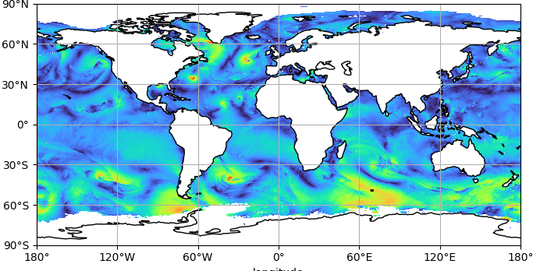
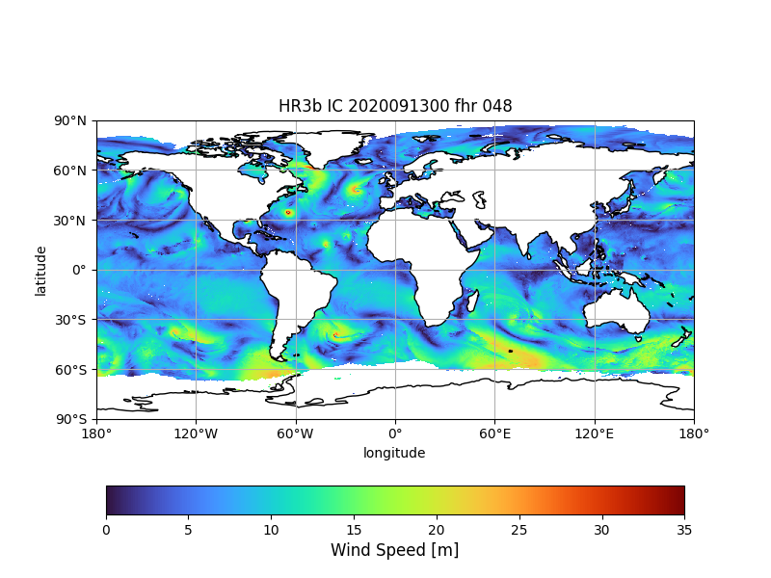
Wind Speed 20200913 00z FHR 048
muli_1
HR1
HR3a
GFSv16
HR2
HR3b

Slide 8
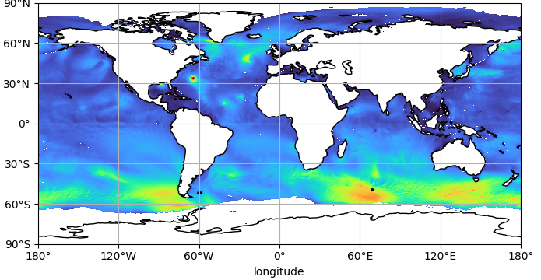
HS 20200913 00z FHR 048
muli_1
HR1
HR3a
GFSv16
HR2
HR3b

Slide 9
HS Speed 20200913 00z FHR 048
muli_1
HR1
HR3a
GFSv16
HR2
HR3b

Slide 10
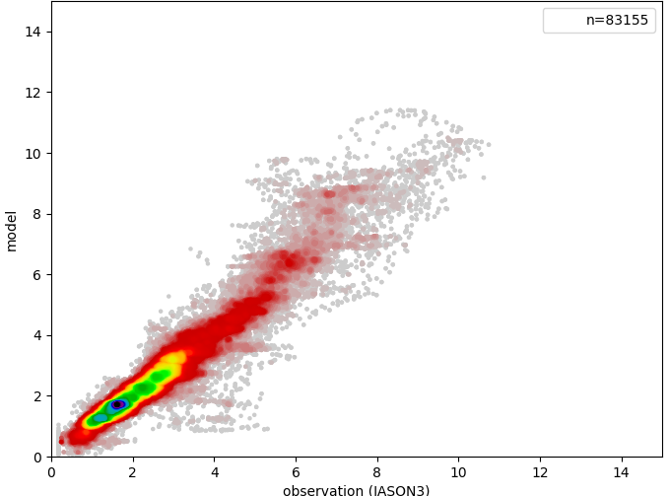
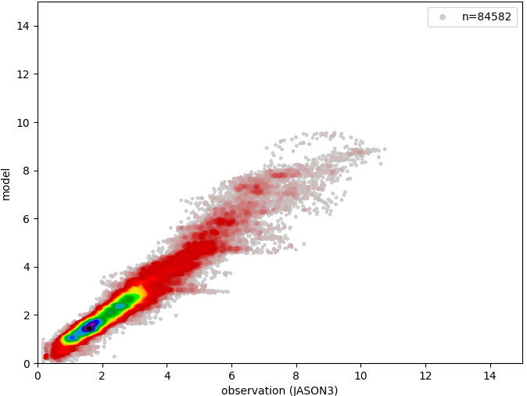
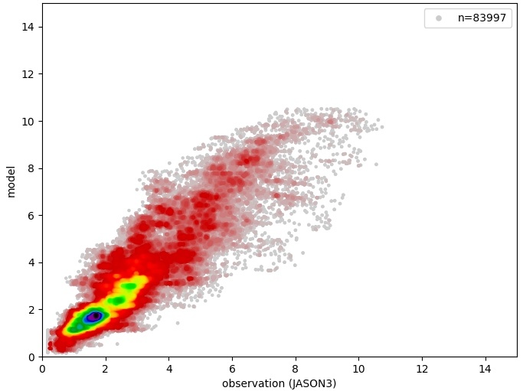
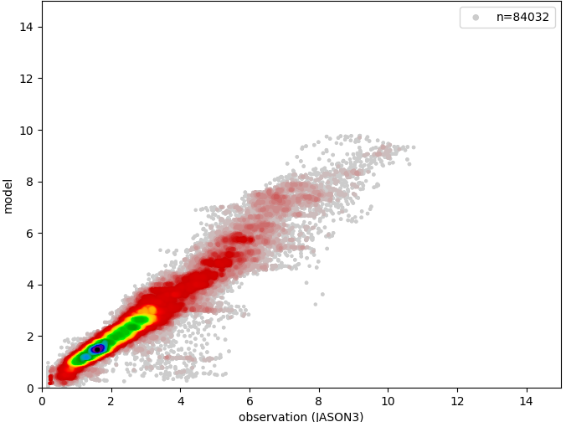
HS 20200913 00z Day 2
muli_1
HR1
HR3a
GFSv16
HR2
HR3b

Slide 11
Wave Evaluation
The next slides include statistical performance of significant wave height (HS) and wind speed compared to JASON3 altimeter from AODN*.
Comparisons with SARAL, CRYOSAT2 and SENTINAL 3A show similar results and not included here.
In plots with HS, dashed lines represent observed HS ≥ 4m.
*AODN: https://thredds.aodn.org.au/thredds/catalog/IMOS/SRS/Surface-Waves/Wave-Wind-Altimetry-DM00/catalog.html

Slide 12
Wind Speed Bulk Statistics
RMSE
Bias
Winter
Summer
Hurricane

Slide 13
HS Bulk Statistics
RMSE
Bias
Winter
Summer
Hurricane
Dashed line is for observed HS ≥ 4m

Slide 14
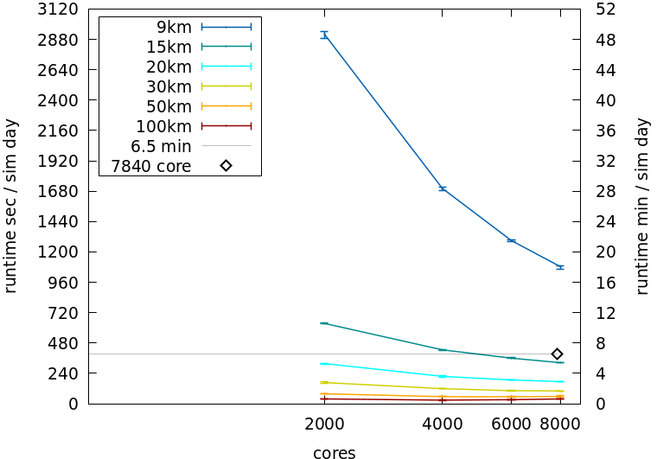
Standalone Wave Unstructured Grid Scaling

Slide 15
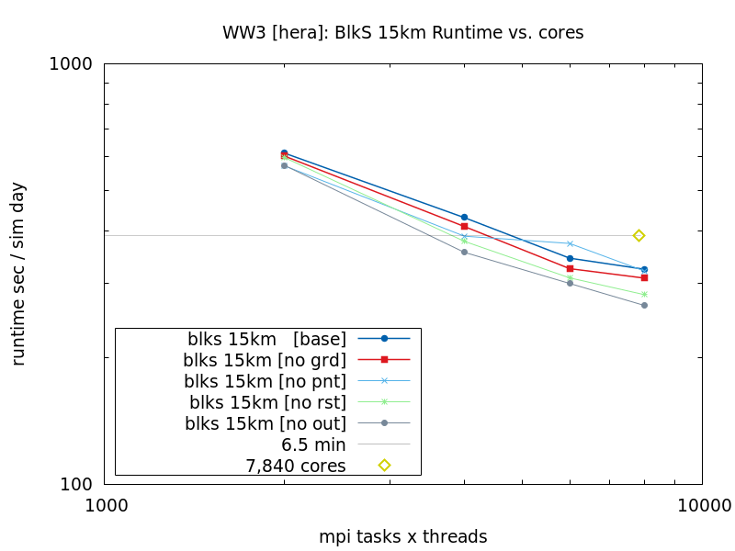
Impact of I/O on Runtime Performance

Slide 16
Summary/Future Work
The next High Resolution prototype (HR4) will use an unstructured grid with ~15 km resolution for waves
Analysis of the computational performance within the coupled system for the new grid is currently in progress.
Wave model performance:
Overall HR3 performance is degraded compared to HR1 & HR2 although storm peaks do appear stronger.
Further optimization of the wave physics is planned to address this, paying particular attention to high seas.
Notes:
Add other cd curves

Slide 17
Questions
Jessica.Meixner@noaa.gov
?

Slide 18
Thank you!

Slide 19
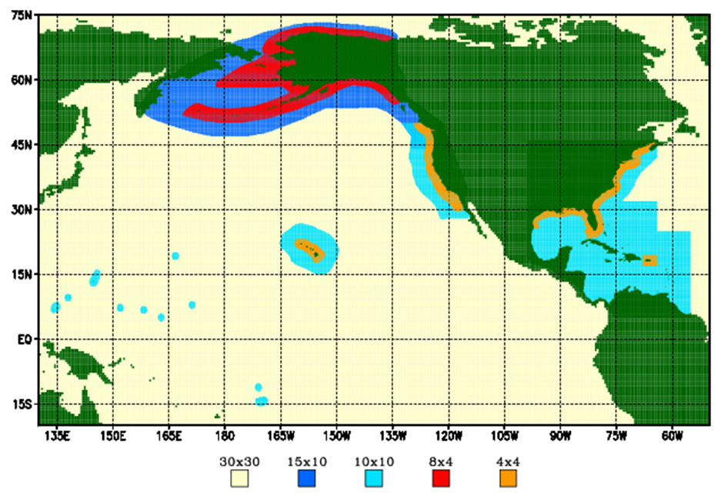
Multi-1 Grid Mosaic

Slide 20
Mulit-1 and GFSv16 Grid Mosaics
Multi_1
GFSv16 wave
Arctic Polar Stereographic
18 km resolution
50°N to 90°N
Global grid: 30 arc min
Regional grids: 10 arc min
ak_10m
wc_10m
at_10m
ep_10m
Coastal grids: 4 arc min
ak_4m
wc_4m
at_4m
Arctic Polar Stereographic
9 km resolution
50°N to 90°N
Global core
16 km (10 arcmin)
15°S to 52.5°N
Southern Ocean
25 km (15 arcmin)
10.5°S to 79.5°S

Slide 21
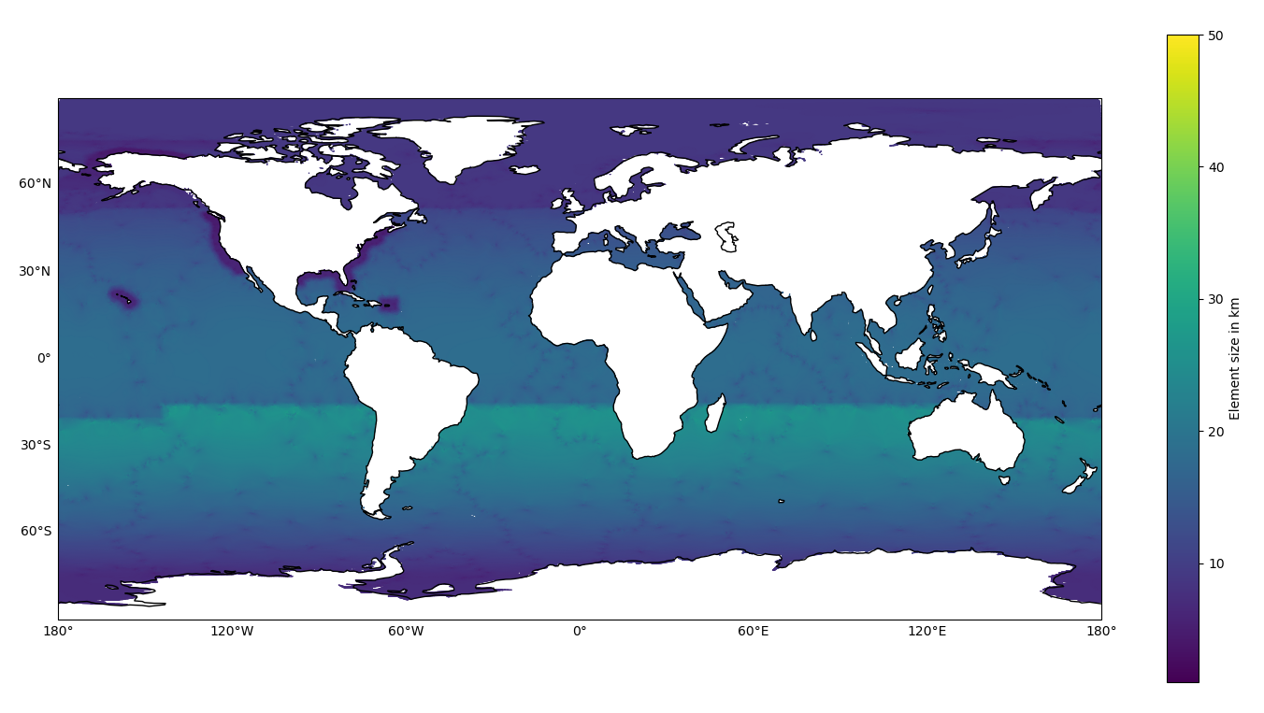
Unstructured Grid for HR3
Mesh was created by Ali Abdoli at Lynker @ NOAA/NWS/NCEP/EMC

Slide 22
High Resolution (HR) Prototypes
Coupled model (ATM, OCN, ICE, WAV)
Free forecast (no DA yet)
Atmosphere:
C768 (HR1, HR2, HR3a), C1152 (HR3b+)
Ocean/Ice:
¼ degree tripolar
Waves:
¼ degree tripolar (HR1-2), Unstructured grid (HR3*)
HR time periods:
Summer: June 1– Aug. 30, 2020, cold start forecasts at 00Z cycle every 3 days, 16 day forecast
Winter: Dec. 03, 2019 – Feb. 26, 2020, cold start forecasts at 00Z cycle every 3 days, 16 day forecast
Hurricane: July 20, 2020 – Nov 20th, 2020, cold start forecasts at 00Z cycle everyday, 7 day forecast

Slide 23
Wind Speed 20200913 00z FHR 048
muli_1
HR1
HR3a
GFSv16
HR2
HR3b

Slide 24
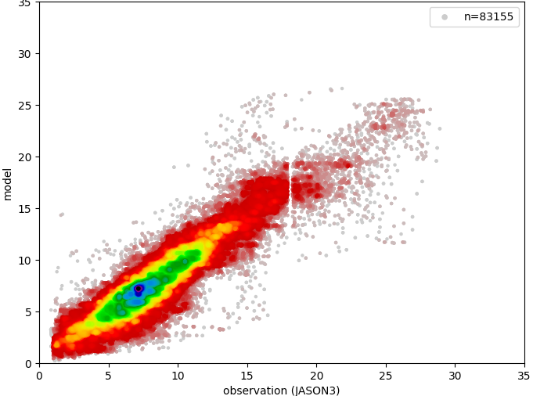
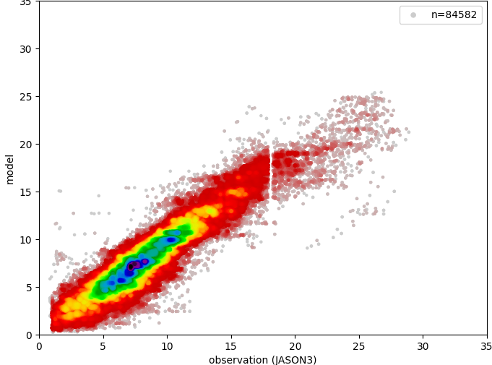
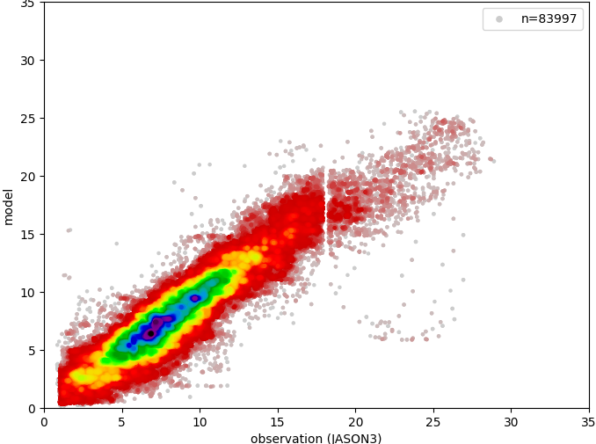
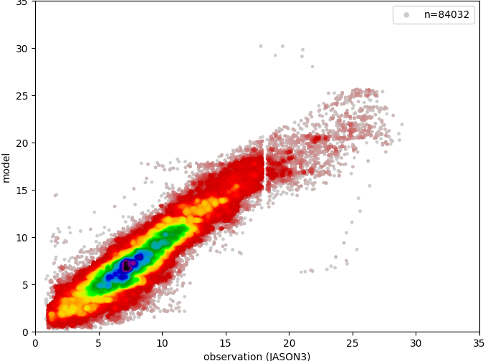
Wind Speed 20200913 00z Day 2
muli_1
HR1
HR3a
GFSv16
HR2
HR3b

