Slide 1
Updates to the UFS-AQM Online Prediction System for the National Air Quality Forecasting Capability
Kai Wang (Lynker@NOAA/NWS/NCEP/EMC)
Jianping Huang, Ivanka Stajner, Fanglin Yang, Raffaele Montuoro, Jeffrey McQueen, Cory Martin (NOAA/NWS/NCEP/EMC)
Ho-Chun Huang, Brian Curtis, Hyundeok Choi, Haixia Liu (Lynker@NOAA/NWS/NCEP/EMC)
Shobha Kondragunta (NOAA/NESDIS/STAR)
Barry Baker (NOAA/OAR/ARL)
Youhua Tang, Patrick Campbell (George Mason University and NOAA/OAR/ARL)
Daniel Tong (George Mason University )
Fangjun Li (South Dakota State University)
Chuanyu Xu (IMSG@NOAA/NESDIS/STAR)
James Wilczak (NOAA/OAR/PSL)
Irina Djalalova, Dave Allured (CIRES and NOAA/OAR/PSL)
Funded by supplemental funding through ASDR19 and DRSA22
Unifying Innovations in Forecasting Capabilities Workshop
Jackson, MS, July 24, 2024

Slide 2
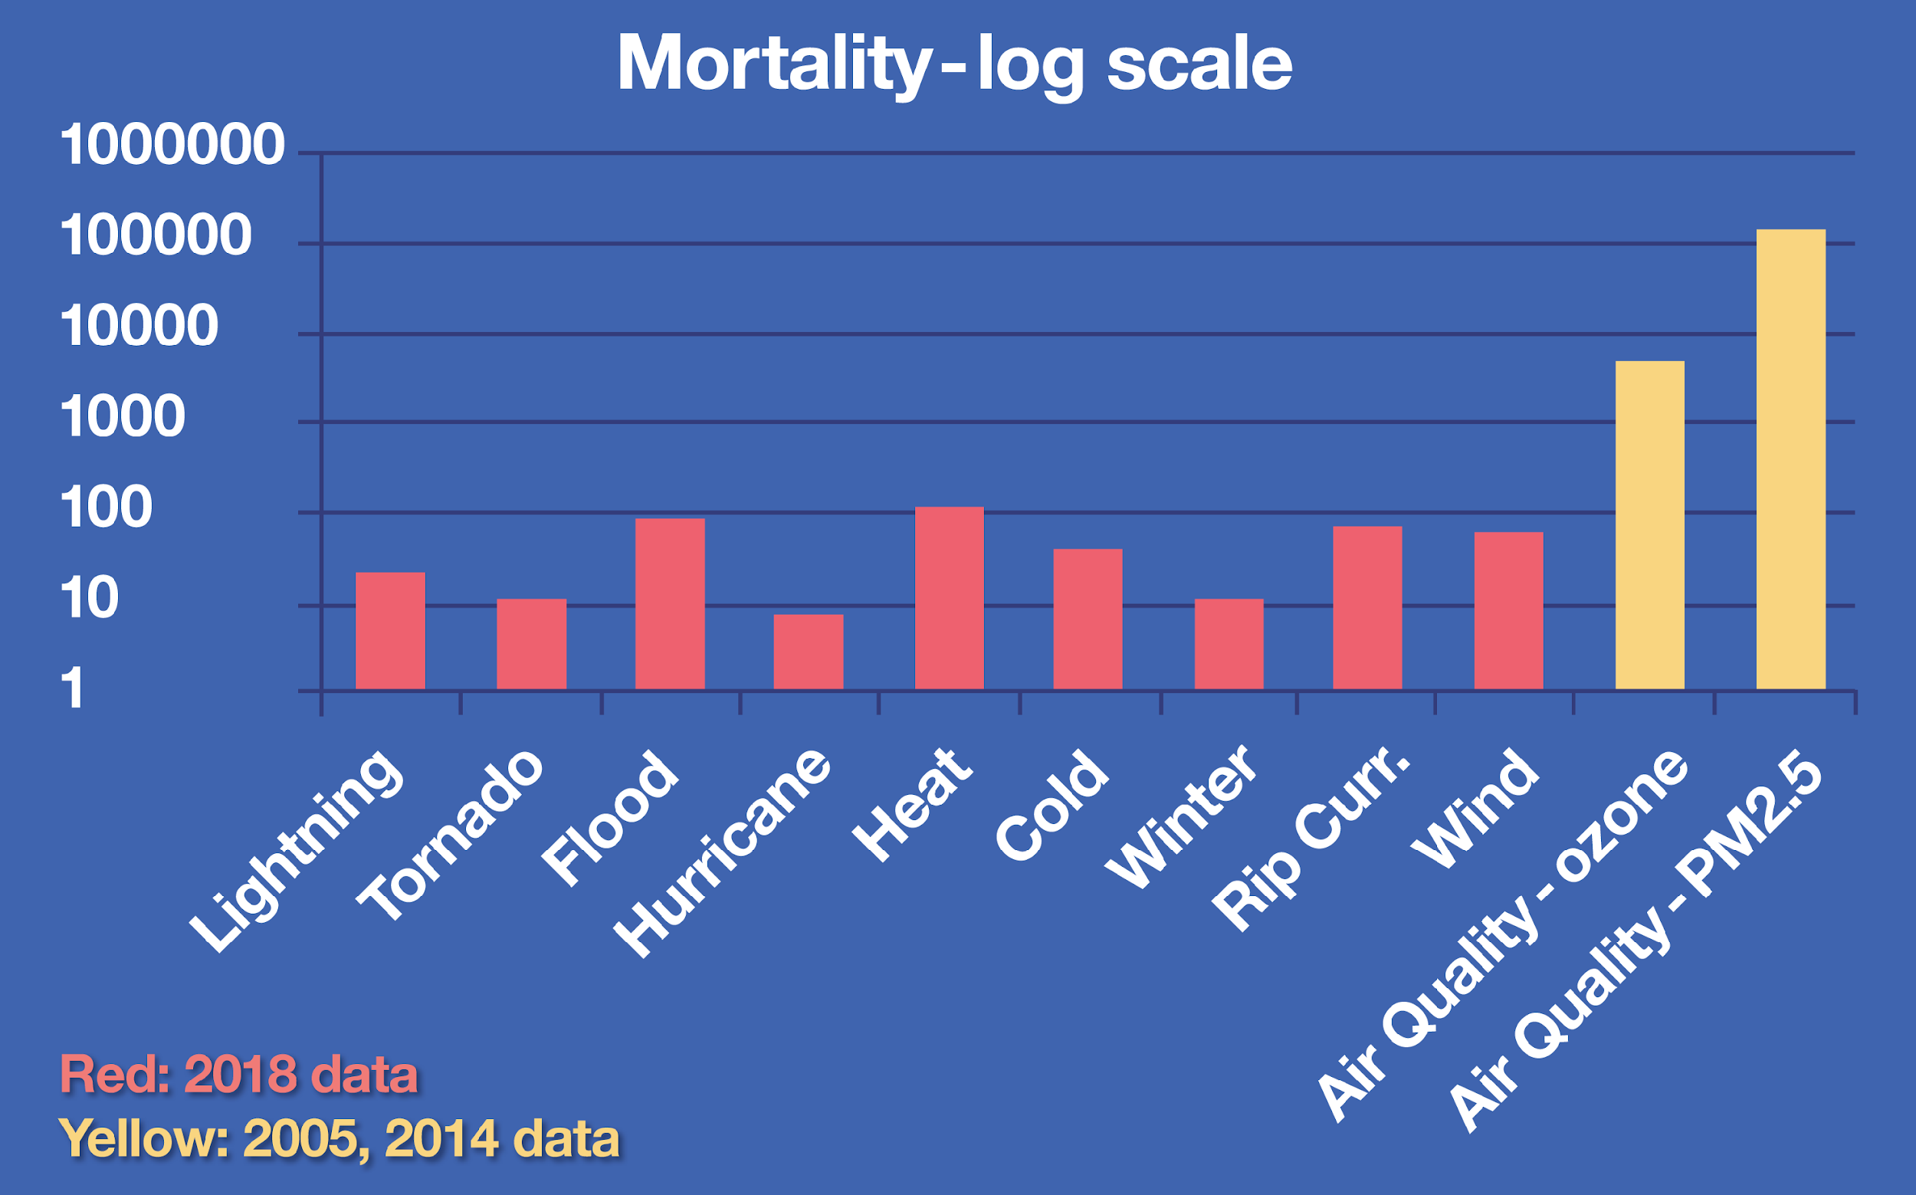
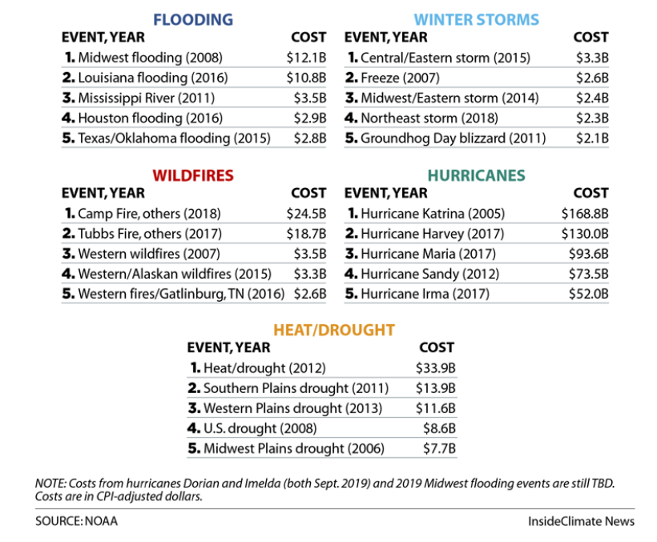
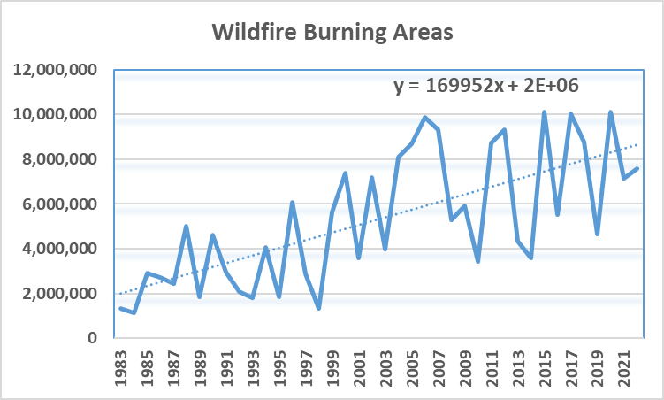
Societal Impacts and Recent Trends of Wildfires
Wildfires become one of major threats to the U.S. air quality!
Source: NOAA

Slide 3
Major Components of the UFS-AQM Online System
WildFire
Emission
(RAVE)
GEFS/Aero +
Chem. Climat. LBCs
Anthrop.
Emission
UFS-AQM
Coupled forecast model
NEXUS
(NOAA Emission and Exchange Unified System)
CMAQ
(gas-chem. and aerosols)
FV3 Atmos.
(transport/physics)
ICs and BCs
Met fields
Biogenic Emission
UFS_Utils
UPP & Post
(PM_{2.5})
Bias Correction
New parallel emissions preprocessing system
GFS outputs
Products
(CS, AK,HI)
Verification
Red boxes: New Components
Available: https://github.com/ufs-community/ufs-srweather-app/tree/production/AQM.v7
Notes:
RAVE: Regional ABL and VIIRS fire emissions

Slide 4
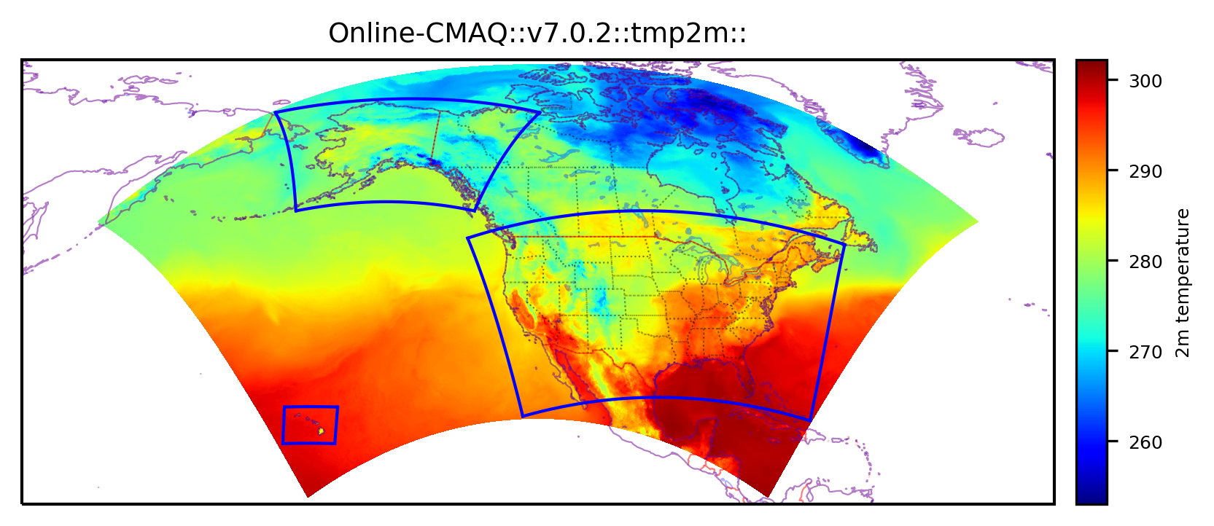
Online Coupled UFS-AQM: Model Configurations
 | UFS-AQM
Atmos. & air quality models | Online coupled UFS_Atmos + CMAQv5.2
Gas & aerosol mechanisms | CB06r3 + Aero6
Grid_spacing & vertical levels | 13 km & 65 levels (topped at 0.2 hpa)
Anthropogenic emissions | NEI 2016v1 for CONUS + EDGAR-for-HTAPv2, CEDSv2 & OMI-HTAP for O-CONUS
Fire emissions | RAVE (hourly, 0.03 deg) + Sofiev plumerise algorithm, linearly-distributed, VOCs off
Biogenic & dust emissions | MEGANv2 & Fengsha
Dynamics & physics | FV3 & CCPP GFSv16 suite
Chem-LBCs | AM4 for gases + GEFS for aerosols
Huang et al. (BAMS in review)
NOAA’s UFS-AQM (i.e., AQMv7.0) was implemented for operation on May 14, 2024
The single UFS-AQM North American domain replaces and now covers all 3 old operational product domains including CONUS, AK and HI

Slide 5
Major Updates from AQMv7.0 to v7.1
Upgrading RAVE products from v1.3 to v2.0
Fixing a bug related to the plume-rise of organic carbon from point-source and wildfires emissions
Applying a reduction factor to the snow-covered fugitive dust emissions
Updating the bias-correction (BC) package with the short observational data gaps infill method, which mitigates the “bulls-eye” issue
Full year retrospective simulation has been conducted between May, 2023-April, 2024 and the near-real time (NRT) run using AQMv7.1 has been ongoing since May, 2024

Slide 6
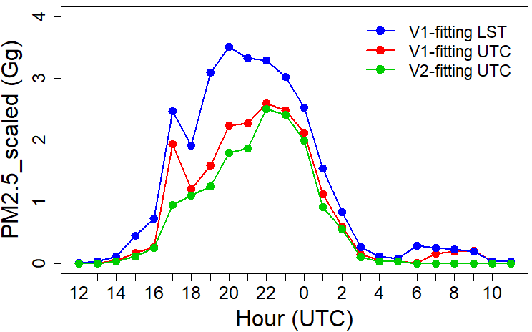
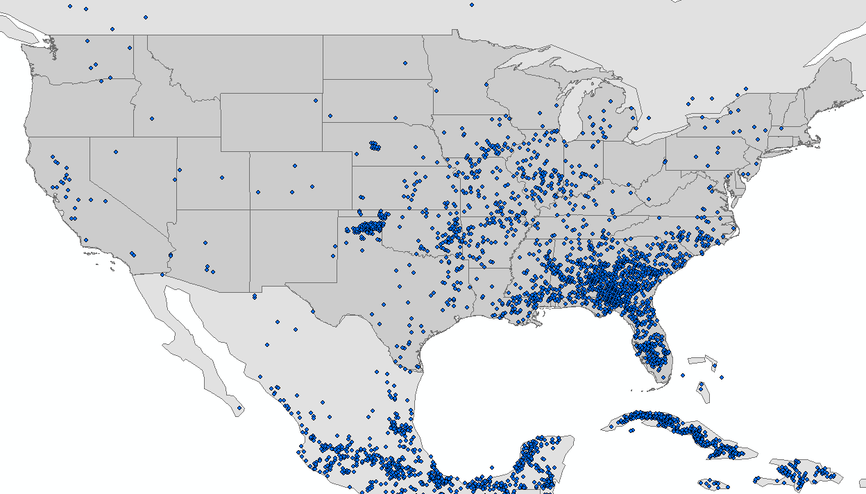
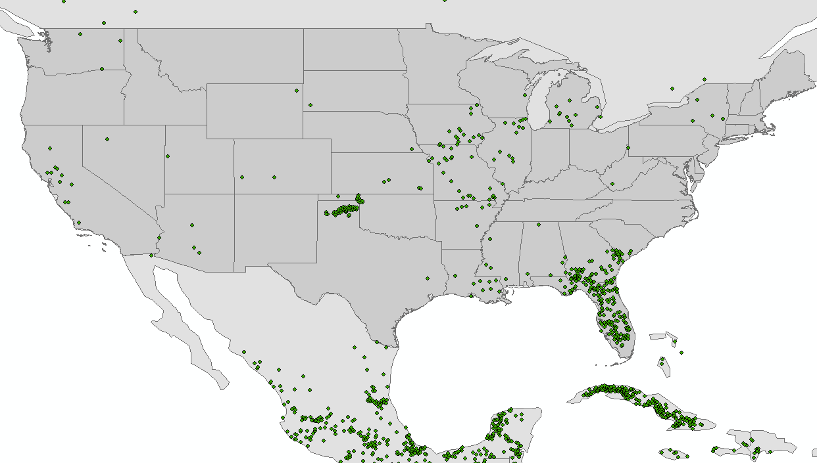
Updates in RAVE v2
Changed fire inputs from NDE AF to eFire of VIIRS product in NOAA-21
Corrected terrain-related parallax in ABI fire product
Algorithm updates (e.g., fixed a bug related to FRP time series fitting)
Removed scaling factors of PM_{2.5} emissions within CONUS
V1
V2
RAVE: Regional Advanced Baseline Imager (ABI) and Visible infrared Imaging Radiometer Suite (VIIRS)

Slide 7
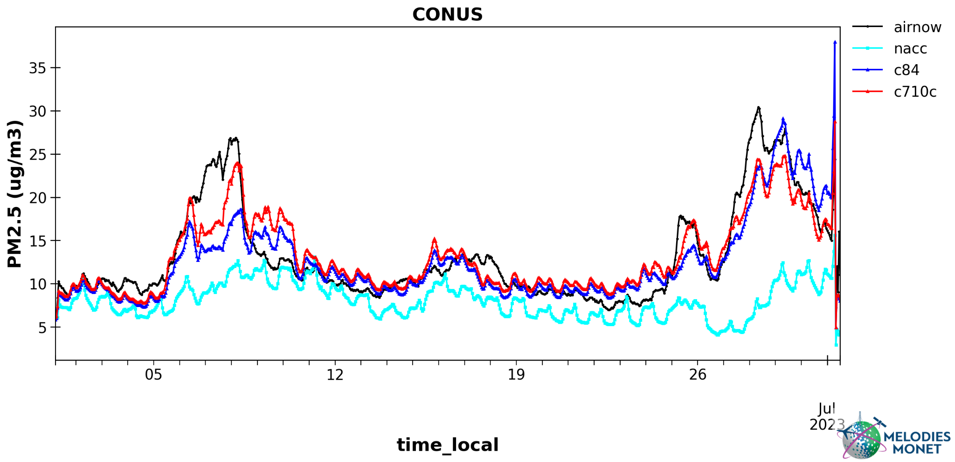
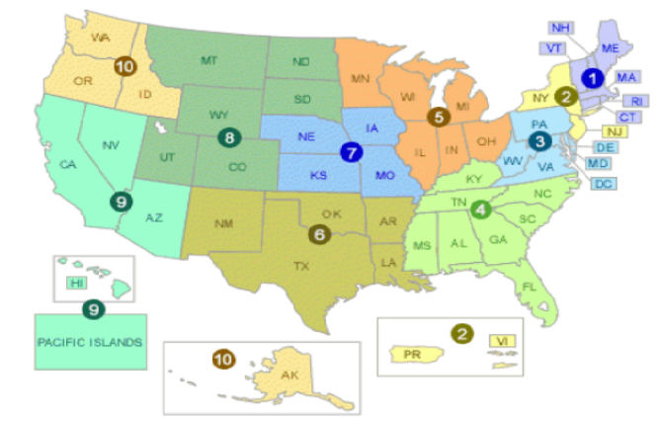
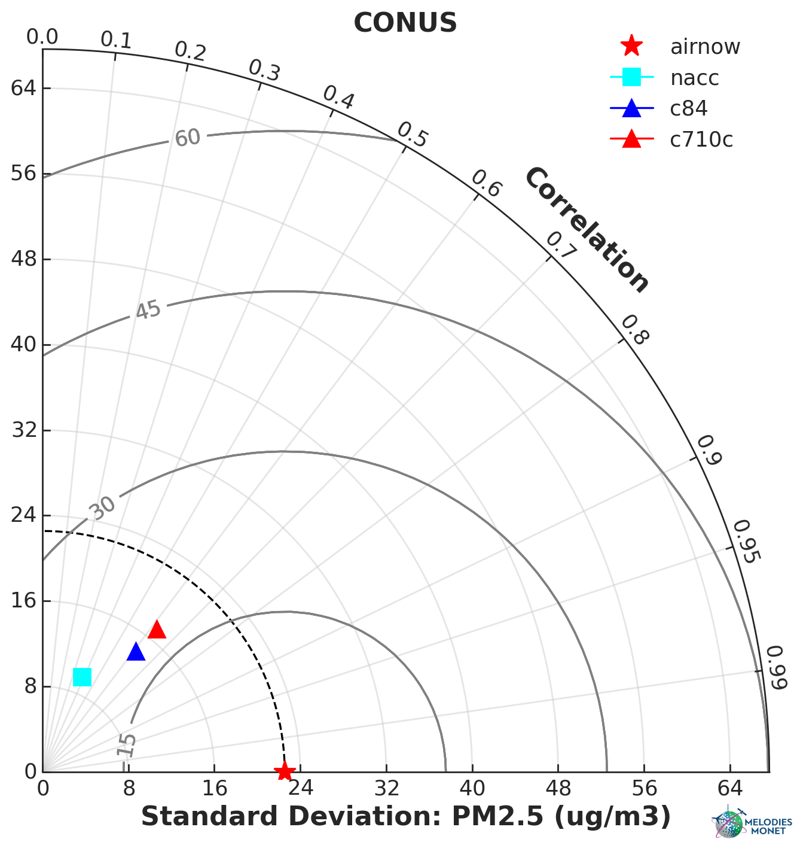
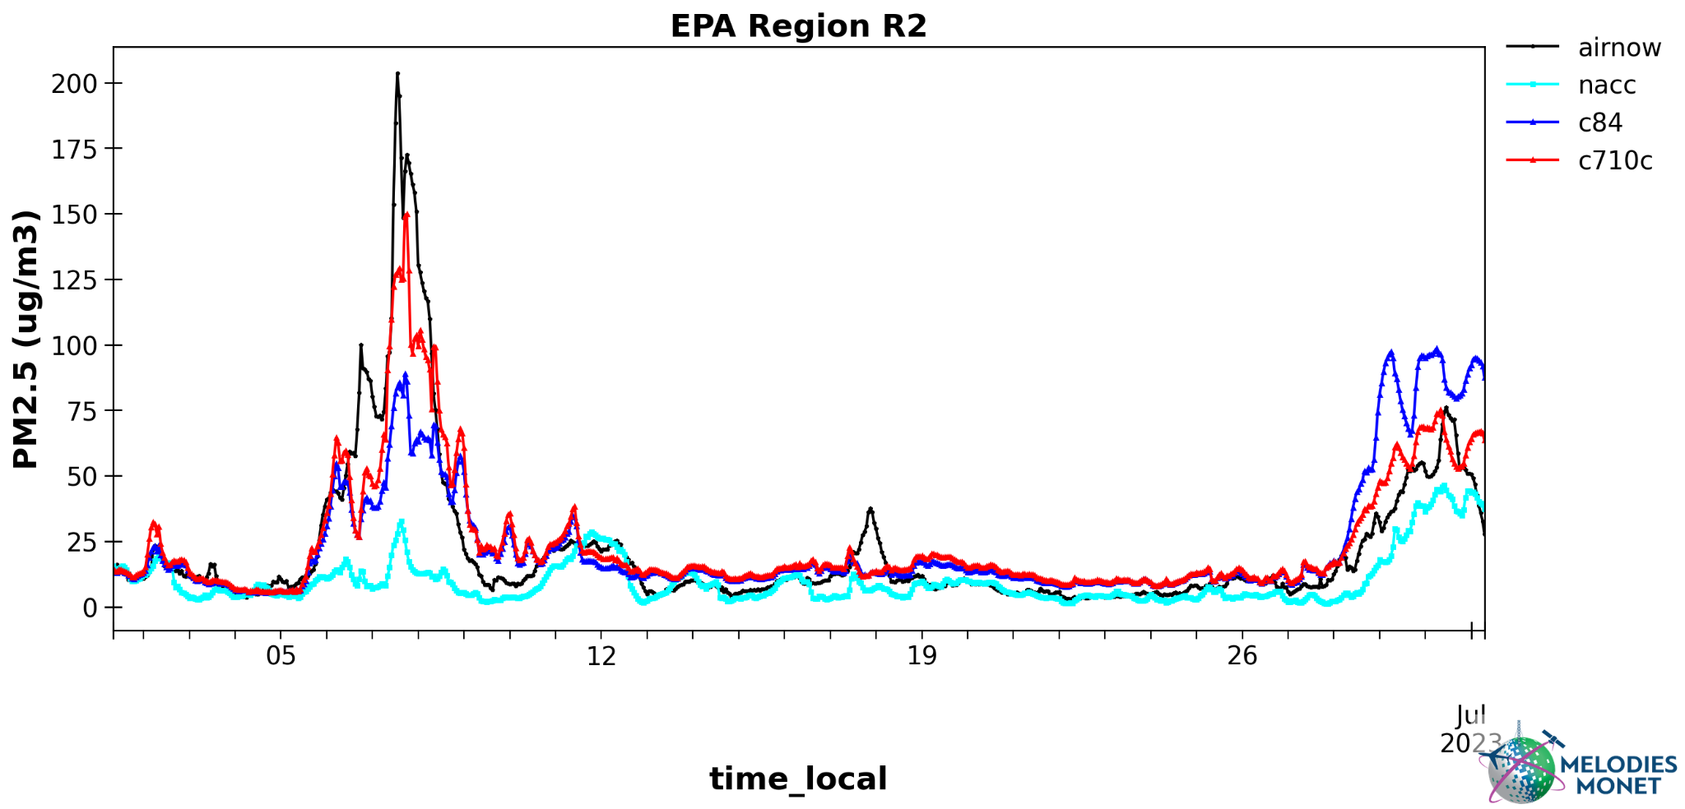
PM_{2.5} Predictions during Quebec Wildfires in June, 2023
Airnow
AQMv6
AQMv7.0
AQMv7.1
Both AQMv7.0 and v7.1 captured much better PM_{2.5} peak values than AQMv6 (then-operational system) over CONUS and northeastern U.S. (represented by EPA R2) during Quebec fires in June, 2023
AQMv7.1 slightly improved PM_{2.5} predictions for both wildfire episodes in June, 2023

Slide 8
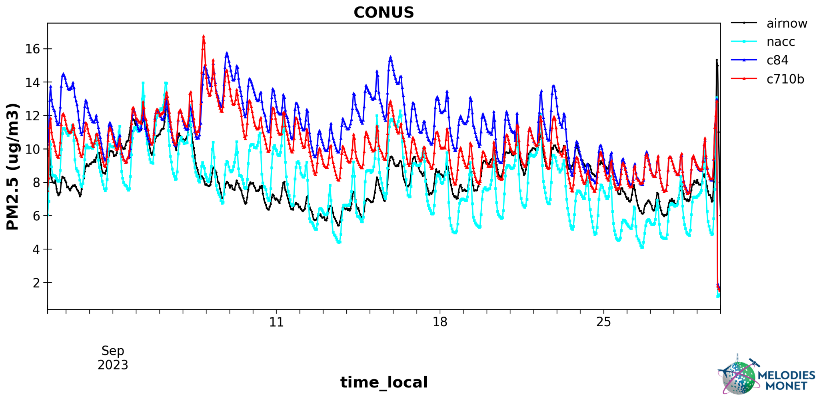
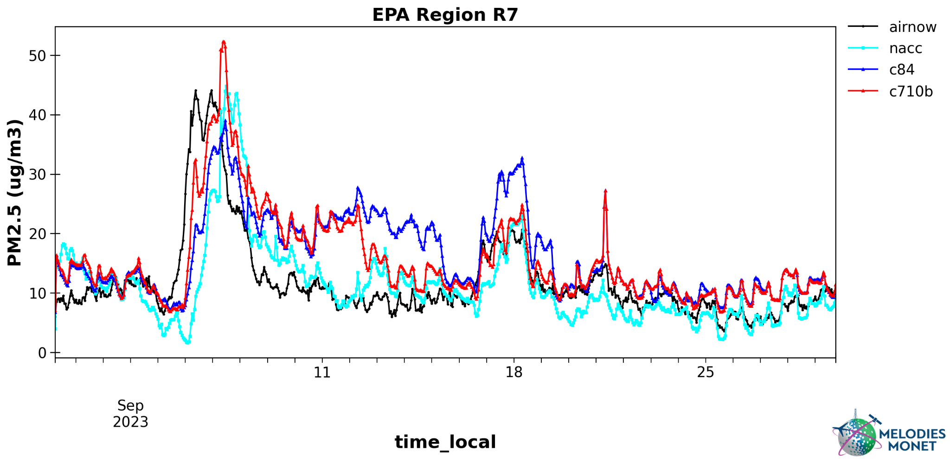
PM_{2.5} Predictions during Alberta Wildfires in September, 2023
Airnow
AQMv6
AQMv7.0
AQMv7.1
Both AQMv7.0 and v7.1 overpredict PM_{2.5} while AQMv6 tends to underpredict PM_{2.5} during the 2nd half of September, 2023 over the CONUS
AQMv7.1 significantly reduces the fire emissions and thus PM_{2.5} overpredictions throughout the CONUS

Slide 9
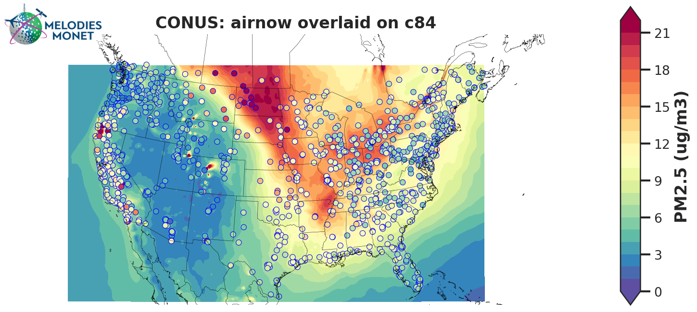
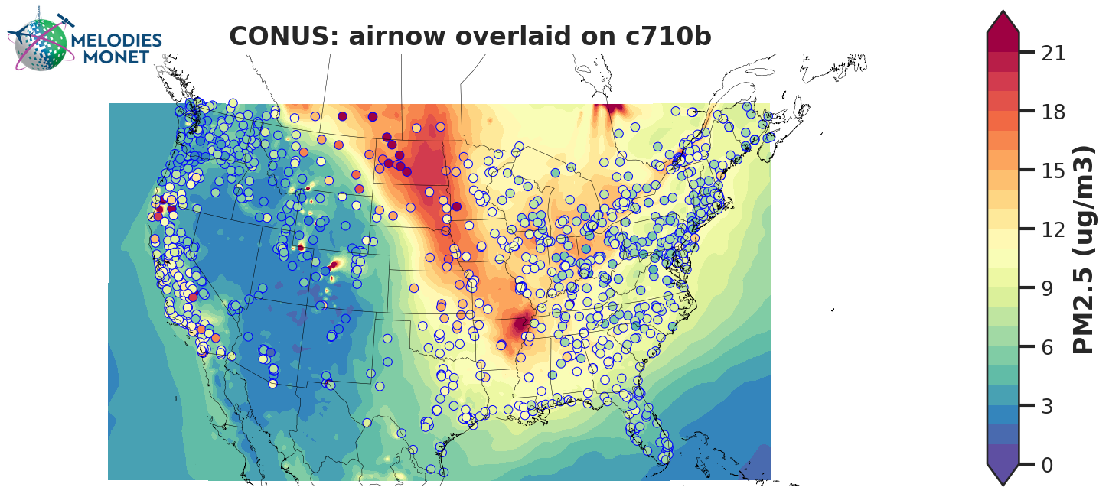
PM_{2.5} Predictions during Alberta Wildfires in September, 2023
AQMv7.0
AQMv7.1
AQMv7.1 shows better PM_{2.5} prediction compared to AQMv7.0 in the downstream regions of Alberta fires mainly caused by the updates in RAVE v2
Some challenges/future work still remain to further improve the performance especially over the midwest U.S.

Slide 10
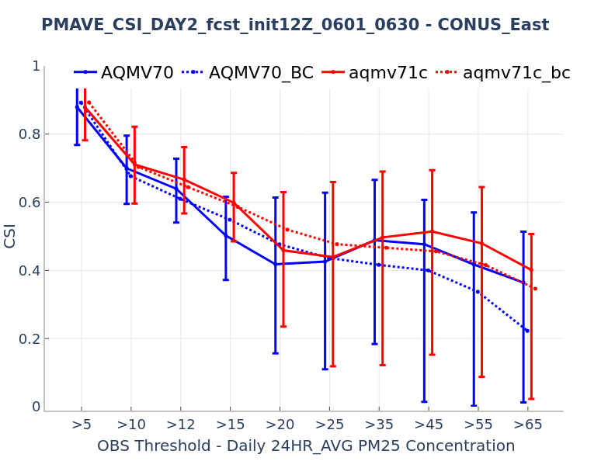
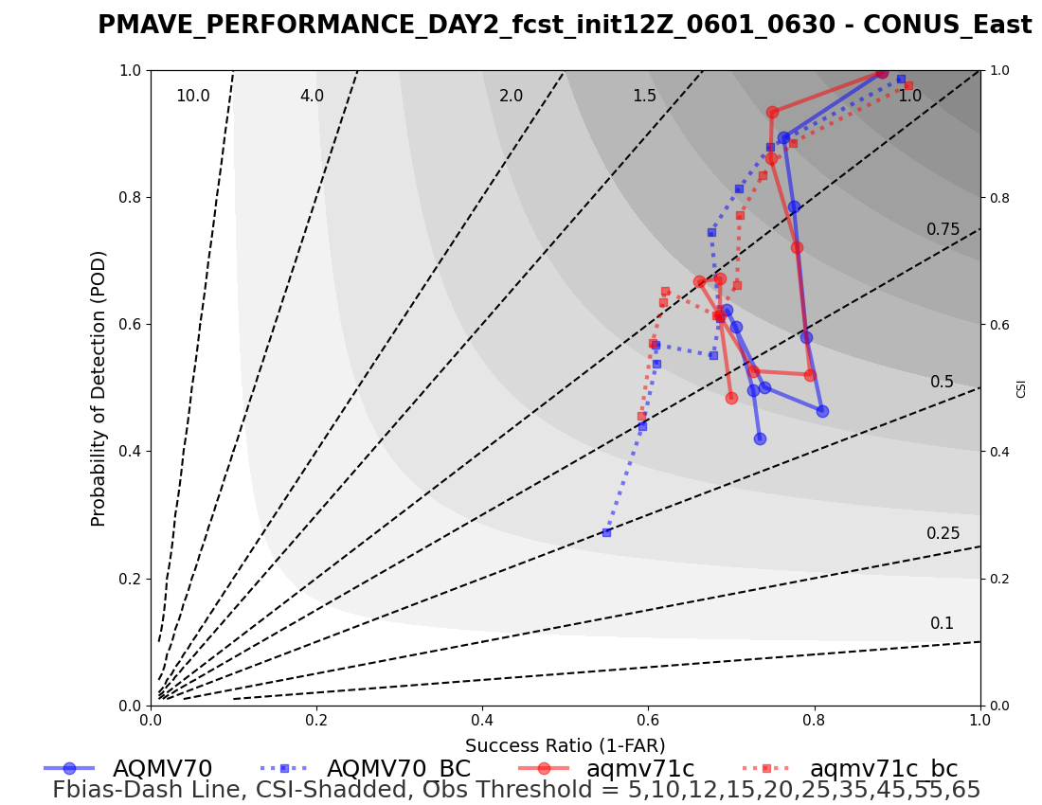
Categorical Evaluation of PM_{2.5} during Quebec Wildfire in June, 2023
CONUS-East categorical performance of AQMv7.1 is slightly improved over the AQMv7.0 for both raw and BC predictions: overall higher CSI and POD for different threshold values

Slide 11
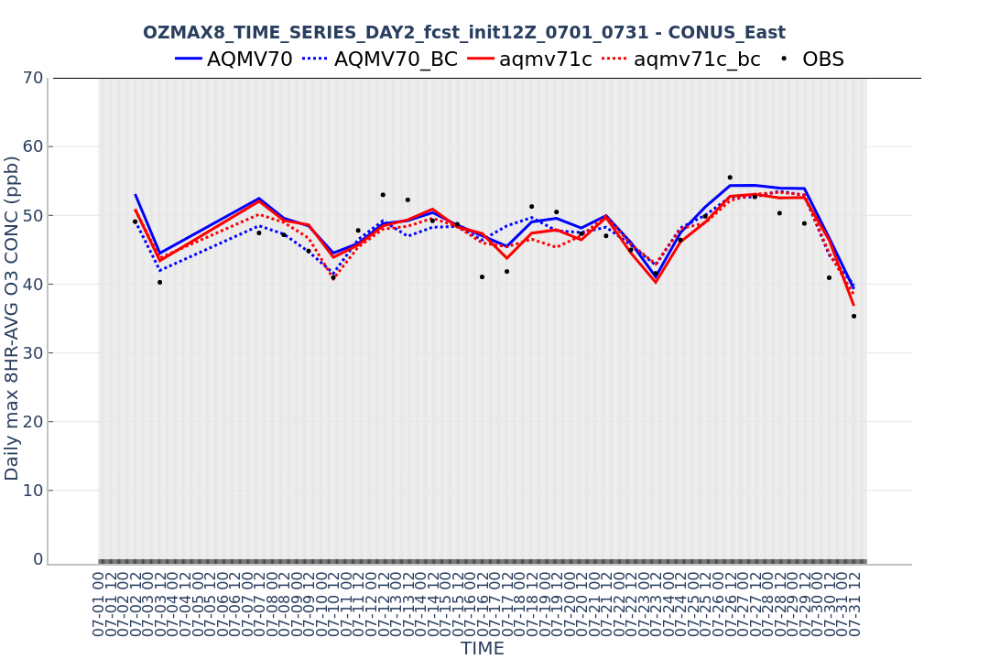
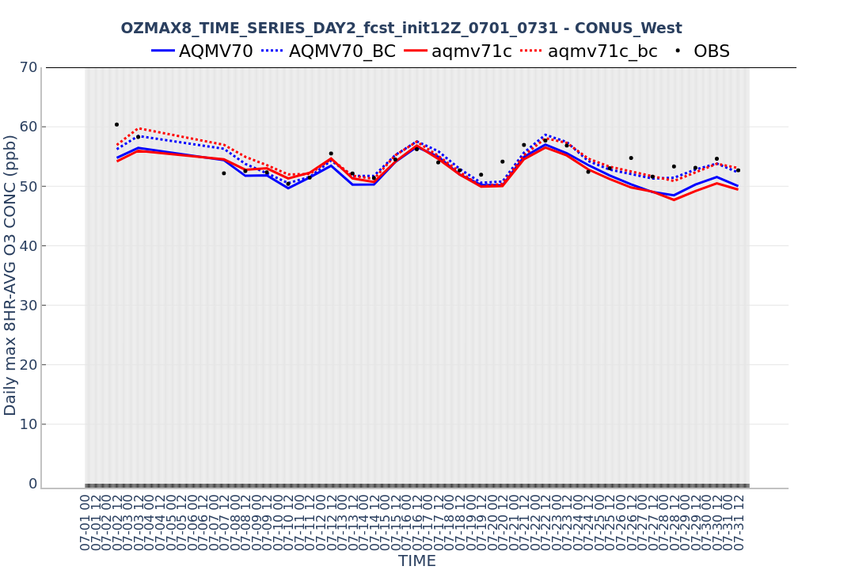
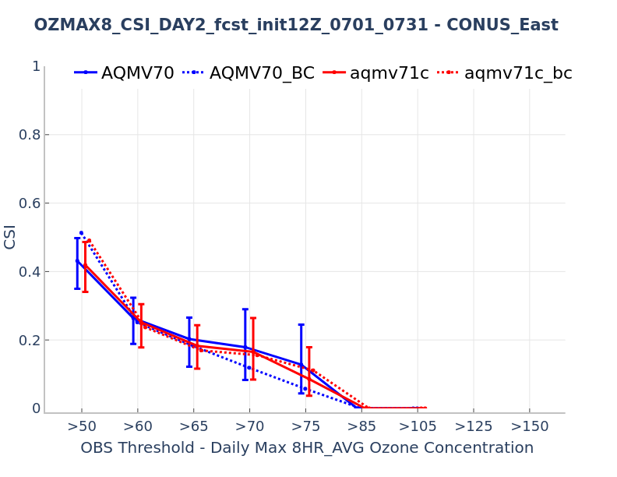
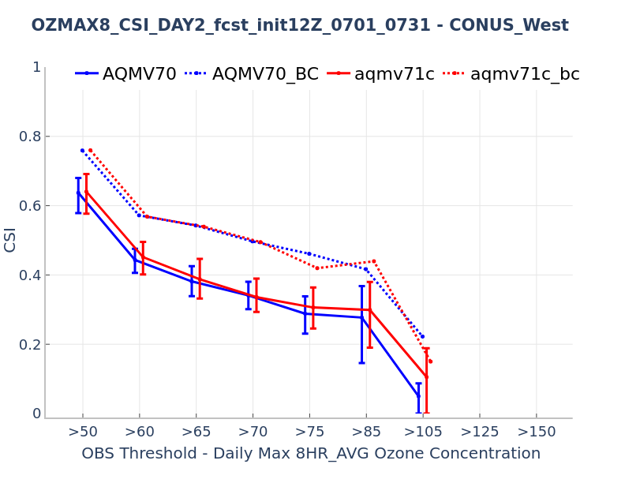
Comparison between AQMv7.0 and AQMv7.1: Daily 8-hr Max O₃

Slide 12
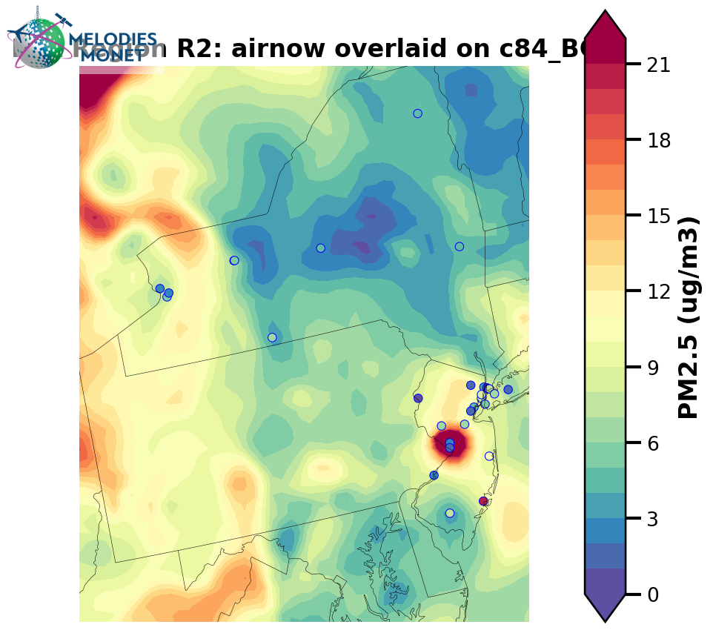
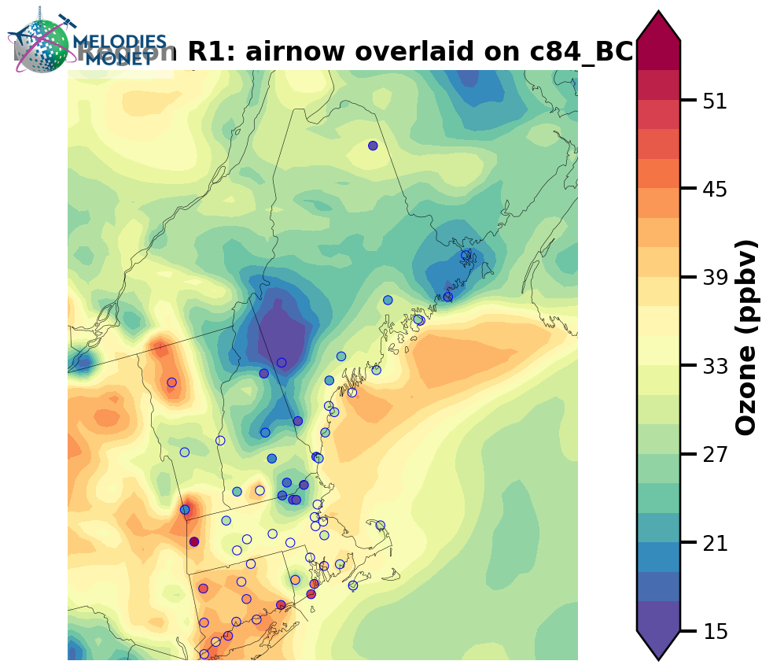
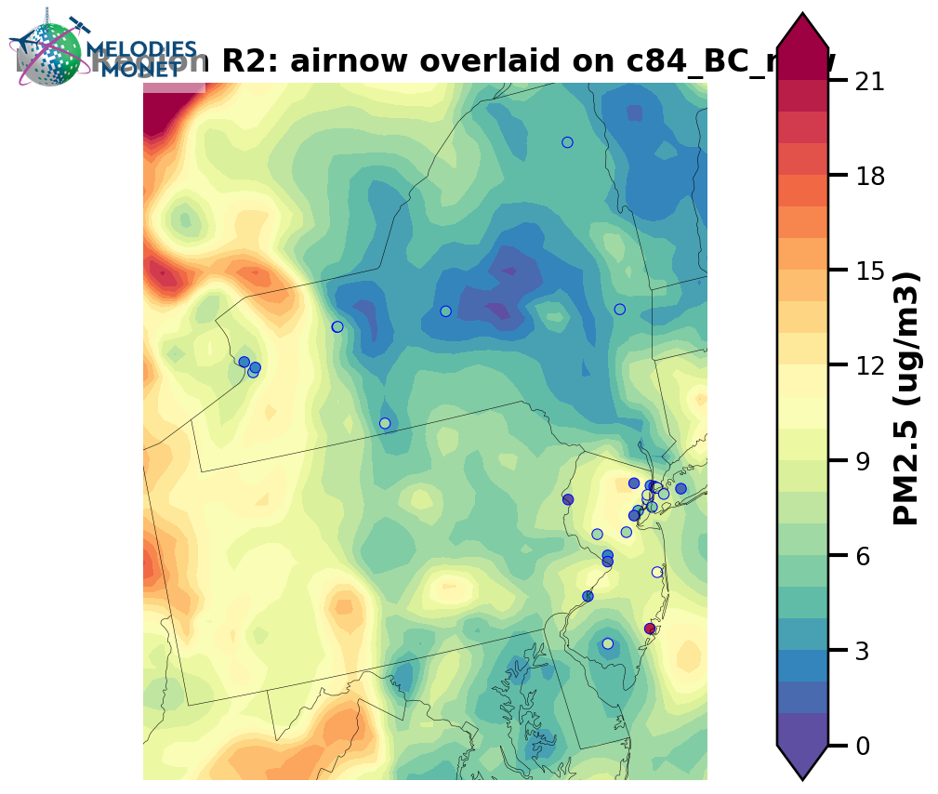
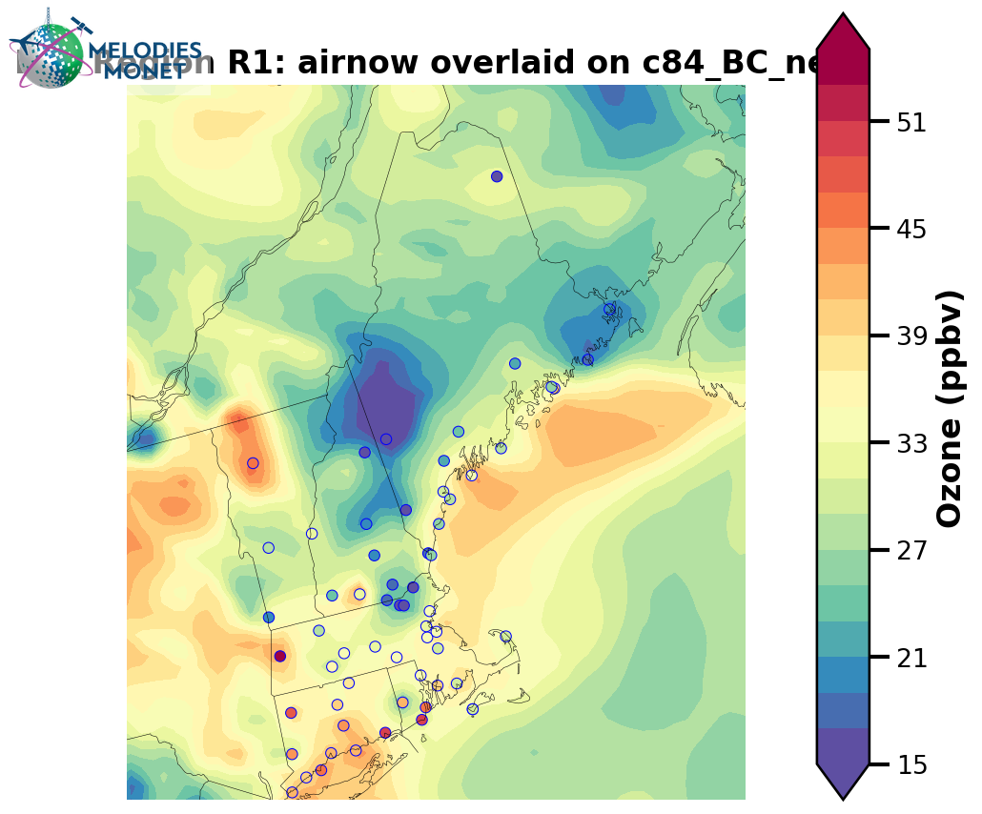
Examples of Fixed Bulls-Eye Issues in AQMv7.1
PM_{2.5} over Trenton, NJ for 2023/06/26 06z
O₃ over Bennington, VT for 2023/06/26 06z
AQMv7.0
AQMv7.0
Caused by combination of high obs. values at certain time and data gaps with missing values at other time over the same site
AQMv7.1
AQMv7.1
The “bulls-eyes” are removed after implementing the gap-fill method in AQMv7.1

Slide 13
Summary and Future Work
NOAA’s UFS-AQM (i.e., AQMv7.0) was implemented for the operation on May 14, 2024
The UFS-AQM system is further developed and tested in AQMv7.1 to better represent the impacts of wildfire emissions on air quality via upgrading to RAVEv2
Both AQMv7.0 and v7.1 demonstrate superior capability in predicting the U.S. air quality (especially for PM_{2.5}) compared to AQMv6 during major fire events (e.g., Quebec fire in June 2023)
AQMv7.1 further improves the model performance in terms of both discrete and categorical evaluation especially for PM_{2.5} during a few fire events in the past and the updated system is being targeted for the implementation in the next couple of months
Future work
Testing the UFS-AQM system at a higher resolution (e.g., 9-km) to address prediction challenges over complex terrain and coastal regions
Updating both UFS atmospheric (e.g., CCPP_GFSv17) and air quality models (e.g., CMAQv5.4) as well as national emissions inventories (e.g., NEI2019)
Refining wildfire emissions (e.g., activating NOx and VOCs emissions)
Improving chemical initial conditions through the data assimilation technology

