Slide 1
Data Assimilation Strategy for NOAA
Daryl Kleist
Chief, Data Assimilation and Quality Control
NOAA/NWS/NCEP/Environmental Modeling Center
Unifying Innovations in Forecasting Capabilities Workshop
July 22-26, 2024
Jackson State University, Jackson, MS

Slide 2
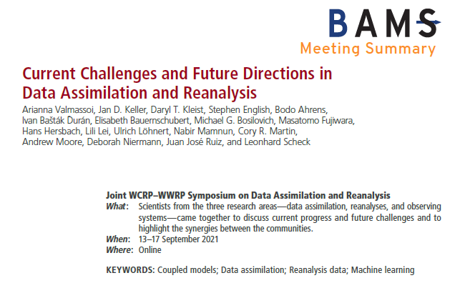
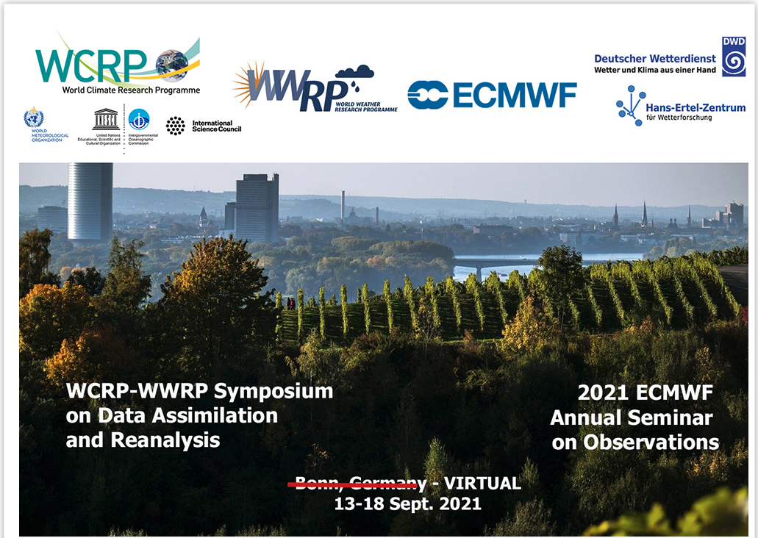
Data Assimilation Grand Challenges
10 year activities and addressing grand challenges in data assimilation:
Coupled assimilation across the Earth system
Multiscale assimilation across temporal and spatial scales
Increase in volume and types of observations (including non-traditional, crowdsourced, more hyperspectral)
Representation of system uncertainty and model error, including coupled systems
Non-Gaussianity and nonlinear in errors
Consideration of future HPC architecture, exascale, AI-ML integration
Reanalysis
We need a strategy, and infrastructure, to address these challenges.

Slide 3
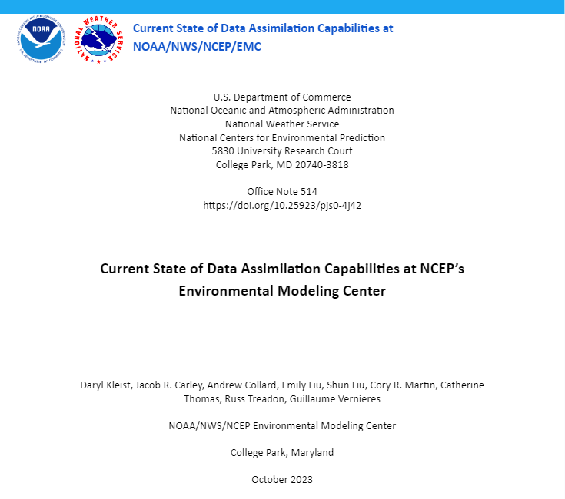
NWS/NCEP/EMC Review and Current State
Introduction
Atmospheric Systems
GSI Unification, Hybrid DA
Marine, Land, Composition, and Coupled Assimilation
Current Use of Observations
Decoding and Obs Processing
In-situ and anchor obs
Remotely sensed (non-satellite)
Remotely sensed (satellite)
Monitoring & Observation Impacts
Current Implementation Procedure
https://doi.org/10.25923/pjs0-4j42

Slide 4
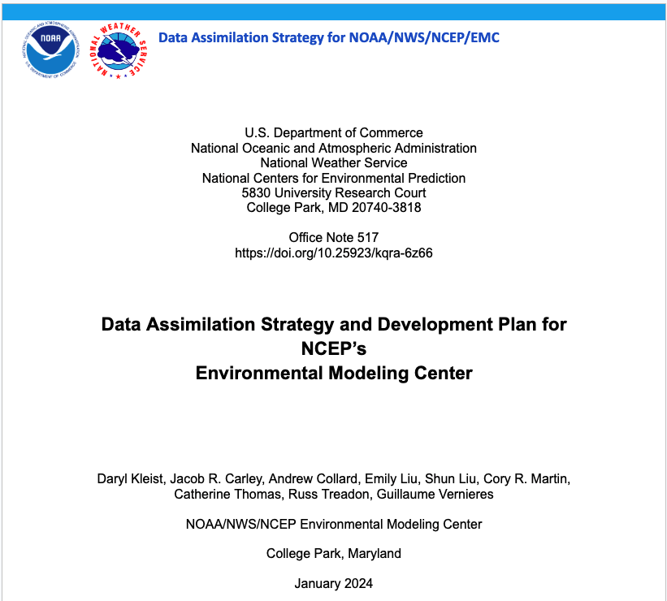
NWS/NCEP/EMC Development Strategy
Introduction
Advanced Infrastructure / JEDI
Research and Development
Use of Observations
New and Upcoming Observations
Algorithms
Toward Continuous DA
Coupled DA
AI/ML
Reanalysis
Development Practices
Data Assimilation Vision - Holistic Approach
JEDI, Partnerships, Embracing Change, and Workforce
Risk Management
https://doi.org/10.25923/kqra-6z66

Slide 5
NOAA DA Strategy
Data Assimilation Strategy Timeline
DA Strategy Writing team established March 2023
First draft completed July 2023
Reviews by NOAA Modeling Team 8/23 and 5/24 (red-flag review)
Brief to the ESIB Coordination Team 5/24
ESIB teams review completed 6/24
Ongoing:
NOAA Line Office red-flag review (due early 8/24)
Writing Team
Kevin Garrett, NWS/STI (lead)
Sergey Frolov, OAR/PSL (co-lead)
Daryl Kleist, NWS/EMC
Vijay Tallapragada, NWS/EMC
Eric Bayler, NESDIS/STAR
Jiangtao Xu, NOS/COOPS
Alex Kurapov, NOS/OCS
Hyun-Sook Kim, OAR/AOML
Curtis Alexander, OAR/GSL
Lidia Cucurull, OAR/RTA
James Thorson, NMFS/AKFSC
Shira Francis, NWS/STI

Slide 6
Data Assimilation
Data assimilation is a (statistically) optimal combination of uncertain environmental models and observations. The result of assimilating observations is an analysis of the Earth system state that is more accurate and complete compared to either the model or observations alone.
Why does NOAA need a DA Strategy?
Objective 2.3 of NOAA’s Modeling Strategy!
NOAA faces compounding challenges that will amplify as observing systems evolve and the society need for tailored, actionable environmental information grows.
To address these challenges, we need to leap-ahead in capabilities, and a One-NOAA effort that is as integrated as the Earth-system. The strategy provides the needed focus.

Slide 7
Strategy Vision and Goals
Vision: To serve societal needs through fully-coupled and continuous Earth-system data assimilation capabilities which maximize the impact of environmental observations
Goal 1: Build required infrastructure for continuous development, integration, and data assimilation.
Goal 2: Maximize the use, value, and impact of Earth-system observations
Goal 3: Transform and build a workforce that synergizes skill sets needed for the advancement of fundamental data assimilation science, emerging technologies, and observing systems to achieve operational success
Goal 4: Optimize efficiencies in research, development, and operational transition of new capabilities across the data assimilation enterprise

Slide 8
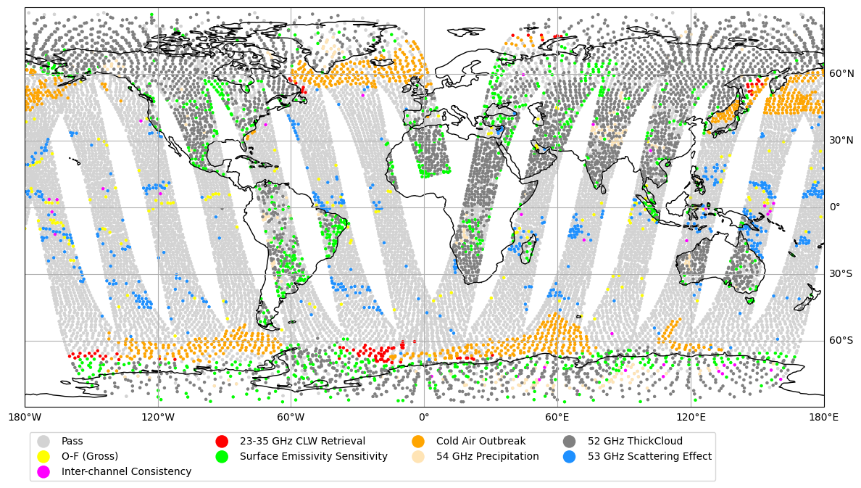
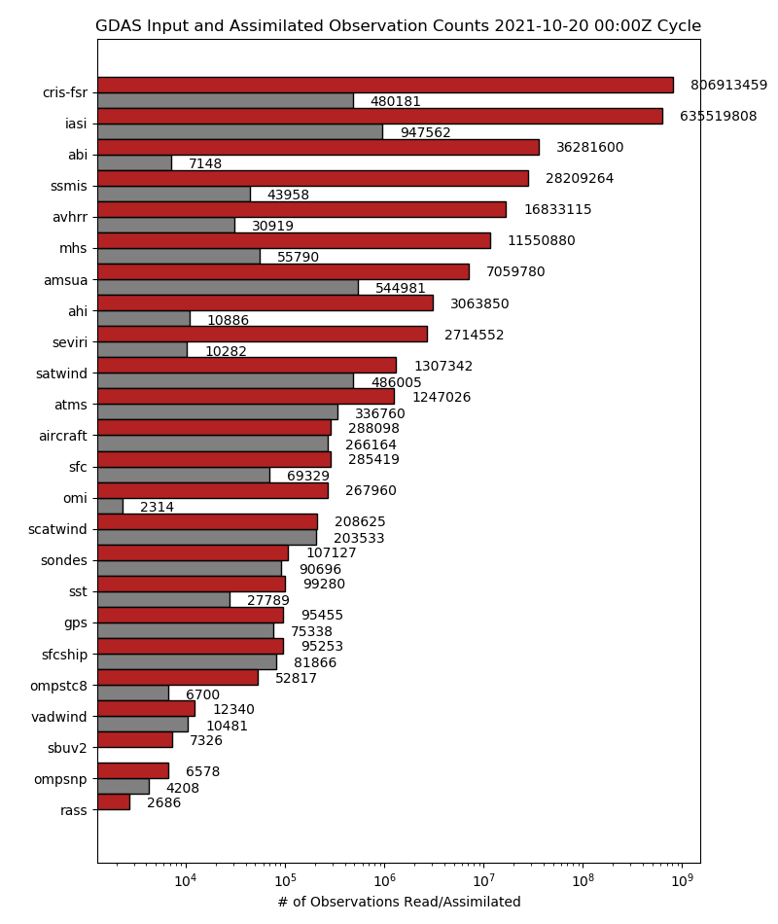
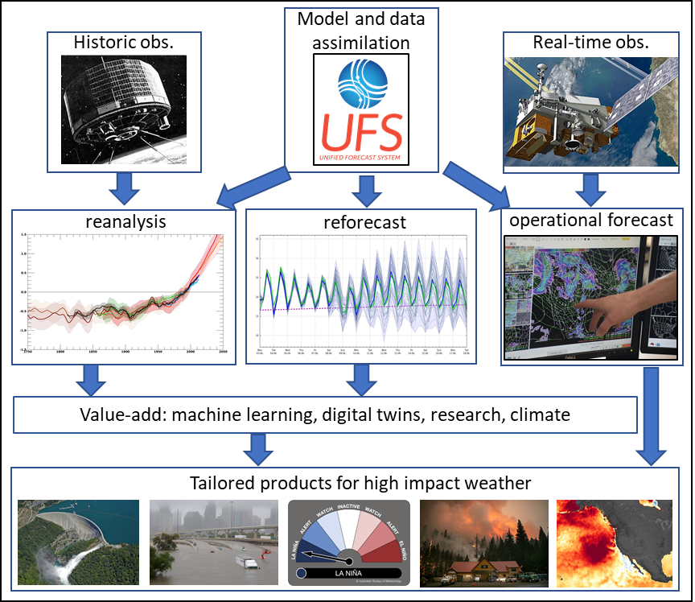
Grand Challenges
Advance science
Coupled DA
(constraints)
Strategy
Build infrastructure
Develop new tools (ML)
Make research and operations seamless
Workforce transformation and capacity building
Non-linear/Non-Gaussian DA
(algorithms)
Use more obs with greater impact
Current Observations
(utilization/impact)
Data gaps
(in-situ ocean)
Fully Coupled and Continuous Earth-system DA
New Observations
(accelerate R2O)
Improve weather, water, climate, fisheries services
Get information faster
Latency
(efficiency)
Reanalysis
(historical obs)

Slide 9
Alignment with Initiatives of Earth System Integration Board
Climate, Ecosystems and
Fisheries Initiative
Coastal Inundation at
Climate Timescales
Precipitation Prediction
Grand Challenge
CEFI Integrated Ocean Modeling and Decision Support System
Coastal Inundation Capability Objectives
PPGC Strategy
Enhance observations - ocean (deep) in-situ, high-res satellite altimetry
Enhance DA - Total Water Level/coastal, coupled DA (for trends, monitoring), AI
Coastal reanalysis - High res/40-year
Infrastructure - HPC, data flow and distribution including cloud
DA Strategy 1.1, 1.2, 1.3, 1.4, 1.5, 2.1, 2.2, 2.4, 4.5, 4.6
Fully coupled continuous DA, supporting infrastructure, cloud and AI, needed observations, HPC, central frameworks.
Improve coupled data assimilation to take advantage of existing and next gen obs
Use new and innovative observations to fill data gaps
Assess optimal observing system architectures
Develop reanalyses and reforecasts
DA Strategy 1.4, 1.5, 2.1, 2.2, 2.3, 2.4
Fully coupled continuous DA, improve use and impact of observations, needed observations and R2O roadmaps.
Enhance Observations
Enhance Ocean Modeling
CFI Information Hub
Ecosystem Prediction
Rapid Response
Climate Ready Decision Support Tools
DA Strategy 1.1, 1.2, 1.3, 1.5, 2.1, 2.2, 2.4, 4.2, 4.4, 4.5
Fully coupled continuous DA, supporting infrastructure, needed observations and R2O roadmaps, HPC.

Slide 10
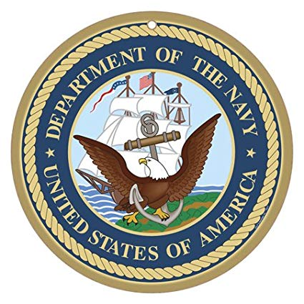
Joint Effort for Data assimilation Integration
JEDI is a project within the Joint Center for Satellite Data Assimilation (JCSDA)
JEDI provides a software infrastructure for data assimilation that
is model agnostic
is generic and portable, from toy models running on laptops to operational Earth system coupled models running in the cloud.
enables DA on the model native grid
does not impose one specific DA methodology or algorithm
provides a framework for rapid uptake of new observations into operations with generic observation handling and modeling
encourages implementation of model-independent observation operators
provides a unified Interface for Observation Data Access (IODA)
is adaptable to exascale computing
JEDI is for scientific exploration and operational forecasting.
The keys to success are separation of concerns and interfaces.
☞

Slide 11
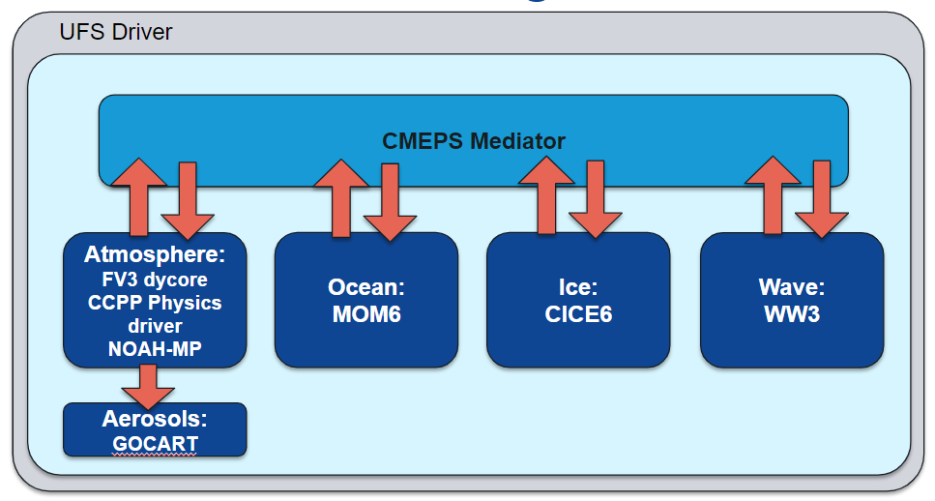
Leveraging JEDI for Coupled DA
JEDI is the foundation for our unified data assimilation strategy. Interfaces exist for most UFS-based components
FV3 (atmosphere)
MOM6 (ocean)
CICE5/6 (sea ice)
WAVEWATCHIII (waves)
GOCART and CMAQ (composition and chemistry)
Noah and noah-mp (land)
CMEPS Mediator (coupler)
In parallel to working out transition for atmospheric systems, we have begun building out “non-atmospheric” JEDI-based assimilation capabilities and those tailored for coupled assimilation.
Marine (ocean and sea ice)
Land (snow and soil moisture/temperature)
Wave (on hold)
Aerosol Optical Depth and Atmospheric Composition

Slide 12
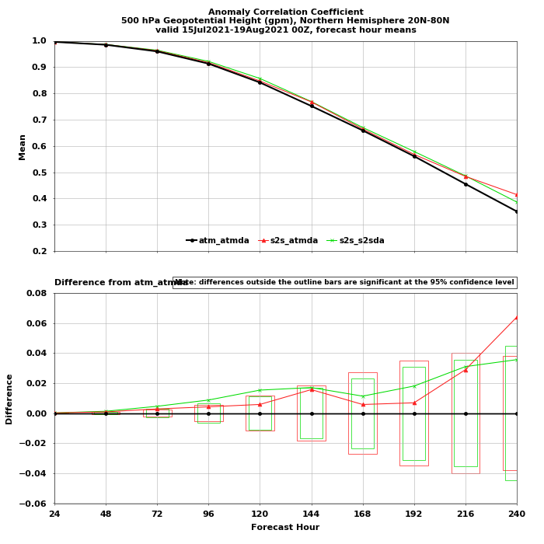
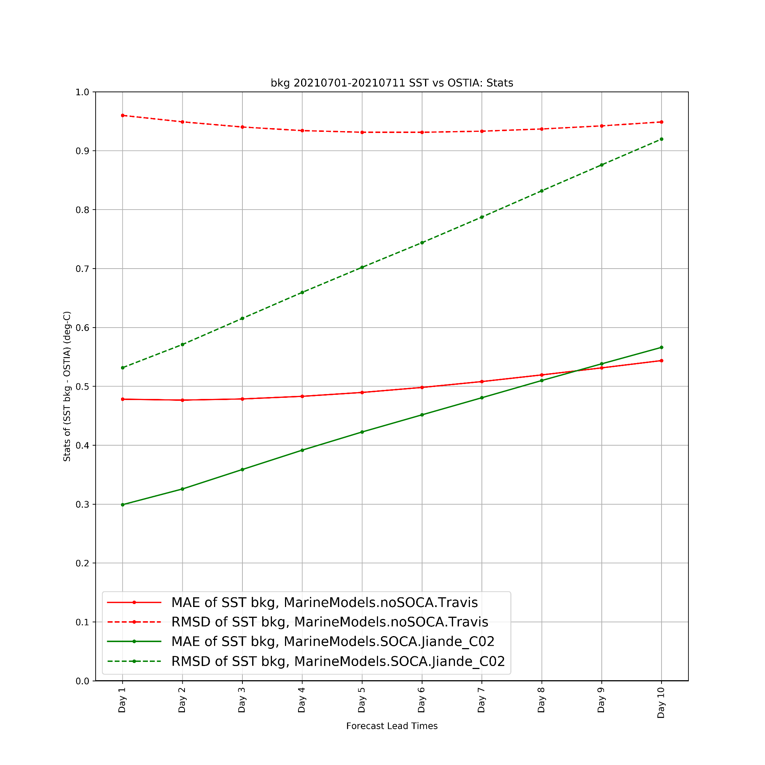
Preliminary 3DVar Cycling Results
(See Thomas et al., GFSv17 Overview)
ATM model, ATM DA
S2S model, ATM DA
S2S model,
S2S DA
Mean stats per lead time for July 1-11, 2021
500 hPa NH ACC
SST vs. OSTIA
Figure courtesy of Katie Lukens
Figure courtesy of Xuanli Li
Valid for 60°S-60°N
Evaluation is ongoing, but initial cycling results with OCN/ICE DA are encouraging.

Slide 13
Summary
Data Assimilation is critical for the success of UFS and improving predictive capabilities
NWS/NCEP/EMC Strategy published; NOAA Strategy going through final review
Time for execution
Unified Infrastructure and Workforce are major themes
JEDI readiness is accelerating, but more work to do
Workforce is evolving; looking forward to TDSA and CADRE collaboration to set stage for the future
Technological advancements are accelerating – need to be proactive, not reactive
AI/ML isn’t coming, it’s already here.

