Slide 1
UFS forecast model evaluation and improvement for S2S hydrometeorological prediction in the Western United States
Andrew Newman¹, Yifan Cheng¹, Andrew Bennett², Arezoo RafieeiNasab¹, Thomas Enzminger¹, Kathryn Newman¹, Ethan Gutmann¹, Andrew Wood¹, Mike Barlage³
¹ NSF National Center for Atmospheric Research
² Department of Hydrology and Atmospheric Sciences, University of Arizona
³ NOAA GSL (previously NOAA EMC)

Slide 2
Outline
Motivation
Iterative Noah-MP testing
Information theory diagnostics
Initial progress
UFS Land-Verification in METplus

Slide 3
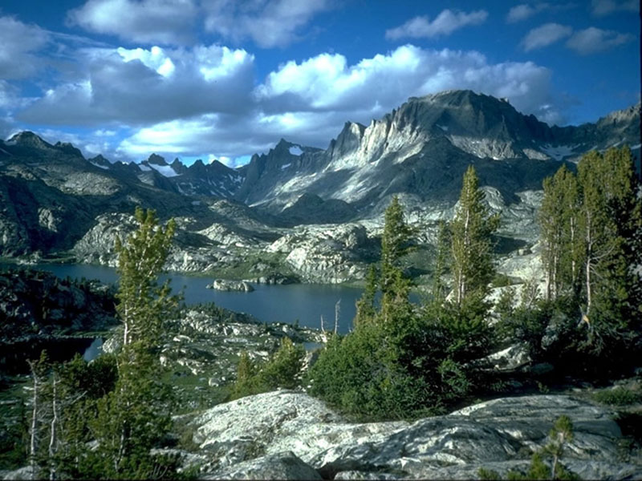
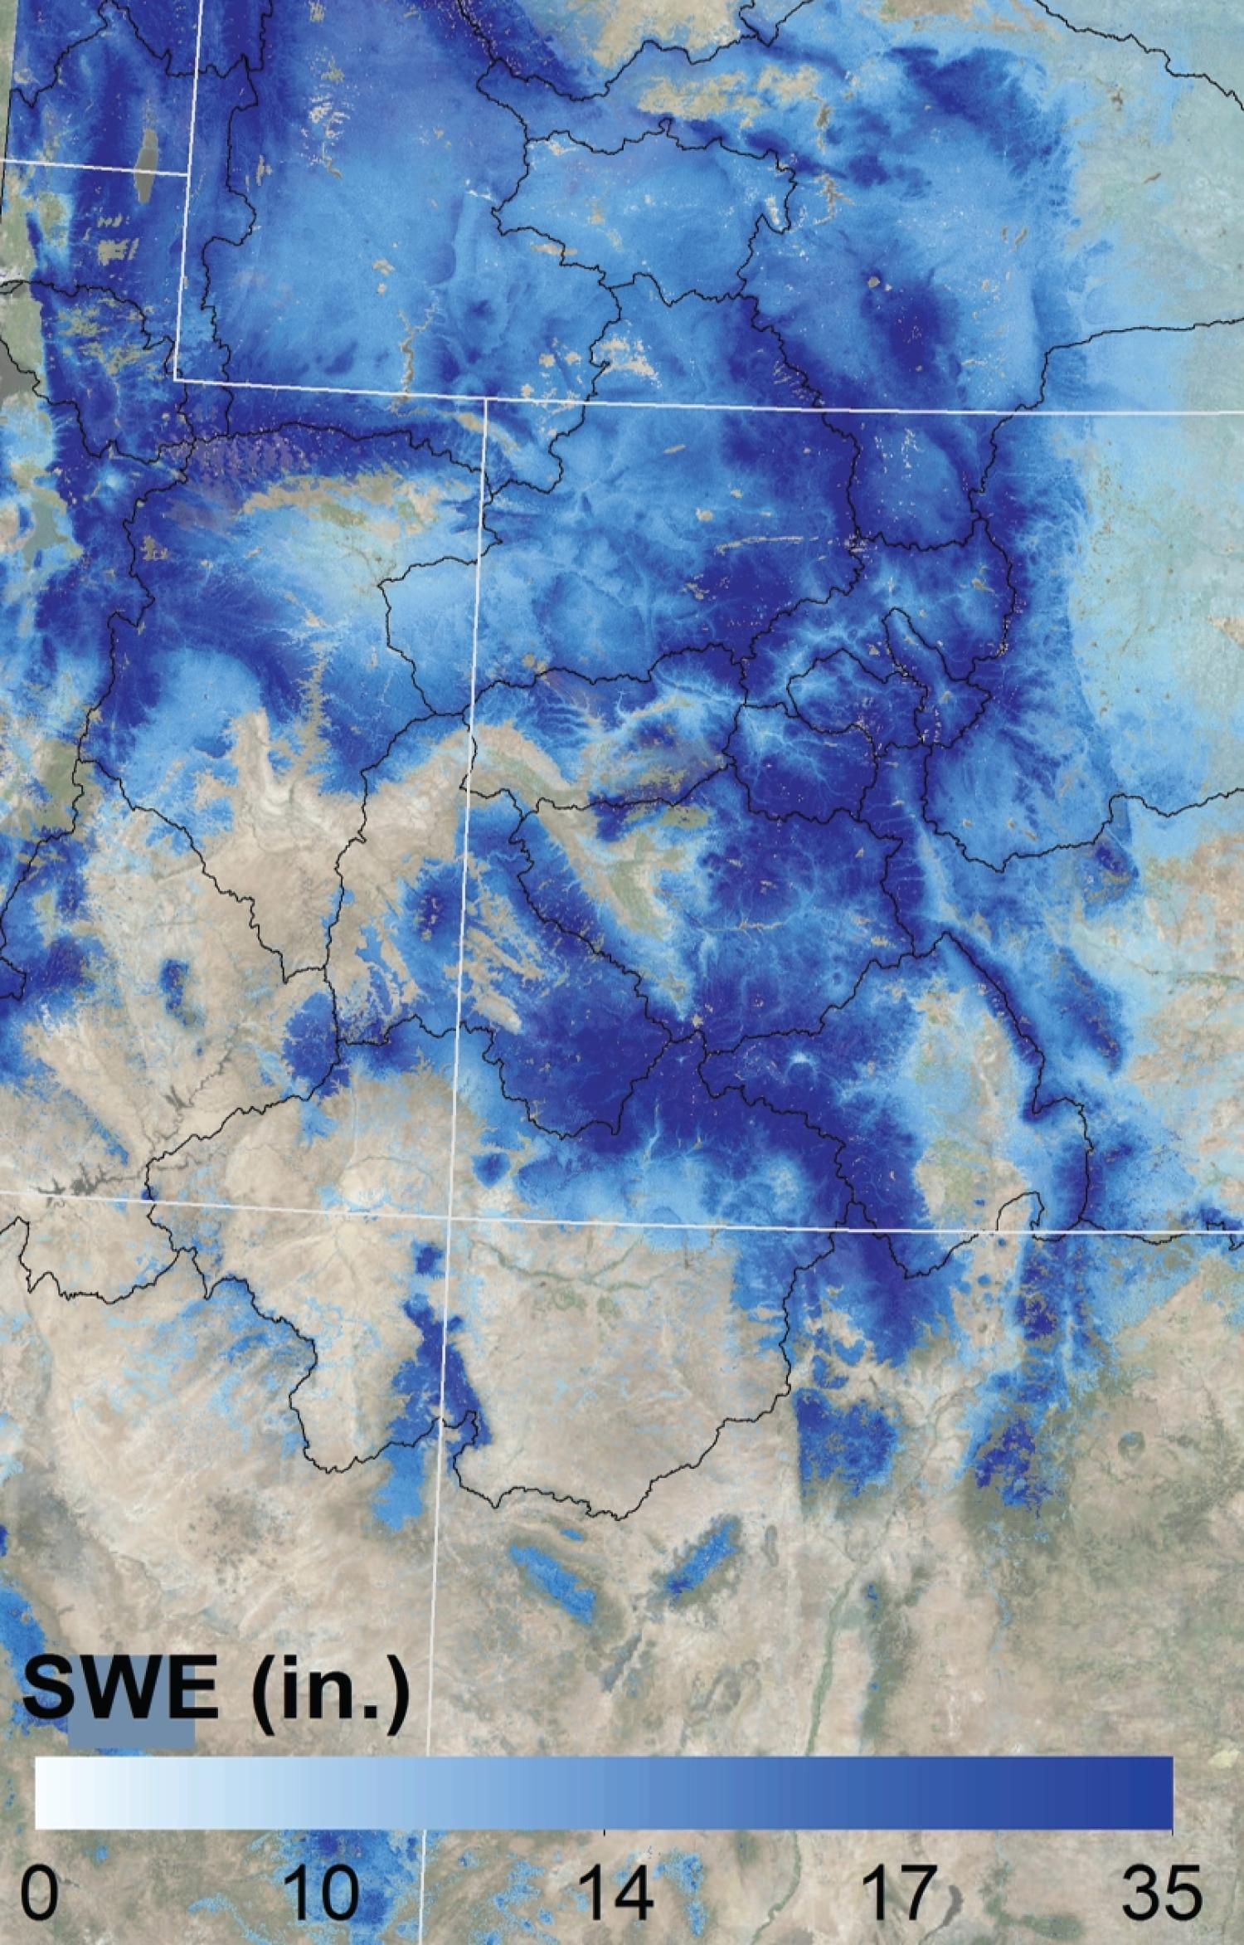
Motivation
NOAA Unified Forecast System (UFS)
Western US hydrometeorology subseasonal to seasonal (S2S) area
Streamflow, soil and snow states, precipitation
S2S forecasts provide an opportunity to mitigate extreme events, improve resource allocation equity
Intermountain west hydrometeorological has local S2S predictability sources
Land state evolution
Local land-atmosphere feedbacks
Above: Wind River Range, WY, photo from USFS, Scott Clemons
Left: Intermountain west SWE from Mountain Hydrology Group, Univ. Colorado-Boulder, Noah Molotch lead

Slide 4
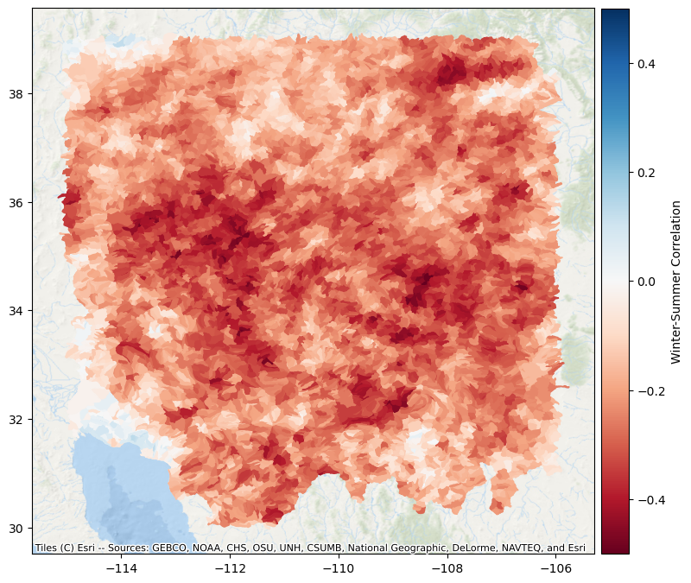
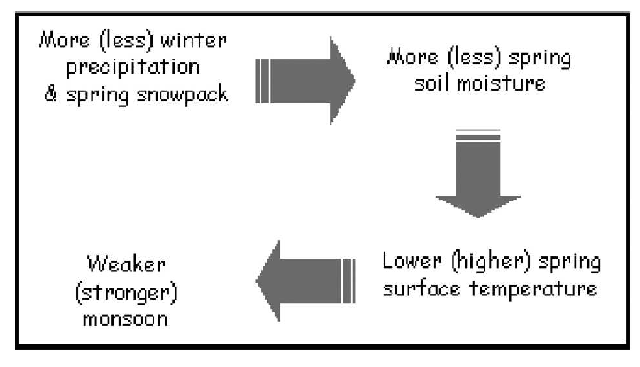
Local Western US Hydrometeorological Predictability
Land states and their evolution play a key role
Hydrological predictability
Soil moisture partitioning (runoff/ET)
Evolution of summer monsoon
Land-atmosphere interactions
Winter – Summer Precipitation Correlation
From Zhu et al. (2005)

Slide 5
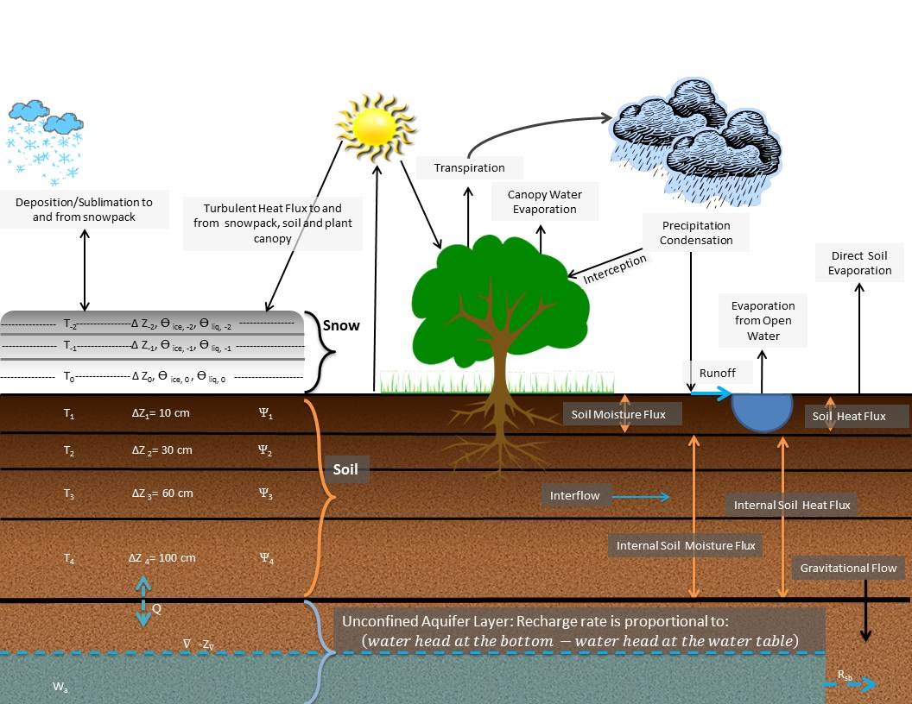
Motivation
Noah-MP is the target LSM for future versions of multiple UFS applications
Noah-MP offers substantial process and parameterization upgrades over Noah
Widely utilized in the research community –> Research to Operations to Research (R2O2R) potential
From Noah-MP User’s website, UT-Austin

Slide 6
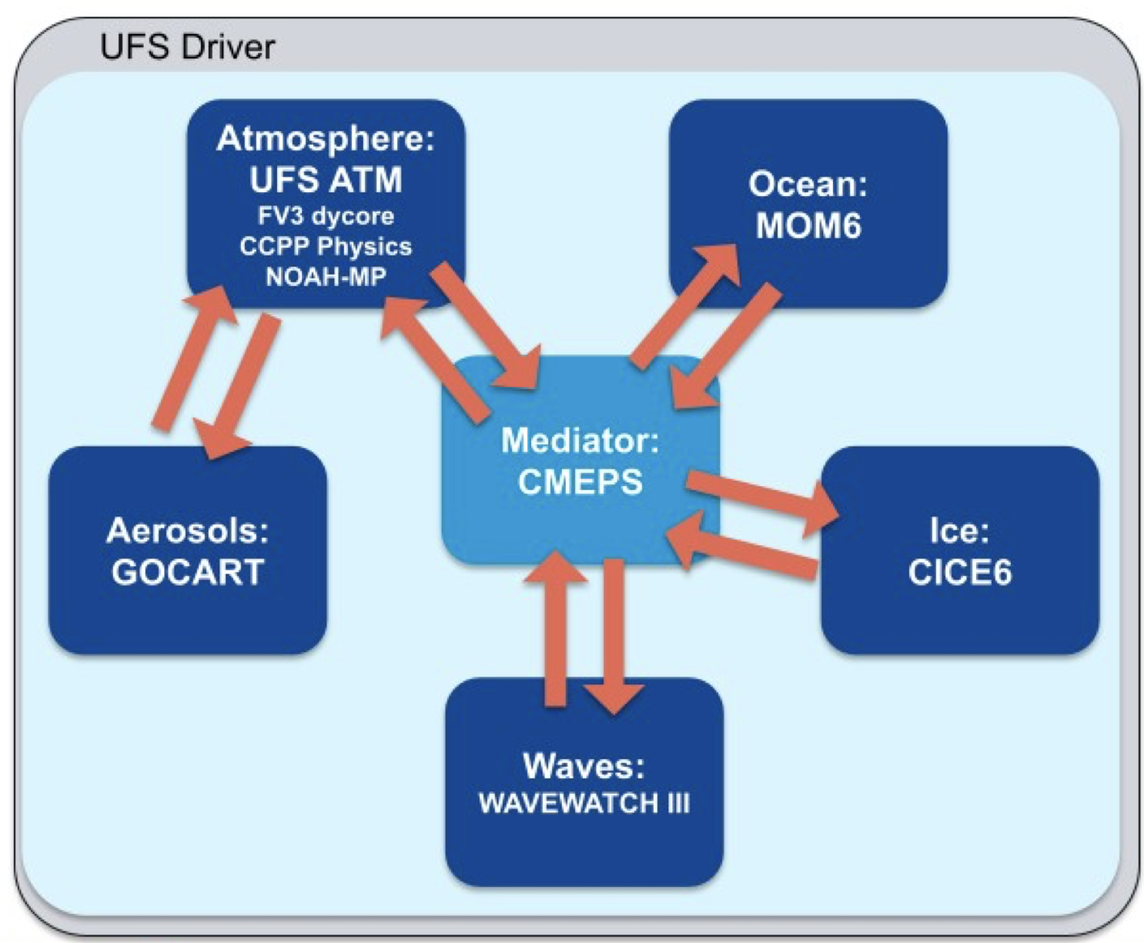
Motivation
UFS Coupled System
Noah-MP behavior is less known within UFS
Coupled model evaluation is difficult and time consuming
Focus on Noah-MP and land-atmosphere coupling
2-5 week lead forecasts
Explore formal Noah-MP optimization offline and within single column model
Rapid iteration of test configurations
Novel evaluation using information theory
Explore causality and connectivity
Provide potential Noah-MP updates to NCEP
From UFS Website
Notes:
FY24-FY25 project

Slide 7
Noah-MP Testing
Noah-MP has significantly more parameters and parameterizations than Noah
Ours and other projects are exploring parameter sensitivity and optimization within UFS
From Cuntz et al. (2016) JGR-A

Slide 8
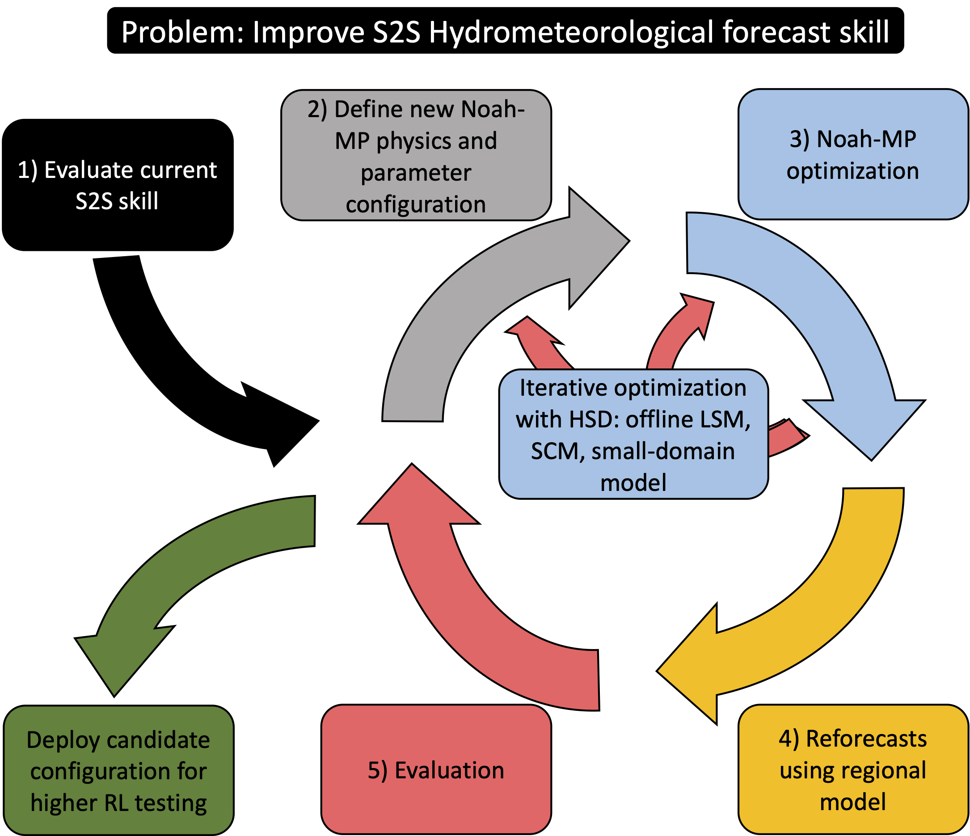
Noah-MP Testing
Noah-MP has significantly more parameters and parameterizations than Noah
Need to have methods and workflows to iteratively test and optimize complex component models
Outcome: Develop community available methods and workflows for rapid hydrometeorological optimization and evaluation

Slide 9
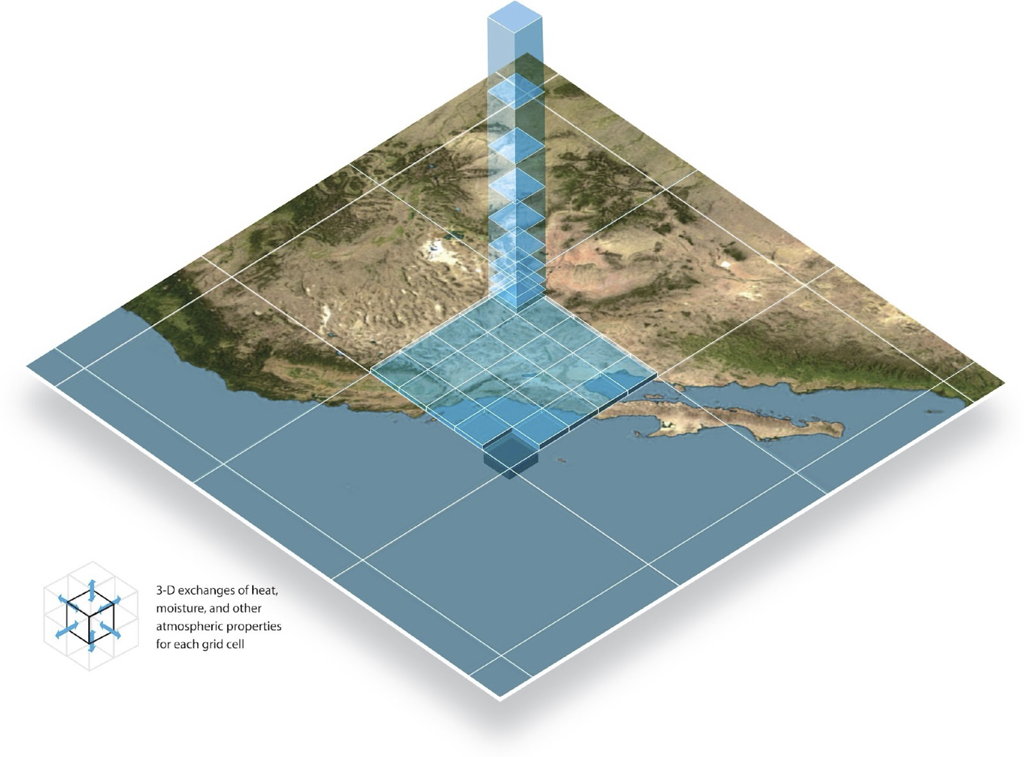
Noah-MP Testing
Leverage concepts and capabilities within the NWP and UFS communities
Hierarchical System Development (lower left and center panels)
Offline, single column model (lower right panel), regional domain modeling
Outcome: Develop candidate Noah-MP configurations tested through regional modeling (RL 4-5)
From Ek et al. (2022) From L. Bernardet (NOAA)

Slide 10
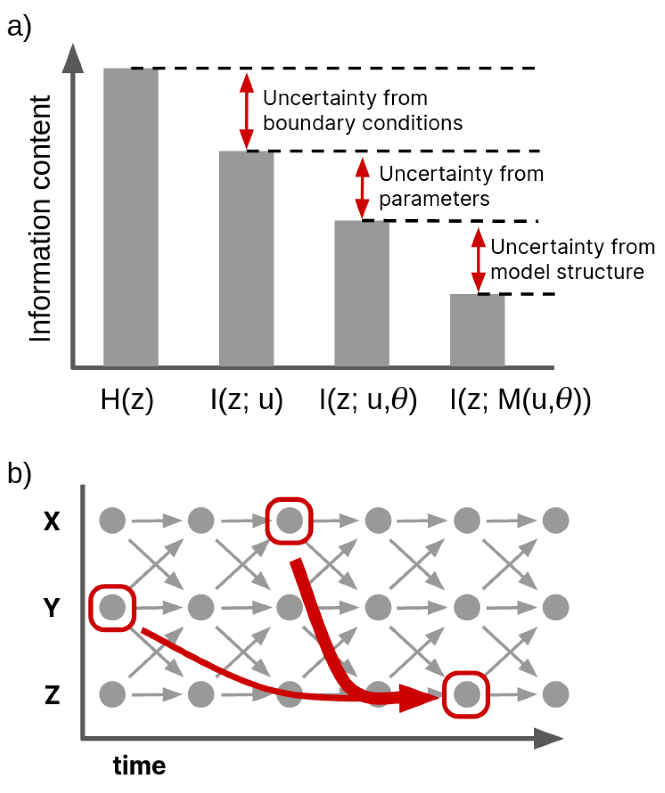
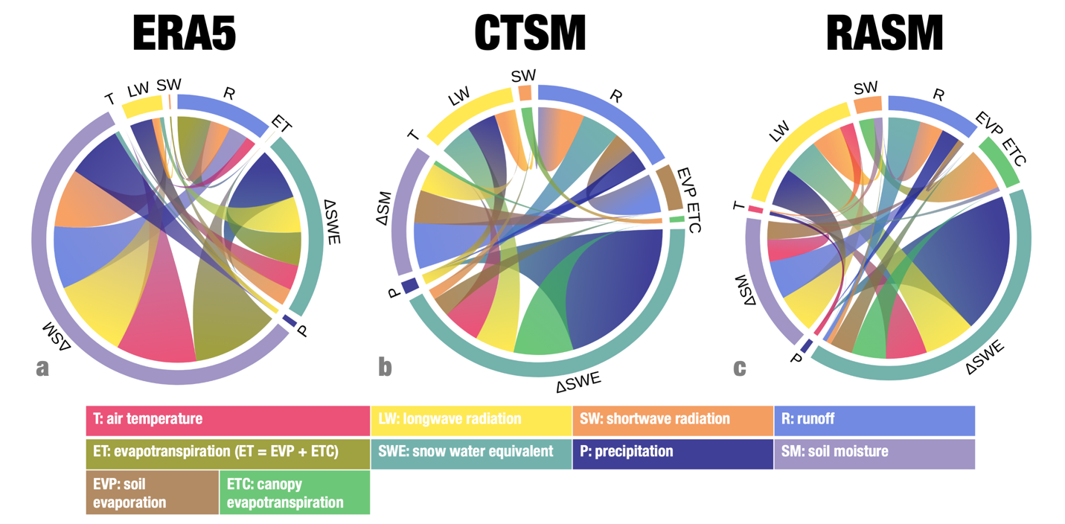
Information Theory Diagnostics
Information Theory (IT) provides statistical framework for deeper understanding of model biases and process behavior
Diagnose information content (left panel a)
Time-lagged process interactions (left panel b)
Flow of information (below)
From Nearing et al. (2016) From Cheng et al. (2024)

Slide 11
Initial Progress
Compiling observational datasets for model verification, optimization, and initial IT diagnostic comparisons
Building out computational infrastructure
Selecting initial Noah-MP optimization sites for land-atmosphere interaction work
Selecting initial sites and watersheds for hydrologic optimization
From Moon et al. 2022

Slide 12
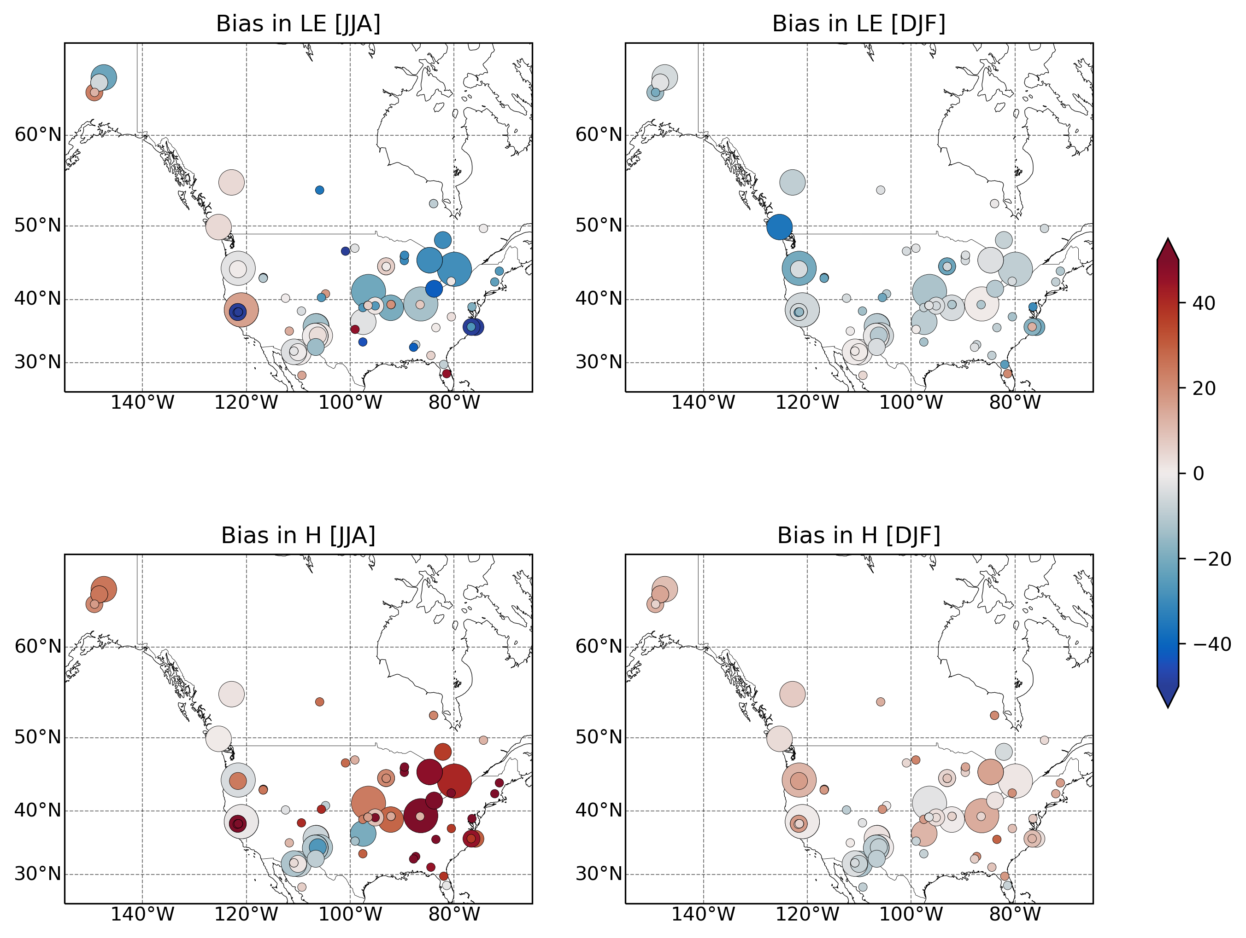
Initial Progress
Point-scale experiments for Ameriflux sites
88 Ameriflux sites were selected
Set up workflow for model spin-up using UFS-land-driver
Conduct model runs for all selected sites
Right plots show seasonal biases in latent heat fluxes (LE) and sensible heat fluxes (H)
Developing community tools to easily modify Noah-MP parameters for parameter tuning work
W/m²

Slide 13
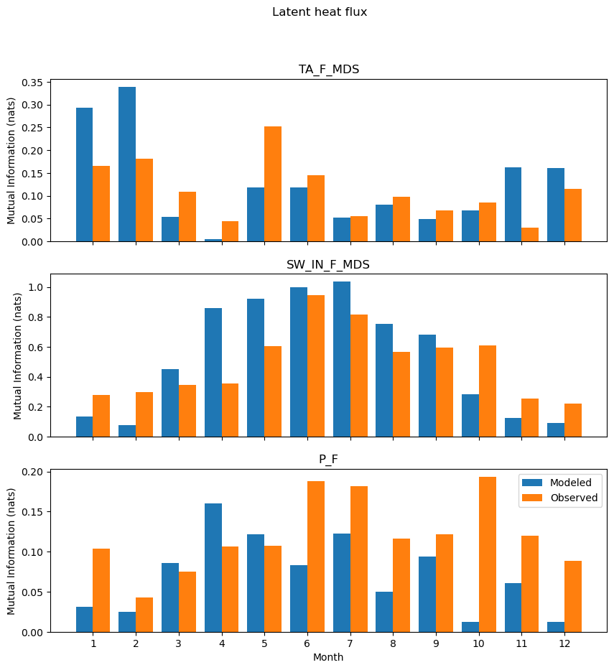
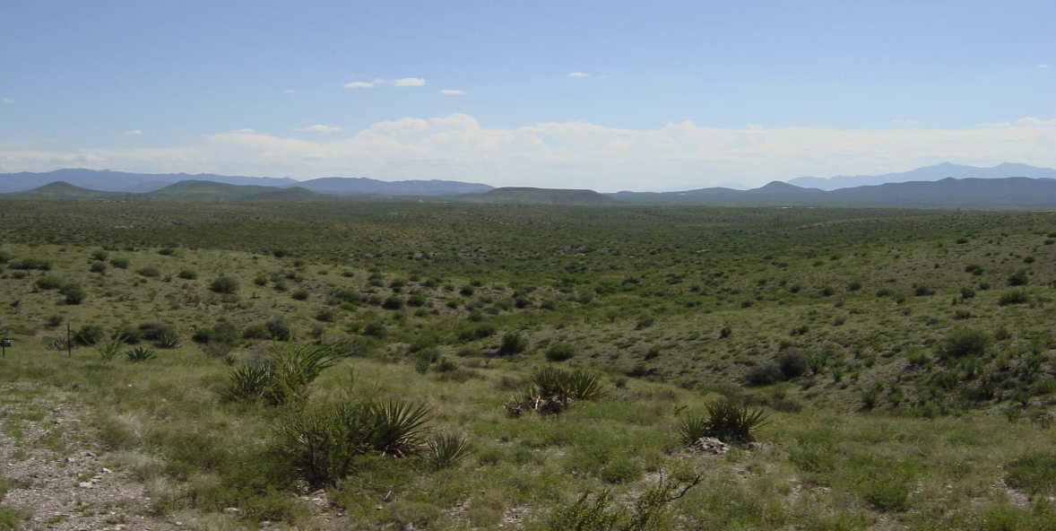
Initial Progress
Temperature
Initial workflows for process diagnostics underway
Arid site test case: Walnut Gulch in Arizona
IT analysis suggests errors driven by
Energy balance in late winter/spring
Water balance in monsoon and winter
Shortwave
Precipitation

Slide 14
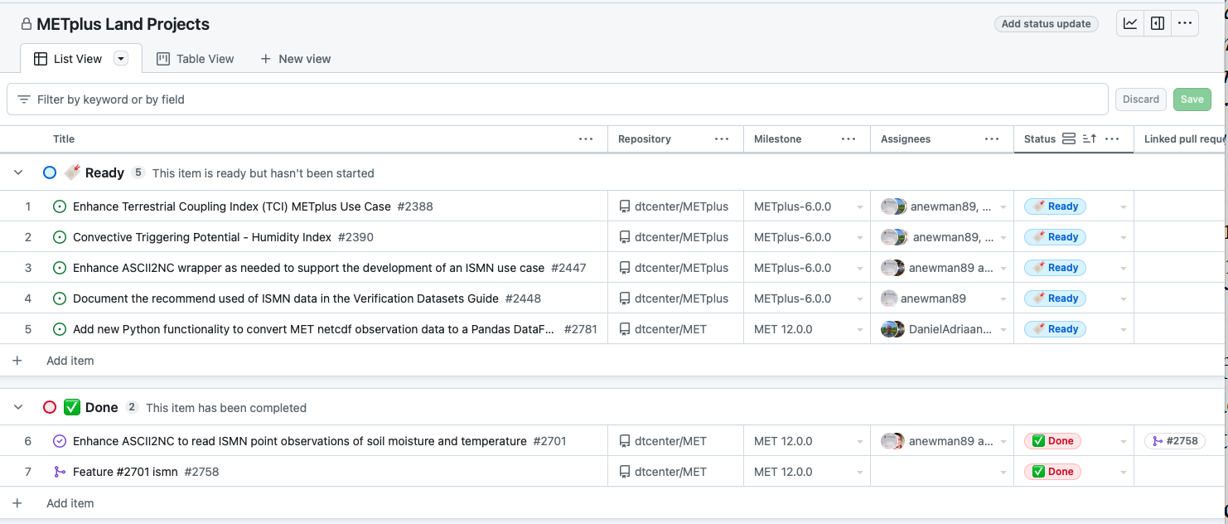
METplus Land Verification
Many projects examining Noah-MP and land-atmosphere coupling across UFS and other systems
Several are directly developing METplus land and land-atmosphere diagnostic and verification capabilities

Slide 15
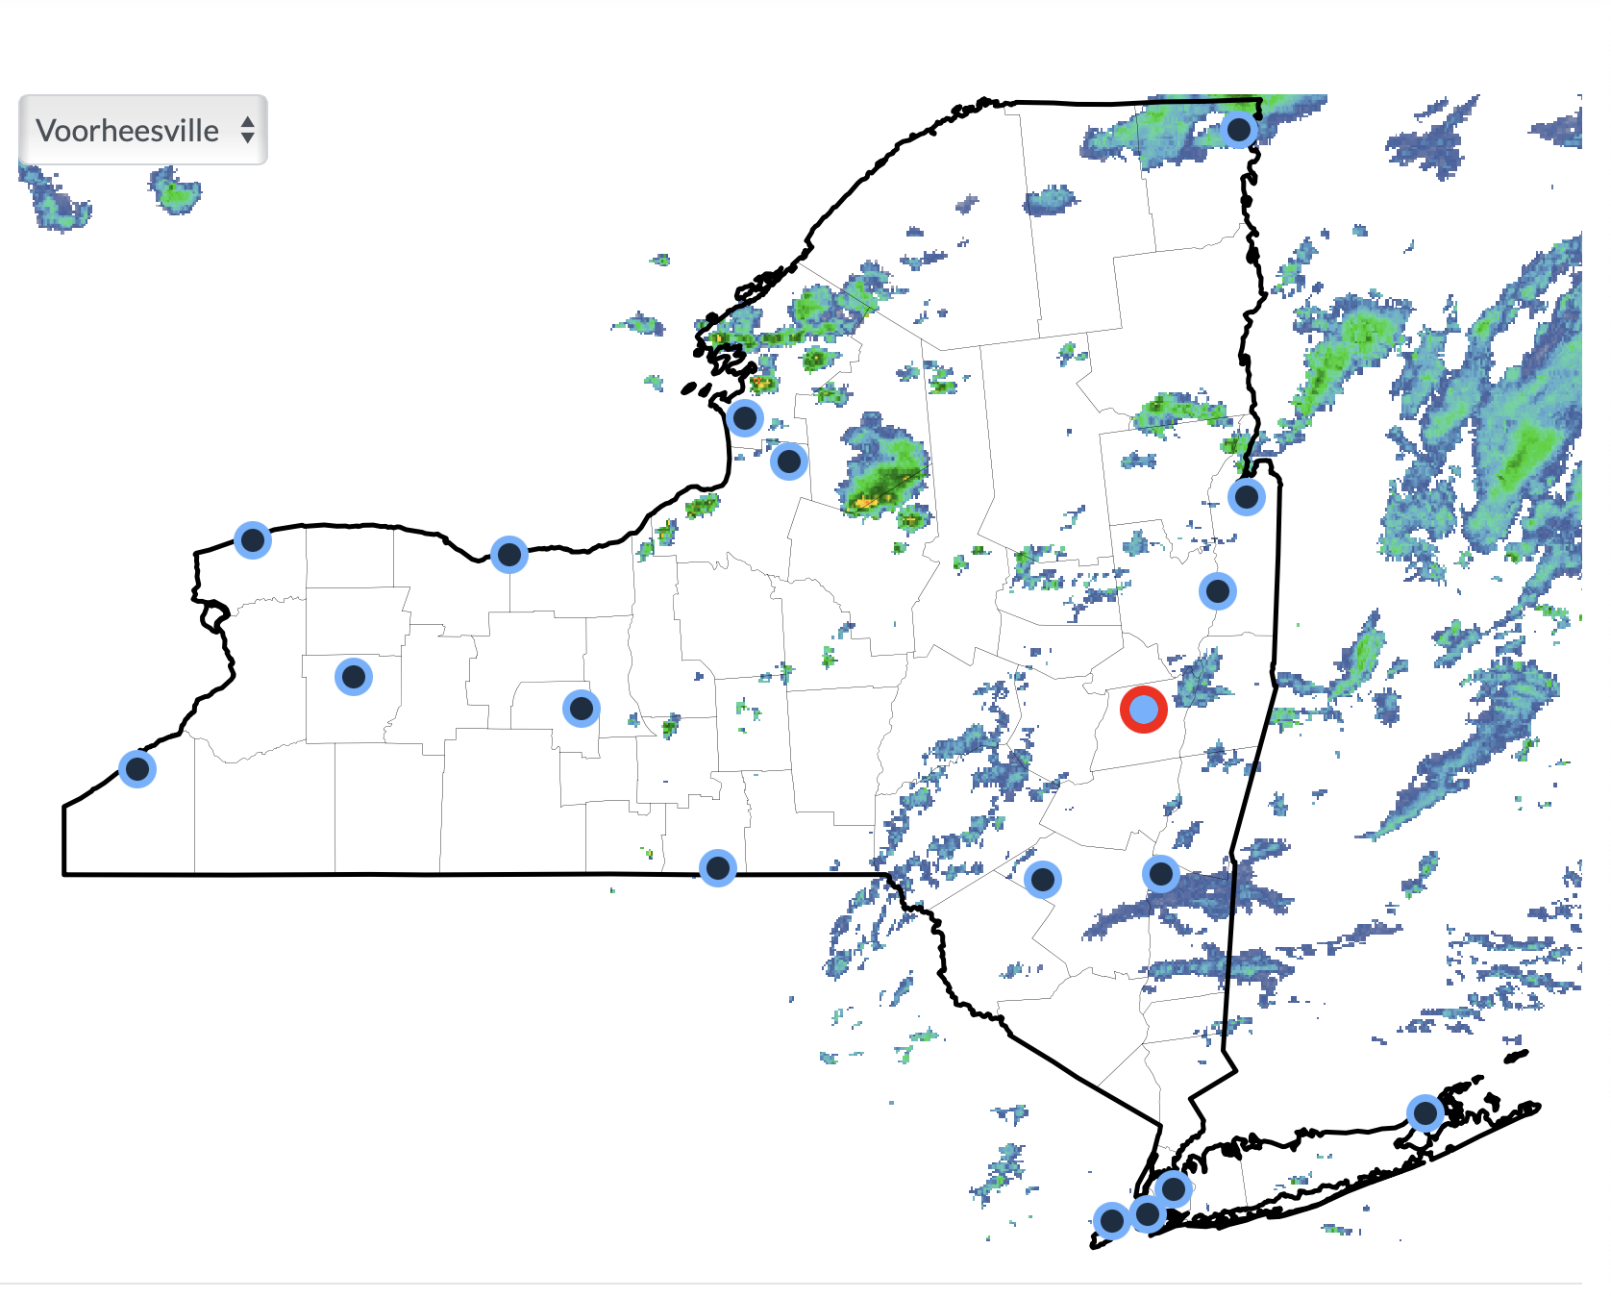
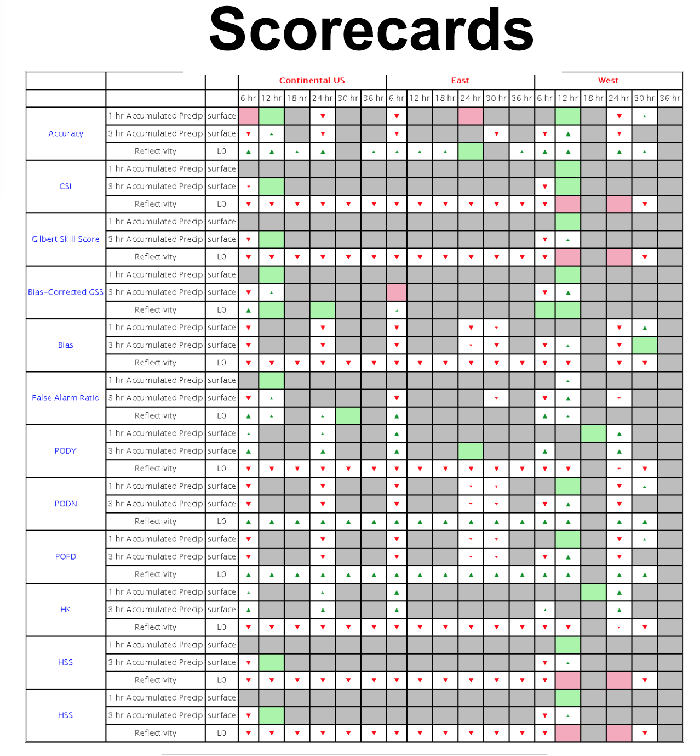
METplus Land Verification
nysmesonet.org
Adding capabilities to MET and METplus
Support for International Soil Moisture Network (ISMN), SCAN, USCRN, NY State Mesonet in METplus
METplus workflows for land-focused verification
Near-real time demonstration using NY State Mesonet (Anna Glodzik’s Tuesday student presentation on NYSM)
Soil moisture, temperature, fluxes, other diagnostics of interest

Slide 16
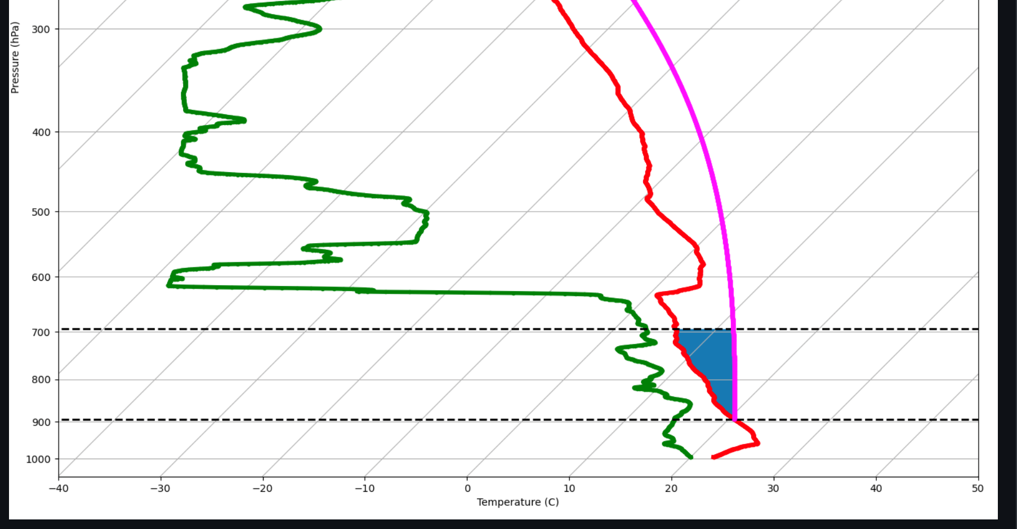
METplus Land Verification
Example CTP Calculation
Convective Triggering Potential – Humidity Index (Findell and Eltahir 2003)
Terrestrial Coupling Index (Dirmeyer 2011)
Vegetation Atmosphere Coupling (Zscheischler et al. 2015)
Others planned over the next year
JJA TCI CESM & FLUXNET2015

Slide 17
Summary
Developing community available methods and workflows for rapid hydrometeorological optimization and evaluation
Developing candidate Noah-MP configurations tested from offline land model through regional land-atmosphere coupled model (~RL 4-5)
Develop improved process and model behavioral understanding using IT
Connect to METplus land and land-atmosphere diagnostic developments
Connect to other NOAA land efforts across applications where relevant

