Slide 1


Unifying Innovations in Forecasting Capabilities Workshop
A Unified Forecast System (UFS) Collaboration Powered by the Earth Prediction Innovation Center (EPIC)
JULY 24th, 2024
Jackson State University Student Center
July 22 - 26, 2024

Slide 2
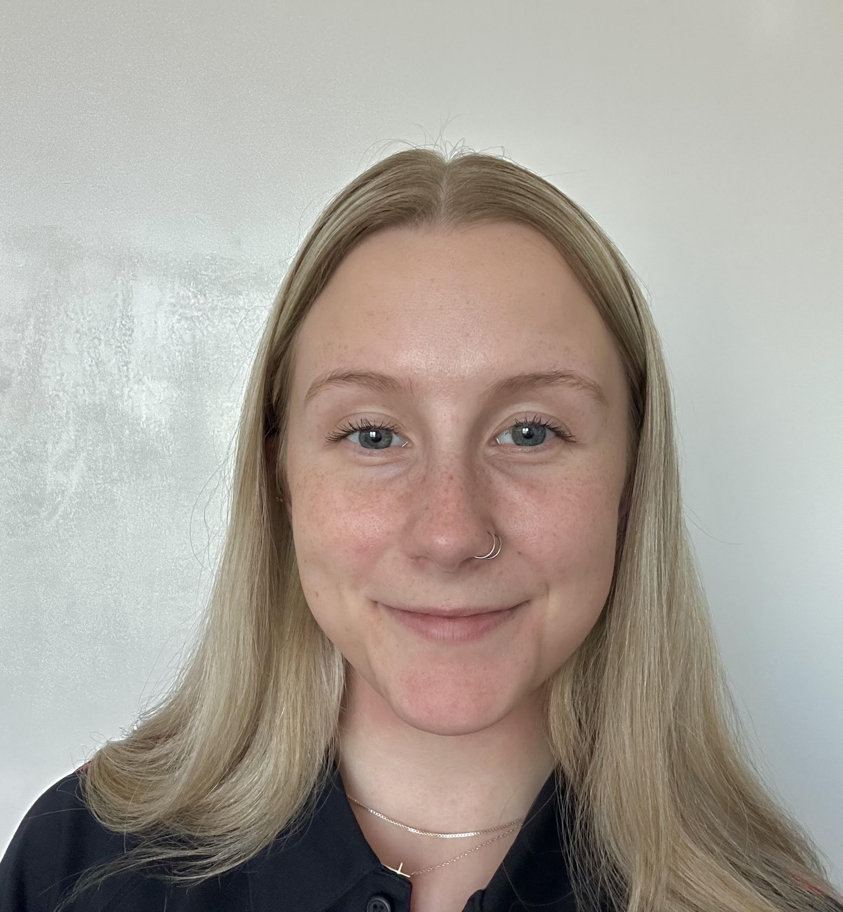
Today’s Master of Ceremonies
Samantha Lang
William M. Lapenta Intern
EPIC

Slide 3
Live Streaming Announcement
The UIFCW is an open event that will be live-streamed online and recorded. By staying in the room (and online), you understand that your image, in video or still, and any sound recorded alongside it, will live-streamed over social media and recorded. The videos will be submitted to NOAA for review before sharing publicly. The information that you provide will be used for websites, agenda's, and event descriptions.
For more information on NOAA's Privacy policy: https://www.noaa.gov/sites/default/files/legacy/document/2021/Mar/NOAAPrivacyPolicy_Final_May2017.pdf

Slide 4
Wednesday, July 24th
9:00 AM – 9:05 AM – Welcome & Kickoff
9:05 AM – 11:00 AM – Parallel Sessions with Q&A
UFS Application – Medium Range Weather (MRW), Subseasonal-to-Seasonal (S2S) and SFS Applications (A&B Ballroom)
Cross-Cutting – System Architecture (Theatre)
Advancing UFS Applications – Air Quality (Senate Chamber)
11:00 AM – 11:15 AM – Break
11:15 AM - Virtual Poster Slam begins concurrently with In-Person Poster Session
11:15 AM – 12:00 PM – In-Person Poster Session (can continue into lunch)
12:00 PM – 1:00 PM - Lunch

Slide 5
Wednesday, July 24th
1:15 PM – 3:30 PM – Parallel Sessions with Q&A
(A&B Ballroom) – UFS Application – Hurricane Analysis and Forecast System (HAFS)
(Theatre) – Advancing UFS Applications – Coastal, Marine, and Space Weather
(Senate Chamber) – Cross-Cutting – Physics, Verification & Validation, Followed by Cross-Cutting – Dynamics and Nesting
3:30 PM – 3:45 PM – Break
3:45 PM – 4:15 PM – A Social Science Approach to Unified Community Modeling
4:15 PM – 4:45 PM – Status Update on MPAS from Across Organizations & Moderated Discussion
5:15 PM – 5:45 PM – Future Plan for Weather and Climate Modeling (GFS, GEFS, S2S, SFS)
5:45 PM – Adjourn

Slide 6


Connect With Us!
Connect with us on Slack, X, and Instagram with #UIFCW24
UIFCW24 Slack workspace
X (Twitter): @NOAAEPIC
Instagram: @NOAAEPIC
Wi-Fi: NOAA_GUEST
Password: NoAa@J$Uz4

Slide 7

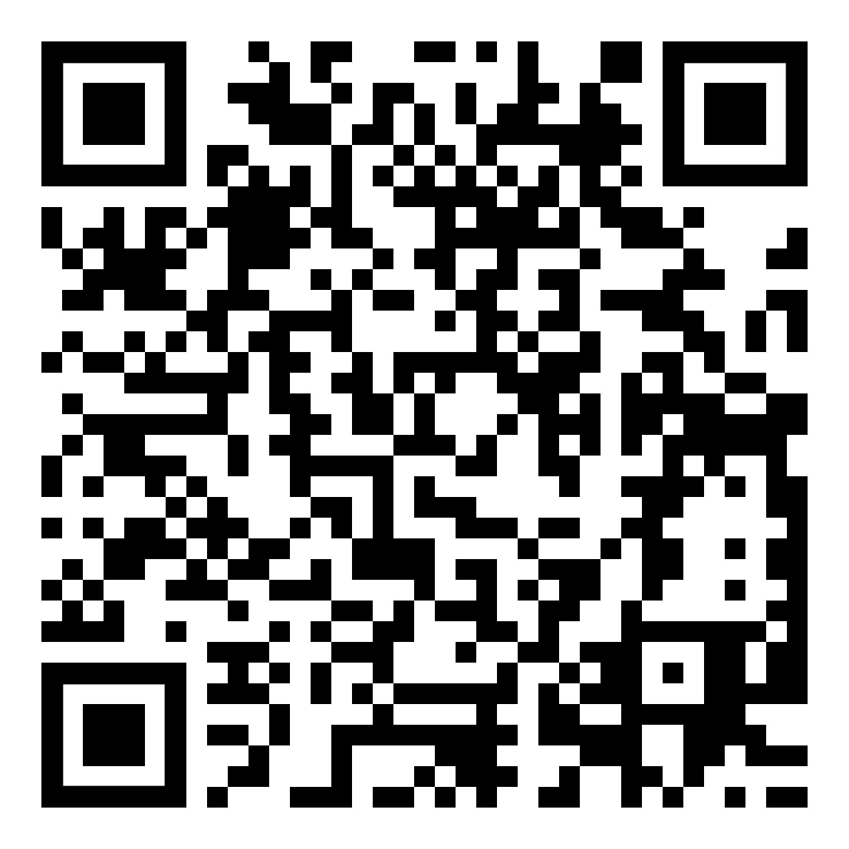
UIFCW Event Guide
UIFCW Slack Space

Slide 8
UIFCW Event Guide
[QR Code]

