Slide 1


Unifying Innovations in Forecasting Capabilities Workshop
A Unified Forecast System (UFS) Collaboration Powered by the Earth Prediction Innovation Center (EPIC)
JULY 25th, 2024
Jackson State University Student Center
July 22 - 26, 2024

Slide 2
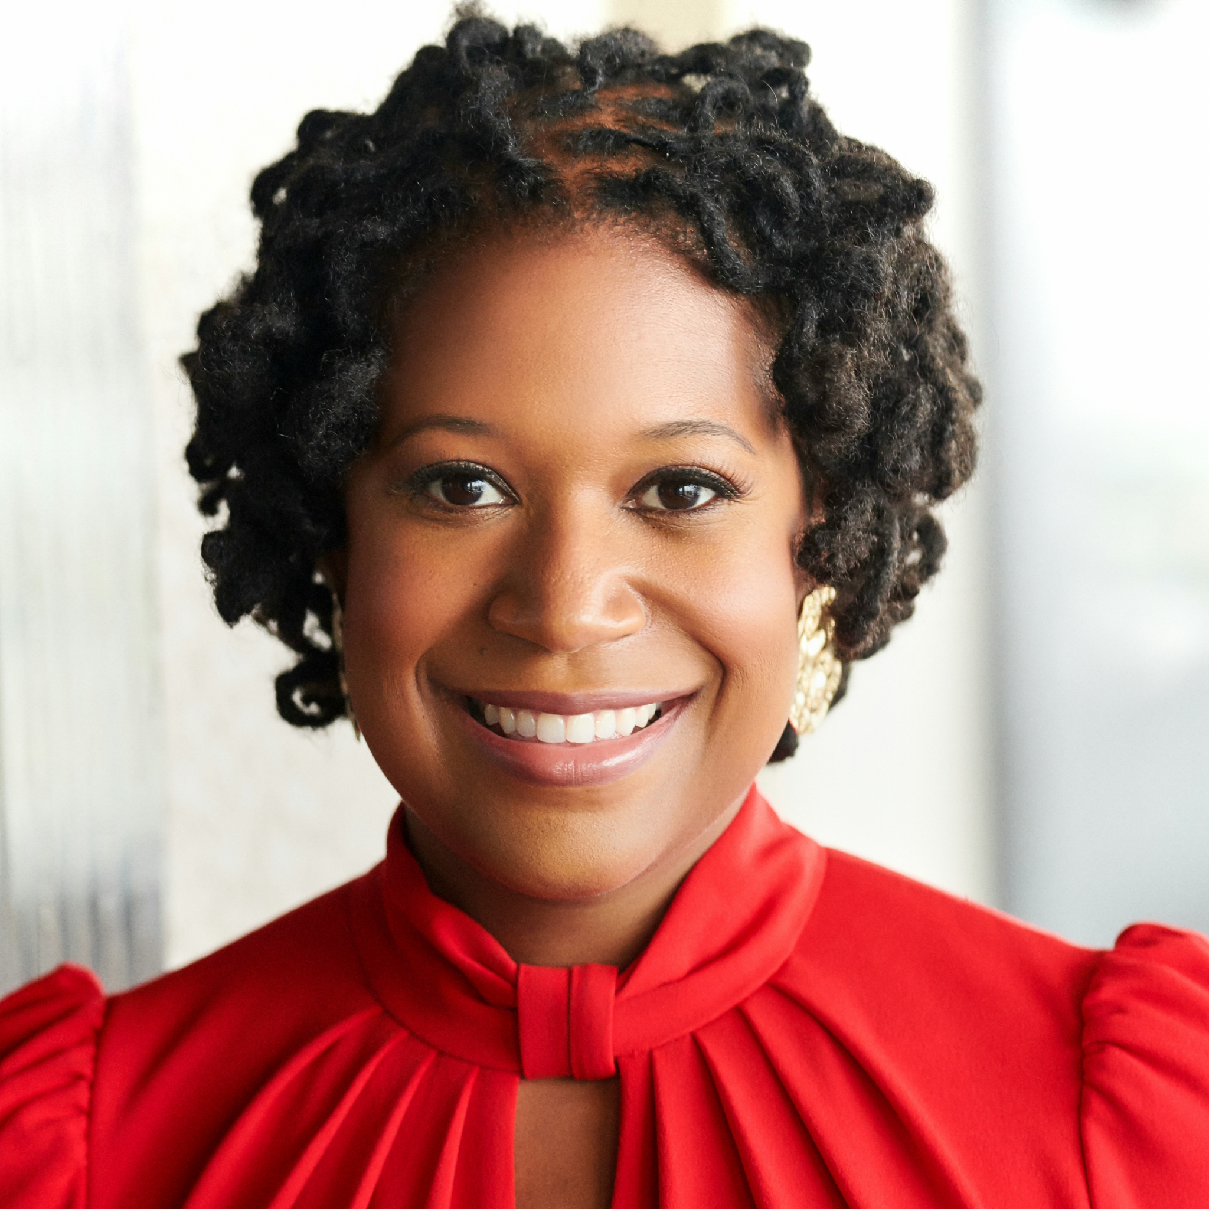
Today’s Master of Ceremonies
Jamese Sims
Owner and CEO
Three Anomaly, LLC

Slide 3
Live Streaming Announcement
The UIFCW is an open event that will be live-streamed online and recorded. By staying in the room (and online), you understand that your image, in video or still, and any sound recorded alongside it, will live-streamed over social media and recorded. The videos will be submitted to NOAA for review before sharing publicly. The information that you provide will be used for websites, agenda's, and event descriptions.
For more information on NOAA's Privacy policy: https://www.noaa.gov/sites/default/files/legacy/document/2021/Mar/NOAAPrivacyPolicy_Final_May2017.pdf

Slide 4
Thursday, July 25th
9:00 AM – 9:05 AM – Welcome & Kickoff
9:05 AM – 10:30 AM – Round-Table Discussion on Community Modeling Including Focus Groups
10:30 AM – 11:00 AM – Invited Student Presentations
11:00 AM – 11:15 AM – Break
11:15 AM – 12:00 PM – Operationalizing “Cool” for the UFS
12:00 PM – 1:00 PM - Lunch

Slide 5
Thursday, July 25th
1:00 PM – 3:30 PM – Parallel Sessions with Q&A
UFS Application – Short Range Weather (SRW) Application and Rapid Refresh Forecast System (RRFS) (A&B Ballroom)
UFS Application – Oceans and Ecology (Theater)
UFS Application - Land/Surface Models, Followed by Cross-Cutting – Data Assimilation (Senate Chamber)
3:30 PM – 3:45 PM - Break
3:45 PM – 4:45 PM - Emerging Technologies: AI/ML
4:45 PM – 6:15 PM Research to Operations (R2O) and Operations to Research (O2R): How Innovations Move Through the Funnel
6:15 PM – Adjourn

Slide 6


Connect With Us!
Connect with us on Slack, X, and Instagram with #UIFCW24
UIFCW24 Slack workspace
X (Twitter): @NOAAEPIC
Instagram: @NOAAEPIC
Wi-Fi: NOAA_GUEST
Password: NoAa@J$Uz4

Slide 7

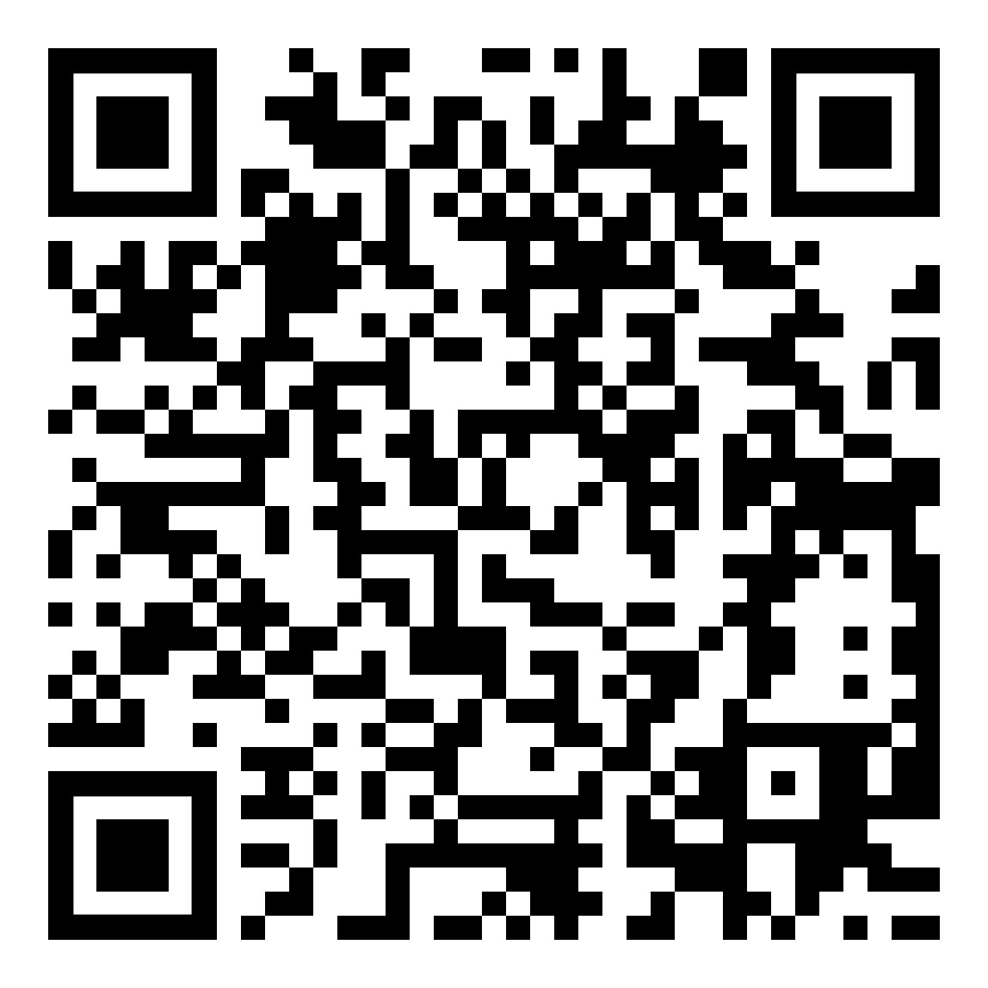
UIFCW Event Guide
UIFCW Slack Space

Slide 8
UIFCW Event Guide
[QR Code]

