Slide 1


Unifying Innovations in Forecasting Capabilities Workshop
A Unified Forecast System (UFS) Collaboration Powered by the Earth Prediction Innovation Center (EPIC)
JULY 26th, 2024
Jackson State University Student Center
July 22 - 26, 2024

Slide 2
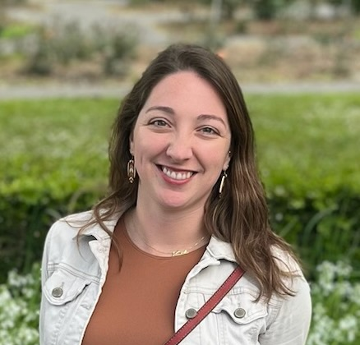
Today’s Master of Ceremonies
Alison Gregory
Community Engagement Specialist for the Unified Forecast System
UCAR | CPAESS

Slide 3
Live Streaming Announcement
The UIFCW is an open event that will be live-streamed online and recorded. By staying in the room (and online), you understand that your image, in video or still, and any sound recorded alongside it, will live-streamed over social media and recorded. The videos will be submitted to NOAA for review before sharing publicly. The information that you provide will be used for websites, agenda's, and event descriptions.
For more information on NOAA's Privacy policy: https://www.noaa.gov/sites/default/files/legacy/document/2021/Mar/NOAAPrivacyPolicy_Final_May2017.pdf

Slide 4
Friday, July 26th
9:00 AM – 9:05 AM – Welcome & Kickoff
9:05 AM – 9:15 AM – NOAA Data Assimilation Strategy
9:15 AM – 10:45 AM – Updates and Challenges for Data Assimilation
10:45 AM – 11:15 AM – Coffee Break / Land DA System Demo (Theatre Room)
11:15 AM – 12:00 PM – Panel Discussion on Partnerships: How to Expand Our Community
12:00 PM – 12:30 PM - Debrief: Findings, Recommendations and Closing Statements
12:30 PM - Adjourn

Slide 5


Connect With Us!
Connect with us on Slack, X, and Instagram with #UIFCW24
UIFCW24 Slack workspace
X (Twitter): @NOAAEPIC
Instagram: @NOAAEPIC
Wi-Fi: NOAA_GUEST
Password: NoAa@J$Uz4

Slide 6

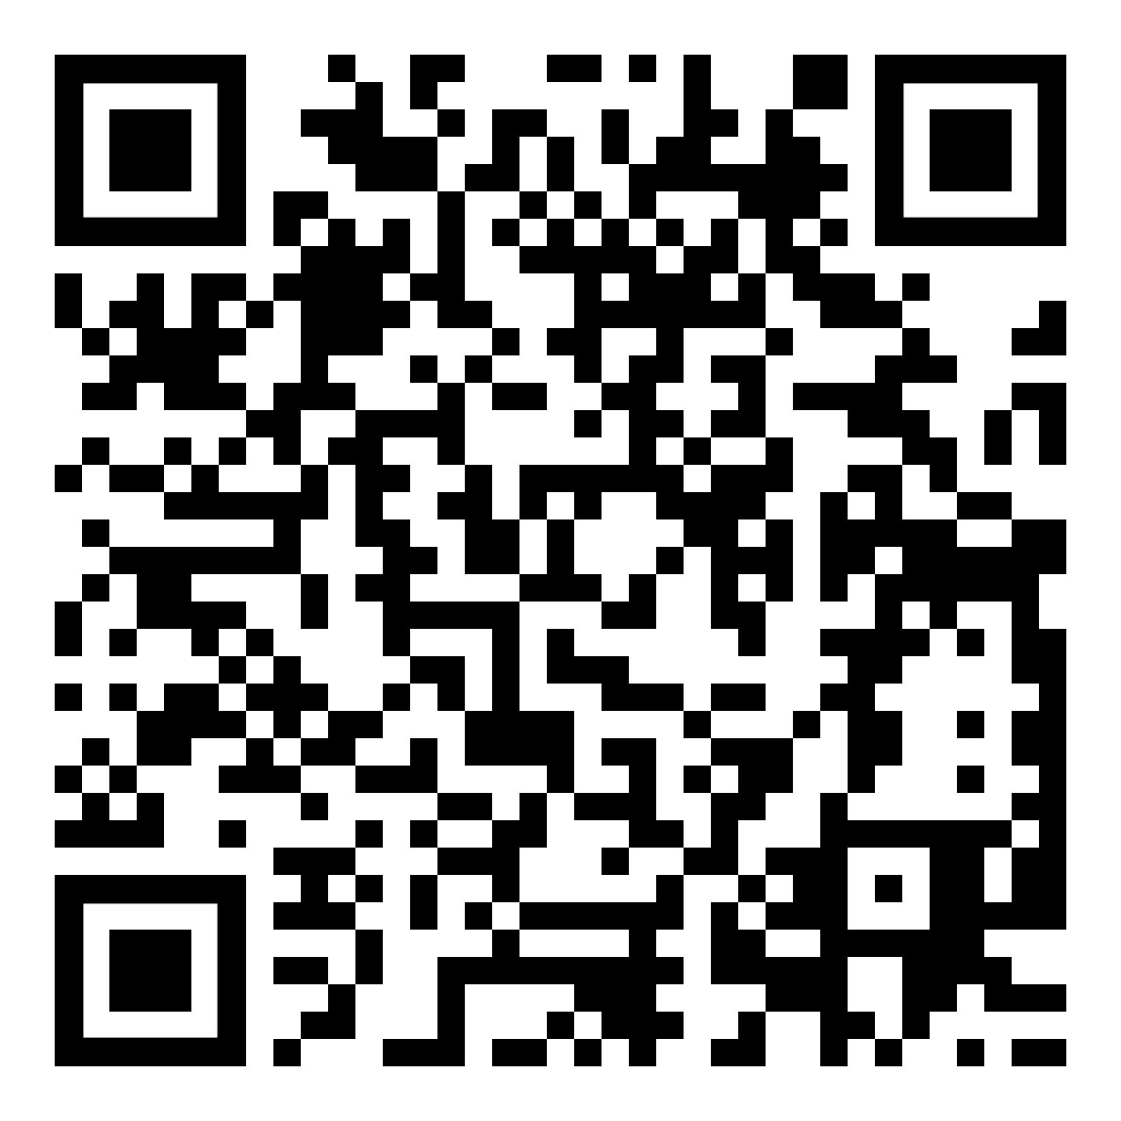
UIFCW Event Guide
UIFCW Slack Space

Slide 7
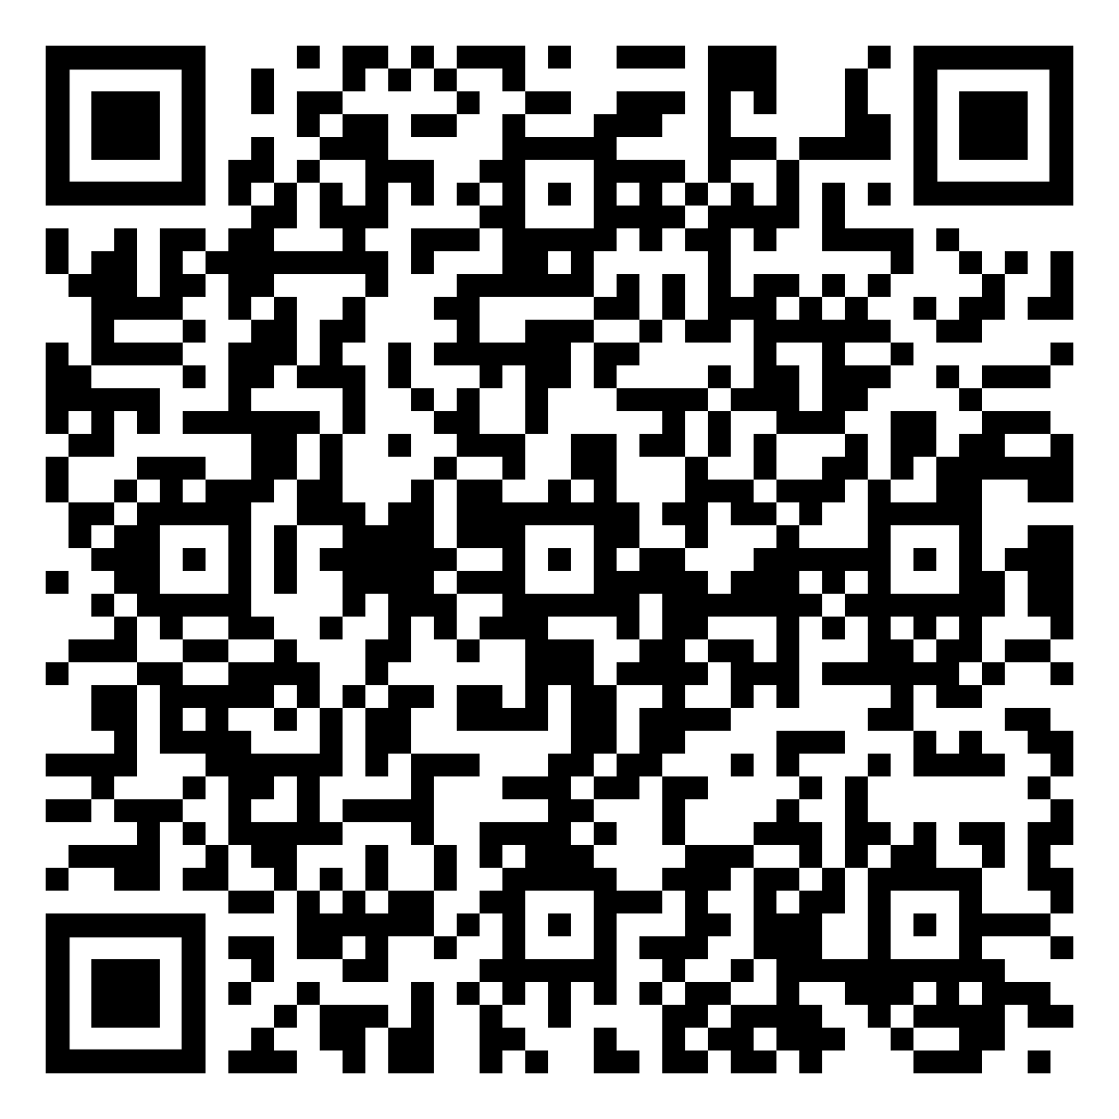
UIFCW Event Survey

