Slide 1
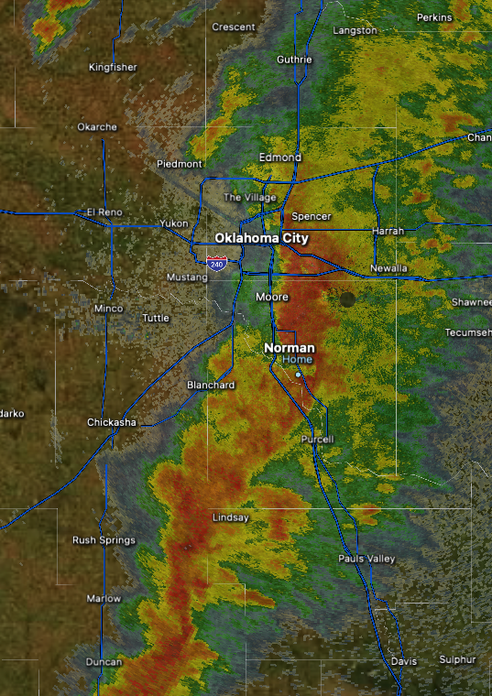
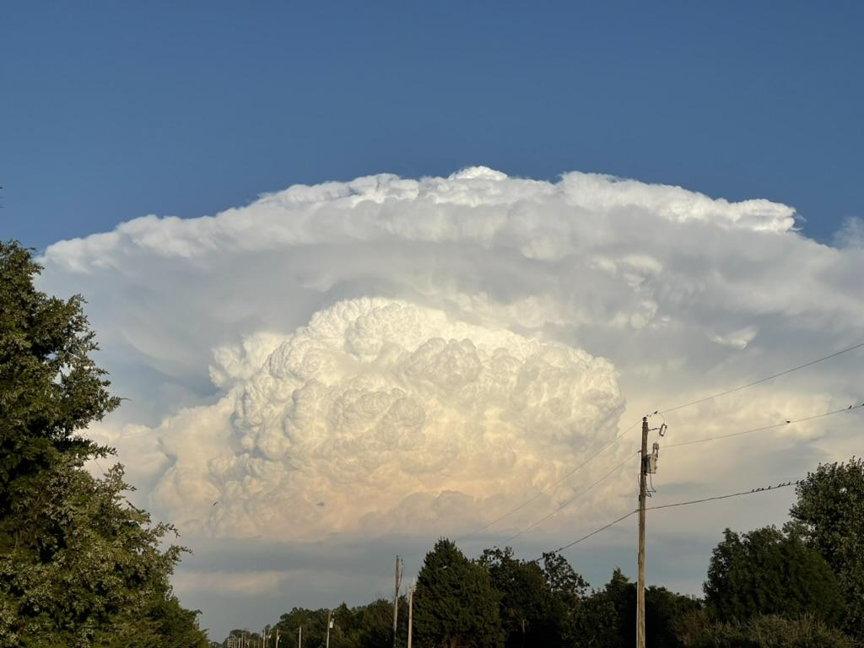
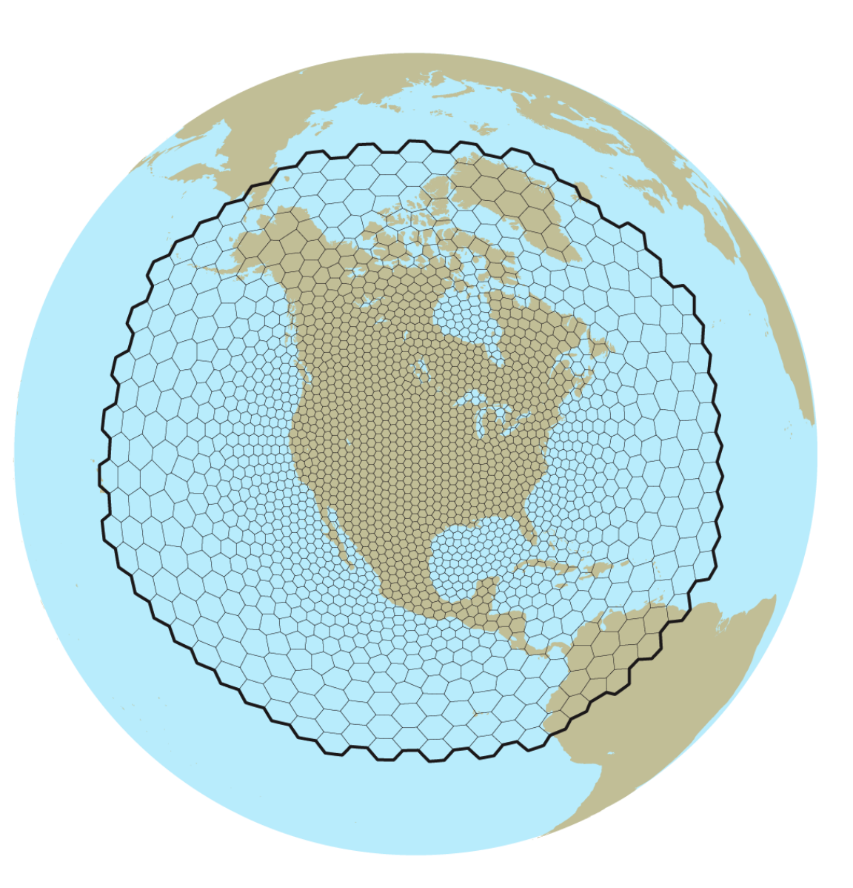
Regional MPAS Research and Development at NSSL
Louis J. Wicker
NOAA National Severe Storms Lab
With Contributions from
J. Martin, B. Matilla, M. Flora, K. Knopfmeier, P. Burke, T. Jones,
C. Kerr, D. Stratman, N. Yussouf, L. Reames, T. Mansell, M. Silcott,
D. Dowell, P. Skinner, A. Clark, P. Heinselman, C. Potvin, and J. Gao

Slide 2
Outline of Talk
MPAS-WoFS development at NSSL
Resolution flexibility using MPAS for CAM NWP?
Summary

Slide 3
Outline of Talk
MPAS-WoFS development at NSSL
Resolution needed from MPAS for CAM NWP?
Summary

Slide 4
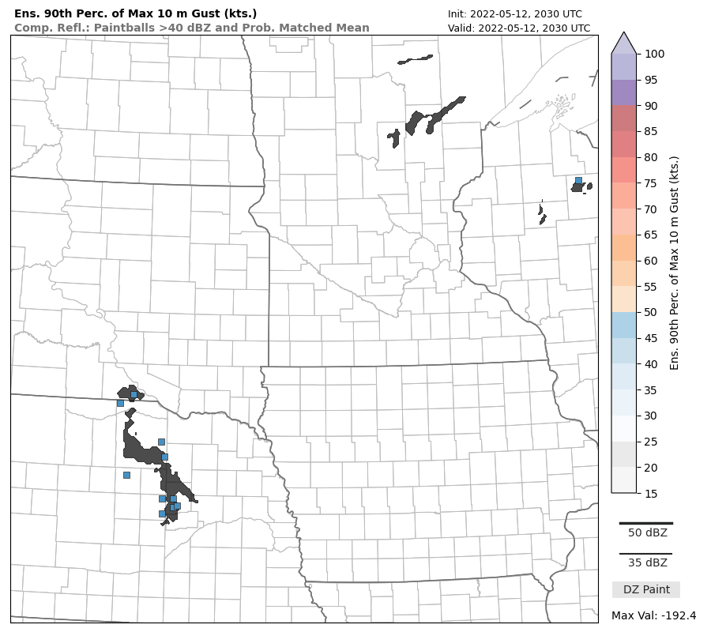
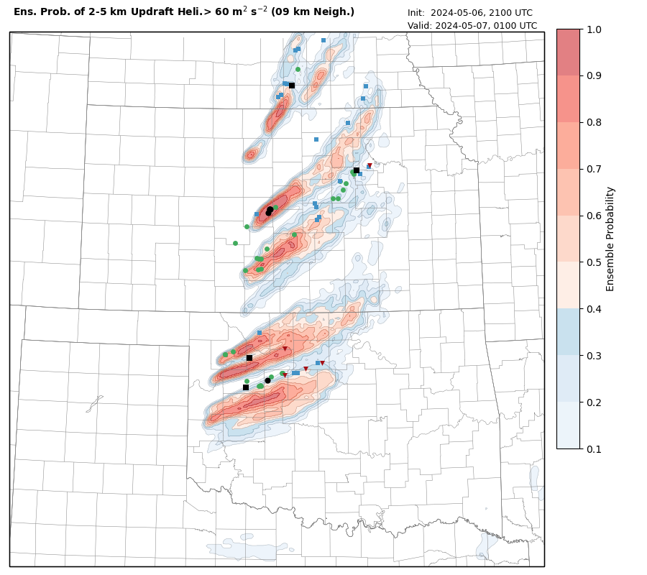
What is Warn on Forecast?
Example 1
3 Hour Ensemble 90% Maximum Surface wind (colors) for 5 May 2022 Derecho
MRMS 40 dBZ observations overlaid in black, svr winds reports as
(90% max: > 105 kts)
Weather adaptive NWP via regional relocatable grid
900 x 900 km with 3 km resolution
36 member ensemble using WRF model (HRRRv4 code) + GSI-ENKF
Two components: data assimilation system and forecast system
36 member EnKF WoFS-DAS (15 minute DA cycling)
Assimilates radar, surface, satellite data
Initialized from HRRR-DAS members, HRRR + GEFS perts for BC’s
18 member forecast system
New 6 hour forecast and web output generated every 30 min
Ensemble output every 5 min over 6 hours (72 outputs per FCST)
Post-processing done in parallel
cb-WoFS: System is containerized
Entire NWP system runs on Azure cloud
(pre, DA, FCST, post, web-viewer)
www.cbwofs.nssl.noaa.gov
Example 2
4 Hour Ensemble Probabilities of Significant Storm Rotation (UH)
7 May 2024
Observed Storm Reports overlaid

Slide 5
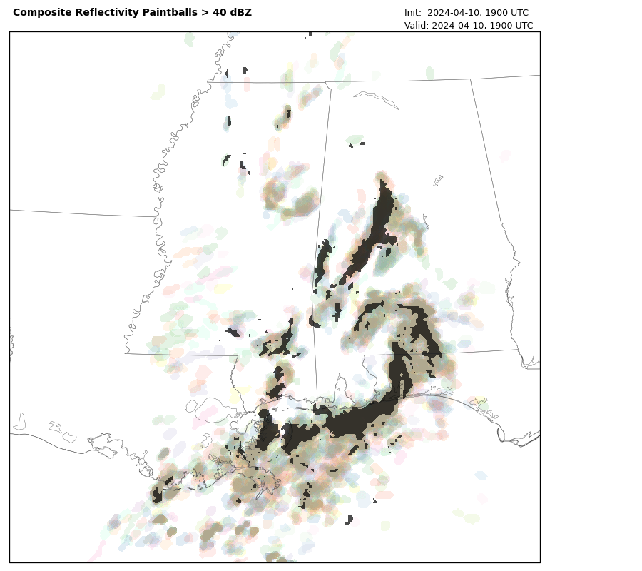
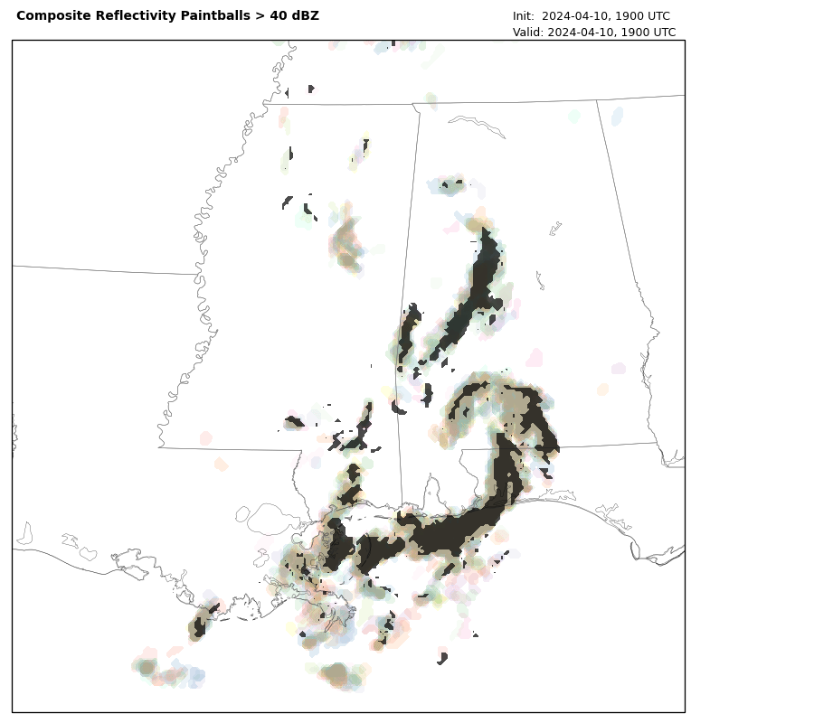
2024: In Development: MPAS-WoFS
Color paintball for MPAS/DART Ensemble (for reflectivity > 40 dBZ)
Black overlay is observed MRMS composite reflectivity > 40 dBZ
MPAS/DART (left) and WRF/GSI EnKF (right) valid at 1900Z
MPAS-WoFS is in reasonable agreement, but suffers from a large number of spurious cells!
Analyses after 4 hours
of cycling every
15 min with radar
surface, and satellite
MPAS-WoFS
WRF-WoFS
Paintball
Analysis at
19 UTC
10 April 2024
Spurious
cells

Slide 6
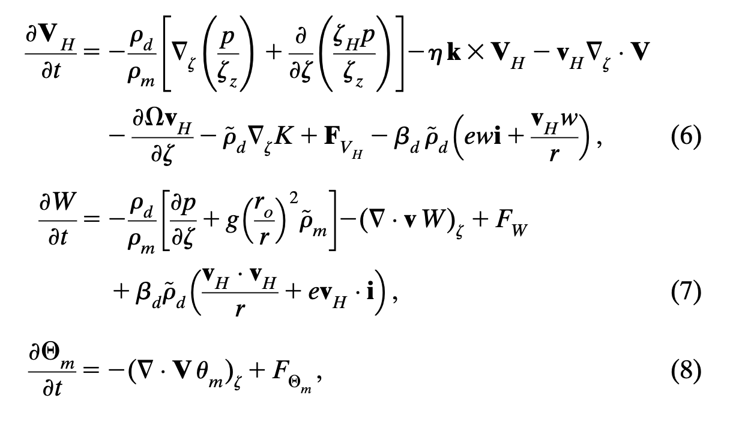
Why is MPAS noisier? Different Equation Sets?
WRF Equations
MPAS Equations

Slide 7
Why is MPAS noisier?
In WRF, horizontal momentum advection (red box) has implicit dissipation for odd-order transport (5th)
MPAS’s vorticity/KE formulation for horizontal dynamics (red boxes) uses non-dissipative discretizations
MPAS has no explicit filtering available for scalars (NSSL is testing a 4th order filter now)
For hydrometeors, the formally 3rd order advection seems to work better (config_coef_3rd_order=1.0)
Easy to add higher-order transport scheme in vertical (5th order, piecewise splines, etc).
More tuning is needed…..because….

Slide 8
Impact from Varying Dissipation in Transport Scheme
Simple idealized squall line simulations
Same physics (Kessler)
Horizontal cross section at 4 hours shown
~4th-Order transport
(weak dissipation)
3rd-Order transport
(strong dissipation)
CM1
W_{max}: 5.7
Cold Pool: 12.3%
WRF
W_{max}: 7.5
Cold Pool: 16.9%
MPAS-3OT
W_{max}: 6.8
Cold Pool: 16.1%
MPAS
W_{max}: 7.7
Cold Pool: 18.1%
MPAS-3
MPAS-4
WRF-5th
MPAS-4th
CM1-5th
MPAS-3rd
Cold Pool
depicted by
grey shading
where ΔT < -1 C
W > 1 m/s below 2 km updrafts
are color pixels
Sub-domain of
400² km shown

Slide 9
Impact from Varying Dissipation in Transport Scheme
Simple idealized squall line simulations
Same physics (Kessler)
Horizontal cross section at 4 hours shown
~4th-Order transport
(weak dissipation)
3rd-Order transport
(strong dissipation)
CM1
W_{max}: 5.7
Cold Pool: 12.3%
WRF
W_{max}: 7.5
Cold Pool: 16.9%
MPAS
W_{max}: 7.7
Cold Pool: 18.1%
MPAS-3OT
W_{max}: 6.8
Cold Pool: 16.1%
WRF-5th
CM1-5th
MPAS-4th
MPAS-3
MPAS-3rd
Cold Pool
depicted by
grey shading
where ΔT < -1 C
Sub-domain of
400² km shown
MPAS with 4^{th-}order transport
has largest cold pool (18% of model grid)
Lots of small storms near rear of cool pool.
MPAS with 3rd-order transport
cold pool size similar to WRF-5th (16%)
Storms are somewhat larger

Slide 10
This is for simple idealized squall lines Obviously, a lot more tuning will be needed for full physics runs…

Slide 11
Outline of Talk
MPAS-WoFS development at NSSL
Does MPAS require 3 km grid for CAM NWP?
Summary

Slide 12
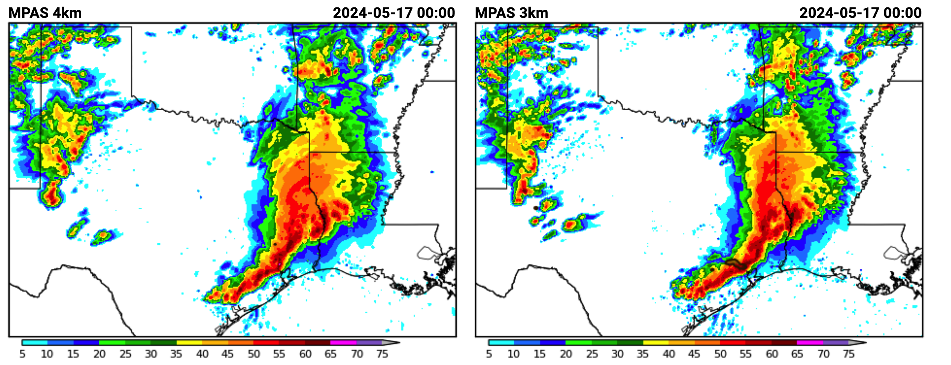
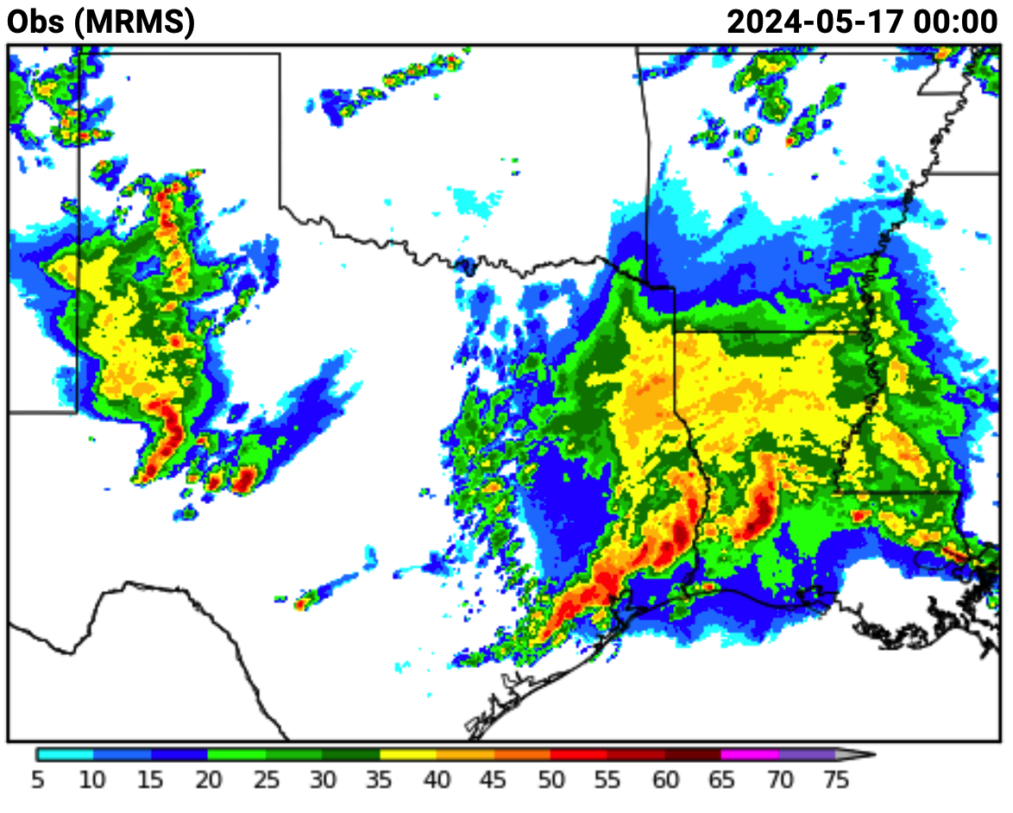
Does MPAS require 3 km grid for CAM NWP?
MPAS
MPAS
Observations

Slide 13
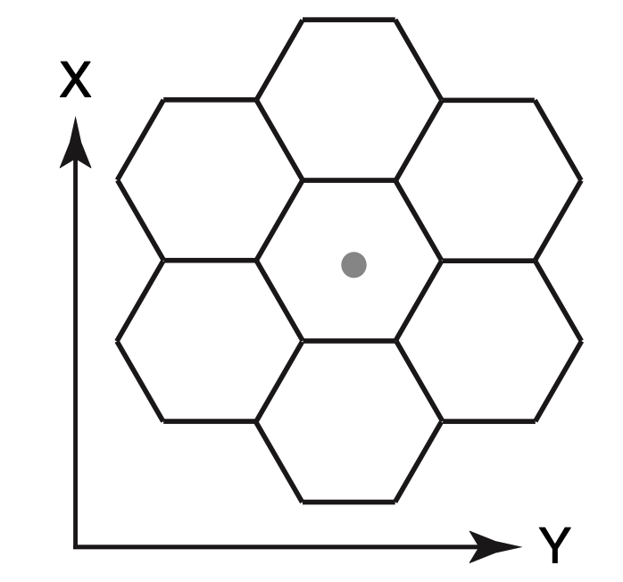
MPAS: Symmetry in three horizontal directions - not just two!
A hexagonal grid has 16% more nodes per unit area than a cartesian grid
Do doing some math….
Δx = 3.00 km in WRF
Δx ~ 3.23 km in MPAS
Δx
Δx
For transport and wave motions, resolution on a cartesian grid is ~41% coarser if the motion occurs at an angle of 45 degrees to primary grid axes.
3 km
3 km
4.2 km

Slide 14
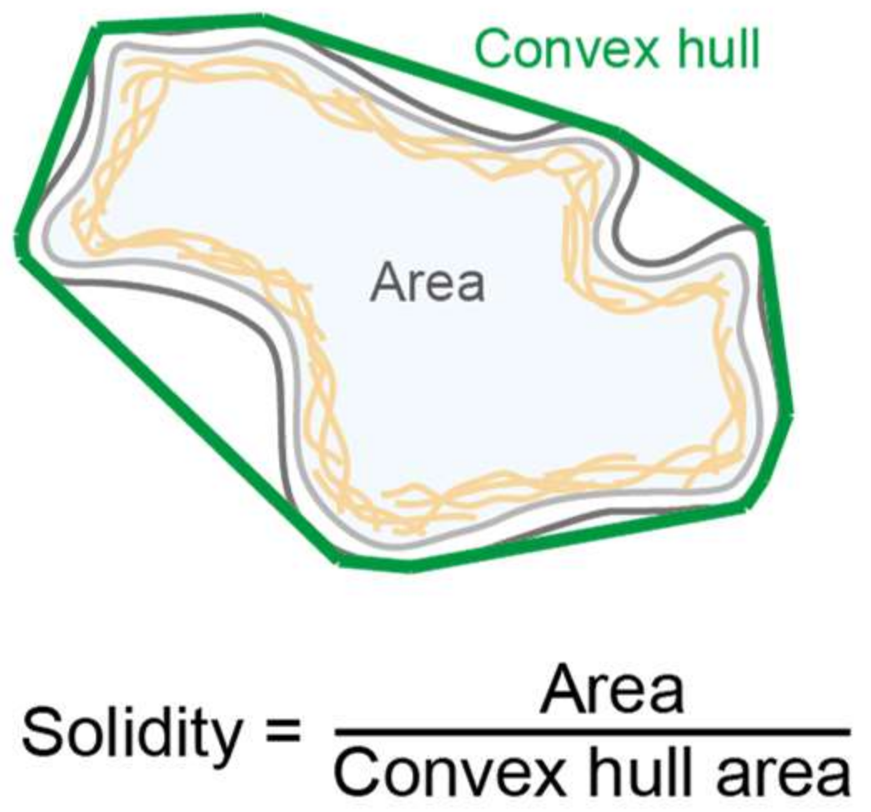
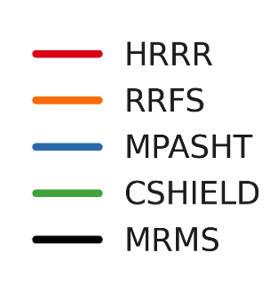
Object Properties—Solidity
Improved dynamics results in better shape preservation!
Solidity Measure
for
Composite Reflectivity
From
Various
Storm Types
Solidity ⇒ 1 object area is a simple shape
(circle, ellipse, rectangle)
Solidity == Convexity
MPAS echos match shape of observations
significantly better
for lower solidity!
Credit
Dr. Larissa Reames,
CIRWO & NSSL

Slide 15
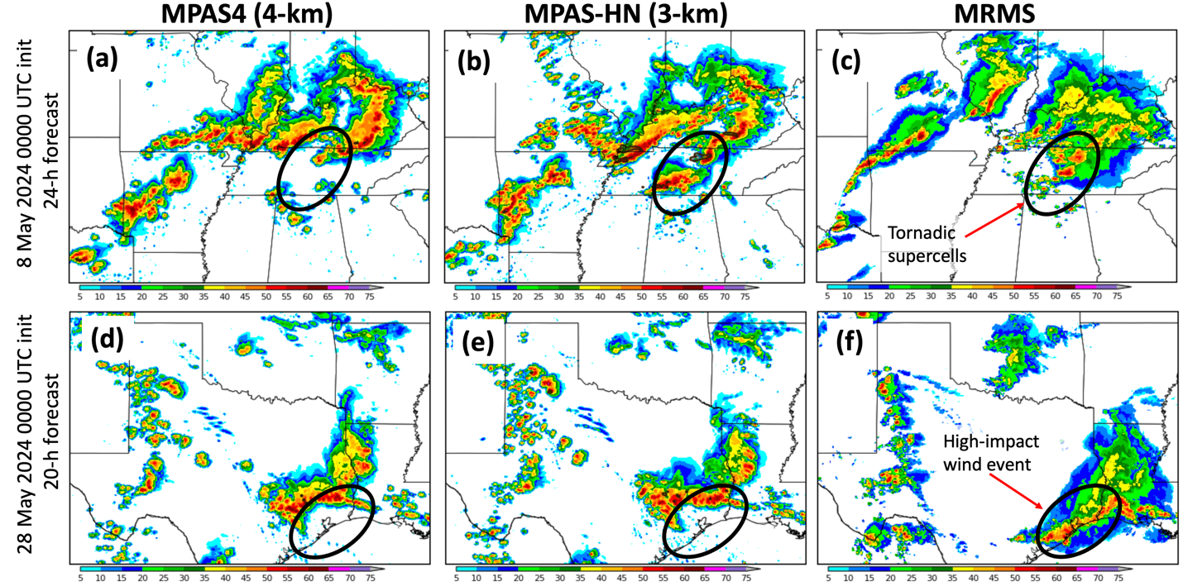
SFE Results Case Day Comparisons – Some differences!
8 May
2024
24 hr
FCST
28 May
2024
20 hr
FCST
Credit
Dr. Adam Clark @ NSSL
Notes:
Simulated composite reflectivity at 24-h lead times from 0000 UTC 8 May 2024 initializations of (a) MPAS4 (4-km grid-spacing), (b) MPAS-HN (3-km grid-spacing), and (c) MRMS observations. Black ovals denote the highest impact weather event occurring at the time. (d)-(f) same as (a)-(c), except for 20-h lead times from 0000 UTC 28 May 2024 initializations.

Slide 16
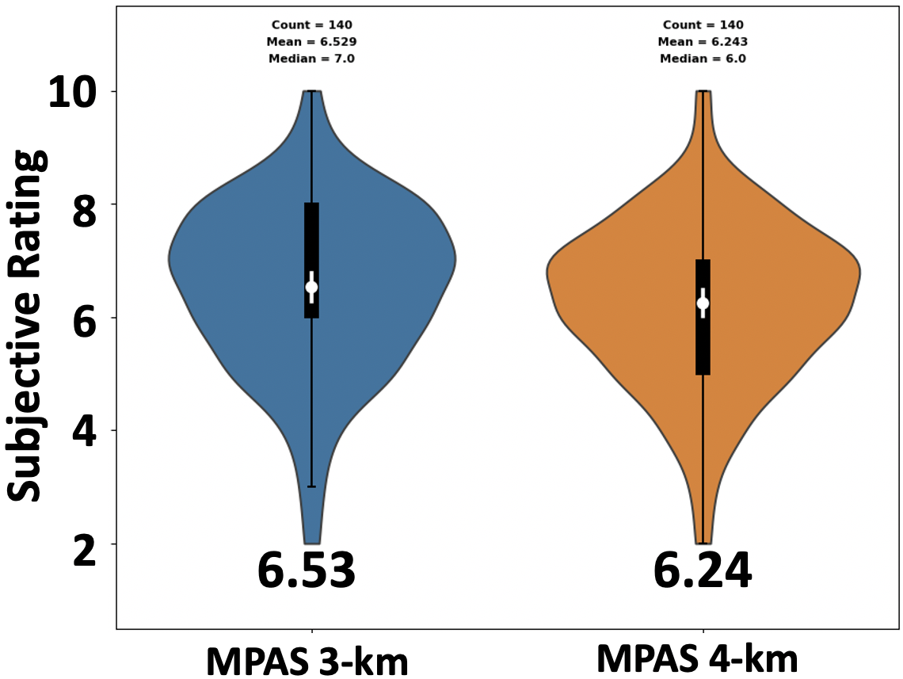
Subjective Forecaster Ratings for 3 & 4 km MPAS
The distributions of subjective ratings were very similar with the mean ratings from NSSL-MPAS-HN (3-km) slightly higher.
Differences were not formally statistically significant, but nearly so.
Forecasters found that surface CAPE, temperature, and dewpoints were also similar
Credit
Dr. Adam Clark @ NSSL

Slide 17
An MPAS RRFSv2 using 3.5 km resolution?
It looks possible to reduce the resolution of the MPAS grid relative to the WRF grid for CAM NWP and get similar forecasts.
For a mesh of 3.5 km: 24% savings in computation! 1.0 – (3 / 3.5)² (even 3.25 km grid saves 15%!)
Important: Also reduction in I/O, data assimilation, and post-processing cost.
It may be worthwhile to test higher-order transport schemes in horizontal (requires regular hexagonal grid, a lot more difficult for variable mesh).
On the other hand: a 3 km MPAS mesh could resolve convective structures with more fidelity.
Final word: MPAS will need to several years of development and testing to bring it up to current CAM standards, and to test a variety of different capabilities and configurations.

Slide 18
Summary
MPAS-WoFS development at NSSL
NSSL running full case studies this summer with more tuning experiments for MPAS-WoFS
MPAS-WoFS behaves somewhat differently than WRF-WoFS (this is different than the cold-start CONUS comparisons)
NSSL adding capabilities to MPAS code that should help improve analyses/forecasts, and help community move from WRF to MPAS
NSSL is eager to try MPAS-WoFS using variable resolution mesh
Resolution needed from MPAS for CAM NWP?
Already have evidence from SFE experiment that MPAS using 4 km grid is comparable to WRF at 3 km.
Even a small decrease in grid resolution results in 10-20% cost reductions
More investigation is needed to access what the trade-offs mean in terms of accuracy and computational performance.
Lots of work to do before MPAS is ready for RRFSv2.

Slide 19
Daisy says thanks for your attention!
As do I !
Questions?
louis.wicker@noaa.gov

