Slide 1
MPAS in the UFS
Bill Skamarock
NSF NCAR Mesoscale and Microscale Meteorology Laboratory
UIFCW24 Workshop, 22-26 July 2024

Slide 2
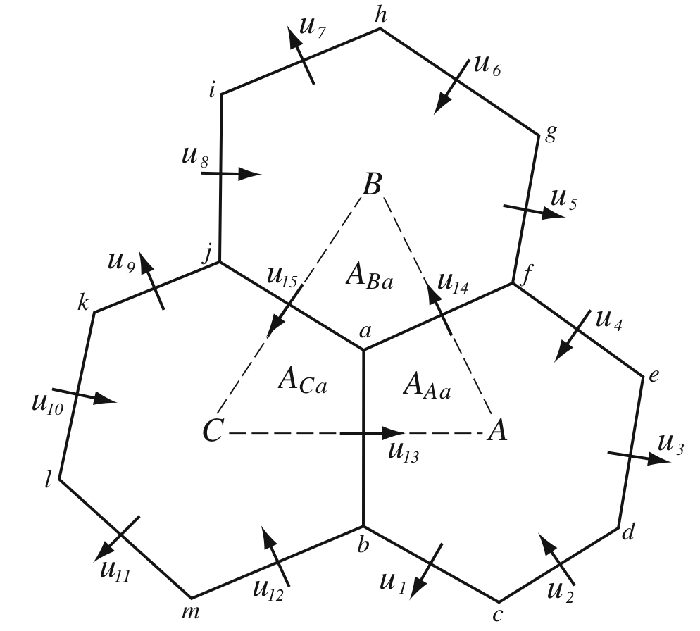
Model for Prediction Across Scales (MPAS)
MPAS-Atmosphere
Fully compressible nonhydrostatic equations
Spherical centroidal Voronoi horizontal mesh (SCVT)
C-grid staggering of the prognostic variables
Uniform global configurations (icosahedral mesh)
Variable resolution capabilities
Regional capability
Developed and supported by NSF NCAR and collaborators
Multiple tutorials offered yearly
New releases as capabilities become available
Freely available on Github
https://github.com/MPAS-Dev/MPAS-Model

Slide 3
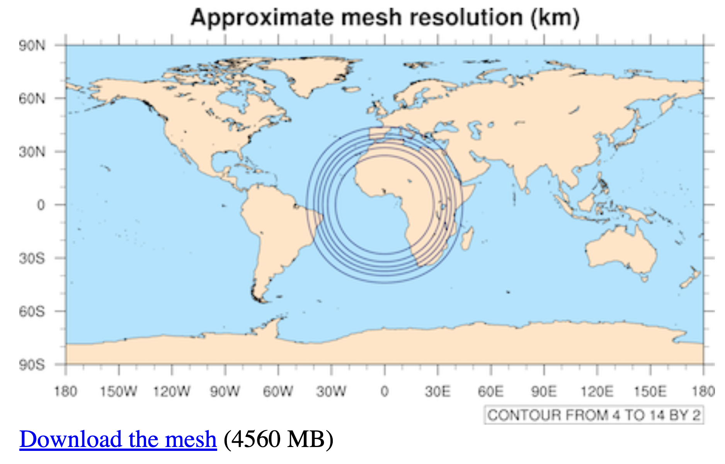
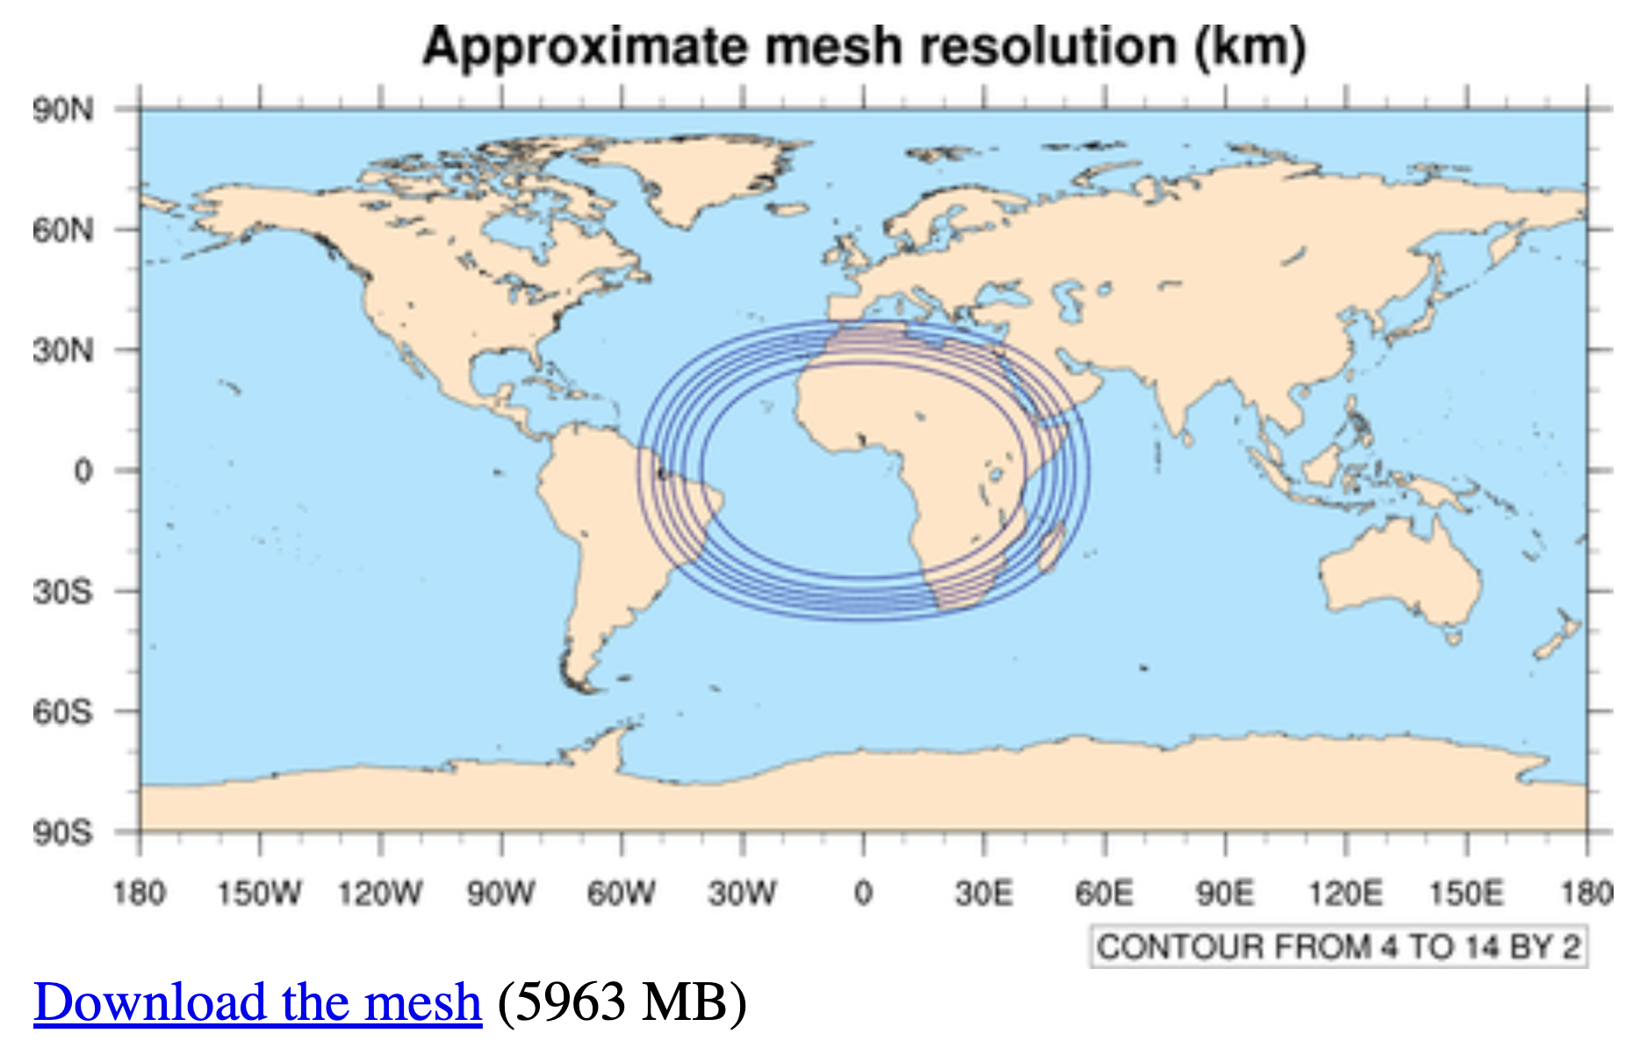
MPAS Development - Meshes
15– 3 km mesh, circular refinement
Mesh generation is expensive.
We’re working on reducing the cost of generating variable-resolution meshes.
We have a collection of meshes available online
For regional applications, we are working on a utility to map a mesh of perfect hexagons to the sphere using traditional projections
Polar Stereographic
Lambert Conformal
Mercator
Expect to release this before the end of 2024
15– 3 km mesh, elliptical refinement

Slide 4
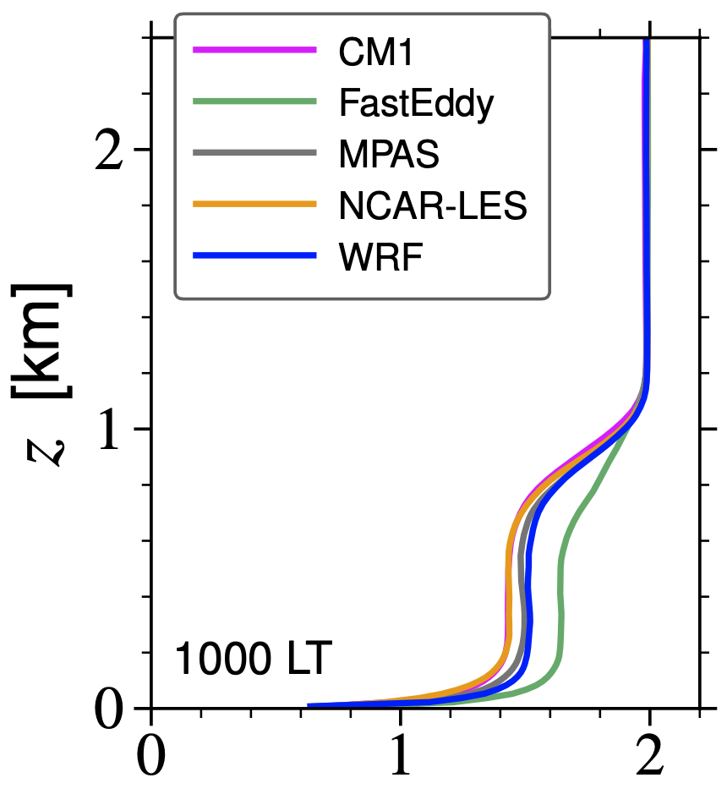
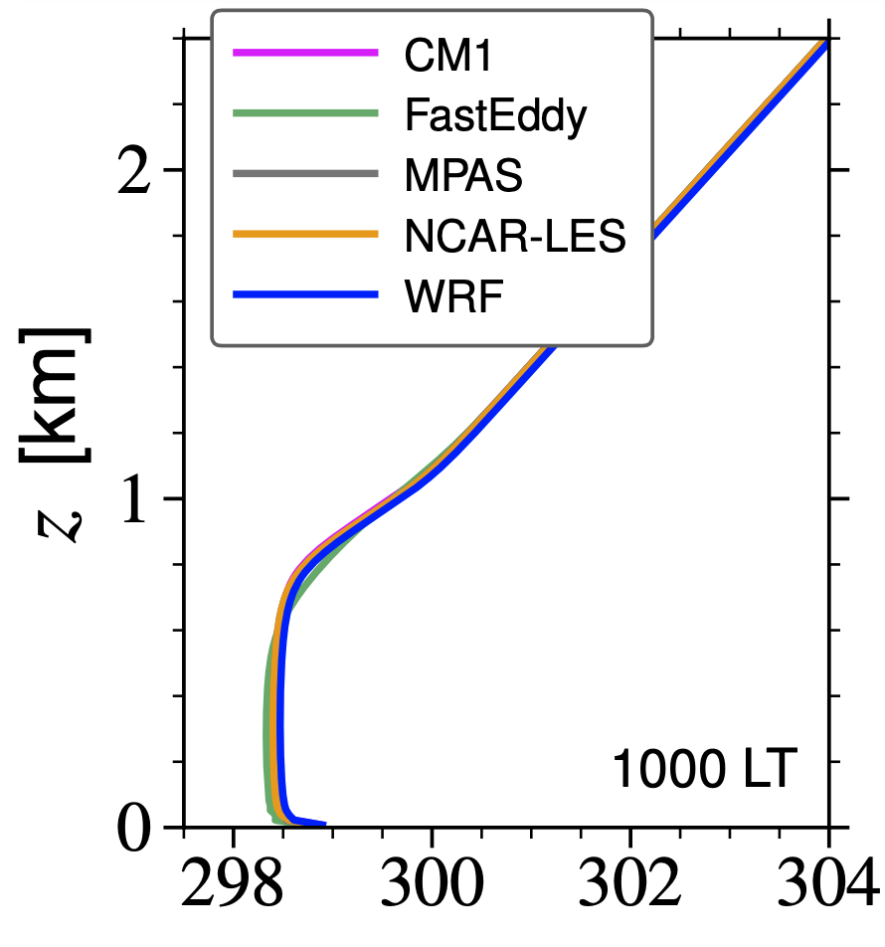
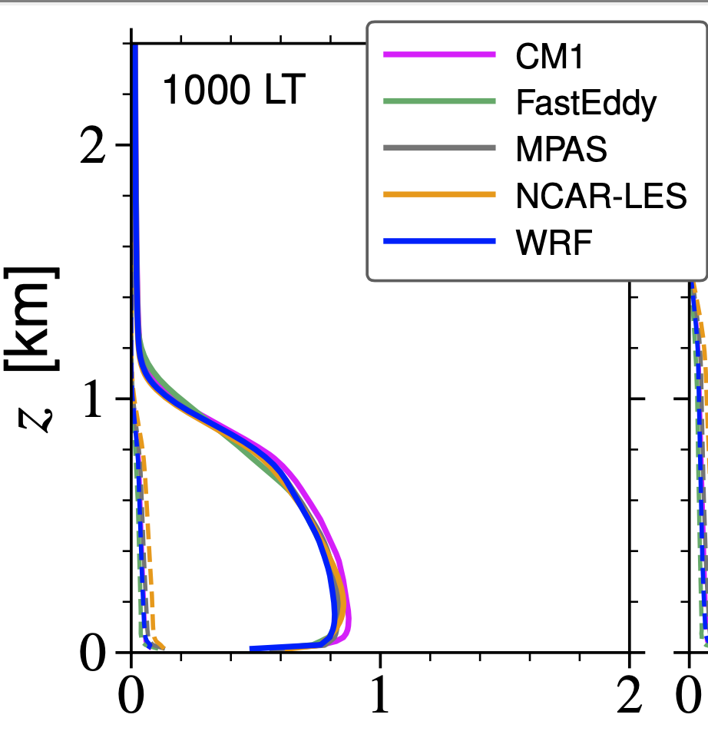
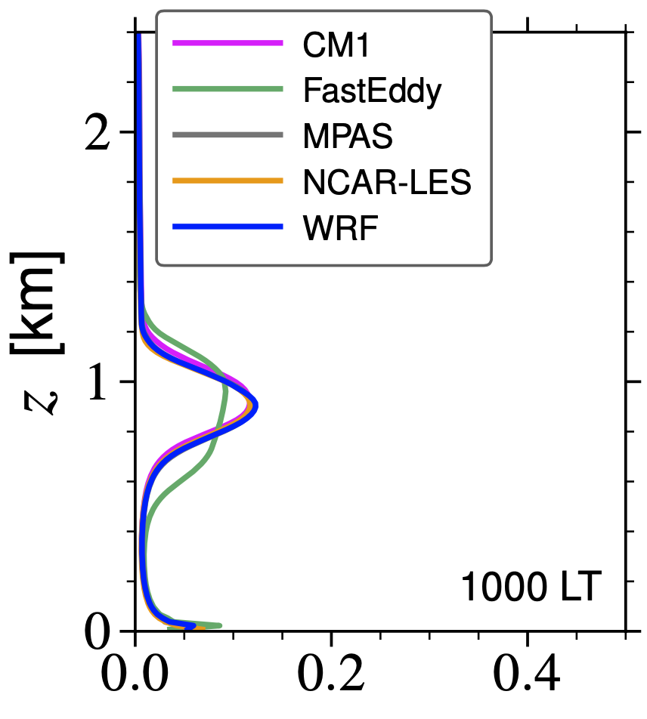
MPAS Development
LES capabilities
We implemented 2 LES SGS turbulence models in MPAS: 3D Smagorinsky scheme (diagnostic) and a 1.5 order TKE scheme (prognostic).
MPAS LES results look at lot like WRF and CM1 results.
Extensions for terrain need implementing.
Release timetable TBD.
θ
U
TKE
w’θ’
SAS LES test case, NCAR PBL reinvestment project

Slide 5

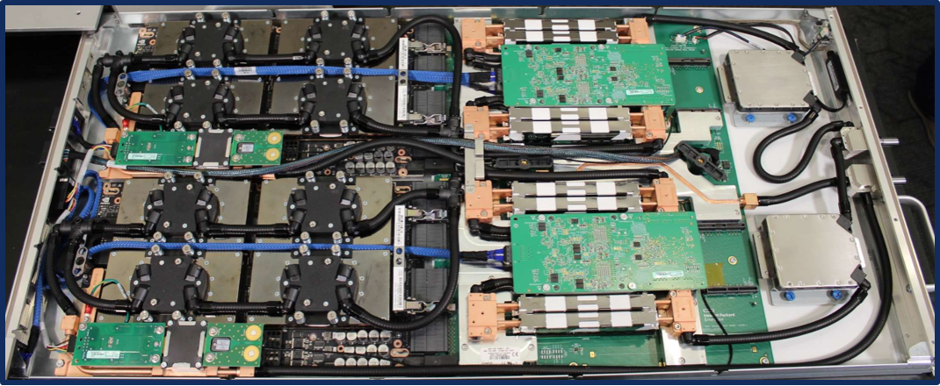
MPAS Development - GPUs
MPAS-Atmosphere GPU Implementation
There is a GPU implementation available for MPAS-Atmosphere
https://mpas-dev.github.io/atmosphere/OpenACC/index.html
Based on MPAS Version 7.0
Based on our experience with this release, we are re-implementing this capability
Initial (partial) GPU capability will be released and supported in MPAS v8.2.0
Subsequent MPAS-A releases will incrementally extend GPU capabilities in the dynamical core and physics.
Builds on lessons learned from past partnerships with IBM, The Weather Company, the University of Wyoming, and NVIDIA.
Above: A Derecho GPU blade with two GPU nodes, each with 1 AMD EPYC Zen3 “Milan” 64-core processor and 4 NVIDIA A100 Ampere GPUs.

Slide 6
MPAS in the UFS: Local Refinement
In contrast to WRF, we did not implement 2-way grid nesting in MPAS as a method for introducing local refinement
Problems with traditional 2-way grid nesting
Nonconforming refinement
Abrupt change in resolution
Implementation adds significantly to infrastructure and solver complexity, especially on DM architectures
Data assimilation is problematic

Slide 7
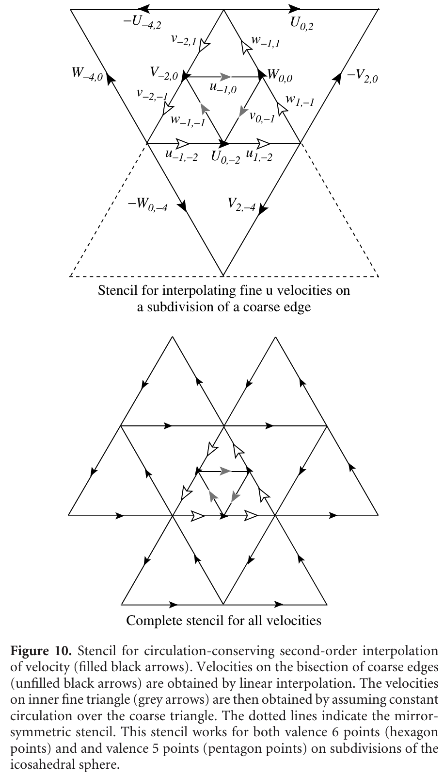
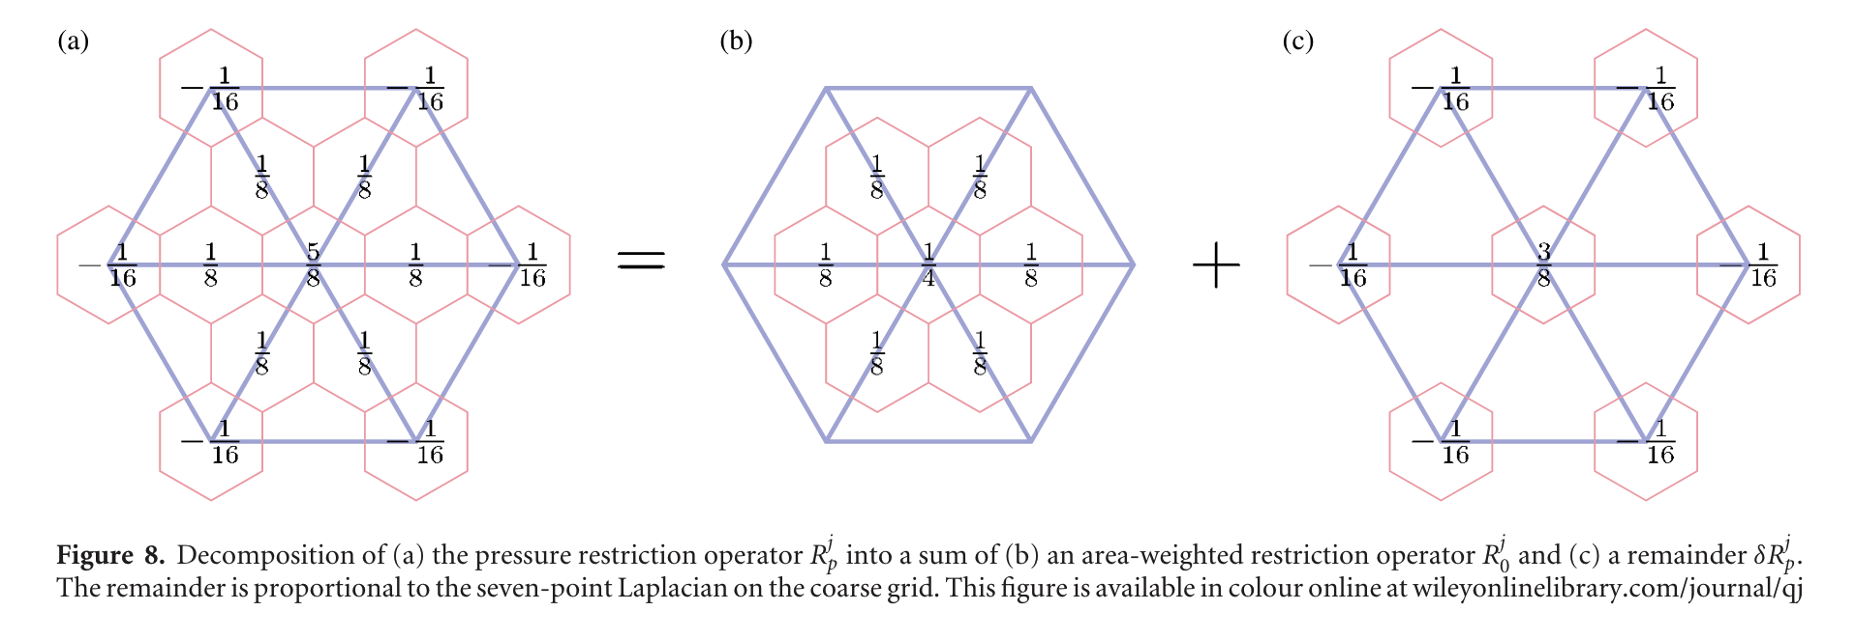
MPAS in the UFS: Local Refinement
Nesting could be implemented in MPAS
Dubos and Kevlahan, 2013:
A conservative adaptive wavelet method for the shallow-water equations on staggered grids. QJRMS, https://doi.org/10.1002/qj.2097

Slide 8

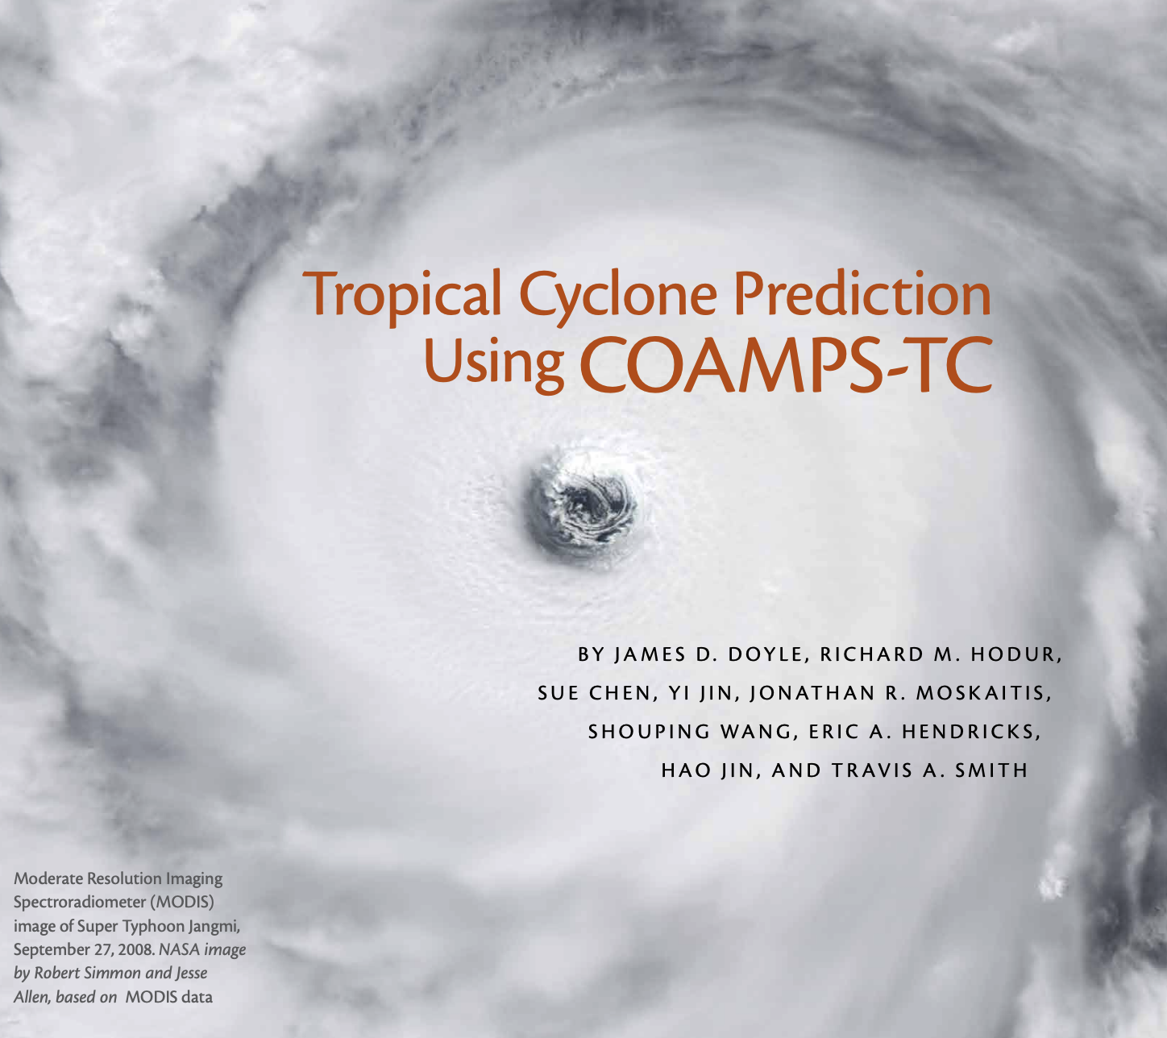
MPAS in the UFS: Local Refinement
For tropical cyclone applications, 2-way moving nests introduce even more problems
Additional problems with 2-way moving nests for TCs
Changing communications patterns during simulations – more infrastructure complexity
Domain-decomposed global meshes make this more complex
Ensemble statistics are problematic
Data assimilation is even more problematic
Nesting and moving-nest technology doesn’t benefit other applications
Mid 2000s ARW, later for HWRF
Oceanography, 2014

Slide 9
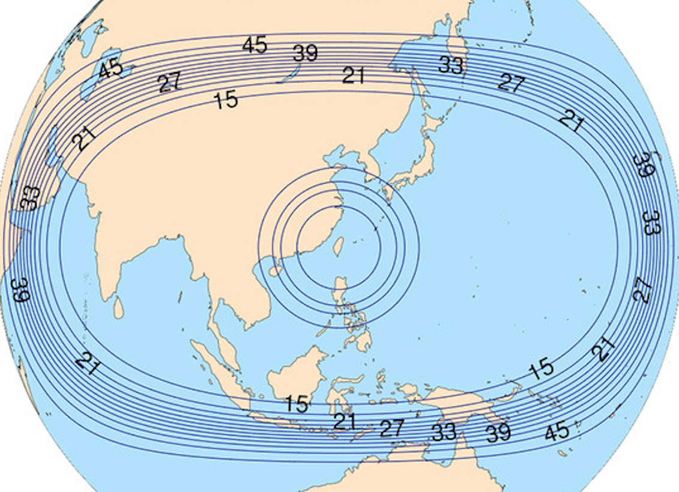
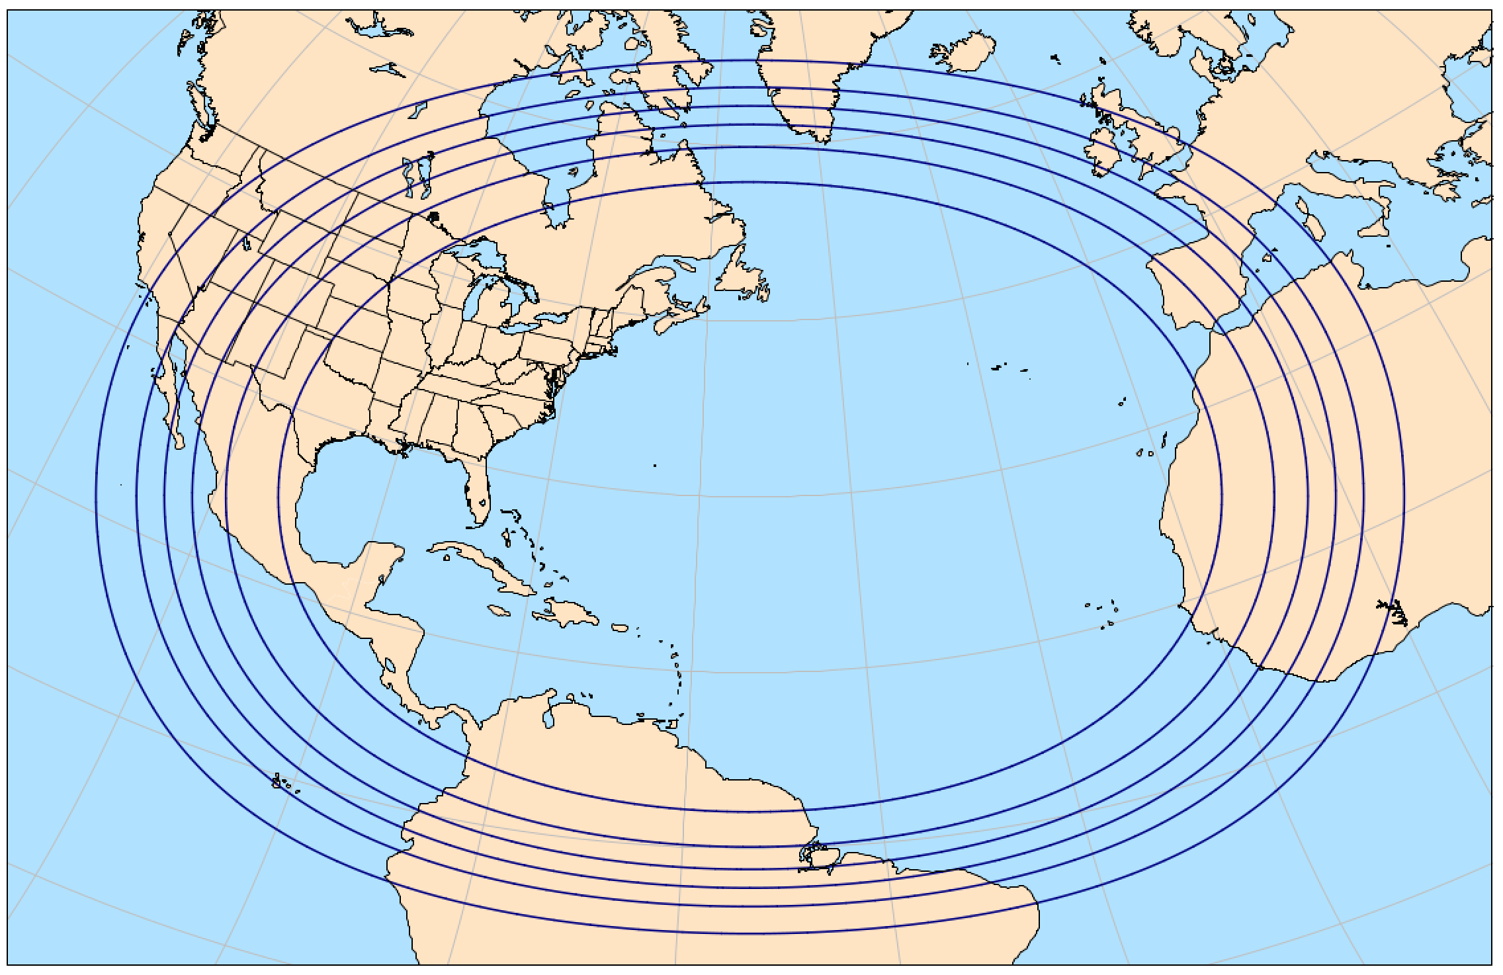
MPAS in the UFS: Local Refinement
For TC forecast applications, we should rapidly implement GPU capabilities in MPAS and use on-demand cloud computing to produce ensembles employing variable resolution MPAS meshes.
Benefits:
DA friendly
Ensemble friendly
Earth friendlier (energy-wise)
Little additional infrastructure needed
GPU capability benefits all applications!
This type of TC forecast applications is an ideal fit for evolving commercial cloud computing capabilities
Δx 60-15-3 km
Δx 15-3 km

Slide 10
MPAS in the UFS: Earth System Modeling
MPAS is used as a dynamical core in NSF NCAR’s Community Earth System Model (CESM)
The UFS and CESM share infrastructure – CIME and NUOPC ESMF-based coupling infrastructure
We have been trying to employ MPAS in CESM at global storm-permitting configurations for nearly a decade.
We still cannot run 3.75 km global, but it looks like we’re close(?)
What have we learned?
The CESM infrastructure was not designed for high-resolution applications – it doesn’t scale properly (memory, speed)
The CIME infrastructure is a major impediment to users (e.g. NWP research community) who want to create new configurations
We need to consider new infrastructure technology that is lightweight and modern.

Slide 11
MPAS in the UFS
Relationship between UFS and its component developers has to be a collaboration.
Expectations between NOAA entities and outside developers need to be explicit and agreed.
Components need to be supported by the developers.
Governance and decision-making for the UFS, and for the modeling systems from which they are pulling components, need to be understood by all.
Commitment is needed on all sides.

