Slide 1
Status Update on MPAS from Across Organizations & Moderated Discussion
Curtis Alexander (NOAA/GSL) and Kate Fossell (NSF-NCAR)

Slide 2
A little history…
UIFCW23
UFS SRW/CAM application team presented findings from CAM ideal and real forecast experiments
UFS-based Rapid Refresh Forecast System (RRFS) prototype configurations using 3km FV3-LAM
HRRRv4 operational baseline using 3km WRF-ARW
MPAS 3km CONUS forecasts initialized from both RRFS and HRRR
NSF-NCAR CM1, FV3-Solo, WRF for ideal experiments
Motivated by persistent convective forecast (very high) biases in precipitation/reflectivity coverage/intensity/structures in RRFS prototypes
Charge to develop “whitepaper” documenting development, testing and provide recommendations
Resulted in NCEP Office Note 516 in December 2023: Carley et al. “Mitigation Efforts to Address Rapid Refresh Forecast System (RRFS) v1 Dynamical Core Performance Issues and Recommendations for RRFS v2” https://doi.org/10.25923/ccgj-7140
Final recommendation: “A transition to a new dynamical core is necessary for long-term, sustained innovation for NOAA’s flagship high-resolution NWP system. Based upon the subject matter expertise within this document, we recommend that the dynamical core for the second version of RRFS (RRFSv2) be MPAS.”

Slide 3
Fast forward to UIFCW24…
RRFSv1 status
Physics/DA changes introduced to RRFSv1 in late 2023 and early 2024 in an attempt to partially address the convective biases documented with 3km FV3-LAM
Results from the 2024 Hazardous Weather Testbed recently led to a decision to likely delay the implementation of RRFSv1.
EMC currently exploring ways forward with NWS leadership, including possibly shifting certain aspects of RRFS to use MPAS.
Path forward towards MPAS for CAM applications
What’s the latest with MPAS? What grid capabilities does it provide? What about nesting?
How does MPAS perform when compared to 3km FV3, WRF, CM1? What can we do to accelerate transition of innovative CAM prediction capabilities into operations?
What is needed (steps, resources) to integrate MPAS into the UFS infrastructure? Should we bring MPAS into the UFS? Who decides this and when?

Slide 4
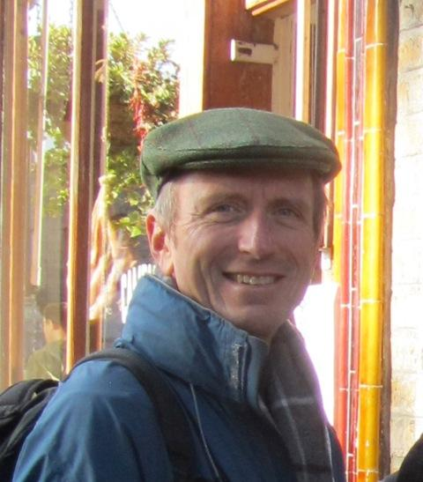
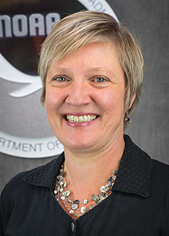
To answer none, some or all of these questions and motivate others, our invited speakers…
Dr. William (Bill) Skamarock (NSF-NCAR) is active in the development of fluid-flow solvers and atmospheric models, particularly nonhydrostatic solvers suitable for cloud-permitting simulations. He is one of the principal architects of the Weather Research and Forecast model. He is currently working on developing global solvers based on unstructured centroidal Voronoi tessellations and is leading NCAR’s effort in the development of the Model for Prediction Across Scales (MPAS). Dr. Skamarock continues to work on problems in atmospheric dynamics at large scales (baroclinic waves), small scales (deep convection) and interactions between scales. He collaborates in studies of chemistry and chemical species transport in deep convective clouds.
Dr. Louis (Lou) Wicker (NOAA/NSSL) has a broad set of research interests which generally are focused on numerical analysis, simulation, and forecasts of severe convection and tornadoes. He has investigated tornadogenesis within supercells using some of the first sub-200m resolution numerical simulations. The work was facilitated and supported by one of the five original and newly formed NSF computing centers, the National Center for Supercomputing Applications. He became very interested in the developing paradigm of "computational science" that is now ubiquitous across most scientific disciplines. His work today continues to focus on severe storms and tornadoes. He currently is the chief scientist for NSSL’s Warn on Forecast Program.
Dr. Ligia Bernardet (NOAA/GSL) straddles the interface between research and operations in numerical weather prediction. As the Chief of the GSL Earth Prediction Advancement Division, she contributes to planning and supporting the execution of model development in the areas of physical parameterizations, interactions between domains of the earth system (atmosphere, land, ocean, and sea ice), air composition, and atmospheric chemistry. She is passionate about creating mechanisms that facilitate synergistic interactions between the research and operational communities. She works on projects for the Developmental Testbed Center that aim at engaging the academic community in using NOAA models and evaluating innovations supplied by the community.

