Slide 1
A Social Science Approach to Unified Community Modeling
Dr. Kim Klockow McClain,
UCAR Senior Social Scientist, NWS/NCEP
Alison Gregory,
Community Engagement Specialist
for the UFS, UCP UCAR

Slide 2
Social Science in NOAA
What People Think It Is
What It Actually Is

Slide 3
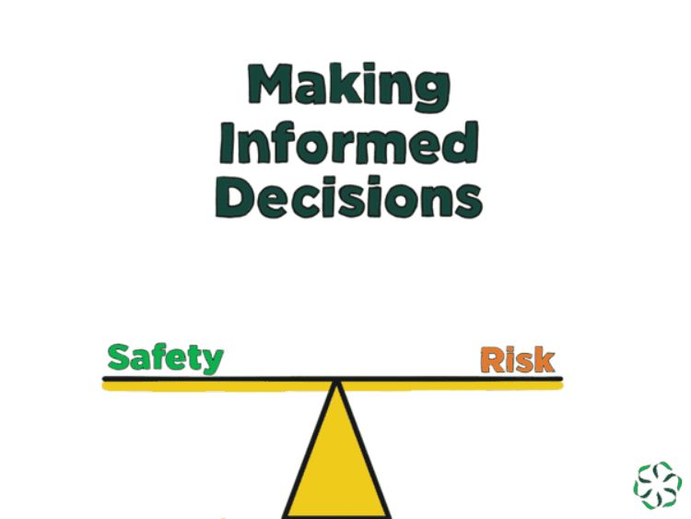
Social Science in Weather:
A Revolution

Slide 4
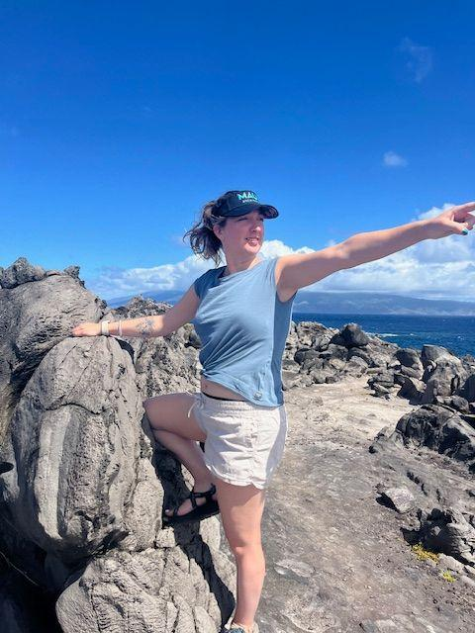
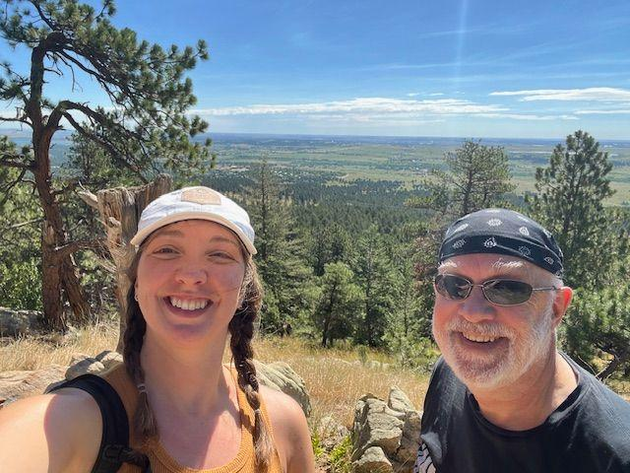
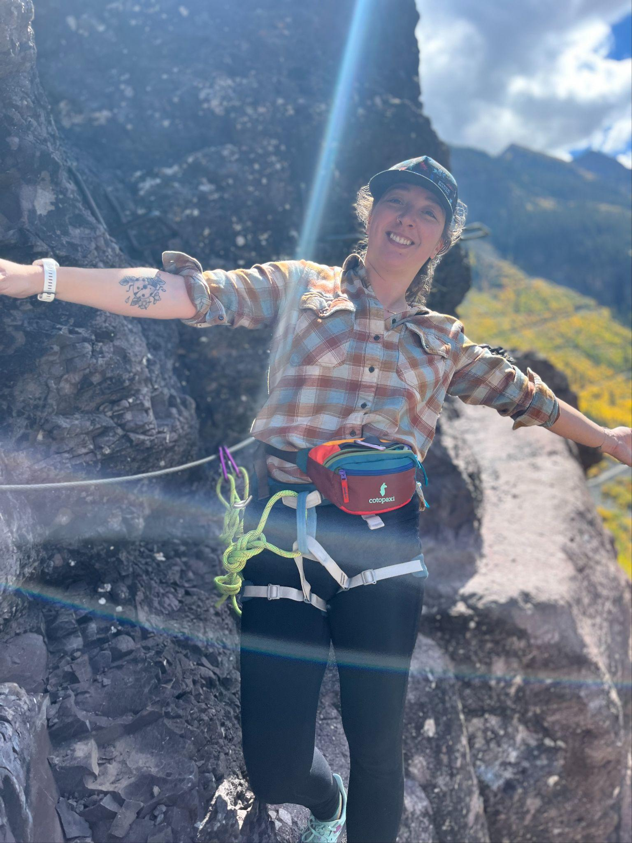
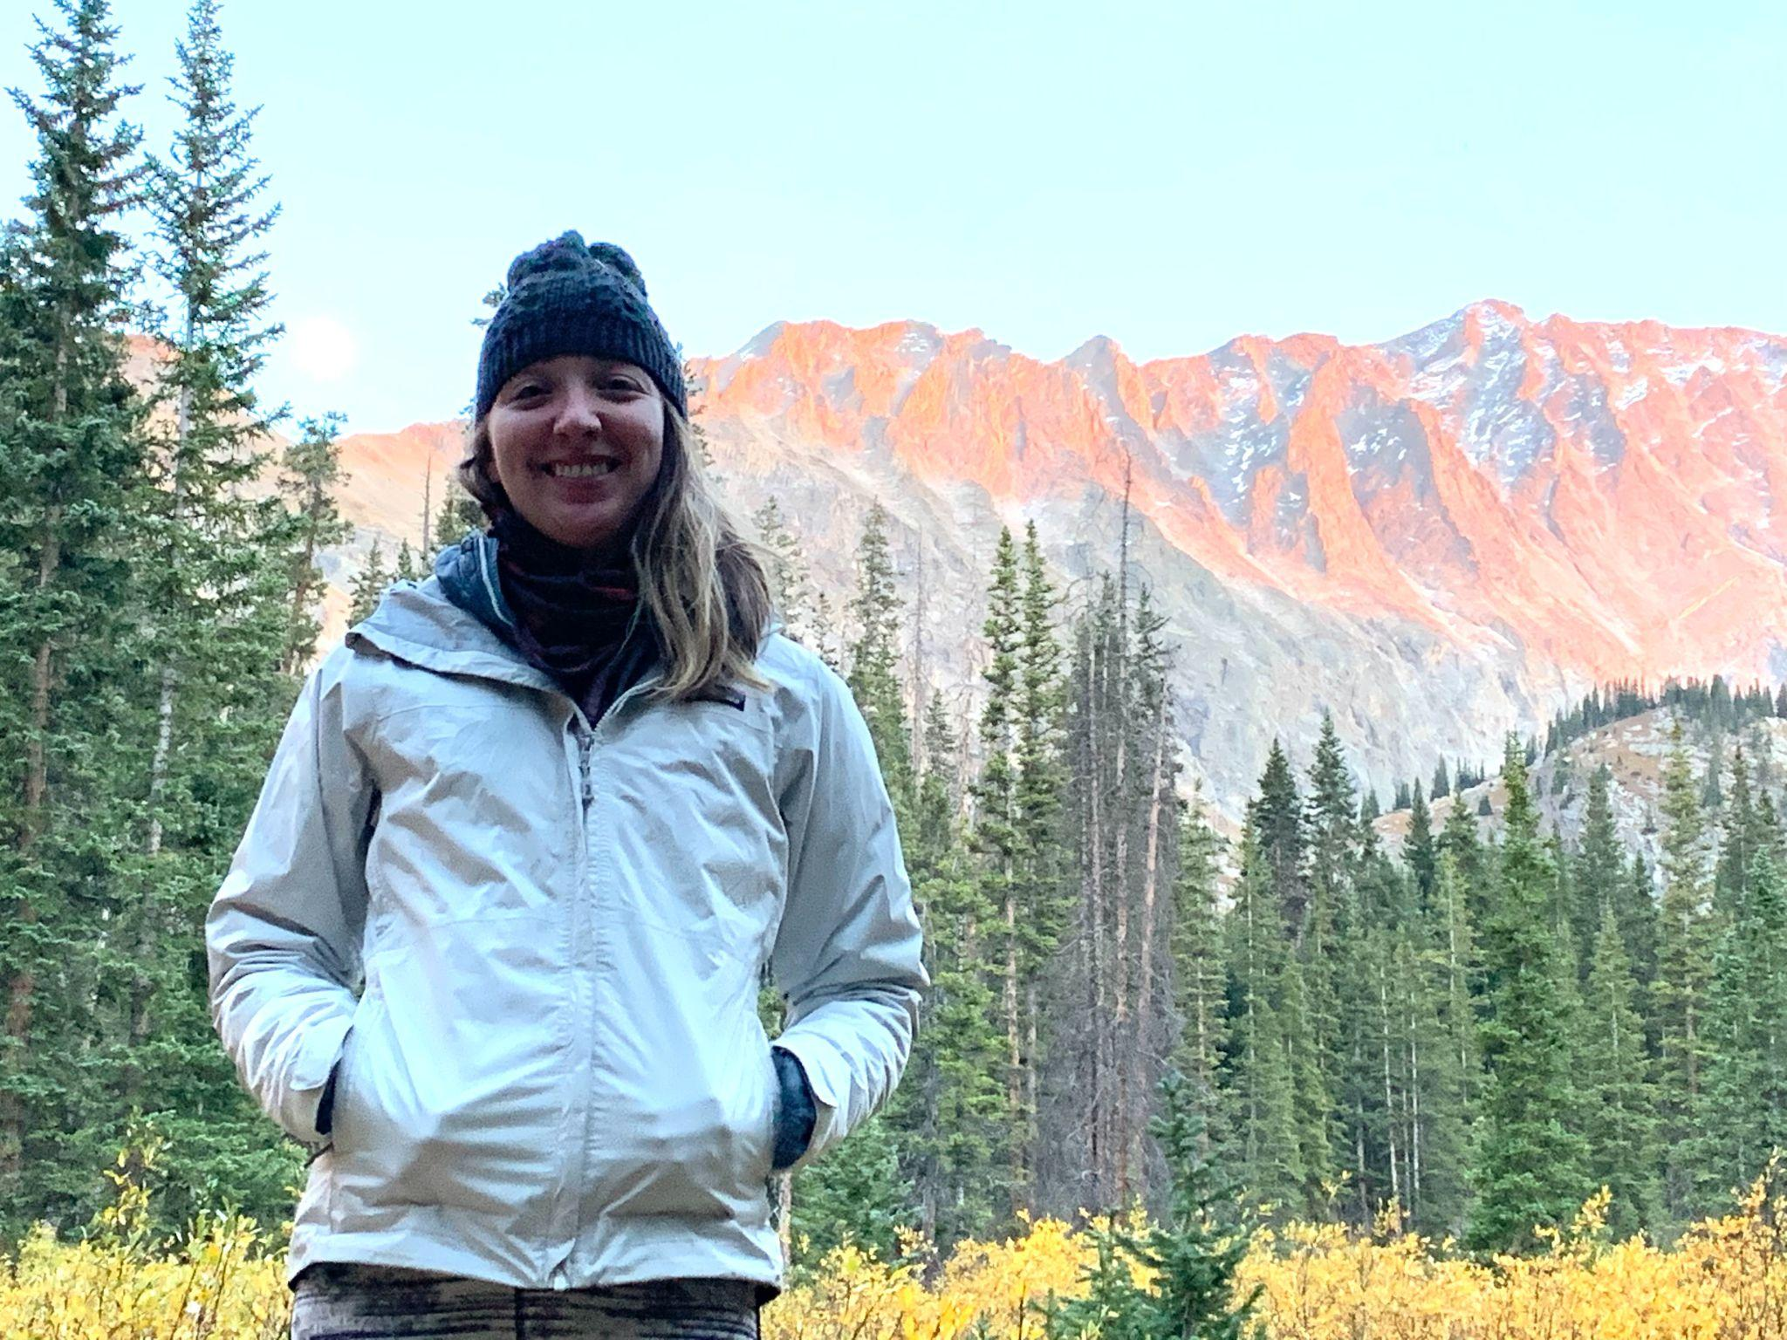
WHO AM I?
ALISON GREGORY
(agregory@ucar.edu)
Community Engagement Specialist for the Unified Forecast System
UCAR UCP CPAESS
Master’s Environmental Sociology
Bachelor’s Atmospheric and Oceanic Science
CIRES, Navigating the New Arctic Community Office
Center for the New Energy Economy - State Legislation

Slide 5
Why Does Community Matter?
Connect People
Provide a shared context
Stimulate Learning
Share Diverse Perspectives
Organize and Share Existing Knowledge
Generate New Knowledge
Sociology: The systematic study of the development, structure, interaction and collective behavior of organized groups of human beings.
Source: Why A Sense of Community is More Important Than Ever
NOAA Social Science Basics

Slide 6
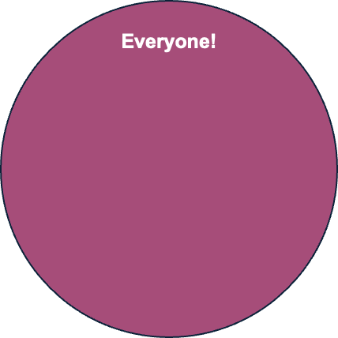
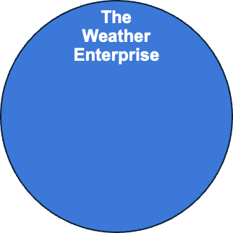
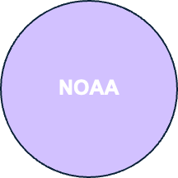
WHO ARE YOU?
THE UFS COMMUNITY IS:
“Every individual and organization from every sector, state, or nation”
Made up of “NOAA and non-NOAA participants”
“The Weather Enterprise (composed of researchers, developers and users from NOAA, educational institutions, federal agencies, or the private sector)”

Slide 7
WHERE IN THE UFS UNIVERSE?
SHARE
THE GREAT BEYOND
“The Impact”
OUR COMMUNITY
EPIC
“Knowledge Center”
EXPLORE
CONNECT
DISCOVER

Slide 8
TYPES OF COMMUNITIES
ACTION
PLACE
Brought together to bring about a specific change
Brought together by geographical boundary
PRACTICE
Brought together by a shared profession, activity, or knowledge domain
INTEREST
CIRCUMSTANCE
Brought together by similar values or passions
Brought together by external events or situations

Slide 9
A Community of Practice
“flexible group of professionals,
informally bound by common interests,
who interact through interdependent tasks guided by a common purpose thereby embodying a store of common knowledge.”
Notes:
Man named Etienne Wenger from Switzerland
-the practice can still be occurring even if the values and passions aren’t aligned
1. Where in the UFS universe?
Now that we’ve set the bounds of our community, I wanted to give ourselves the opportunity to look at our community visually.
We can think of our universe as everything related to the UFS, we can think of the universe as the “Everyone” in our original community definition.
To the right we have our knowledge center. This is where we keep the official knowledge organized and ensure integration with the rest of our solar system. Consider this the EPIC Program office, the github repositories, and all the support provided by our working groups.
This is where we have formalized access to the knowledge structure.
In the middle is most of you. In this part of the universe, we are trying to figure out how to share, support, and collaborate with one another. We can use this conference to connect with one another and share our work. Communities of Practice act as the bridge between everyone in our network and the knowledge center, they can bring new information in, and disseminate knowledge outward.
On the left we have our unvisited planets, that may hold knowledge we are unaware of. Think of this as the community of modelers who have not yet connected to the UFS. Here is where our explorers will find ways to engage with new audiences. They can go out on a scouting mission, interpret the impact of the UFS and bring that information back to our community of practice.
So is the UFS Community actually EVERYONE? I would argue no.
The UFS has access to different networks in the great beyond and the potential to IMPACT everyone, but EVERYONE is not in our community of practice.

Slide 10
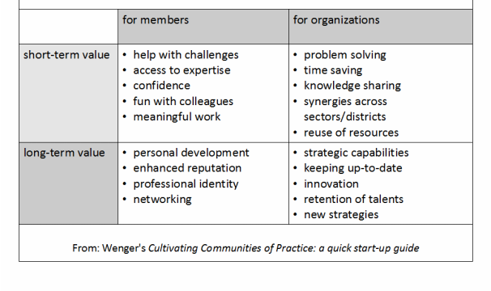
Why use a CoP framework?
Overcome silo mentalities
Align priorities
Improve performance
Communicate better together
Organize planning
Translate vision into action
Notes:
There was a Community of Practice success wheel created after observing 20 communities

Slide 11
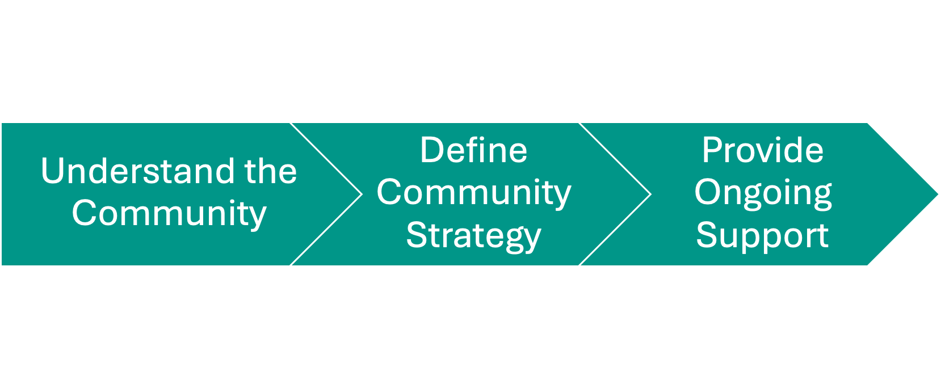
Where do we go from here?
•Ongoing Support
“the organic, spontaneous, and informal nature of communities of practice
make them resistant to supervision and interference.”
Notes:
What is the role of social science for the UFS community?

Slide 12
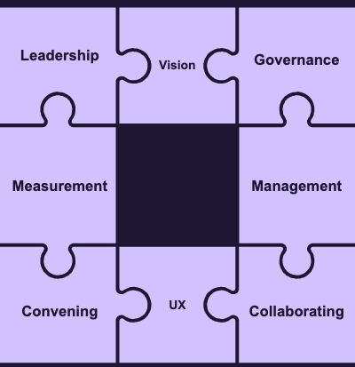
The Community Strategy
Management / Strategy (aka Mission Control)
Governance & Leadership
Vision & Collaborating
Convening
User Experience & Ongoing Measurement/Monitoring

Slide 13
—AFRICAN PROVERB
Questions / Discussion
Alison Gregory
agregory@ucar.edu
UFS Community
Focus Group
Thursday
9:05am - 10:30am
“If you want to go fast, go alone. If you want to go far, go together”

Slide 14
Relevant Resources
European Commission Joint Research Center, European Union (2021). The Communities of Practice Playbook: A playbook to collectively run and develop communities of practice.
Pyrko, I., Dörfler, V., & Eden, C. (2017). Thinking together: What makes Communities of Practice work? Human Relations, 70(4), 389-409. https://doi.org/10.1177/0018726716661040
Introduction to communities of practice Wenger
Why Communities of Practice are Important. Edmonton Regional Learning Consortium. 2016. https://www.communityofpractice.ca/background/why-communities-of-practice-are-important/

Slide 15
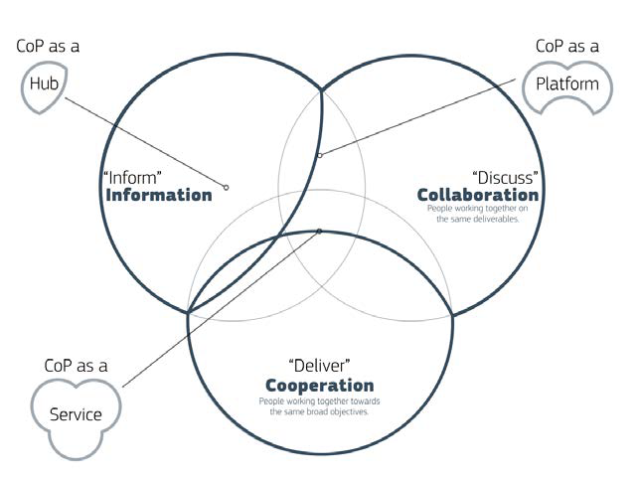
Notes:
“A group of individuals who have interests and problems within the same topic and gain a greater degree of knowledge and expertise through regular interaction.”

Slide 16
EXTRA PLANETS

Slide 17
Building A UFS Community
Community Matters
DATA
We have strategies
Sociology: the systematic study of the development, structure, interaction, and collective behavior of organized groups of human beings
Get Involved
Focus Group Session Thursday 9:05-10:30am
Provide Feedback
Notes:
Community Matters - You are attending this meeting, you’re already a member of the community. What do WE want to do as a community?
We have strategies -
Get Involved -

