Slide 1
Surface Energy Balance Across the 18-site New York State Mesonet Flux Network
Anna Glodzik*, Scott Miller, Sarah Lu, Jason Covert, Atmospheric Sciences Research Center, University at Albany (UAlbany)
Andrew Newman, Mike Ek, Tara Jensen, Kathryn Newman, National Center for Atmospheric Research (NCAR)
Helin Wei, National Oceanic and Atmospheric Administration (NOAA)
Funded by NOAA Joint Technology Transfer Initiative (JTTI) – Collaborative project between UAlbany and NCAR

Slide 2
Advanced Coupling Evaluation Metrics in METplus for UFS Land Surface Models
Aims to advance land-atmosphere coupling evaluation metrics using New York State Mesonet observations in METplus and evaluate high-resolution forecast model output
The New York State Mesonet (NYSM) Flux Network consists of 18 sites across New York that have been measuring surface energy balance components since 2018
To ensure the accuracy of the flux site data, quality assurance flags and/or scores were assigned to each flux measurement
Quality controlled radiation components, turbulent fluxes, and ground heat flux from each flux site were evaluated to identify diurnal, seasonal, and interannual variability in the surface energy budget

Slide 3
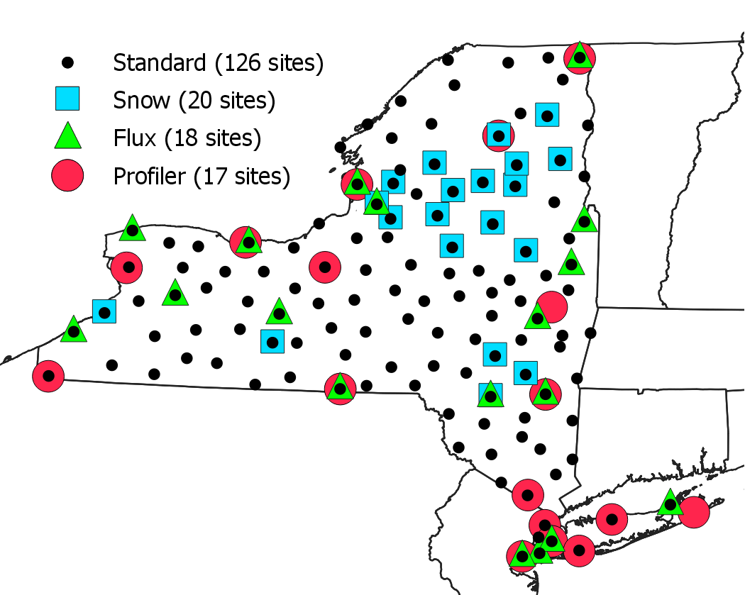
New York State Mesonet
Created in 2014 to be apart of the NYS Early Warning Weather Detection System
126 weather stations across the state that measure standard meteorological variables plus solar radiation, soil temperature and moisture profiles, snow depth
Contains several sub-networks, including a flux network beginning in 2018. Currently 100+ site years of 30-minute flux data
Operated by the University at Albany, the NYSM collects, archives, and processes data every 5 minutes

Slide 4
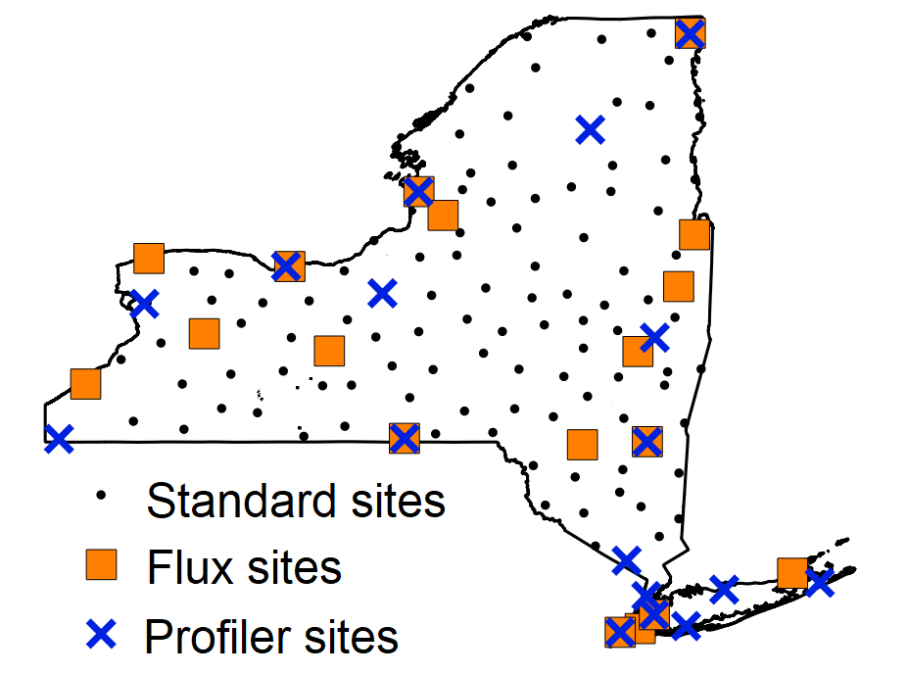
ff
Evaluation Metrics for LSM Processes
Coupled UFS model output
from NOAA/EMC
Standard: T, q,...
Flux and profiler: B, z_{i}, z₀, z_{0h}, z_{0q}, 𝜙(z / L),...
New York State Mesonet
Observations
Retrospective METplus use-cases
Near real-time METplus
Guidance/
feedback
Noah-MP (uncoupled)

Slide 5
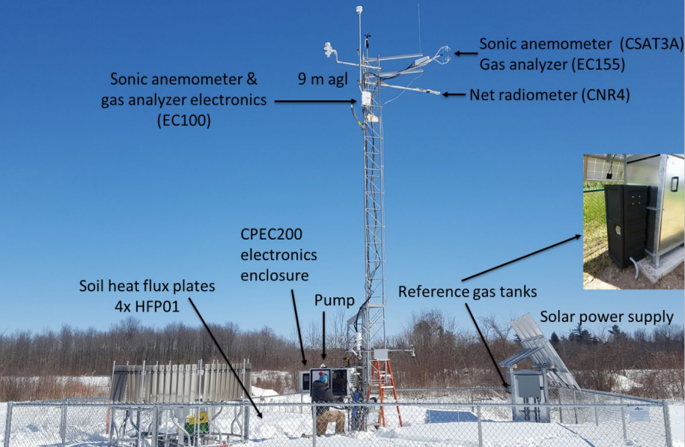
Flux Network
18 eddy covariance stations
Sensors measure both incoming and outgoing shortwave and longwave radiation, soil heat flux, and turbulent fluxes of momentum, sensible and latent heat, and carbon dioxide
Turbulence sensors measure at 10 Hz
Chazy Flux Site

Slide 6
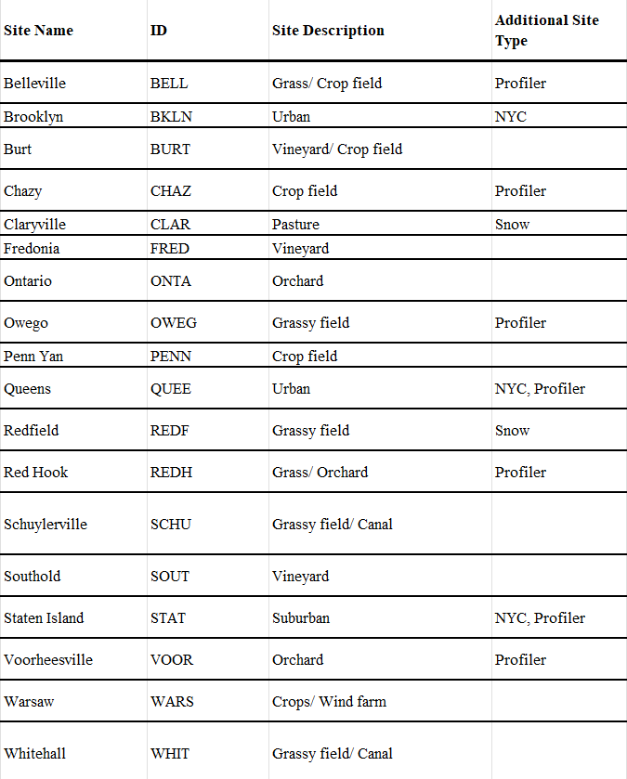
Data & Quality Control
Radiation (SW_{in}, SW_{out}, LW_{in}, LW_{out}), ground heat flux
Turbulent fluxes: momentum (𝜏), heat (H_{S}), moisture or latent heat (H_{L}), CO₂ (micromol/m²/s)
30-minute fluxes computed in real time on Campbell CR6 datalogger using EZFlux software and transferred back to NYSM servers
For each 30 minute flux, a QC flag is included in the final dataset
Based on a series of three tests that assign a value of 1-9 to each reading

Slide 7
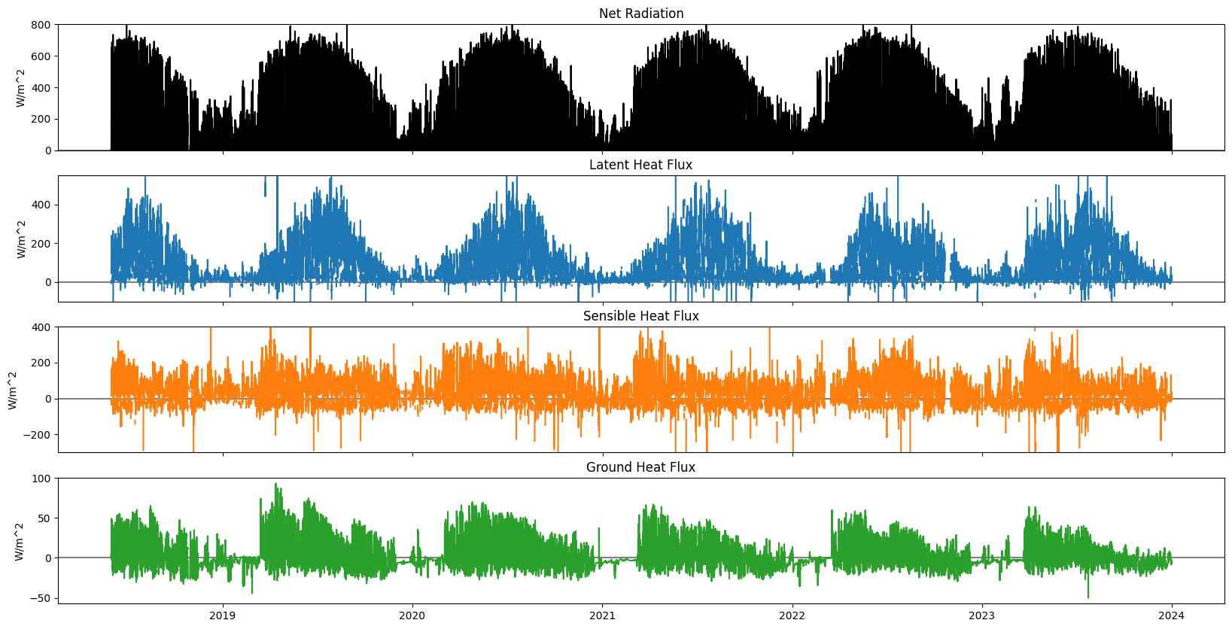
30-minute Fluxes (6 years,Voorheesville)
R_{n}-G=H_{S}+H_{L}
QC 1-6

Slide 8
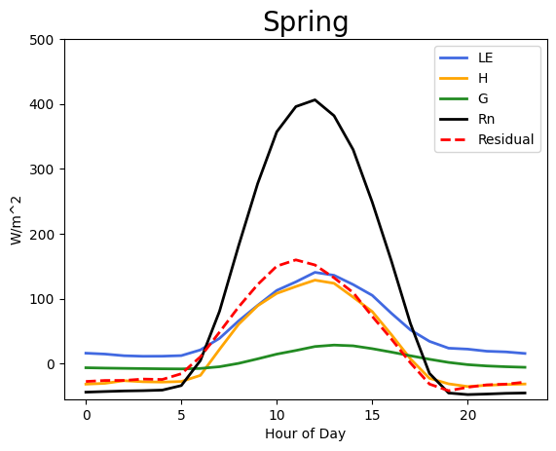
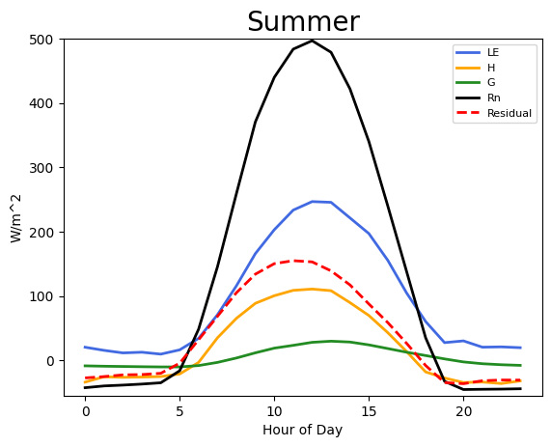
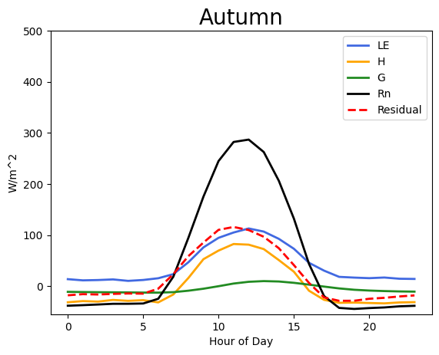
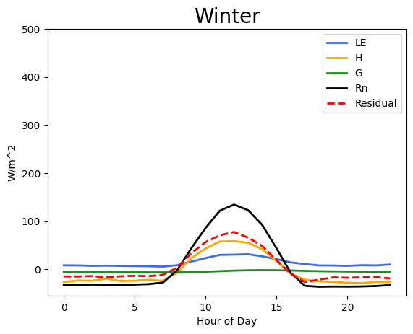
Seasonal Diurnal Energy Budget (Voorheesville)
Residual = R_{n}- G - H_{S} - H_{L}
Residual is the amount of energy not accounted for in the energy budget equation when closure is not 100%
Higher residual values in warmer months… but a larger radio of residual to total radiation in the winter

Slide 9
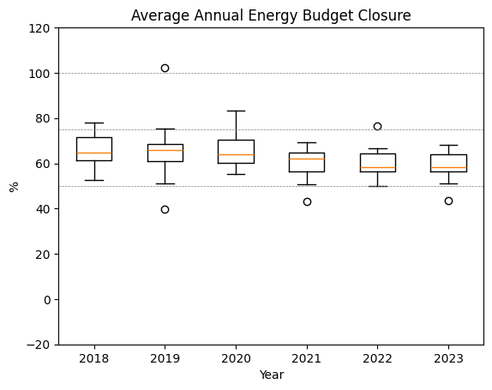
Annual Midday Surface Energy Balance
Each boxplot represents the 15 non-urban sites
Calculated the average energy budget closure during peak radiation hours at each site each year (approx 10am-2pm)
Note: does not include ground storage between surface and 6 cm
Energy budget closure = (H_{S}+H_{L})/(R_{n}-G)*100

Slide 10
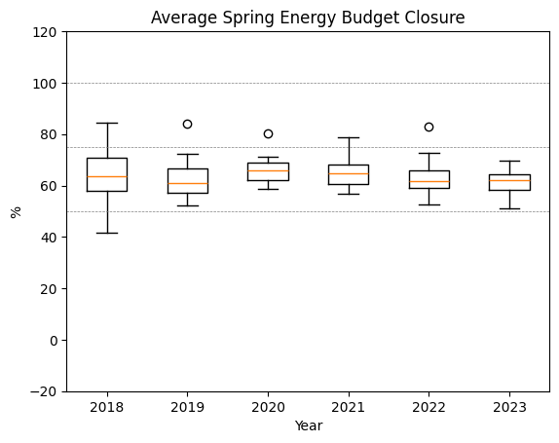
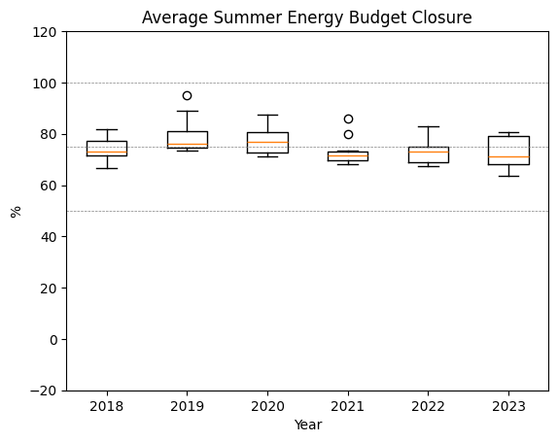
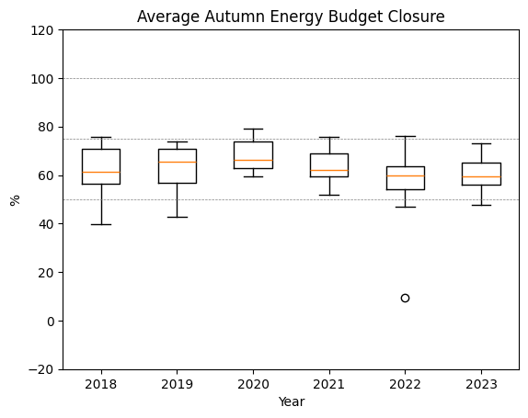
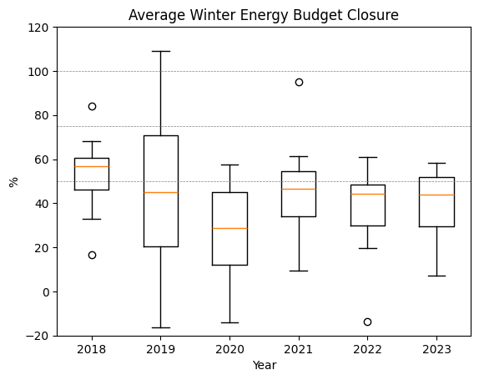
Seasonal Surface Energy Balance
Highest and most consistent energy budget closure across all sites in the summer
Low closure in the winter
Fluxes and net radiation components are all smaller
Snow and ice adds complexity to calculating heat exchange

Slide 11
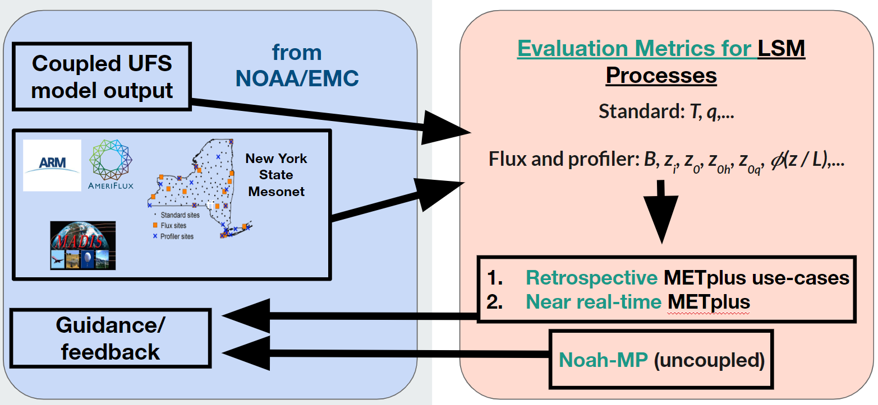
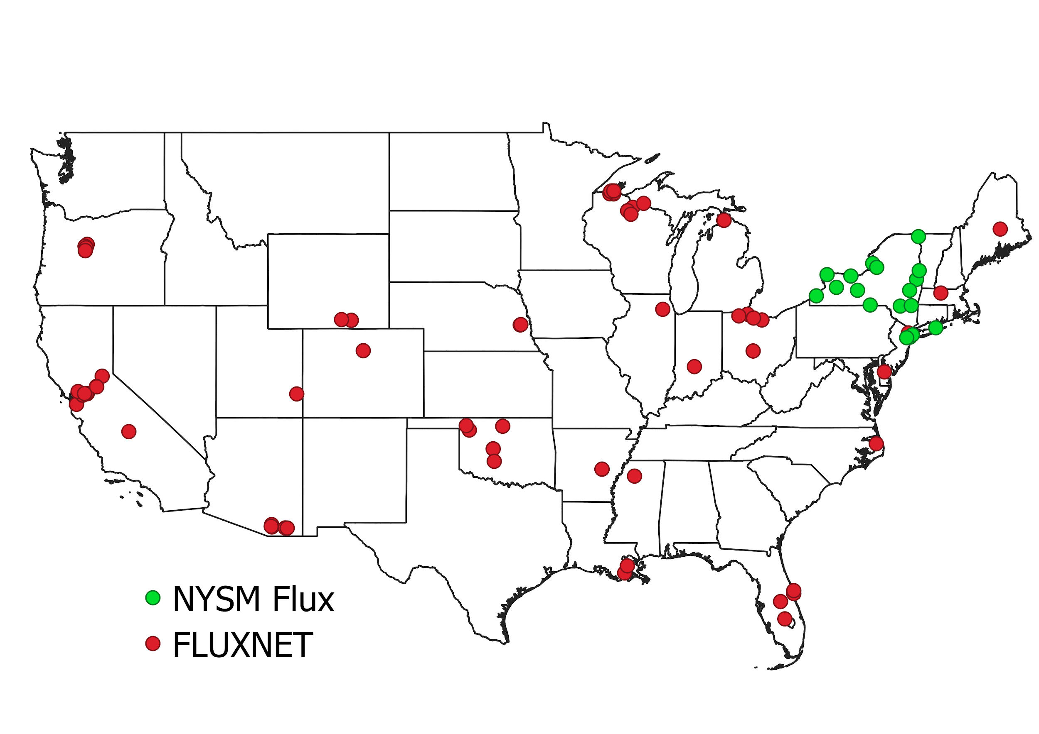
Future Work
Combine model output with NYSM data to create METplus suite metrics
Run Noah MP uncoupled offline simulations driven by NYSM meteorological data
Bring in other flux networks (AmeriFlux, NEON)

Slide 12
Thank you!
Questions?
NOAA Weather Program Office FY22 JTTI
Award number: NA22OAR4590181

Slide 13
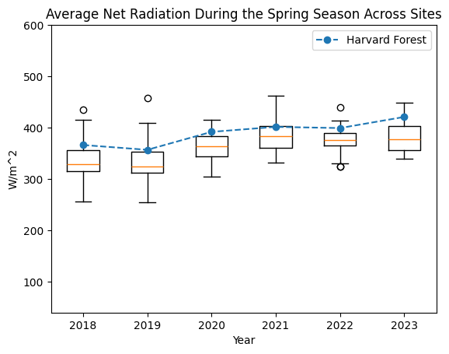
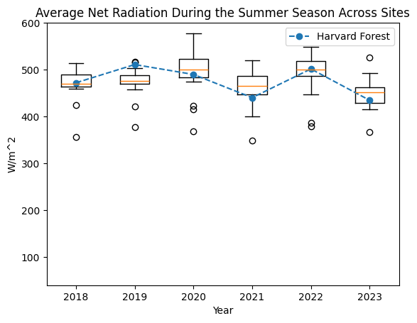
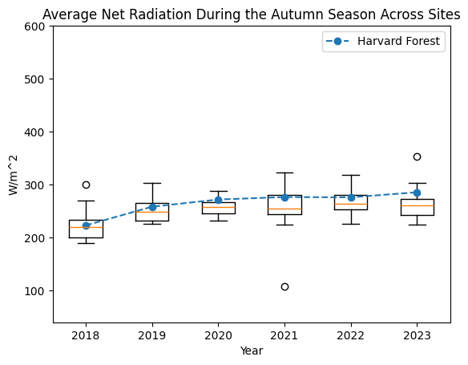
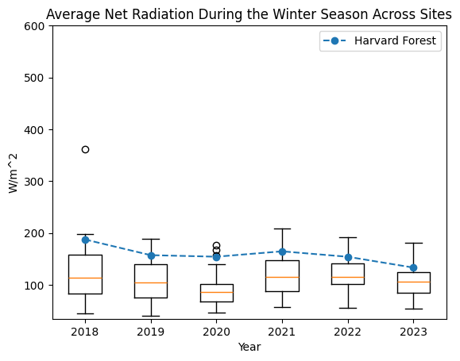
Data Validation
NEON Harvard
forest site

