Slide 1


Change in Lake Michigan’s circulation dynamics with varying bathymetry
Nowrin MOW¹*, Bishnupriya SAHOO¹, Meng XIA¹, Ayumi FUJISAKI-MANOME²
¹University of Maryland Eastern Shore, United States, ²University of Michigan, United States

Slide 2
Background
Lake Michigan
The second largest of the Laurentian Great Lakes by water volume
Impacts regional weather and climate
And have
Tourism industry
Lakeside developments
Coastline protection
Notes:
The vast water body maintains a lower air temperature in the surrounding area in summer and vice versa in winter.
Beach tourism alone brings 14–31 million people to the Chicago’s shoreline per year
Chicago visitors spent nearly $17 billion in 2022

Slide 3
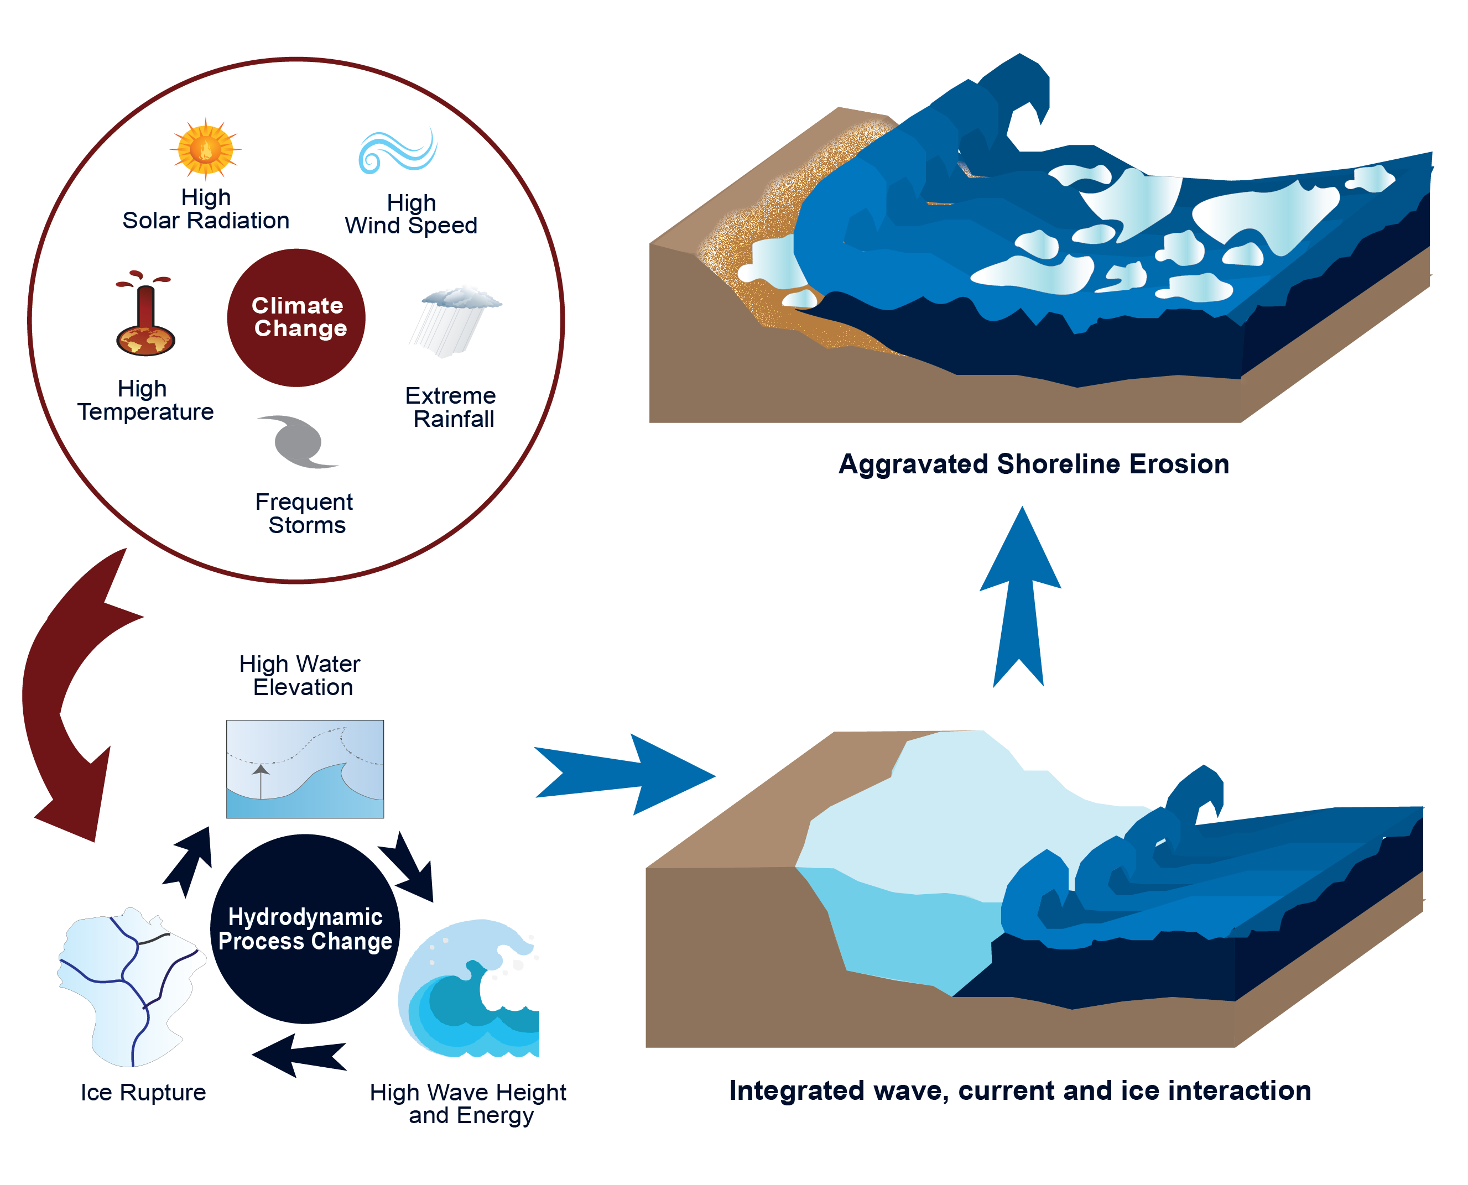
Background
However
Climate is Changing
Affected hydrodynamic processes
Reported increased coastal erosions
Sediment plumes
Affected lake ecology and coastal community health.
Notes:
The vast water body maintains a lower air temperature in the surrounding area in summer and vice versa in winter.
Beach tourism alone brings 14–31 million people to the Chicago’s shoreline per year
Chicago visitors spent nearly $17 billion in 2022

Slide 4
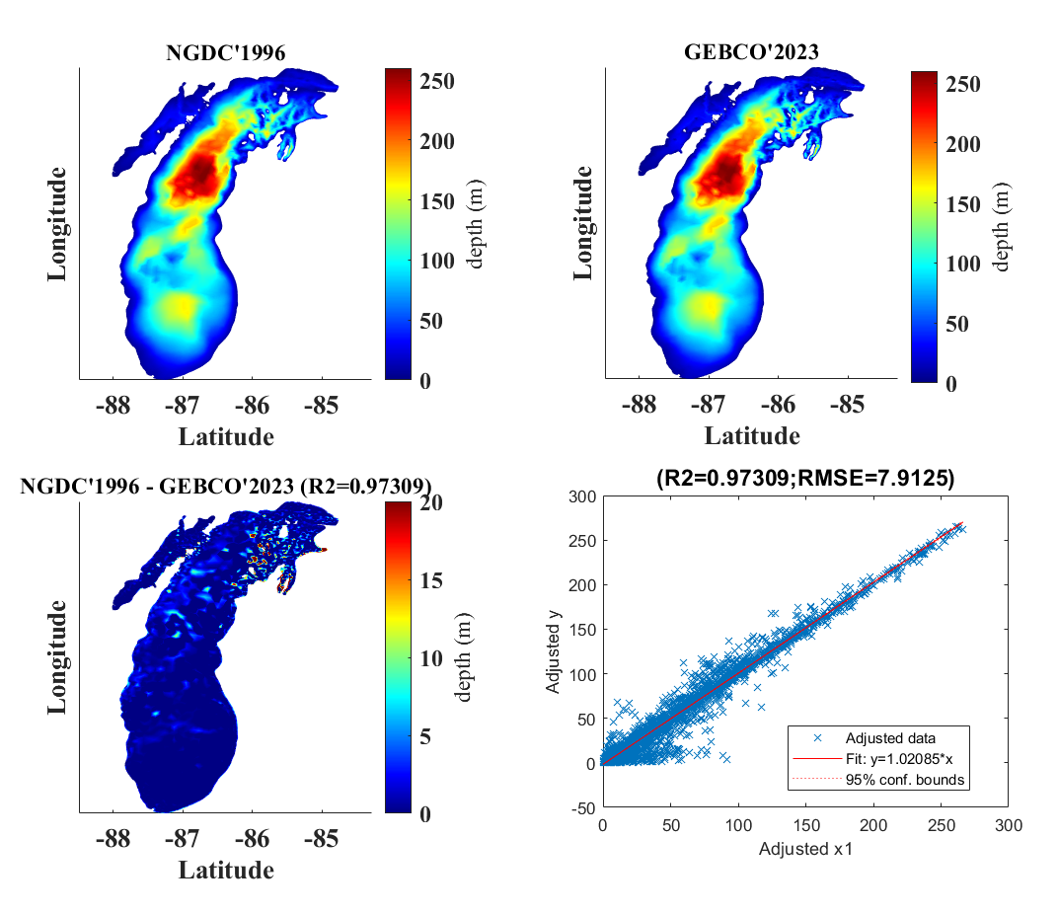
Background
Bathymetry compiled by the National Geophysical Data Center in 1996 (old)
GEBCO’s current gridded bathymetric data set, a global terrain model (2023) (new)
Bathymetric variation of about 50 m in north-east to mid-east Lake Michigan.
  Therefore
  This study offers-
  Comparisons of the effect of lake bathymetry change on lake circulation dynamics
Notes:
The vast water body maintains a lower air temperature in the surrounding area in summer and vice versa in winter.
Beach tourism alone brings 14–31 million people to the Chicago’s shoreline per year
Chicago visitors spent nearly $17 billion in 2022

Slide 5
Methodology
Input forcings
Air temperature and pressure, precipitation, evaporation, heat fluxes, cloud cover, specific relative humidity (NARR)
Wind speed (CFSV2)
Open boundary water level (NOAA station)
5 rivers – flow and temperature (USGS)
Mesh
Triangular mesh
Unstructured grid
Nearshore resolution 340 m, offshore resolution 7.6 km
Nodes: 5256
Elements: 9581
FVCOM-SWAVE-CICE coupled model
Hydrodynamic
SWAVE
SWAVE-CICE
Notes:
The vast water body maintains a lower air temperature in the surrounding area in summer and vice versa in winter.
Beach tourism alone brings 14–31 million people to the Chicago’s shoreline per year
Chicago visitors spent nearly $17 billion in 2022

Slide 6
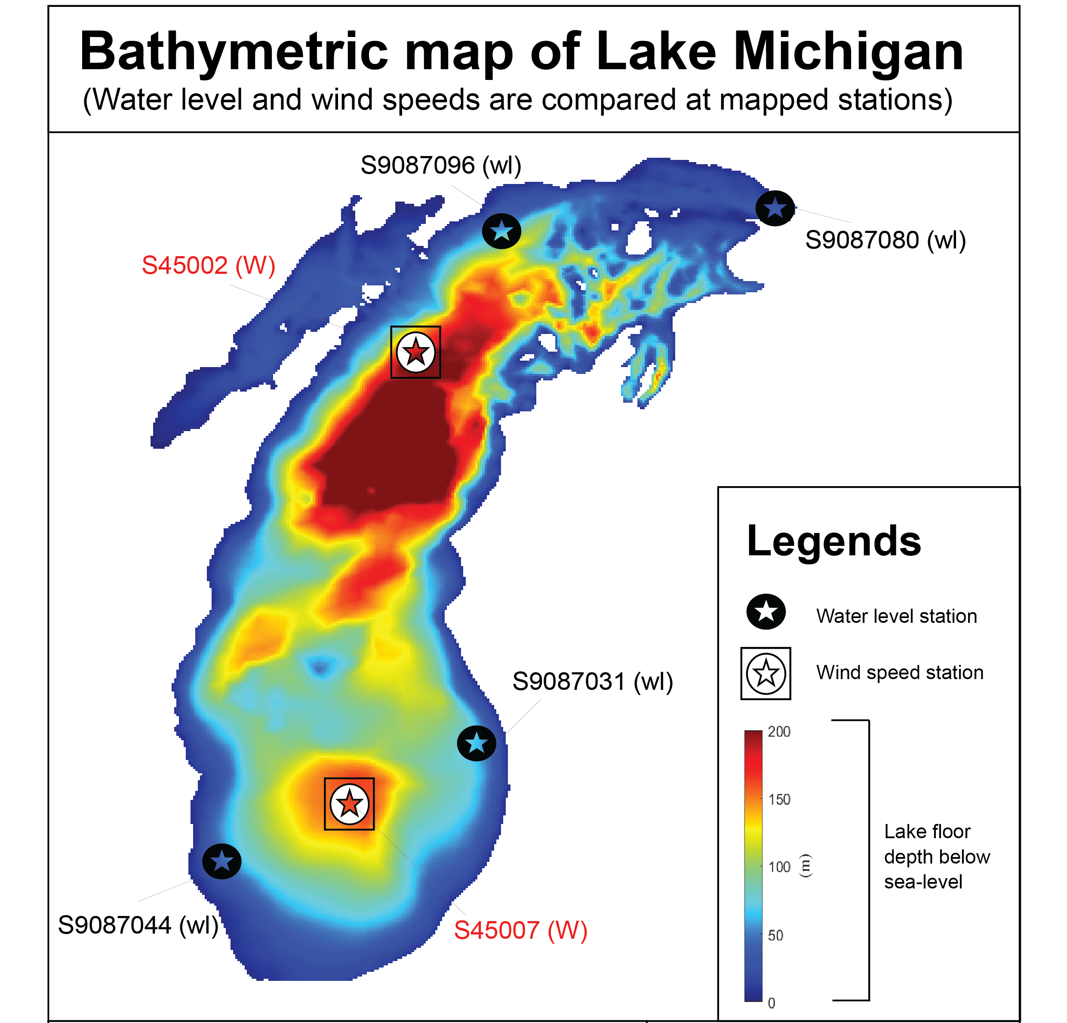
Methodology
Results
Models/ Bathymetry | Hydrodynamic (H) | Wave-current (WC) | Wave-current-ice (WCI)
NGDC’1996 | Jan-Dec’23 | July-Aug’23 | Jan-Feb’23
GEBCO’2023 | Jan-Dec’23 | July-Aug’23
% of change = (Y-X)/X*100
Here, Lake average of Model data using
NGDC’1996 bathymetry = X
GEBCO’2023 bathymetry = Y
Validation
LST, WL, SWH (NDBC)
Current (ADCP)
geoid
Notes:
The vast water body maintains a lower air temperature in the surrounding area in summer and vice versa in winter.
Beach tourism alone brings 14–31 million people to the Chicago’s shoreline per year
Chicago visitors spent nearly $17 billion in 2022

Slide 7
Results and Discussions
Water Elevation (m)
Water elevation
Average lake water surface level (176 m above mean sea level)
Notes:
The vast water body maintains a lower air temperature in the surrounding area in summer and vice versa in winter.
Beach tourism alone brings 14–31 million people to the Chicago’s shoreline per year
Chicago visitors spent nearly $17 billion in 2022

Slide 8
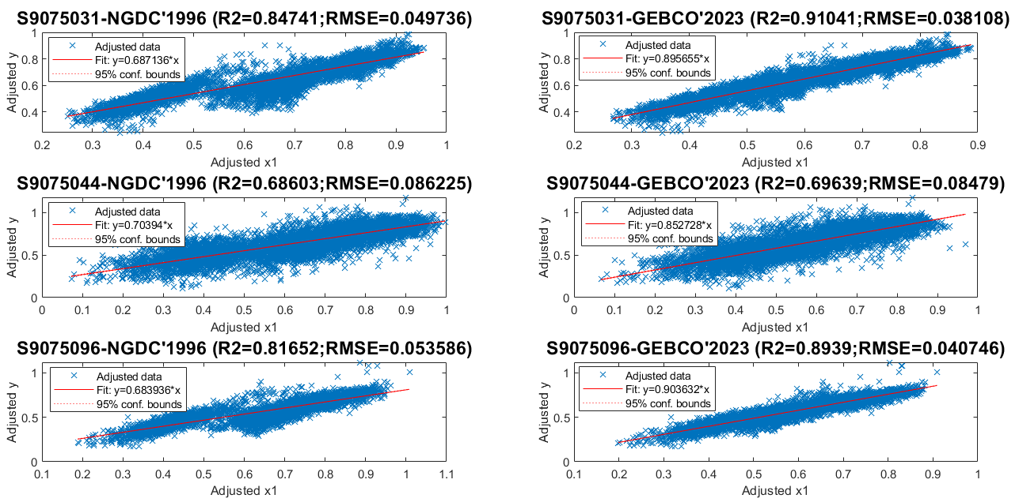
Results and Discussions
Water Elevation (m)-H
R2₉₆ < R2₂₃
RMSE₉₆ > RMSE₂₃
Notes:
The vast water body maintains a lower air temperature in the surrounding area in summer and vice versa in winter.
Beach tourism alone brings 14–31 million people to the Chicago’s shoreline per year
Chicago visitors spent nearly $17 billion in 2022

Slide 9
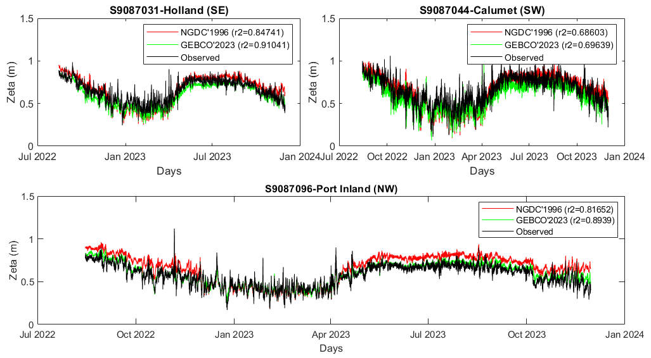
Results and Discussions
Water Elevation (m)-H
% of change
- 9.36
Notes:
The vast water body maintains a lower air temperature in the surrounding area in summer and vice versa in winter.
Beach tourism alone brings 14–31 million people to the Chicago’s shoreline per year
Chicago visitors spent nearly $17 billion in 2022

Slide 10
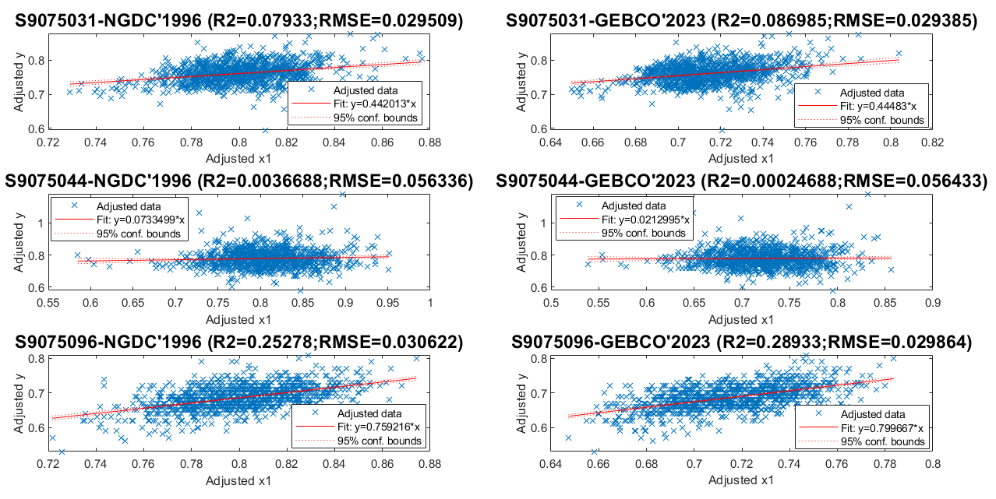
Results and Discussions
Water Elevation (m)-WC
Summer 2023
R2₉₆ < R2₂₃
RMSE₉₆ > RMSE₂₃
Notes:
The vast water body maintains a lower air temperature in the surrounding area in summer and vice versa in winter.
Beach tourism alone brings 14–31 million people to the Chicago’s shoreline per year
Chicago visitors spent nearly $17 billion in 2022

Slide 11
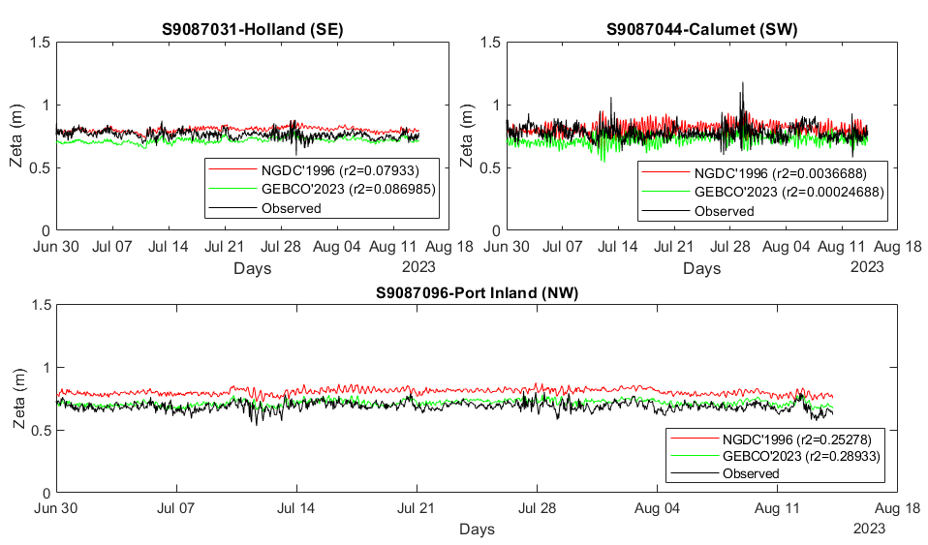
Results and Discussions
Water Elevation (m)-WC
Summer 2023
% of change
- 10.46
Notes:
The vast water body maintains a lower air temperature in the surrounding area in summer and vice versa in winter.
Beach tourism alone brings 14–31 million people to the Chicago’s shoreline per year
Chicago visitors spent nearly $17 billion in 2022

Slide 12
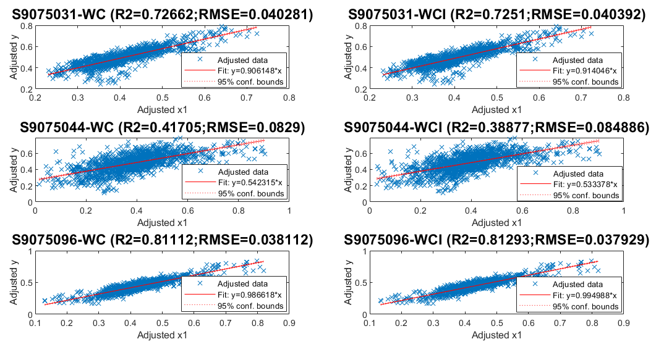
Results and Discussions
Water Elevation (m)-WCI
Winter 2022-2023
R2₉₆ < R2₂₃
RMSE₉₆ > RMSE₂₃
Notes:
The vast water body maintains a lower air temperature in the surrounding area in summer and vice versa in winter.
Beach tourism alone brings 14–31 million people to the Chicago’s shoreline per year
Chicago visitors spent nearly $17 billion in 2022

Slide 13
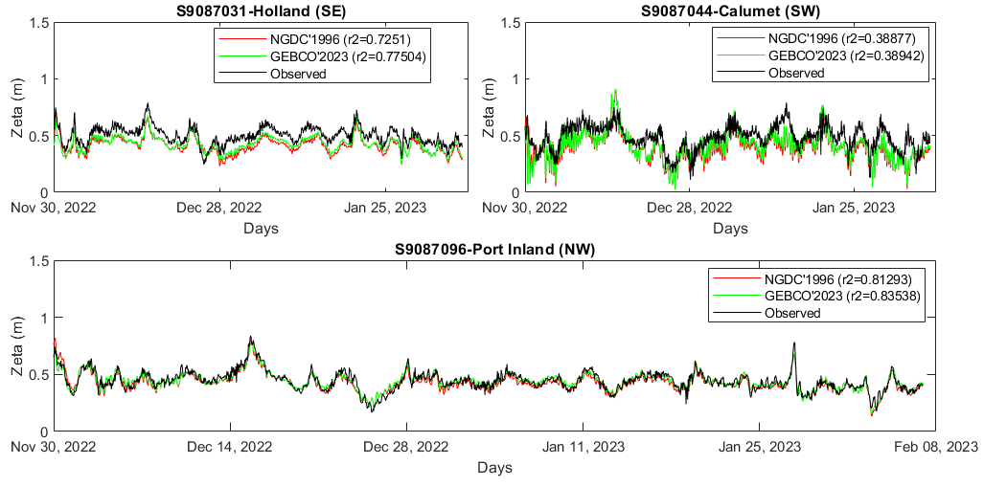
Results and Discussions
Water Elevation (m)-WCI
Winter 2022-2023
% of change
+3.1
Notes:
The vast water body maintains a lower air temperature in the surrounding area in summer and vice versa in winter.
Beach tourism alone brings 14–31 million people to the Chicago’s shoreline per year
Chicago visitors spent nearly $17 billion in 2022

Slide 14
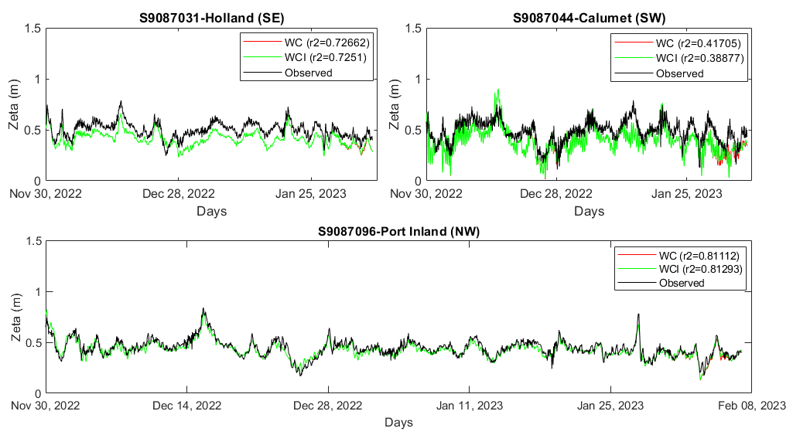
Results and Discussions
Water Elevation (m)- WC vs WCI
Winter 2022-2023
RMSE_{WCI}> RMSE_{WC}
(Southern lake)
RMSE_{WC}> RMSE_{WCI}
(Northern lake)
Notes:
The vast water body maintains a lower air temperature in the surrounding area in summer and vice versa in winter.
Beach tourism alone brings 14–31 million people to the Chicago’s shoreline per year
Chicago visitors spent nearly $17 billion in 2022

Slide 15
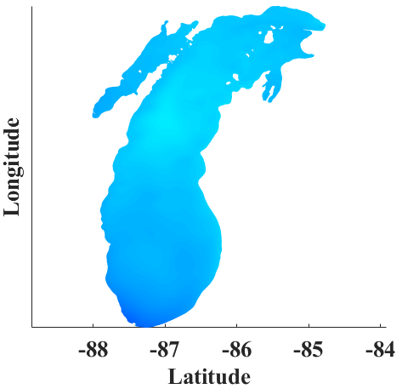
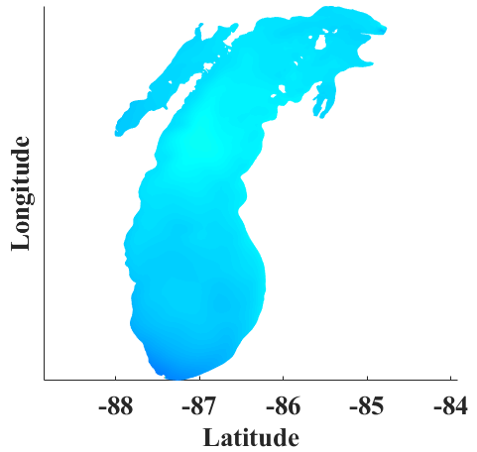
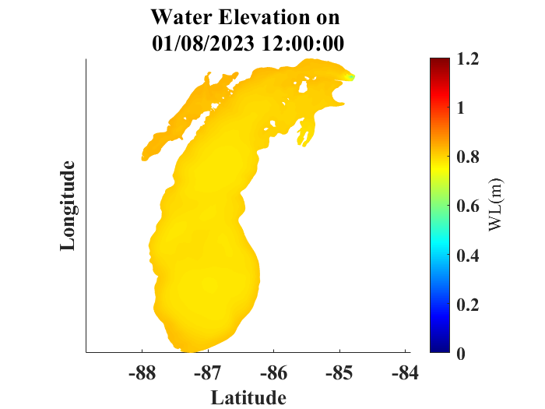
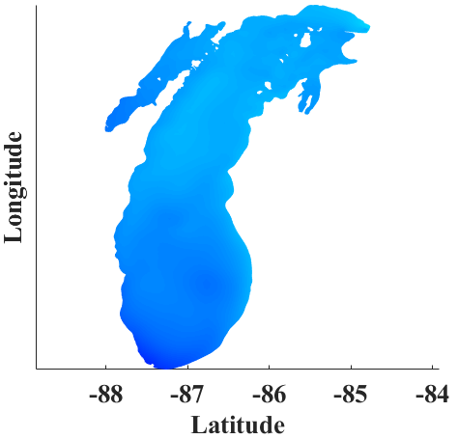

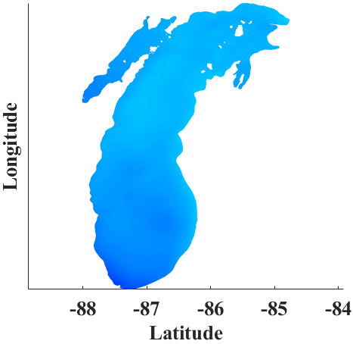
Results and Discussions
Water Elevation (m) on 05 Feb’23
Winter 2023
NGDC’1996-H
GEBCO’2023-H
NGDC’1996-WCI
NGDC’1996-WC
GEBCO’2023-WCI
Notes:
The vast water body maintains a lower air temperature in the surrounding area in summer and vice versa in winter.
Beach tourism alone brings 14–31 million people to the Chicago’s shoreline per year
Chicago visitors spent nearly $17 billion in 2022

Slide 16
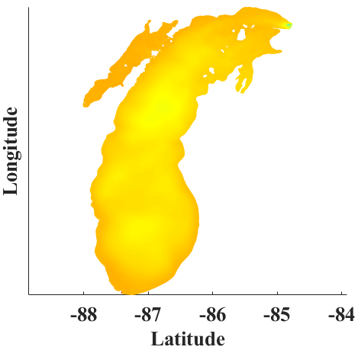
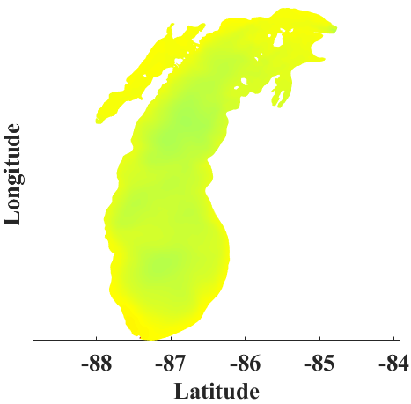

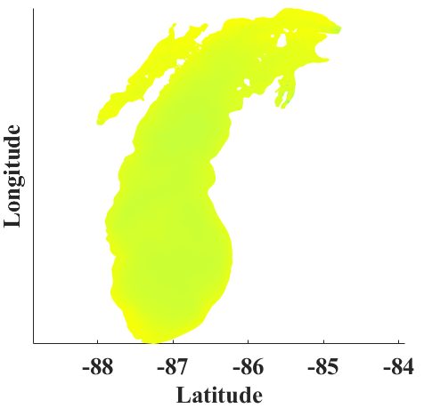
Results and Discussions
Water Elevation (m) on 01 Aug’23
Summer 2023
NGDC’1996-H
GEBCO’2023-H
NGDC’1996-WC
NGDC’1996-WCI
GEBCO’2023-WC
Notes:
The vast water body maintains a lower air temperature in the surrounding area in summer and vice versa in winter.
Beach tourism alone brings 14–31 million people to the Chicago’s shoreline per year
Chicago visitors spent nearly $17 billion in 2022

Slide 17
Results and Discussions
Lake Surface Temperature (LST) (⁰C)
Notes:
The vast water body maintains a lower air temperature in the surrounding area in summer and vice versa in winter.
Beach tourism alone brings 14–31 million people to the Chicago’s shoreline per year
Chicago visitors spent nearly $17 billion in 2022

Slide 18
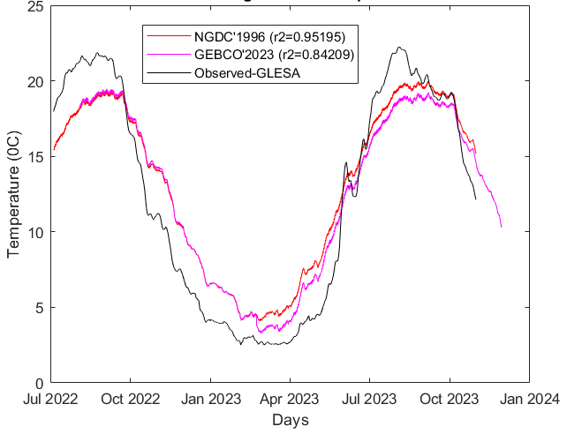
Results and Discussions
Average LST (⁰C)-H
% of change
4.792
R2₉₆ > R2₂₃
Notes:
The vast water body maintains a lower air temperature in the surrounding area in summer and vice versa in winter.
Beach tourism alone brings 14–31 million people to the Chicago’s shoreline per year
Chicago visitors spent nearly $17 billion in 2022

Slide 19
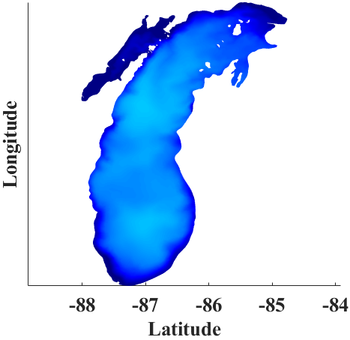
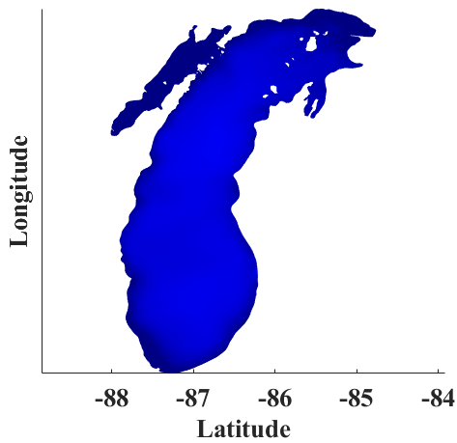
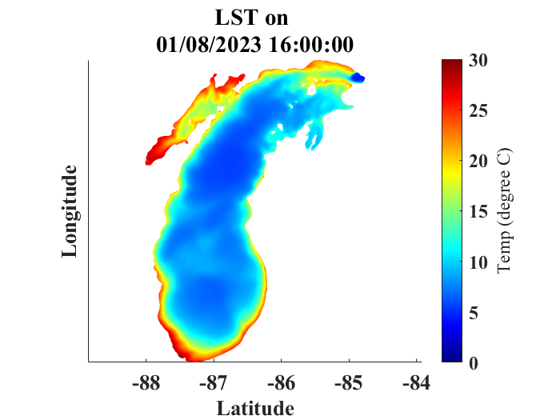



Results and Discussions
LST (⁰C) - on 05 Feb’23
Winter 2023
NGDC’1996-H
GEBCO’2023-H
NGDC’1996-WCI
NGDC’1996-WC
GEBCO’2023-WCI
However
Notes:
The vast water body maintains a lower air temperature in the surrounding area in summer and vice versa in winter.
Beach tourism alone brings 14–31 million people to the Chicago’s shoreline per year
Chicago visitors spent nearly $17 billion in 2022

Slide 20
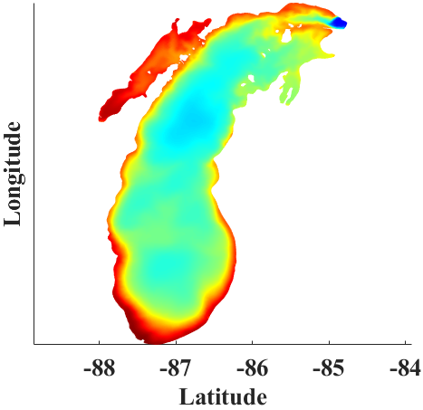
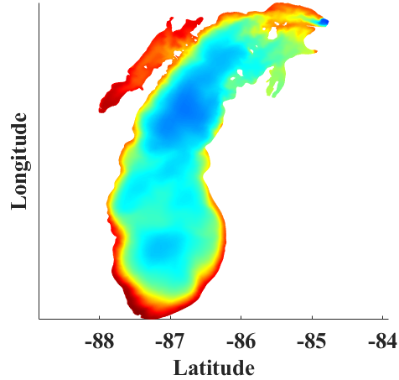


Results and Discussions
LST (⁰C) - on 01 Aug’23
Summer 2023
NGDC’1996-H
GEBCO’2023-H
NGDC’1996-WC
NGDC’1996-WCI
GEBCO’2023-WC
However
Notes:
The vast water body maintains a lower air temperature in the surrounding area in summer and vice versa in winter.
Beach tourism alone brings 14–31 million people to the Chicago’s shoreline per year
Chicago visitors spent nearly $17 billion in 2022

Slide 21
Results and Discussions
Current Speed (cm/s)
Notes:
The vast water body maintains a lower air temperature in the surrounding area in summer and vice versa in winter.
Beach tourism alone brings 14–31 million people to the Chicago’s shoreline per year
Chicago visitors spent nearly $17 billion in 2022

Slide 22
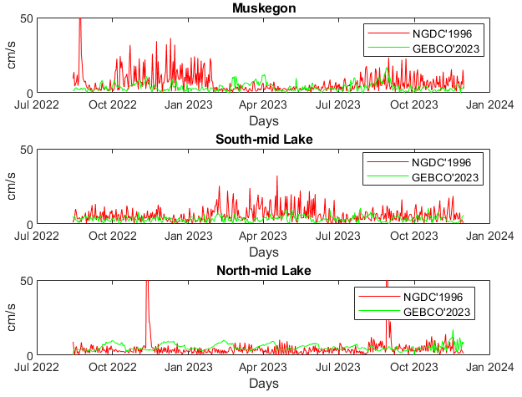
Results and Discussions
Current speed (cm/s)-H
% of change
-1.52
However
Notes:
The vast water body maintains a lower air temperature in the surrounding area in summer and vice versa in winter.
Beach tourism alone brings 14–31 million people to the Chicago’s shoreline per year
Chicago visitors spent nearly $17 billion in 2022

Slide 23
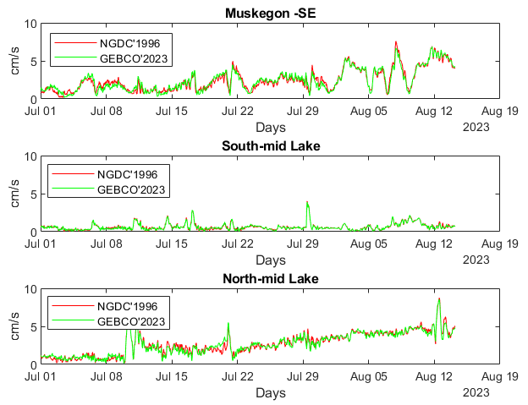
Results and Discussions
Current speed (cm/s)-WC
Summer 2023
% of change
+1.8
However
Notes:
The vast water body maintains a lower air temperature in the surrounding area in summer and vice versa in winter.
Beach tourism alone brings 14–31 million people to the Chicago’s shoreline per year
Chicago visitors spent nearly $17 billion in 2022

Slide 24
Results and Discussions
Ice cover
-Ice thickness (inches/grid area)
-Ice concentration (%)
Notes:
The vast water body maintains a lower air temperature in the surrounding area in summer and vice versa in winter.
Beach tourism alone brings 14–31 million people to the Chicago’s shoreline per year
Chicago visitors spent nearly $17 billion in 2022

Slide 25
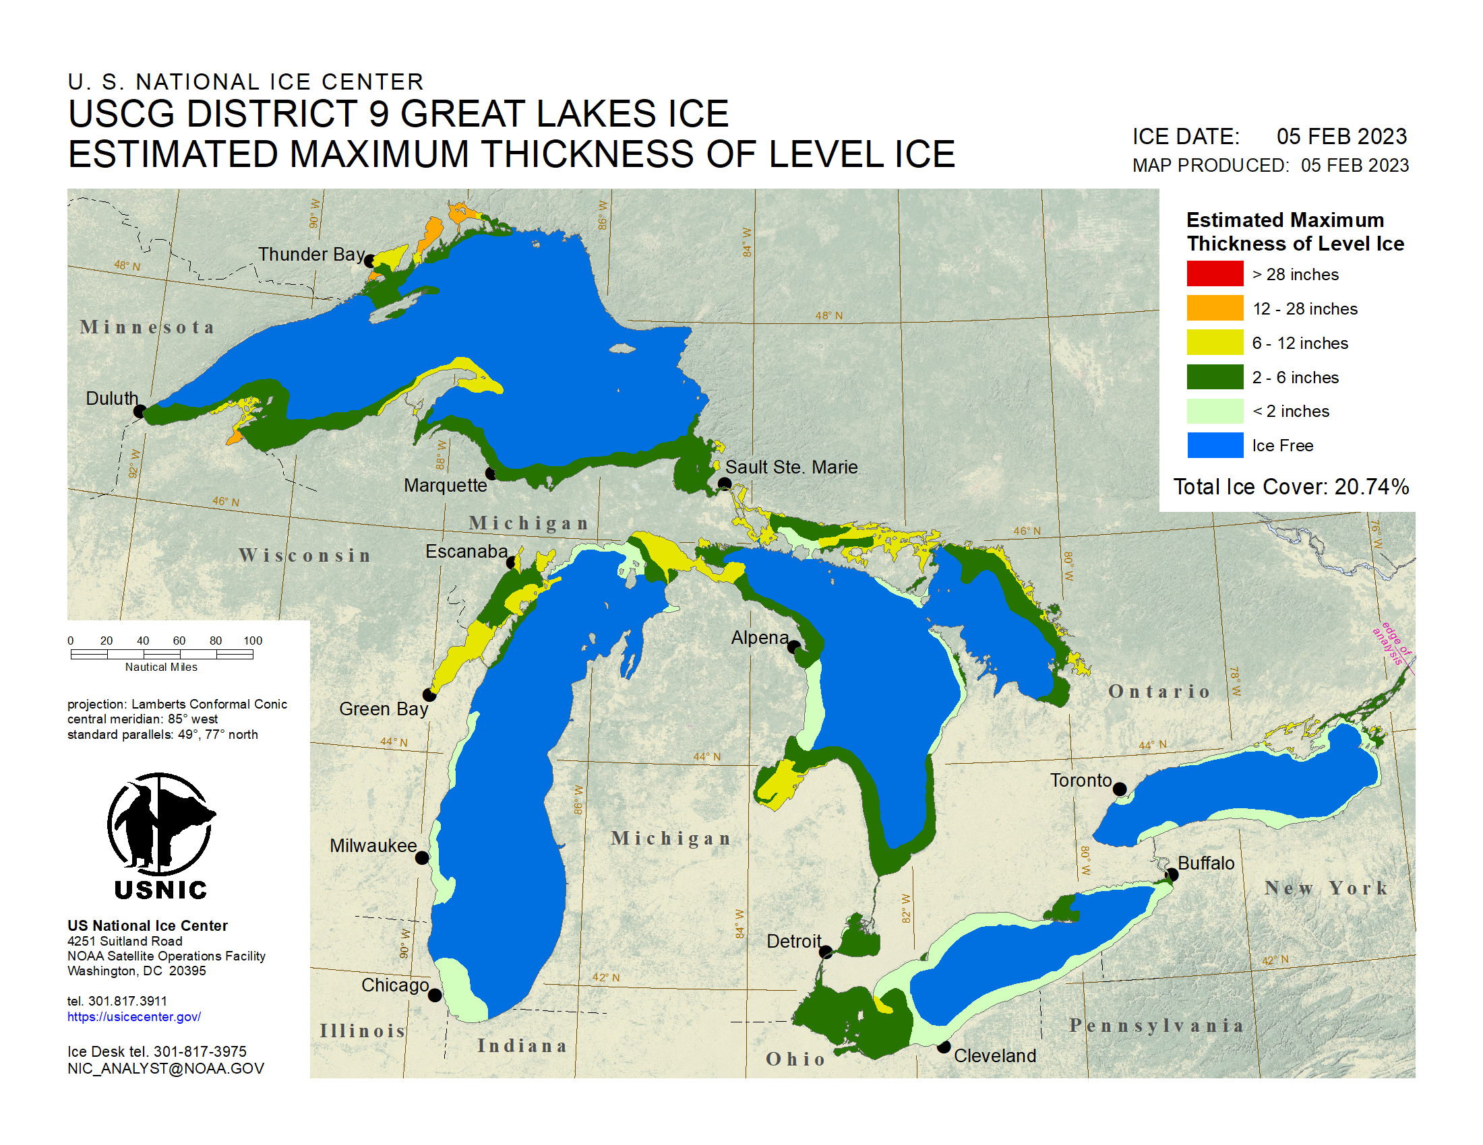
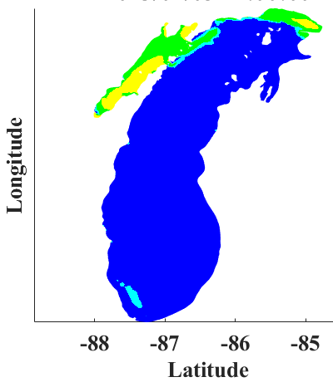


Results and Discussions
Ice thickness –WCI
05 Feb’2023
% of change +1.3
NGDC’1996-WCI
GEBCO’2023-WCI
However
Notes:
The vast water body maintains a lower air temperature in the surrounding area in summer and vice versa in winter.
Beach tourism alone brings 14–31 million people to the Chicago’s shoreline per year
Chicago visitors spent nearly $17 billion in 2022

Slide 26
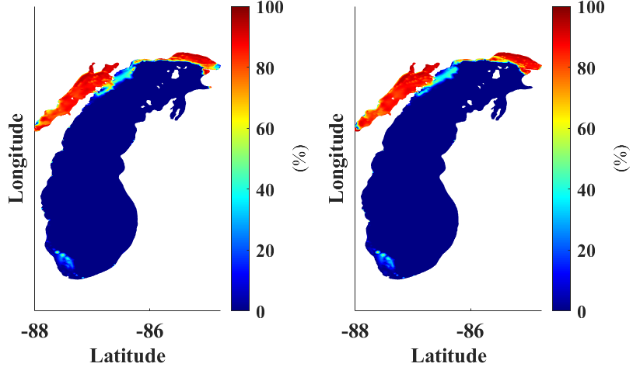
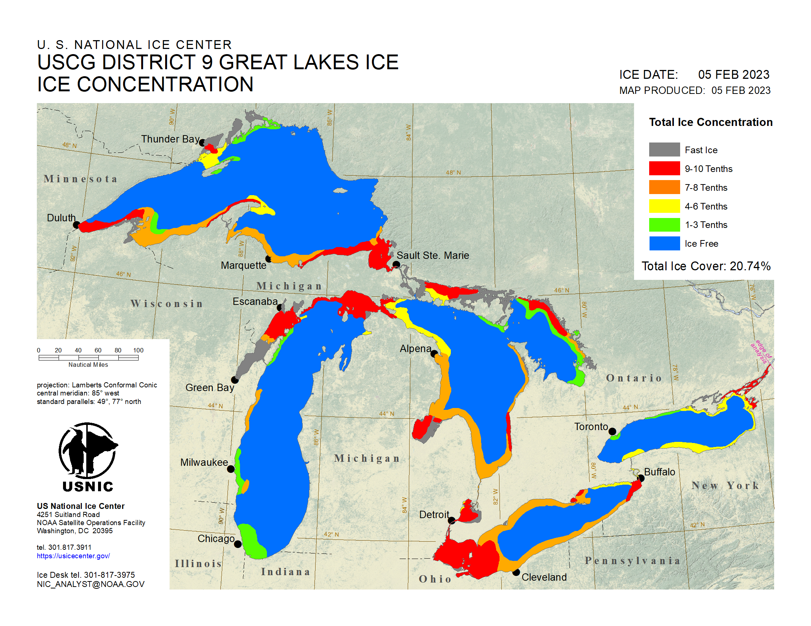
Results and Discussions
Ice concentration (%) –WCI
05 Feb’2023
NGDC’1996-WCI
GEBCO’2023-WCI
Notes:
The vast water body maintains a lower air temperature in the surrounding area in summer and vice versa in winter.
Beach tourism alone brings 14–31 million people to the Chicago’s shoreline per year
Chicago visitors spent nearly $17 billion in 2022

Slide 27
Results and Discussions
Significant Wave Height (SWH) (cm)
Notes:
The vast water body maintains a lower air temperature in the surrounding area in summer and vice versa in winter.
Beach tourism alone brings 14–31 million people to the Chicago’s shoreline per year
Chicago visitors spent nearly $17 billion in 2022

Slide 28
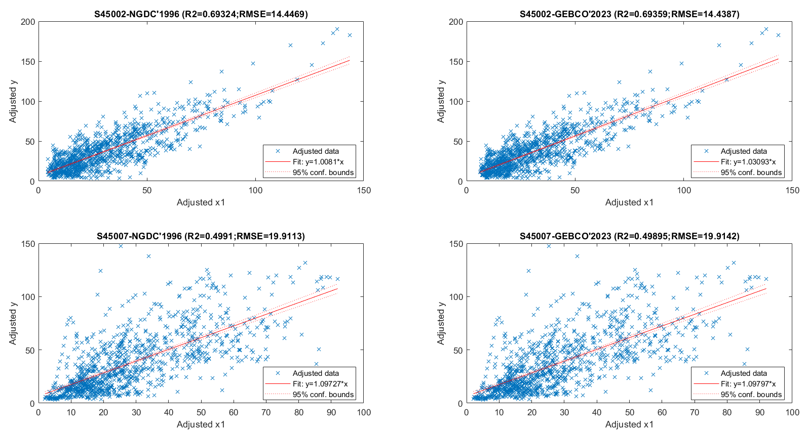
Results and Discussions
Significant wave height (cm)-WC
R2’96 < R2’23
RMSE’96 > RMSE’23
However
Notes:
The vast water body maintains a lower air temperature in the surrounding area in summer and vice versa in winter.
Beach tourism alone brings 14–31 million people to the Chicago’s shoreline per year
Chicago visitors spent nearly $17 billion in 2022

Slide 29
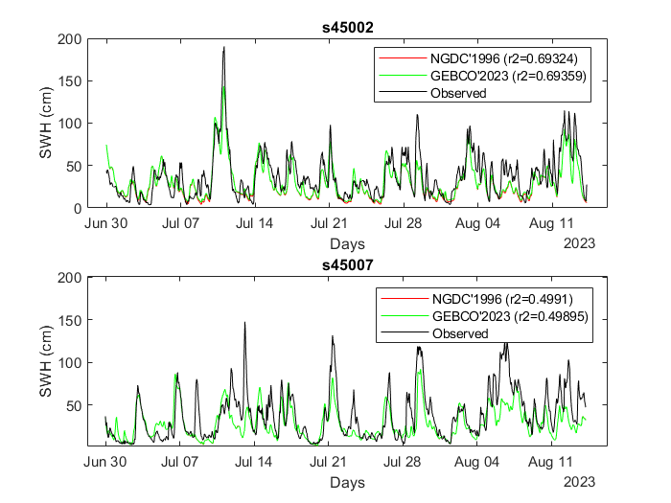
Results and Discussions
Significant wave height (cm)-WC
Summer 2023
% of change
+4.031
However
Notes:
The vast water body maintains a lower air temperature in the surrounding area in summer and vice versa in winter.
Beach tourism alone brings 14–31 million people to the Chicago’s shoreline per year
Chicago visitors spent nearly $17 billion in 2022

Slide 30
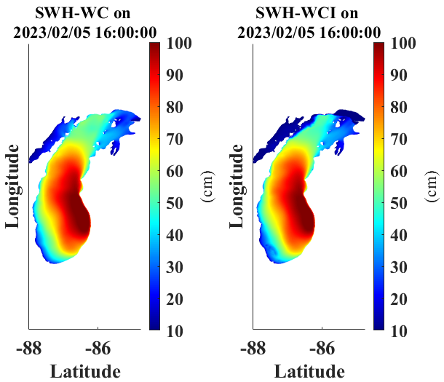
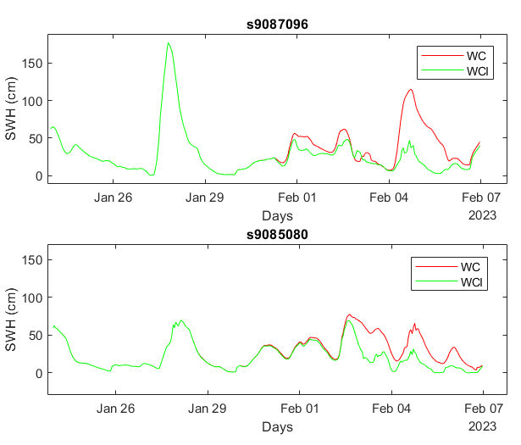
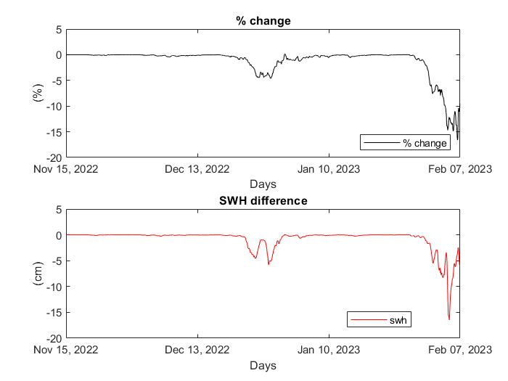
Results and Discussions
Significant wave height (cm)-WC vs WCI
% of change
- 5.4
(26 Jan –
06 Feb)
Lake average
However
Notes:
The vast water body maintains a lower air temperature in the surrounding area in summer and vice versa in winter.
Beach tourism alone brings 14–31 million people to the Chicago’s shoreline per year
Chicago visitors spent nearly $17 billion in 2022

Slide 31
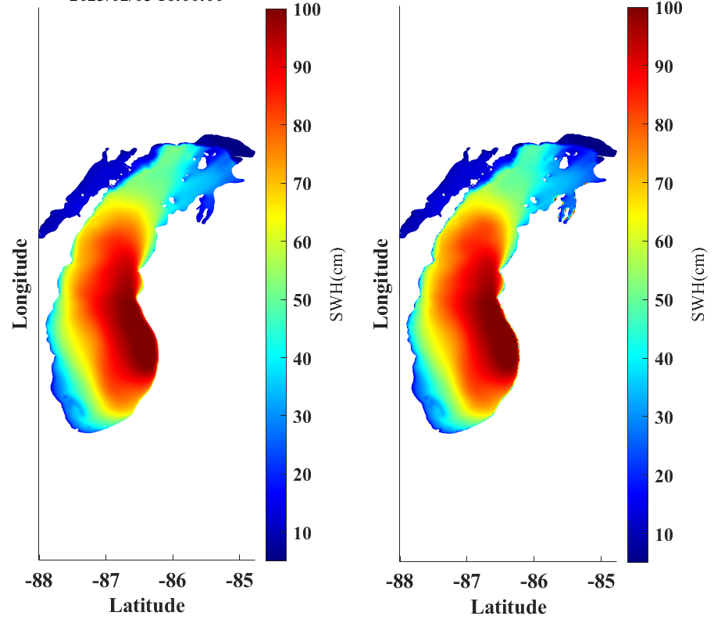
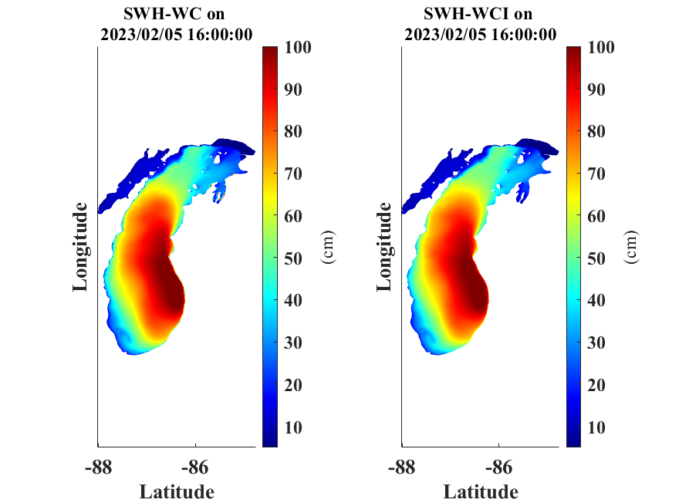
Results and Discussions
Significant wave height (cm)-WCI
% of change
- 2.1
NGDC’1996
GEBCO’2023
Notes:
The vast water body maintains a lower air temperature in the surrounding area in summer and vice versa in winter.
Beach tourism alone brings 14–31 million people to the Chicago’s shoreline per year
Chicago visitors spent nearly $17 billion in 2022

Slide 32
Conclusion
Significant effect on water elevation, current speed, significant wave height, and ice cover in northern lake
Using GEBCO’2023 bathymetry shows lower RMSE (0.04-0.08) for simulated water elevation throughout the lake
Using GEBCO’2023 bathymetry shows lower RMSE (14.44 at s45002) for simulated significant wave height in North Lake
Mean water level, temperature, current speed, and significant wave height decreased by 9.4(H)-10.4(WC)%, 0.04(WC)-4.8(H)%, 1.5(H)%, and 2.1(WCI)%, respectively
Mean water level, current speed increased, significant wave height, and ice thickness by 3.1 (WCI)%, 1.8(WC)%, 4.03(WC)%, and 1.3(WCI)% respectively
However
Notes:
The vast water body maintains a lower air temperature in the surrounding area in summer and vice versa in winter.
Beach tourism alone brings 14–31 million people to the Chicago’s shoreline per year
Chicago visitors spent nearly $17 billion in 2022

Slide 33
On going and future work
Coupling sediment or particle transport model with FVCOM-SWAVE-CICE to understand the impact of wave-current-ice interaction on sediment plume
However
Notes:
The vast water body maintains a lower air temperature in the surrounding area in summer and vice versa in winter.
Beach tourism alone brings 14–31 million people to the Chicago’s shoreline per year
Chicago visitors spent nearly $17 billion in 2022

Slide 34
Thank You
However
Notes:
The vast water body maintains a lower air temperature in the surrounding area in summer and vice versa in winter.
Beach tourism alone brings 14–31 million people to the Chicago’s shoreline per year
Chicago visitors spent nearly $17 billion in 2022

Slide 35
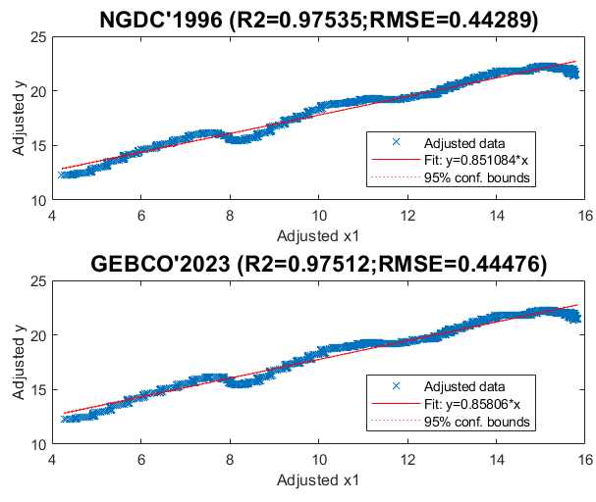
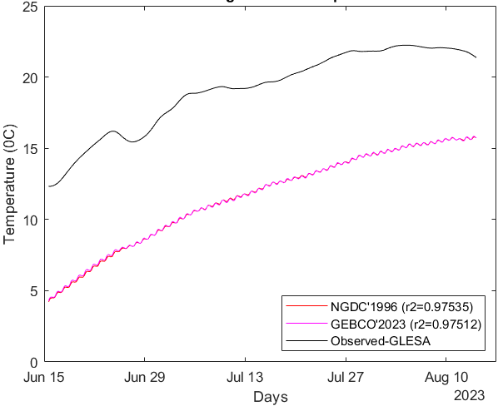
Results and Discussions
Average Lake surface temperature (⁰C)- WC
% of change
- 0.04
R2’96 > R2’23
Notes:
The vast water body maintains a lower air temperature in the surrounding area in summer and vice versa in winter.
Beach tourism alone brings 14–31 million people to the Chicago’s shoreline per year
Chicago visitors spent nearly $17 billion in 2022

