Slide 1
UFS Community Support & Data Management
By: Gillian Petro and Jong Kim

Slide 2
Overview & Theme
Overview of EPIC’s community support & data management work
Website Resources
Documentation (User Guides and wikis)
GitHub Discussions
Data Buckets & Other Data Management Tools
Testing Resources
Releases
Theme: EPIC’s strategic effort to build UFS testing infrastructure
Key role of UFS test infrastructure for community support
Develop a publicly accessible end-to-end testing and development environment for the Unified Forecast System
Q&A (time-permitting)
Notes:
I will discuss the resources available to the community, and then Jong will delve into our testing theme and talk about why testing at all levels is so important. He’ll speak to EPIC’s efforts to move this forward. If there is time at the end, we’ll have a Q&A, but if we run out of time, please do come and talk to us and/or submit your questions via email or GitHub.

Slide 3
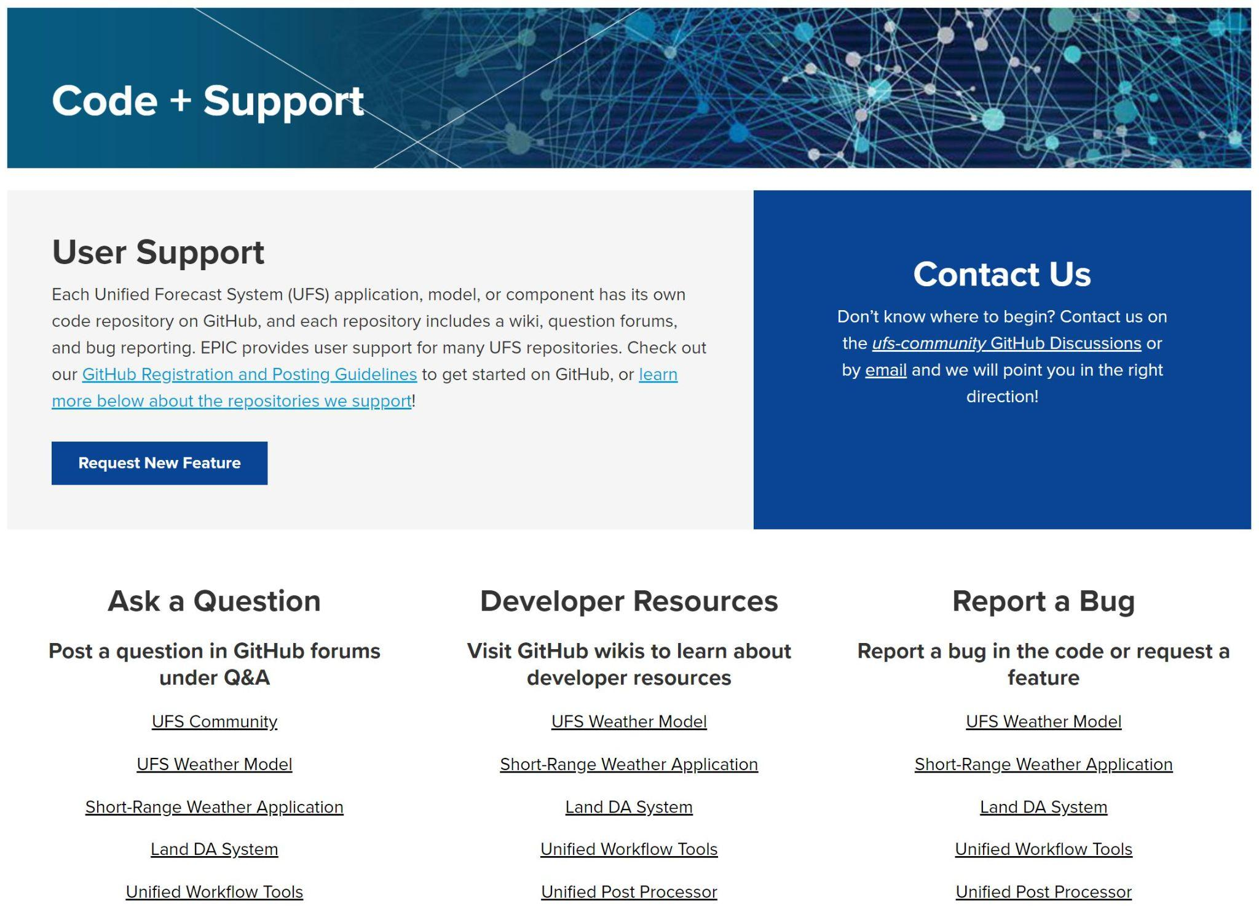
EPIC Community Portal (epic.noaa.gov)
Several Relevant Pages:
Get Support
Get Code
Technical FAQs
Tutorials
Get Support includes links to:
GitHub Discussions Q&A
GitHub wikis
GitHub Issues
Feature requests
EPIC Email
Notes:
So, first, I want to walk you through the many, many resources that we have available for users and developers in the UFS community. Most of these are linked from the EPIC website.
For example, there are Get Support and Get Code pages, as well as Technical FAQs and Tutorials. All of these are updated periodically – about quarterly.
We’ll start with the Get Support, accessible at the top navigation bar. We encourage any user or developer to submit requests for features they’d like to see in the UFS. There’s a link for that, or you can email us.
On the Get Support page, there are also links to the GitHub Discussions, where you can ask questions, the GitHub wikis, with resources, and GitHub Issues, for filing a bug report.

Slide 4
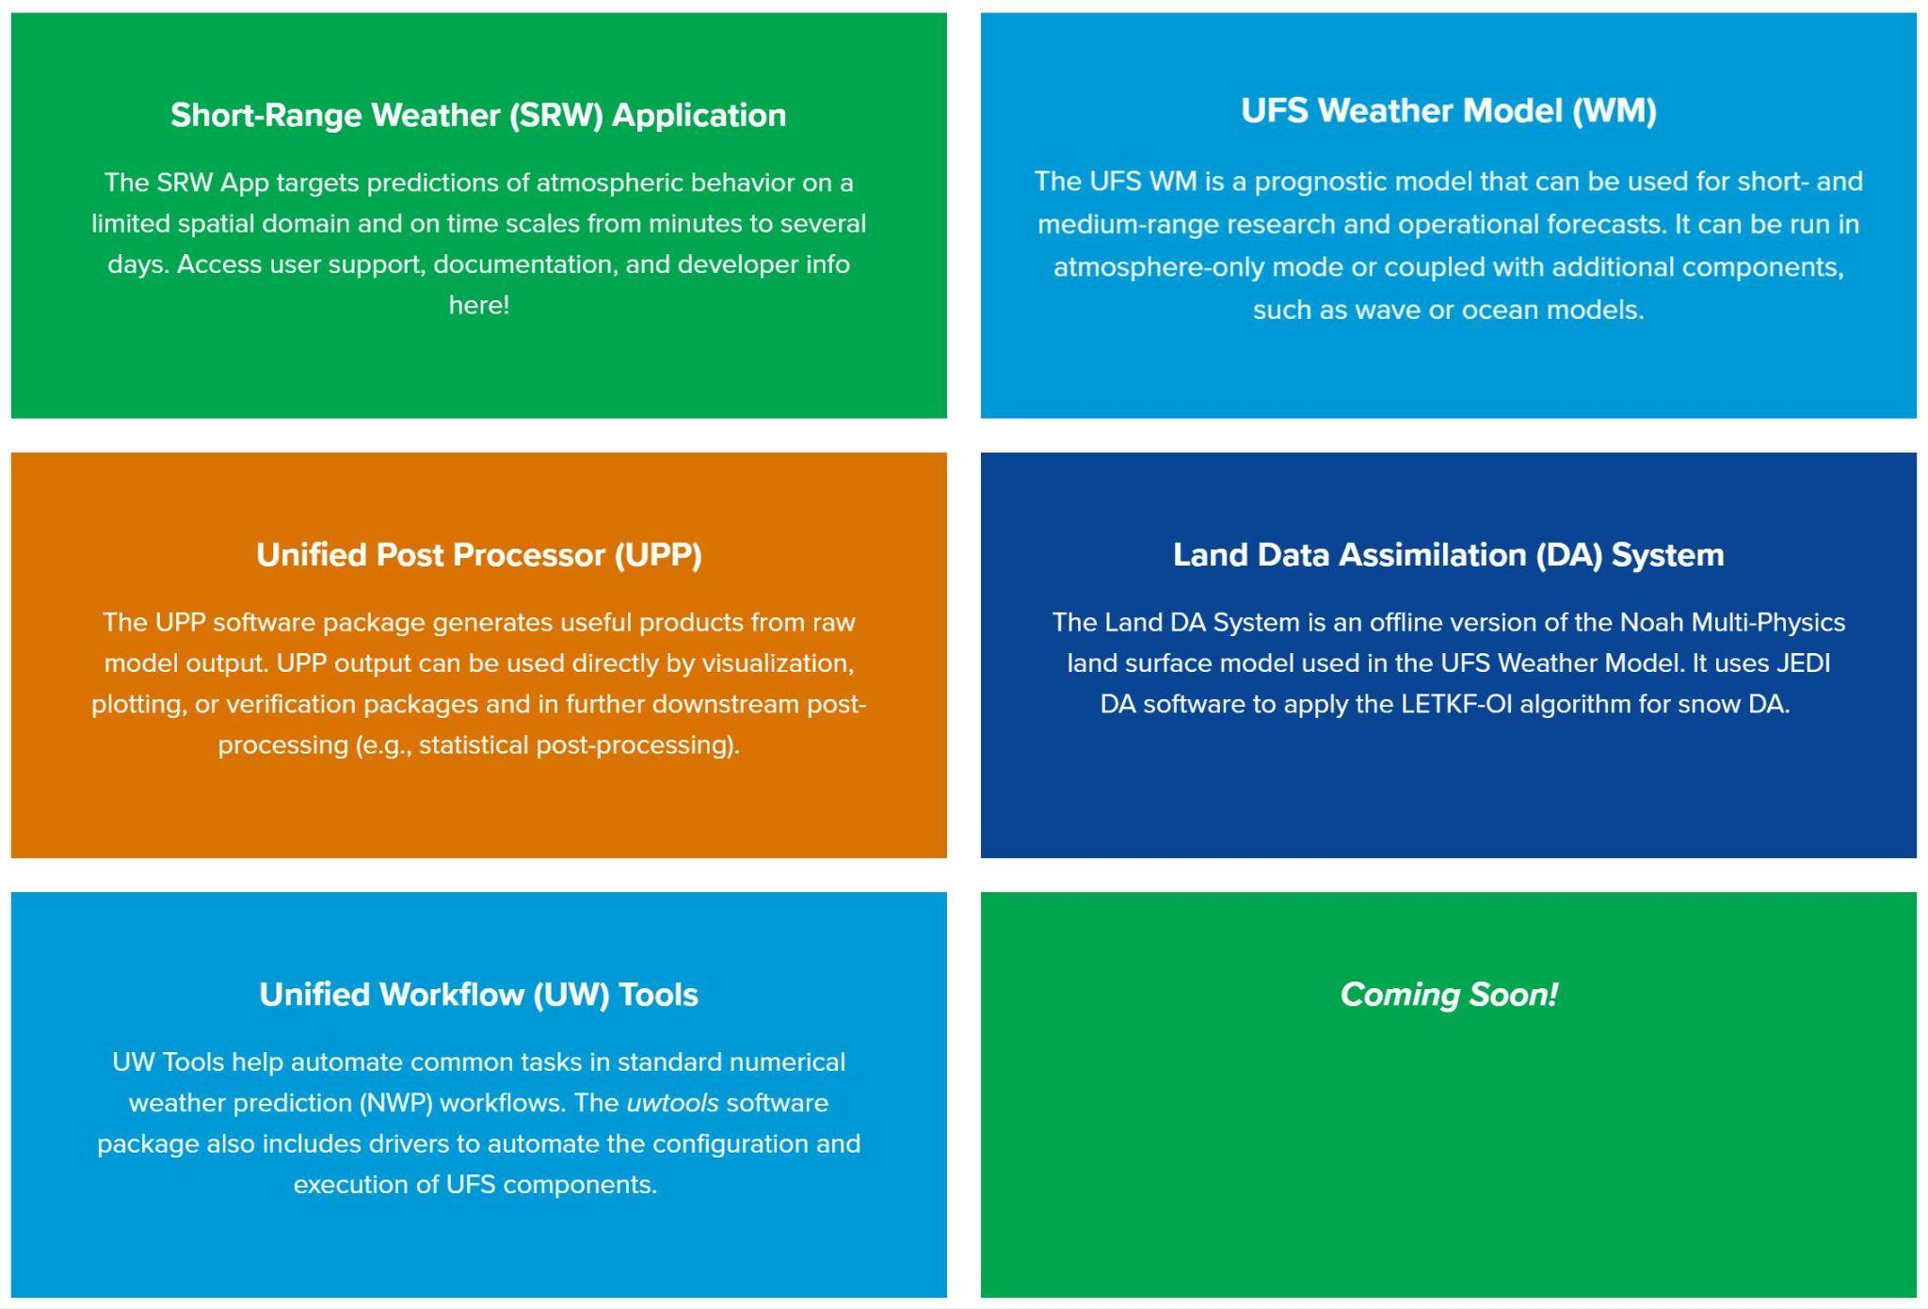
EPIC Community Portal (epic.noaa.gov) cont’d
The Get Code page links to EPIC’s supported repositories:
The Short-Range Weather Application
The UFS Weather Model
The Land Data Assimilation System
The Unified Post Processor
Unified Workflow Tools

Slide 5
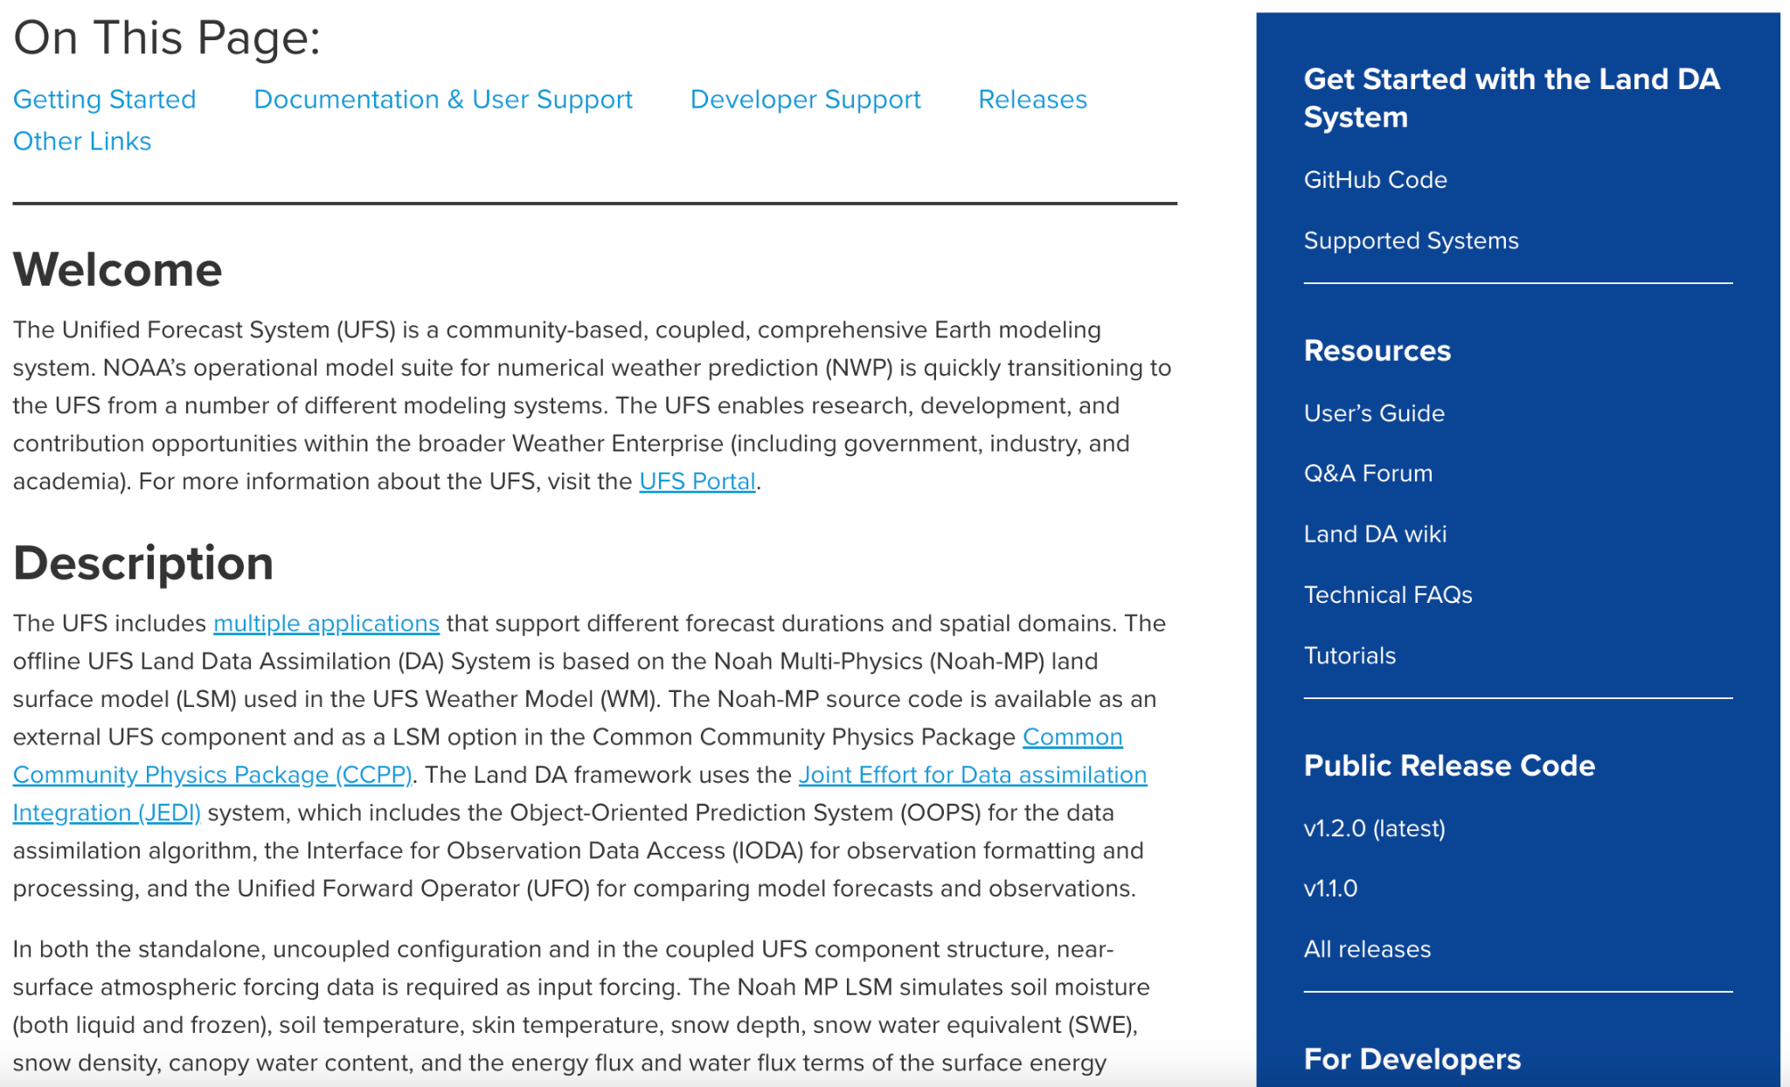
EPIC Community Portal (epic.noaa.gov) cont’d
Each Get Code page has:
A sidebar for easy navigation to external resources
A top bar to jump to information of interest on the page.

Slide 6
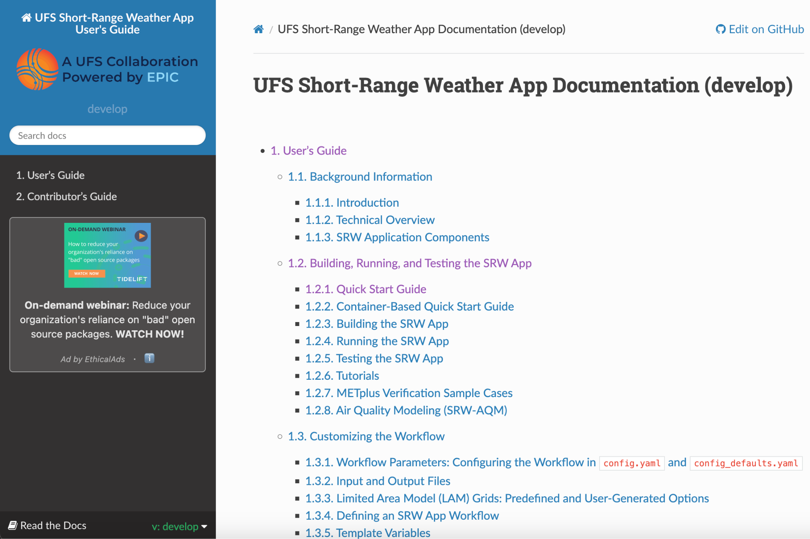
Documentation
Each supported repository contains a User’s Guide:
The Short-Range Weather Application
The UFS Weather Model
The Land Data Assimilation System
The Unified Post Processor
User’s Guide
Technical Documentation
Unified Workflow Tools
Switch versions using the caret at the bottom left.
NOTE: Switch versions from documentation homepage to avoid 404 not found errors.
Notes:
As documentation has expanded, it has been reorganized, and paths have changed, making the toggle between specific pages incompatible at times.

Slide 7
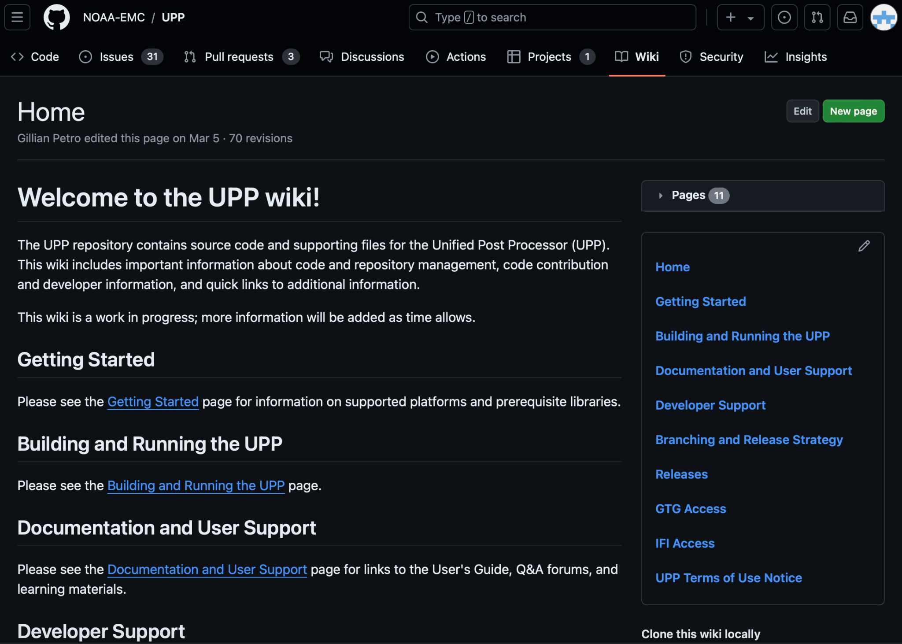
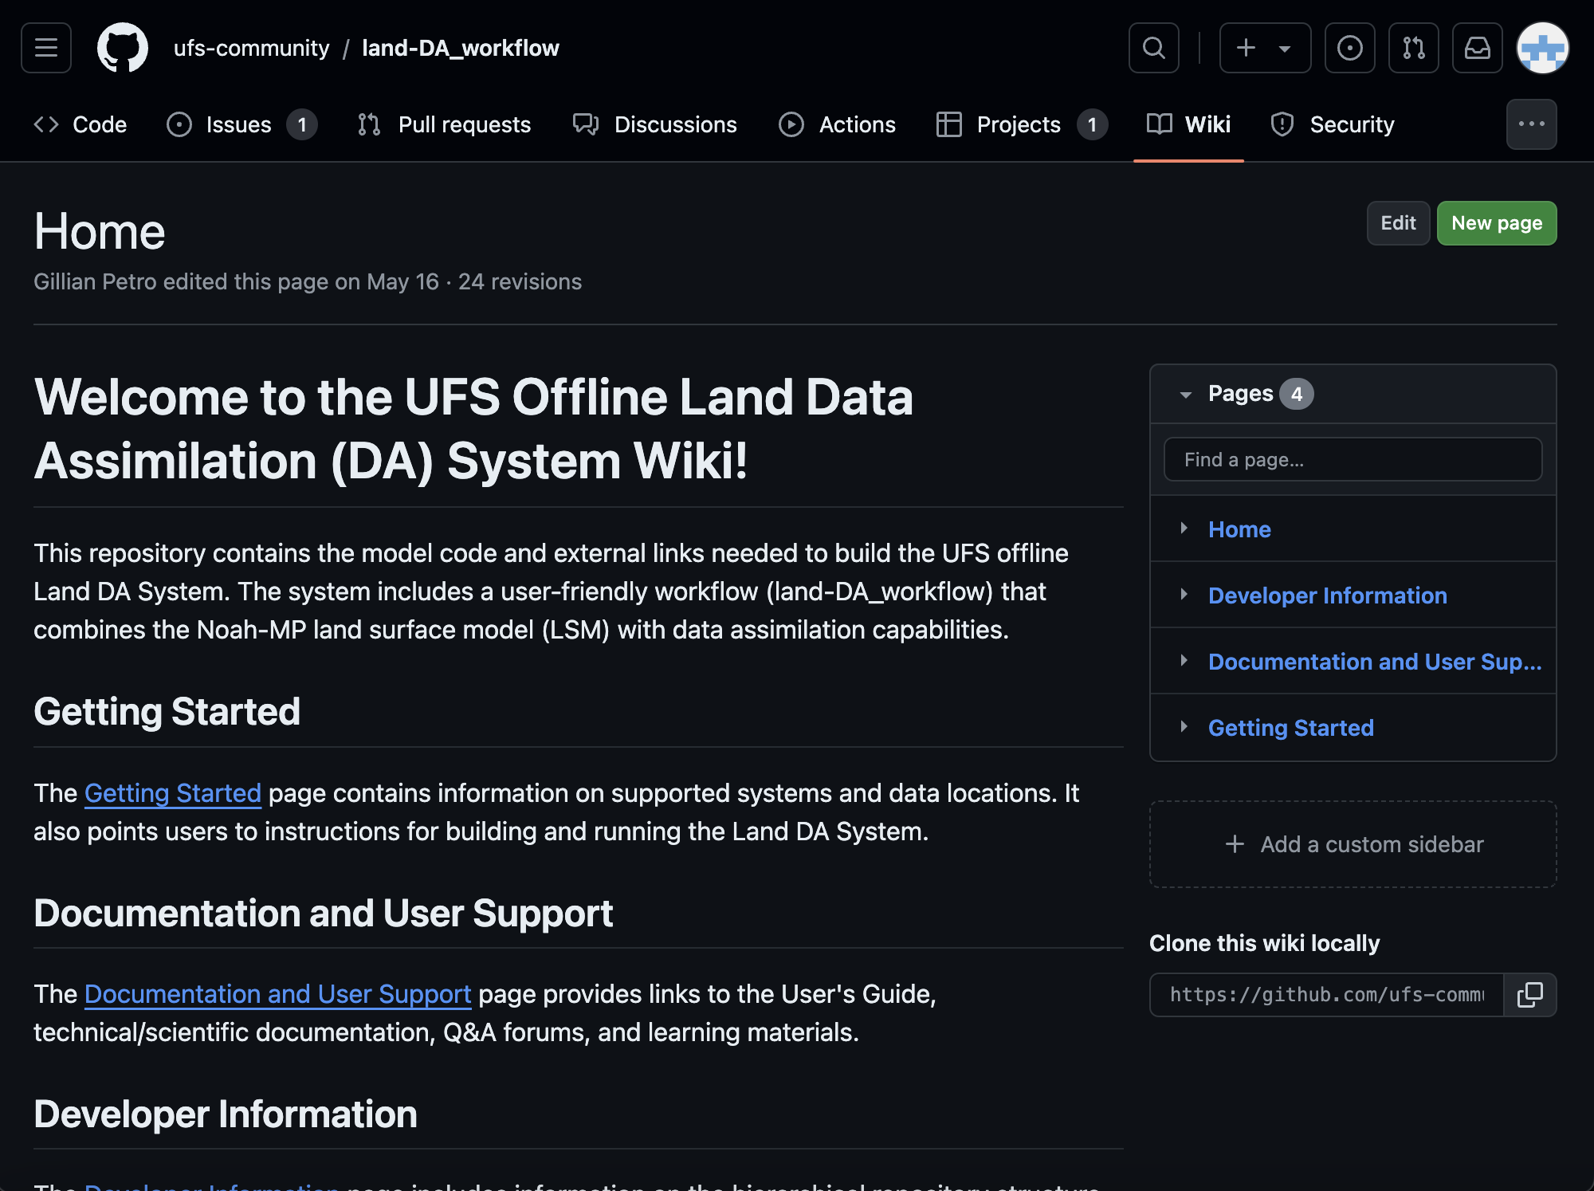
Wikis
Each supported repository contains a GitHub wiki:
The Short-Range Weather Application
The UFS Weather Model
The Land Data Assimilation System
The Unified Post Processor
Unified Workflow Tools
Wikis generally contain sections for:
Getting Started
Documentation & User Support
Developers
Notes:
Depending on the wiki, there may be additional information. For example, the WM has a Commit Queue, and the UW Tools repo has a blog.

Slide 8
GitHub Discussions
Post Questions on GitHub Discussions:
General/Miscellaneous Questions
The Short-Range Weather Application
The UFS Weather Model
The Land Data Assimilation System
The Unified Post Processor
Unified Workflow Tools
Submit feature/enhancement requests:
Post in the ufs-community Enhancement category.
Post in the “Enhancement” category for the relevant repository.
Email us! support.epic@noaa.gov

Slide 9
Data Buckets
Application releases include data for sample cases:
SRW App Data Bucket
Land DA Data Bucket
The WM provides regression test data for the last 60 days of develop branch code:
Weather Model Regression Test Data Bucket

Slide 10
Data Management Tools
Tools to maintain data buckets up-to-date:
UFS Data Tracking, Migration, & Maintenance Bot
Robotic Process Automation tool for data migration & management of UFS WM RT data
Multi-thread data uploader applications for WM, SRW, Land DA
Partitions large files into chunks to assist in improving upload performance to cloud storage
EPIC Health Dashboard
Main tab: Status of nightly builds for spack-stack, UFS WM, SRW App, Land DA
CI/CD Artifacts Tab → View log files from Jenkins pipeline tests.
EPIC Health Dashboard

Slide 11
Data Management Tools (cont’d)
UFS Data Mapping tool to support data ingestion
Maps each set of UFS data files into its associated categories: UFS application-to-physics suite build, UFS component, regression test, file format, test type, applicable compiler, file size, hierarchy, source location, etc.
UFS Data Analytics tool
Continual use for analyzing data as development advances for the UFS WM
UFS WM RT Log Extraction application
Extracts, parses & summarizes test performance metrics featured within each RDHPCS UFS WM RT log files into visual plots.
Successfully transferred log information into visual plots

Slide 12
Testing Resources
80-90% of current testing
Regression & WE2E Tests
Current Testing Frameworks:
Weather Model Regressions Tests
SRW App Workflow End-to-End (WE2E) Tests
Land DA System CTest functionality
Pros:
Ensures that major functionality continues to work
Provides sample test cases for users
Cons:
Imbalance: Little to no component-level testing or integration testing
Current testing is expensive
Integration & Acceptance Tests
Unit Tests
Cost

Slide 13
Releases
Most Recent:
SRW App v2.2.0 (Oct. 2023)
Land DA v1.2.0 (Dec. 2023)
uwtools v2.3.2 (June 2024)
Planned:
Two Hierarchical Testing Framework (HTF) releases
Idealized test cases for academic audience
Land DA
SRW App
Notes:
The three most recent releases have been the SRW App (last October), Land DA (last December), and uwtools (in June). For those who don’t know, Unified Workflow Tools (aka uwtools) is a Python package developed to solve common problems or tasks in numerical weather prediction workflows. They have regular software releases, often 1-2 per quarter, and the tools range from configuration tools that users can employ to specify details of their experiment, to drivers for different tasks, such as file preparation, forecast runs, post-processing, and so on.

Slide 14
Challenges
Testing Resources
HPC allocation
Testing infrastructure → Inverted pyramid
External SME access
Repository ownership / knowledge transfer
Coding standards
Notes:
Testing Resources: The regression tests for the WM test many different types of functionality and are therefore costly to run, so we run up against HPC allocation issues. A proper testing infrastructure focusing on inexpensive unit tests and component-level tests would remediate this issue. Best practice would be the pyramid, not the inverted pyramid.
External SME Access: Many SMEs want to help but cannot prioritize this work, so it takes longer to get answers
Repository ownership: EPIC only shares ownership of top-level repositories, e.g., SRW, Land DA, WM. Since it doesn’t own the subcomponents, there has been limited knowledge transfer there and little to no sharing of responsibilities. This extends the time for merging PRs if a sole code owner is out, and it compromises EPIC’s ability to provide thorough user support.
Knowledge transfer: Knowledge concentrated in one person, particularly in the absence of complete documentation makes it difficult to provide quality user support broadly. When subcomponents are owned by other teams who do not have the time to share their knowledge (via documentation, code walkthroughs, etc.), CMs, user support, and community engagement can suffer in the long term.
Coding standards: Everyone thinks they’re a great idea in theory, but no one wants to require them for fear of slowing down development. In reality, it has to potential to speed up development as people spend less time trying to figure out what the code is doing and can begin using and developing the UFS.

Slide 15
Roles of UFS Test Infrastructure
Roles of UFS test systems: Regression and WE2E Tests
UFS Forecast System consolidation process
UFS code integration processes and key test parameters
Current EPIC-supported UFS testing activities: CI/CD pipelines and code management
UFS Weather Model, SRW, UPP, Land DA, Stochastic Physics
Global workflow, GDAS, JEDI UFS-bundle, UFS Coastal application
Data management support for daily regression and WE2E test system
Factors for further improvement of UFS Test system
Need to systematically build hierarchical test framework (HTF) to deploy and support hierarchical system development (HSD) approaches
Q&A

Slide 16
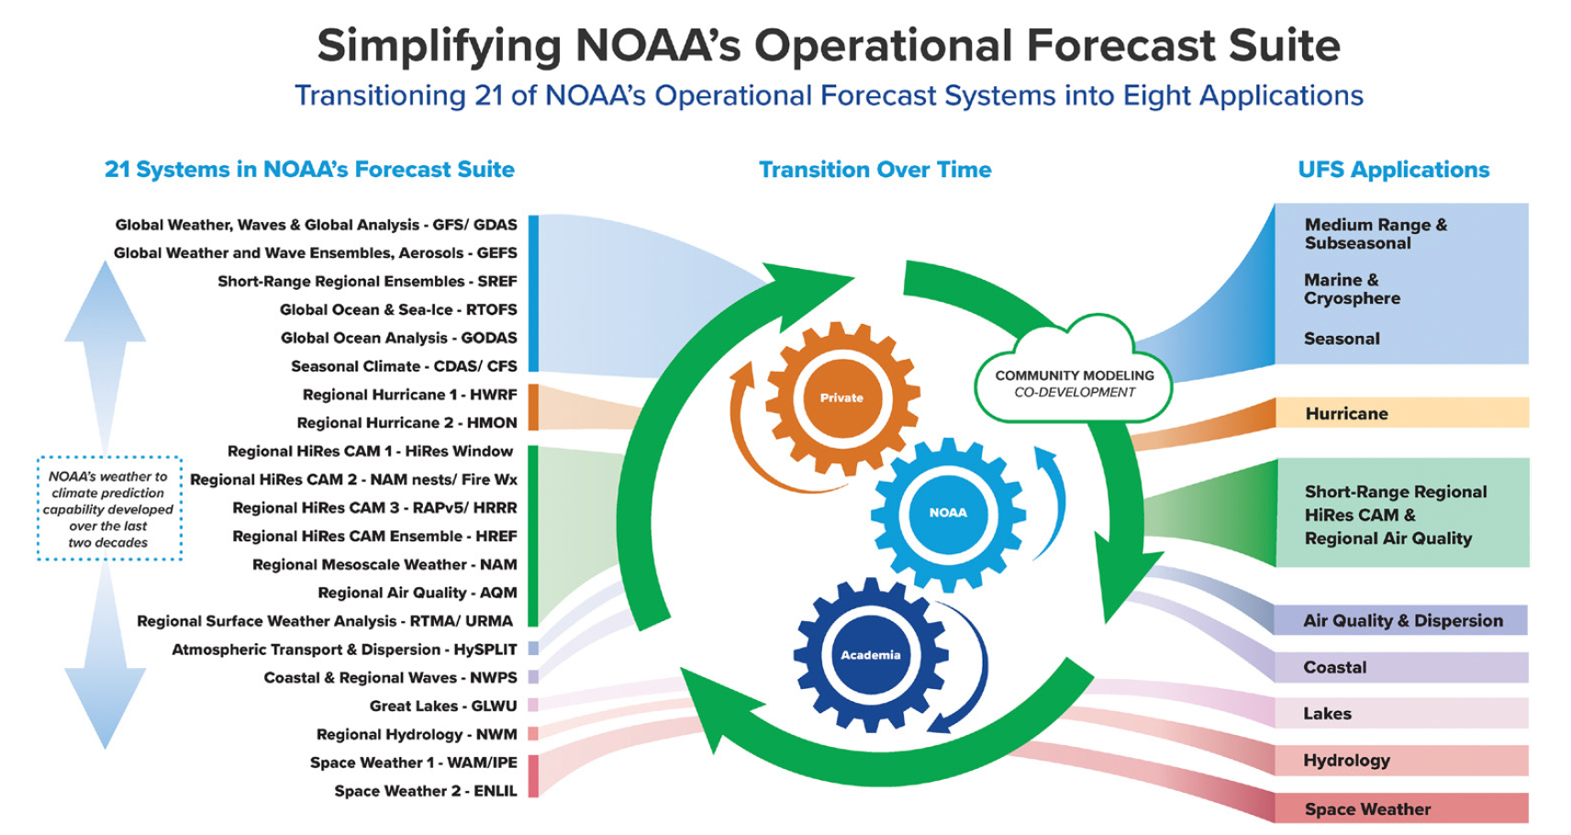
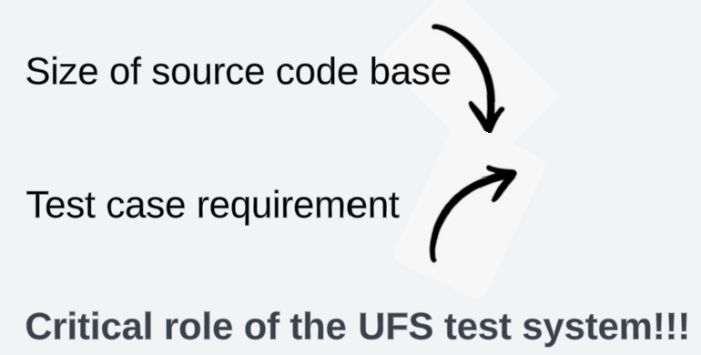
UFS Forecast System Consolidation
Reduced source code base but increased intensity of test requirement during the consolidation process
Critical role of UFS test approaches and systems including unified CI/CD infrastructure in code management process

Slide 17
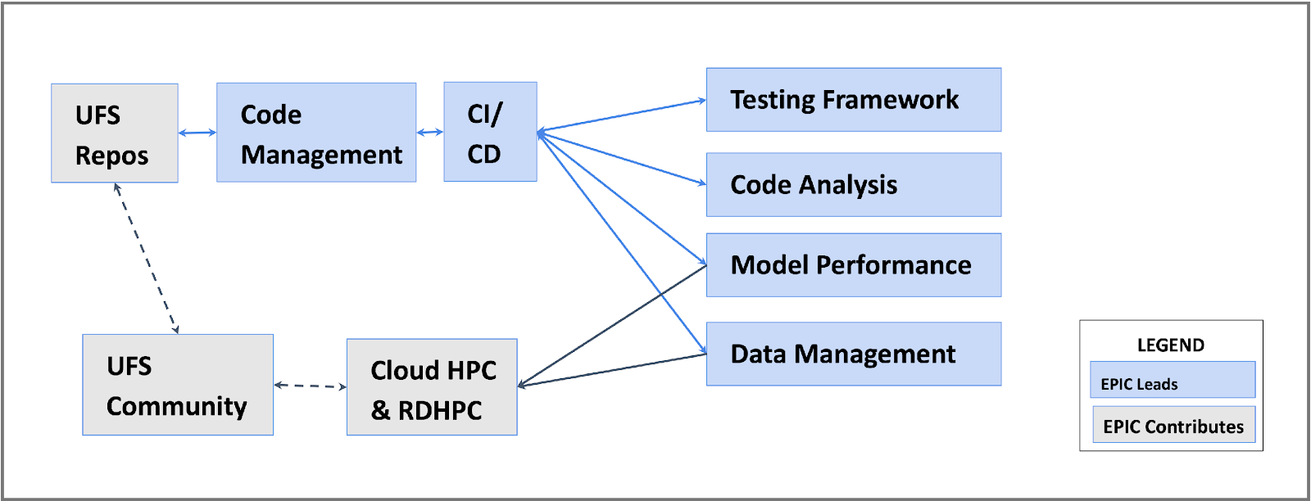
EPIC Strategic Goal: Infrastructure
Develop a publicly accessible end-to-end testing & development environment for the UFS.
Develop/provide necessary software Infrastructure
Manage, maintain, test, and evaluate the UFS WM and Apps source code
Develop and maintain the appropriate test frameworks
Support the transition of the UFS WM and Apps to Cloud-based HPC
Collaborate with the R2O community, e.g. DTC, JCSDA/JEDI, NOAA labs, academia

Slide 18
Regression Tests in the UFS WM
UFS WM Regression Test: All regression tests are validated with bit-to-bit reproducibility
Key test parameters to define test cases: operational and development applications, coupled model configurations, resolutions, physics parameterization suites, compilers, compile options, computing platforms, thread, decomposition, IO (restart)
Fixed set of regression test cases running on all NOAA RDHPCS for code integration
Intel and GNU compilers, 57 build options and 249 test cases
15 operational requirement tests on limited NOAA RDHPCS
About 10% annual growth rate of total test cases

Slide 19
WE2E Tests in the SRW App & CTests in Land DA
UFS Short-Range Weather (SRW) Application WE2E tests ensure that common configurations of the workflow run properly.
Key parameters: CCPP physics, grid, external model ICs/LBCs, and cycle dates
6 fundamental tests are not resource intensive & are run before a PR is opened.
76 comprehensive tests are split between RDHPCS platform (11-12 per machine).
Land DA System CTests
A series of unit tests to validate the functionality of code for specific workflow procedures (e.g., applying DA increment), run on RDHPCS (Orion, Hera).

Slide 20
UFS WM and Application Testing (cont’d)
Conventional inverted pyramid test approach: Takes significant time to certify that new features work as expected and that current functionality continues to work. Long testing cycle can get worsen with unexpected test failures.
Key factors to decide the agility of test strategies: quality of code changes, velocity of code integration, test speed, test predictability, test reliability, validation of production application.

Slide 21
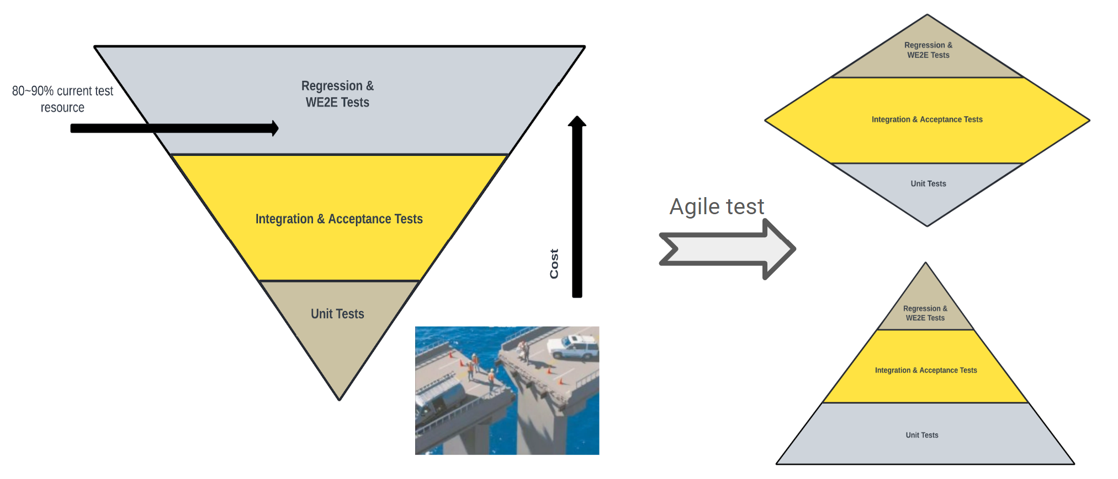
Test Structure: Inverted Pyramid
Need right balance of test approaches: WE2E, regression tests, acceptance tests and unit tests

Slide 22
Test Structure: Inverted Pyramid
Right balance of test approaches: WE2E, regression tests, acceptance tests and unit tests
Pyramid: Ideal and most preferable
Diamond: Optimized and practical for systematic application development
Inverted Pyramid: Suitable for pre-defined prototype-oriented project
Test Metric | Pyramid | Diamond | Inverted Pyramid
Test code quality | High | Medium | Low
Velocity of code integration | Medium | High | Low
Test predictability | High | High | Low
Test suite reliability | High | High | Low
Test speed | High | Medium | Low
High-end user applications | Medium | High | Low

Slide 23
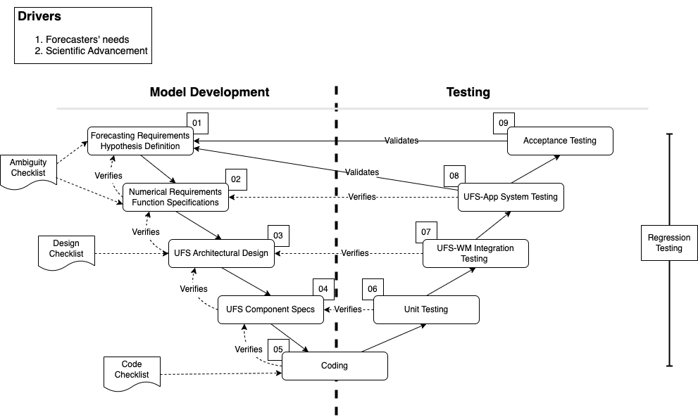
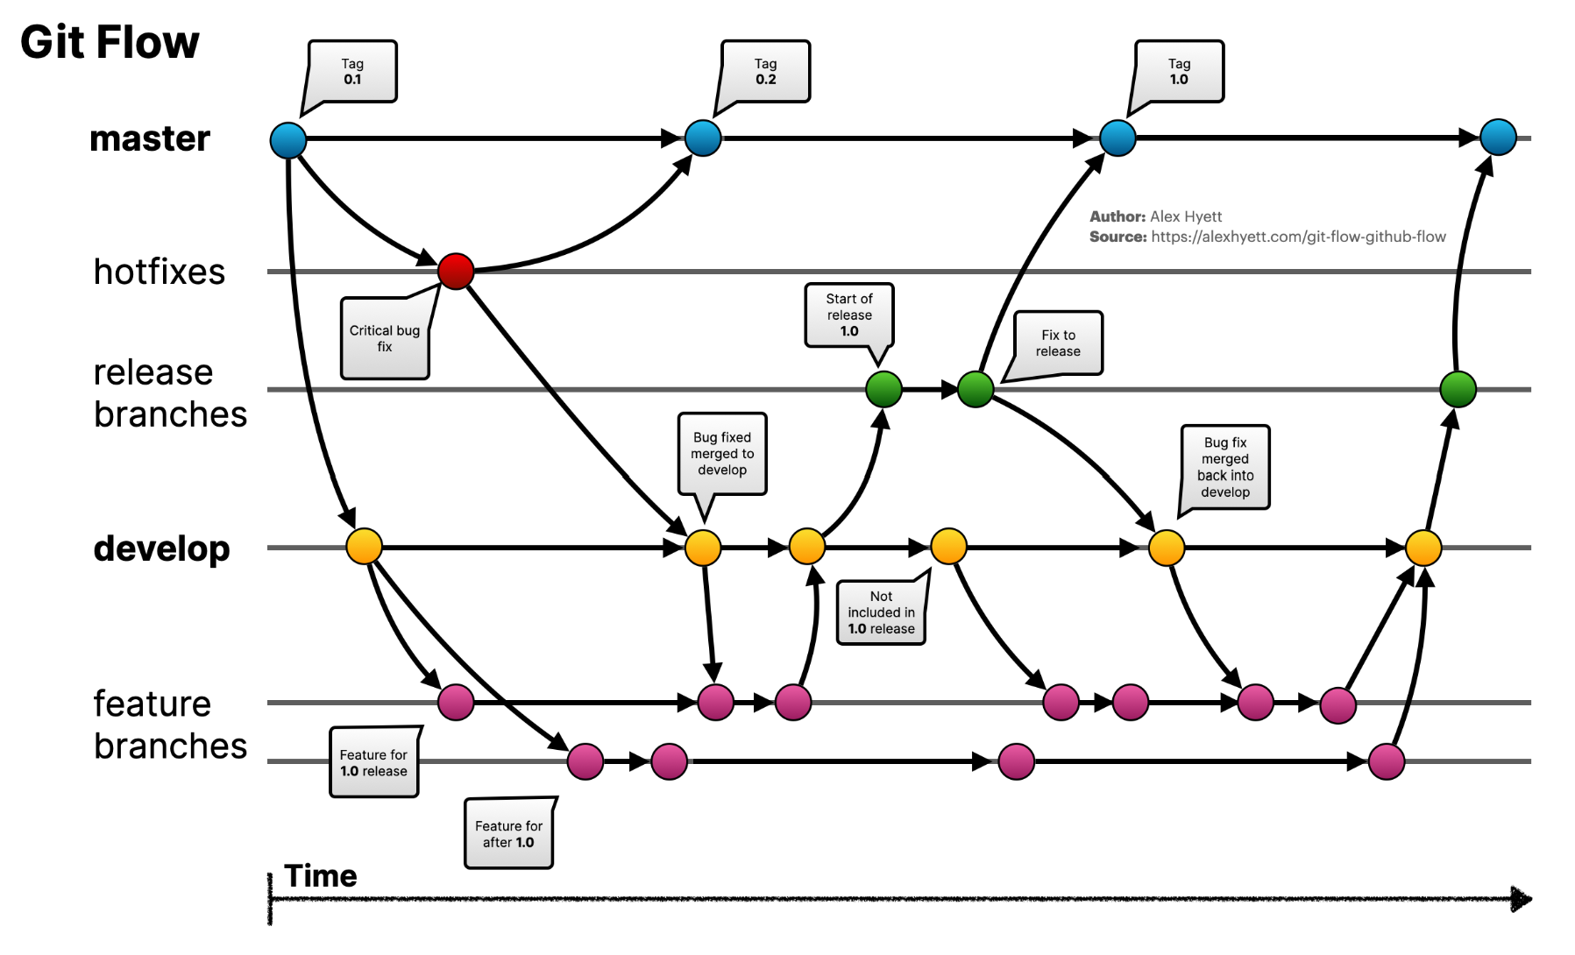
Plan for UFS HTF/HSD Integration
HTF/HSD plan for developing a robust set of testing standards and processes for science and software
Ongoing UFS cases studies Integration into UFS WM and SRW App
‹#›

Slide 24
UFS HTF/HSD Future Directions and Releases
Future Directions
Integration of subcomponent-specific tests into UFS WM (e.g., FV3)
Addition of idealized, regional, and global test cases to UFS WM
June UFS HTF meeting to provide progress update & scope out test cases
Proposed Release Plan
Public-facing releases targeting researchers and new users
Enable end-users to run the UFS WM standalone w/out workflow or app
Include documentation and user support
Initial release to focus on atmosphere-only configurations
Aquaplanet, warm bubble, global/regional cases
At subcomponent level, begin with FV3 test integration
After demonstrating ATM-only, move toward coupled configs. (e.g., FV3-MOM6-CICE6)
‹#›

Slide 25
Key Roles of UFS HTF/HSD Integration
HTF/HSD plays a key role in addressing UFS development issues, including:
Deep domain knowledge and high technical skills required to write quality regression and E2E tests.
Resource-intensive to implement new tests—takes a lot of time to execute.
Weak foundation of low level tests: Difficult (or impossible) to apply top-down test paths and compare high-level E2E or internal regression test to lower-level development activities.
E2E test failures do not provide pin-pointed feedback about what went wrong.
E2E tests are fragile; they are tightly coupled with the environment and have external dependencies. Slight environment changes can cause test failures (false negative).
From a refactoring point of view, E2E tests don’t give the same sense of comfort/assurance to developers as unit tests can give.

Slide 26
Q&A
Emails: gillian.petro@noaa.gov and jong.kim@noaa.gov
User Support: support.epic@noaa.gov

