Slide 1
The Transatlantic Data Science Academy: A UK perspective
Dr Damian Wilson
Zorica Jones, Becky McCoy, Shannon Jackson, George Pankiewicz, Amy Watts
23 July 2024
Unifying Innovations in Forecasting Capabilities Workshop 2024, Jackson, MS

Slide 2
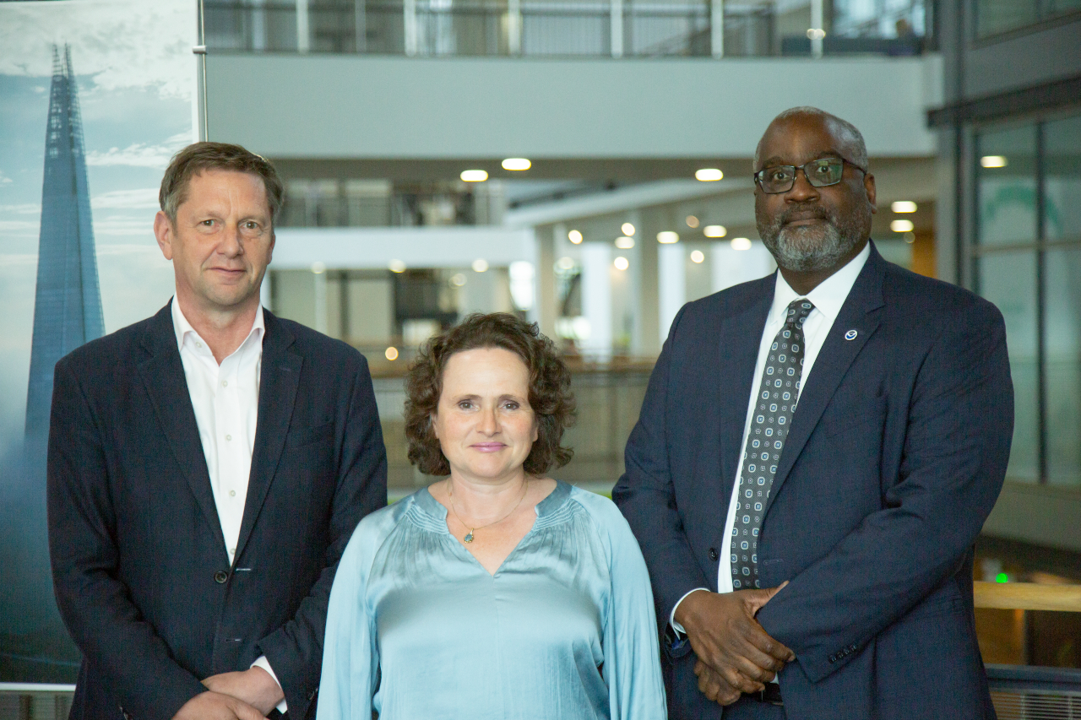
We need to develop our data science skillsets
A very fast transition towards using data driven approaches for weather and climate advice
Huge potential of £1.2bn high performance computing investment
Need for data engineering, data science, data assimilation and research software engineering skills
A wealth of untapped, diverse talent available
A Met Office / NOAA vision for a Transatlantic Data Science Academy
Professor Stephen Belcher, Met Office Chief of Science and Technology; Professor Penny Endersby, Met Office Chief Executive and Dr Michael Morgan, NOAA Assistant Secretary of Commerce for Environmental Observation and Prediction
Notes:
Since the 1950s, Earth System Model communities have developed skills in physical fluid dynamics, using cpu based supercomputers and Fortran coding
Science & Technology needed to advance our ability to build Earth System Models is undergoing a radical transformation:
Big data from our model systems, new analysis techniques needed
Machine Learning speeding up prediction and projection and introducing entirely new methods
New computing architectures to take advantage of
New coding skills needed in python, C++, using git, github
Future development and application of atmospheric and climate science will need a new generation of scientists and technologists working together
So, in May 2022, NOAA NWS Director Ken Graham met with Met Office CEO Penny Endersby and Chief Scientist Stephen Belcher and created a vision for a Transatlantic Data Science Academy

Slide 3
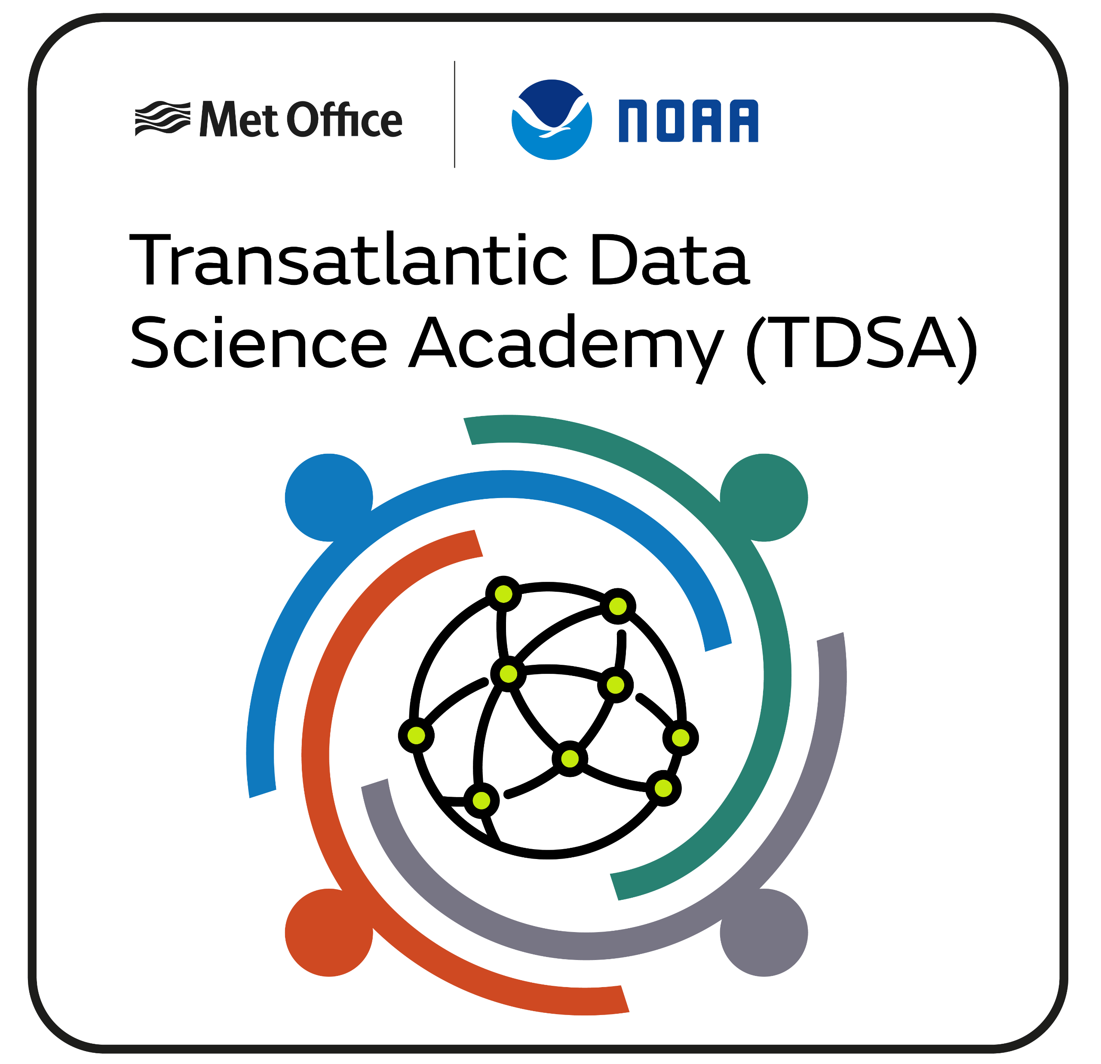
A Transatlantic Data Science workforce fit for the future
Our mission:
To develop an enabling environment to attract, retain and grow the skilled and diverse workforce needed to realise the potential of a new frontier in Data Science in weather and climate science now and in the future

Slide 4
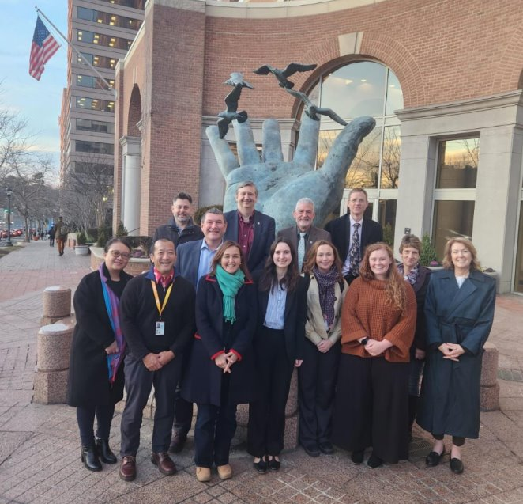
Planning for the future
NOAA and Met Office teams met in January 2024 to develop a Joint Academy Plan
We agreed four key focuses for the next 1-2 years
Develop a Joint Academy with common goals, objectives, expectations, timings & governance
Agree plans to secure future funding and resources to create a sustainable Academy
Build and develop relationships with our stakeholders and partners within the Academy
Support effective communication and collaborative working between the Met Office and NOAA

Slide 5
The Academy focuses on four main themes
Career Development: Pathways, training, learning interventions etc.
Exchanges: Met Office, NOAA and partner universities; staff and students
Communication: Reaching wide internal, partner and external audiences
Sandbox: A common platform to share tools, data and expand communities and innovation

Slide 6
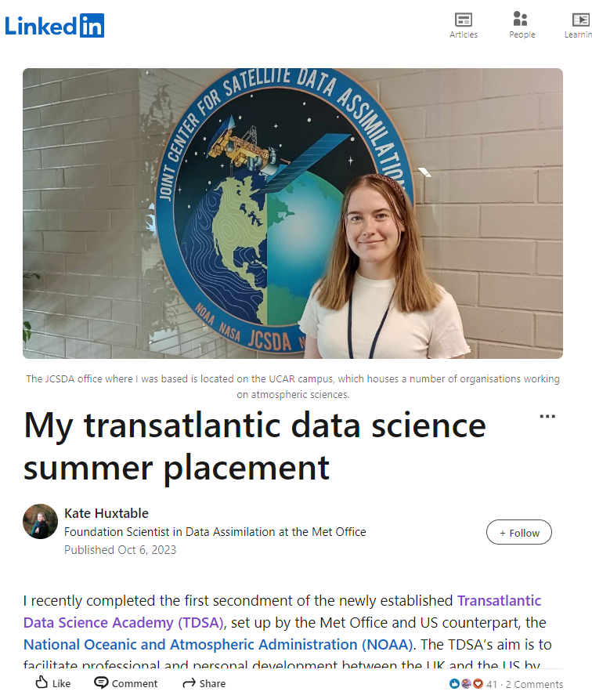
Exchanges develop new skills and employee experiences
Placing Met Office and NOAA staff together on joint project work over several weeks
Improving exchange processes, and increasing diversity of skills
Several visits of Met Office staff to NOAA establishments
Aim to support much wider organisational placements
“Working with other women at JCSDA helped to develop my confidence.” – Kate Huxtable, Met Office
Notes:
Exchanges WP aims to offer opportunities for MO staff to work with NOAA and their Partner affiliates – in the US. And vice-versa. In time, we also hope to open up these opportunities to the MOAP. & increase diversity.
Kate Huxtable, Foundation Scientist in Data Assimilation team, spent 5 weeks in Boulder at JCSDA.
Kate worked with US scientists who had implemented a more established Ensemble Data Assimilation approach in JEDI. They wanted to test and compare the two methods at the earliest-possible opportunity.
Testing the algorithm highlighted unforeseen problems with the code. They were able to create innovative solutions to the issues – made a lot of progress in person.
Kate found the trip to have lots of benefits for her personal development: working with established women in senior scientist roles, networking, giving in-depth technical presentations, increased learning.
JCSDA colleagues took Kate on walks eg Boulder Flatirons.
Tom Hill, Satellite & Surface Assimilation team, current in the US.
Looking to scale this up.
I’m keen to talk to anyone who has a project (or may have a project in future)/hackathon/time-boxed sprint that would benefit from an exchange – MO to US, or vice versa.

Slide 7
Developing a full career proposition is essential for providing motivating jobs
We’ve been working with a group of our Academic Partners to establish best practice
Identifying suitable interventions at each career stage
Identifying and developing career frameworks
Exploring course and personal accreditation
Supporting higher degree and apprenticeship study
Developing on-line work-experience modules for school children
Connecting communities across organisations
Establishing training options and bespoke courses
Notes:
Including things like:
Supporting RSE communities – e.g. RSECON24 discussion session
Supporting SpaceApps challenge; other hackathons

Slide 8
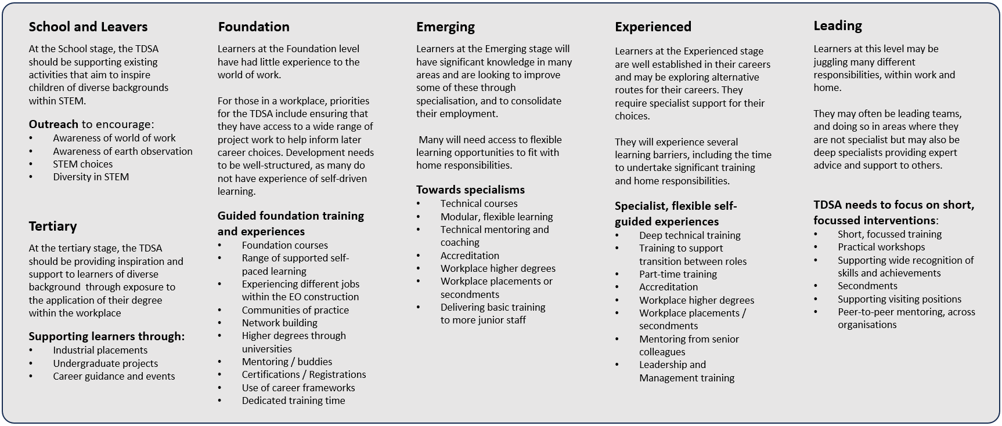
We need to be flexible with learning interventions
Notes:
Supporting a diverse set of learners

Slide 9
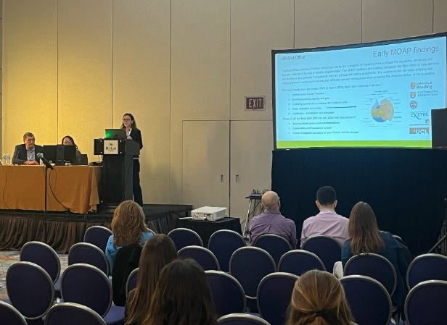
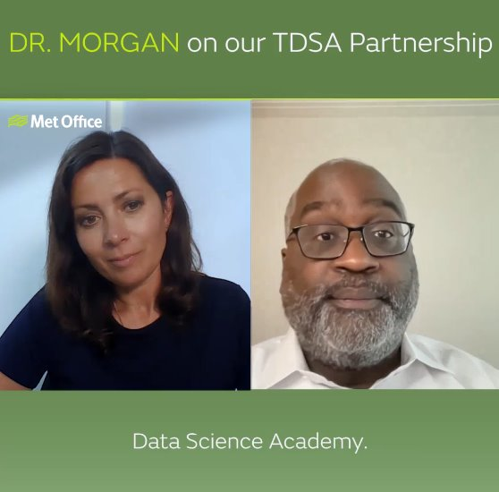
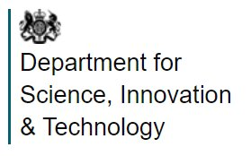
Promoting the academy is an essential part of a successful academy
Outreach has included:
A discussion panel at RSECon24 on motivating and meaningful careers for research software engineers
Presentation of the Academy work at AMS
Met Office Weather Snap interview with Dr Michael Morgan
Case study for UK government’s Department for Science Innovation and Technology
News releases
The full recording is available on YouTube here ​

Slide 10
There is much still to do to establish an enduring Academy
Embedding the university relationships within the Met Office – NOAA relationship
Expanding the reach of the Academy
Ensuring exchanges are as frictionless as possible
Maintaining development opportunities; keeping pace with state-of-the-art
Enabling longer-term funding arrangements
Realising increased skills and diversity in the Earth Observation workforce
Communities
of Practice
Professions
HMRC
Academies

Slide 11
The Transatlantic Data Science Academy
Establishing a skills pipeline for:
Data engineering;
Data science;
Data assimilation; and
Research software engineering
for Earth Observation

