Slide 1
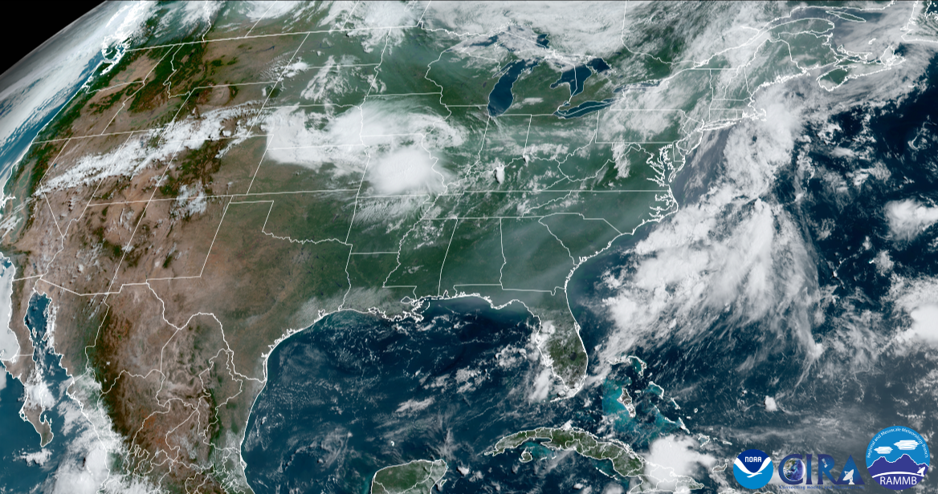
Future of Modeling & Data Assimilation Consortium
Presenters: John Ten Hoeve¹, Ivanka Stajner², Stephan Smith³
Weather Program Office, OAR, Silver Spring, MD, 20910
Environmental Modeling Center, NWS, College Park, MD, MD 20740
Office of Science & Technology Integration, NWS, Silver Spring, MD, 20910

Slide 2
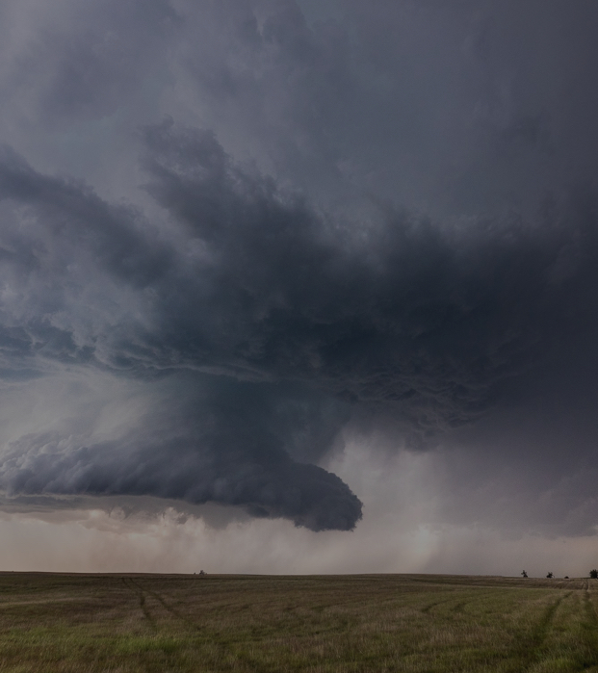
WPO SCIENCE DIVISIONS
WEATHER PROGRAM OFFICE
Mission: Cultivating, funding, and transitioning collaborative weather research that results in accurate and actionable weather information for all.
WE FUND RESEARCH TO IMPROVE FORECASTS
Observations and Research Support
Observations
Supplemental Appropriations
Research Transitions
Earth System Research and Modeling
Subseasonal to Seasonal Research (S2S)
Earth Prediction Innovation Center (EPIC)
Air Quality & Fire Weather
Synoptic Weather
Science, Technology, and Society
Social Science
Joint Technology Transfer Initiative (JTTI)
Testbeds
VORTEX-USA

Slide 3
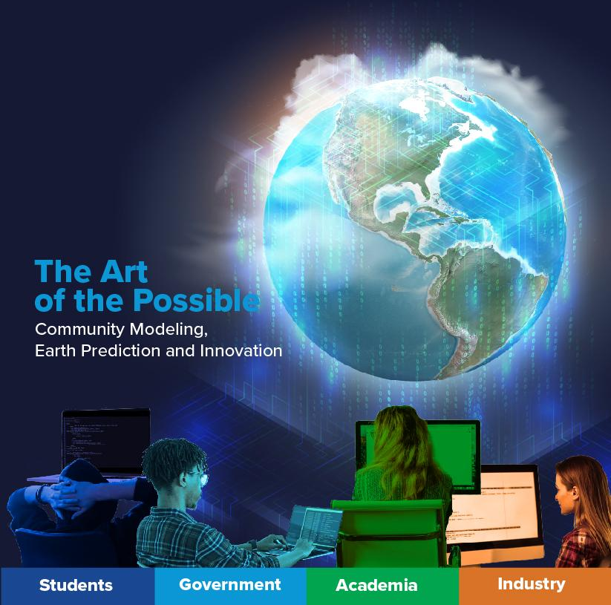
Community-Based Earth System Modeling is (still) the Vision
(and also the requirement as directed by Congress)
Notes:
John
We can’t do it alone
Several pieces of legislation, from the Weather Act Reauthorization that passed in X to the LEGEND Act that passed in X, Congress is asking not for us to do work alone, but to work together as the U.S. weather modeling community
We are seeing successes - the participation for EPIC tutorials and workshops continue to grow at a rate of 300% year over year. There is significant interest from students, academia, and the private sector

Slide 4
2021 Vision
Operational release vX
GitHub develop branch
Commits of innovations
pub release v N+2
pub release v N+1
pub release v N
Courtesy of UFS Release Coordination WG (POC: Ligia Bernardet and Mark Potts)
Notes:
John

Slide 5
How it is Working Today (for some applications)
Develop operational branch
(EMC and NOAA Labs)
EPIC-facilitated
Develop community branch
(EPIC)
pub release v N+2
pub release v N+1
pub release v N
Notes:
John

Slide 6
Challenges to Community Modeling Bliss
Technical:
UFS is bulkier than some other research codes (but it is easier to run than ever)
The research community wants to use new techniques while operational standards are often antiquated (sometimes for good reason)
Process / Culture:
Different cultures and communities with different ways of doing things
No consistent set of rules for collaboration (e.g. governance)
Budgetary / Organizational:
Need to incentivize the research community to participate (💰💰💰).
Need to incentivize the operational community to participate when
faced with competing implementation deadlines (🕐🕐🕐, 💰💰💰).
Notes:
John
John

Slide 7
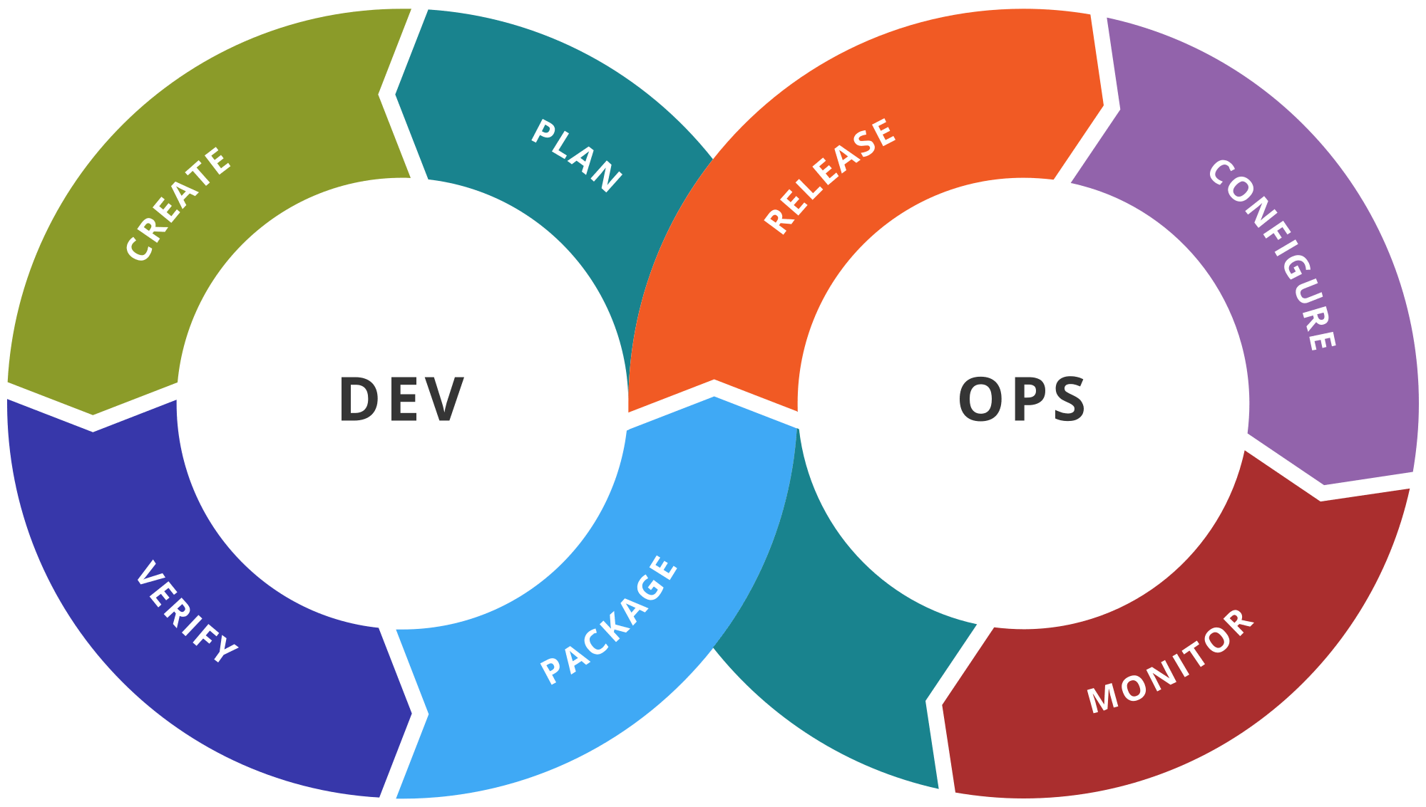
(Possible) Solutions
Technical:
Code standards that work for research and operations
Apply DevOps approaches
(e.g. WCCOS2 replica in the cloud, CI/CD, unified workflow tools)
Process / Culture:
Need a UFS governance for research and operations that is followed
A new definition of “operations” for some applications?
Supporting positive change agents across the enterprise
Budgetary/Organizational:
Focus EPIC community engagement on fewer applications and developers
Foster partnerships (e.g. NSF)
Highlight the societal impact of a better forecast
Notes:
John

Slide 8
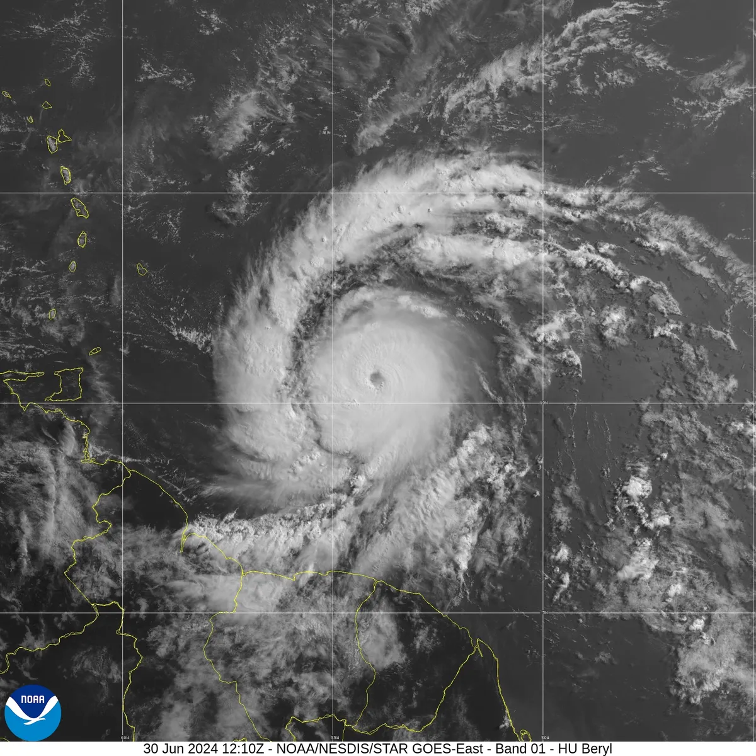
The Social Value of Hurricane Forecasts
“Improvements in hurricane forecasting (for wind speed only) since 2007 reduced per hurricane costs by 19%, averaging $5 billion per hurricane, inclusive of unobserved protective spending.
“How large is this value? $5 billion is nearly the entire NOAA budget and more than ten times cumulative budget of the HFIP since its inception in 2007”.
The Social Value of Hurricane Forecasts, Molina and Rudik, National Bureau of Economic Research, 2024
Notes:
John

Slide 9
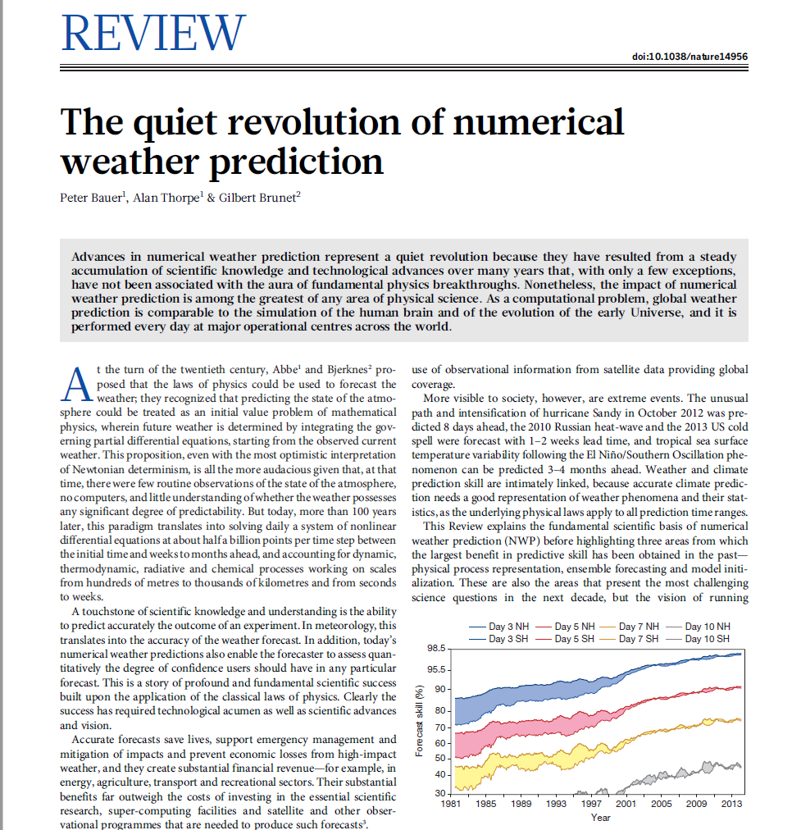
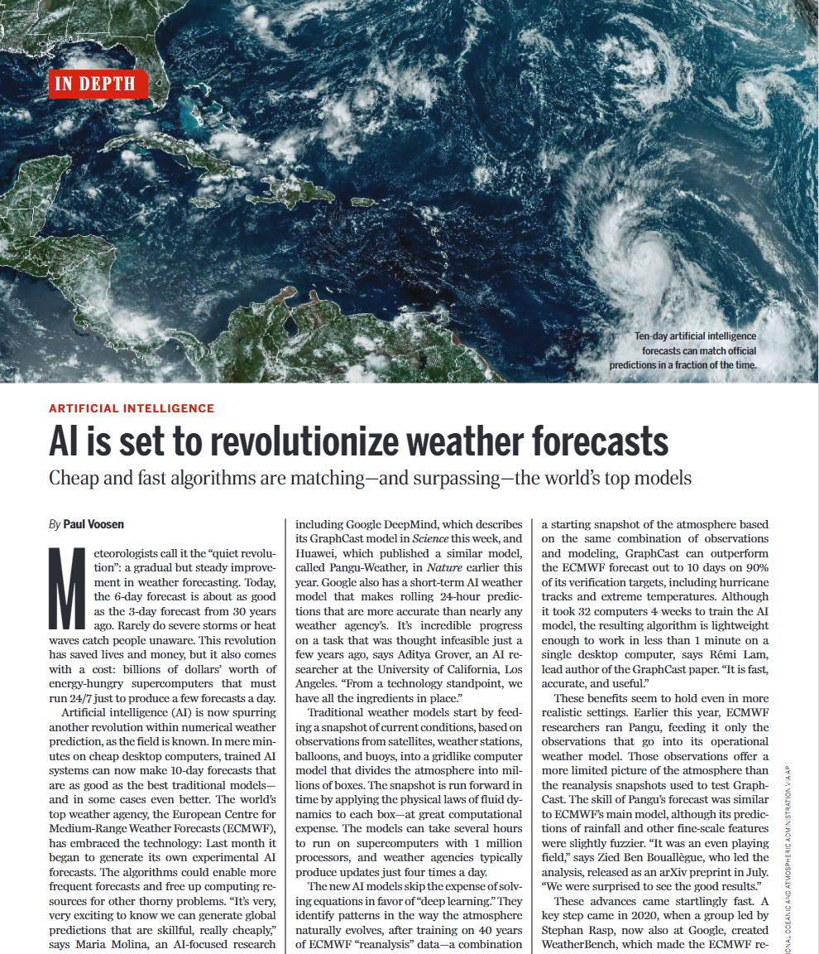
Moving from a quiet revolution to a noisy one?
“NWP did not get where it is today as the result of a single, or a few big discoveries as has been the case in other scientific disciplines, but rather through steady improvements in areas such as physical process representation, model initialisation, and the characterization of analysis/forecast uncertainties through ensembles.” - Peter Bauer, 2015
Notes:
John

Slide 10
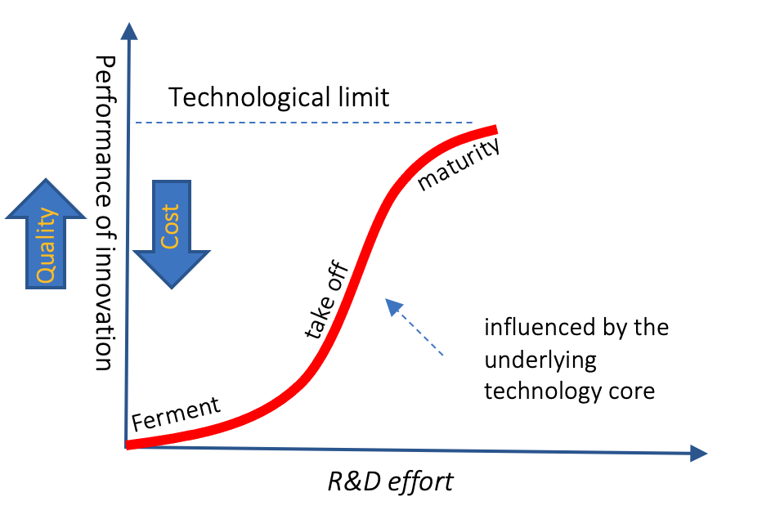
Technology S Curve - Where is AI modeling on this curve?
We need to facilitate experimentation within a common research to development to operations framework
While partnerships will be critical, the federal government still needs to build expertise
(Time)

Slide 11
A single community model?
or
a single modeling community?
Notes:
John
facilitated by similar standards, coding practices, etc…

Slide 12
Future of Modeling: Models for Mission
Quantitative Precipitation Forecasting
Very Short-range, Hyper-Local Modeling: DA implications
Linking Models to Impacts, Decision-Making, Societal Outcomes, and Communities
Notes:
Steve

Slide 13
Average Flash Flood Events Per Week in the United States (based on Storm Data)
R=0.711
1985 | 1990 | 1995 | 2000 | 2005 | 2010 | 2015 | 2020 | 2025
Notes:
Steve

Slide 14
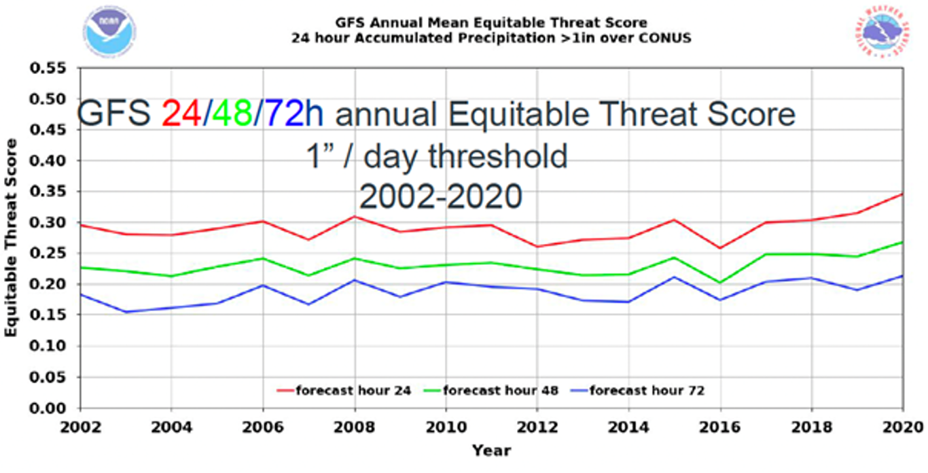
From: A Report on Priorities for Weather Research (NOAA SCIENCE ADVISORY BOARD, 2021)
Notes:
Steve

Slide 15
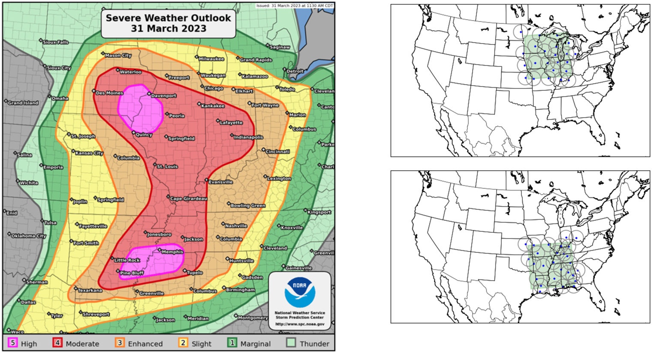
NSSL Warn-on-Forecast System (WoFS)
WoFS setup for 31 March 2023
WoFS
WRF-based system
Deployed on Azure cloud by NSSL
Single or dual domains (900 km x 900 km)
½-hourly 6h forecasts at 3km resolution
5m output frequency
18 ensemble members
Transitioning WoFS demonstration from NSSL to NWS in FY25
SPC Outlook
WoFS Domains
Aims to improve forecasts, warnings, and decision support for high-impact weather events within the watch-to-warning time frame, 0-6 hours in advance of an event.
*Figures courtesy Patrick Burke (NSSL)
Notes:
Steve

Slide 16
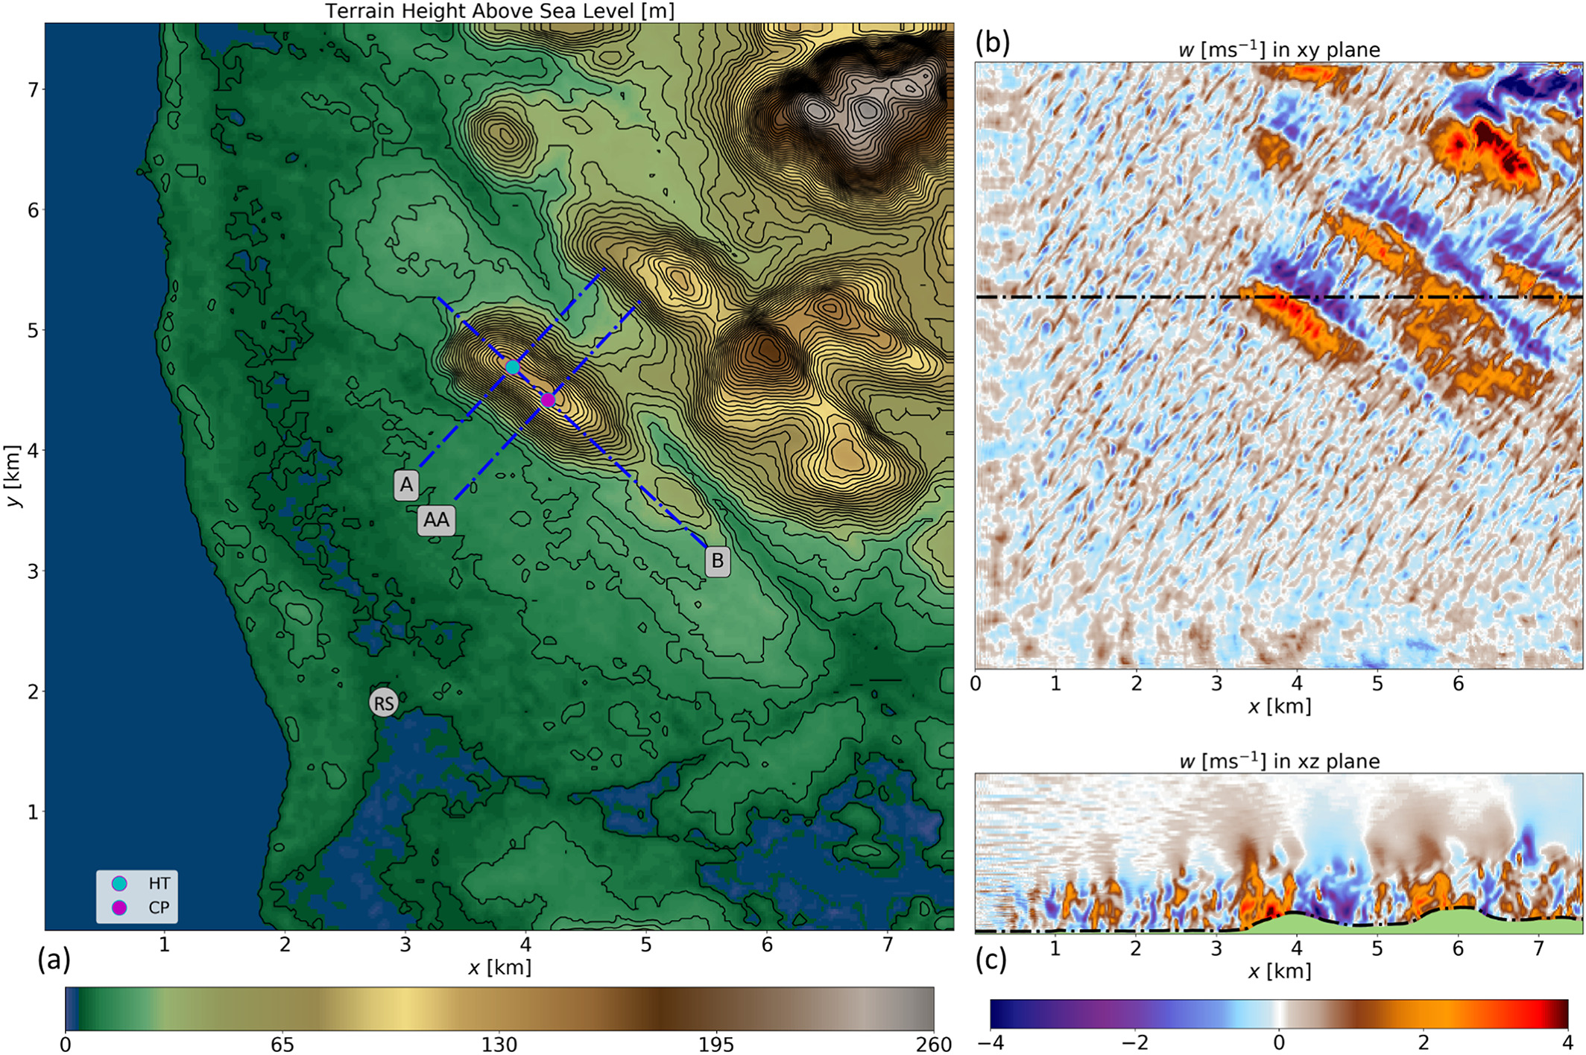
NCAR FastEddy®: A GPU-Accelerated Microscale Model
J Adv Model Earth Syst, Volume: 12, Issue: 11, First published: 13 November 2020, DOI: (10.1029/2020MS002100)
The FastEddy® Resident‐GPU Accelerated Large‐Eddy Simulation Framework: Model Formulation, Dynamical‐Core Validation and Performance Benchmarks
Notes:
Steve

Slide 17
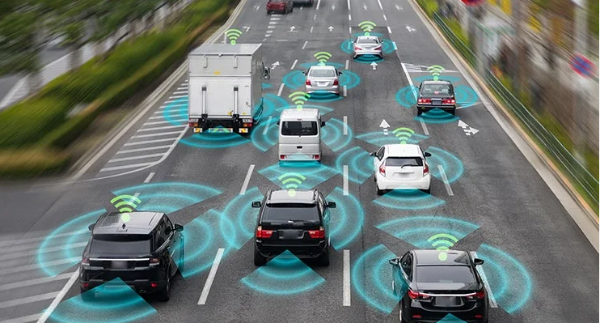
Notes:
Steve

Slide 18
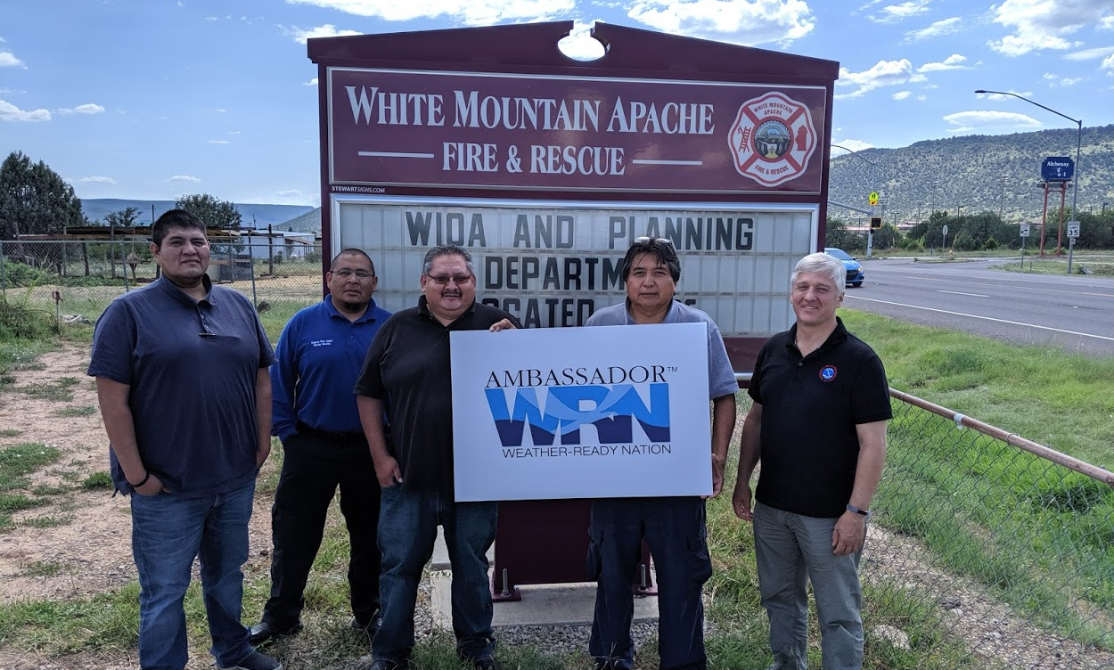
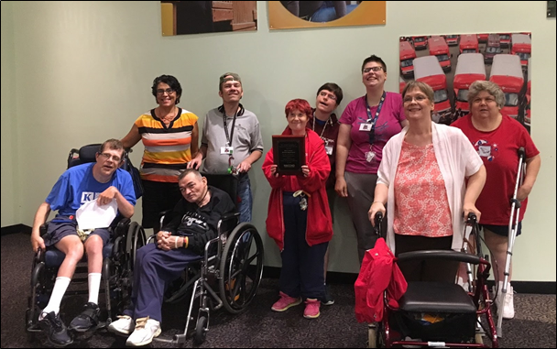
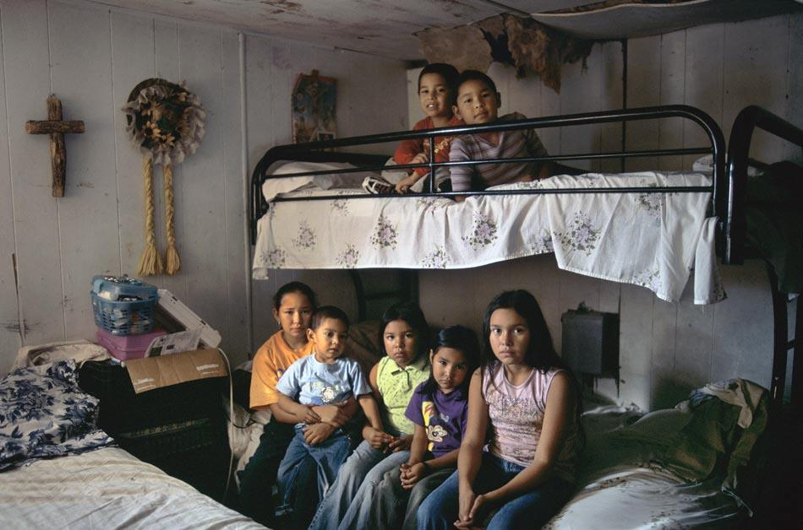
Equitable Services for a Weather-Ready Nation “Building a Weather-Ready Nation, One Community at a Time”
Service
Equity
Gaps
“One-Size” Services Unequal Outcomes
Equitable Services Equality of Outcomes
Notes:
Steve

Slide 19
High-Impact
Weather/Flood
Event
Level of
Activity
General Community Activity
Disruption
Time
Notes:
Steve

Slide 20
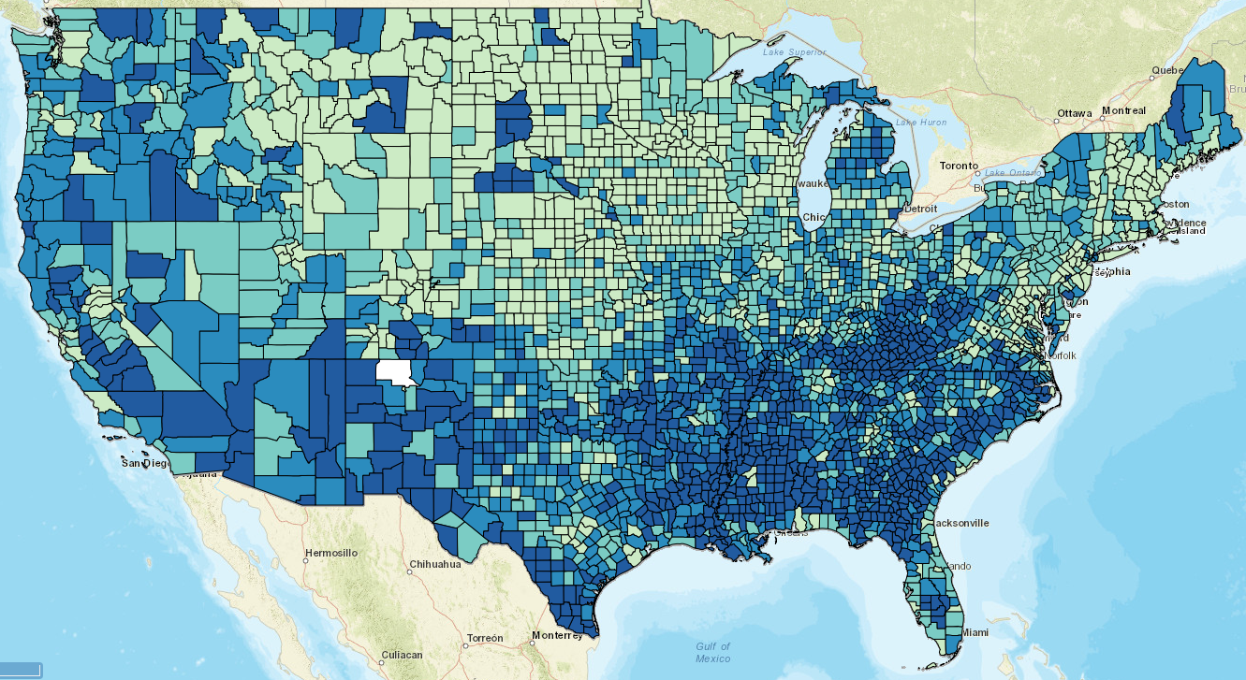
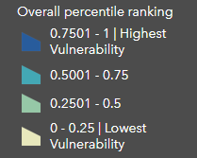
CDC Social Vulnerability Index
$562M
Excess annual property damage
and fatalities due to
weather/flooding
Notes:
Steve

Slide 21
The Last Critical Mile of Our Mission
Prepare Communities and Individuals to Take Protective Actions as Early as Possible in the Face of Hazardous Weather and Flooding
Success in the Last Mile depends on the First Mile
-> Community Engagement
First Mile
Last Mile
Notes:
Steve

Slide 22
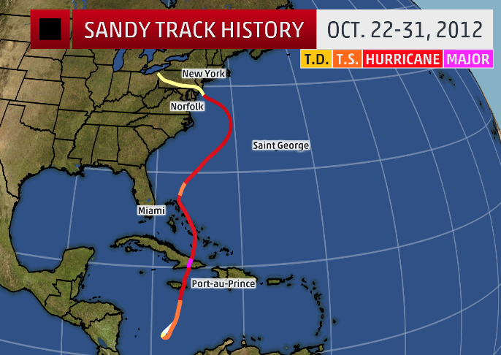
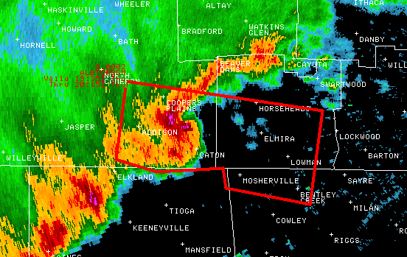
The operational modeling suite provides the foundational numerical guidance for forecasts, warnings, and decision support service products.
Must get the science right… to get the forecast right …. to aid the right decisions!

Slide 23
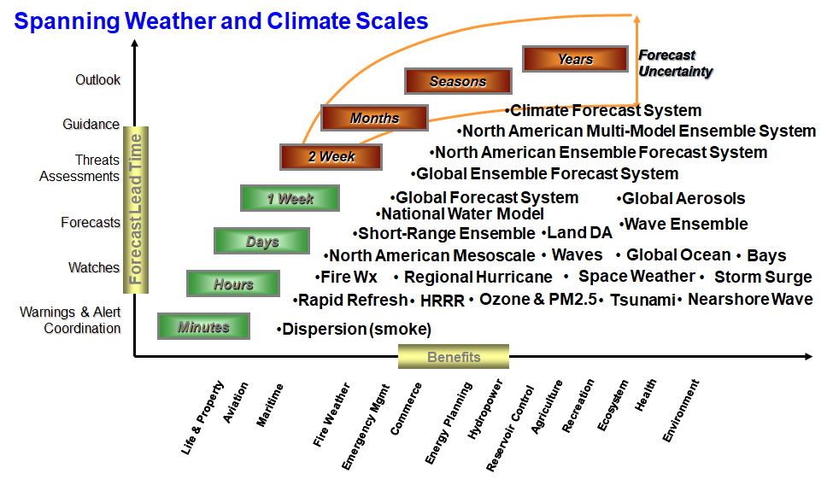
EMC’s Operational Numerical Guidance Systems
GEFS now includes wave and aerosol components

Slide 24
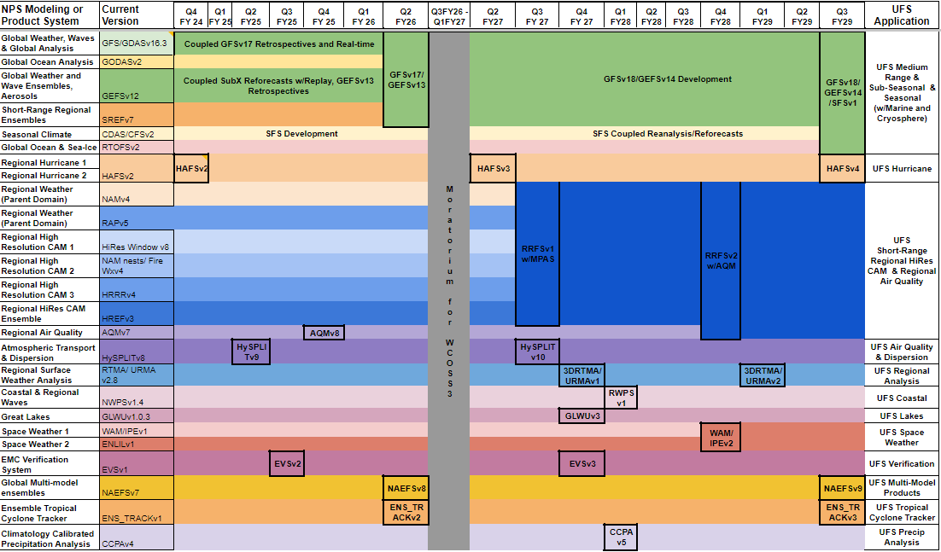
Notional Schedule for Transitioning NCEP Modeling Systems to UFS-based Applications

Slide 25
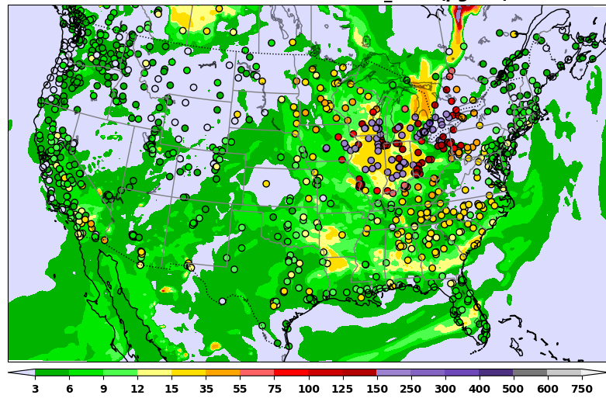
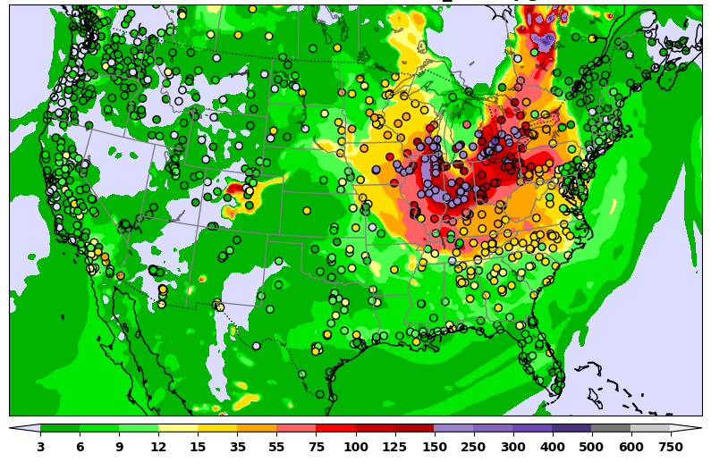
Recent Operational Modeling Achievements
Fine particulate matter: Quebec fires (June 26, 2023)
Model version# | Implementation date
RTMA/URMAv2.10.5 | 1/24/2023
GLWUv2 | 5/9/2023
HAFSv1 | 6/27/2023
NAEFSv7 | 12/5/2023
EVSv1 | 3/26/2024
AQMv7 | 5/14/2024
HAFSv2 | 7/16/2024
AQMv6
AQMv7

Slide 26
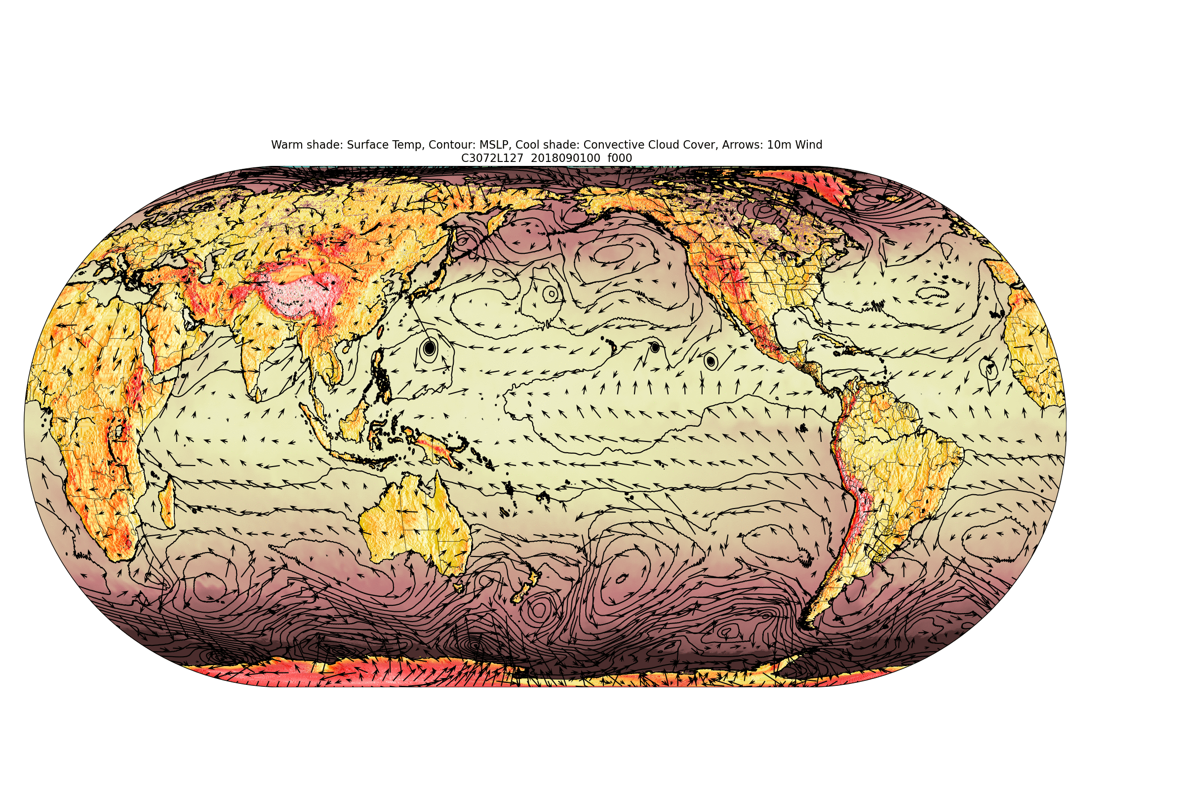
A Six-Way Global Coupled Unified Forecast System (UFS) -- a first for NOAA/NWS
UFS Earth System Model Components:
A fully coupled UFS serves as a foundation for future operational global forecast systems at NOAA/NWS/NCEP ranging from weather to subseasonal to seasonal scales.
FV3 (Atmosphere)
MOM6 (Ocean)
CICE6 (Sea Ice)
WW3 (Waves)
NOAH-MP (Land)
GOCART (Aerosols)
Animation Courtesy: S. Moorthi and Keqin Wu, NWS/NCEP/EMC
Critical role of the community and community partnerships
‹#›

Slide 27
Current/Planned AI/ML Activities at NCEP/EMC
Observations | Data Assimilation | Forecast | Post/Product
Radiosonde processing | Physics emulation | AC Accelerated Transport | Wave Systems
Satellite Thinning | Improved Background | Atmospheric Chemistry Emulator | Air Quality Bias Correction
AMV super-observations and error estimation | Background Error Covariances | Physics Suite Emulation | Sub-Seasonal/ Seasonal forecast products
Conventional / Aircraft quality control | CRTM emissivity modeling | Radiation Parameterizations
Observation Anomaly Detection | High-resolution background downscaling and emulation | Ensemble Forecasting / Forecast Model Emulation
 | Radiance bias correction | Fire emissions for sub-seasonal to seasonal predictions

Slide 28
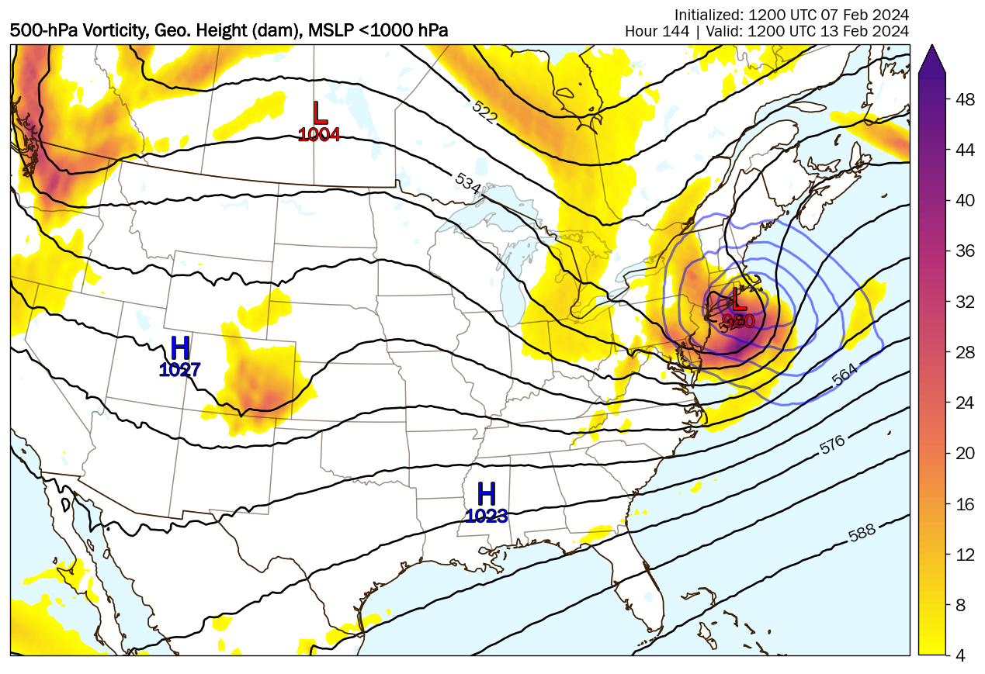
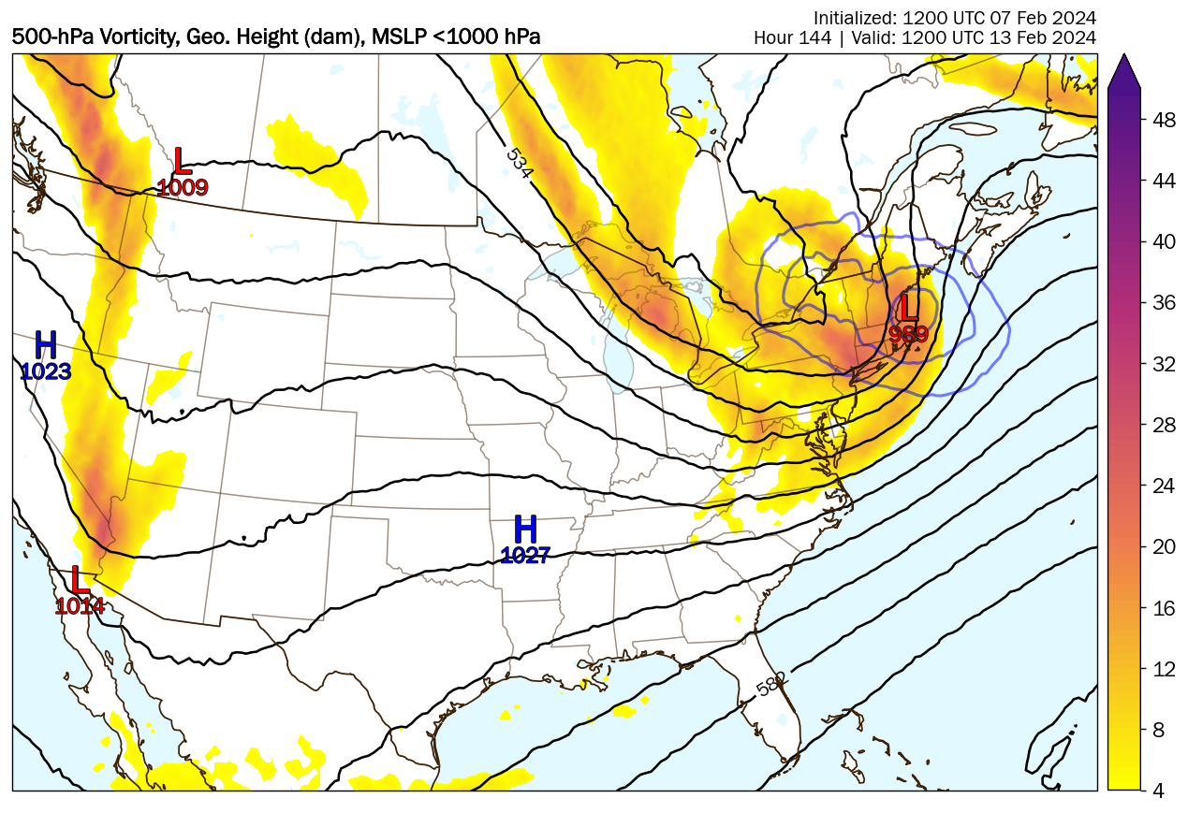
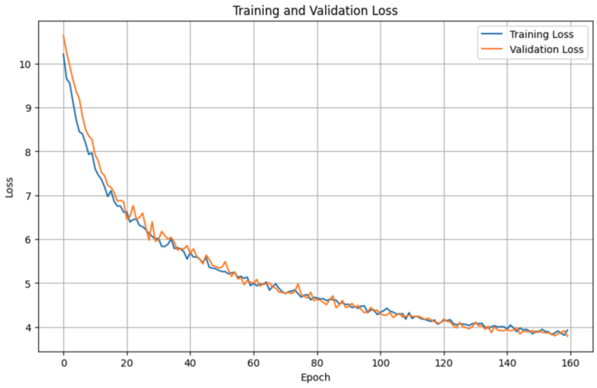
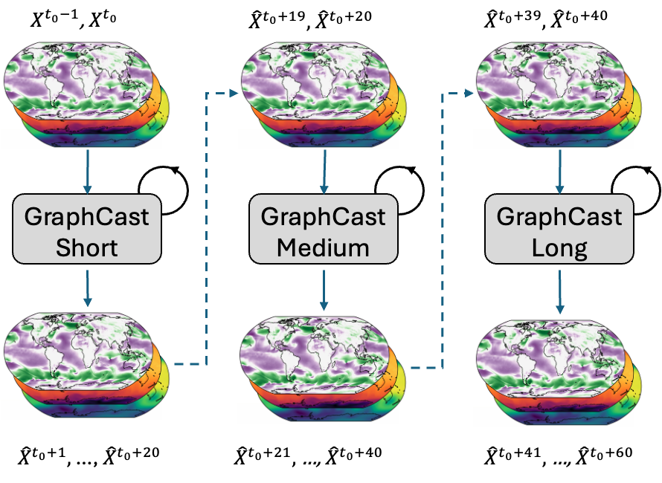
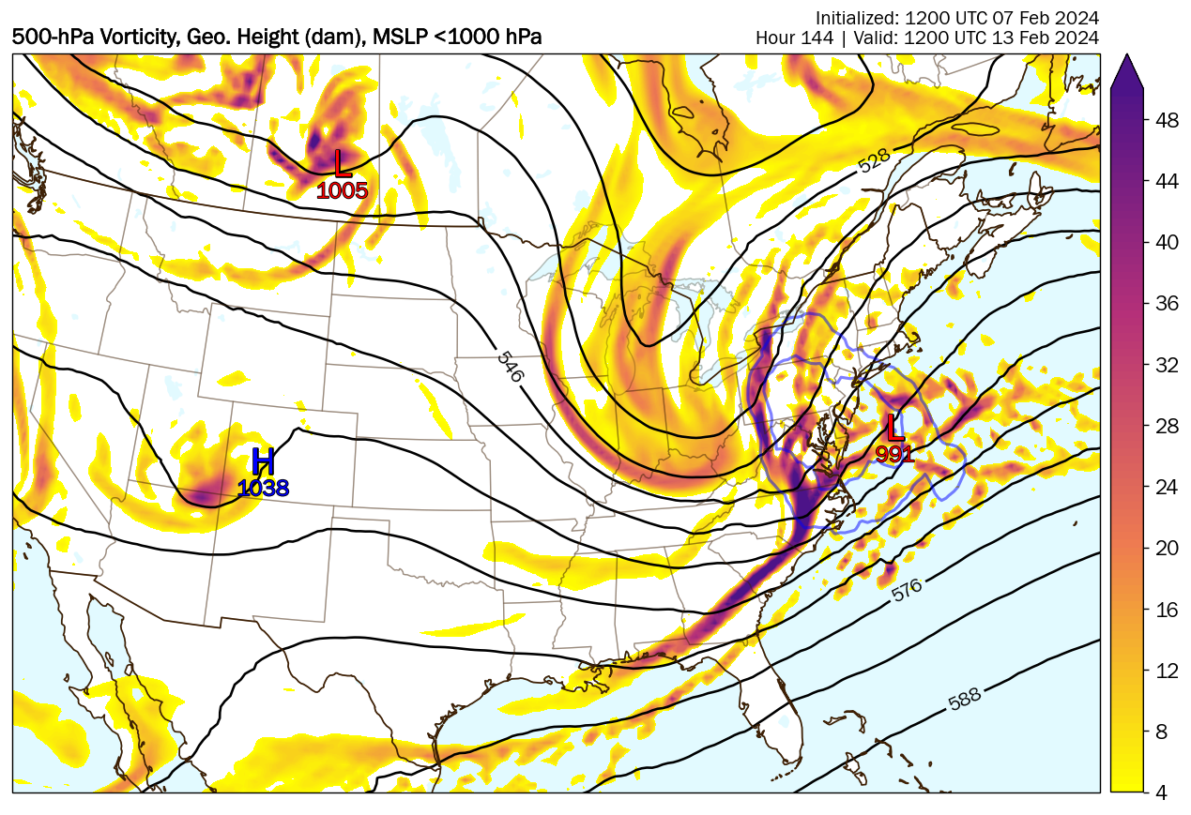
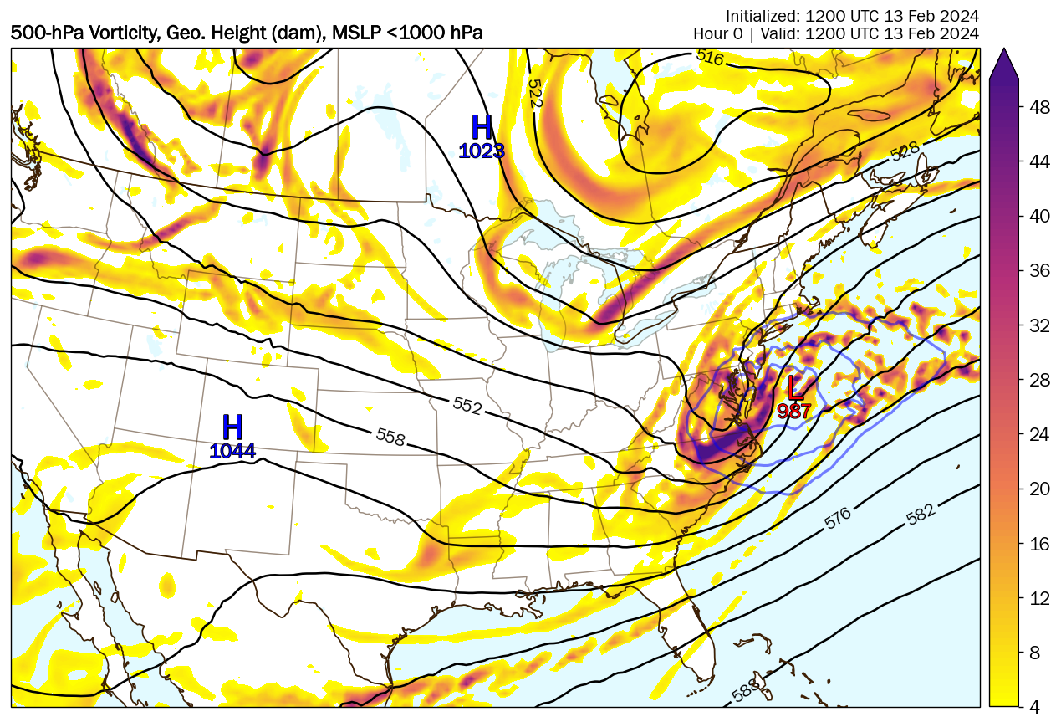
Develop data driven Machine Learning Weather Prediction models
Leverage the latest MLWP models and the advanced training techniques to develop the MLWP models at EMC for global weather and climate prediction
Status:
Built GraphCast and FourCastNet with ERA5 data and GDAS data on NOAA cloud and R&D HPC platforms; setup the real time experimental GraphCastGFS on NODD: https://noaa-nws-graphcastgfs-pds.s3.amazonaws.com/index.html
Fine tuning GraphCast with GFS input using GFS analysis data
Developing autoencoder ML models to correct biases of GFSv16 products
Created the first prototype of MLGEFSv1 with GraphCast model with GEFS 30 member ensembles
Plan:
Train GraphCast with GEFS reanalysis and improve MLGEFS long lead time prediction
Develop hybrid ensemble forecast system with MLWP and NWP GEFS.
Develop hybrid ensemble hurricane forecast system and ML2Ops system to support MLWP operational implementation
MLGEFSv1
GraphCast training
GFS-GC 13 levels
GFS-GC 37 levels
GFS
GFS Anl.

Slide 29
Future of modeling
Priorities:
Data Assimilation using Joint Effort for Data assimilation Integration (JEDI)
History & Current Status
10 Year Strategy
Community-based development of the Unified Forecast System:
6-way fully coupled representation of the Earth system to better support NWS mission of saving lives and property
Artificial Intelligence and Machine Learning methods:
Computational efficiency, post processing and bias correction, better use of data, representation of uncertainty, hybrid modeling
Partnerships with national and international community (AI4NWP; workshops with other federal agencies, private sector and academia; collaboration with international NWP centers)
All strongly rely on community development and collaboration
Problems are challenging - need a focused deliberate approach and contributions from the broad community

Slide 30
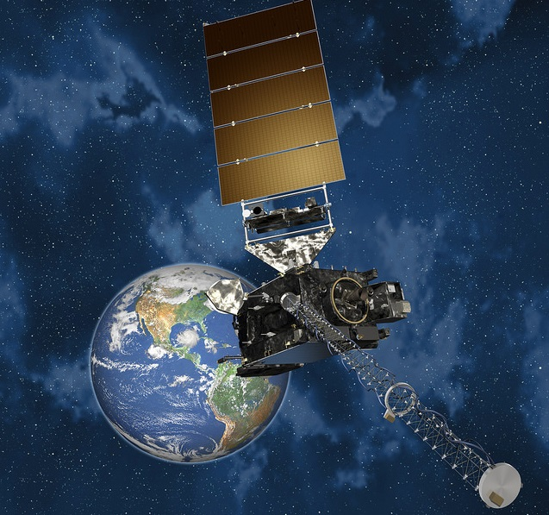
How NOAA is addressing the need for better DA
DA Consortium University teams to train students in DA advances
Vestibulum congue
NOAA Labs and Weather Service
Partner with DA Consortium
In-kind to JCSDA
Advance UFS DA
Data Assimilation
Transatlantic Data Academy UK-Met Office University affiliates partner with DA Consortium
Vestibulum congue
Data Assimilation
Vestibulum congue
Establishment of a Data Assimilation Consortium
NOAA DA Strategy
More info during Friday DA Strategy session
at 9:05am here in the main Ballroom
The Unified Forecast System
Land Data Assimilation System
Data Assimilation Working Group
UFS teams
Supporting the Joint Center for Satellite Data Assimilation
Ensuring JEDI implementation is a top priority
International Partnerships
UKMet office Transatlantic Data Science Academy
Vestibulum congue
JCSDA
Notes:
John

Slide 31
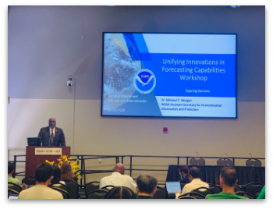
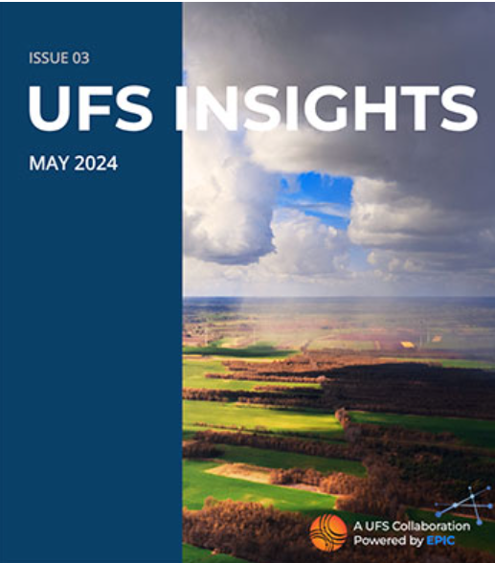
What you can do to get involved
Community events
UIFCW…
Codefests
Hackathons
Github
Newsletters
Ask a question
Explore the website
Follow on Social media
Submit a proposal to a Notice of Funding Opportunity (NOFO)
Notes:
John

Slide 32
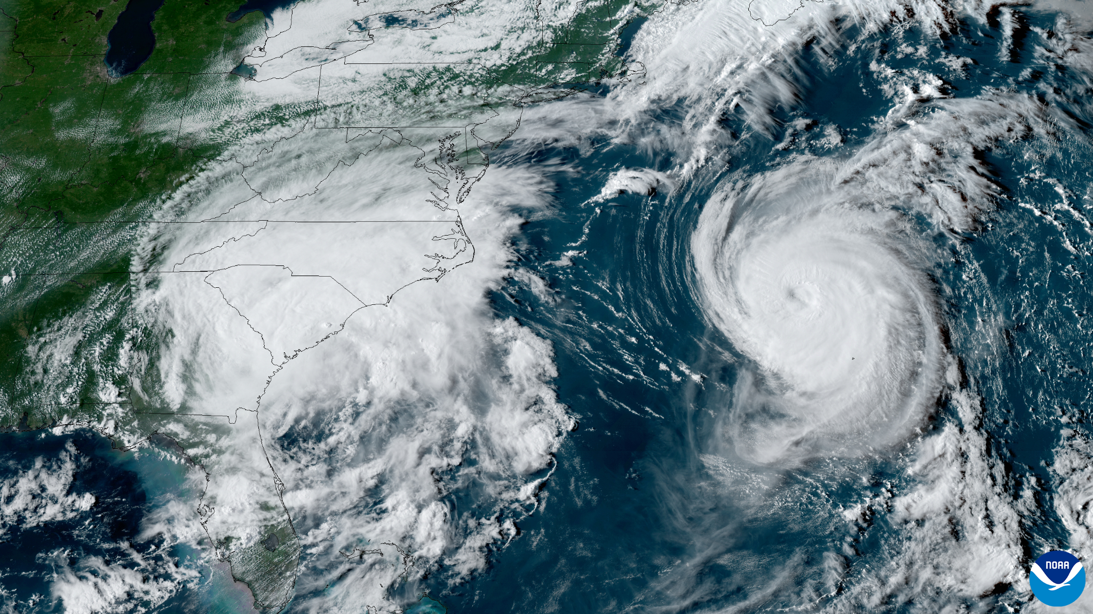
Please Welcome our Next Speaker…
Dr. Xuguang Wang
From the University of Oklahoma
On A Multi-University Consortium for Advanced Data Assimilation Research and Education (CADRE)
Image: NOAA's GOES-16 satellite of Tropical Storm Idalia and Hurricane Franklin on August 30, 2023

Slide 33
Please Welcome our Next Speakers…
Damian Wilson, Zorica Jones, Becky McCoy and George Pankiewicz
From the United Kingdom Met Office (UKMO)
On Developing the Transatlantic Data Science Academy: The UK experience

Slide 34
Questions? Let’s chat
John Ten Hoeve - Acting Director, NOAA Weather Program Office
john.tenhoeve@noaa.gov
Maoyi Huang - EPIC Program Manager, NOAA Weather Program Office
maoyi.huang@noaa.gov
Stephan Smith - Director, NOAA National Weather Service Office of Science & Technology Integration
stephan.smith@noaa.gov
Ivanka Stajner - Acting Director, NOAA Environmental Modeling Center
ivanka.stajner@noaa.gov

Slide 35
Data Assimilation and its Relevance in the Modern World
Data Assimilation (DA) is observations combined with a computer model
Applications for atmosphere, ocean, land, etc…
Can be combined with Machine-learning (ML) which can help “sort through the data” but cannot replace DA…at least not right now
DA addresses nearly all NOAA mission areas across all scales
With more effective use of satellite, surface, air and ocean observations, DA can improve:
Tropical cyclone intensity and rainfall projection
Surface wind estimates
Snow depth and snow cover forecasts in winter storms

Slide 36
Societal Impacts, Needs and Goals
Why
Hurricane forecasting
Onset of flash flooding
Severe weather
Hail
Tornadoes
Lightning
Wind
Drought
Cold snaps
Heat waves
Soil moisture
Ocean temperature
What
Shortage of DA:
Experts
Workforce
Training
Sparse observation network/utilization
Limited infrastructure
Inefficiencies in R&D and R2O and O2R
SAB’s Priorities for Weather Research
Outcomes
Train the next generation of DA experts
UFS innovations
DA/ML advancements
Community involvement
Infrastructure improvements
Climate and Weather-ready nation
Increase obs. usage

