Slide 1
Necessary investments to advance NOAA predictive capabilities
Unifying Innovations in Forecasting Capabilities Workshop 2024
Jackson State University
Dr. Michael C. Morgan
Assistant Secretary of Commerce for Environmental
Observation & Prediction
23 July 2024

Slide 2
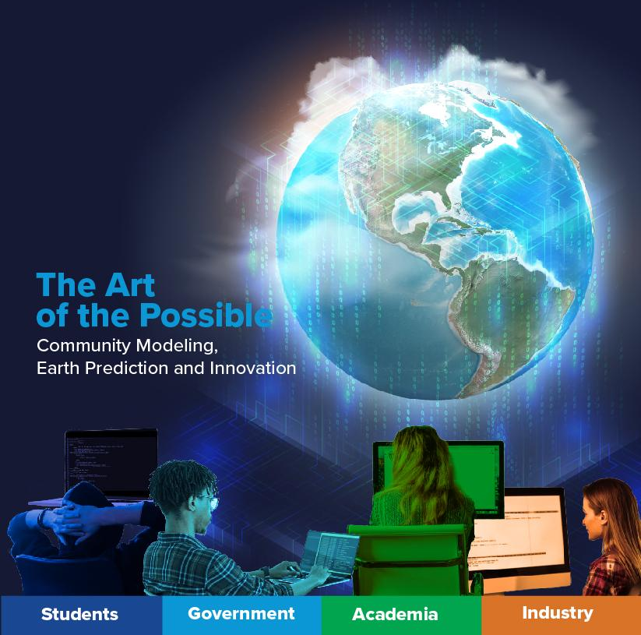
PARTNERING WITH THE COMMUNITY FOR THE BENEFIT OF THE NATION
Vision
To enable the most accurate and reliable operational numerical forecast model in the world.
Mission
To be the catalyst for community research and modeling system advances that continually inform and accelerate advances in our nation’s operational forecast modeling systems.
Notes:
The EPIC vision – to enable the accurate and reliable forecast system, entails a mission that supports and will ultimately leverage and benefit from innovative contributions from and by the broader weather enterprise.
Legislatively, the EPIC program was born under the 2018 National Integrated Drought Information System Reauthorization Act of 2018 (NIDISRA), which instructed NOAA to establish the Earth Prediction Innovation Center (EPIC) in partnership with the Weather Enterprise, including academia, government, and industry, to accelerate the process of incorporating community innovations to NOAA’s forecast systems.

Slide 3
NOAA’s Data value chain
Bridging the Gap: Ensuring Seamless Data Flow from Acquisition to Access
Data to Decisions
Research and Development (Technology, Science, including Social Science)
Phenomena
Observations
Level 1-3 Products
Modeling Assimilation Analysis
Monitoring
Forecasting
Service Delivery
Societal Benefit
Data Processing and Transport Infrastructure / Data Management

Slide 4
ASEOP priorities for advancing NOAA’s predictive capabilities
Data Assimilation
Completion of JEDI software
Operationalizing JEDI within NOAA
DA workforce development (UC & TDSA)
Outcomes:
Improved use of observations
Reduced uncertainty in analyses
Creation of high-quality coupled reanalyses (useful for AI/DL training datasets)
AI/DL for NWP and WP
Creation of AI-enhanced parameterizations
Building open-science infrastructure for NOAA-native data-driven model development.
Developing data-driven models and data-driven DA systems
Outcomes:
Faster physics-model execution
Large-sized ensembles
“On-demand” DA and forecasting
Creation of bespoke forecast guidance
HPC
On-prem and cloud
CPUs and GPUs
EPIC and NCAI can play a leading role in advancing this work

Slide 5
THANK YOU

Slide 6
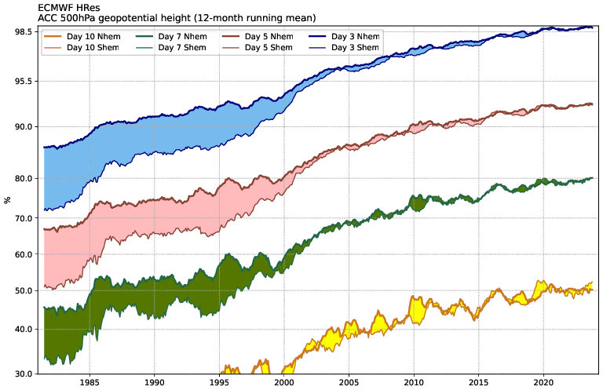
Increasing skill in physics-based models
skill increasing at about 10% a decade
Source ECMWF: https://charts.ecmwf.int/products/plwww_m_hr_ccaf_adrian_ts?player_dimension=single_product&single_product=latest

Slide 7
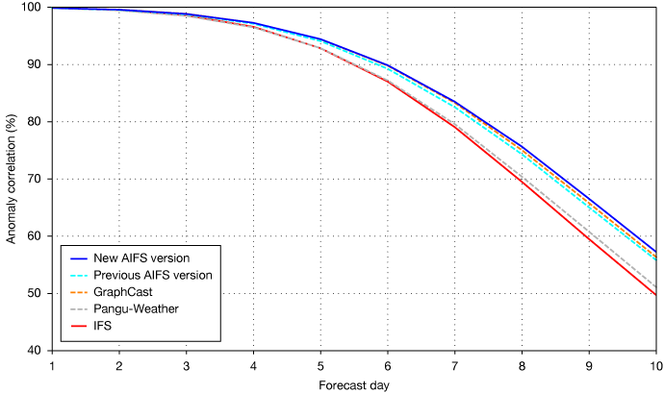
A leap in skill in from AI-based models
New AIFS (released just in the last 6 months) shows an increase in skill at Day 10 by about 7 percentage points. Would have taken more than a decade with physics-based models
skill increasing at about 10 percentage points a decade
Source ECMWF: https://charts.ecmwf.int/products/plwww_m_hr_ccaf_adrian_ts?player_dimension=single_product&single_product=latest

