Slide 1
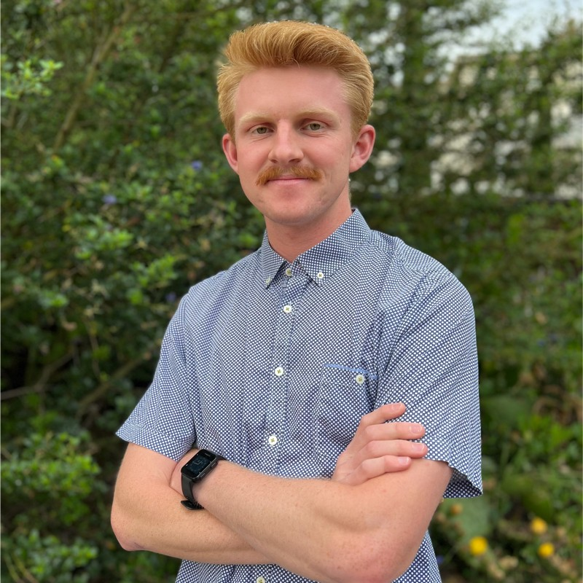
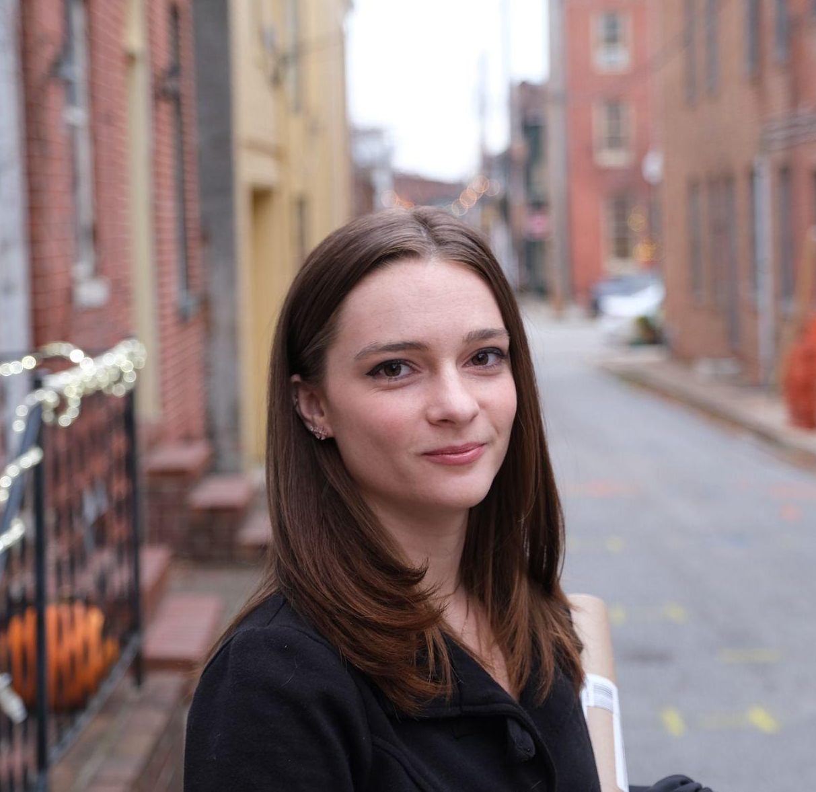
13 students from across the country were selected to receive a travel grant to attend UIFCW24!
Say Hello!
UIFCW24 Travel Grant Awardees
 | Clinton Alden University of Washington |  | Emily Faber University of Maryland, Baltimore County
 | Daoyang Bao Louisiana State University

Slide 2
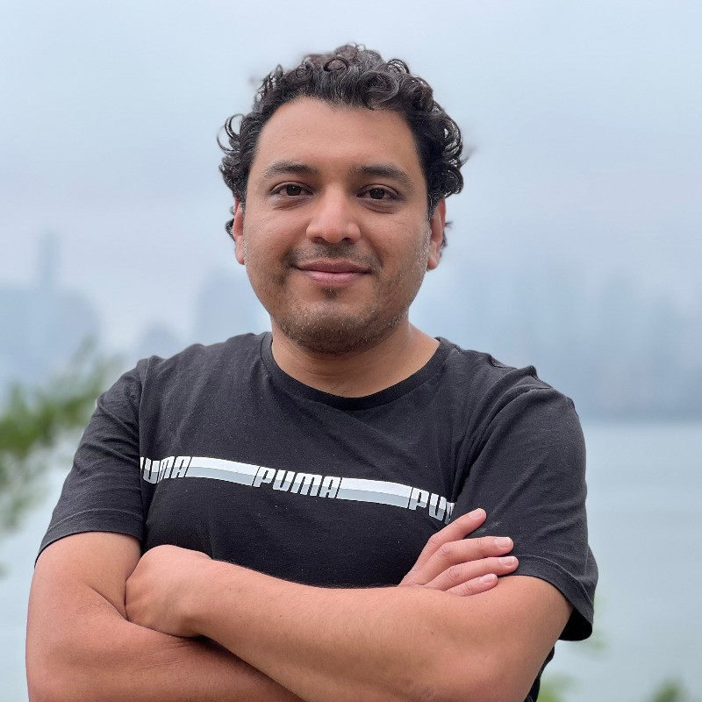
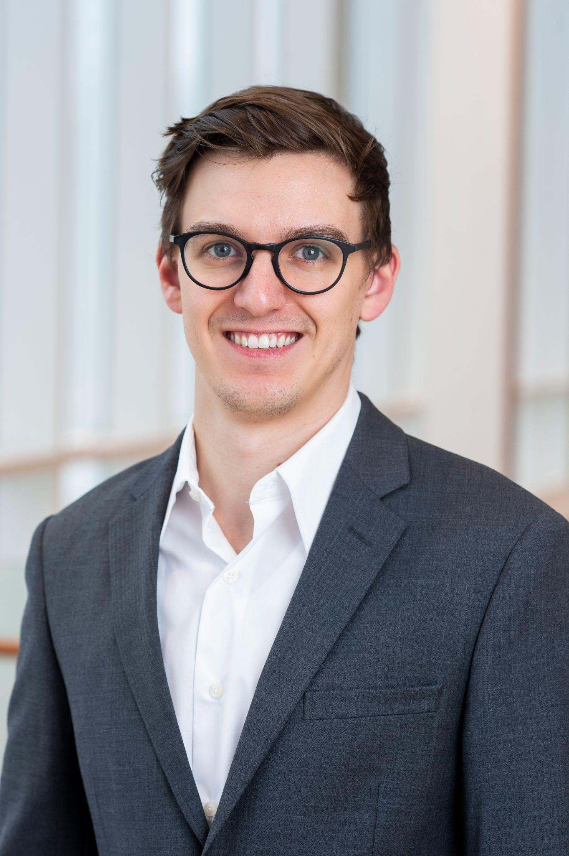
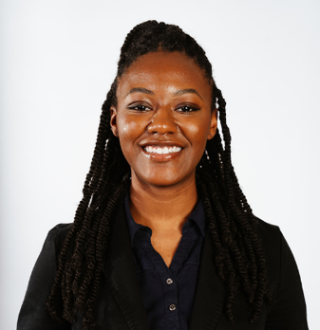
13 students from across the country were selected to receive a travel grant to attend UIFCW24!
Say Hello!
 | Jorge Bravo Stevens Institute of Technology |  | Joseph Knisely University of Maryland, College Park
 | Zakiya Johnson Jackson State University |  | Anna Glodzik University of Albany

Slide 3
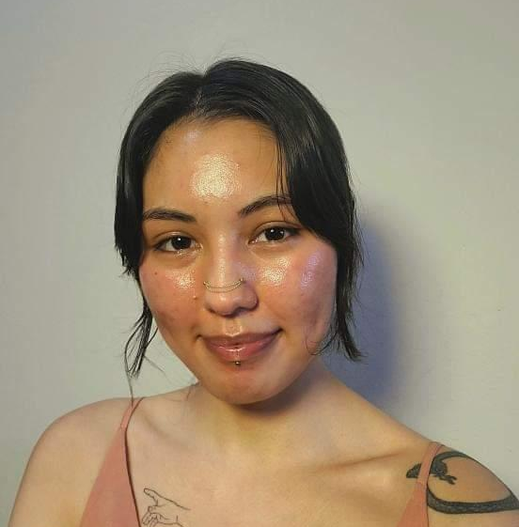
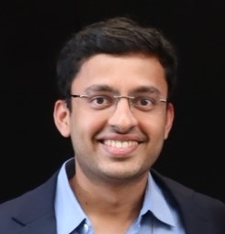
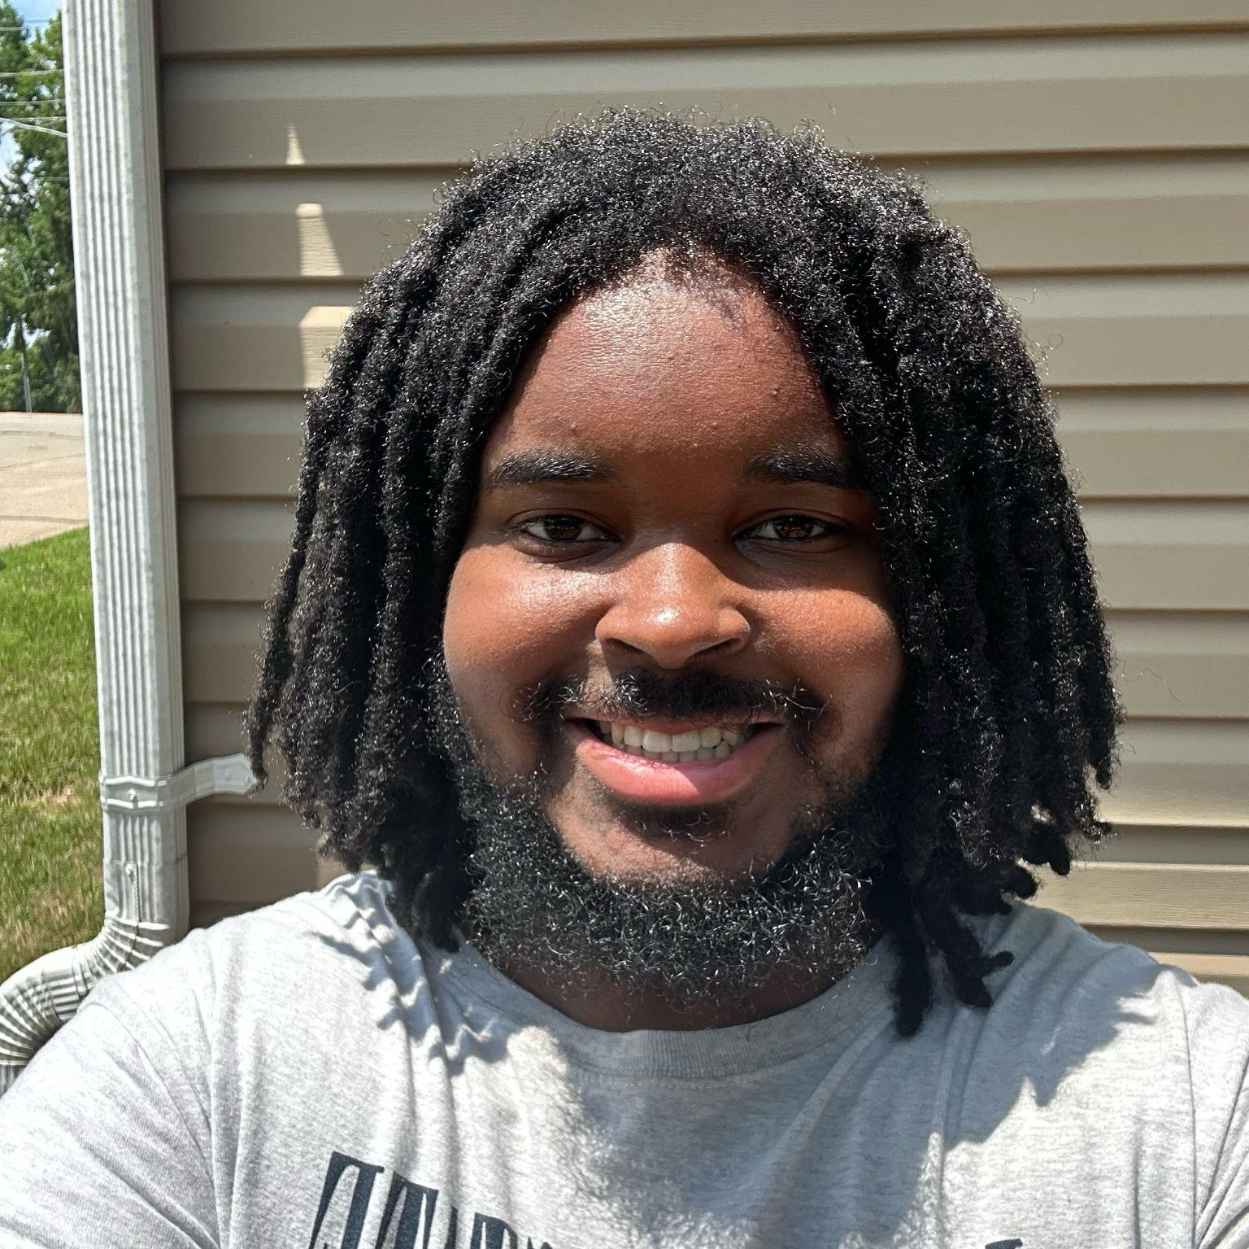
13 students from across the country were selected to receive a travel grant to attend UIFCW24!
Say Hello!
UIFCW24 Travel Grant Awardees
 | Margarita Mora Howard University |  | Shreyas Rajendra Dhavale North Carolina State University
 | Zion Murphy Jackson State University

Slide 4
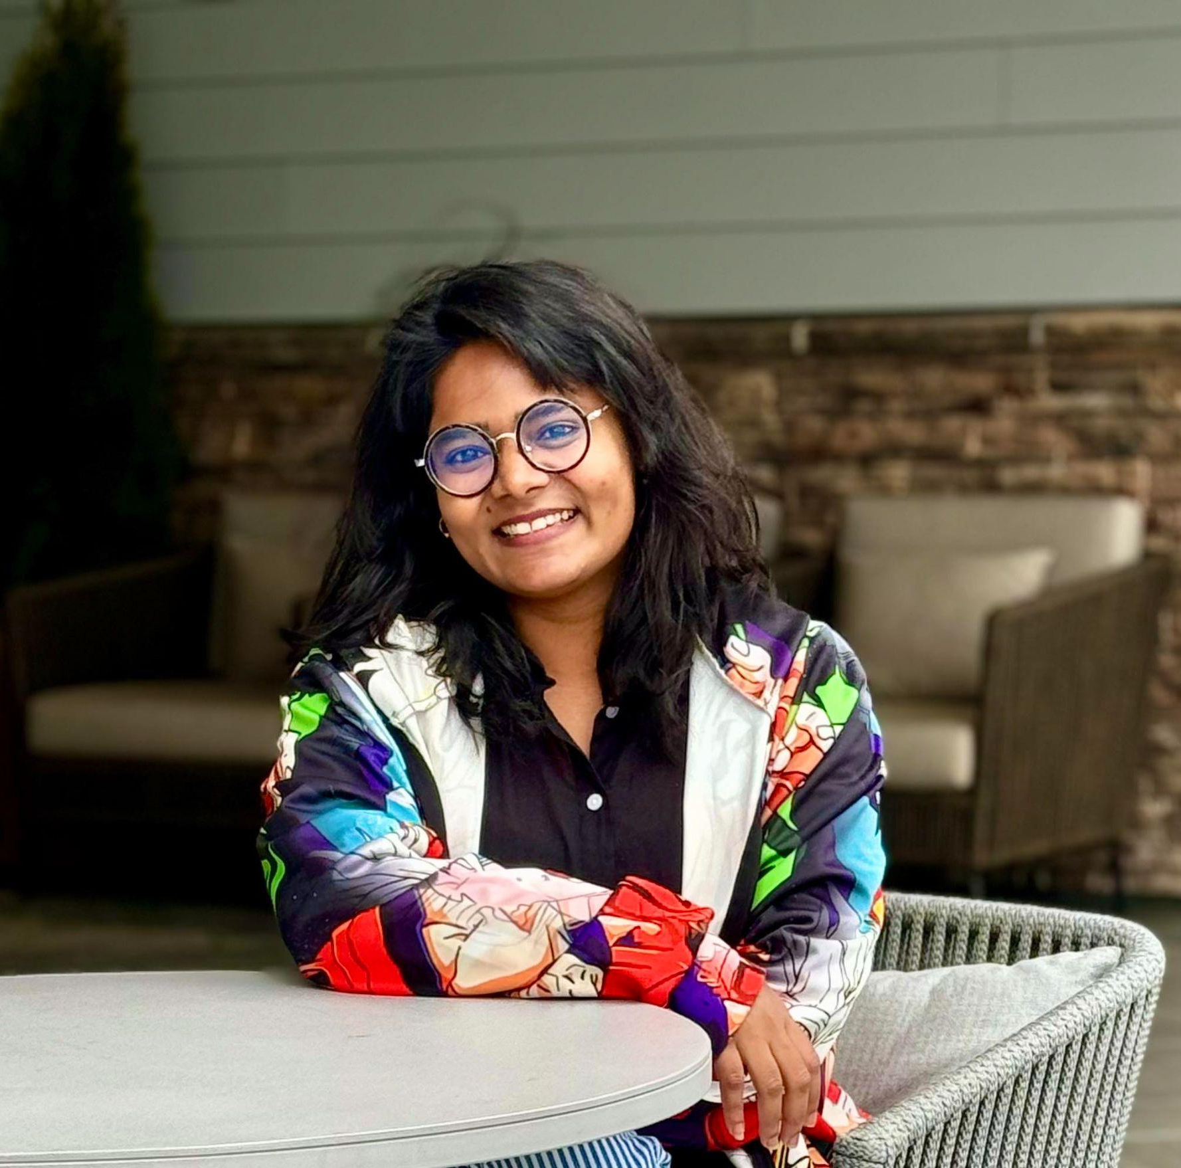
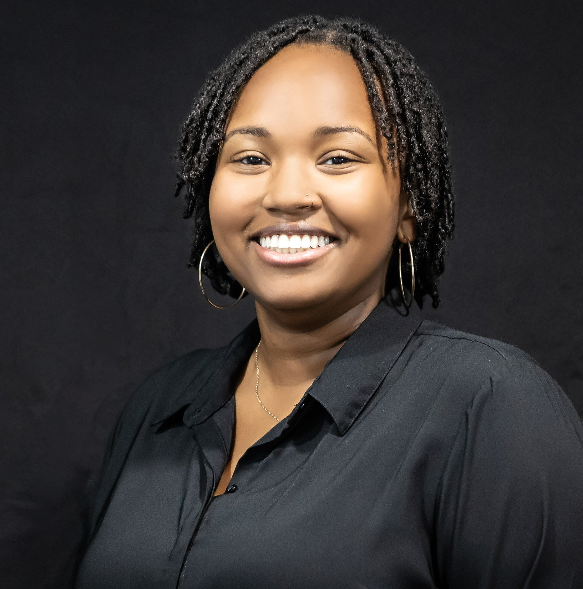
13 students from across the country were selected to receive a travel grant to attend UIFCW24!
Say Hello!
UIFCW24 Travel Grant Awardees
 | Nowrin Mow University of Maryland, Eastern Shore |  | Yu-Cian Tsai Colorado State University
 | Alycia Triplett Howard University

