Slide 1


Unifying Innovations in Forecasting Capabilities Workshop
A Unified Forecast System (UFS) Collaboration Powered by the Earth Prediction Innovation Center (EPIC)
JULY 23rd, 2024
Jackson State University Student Center
July 22 - 26, 2024

Slide 2
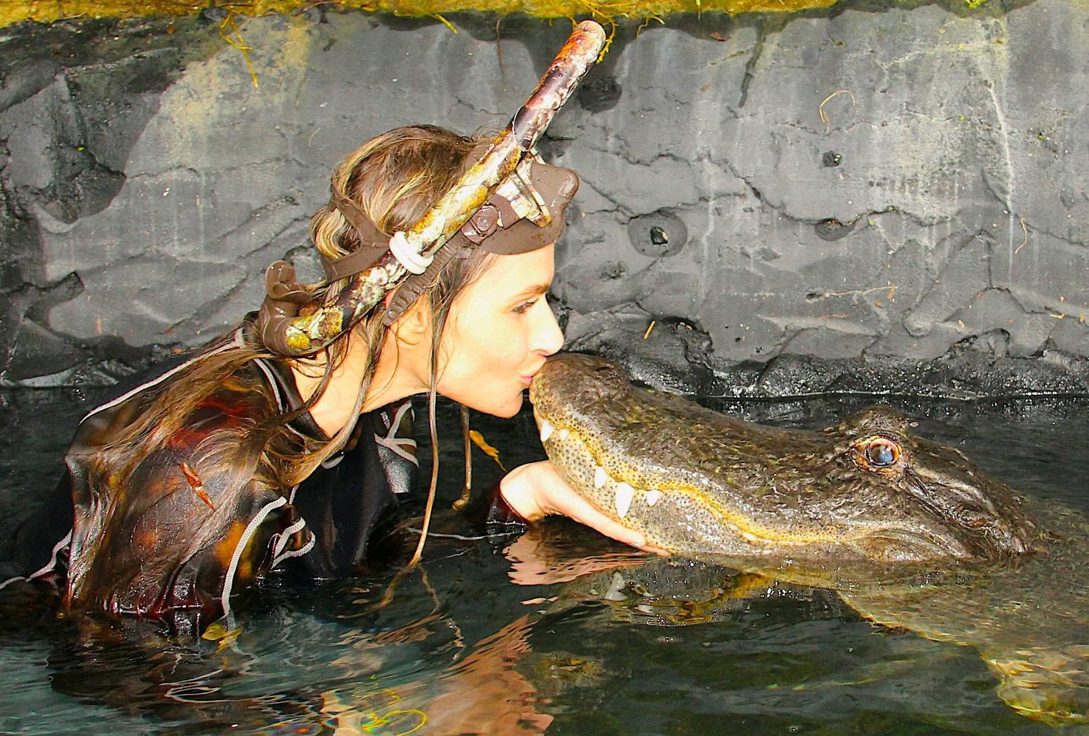
Today’s Master of Ceremonies
Tracy Fanara
Coastal Modeling Portfolio Manager
NOAA/NOS/IOOS

Slide 3
Live Streaming Announcement
The UIFCW is an open event that will be live-streamed online and recorded. By staying in the room (and online), you understand that your image, in video or still, and any sound recorded alongside it, will live-streamed over social media and recorded. The videos will be submitted to NOAA for review before sharing publicly. The information that you provide will be used for websites, agenda's, and event descriptions.
For more information on NOAA's Privacy policy: https://www.noaa.gov/sites/default/files/legacy/document/2021/Mar/NOAAPrivacyPolicy_Final_May2017.pdf

Slide 4
Tuesday, July 23rd
9:00 AM – 9:05 AM – Welcome & Kickoff
9:05 AM – 9:15 AM – Opening Remarks by Dr. Michael Morgan
9:15 AM – 10:25 AM – Future of Modeling & Data Assimilation Consortium
10:25 AM – 10:55 AM – EPIC's UFS Community Support and Data Management
10:55 AM – 11:55 AM – Break
11:15 AM – 12:15 PM – Student Session
12:15 PM – 1:15 PM - Lunch

Slide 5
Tuesday, July 23rd
1:15 PM – 2:30 PM – Effective Use of Artificial Intelligence/Machine Learning (AI/ML) in Numerical Weather Prediction (NWP)
2:30 PM – 3:00 PM – Keynote: Breakthroughs in Model Performance
3:00 PM – 3:30 PM - Break
3:30 PM – 4:00 PM - A Social Science Approach to Unified Community Modeling
4:00 PM – 5:30 PM - Status Update on MPAS from Across Organizations & Moderated Discussion
5:30 PM – Adjourn

Slide 6


Connect With Us!
Connect with us on Slack, X, and Instagram with #UIFCW24
UIFCW24 Slack workspace
X (Twitter): @NOAAEPIC & @ufs_community
Instagram: @NOAAEPIC
Wi-Fi: NOAA_GUEST
Password: NoAa@J$Uz4

Slide 7

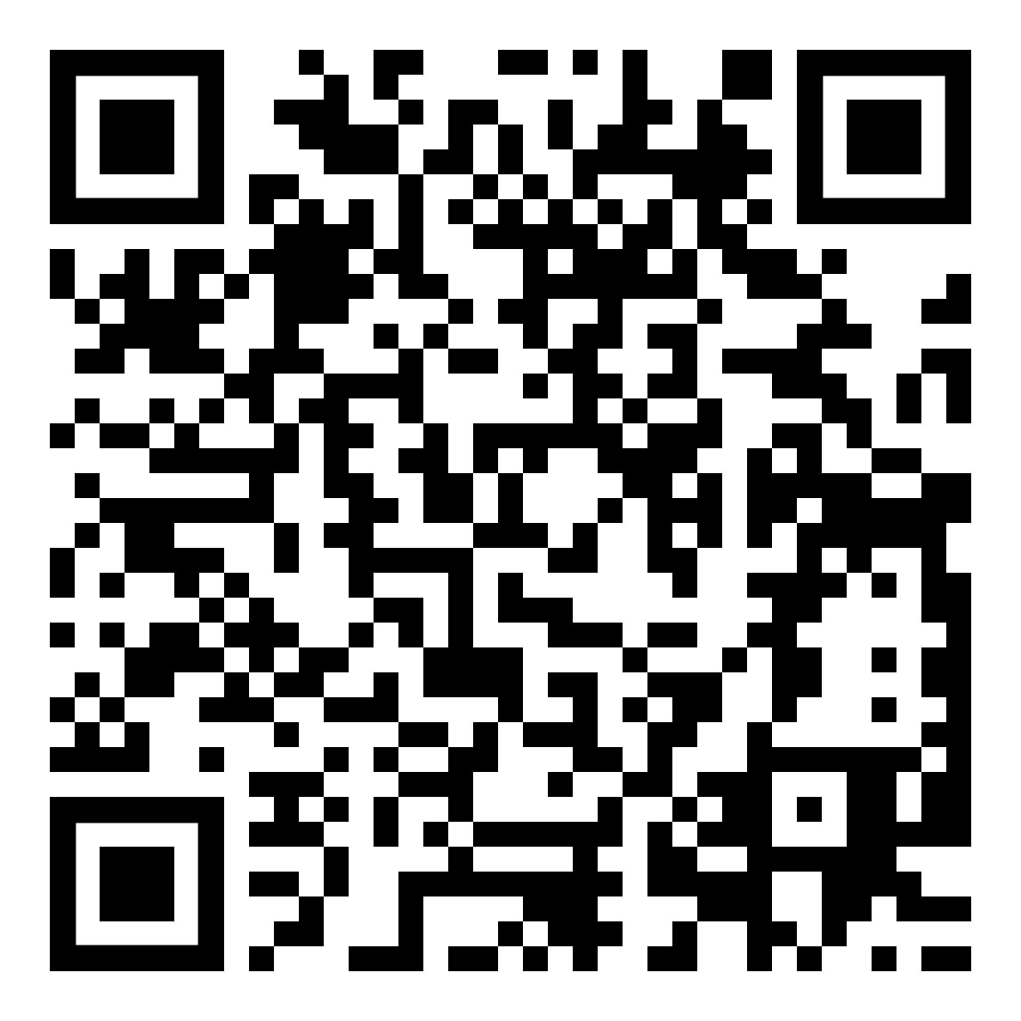
UIFCW Event Guide
UIFCW Slack Space

Slide 8
UIFCW Event Guide

