Slide 1


Unifying Innovations in Forecasting Capabilities Workshop
A Unified Forecast System (UFS) Collaboration Powered by the Earth Prediction Innovation Center (EPIC)
JULY 22nd, 2024
Jackson State University Student Center
July 22 - 26, 2024

Slide 2
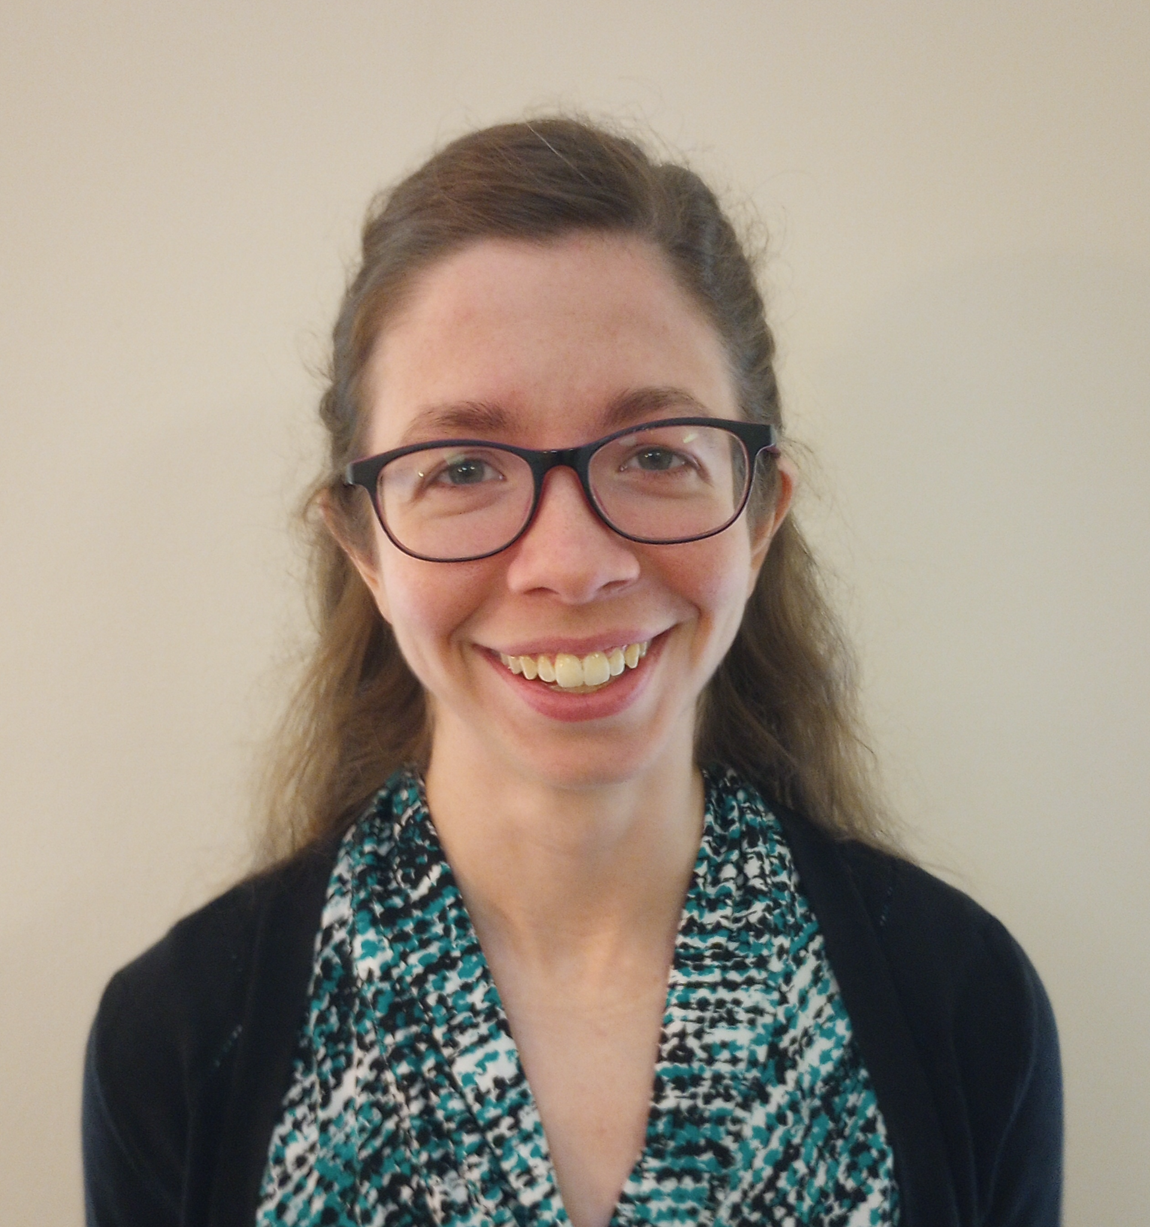
Today’s Master of Ceremonies
Gillian Petro
EPIC User Support Team Lead & Technical Writer
EPIC/STC

Slide 3
Live Streaming Announcement
The UIFCW is an open event that will be live-streamed online and recorded. By staying in the room (and online), you understand that your image, in video or still, and any sound recorded alongside it, will be live-streamed over social media and recorded. The videos will be submitted to NOAA for review before sharing publicly. The information that you provide will be used for websites, agendas, and event descriptions.
For more information on NOAA's Privacy policy: https://www.noaa.gov/sites/default/files/legacy/document/2021/Mar/NOAAPrivacyPolicy_Final_May2017.pdf

Slide 4
Travel Issues
If you are an in-person presenter or volunteer delayed due to the current travel issues, and you expect your role to be impacted, please contact us to update our documents or adjust your presentation to virtual.
support.epic@noaa.gov

Slide 5
Monday, July 22nd
1:00 PM – 1:15 PM – Welcome & Kickoff
1:15 PM – 1:30 PM – Opening Remarks by Dr. Denise Jones Gregory
1:30 PM – 2:30 PM – Collaborative Progress in Community Modeling, the Importance & Need for Diversity & Inclusion
2:30 PM – 3:15 PM – UFS Governance
3:15 PM – 3:45 PM – Break
3:45 PM – 4:30 PM – NOAA Modeling Team Accomplishments and Future Direction
4:30 PM – 5:30 PM – State of EPIC and the UFS
5:30 PM – 7:30 PM – Network Mixer at the 2nd Floor Commuter Lounge
5:50 PM – Opening Remarks by Dr. Almesha Campbell
7:30 PM – Adjourn

Slide 6


Connect With Us!
Connect with us on Slack, X, and Instagram with #UIFCW24
UIFCW24 Slack workspace
X (Twitter): @NOAAEPIC
Instagram: @NOAAEPIC
Wi-Fi: NOAA_GUEST
Password: NoAa@J$Uz4

Slide 7

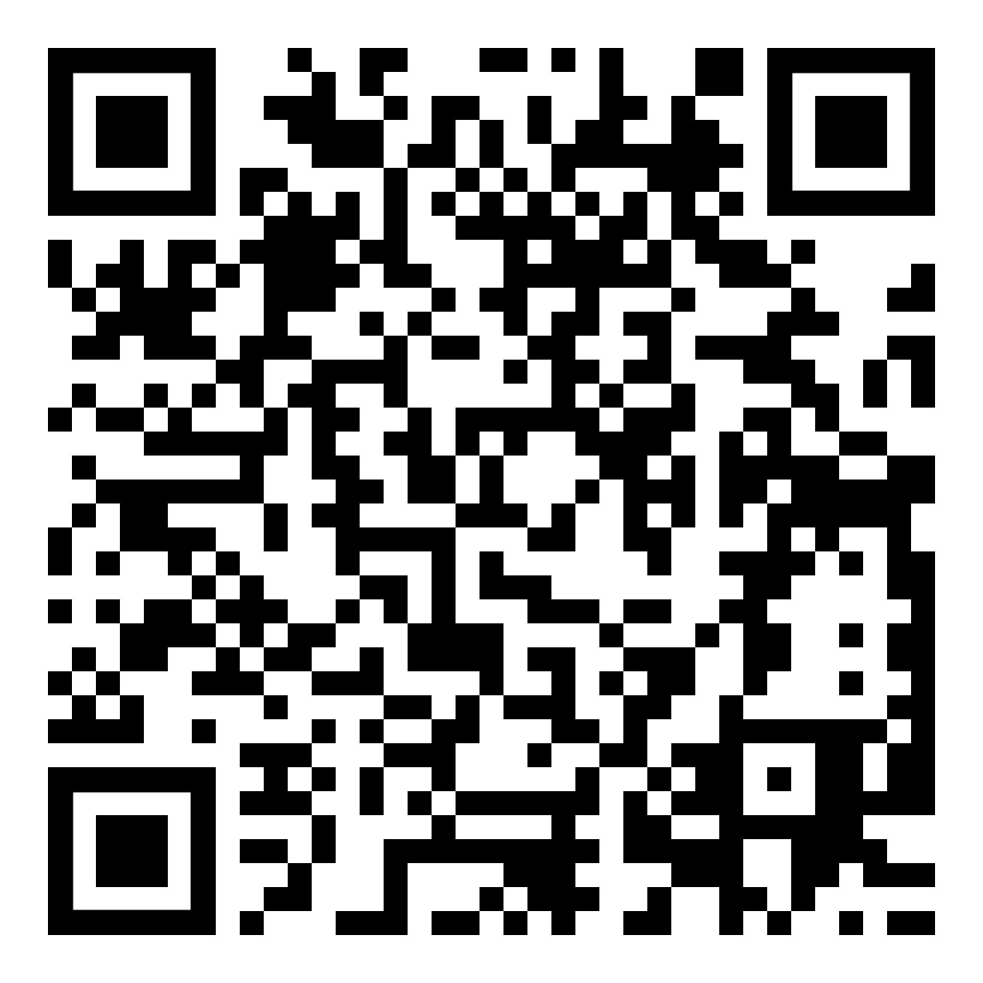
UIFCW Event Guide
UIFCW Slack Space

