Slide 1
Unifying Innovations in Forecasting Capabilities Workshop
A Unified Forecast System (UFS) Collaboration Powered by the Earth Prediction Innovation Center (EPIC)
JULY 25th, 2023
Center Green Auditorium, Boulder, CO
July 24-28, 2023

Slide 2
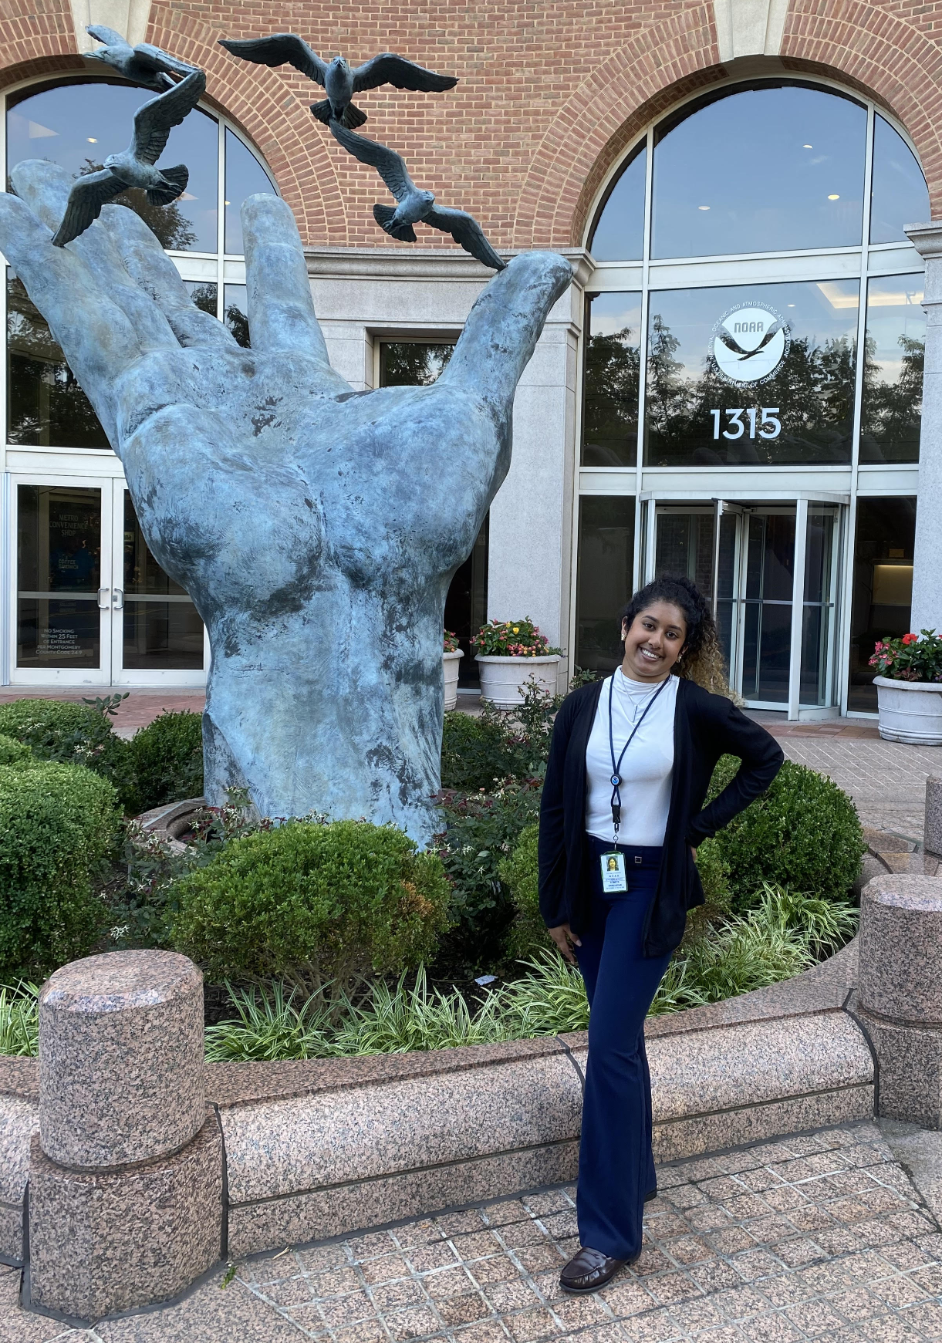
Today’s Moderator
Alekya Srinivasan
William M. Lapenta Intern
EPIC

Slide 3
Tuesday, July 25th
9:00 – 9:05 – Welcome and Kickoff
9:05 – 10:30 – Parallel Sessions with Updates and Challenges on UFS Applications
10:30 – 11:00 – Break
11:00 – 11:35 – Continuation of Parallel Sessions on UFS Applications
11:35 – 12:00 – Q & A for Parallel Sessions with Updates on UFS Applications
12:00 – 1:0 0 – Lunch Break
***Opportunity for students to talk with Alekya in Room 2126 during lunch***

Slide 4
Tuesday, July 25th
1:00 – 2:00 – Community Discussions: Insights from Industry and Academia
2:00 – 3:00 – Panel Discussion on Use Cases & Needs of UFS Applications by New Professionals, Professors, and Industry
3:00 – 3:15 – BREAK
3:15 – 4:45 – Parallel Sessions with Cross-Cutting Concepts
4:45 – 5:00 – BREAK
5:00 – 5:30 – Joint Q&A for Parallel Sessions with Cross-Cutting Concepts
5:30 – Adjourn

Slide 5
Live Streaming Announcement
We are livestreaming the event, so please be aware of hot mics and video recording.
If you would like to be further from the microphone, we suggest sitting in the back of the room.

Slide 6
Connect with us!
Connect with us on Twitter and Instagram with #UIFCW23
Twitter: @NOAAEPIC & @ufs_community
Instagram: @NOAAEPIC
Wi-Fi: UCAR Visitor

