Slide 1
The Rapid Refresh Forecast System: Looking Beyond the First Operational Version
25 July 2023
Curtis Alexander¹, Jacob Carley²,
Matt Pyle²
and many developers from NOAA/GSL and NOAA/EMC
¹NOAA/OAR/GLOBAL SYSTEMS LABORATORY
²NOAA/NWS/NCEP/ENVIRONMENTAL MODELING CENTER

Slide 2
Unified Forecast System Forecast Suite
Production Suite

Slide 3
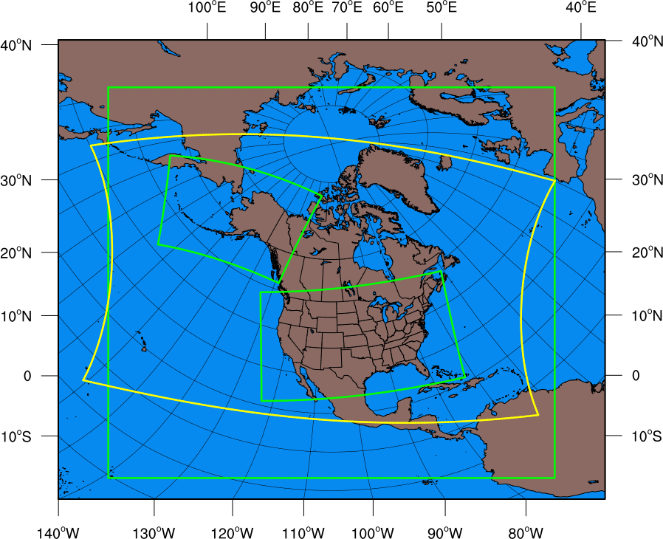
FV3 “ESG” Grid: The RRFS Domain
13-km RAP
13-km RAP
3-km RRFS
3-km RRFS
3-km
HRRR
3-km
HRRR
3-km RRFS
• ESG map projection (yellow) is comparatively new and requires transformation to familiar rotated lat-lon projection (red) for post-processing etc…
• RRFS grid is very large compared to RAP/HRRR:
RAP 13-km
953x834x50
(794,802)x50
300MB/3Dnative file
Rotated Lat-Lon
HRRR-CONUS 3-km
1799x1059x50
(1,905,141)x50
800MB/3Dnative file
Lambert Conformal
HRRR-AK 3-km
1299x919x50
(1,193,781)x50
500MB/3Dnative file
Polar Stereographic
RRFS 3-km
4881x2961x65
(14,452,641)x65
10GB/3Dnative file
Rotated Lat-Lon
7.6 times as many 2-D gridpoints
9.7 times as many 3-D gridpoints
925 million 3-D forecast grid points
and 2-3 times 13-km GFS
RRFS Domain

Slide 4
RRFSv1 Development and Testing Progress
2018-19
2020
2021
2022-23
Model Infrastructure
FV3LAM established
ESG grid
GFS IC/LBC option
RAP/HRRR IC/LBC option
Initial dynamics options
SRWv1.0 app release
N. America domain
Cloud HPC deployment
65 vertical layers set
VGF/IMS snow/ice updating
SRWv2.0/2.1 app releases
FVCOM Great Lakes
Ensemble ICs
UPP read ESG grid
Dynamics/Physics
CCPP ready
RRFSv1 alpha suite
Thompson/RRTMG
UGW/MYNN/GFS SL
MYNN SL
RUC/Noah LSM
SPPT
SPP
Smoke
8th order damping
Inner loop MP
Semi-Lag Mp
Ensemble physics
CLM Lake
GF Convective Param
Data Assimilation
GSI FV3LAM interface
Conventional DA
Partial cycling design
Soil temp/moisture adj
Radar reflectivity LH DA
Satellite clear radiances
Soil temp/moisture adj
EnKF ensemble
Cloud analysis
Stoch phys in EnKF mems
EnKF recentering/coupling
Testing/Eval/T2O
SFE/FFaIR/WWE
RAPv5/HRRRv4
SFE/FFaIR/WWE
HREFv3
DTC benchmark
MEG Alpha Eval
SFE/FFaIR/AWT/WWE
Agile prototyping
•Tested in real-time experiment • Some testing • More development needed
UIFCW
Progress
25 July 2023
Notes:
We’ve made

Slide 5
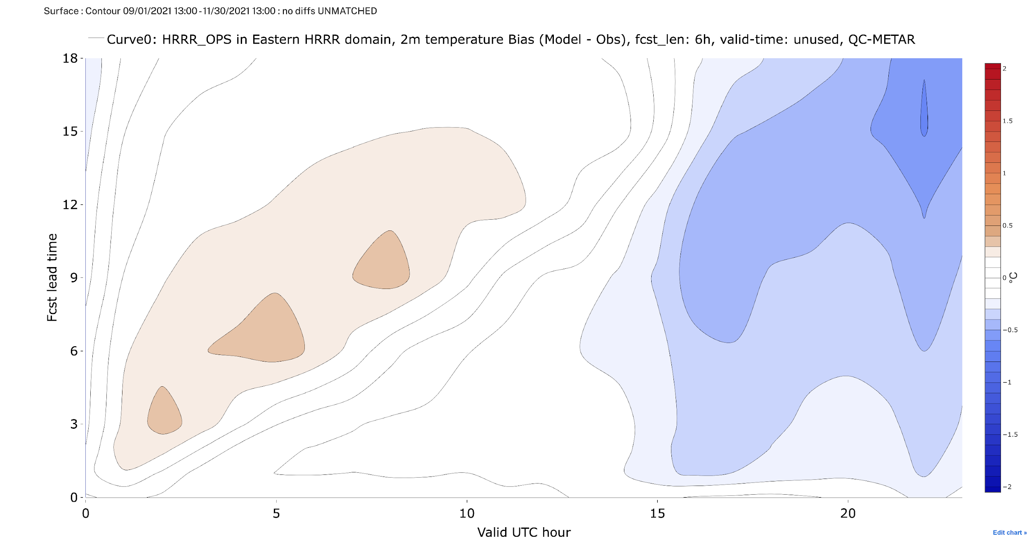
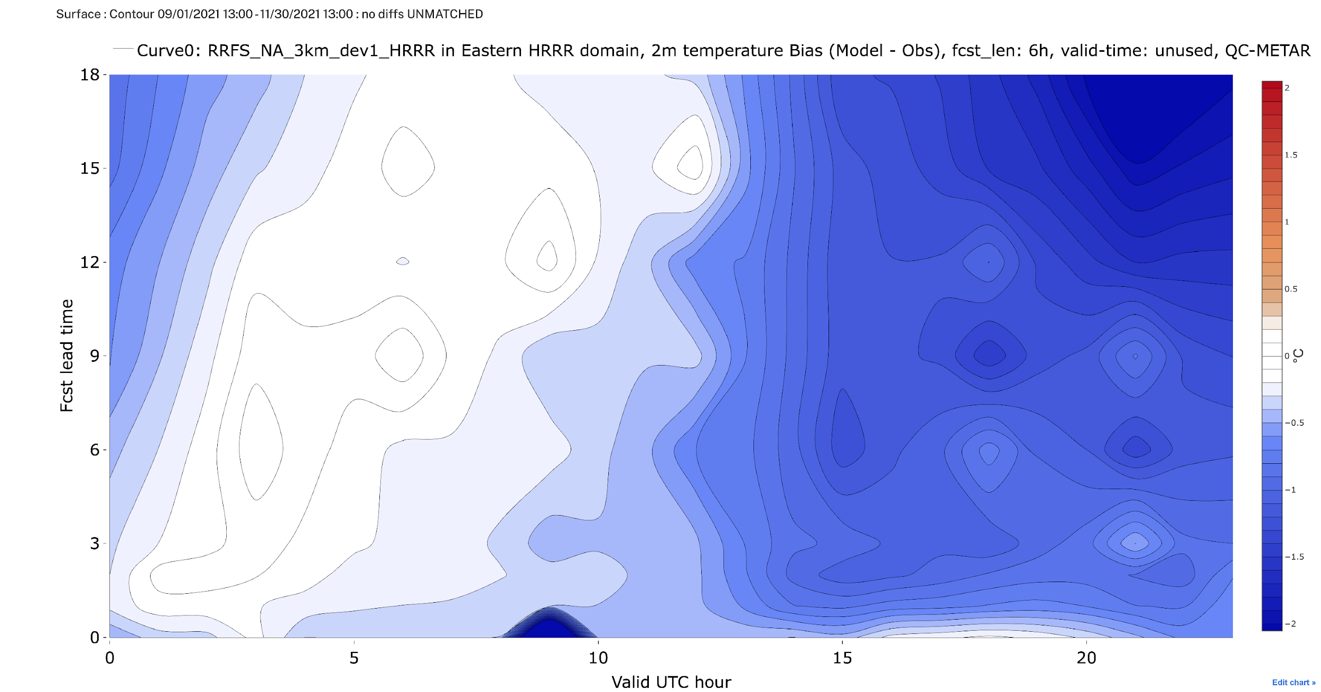
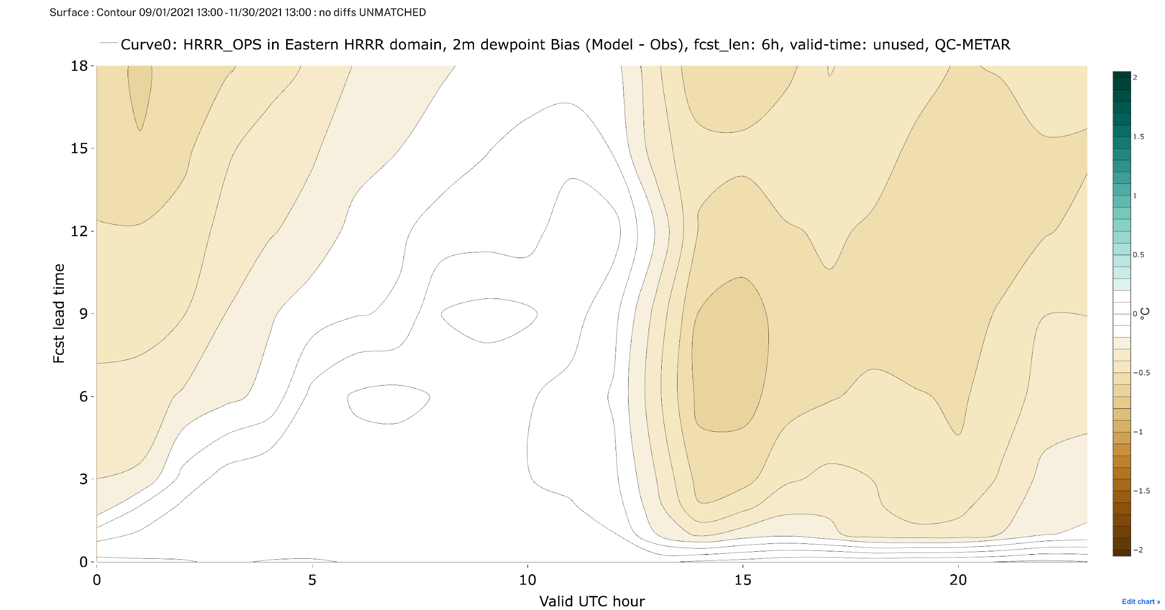
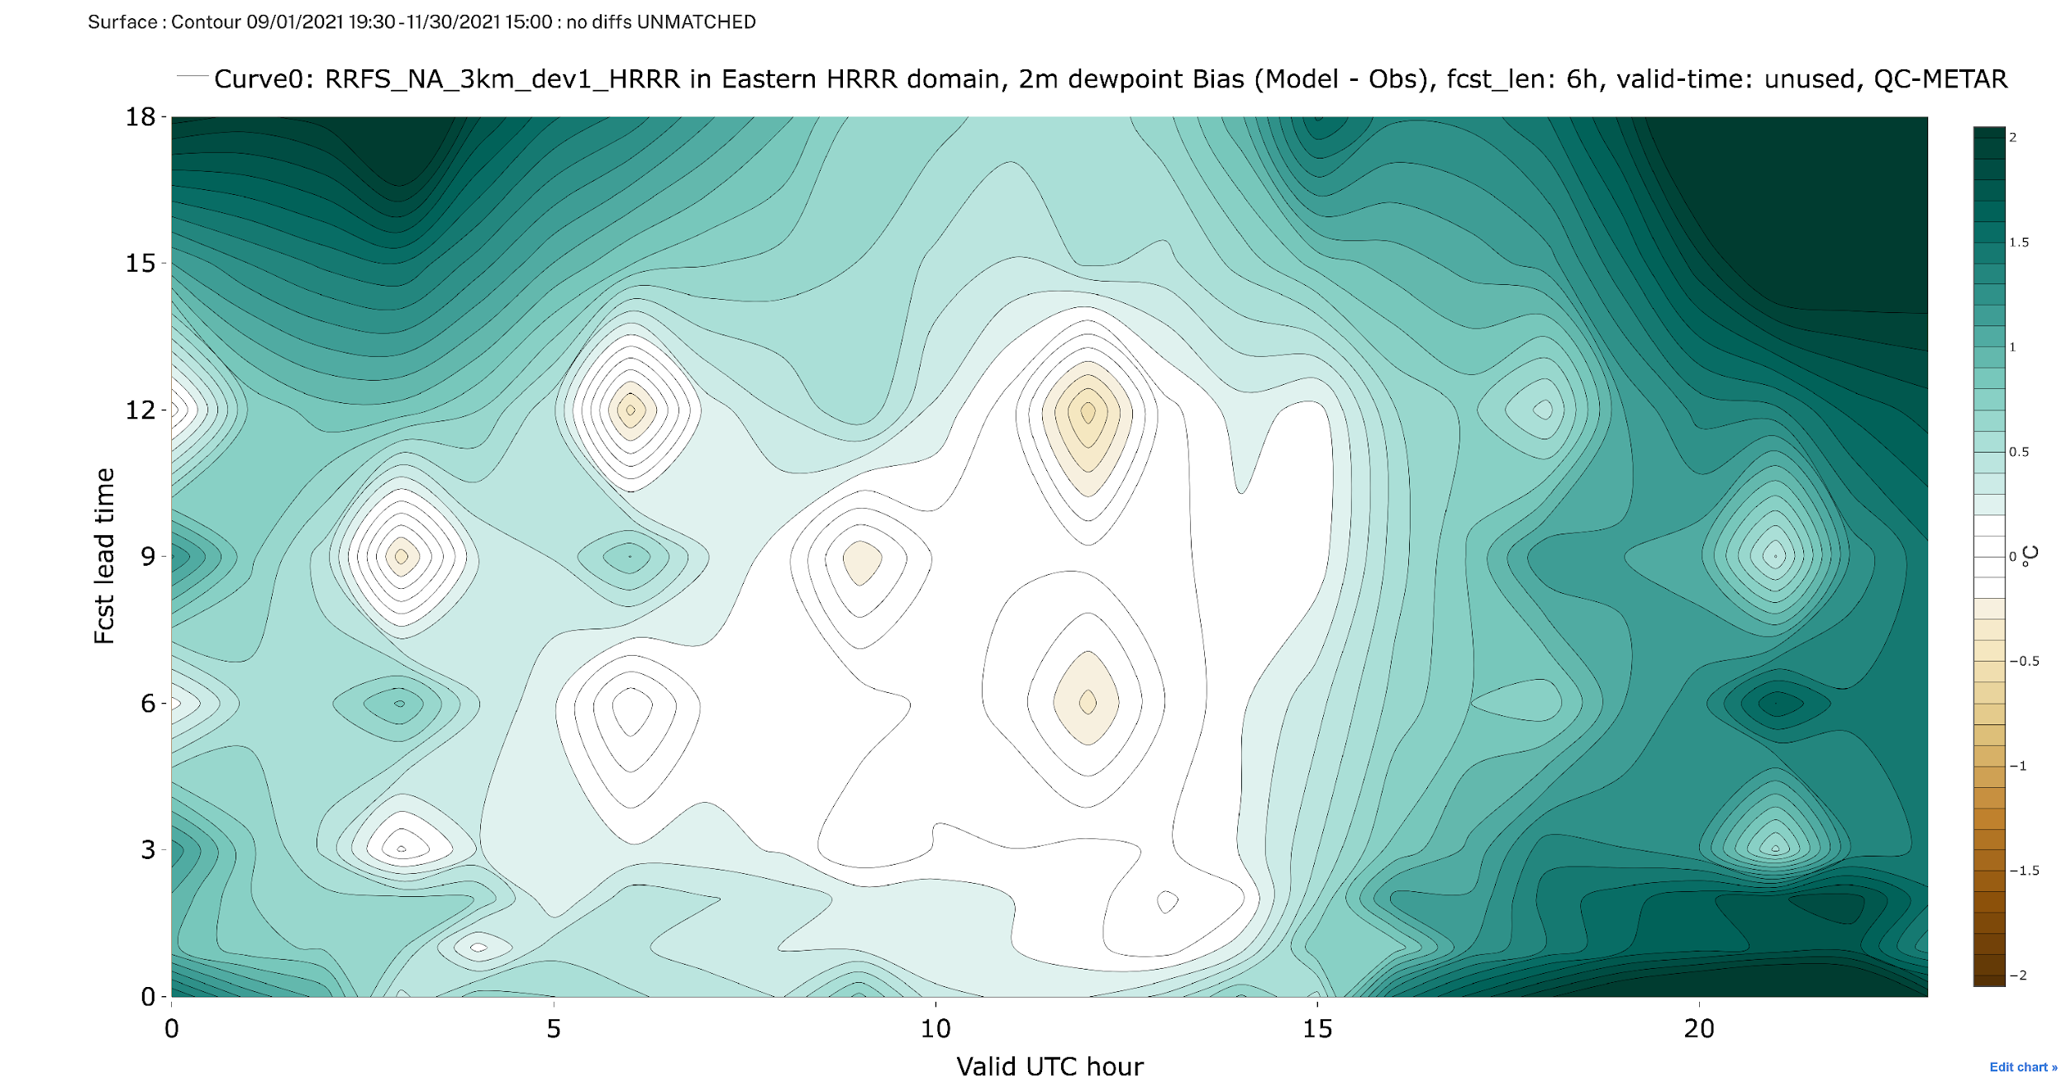
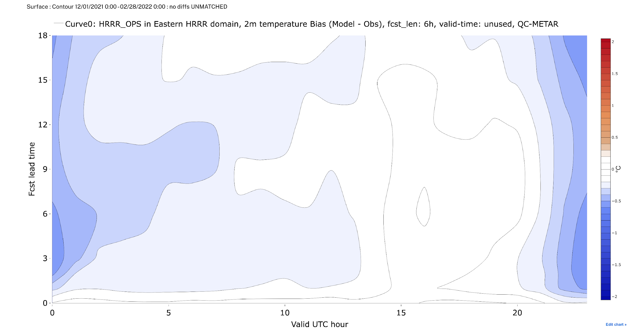
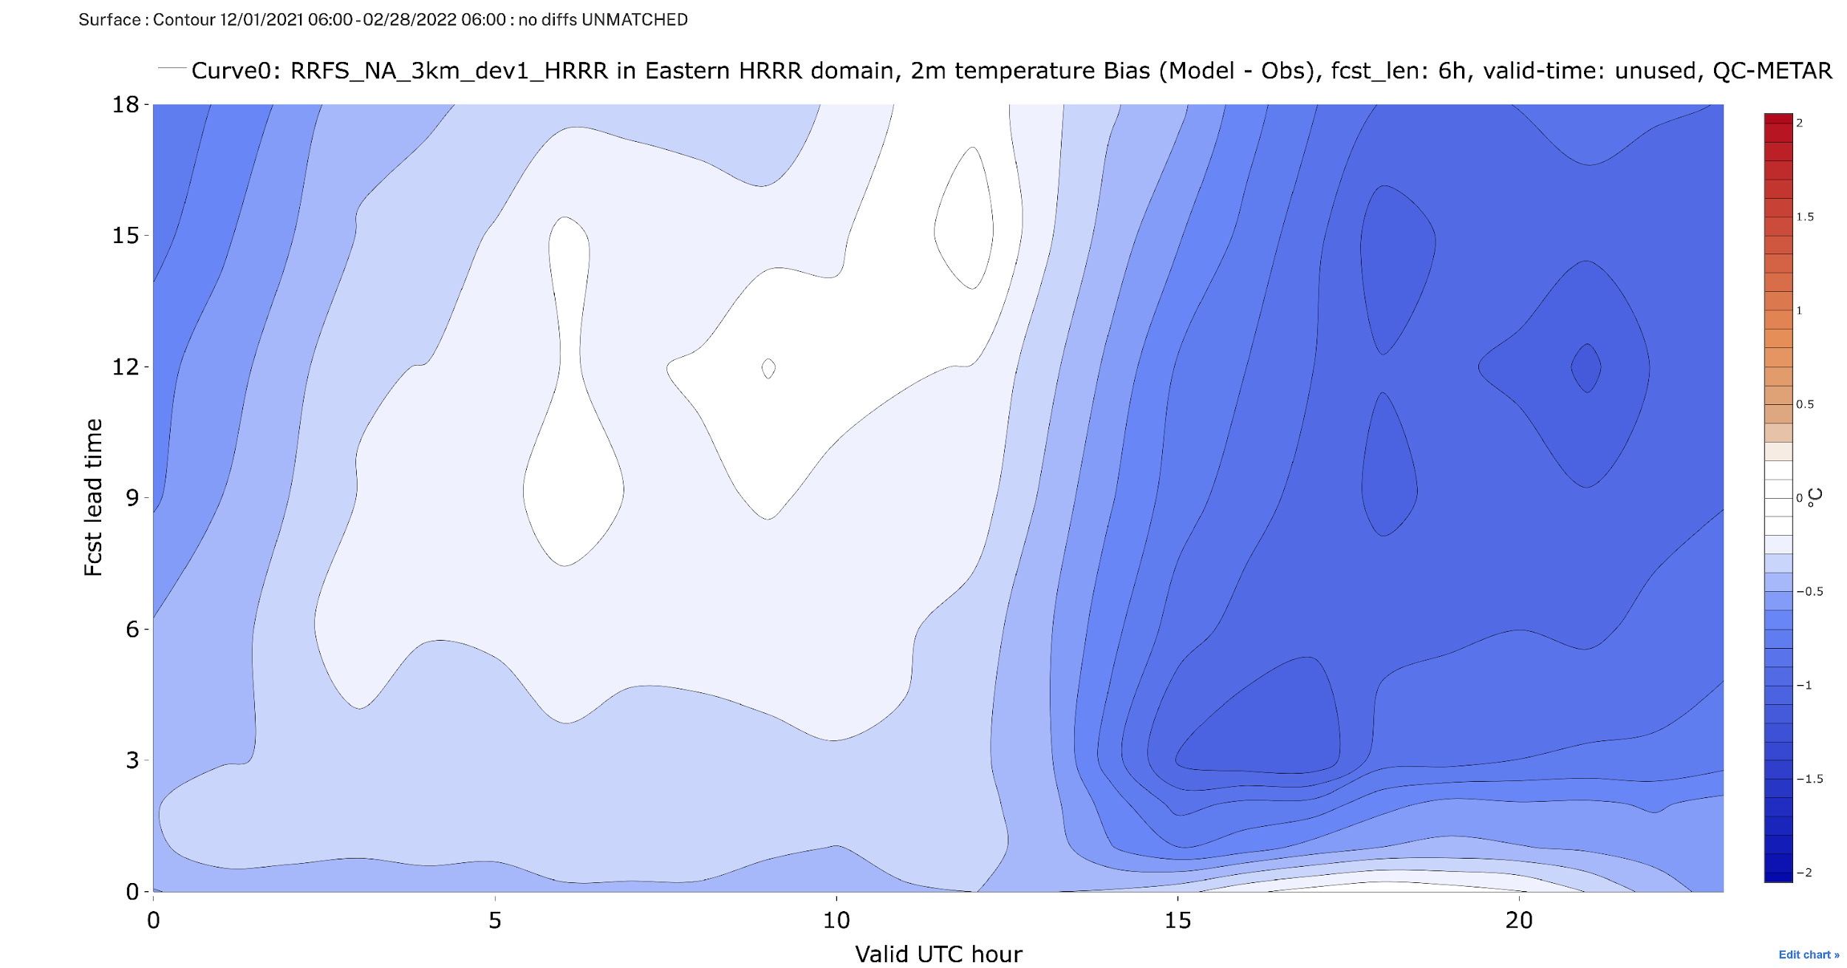
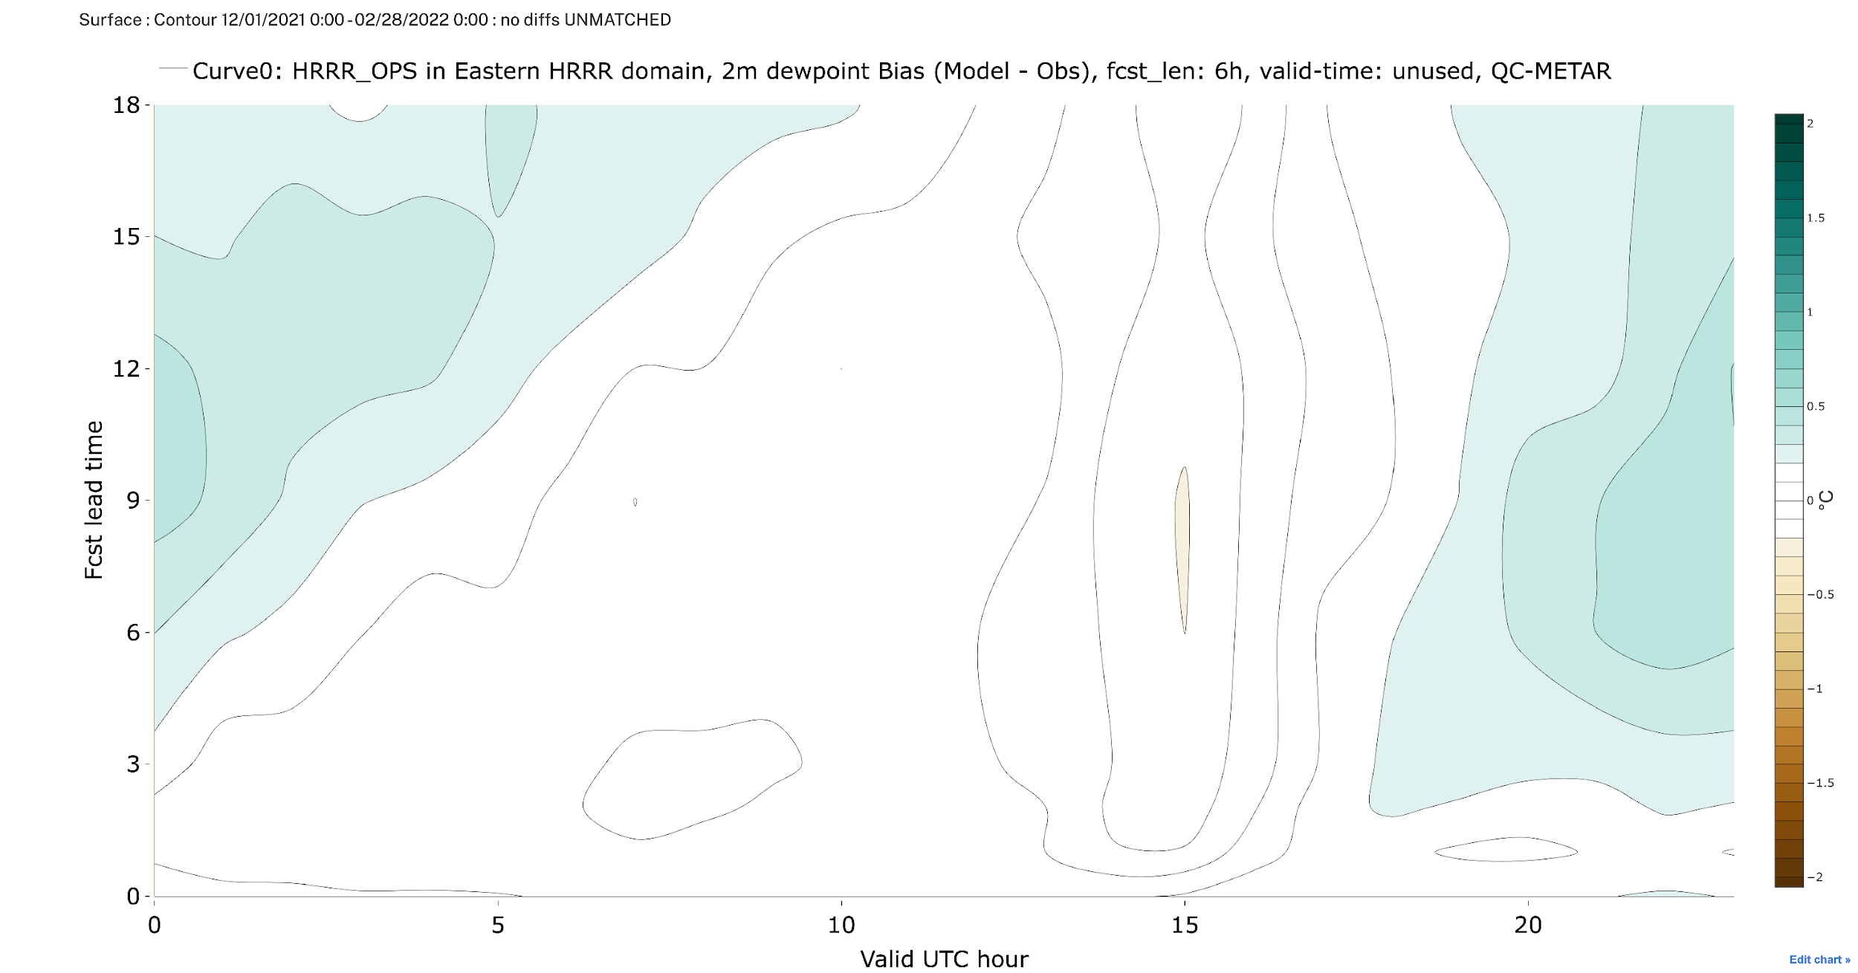
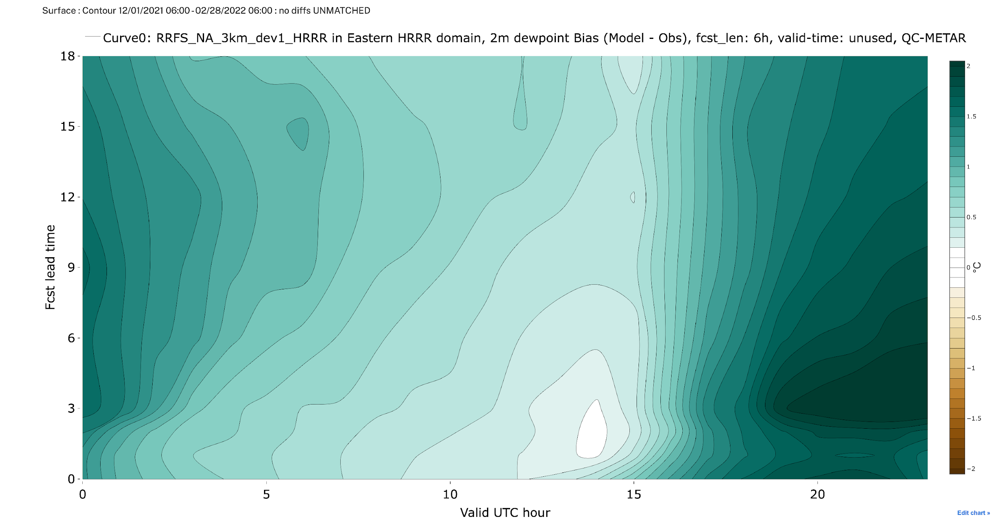
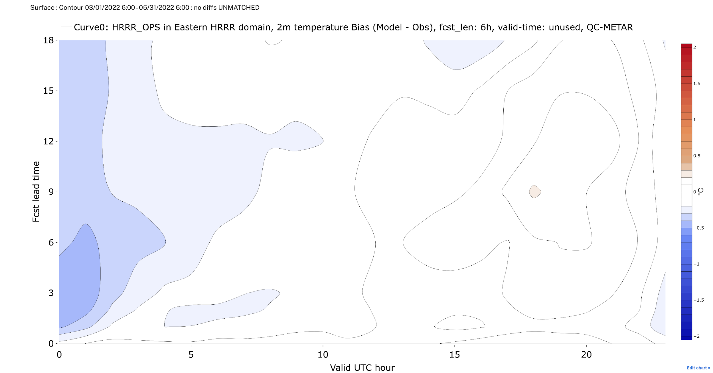
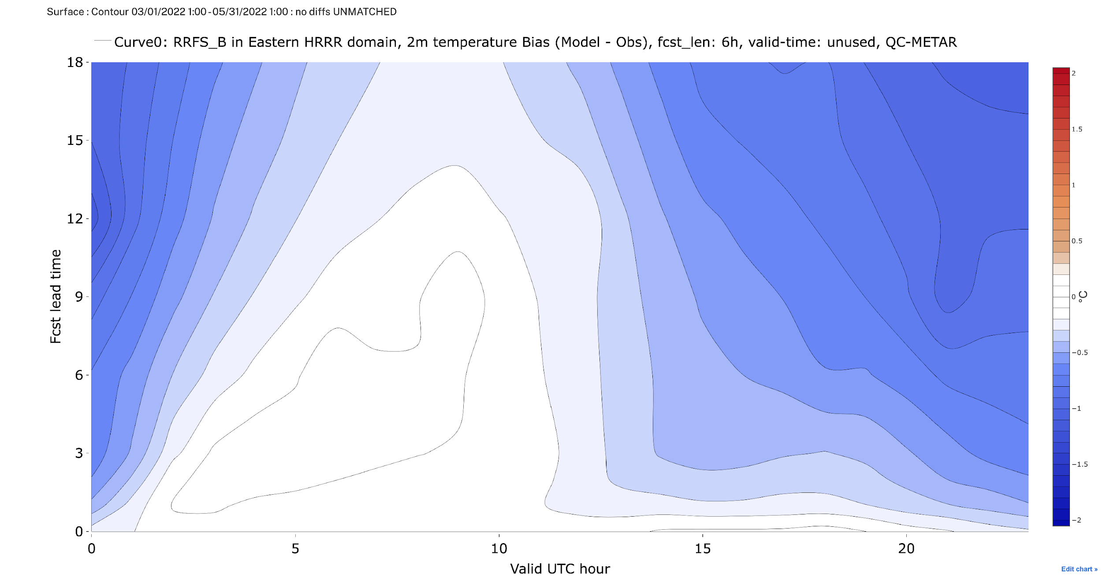
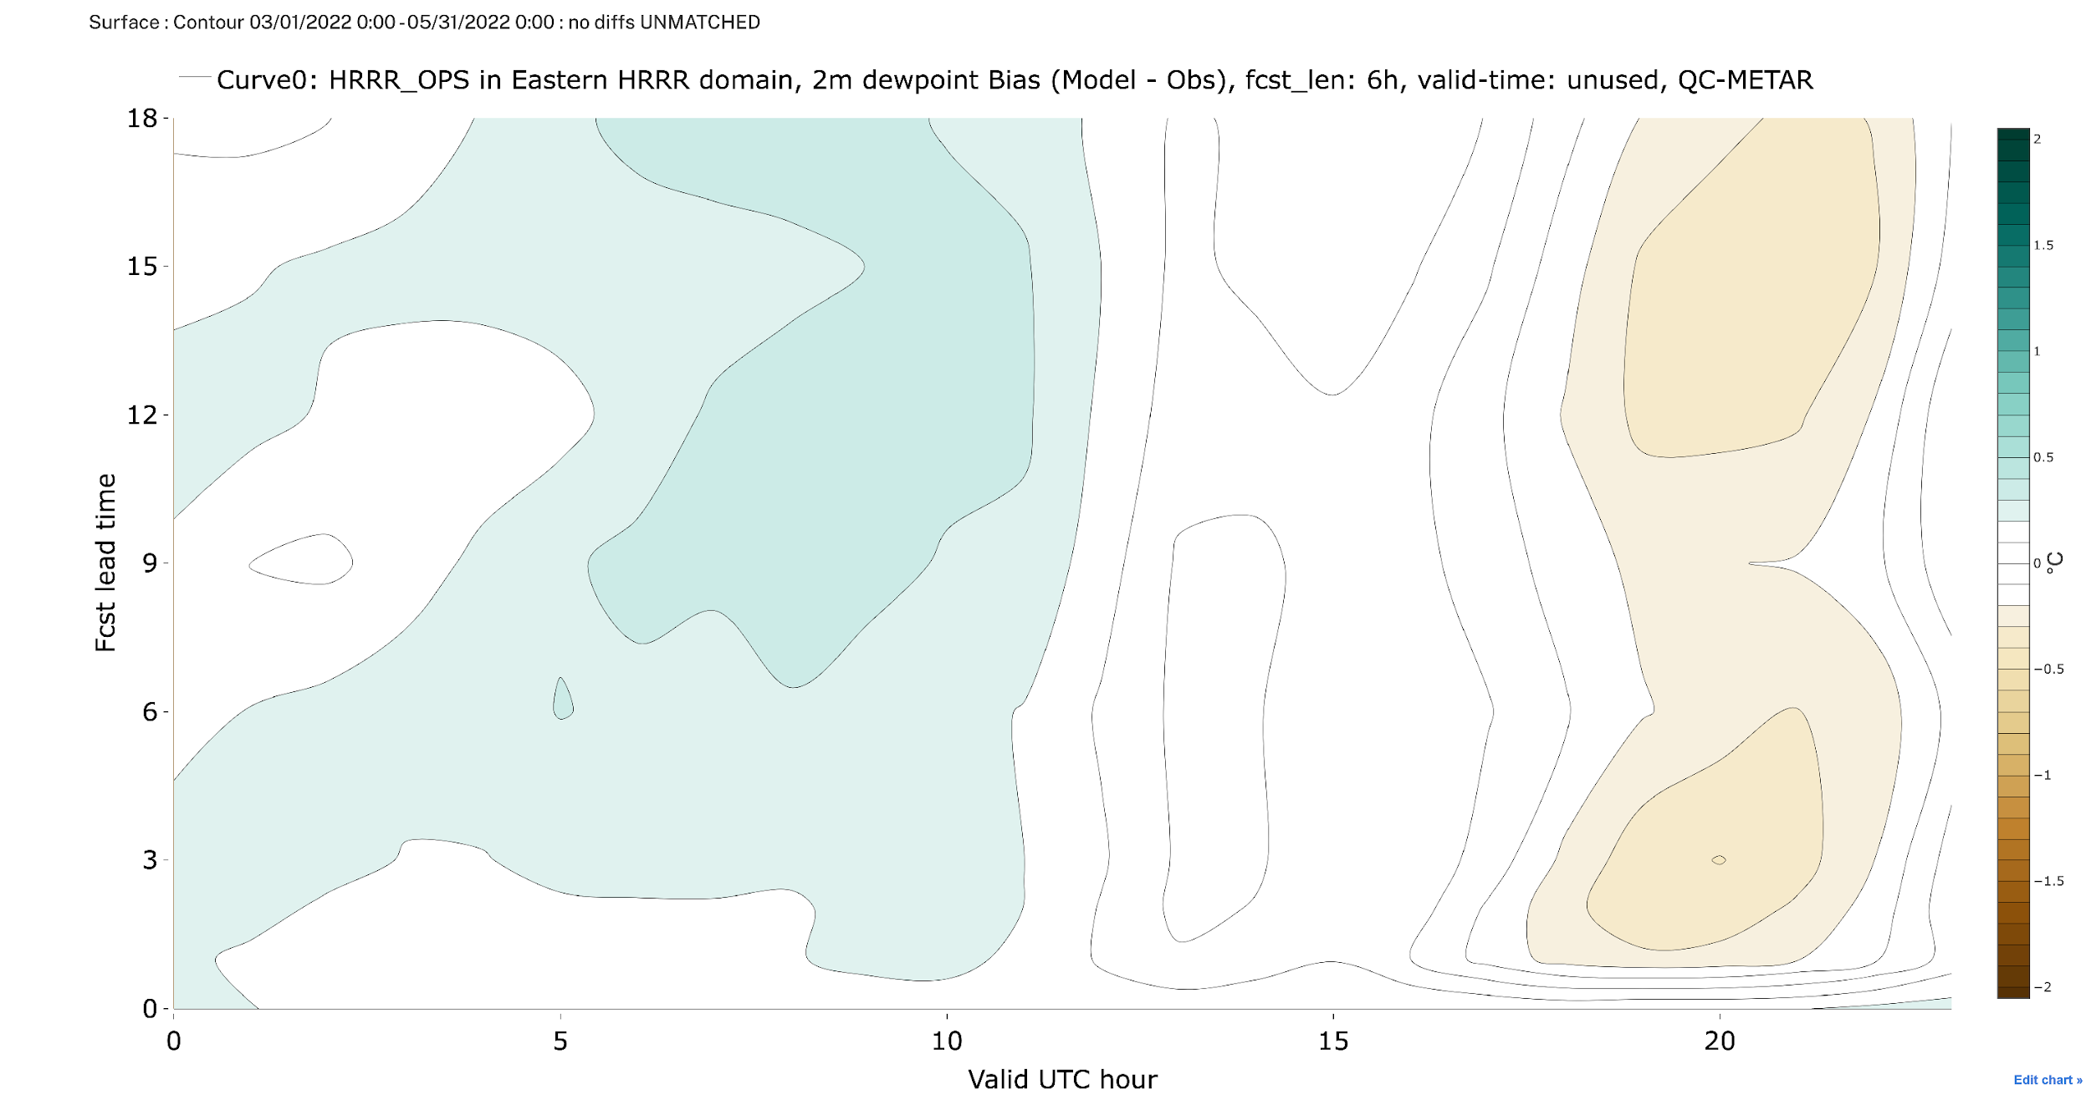
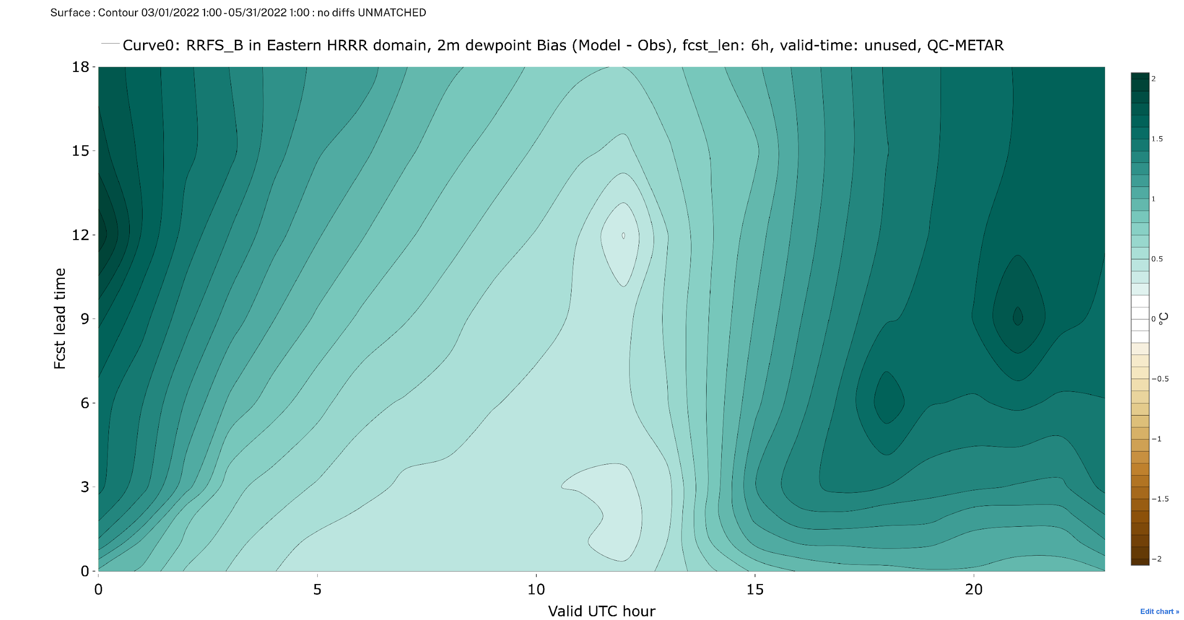
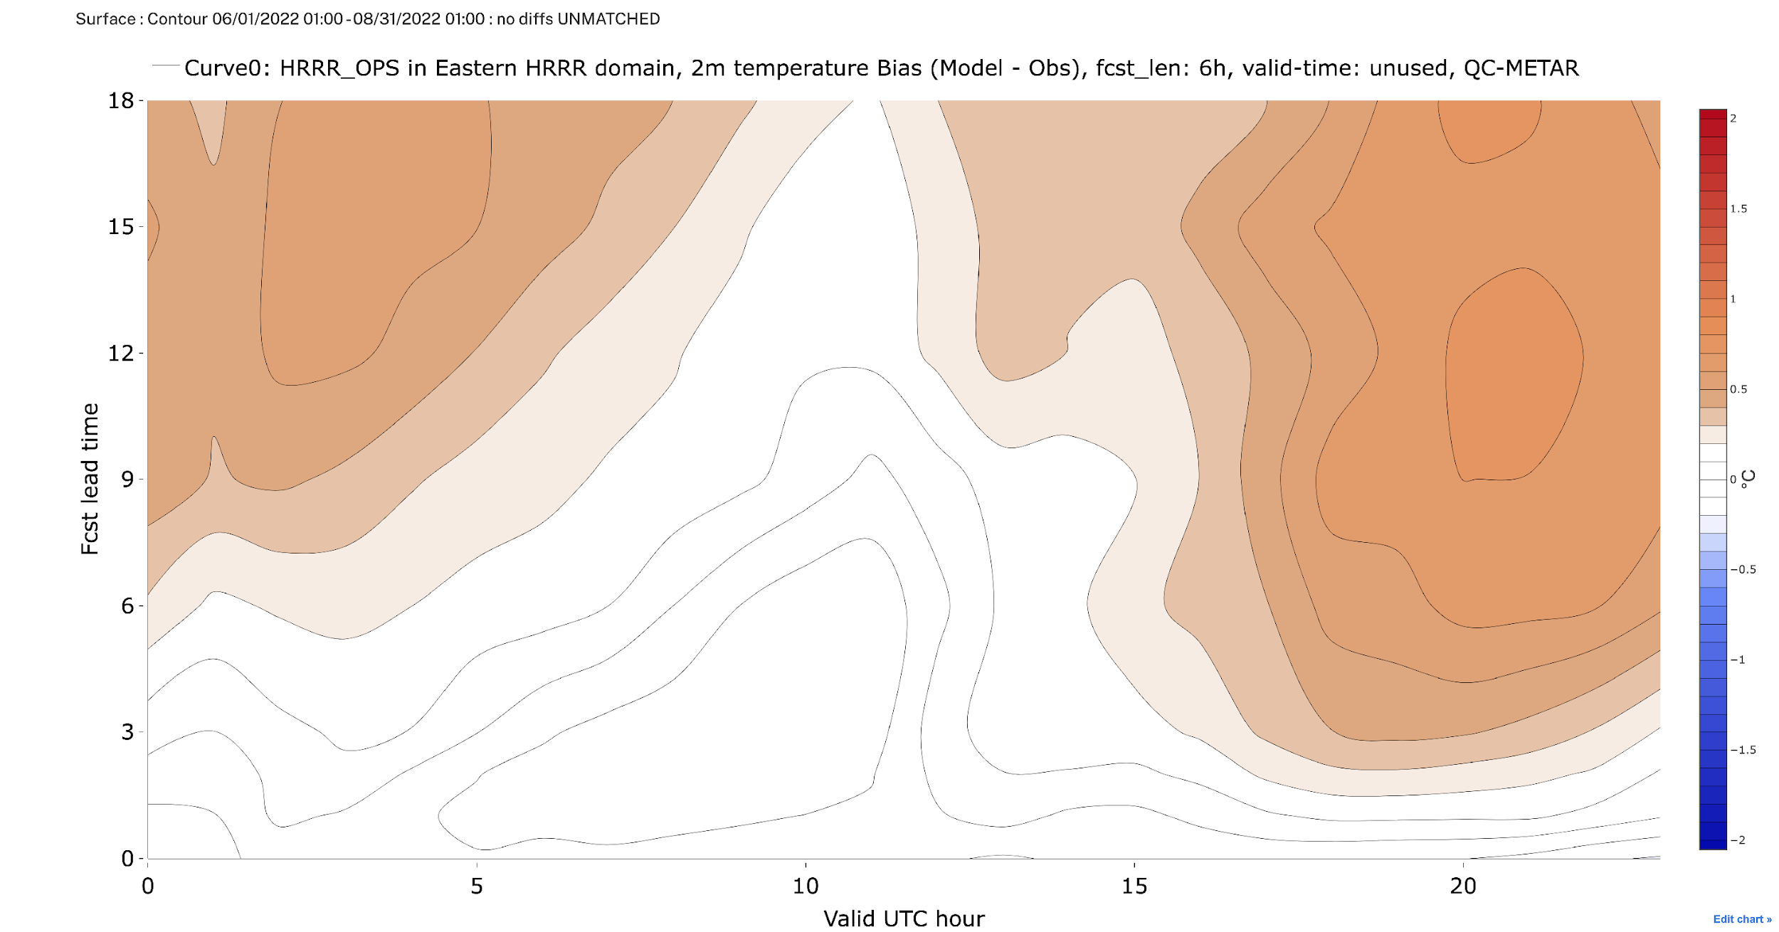
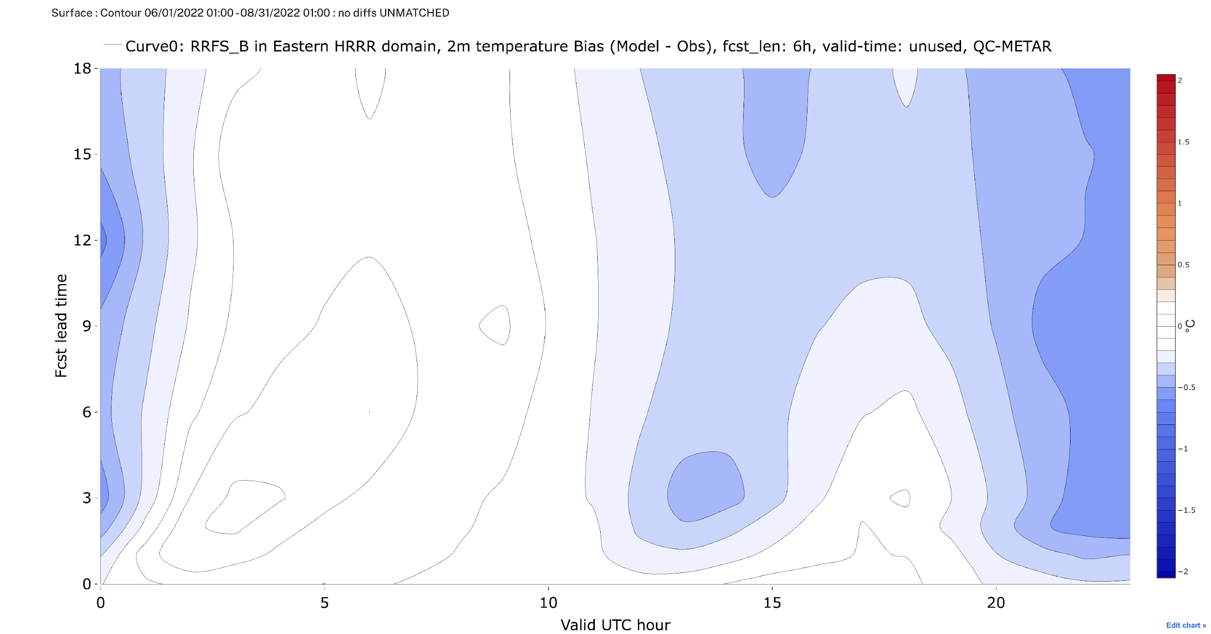
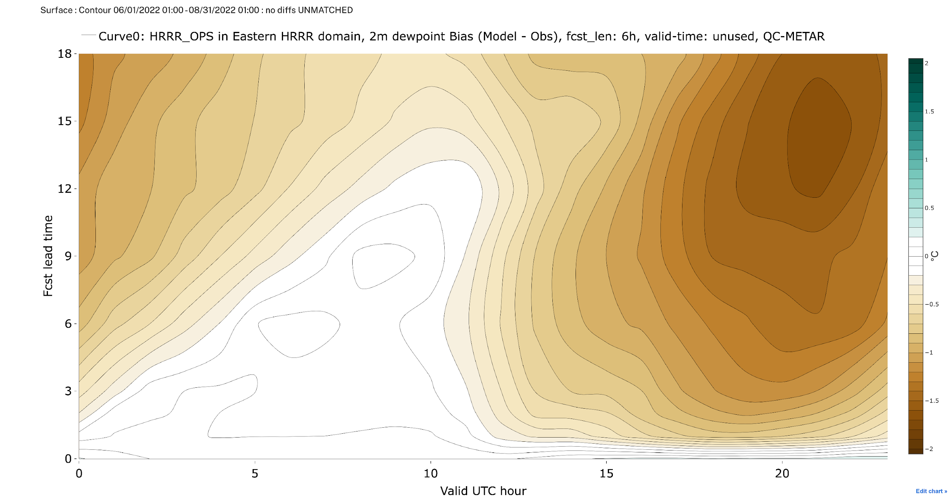
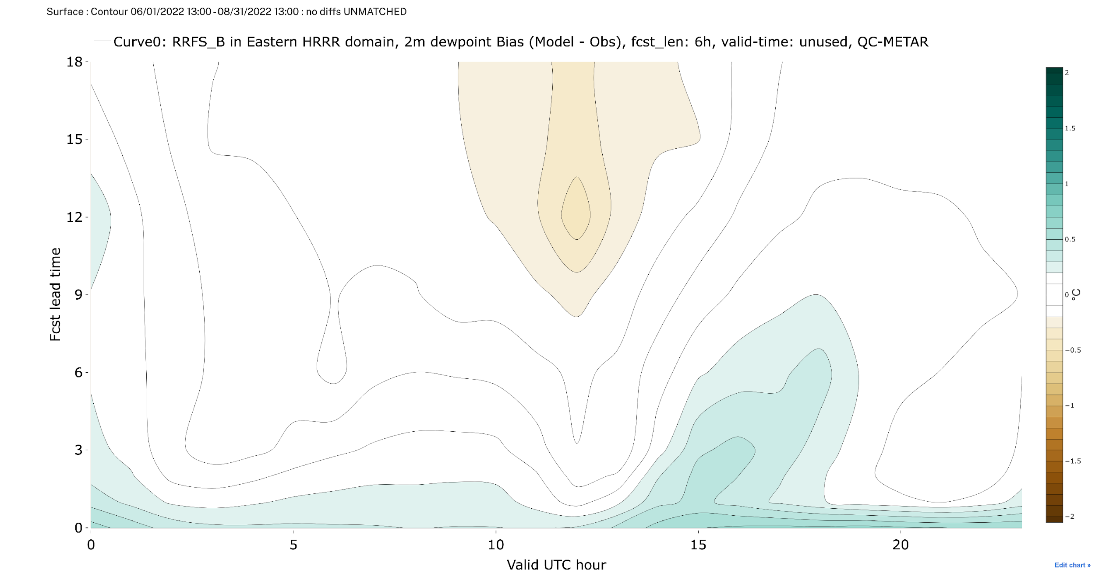
RRFS Seasonal 2m Bias Reduction
HRRRv4 RRFS prototypes HRRRv4 RRFS prototypes
0hr Forecast Length 18hr
0hr Forecast Length 18hr
-2C° 2mT Bias 2C°
0hr Forecast Length 18hr
0hr Forecast Length 18hr
-2C° 2mT_{d} Bias 2C°
Summer (JJA) Spring (MAM) Winter (DJF) Fall (SON)
2022 2022 2021/22 2021
2022 2022 2021/22 2021
Summer (JJA) Spring (MAM) Winter (DJF) Fall (SON)
00Z Time of Day 23Z
00Z Time of Day 23Z
00Z Time of Day 23Z
00Z Time of Day 23Z
Seasonal Performance

Slide 6
RRFSv1 Initial Operational Capability for Forecasts
10 members 48 hrs
10 members 48 hrs
10 members 48 hrs
10 members 48 hrs
30-40 mem
30-40 mem
30-40 mem
30-40 mem
30-40 mem
30-40 mem
30-40 mem
30-40 mem
30-40 mem
30-40 mem
30-40 mem
30-40 mem
30-40 mem
30-40 mem
30-40 mem
30-40 mem
30-40 mem
30-40 mem
30-40 mem
30-40 mem
30-40 mem
30-40 mem
30-40 mem
30-40 mem
00
01
02
03
04
05
06
07
08
09
10
11
12
13
14
15
16
17
18
19
20
21
22
23
Land
Deterministic 60 hrs
Deterministic 18 hrs
Deterministic 18 hrs
Deterministic 60 hrs
Deterministic 18 hrs
Deterministic 60 hrs
Deterministic 18 hrs
Deterministic 60 hrs
RRFSv1 Design
Notes:
ensemble forecasts!

Slide 7
RRFSv2+ Forecasts
10 members 48 hrs
10 members 48 hrs
10 members 48 hrs
10 members 48 hrs
More members and/or cycles
30-40 mem
30-40 mem
30-40 mem
30-40 mem
30-40 mem
30-40 mem
30-40 mem
30-40 mem
30-40 mem
30-40 mem
30-40 mem
30-40 mem
30-40 mem
30-40 mem
30-40 mem
30-40 mem
30-40 mem
30-40 mem
30-40 mem
30-40 mem
30-40 mem
30-40 mem
30-40 mem
30-40 mem
00
01
02
03
04
05
06
07
08
09
10
11
12
13
14
15
16
17
18
19
20
21
22
23
Land
Deterministic 60 hrs
Deterministic 18 hrs
Deterministic 18 hrs
Deterministic 60 hrs
Deterministic 18 hrs
Deterministic 60 hrs
Deterministic 18 hrs
Deterministic 60 hrs
RRFSv2 Design
Notes:
ensemble forecasts!

Slide 8
RRFSv2+ Highlights
Physics
Progress

Slide 9
RRFSv1 Physics
“HRRR physics” fully implemented and further optimized within RRFS
Component | Scheme | Features/Status
Land-Surface: | RUC | 9-layer soil model, 2-layer snow
Lake Model | CLM (small lakes) | FVCOM for Great Lakes
Surface Layer: | MYNN | Adding fractional sea-ice capability
PBL: | MYNN-EDMF | Includes SGS partial cloud component Updated diffusion
Convection: | Grell-Freitas | Final testing
Drag: | Unified Drag Suite | Minor changes from HRRR
Radiation: | RRTMG | Update to provide qc, qi, qs as in-cloud means
Microphysics: | Thompson Aerosol-aware | Small adjustments for reflectivity bias
Progress

Slide 10
RRFSv2+ Physics
Component | Scheme | Features/Status
Land-Surface: | NoahMP | 9-layer soil model?, 2-layer snow? Tuning for land assimilation VIIRS VGF update consistency IMS snow update consistency Variable density snowfall consistency
Lake Model | CLM (small lakes)
Surface Layer: | MYNN
PBL: | MYNN-EDMF
Convection: | Grell-Freitas
Drag: | Unified Drag Suite
Radiation: | RRTMGP?
Microphysics: | Thompson Aerosol-aware
Progress

Slide 11
RRFSv2+ Highlights
Data Assimilation
Progress

Slide 12
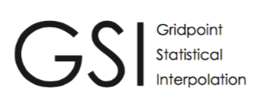
Data Assimilation Software Framework RRFSv2+
Joint Effort for Data assimilation Integration (JEDI)
Progress

Slide 13
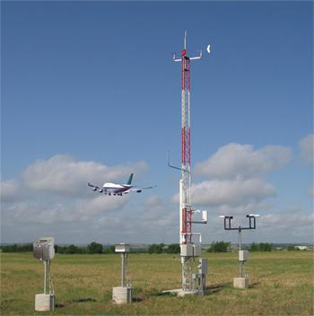
RRFSv2+: Land-Atmosphere DA
RRFSv1 one-way (moderately) coupled DA Soil Adjustment
RRFSv2+ strongly coupled land/atmosphere DA
Model too
warm/moist
compared to atmos obs?
Model too
cold/dry
compared
to atmos obs?
Soil temp/moisture observations
(i.e. SMAP)
Cool/dry soil
Warm/moisten soil
Leverage soil temp/moist observations (SMAP)
Cross-covariances between land and atmosphere
JEDI EnKF using RDAS ensemble for BECs
Leveraging with global DA
Atmos Temp Increment (K)
Soil Temp Increment (K)
Leverages experience with RUC/RAP/HRRR soil DA in GSI (see Benjamin et al 2022: https://doi.org/10.1175/JHM-D-21-0198.1 )
Attribution of some model error to incorrect latent/sensible fluxes to/from ground
No soil observations used (one-way adjustment into soil)
Land DA

Slide 14
RRFS Design: Atmospheric DA/Cycling
GFS/RRFSv1 dependencies
GFS/RRFSv2 dependencies
RRFS
00 UTC
01 UTC
02 UTC
03 UTC
04 UTC
05 UTC
06 UTC
07 UTC
GFS
atmospheric
fields
Blend ICs w/GEFS Longwaves
RRFS
Hourly free forecasts
RRFSv1 Partial Cycling
Mitigates risk with familiar LAM cycling design (e.g. RAP)
Ensures inclusion of longer wavelength information limiting drift
Collects latent observations
Partial cycling still more expensive than continuous cycling
Workflow is more complex than continuous cycling
RRFSv2 Full Cycling
Blending GDAS/GEFS longwave perturbations into ICs
Overlapping windows to collect latent observations
Reduced computation cost compared to partial cycling
Simplified workflow
More development needed prior to operational transition
Schwartz, et al. , 2022: Comparing Partial and Continuously Cycling Ensemble Kalman Filter Data Assimilation Systems for Convection-Allowing Ensemble Forecast Initialization. WAF, 37, 85-112.
RRFS Design

Slide 15
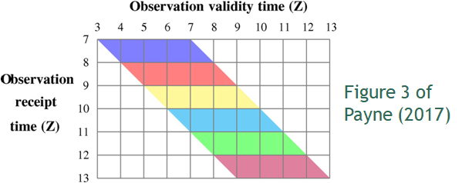
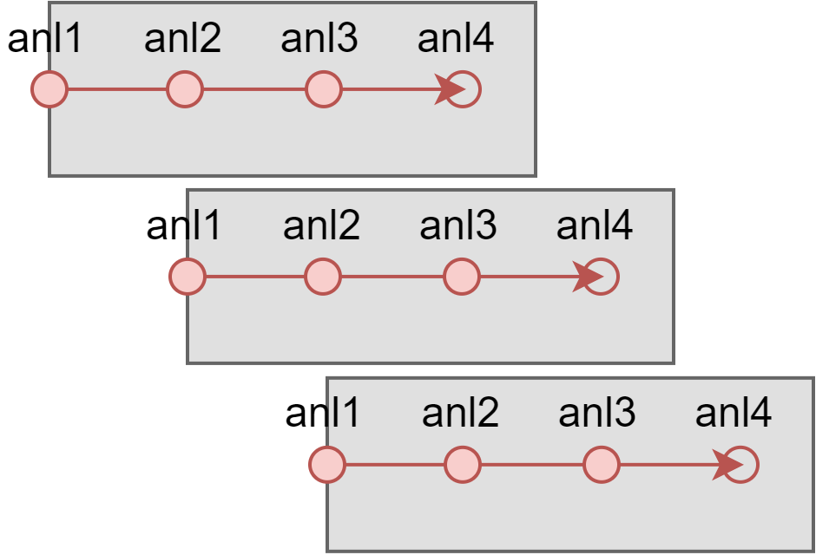
RRFSv2+ Design: Atmospheric DA/Cycling
Future Approach: Overlapping windows to update every hour assimilating observations that have arrived within the past hour and are valid within the past 3 hours
Figures courtesy D. Lippi and NOAA collab on HSUP 1-A5
Slivinski, L. C., D. E. Lippi, J. S. Whitaker, G. Ge, J. R. Carley, C. R. Alexander, and G. P. Compo, 2022: Overlapping Windows in a Global Hourly Data Assimilation System. Mon. Wea. Rev., 150, 1317–1334, https://doi.org/10.1175/MWR-D-21-0214.1.
Cycling Design

Slide 16
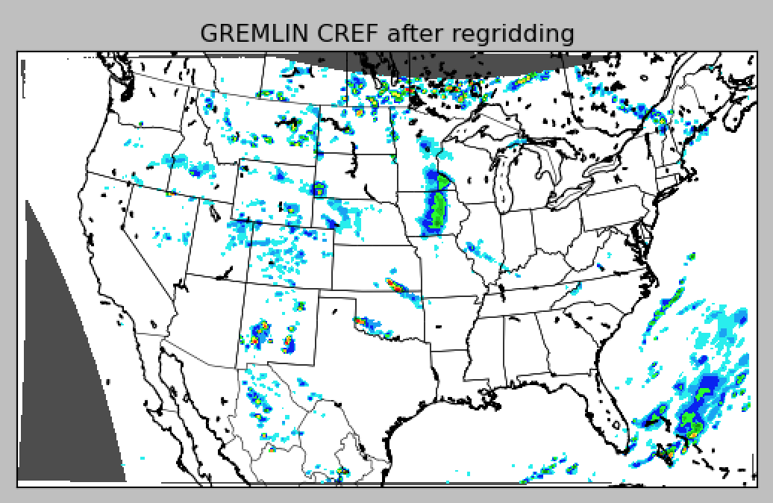
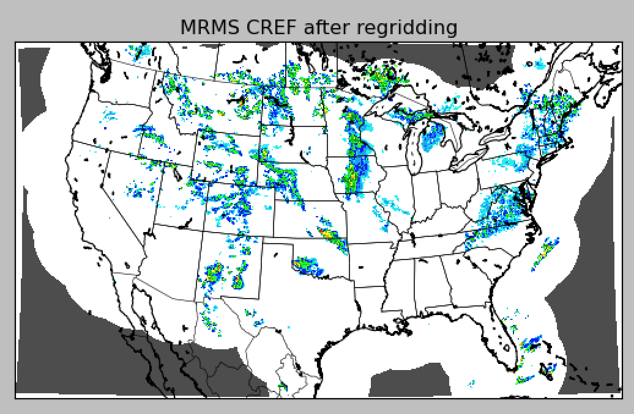
RRFSv2+: GOES-based Synthetic Radar Imagery
GREMLIN (GOES Radar Estimation via Machine Learning to Inform NWP)
Experimental CSU CIRA product (Hilburn et al.)
Neural net synthesizes radar from GOES-East ABI & GLM
Intended to supplement MRMS coverage; test in place of MRMS
GREMLIN SYNTHETIC CREF
MRMS CREF OBSERVATIONS
dBZ
dBZ
GREMLIN column-max reflectivity at 19Z, 5/14/2021
MRMS column-max reflectivity at 19Z, 5/14/2021
GREMLIN

Slide 17
RRFSv2+ Design: Analysis Stages
RDAS Methodology
Components of Each Assimilation Cycle
RDAS-EnKF
BEC
1-hr
forecast
Hydrometer Analysis
1-hr
forecast
Hybrid Analysis
Hybrid Analysis
Static
BEC
Obs
Radar Obs
Cloud Obs
Radar Obs
RRFS 3-km control free forecast
Multiscale DA can simplify these components while improving the analysis
Cloud Analysis

Slide 18
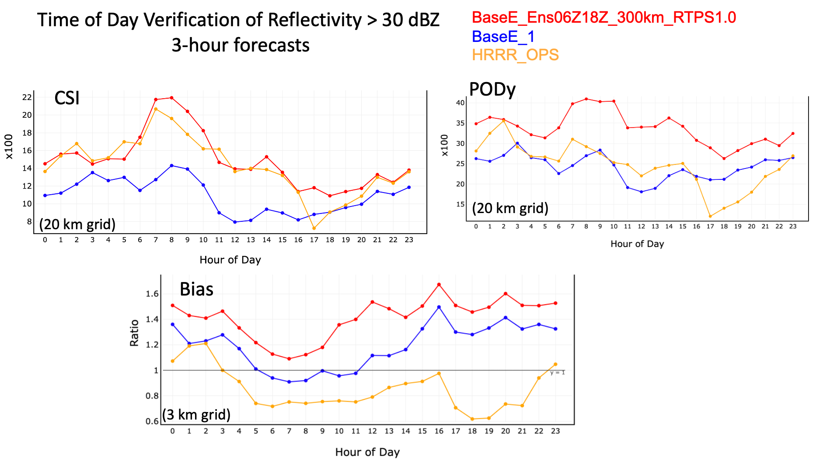
RRFSv1 Design: Radar DA
Inclusion of radar assimilation in RRFS
Overall better than without radar
Improves skill, comparable to HRRR
Improves probability of detection, better than HRRR
Increases high bias, potential improvement from cumulus scheme
Radar DA

Slide 19
RRFSv2+ Highlights
Dynamic Core
Progress

Slide 20
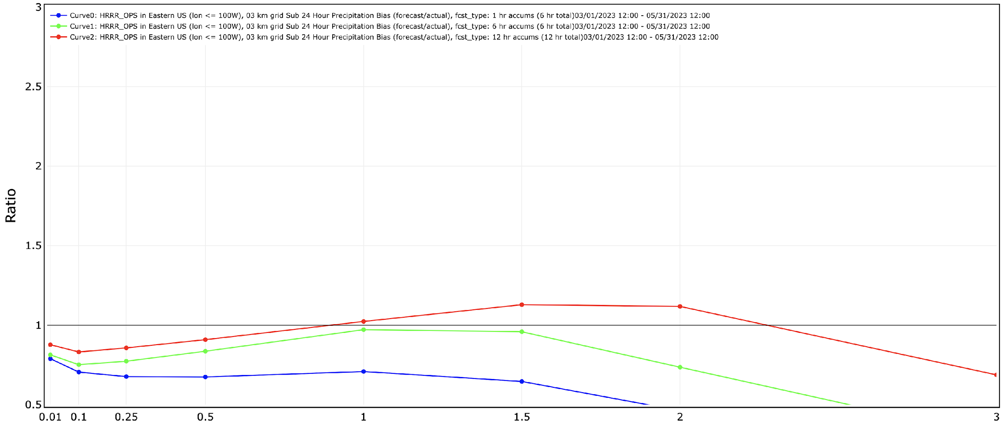
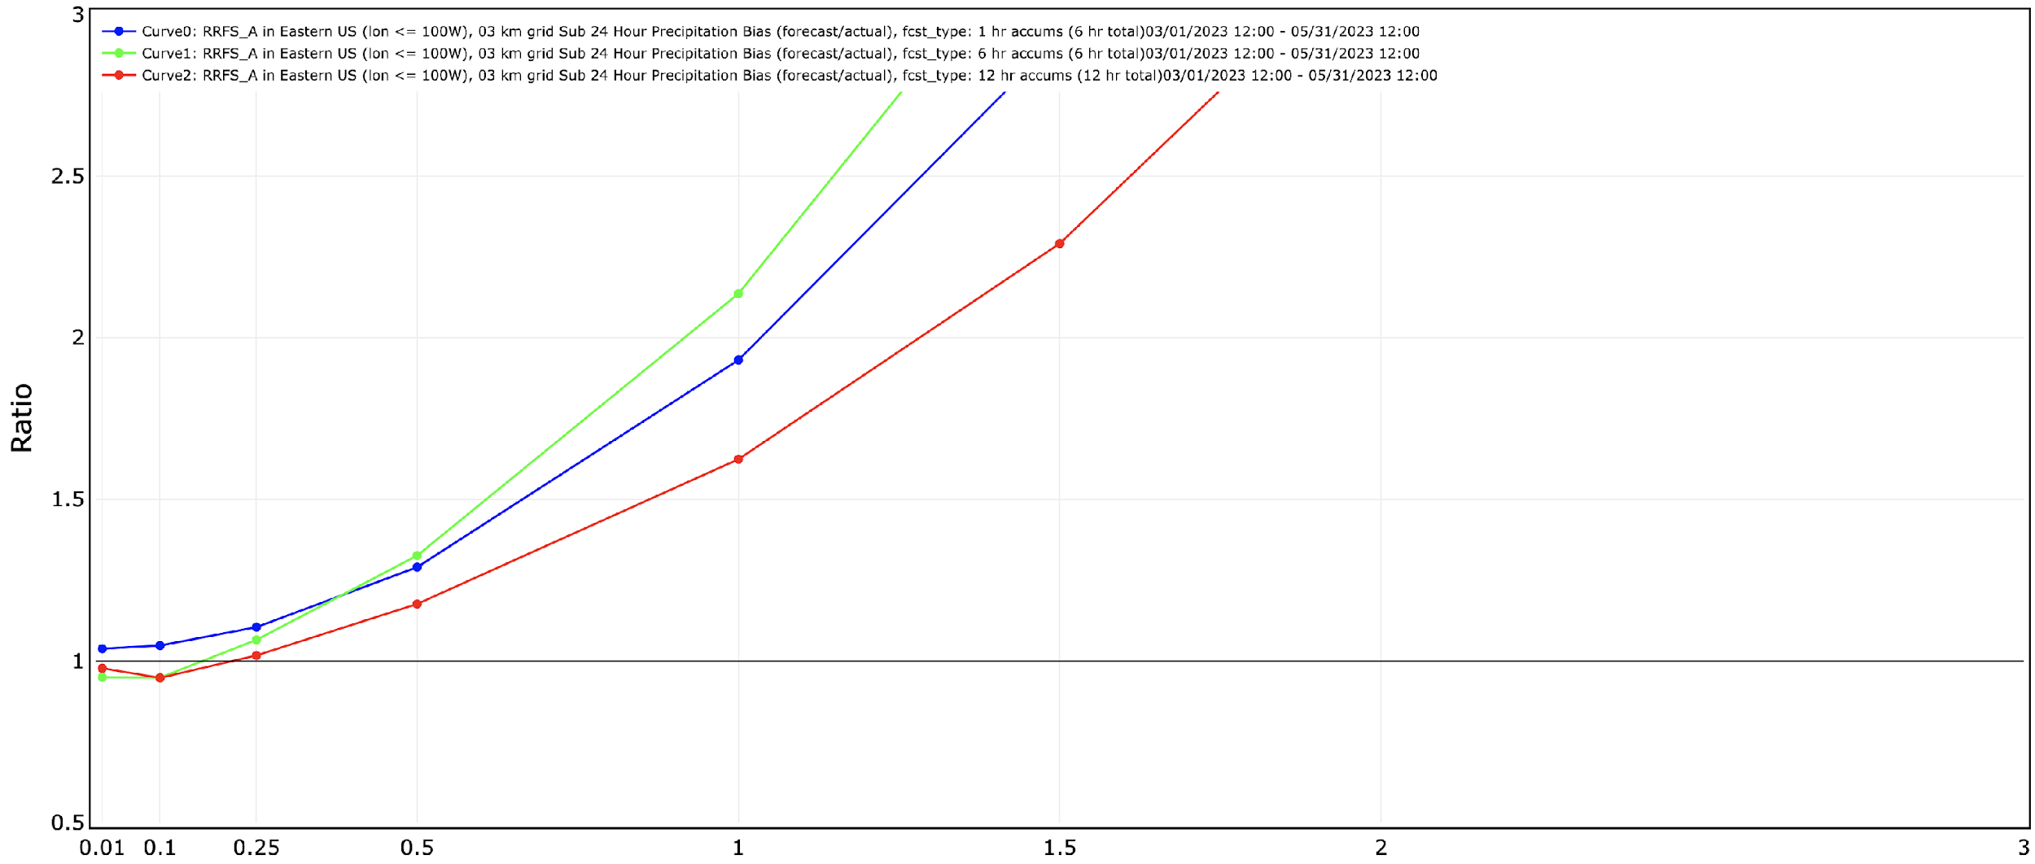
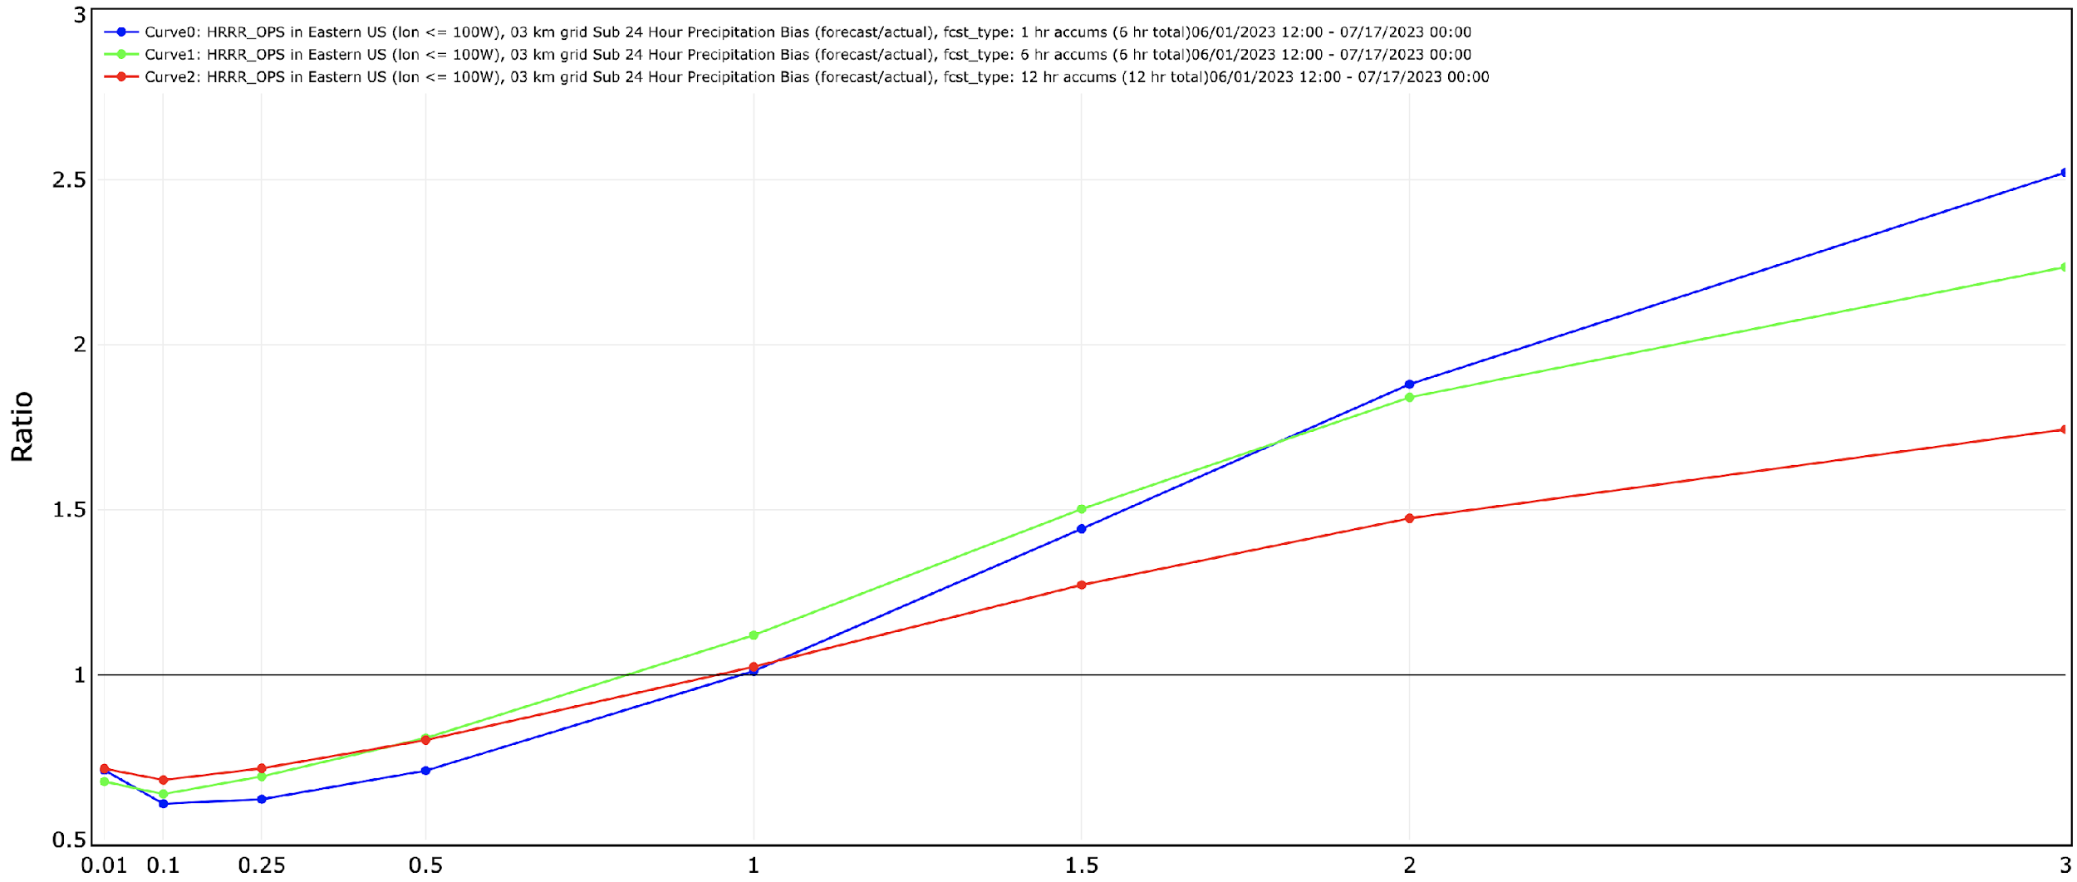
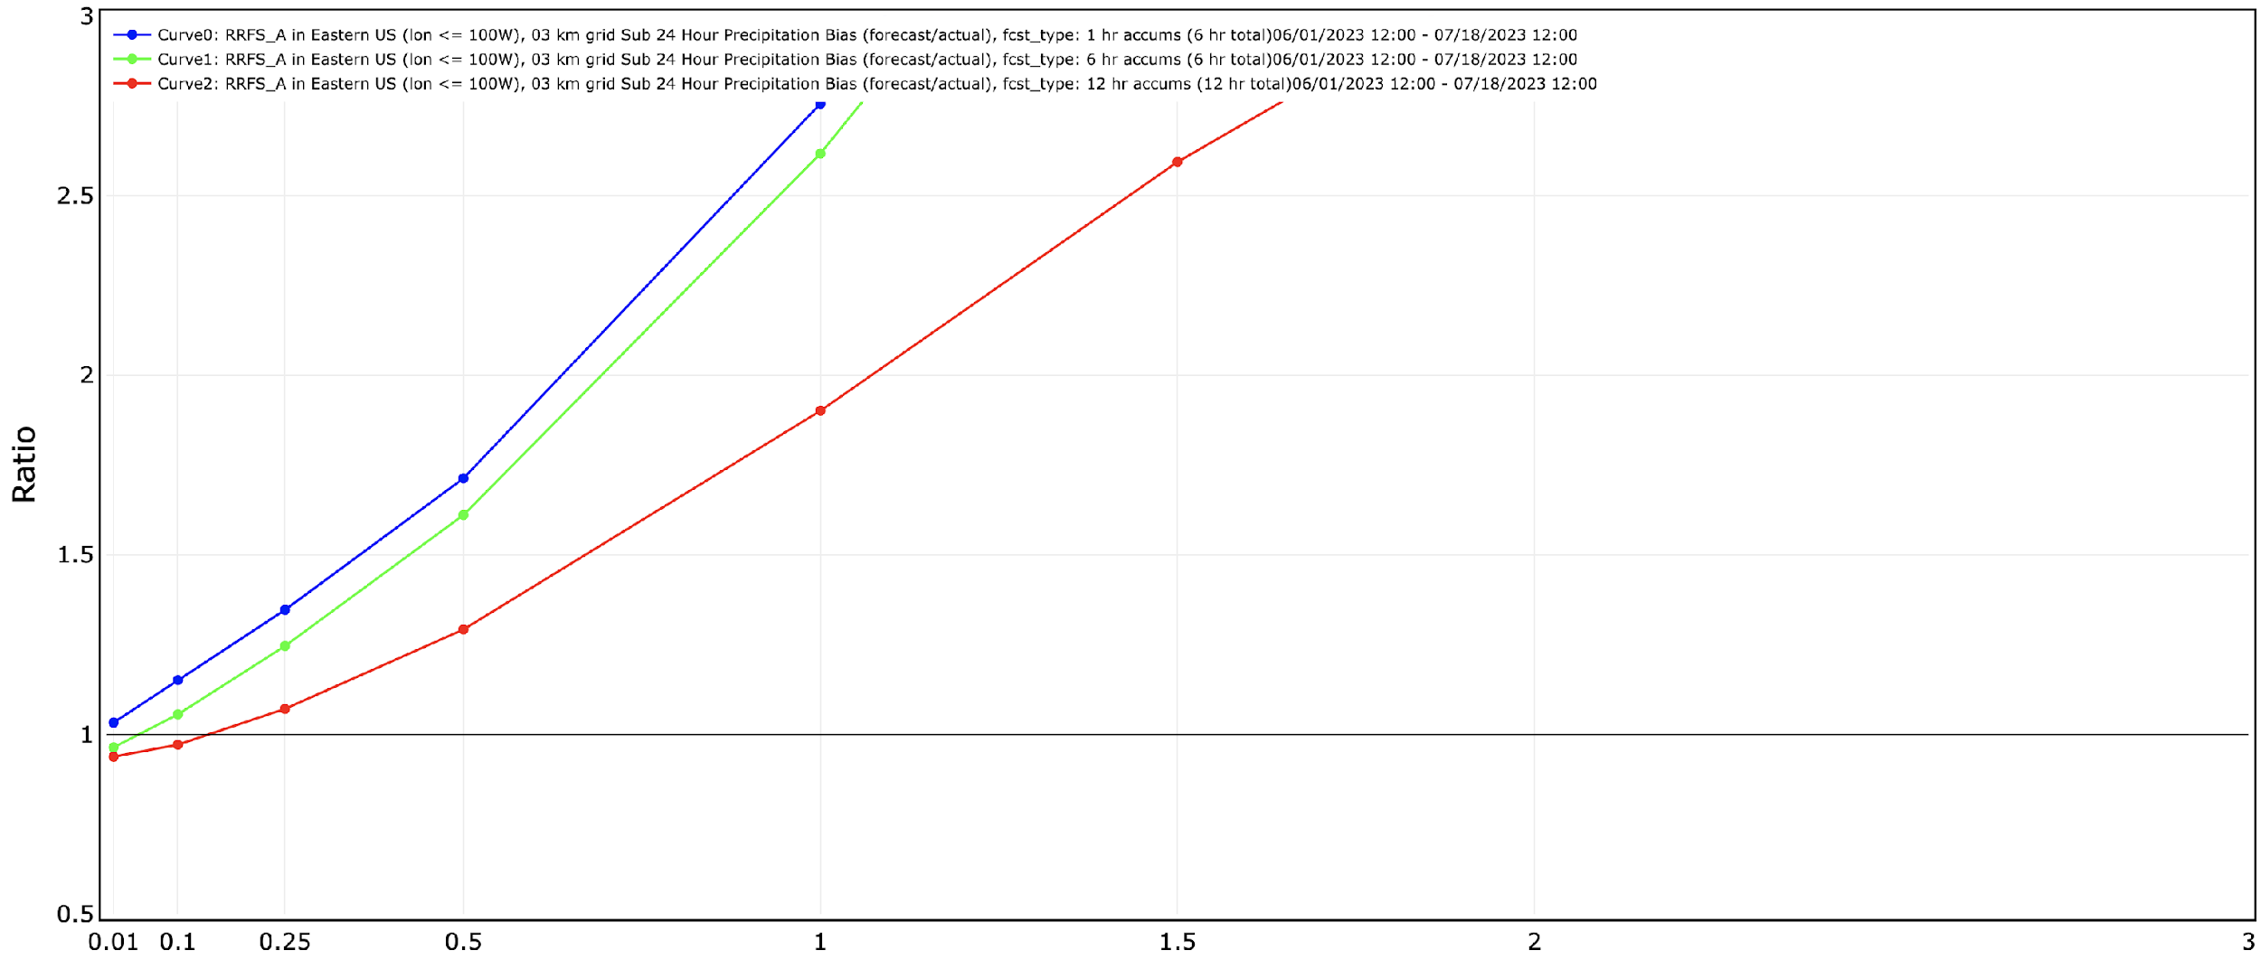
RRFSv1 Challenges: QPF Warm Season Bias
3 km Eastern CONUS QPF Frequency Bias 2023
HRRRv4 RRFS_Prototype
1 hr
6 hr
12 hr
1 hr
6 hr
12 hr
Low bias at most thresholds
High bias at higher thresholds
Optimal
Optimal
Summer 2023 (JJ) Spring 2023 (MAM)
High bias at higher thresholds
Optimal
Optimal
Low bias at low thresholds
Seasonal Performance

Slide 21
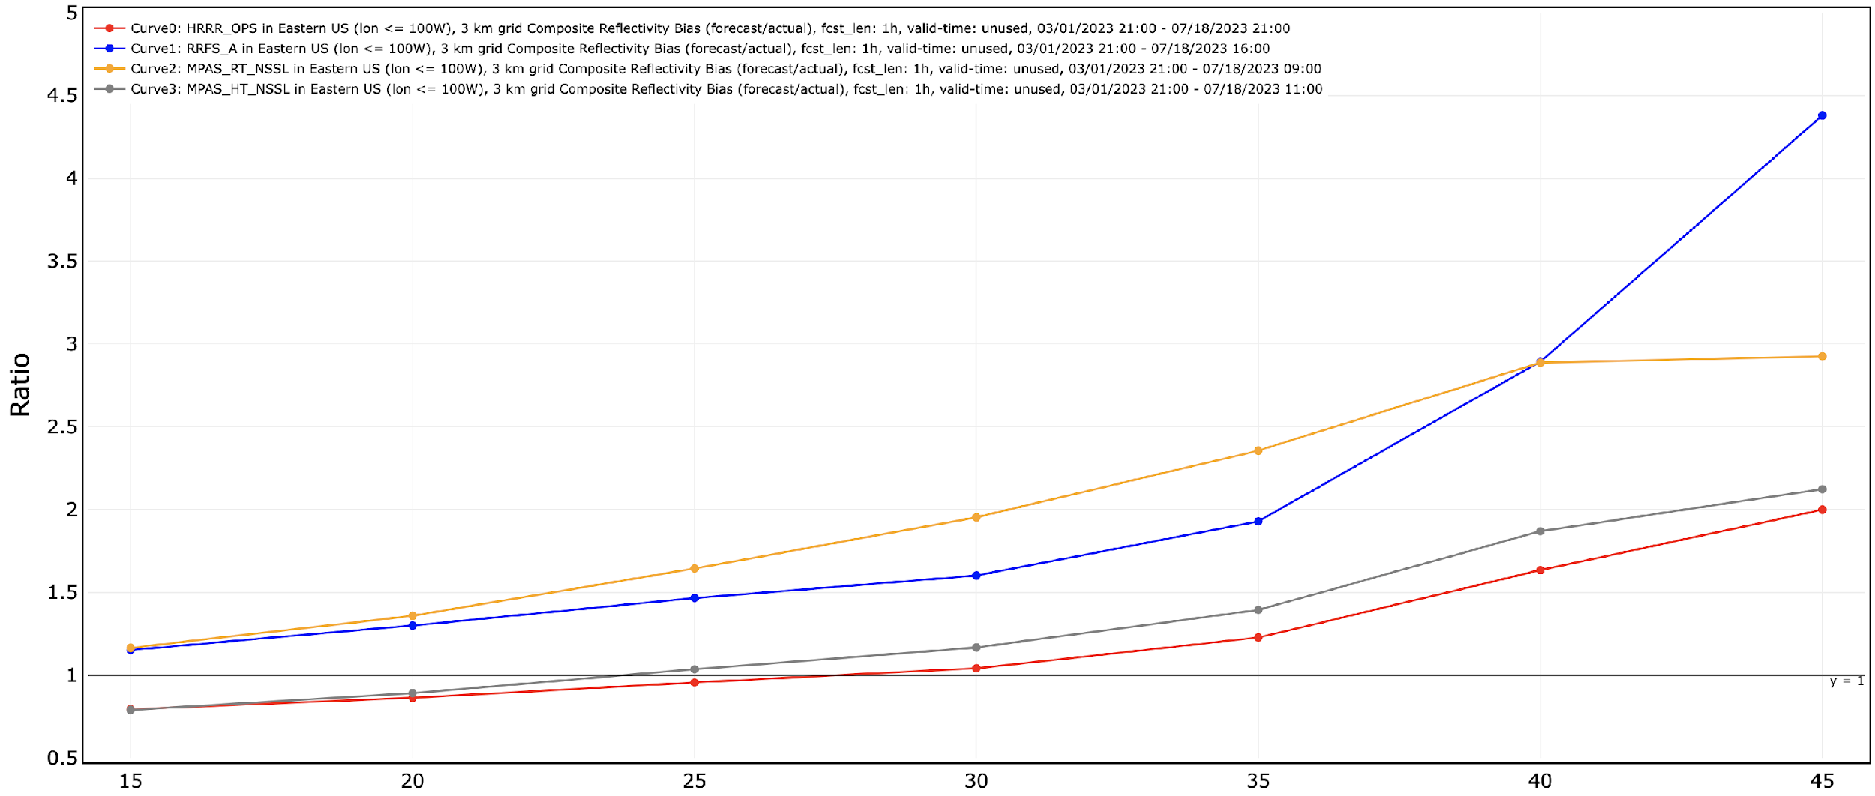
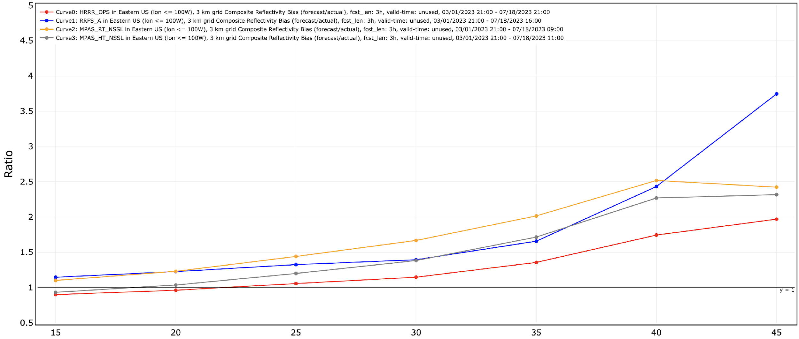
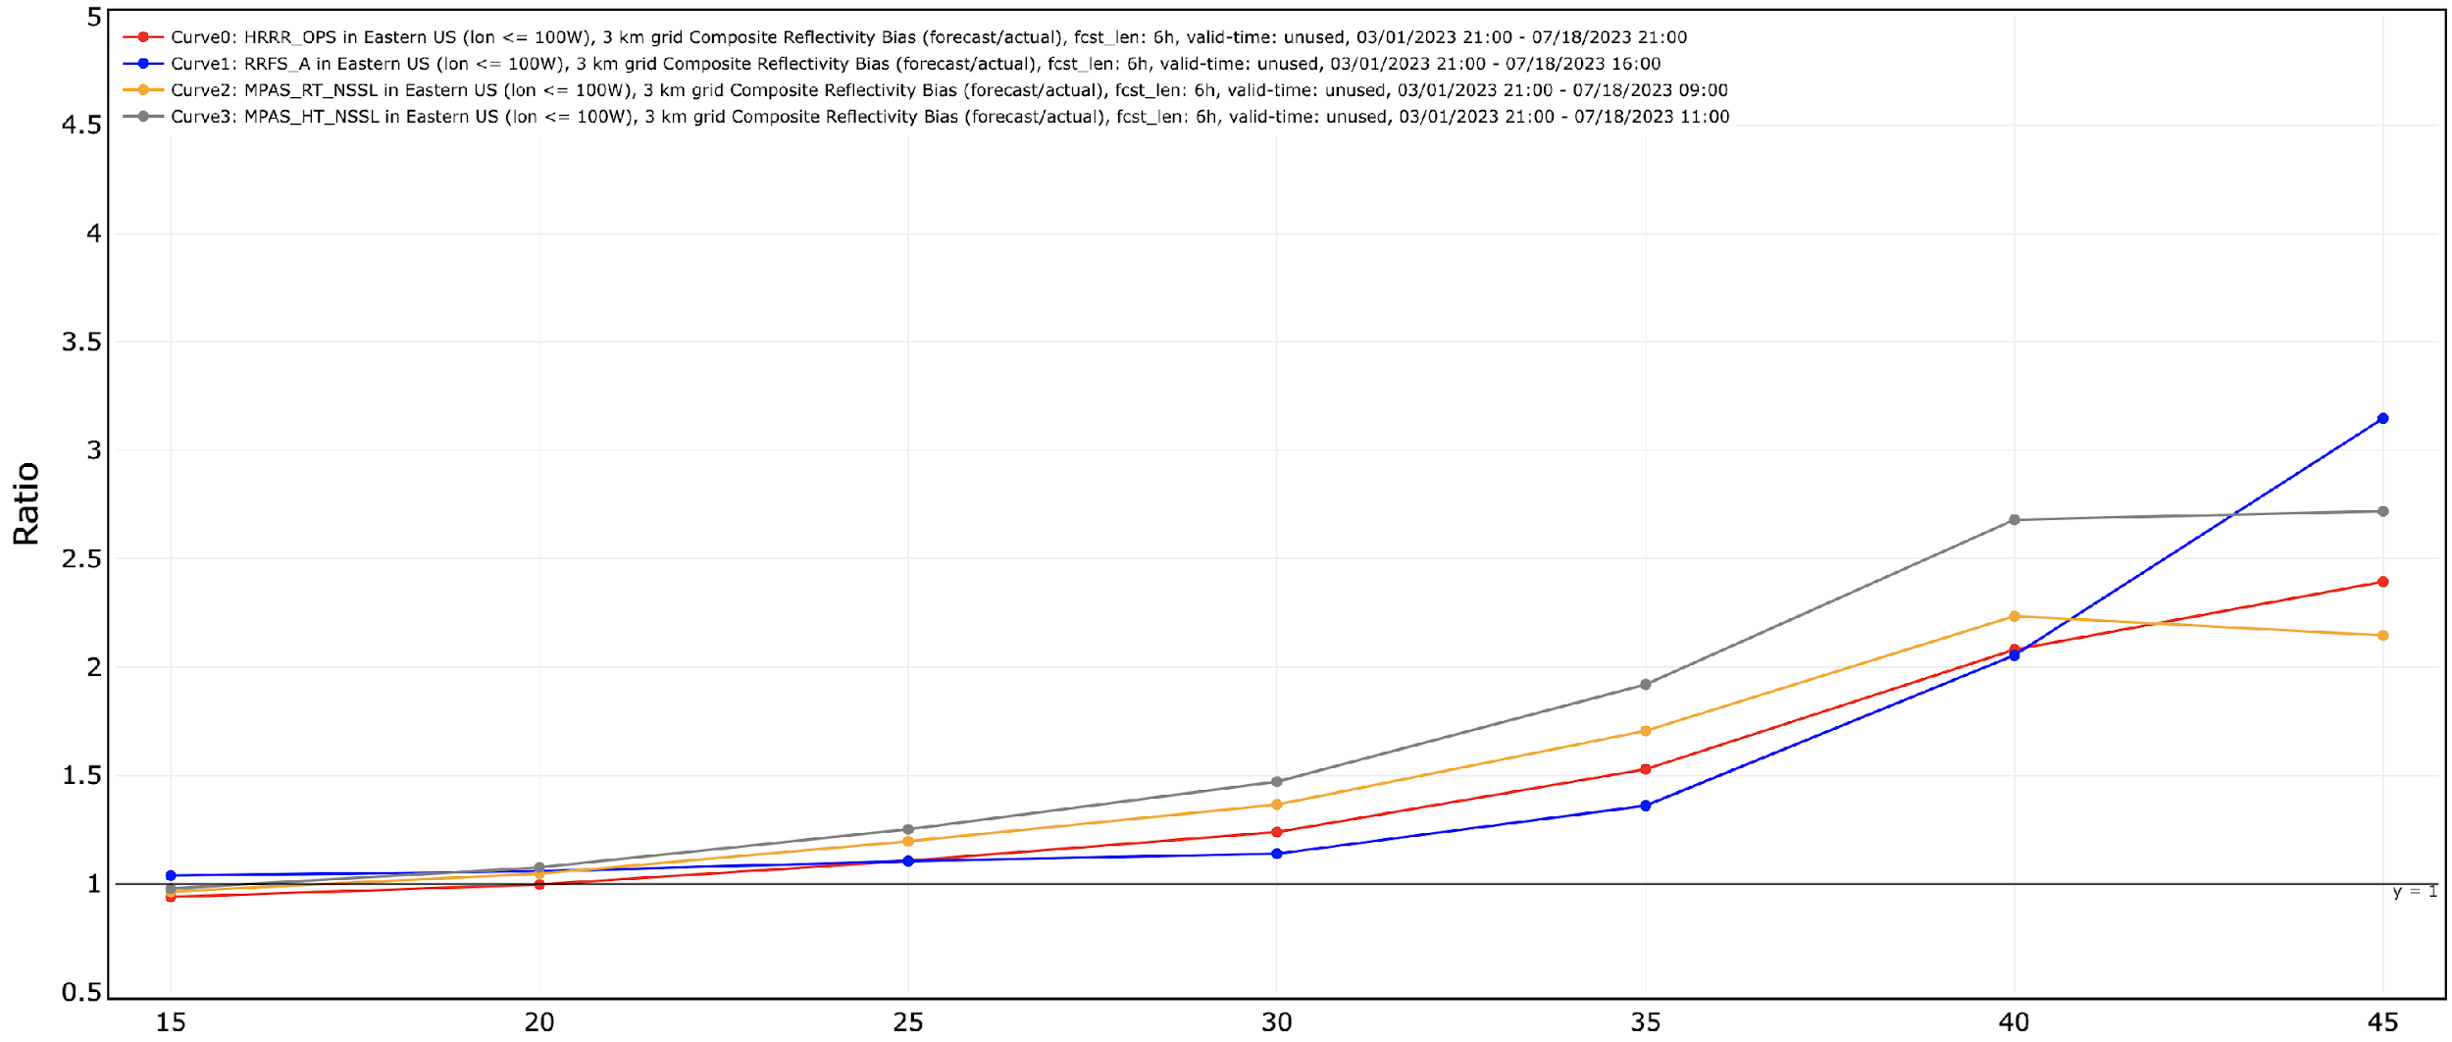
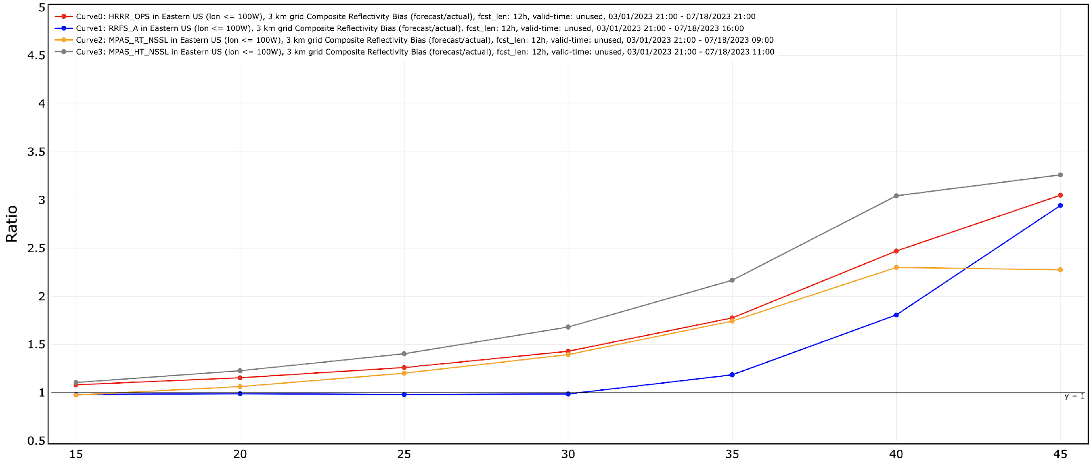
RRFSv1 Challenges: Reflectivity Warm Season Bias
3 km Eastern CONUS Composite Reflectivity Frequency Bias (Mar-Jul 2023)
1 hr
3 hr
HRRR_OPS (WRF-ARW)
RRFS_A (FV3-LAM)
MPAS (HRRR IC)
MPAS (RRFS IC)
HRRR_OPS (WRF-ARW)
RRFS_A (FV3-LAM)
MPAS (HRRR IC)
MPAS (RRFS IC)
High bias at high thresholds
Optimal
Optimal
Low bias at low thresholds
6 hr
12 hr
HRRR_OPS (WRF-ARW)
RRFS_A (FV3-LAM)
MPAS (HRRR IC)
MPAS (RRFS IC)
HRRR_OPS (WRF-ARW)
RRFS_A (FV3-LAM)
MPAS (HRRR IC)
MPAS (RRFS IC)
RRFS becomes optimal at lower thresholds
MPAS-RRFS more optimal
at higher thresholds
Optimal
Optimal
Seasonal Performance

Slide 22
RRFSv1 Challenges: Warm Season Convective Biases
Hazardous Weather Testbed 2023 Spring Forecast Experiment (24 hr forecasts valid 00z 31 May 2023)
HRRR_OPS
RRFS_A
Captures convection along old outflow boundary in northern Kansas
All convection appears very intense with larger cells
Does not capture new convection along old outflow boundary in northern Kansas
MPAS (RRFS_A IC)
Truth (MRMS Radar)
Captures convection along old outflow boundary in northern Kansas
Greater diversity of cell intensity and sizes
Still slight overforecast (TX)
Seasonal Performance

Slide 23
RRFSv1 Challenges: Storm type differences
Similar Overall Distributions
Analysis courtesy of NSSL/CIWRO
Larissa Reames and Lou Wicker
10 cases from May, June 2022, 6-12 forecast hours each (total 92 hr)
RRFS_B (GSL), HRRR, and MRMS data all interpolated to same ECONUS domain
Over 23,000 total objects – 7000-8000ish objects per dataset
Mostly ordinary cell, “other”
Models have more ordinary cells, less “other” and QLCS Cells
2022 Spring Performance

Slide 24
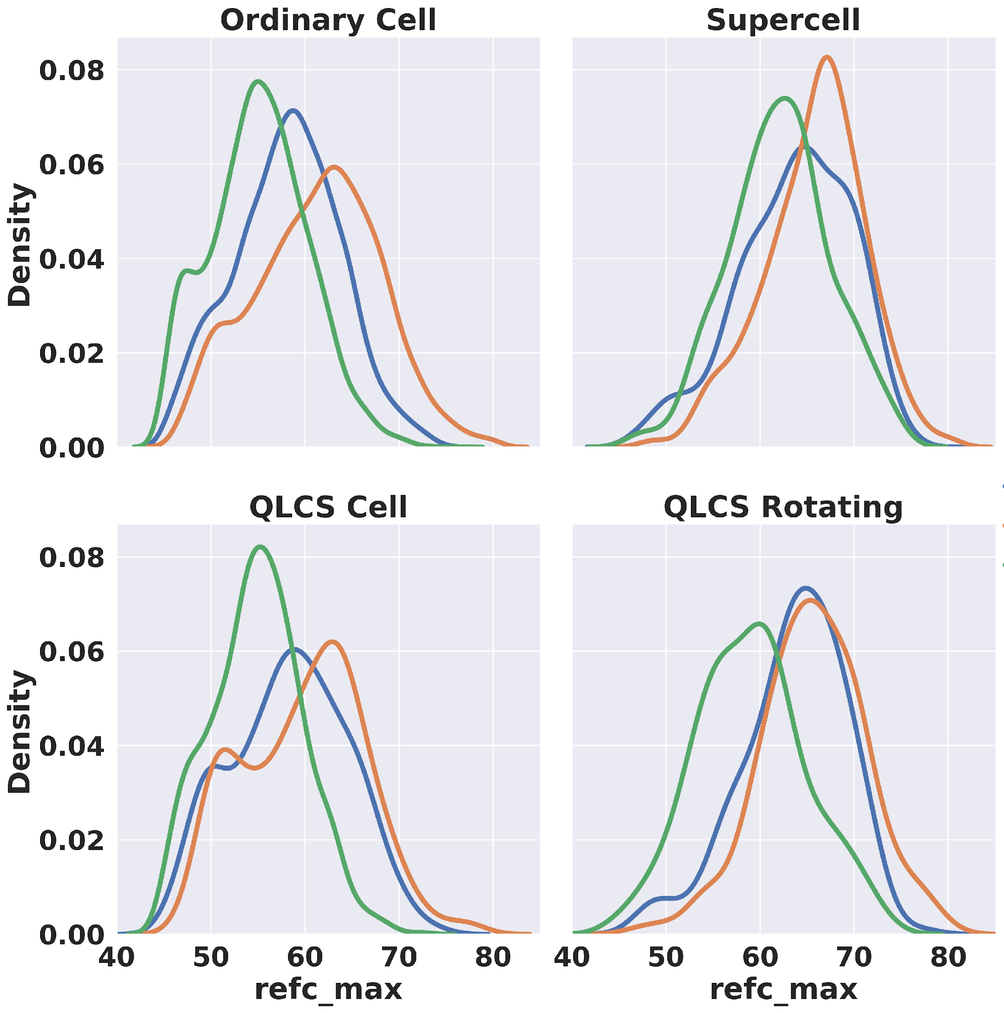
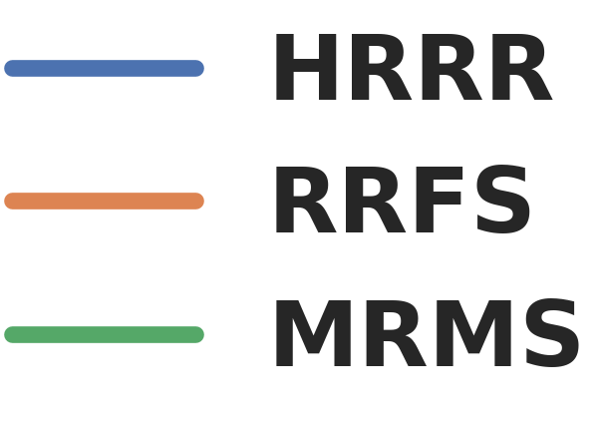
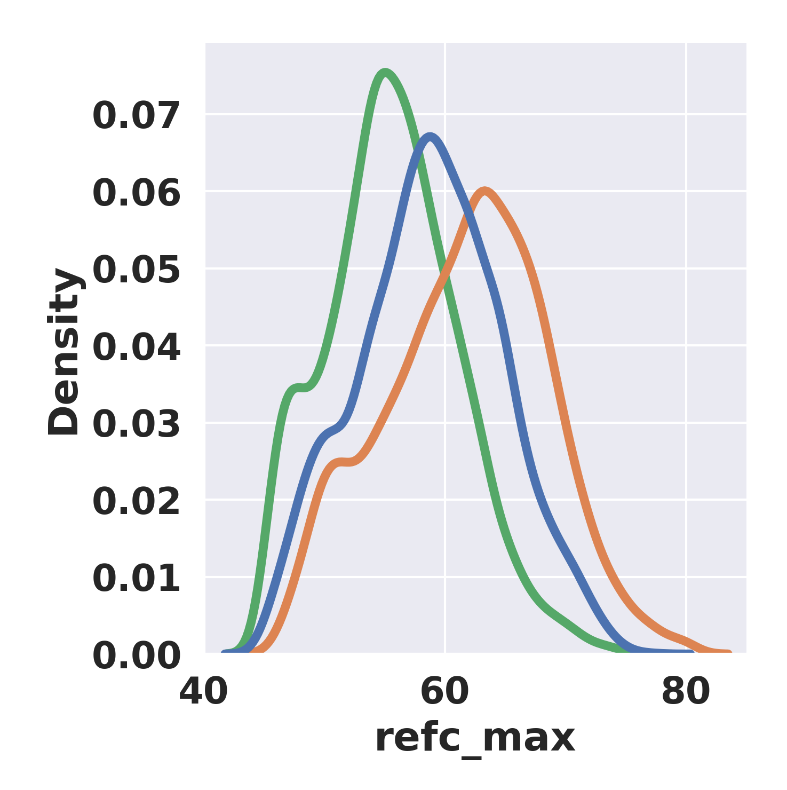
RRFSv1 Challenges: Storm type differences
COMBINED
Higher Overall Bias
Apparent in RRFS
Analysis courtesy of NSSL/CIWRO
Larissa Reames and Lou Wicker
2022 Spring Performance

Slide 25
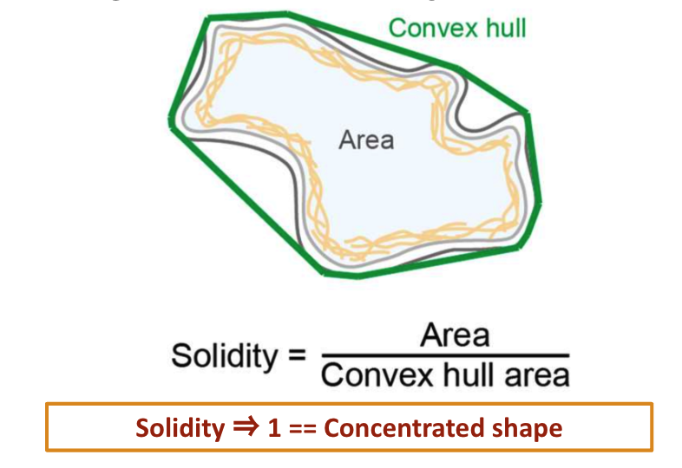
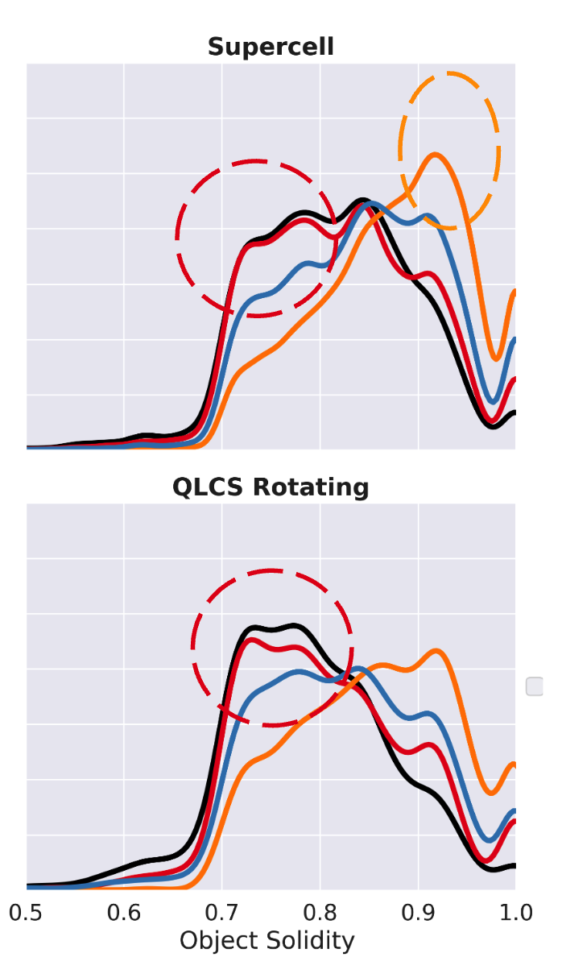
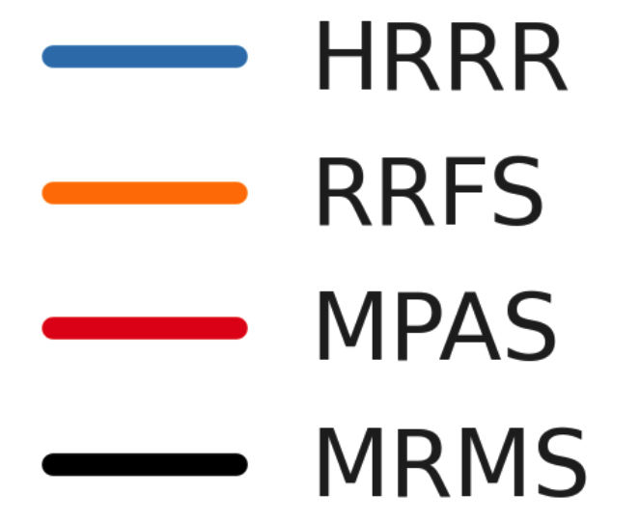
RRFSv1 Challenges: Storm structure differences
(HRRR IC)
Up to 61 forecasts from May-June 2023
36 forecast hours each
RRFSA, HRRR, MPAS, & MRMS data all interpolated to same 3km ECONUS domain
Removed objects over water
Analysis courtesy of NSSL/CIWRO
Larissa Reames and Lou Wicker
2023 Spring Performance
Notes:
RRFS has more solidity that MRMS or other models: more blobby…
MPAS is nearly perfect for supercell and QLCS

Slide 26
RRFSv1+ Status Summary
RRFSv1
RRFSv1 is a major upgrade over HRRR (bigger domain, longer forecast length, ensemble forecasts)
Scheduled for September 2024-March 2025 operational implementation (FY25)
Code freeze fall 2023 to spring 2024, science evaluation 2024
Deterministic forecasts (hourly to 18h, 6-hourly to 60h), ensemble forecasts (6-hourly to 48h)
Advanced scale-aware physics, two-way coupled storm-scale ensemble data assimilation
Significant improvement in RRFS forecast skill over past two years, now close to HRRR and HREF
RRFS forecast bias characteristics somewhat different than HRRR
RRFSv2+ (highlights, not exhaustive)
RRFSv2 estimated implementation FY27
Expanding support for Pacific Region (American Samoa, Micronesia, etc…)
Expanding ensemble forecast membership/cycles
Transition from GSI to JEDI data assimilation software/infrastructure
Transition to strongly-coupled land-atmosphere DA
Inclusion of more blending/overlapping-windows/multi-scale information for analysis
Addition of new observations: DPQC radial velocities, GREMLIN, PBL height, all-sky radiances, etc…
Transition to Noah-MP LSM, RRTMGP?, Air Quality/Chemistry?
Explore transition to MPAS dynamic core
Summary

Slide 27
RRFSv2+
FV3 fundamental design emphasis on vorticity dynamics is good for large scales
Numerical design of the dycore for 3D divergent motions results in a loss of precision for CAM applications
Difficulty in tuning model filtering to both:
(1) represent convection
(2) prevent spurious storms that produce excessive precipitation and contamination of the environment
Data assimilation, which can generate spurious motions due to imbalances, also triggers excessive convection
Increasingly difficult to mitigate this problem as the frequency of data assimilation increases (sub-hourly DA):
Warn on Forecast (WoFS)
Land-falling TCs
Fire prediction
The moving vertical coordinate, while shown useful in non-convective applications to increase efficiency, becomes much more problematic at CAM scales:
Lagrangian surfaces can collapse even within the small time step cycling
Between remapping steps in the presence of strong updrafts
Physics tendencies from the model are implemented in a way not used in other operational models
Also introduces imbalances
Can be improved but would require non-trivial effort
Explore MPAS for RRFSv2+
Dynamic Core

Slide 28
RRFSv2+ Status Summary
Why not just jump straight to RRFSv2?
Schedule
NAMv4: 2017 (now more than 6 years ago)
RAPv5/HRRRv4: December 2020 (now more than 2.5 years ago)
HREFv3: May 2021 (now more than 2 years ago)
RRFSv1 best case: September 2024-March 2025 (~4 years after last CAM upgrade)
WCOSS2 implementation moratorium coming during FY26
Need to retire legacy systems before moratorium less code porting be needed without SME
Data Assimilation
GSI-MPAS development limited with no direct interface to unstructured grid
Continued investment in GSI development not viable with needed resources moving to JEDI
JEDI-MPAS only practical option
Physics
Need full CCPP framework/suite integration into MPAS
Stochastic physics not currently available in MPAS for RRFS ensemble
Given needed DA, physics, infrastructure development with MPAS and scheduling factors:
RRFSv2 best case implementation: FY27 (6-7 years after last legacy CAM upgrade)
RRFSv1 has a lot of (equitable) benefits with increased domain size, direct radar DA, advanced physics, smoke/dust, two-way coupling with ensemble, etc…
Summary

Slide 29
HRRRv4 References
Benjamin, S. G., James, E. P., Hu, M., Alexander, C. R., Ladwig, T. T., Brown, J. M., Weygandt, S. S., Turner, D. D., Minnis, P., Smith, W. L., Jr., and Heidinger, A. K. (2021). Stratiform Cloud-Hydrometeor Assimilation for HRRR and RAP Model Short-Range Weather Prediction. Monthly Weather Review 149, 8, 2673-2694, https://doi.org/10.1175/MWR-D-20-0319.1
Benjamin, S. G., Smirnova, T. G., James, E. P., Lin, L., Hu, M., Turner, D. D., and He, S. (2022). Land–Snow Data Assimilation Including a Moderately Coupled Initialization Method Applied to NWP. Journal of Hydrometeorology 23, 6, 825-845, https://doi.org/10.1175/JHM-D-21-0198.1
Dowell, D. C., Alexander, C. R., James, E. P., Weygandt, S. S., Benjamin, S. G., Manikin, G. S., Blake, B. T., Brown, J. M., Olson, J. B., Hu, M., Smirnova, T. G., Ladwig, T., Kenyon, J. S., Ahmadov, R., Turner, D. D., Duda, J. D., and Alcott, T. I. (2022). The High-Resolution Rapid Refresh (HRRR): An Hourly Updating Convection-Allowing Forecast Model. Part I: Motivation and System Description. Weather and Forecasting 37, 8, 1371-1395, https://doi.org/10.1175/WAF-D-21-0151.1
James, E. P., Alexander, C. R., Dowell, D. C., Weygandt, S. S., Benjamin, S. G., Manikin, G. S., Brown, J. M., Olson, J. B., Hu, M., Smirnova, T. G., Ladwig, T., Kenyon, J. S., and Turner, D. D. (2022). The High-Resolution Rapid Refresh (HRRR): An Hourly Updating Convection-Allowing Forecast Model. Part II: Forecast Performance. Weather and Forecasting 37, 8, 1397-1417, https://doi.org/10.1175/WAF-D-21-0130.1
Turner, D. D., Cutler, H., Shields, M., Hill, R., Hartman, B., Hu, Y., Lu, T., and Jeon, H. (2022). Evaluating the Economic Impacts of Improvements to the High-Resolution Rapid Refresh (HRRR) Numerical Weather Prediction Model. Bulletin of the American Meteorological Society 103, 2, E198-E211, https://doi.org/10.1175/BAMS-D-20-0099.1
Weygandt, S. S., Benjamin, S. G., Hu, M., Alexander, C. R., Smirnova, T. G., and James, E. P. (2022). Radar Reflectivity–Based Model Initialization Using Specified Latent Heating (Radar-LHI) within a Diabatic Digital Filter or Pre-Forecast Integration. Weather and Forecasting 37, 8, 1419-1434, https://doi.org/10.1175/WAF-D-21-0142.1
References

