Slide 1
Introduction of the next Global Ensemble Forecast System for weather, subseasonal
and monthly predictions.
Yuejian Zhu
Co-Authors: Bing Fu, Hong Guan, Eric Sinsky, Neil Barton, Philip Pegion*, Avichal Mehra and Fanglin Yang
Environmental Modeling Center/NCEP
*Physical System Laboratory/OAR
Acknowledgements:
EMC ensemble team, coupling team, model team
OAR/PSL; OAR/WPO; CPC/CTB; NWS/OSTI

Slide 2
Key Points
Background and current operational GEFS
GEFSv11 vs GEFSv12
Accomplishments of 2020 implementation
Next Global Ensemble Forecast System
GEFSv12 vs GEFSv13
Expectation: Weather, S2S, ocean, seaice, wave and aerosol
Summary

Slide 3
NCEP GEFS v12 Configurations
Components | V11 (Dec. 2015) | V12 (Sept. 2020)
GFS Model | Semi-Lagrangian, 2015 | FV3 (Finite-Vol Cubed-Sphere)
Physics | GFS13 package (Zhao-Carr MP) | GFSv15 packages (GFDL MP)
Initial perturbations | EnKF f06 | EnKF f06
Model uncertainty | STTP (Stoch. Total Tend. Pert) | 5-scale SPPT and SKEB
Boundary forcing | SST - Climatology relaxation | NSST + 2-tiered SST
Tropical storm | Relocation for all members | No relocation
Horizontal Resolution | T_{L}574 (34km)/T_{L}382 (55km) | C384 (25km)
Vertical resolution | L64 (hybrid) | L64 (hybrid)
Daily frequency | 00, 06, 12 and 18UTC | 00, 06, 12 and 18UTC
Forecast length | 16 days | 16 days, 35 days (00UTC)
Members | Control + 20 pert members | Control + 30 pert members
Output resolution | 0.5º x 0.5º | 0.25º x 0.25º and 0.5º x 0.5º
Output frequency | 3h the first 8 days; 6h the rest | 3h the first 10 days; 6h the rest
Reforecast | EMC offline – 20 years | 30 years (1989-2018)
Implementation | December 2nd 2015 | September 2020

Slide 4
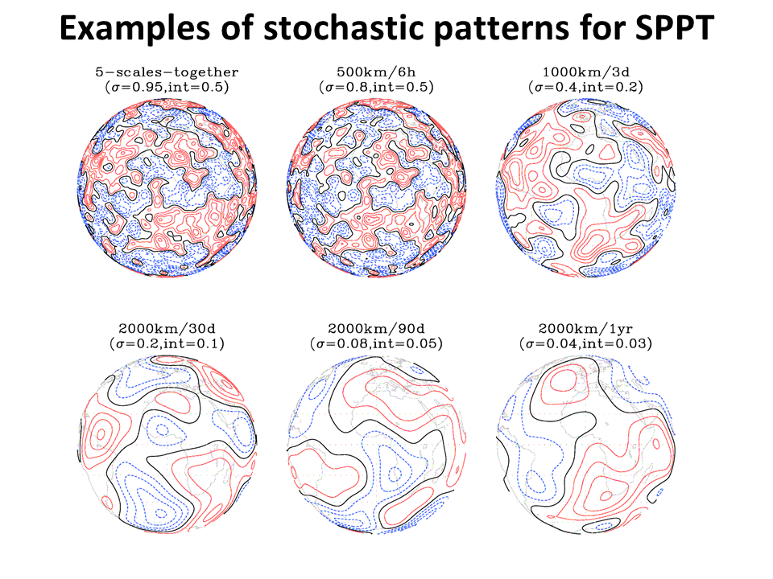
500hPa zonal wind
Error/Spread ratio
GEFSv11 with STTP
GEFSv12 with SPPT + SKEB
Fig.: 5-scale random patterns used in Stochastic Perturbed Physics Tendencies (SPPT). On the top of each plot, the numbers (except for upper left) represent the scales of spatial and temporal perturbations with the maximum amplitude and contour intervals in the bracket.
No radiative perturbation for clear sky
No perturbation under divided streamline

Slide 5
Accomplishments of GEFSv12 (highlights)
Weather -
Improved probabilistic forecast skill and predictability
Improved PQPF and T2m
Improved TC tracks and spread
Week-2; Weeks 3&4 -
An improvement for temperature, precipitation, 500 hPa heights tropical cyclone and stratosphere.
Wave -
Reduce bias and RMSE; An improvement of wave spread.
Aerosol (control member only) -
Improvement in the dust predictions (signals and errors)
31-year Reforecasts
Support forecast calibration and validation of hydrometeorological application

Slide 6
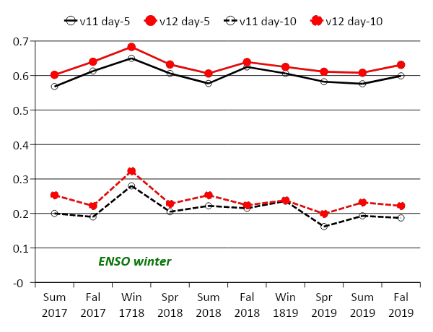
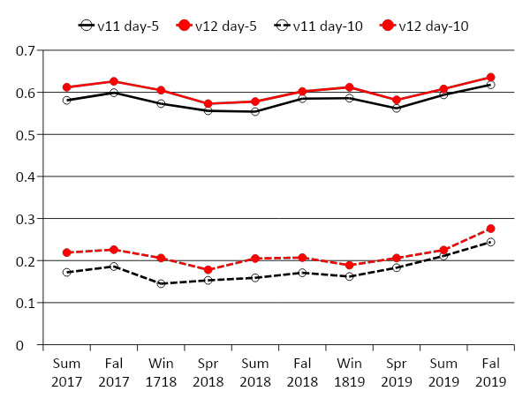
CRPS Skill of 500hPa geopotentoal height
0.628
0.601
0.603
0.581
North Hemisphere
South Hemisphere
0.214
0.179
0.239
0.209
CRPSS – Continuous Ranked Probabilistic Skill Score is one of evaluation tools to measure ensemble based probabilistic forecast. CRPSS=1 is for perfect forecast, CRPSS=0 is for no skill from reference, CRPSS=0.25 is similar to PAC=0.6 (pattern anomaly correlation of ensemble mean). GEFS v12 has better CRPSS for both hemispheres, day-5 and day-10, all two and half years.

Slide 7
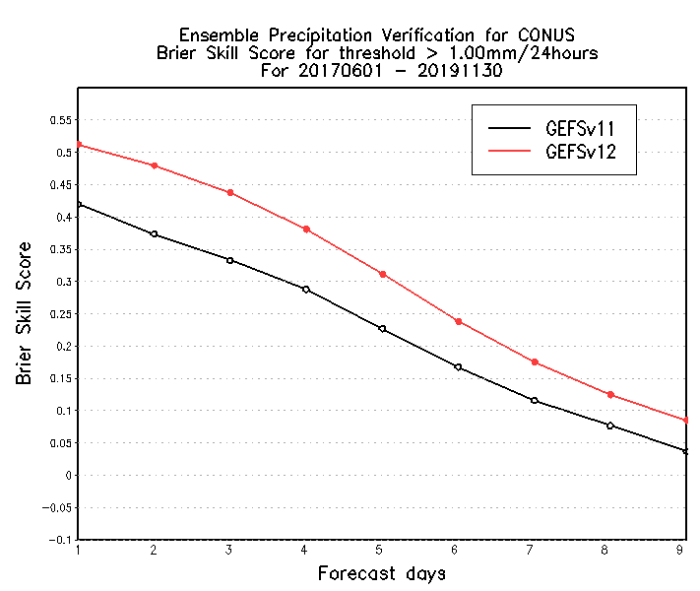
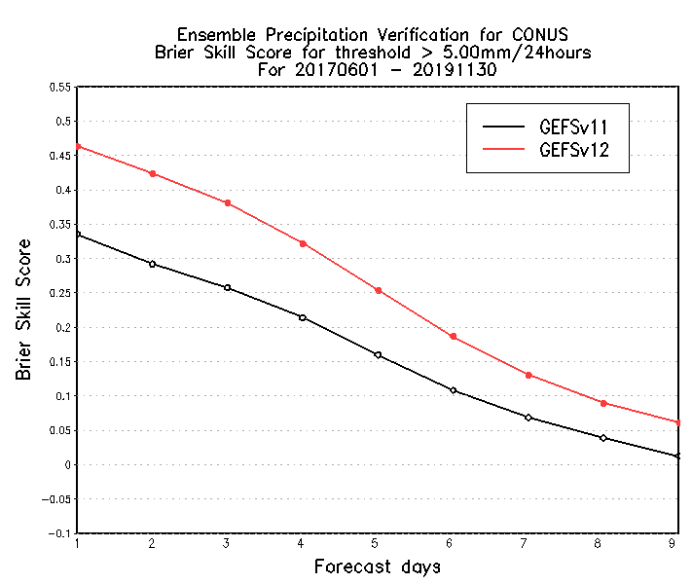
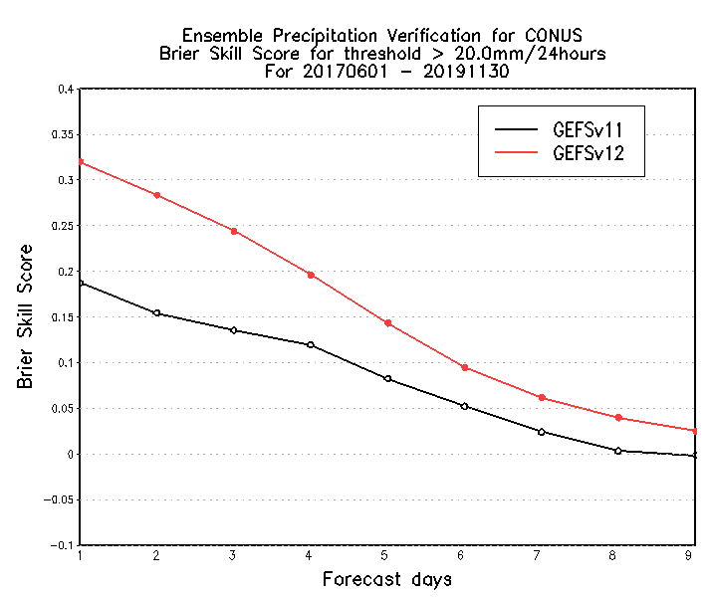
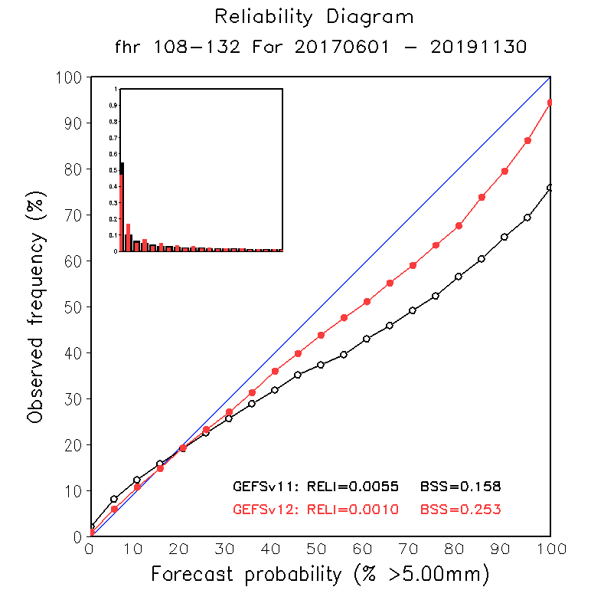
Brier Skill Scores of the CONUS PQPF
0.628
0.601
Extend skill ~ 1 days
Extend skill > 1 days
Extend skill ~ 1 days
South Hemisphere
0.214
0.179
>=1.00mm/24hours
>=5.00mm/24hours
0.239
0.209
>=20.00mm/24hours
Brier Score – Brier score is a very popular verification tool to evaluate (probabilistic) forecast performance. It is easy to decompose to three components (resolution, reliability and uncertainty). BSS=1 is for perfect forecast, BSS=0 is for no skill from reference of climatology. GEFSv12 probabilistic Quantitative Precipitation Forecast (PQPF) is over performance than GEFSv11 for all forecast categories, all forecast lead-time. Statistically, GEFSv12 has extended one more day(s) probabilistic forecast skills over GEFSv11. The forecast is much reliable (left plot) than GEFSv11.

Slide 8
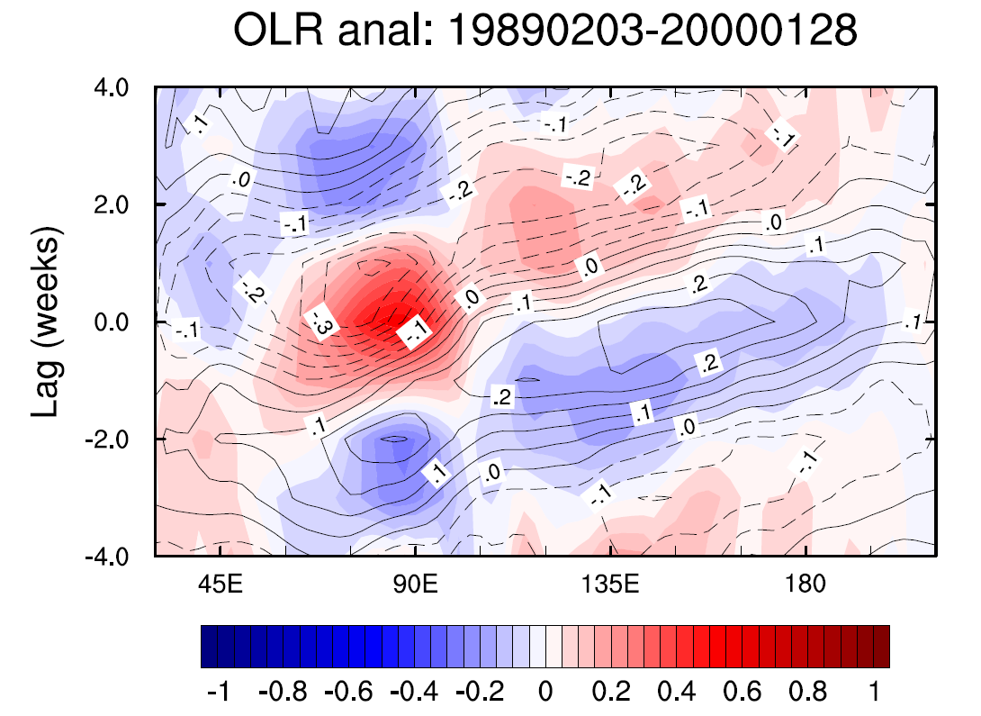
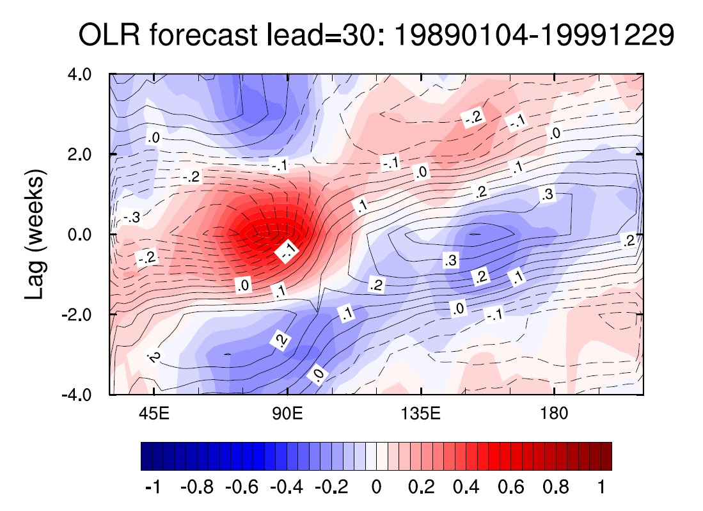
Example of impact: Spatial and Time-Lag Correlation
at tropical equator OLR and 850 hPa Zonal Wind
1989 - 1999
Figure: Spatial and time correlation (anomaly) between Centre India Ocean and different longitudes/time-lag of 11 years analysis (CFSR; left) and 30-day forecast (GEFS ensemble mean; right). The correlation coefficient of OLR is in shaded and 850 zonal wind is in contours.
The statistics indicate that there is a very good eastward propagation of signal (or MJO) from Indian Ocean. However, it is challenge for northward propagation of India Ocean (Not show).

Slide 9
References:
Zhu, Y., X. Zhou, W. Li, D. Hou, C. Melhauser, E. Sinsky, M. Pena, B. Fu, H. Guan, W. Kolczynsk, R. Wobus and V. Tallapragada, 2018: An Assessment of Subseasonal Forecast Skill Using an Extended Global Ensemble Forecast System (GEFS). J. Geophys. Res. 6732-6745 https://doi.org/10.1029/2018JD028506
Li, W., Y. Zhu, X. Zhou, D. Hou, E. Sinsky, C. Melhauser, M. Pena, H. Guan, R. Wobus, 2018: Evaluating the MJO Forecast Skill from Different Configurations of NCEP GEFS Extended Forecast, Climate Dynamics, 52, 4923–4936 https://doi.org/10.1007/s00382-018-4423-9
Zhou, X., Y. Zhu, D. Hou, B. Fu, W. Li, H. Guan, E. Sinsky, W. Kolczynski, X. Xue, Y. Luo, J. Peng, B. Yang, V. Tallapragada and P. Pegion, 2022: The Introduction of the NCEP Global Ensemble Forecast System version 12, Wea. Forecasting https://doi.org/10.1175/WAF-D-21-0112.1
Hamill, T., J. S. Whitaker, A. Shlyaeva, G. Bates, S. Fredrick, P. Pegion, E. Sinsky, Y. Zhu, V. Tallapragada, H. Guan, X. Zhou, and J. Woollen, 2022: The Reanalysis for the Global Ensemble Forecast System, version 12, Mon. Wea. Rev. https://doi.org/10.1175/MWR-D-21-0023.1
Guan, H., Y. Zhu, E. Sinsky, B. Fu, W. Li, X. Zhou, X. Xue, D. Hou, J. Peng, M. M. Nageswararao, V. Tallapragada, T. M. Hamill, J. S. Whitaker, G. T. Bates, P. Pegion, S. Frederick, M. Rosencrans, A. Kumar, E. Wells, 2022: The GEFSv12 reforecast dataset for supporting subseasonal and hydrometeorological applications, Mon. Wea. Rev. https://doi.org/10.1175/MWR-D-21-0245.1

Slide 10
Key Points
Background and current operational GEFS
GEFSv11 vs GEFSv12
Accomplishments of 2020 implementation
Next Global Ensemble Forecast System
GEFSv12 vs GEFSv13
Expectations: Weather, S2S, ocean, seaice, wave and aerosol
Summary

Slide 11
NCEP Global Ensemble Forecast System (Configuration)
Components |  | V12 (Oct. 2020) | V13 (Q2FY25)
Atmos | Dynamics | FV3 (Finite-Vol Cubed-Sphere) GFSv15 | FV3 (Finite-Vol Cubed-Sphere) GFSv17
 | Physics | saSAS, GFDL-MP, K-EDMF, oroGWD | saSAS, Thompson-MP, sa-TKE-EDMF, uGWD
 | Initial perturbation | EnKF f06 (previous cycle) | EnKF f00 (early cycle)
 | Model uncertainty | 5-scale SPPT and SKEB | 5-scale SPPT, SKEB, SPP, CA
 | Boundary (ocean surface) | NSST + 2-tiered SST | NSST
 | Resolutions | C384L64 (25km) | C384L127 (25km)
Land | Model | NOAH-LSM | NOAH-MP
 | Initial perturbation | N/A | Soil moisture
Ocean | Model | N/A | MOM6 (0.25ºL75)
 | Initial perturbation | N/A | SOCA-Ens
 | Model uncertainty | N/A | 5-scale oSPPT and ePBL
Ice | Model | N/A | CICE6 (0.25º)
 | Initial condition | N/A | SOCA-Ens
Wave | Model | WW3 (one way) | WW3 (2-way) (0.25º lat/lon grid)
Aerosol | Model | GOCART (one way) | GOCART (2-way)
new

Slide 12
NCEP Global Ensemble Forecast System (Support)
Components |  | V12 (Oct. 2020) | V13 (Q2FY25)
Forecast frequency and leads |  | 35 days (00UTC); 16 days (06, 12, 18UTC) | 35/48 days (00UTC); 16 days (06, 12, 18UTC)
Atmos | Output (GRIB2) | Day 1-10, every 3 hours | Day 1-10, every 3 hours
 |  | > day-10, every 6 hours | > day-10, every 6 hours
 |  | Top level : 10 hPa | Top level: 1 hPa
Land | Output (GRIB2) | Day 1-10, every 3 hours | Day 1-10, every 3 hours
 |  | > day-10, every 6 hours | > day-10, every 6 hours
Ocean | Output (GRIB2) | N/A | Average for 24 hours
 | Output (NetCDF) | N/A | Average for 24 hours
Ice | Output (GRIB2) | N/A | Average for 24 hours
 | Output (NetCDF) | N/A | Average for 24 hours
Wave | Output (GRIB2) | Out to 16 days | The same as atmosphere
Aerosol | Output (GRIB2 | Day 1-5, every 3 hours | The same as atmosphere
Reanalysis |  | 20 years (2000 - 2020) | 30 years (1994 - 2023)
Reforecast |  | 31 years (1989 - 2020) | 30 years (1994 - 2023)
new

Slide 13
Expectations
The benefits from coupled GEFS (Global Ensemble Forecast System)
Further improvement of probabilistic weather forecasting
Including PQPF, T2m and TC
Improvement of MJO predictions
Including propagation, intensity and skill
Improvements from two way coupling between atmosphere/waves/aerosol
New products for the ocean and sea ice
30 years GEFSv13 reforecast

Slide 14
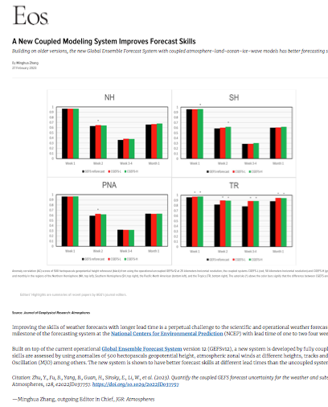
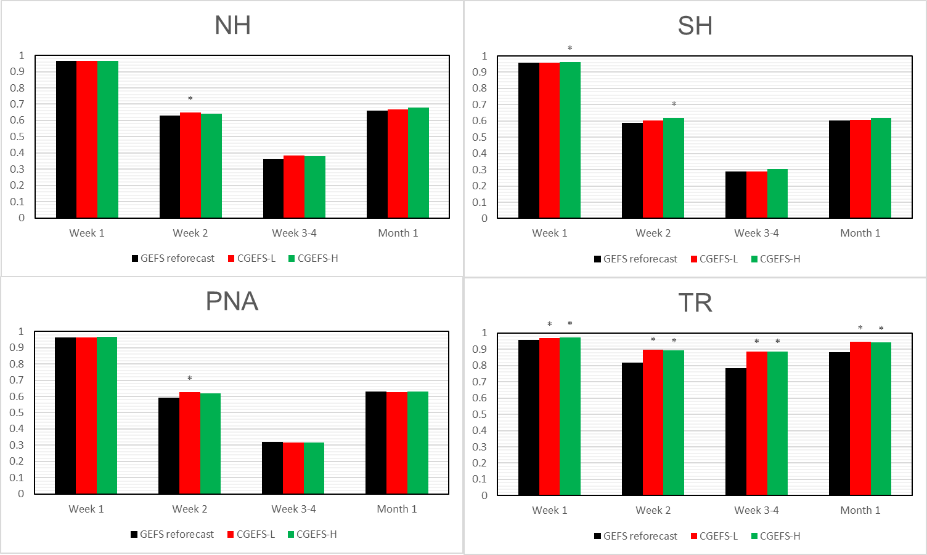
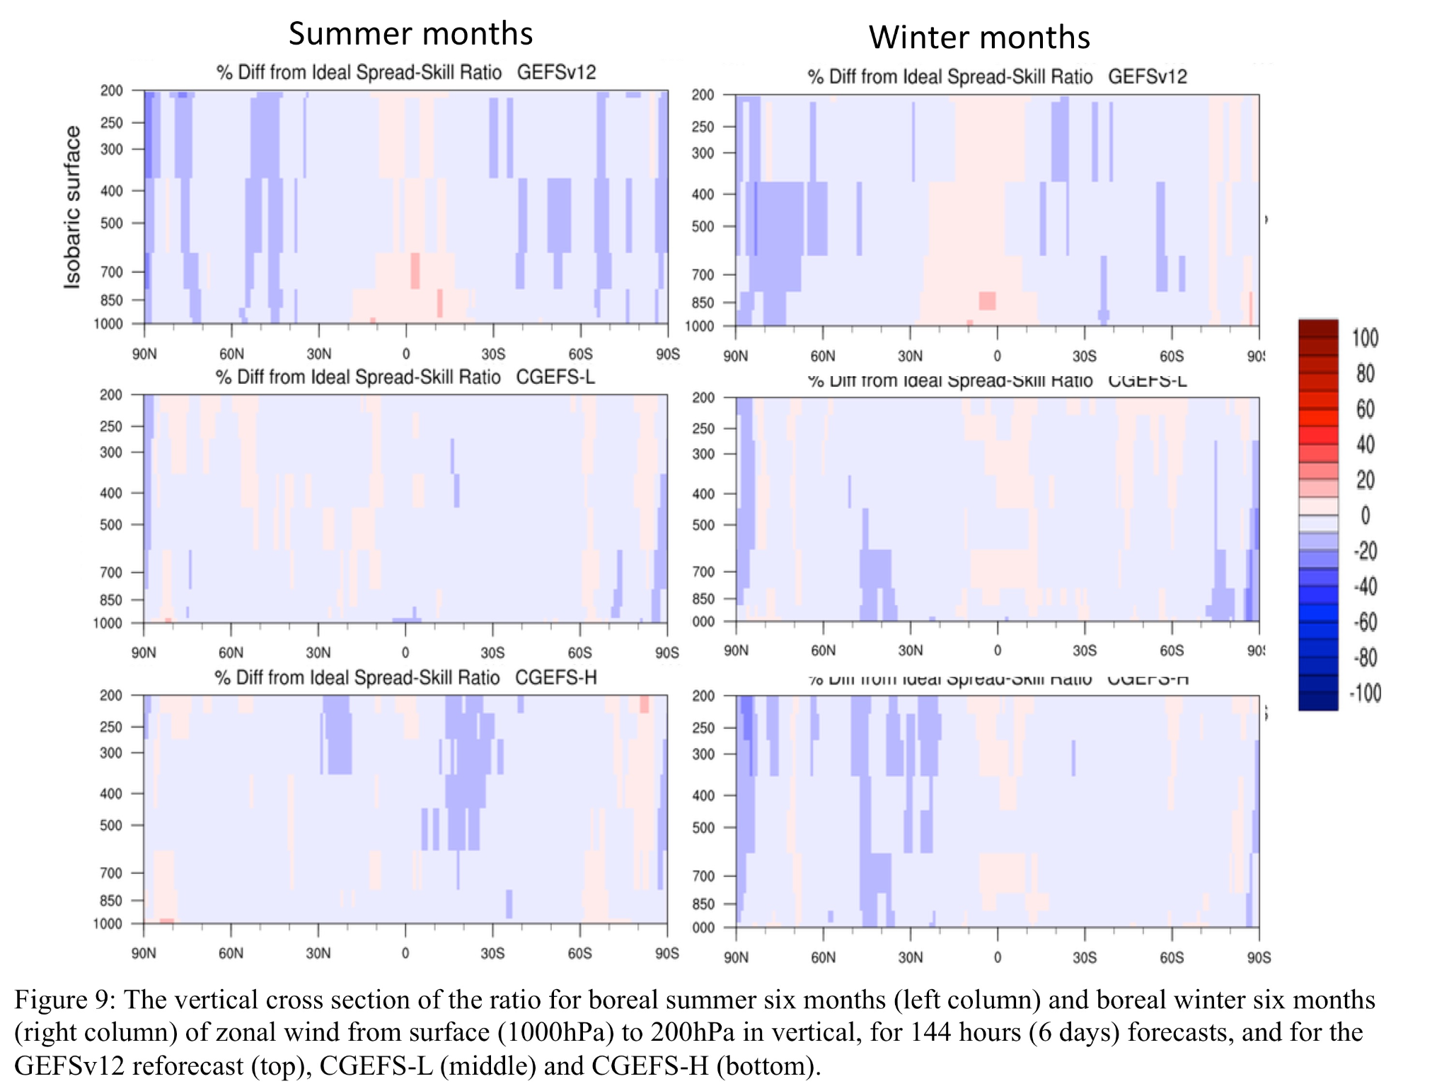
GEFSv13 Prototype Experiments - EOS highlights
Editor’s highlights - JGR Atmosphere (2023) --- Zhu, Y., B. Fu, B. Yang, H. Guan, E. Sinsky, W. Li, J. Peng, X. Xue, D. Hou, X.-Z. Liang and S. Shin, 2023: Quantify the Coupled GEFS Forecast Uncertainty for the Weather and Subseasonal Prediction.
Opr
Tropical overdispersion is reduced.
CGEFS-L
CGEFS-H
Significantly improve the skills

Slide 15
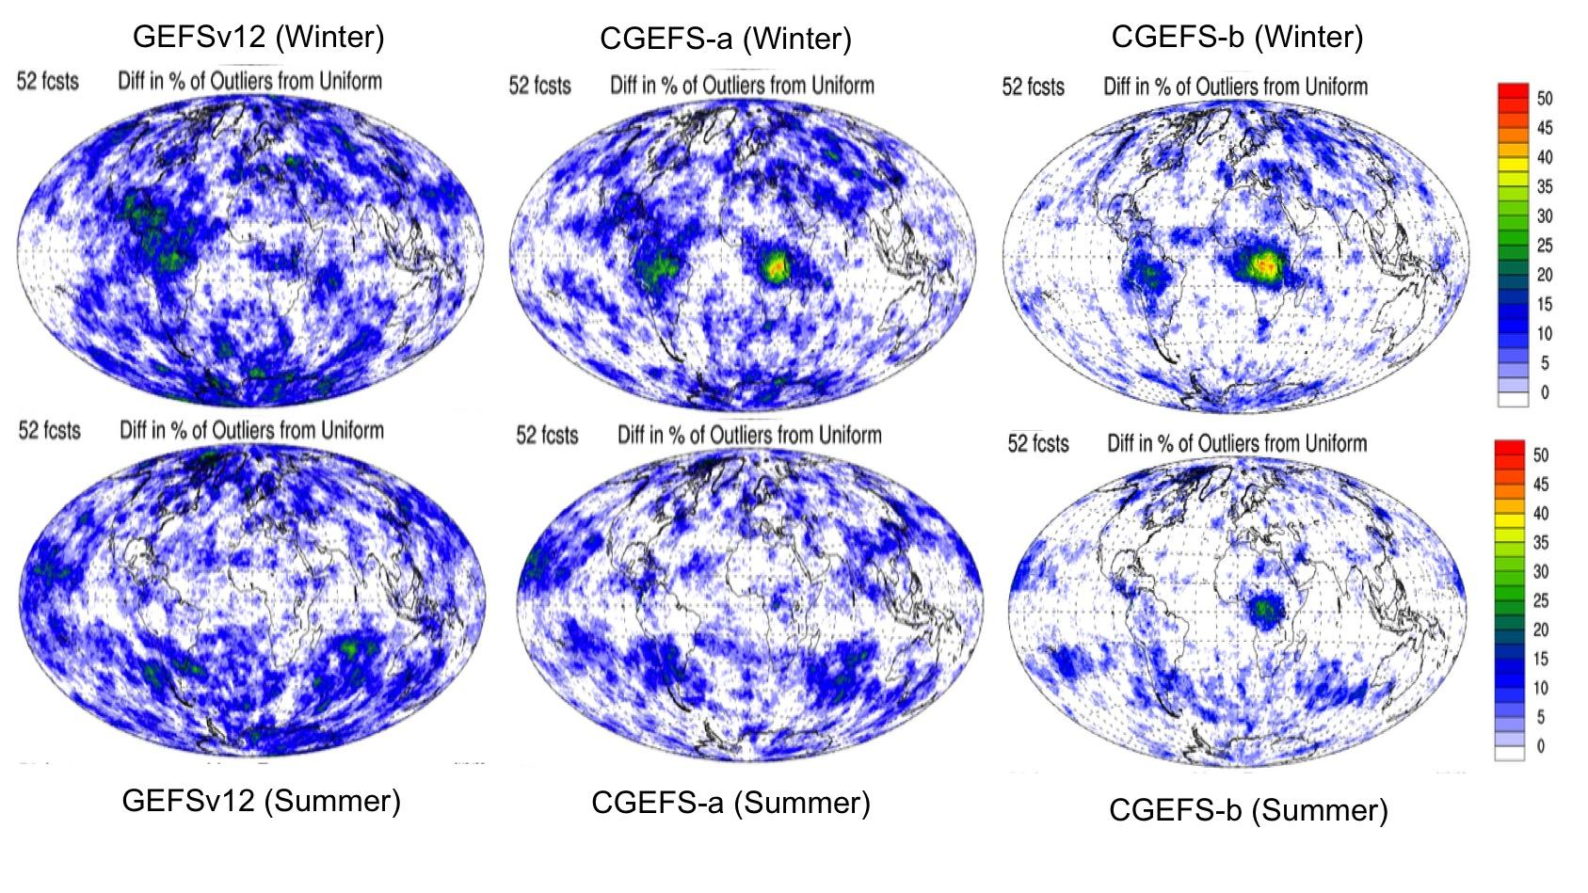
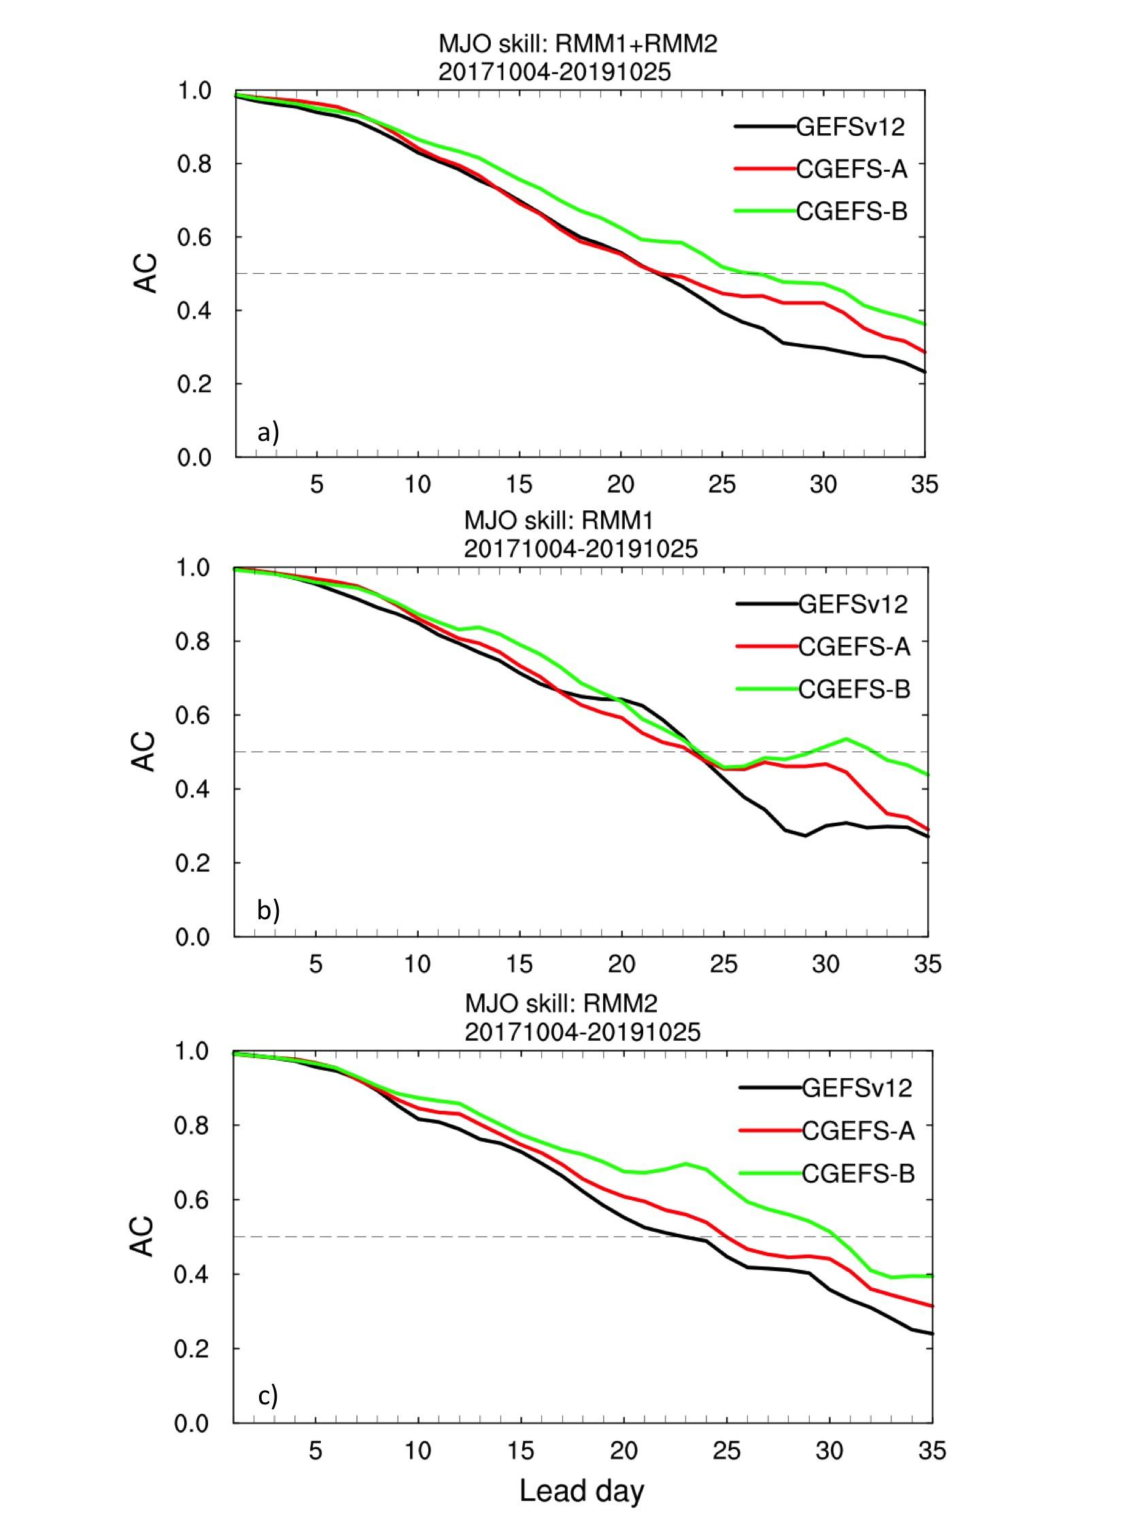
GEFSv13 ensemble prototype performances
27 days
Outliers are reduced for winter time
Figure 3. Distribution of the ratio of 500 hPa height 120h forecast outliers from uniform (in percentage) in GEFSv12 (left), CGEFS-a (middle) and CGEFS-b (right) for summer (bottom) and winter (top).
Figure 11. The MJO index for the GEFSv12 (black), CGEFS-a (red) and CGEFS-b (green).The MJO forecast skill is defined as the bi-variate anomaly correlation between the analysis and forecast real-time multivariate MJO index 1 and 2
Bing Fu et al. 2023: Weather to subseasonal prediction from the UFS coupled Global Ensemble Forecast System

Slide 16
Summary
GEFSv12 implementation
1st UFS one-way coupled (wave and aerosol) system for operation since Sep. 23 2020
31 years reforecast to support GEFS applications
GEFSv13 configurations
GEFSv13: Atmosphere (C384L127), Ocean (0.25ºL75), Sea Ice (0.25º), wave and aerosol fully coupled model.
Expectations from GEFSv13
Benefits of fully coupled GEFS (Global Ensemble Forecast System)
Improved probabilistic weather forecast and MJO predictions
New ocean and sea ice products
30 years replay-reforecasts
Timelines for GEFSv13 implementation
Q2FY24 - Frozen GEFSv13 and start GEFSv13 reforecast
Q1FY26 - GEFSv13 implementation

Slide 17
References for GEFSv13 development:
Zhu, Y., B. Fu, B. Yang, H. Guan, E. Sinsky, W. Li, J. Peng, X. Xue, D. Hou, X.-Z. Liang and S. Shin, 2023: Quantify the Coupled GEFS Forecast Uncertainty for the Weather and Subseasonal Prediction. JGR Atmosphere, 128 1-19, https://doi.org/10.1029/2022JD037757
Fu, Bing, Y. Zhu, H. Guan, E. Sinsky, B. Yang, X. Xue, P. Pegion and F. Yang, 2023: Weather to subseasonal prediction from the UFS coupled Global Ensemble Forecast System, Weather and Forecasting (in review process)
Zhu, Y., B. Fu, H. Guan, E. Sinsky, B. Yang, 2023: The Development of UFS Coupled GEFS for Subseasonal and Seasonal Forecasts. STI Climate Bulletin, page 1-10 (published in June 2023)
Zhu, Y., B. Fu, B. Yang, H. Guan, E. Sinsky, W. Li, J. Peng, X. Xue, D. Hou, P. Pegion, X-Z Liang and S. Shin, 2022: The Development of UFS Coupled GEFS for Weather and Subseasonal Forecasts, NOAA S2S webinar seminar presentation, 8/8/2022

Slide 18
Thanks for your attention!!!
Questions?

