Slide 1
Simultaneous Multiscale Data Assimilation with scale dependent localization (SDL) for HAFS 4DEnVar
Xu Lu and Xuguang Wang
Multiscale data Assimilation and Predictability (MAP)
Lab
University of Oklahoma, Norman, OK, USA

Slide 2
Cycled, self consistent EnVar DA for HAFS
Next cycle
grid_ens
chgres_ic_ens
chgres_ic_ens
GSI Ens Hx
product_ens
chgres_bc_ens
chgres_bc_ens
Ens VR
EnKF
forecast_ens
post_ens
HAFS Ens
From GDAS
HAFS Ens Relocated
HAFS EnKF Analyses
HAFS Ens forecasts
HAFS Ens Post
GSI-ACV
Recenter
Dual-Reso
OU MAP Implemented
HAFS control from GFS
HAFS control Relocated
HAFS control Analysis
HAFS control forecast
HAFS control Post
grid
VR
(GSI VR)
3DEnVar
forecast
post
chgres_ic
chgres_ic
4DEnVar
4DEnVar implemented in HAFSv1 scheduled to be operational this year!
chgres_bc
chgres_bc
FGAT VR
FGAT
Hi-Reso
Next cycle

Slide 3
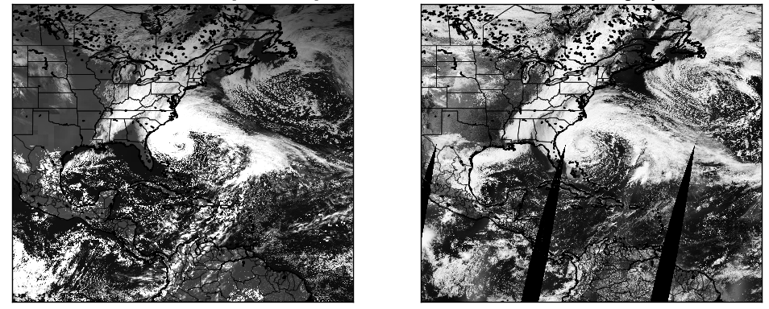
Why Multiscale DA?
New computing resources and technologies allow
Next generation NWP models to resolve a wide range of scales for individual earth system component
Coupled earth system modeling
ingesting a myriad of existing and new observations that sample a variety of scales to the NWP models
The next generation data assimilation system is required to effectively analyze the state and quantify its uncertainty across multiple scales, termed as “multiscale data assimilation (MDA)” (Wang et al. 2021).
FV3 convection permitting forecast of GOES visible imagery during Hurricane Sandy 2012
FV3 model
MODIS visible imagery
Source: https://www.gfdl.noaa.gov/fv3/fv3-applications/fv3-full-physics-cloud-permitting-simulation/

Slide 4
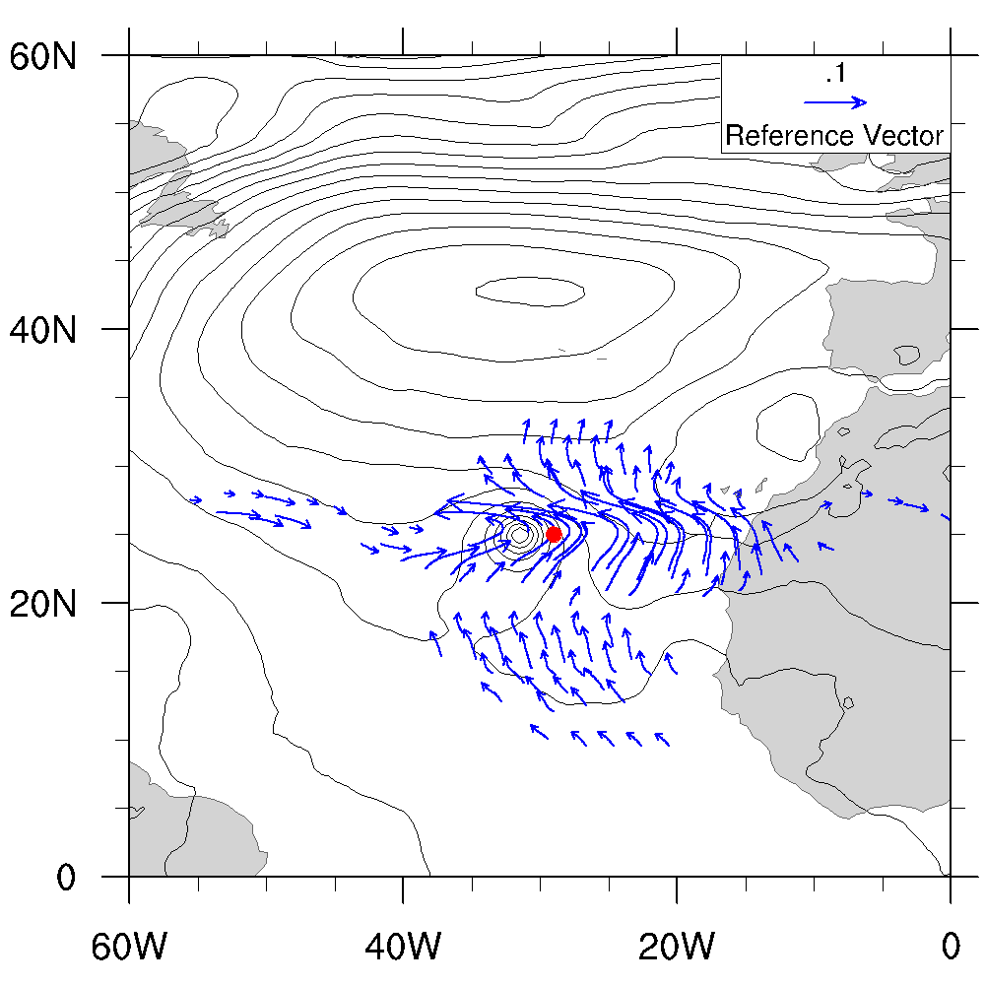
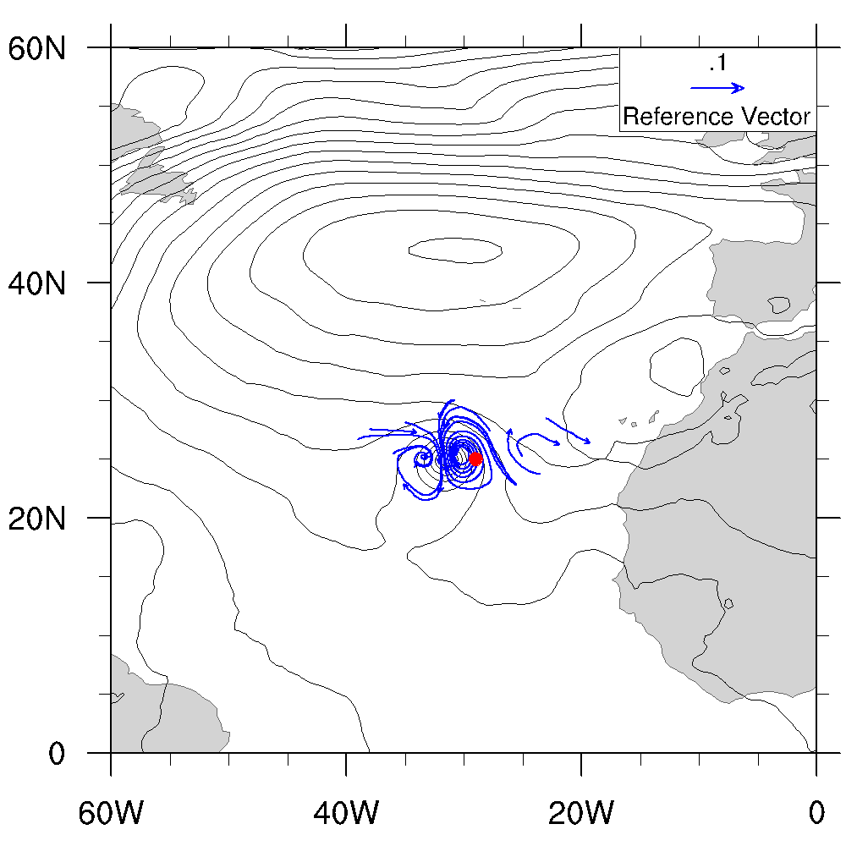
Simultaneous Multiscale DA in 4DEnVar
A simultaneous multiscale DA approach, as opposed to a sequential approach, allows all observations to correct all resolved scales at once (e.g. Wang et al. 2021).
Increment for scales >4000km
Increment for scales < 4000km
A single obs. can correct multiple scales in simultaneous MDA
Simultaneous multiscale DA also defines cross scale band error correlation
Scale dependent localization (SDL) is implemented in EnVar to realize simultaneous MDA
SDL has been implemented and tested for FV3GFS 4DEnVar and show improvement on global and hurricane forecasts (Huang* et al. 2021)
Huang*, Wang et al. 2021
* Denote OU MAP student/early career scientist

Slide 5
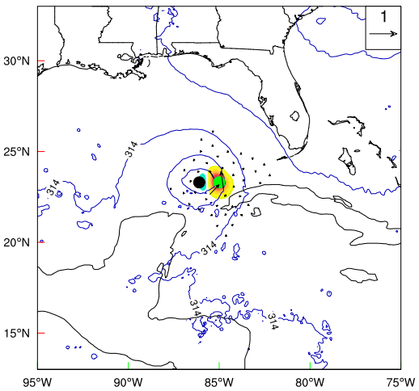
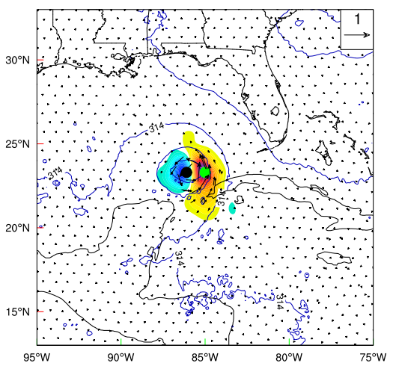
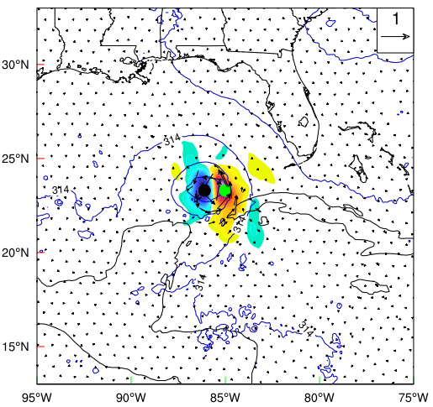
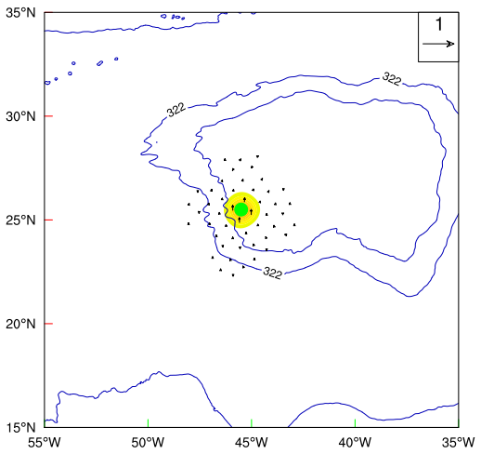
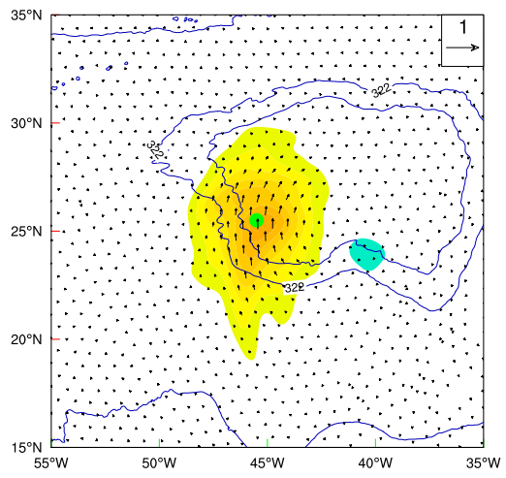
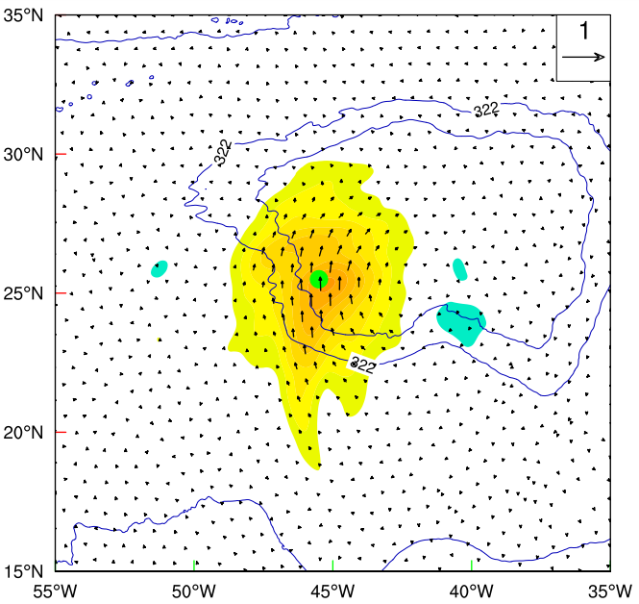
Development of Simultaneous MDA in HAFS 4DEnVar
~180-km SSL
SDL
~1600-km SSL
The simultaneous MDA with SDL is recently further extended and implemented for HAFS EnVar
Two-observation experiments show MDA with SDL can simultaneously properly correct both the TC and its large-scale steering environment (subtropical high)
Near Storm V Inc
Environmental Subtropical High western edge V Inc

Slide 6
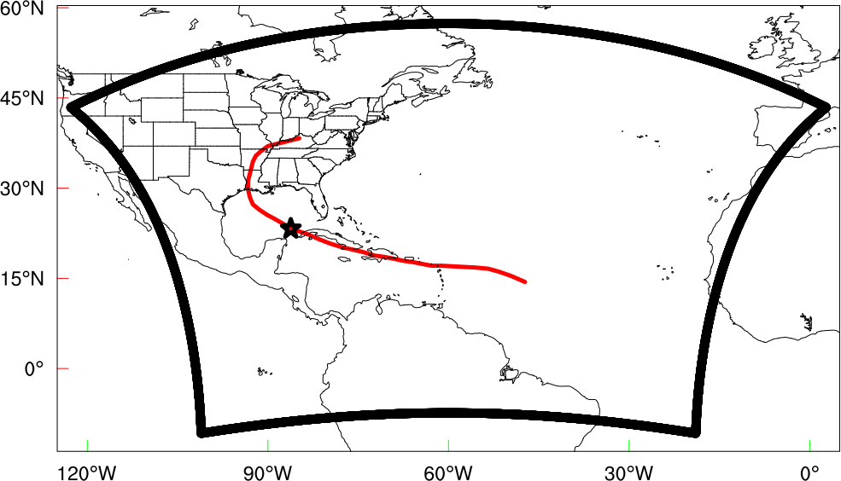
Experiment Design
Exp Names | 4DS | 4DL | 4DSDL
Localization Scale (e-folding scale) | SSL (~180 Km) | SSL (~1600 Km) | SDL (~180, 1600 Km)
Domain Size | 2160 X 2880 horizontal grid points (~65 X 85°)
Assimilated observations | conventional observations (contained in prepbufr file) with some satellite AMVs; NOAA P3 aircraft Tail Doppler Radar; satellite radiance observations; HS3 Global Hawk dropsonde and TCVital mean sea-level pressure (MSLP) data; High-resolution flight-level data; Hourly shortwave, clear air-water vapor, and visible Atmospheric Motion Vectors (AMVs) from GOES
Ocean Coupling | HYCOM
Ensemble | 80-member GFS ensemble
Physics Schemes | GFDL microphysics; RRTMG radiation; Scale-aware SAS convection; Noah LSM; GFS surface layer with HWRF exchange coefficients; Modified GFSv16 scale-aware TKE-EDMF PBL scheme; orographic GWD

Slide 7
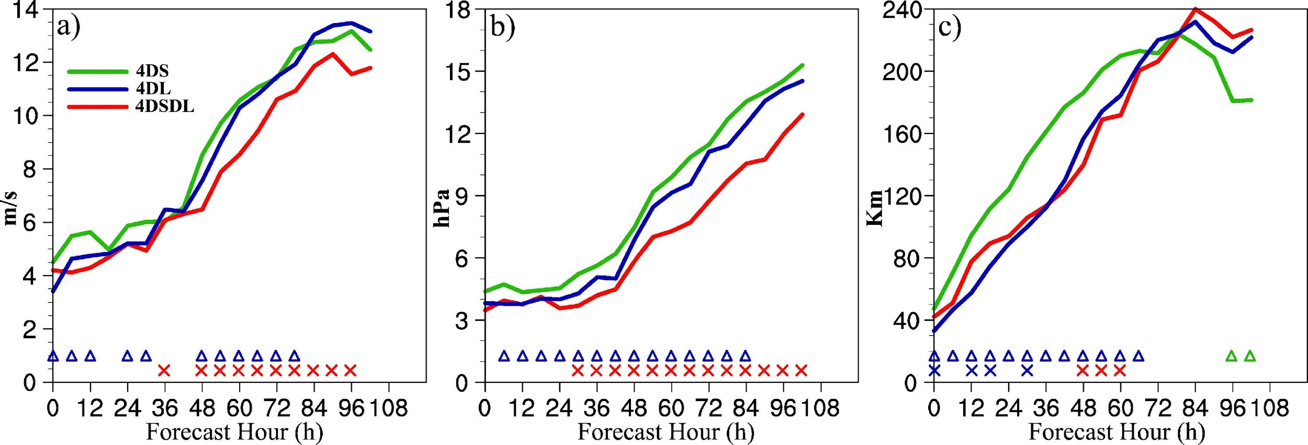
Impact of simultaneous MDA
Mean Absolute Forecast Errors during Hurricane Laura (2020)
a) Vmax
b) MSLP
c) Track
Localization Impacts on Forecasts
4DL outperforms 4DS for almost all aspects
4DSDL outperforms 4DL and 4DS in intensity predictions
4DSDL outperforms 4DS in track prediction and has mixed results compared to 4DL

Slide 8
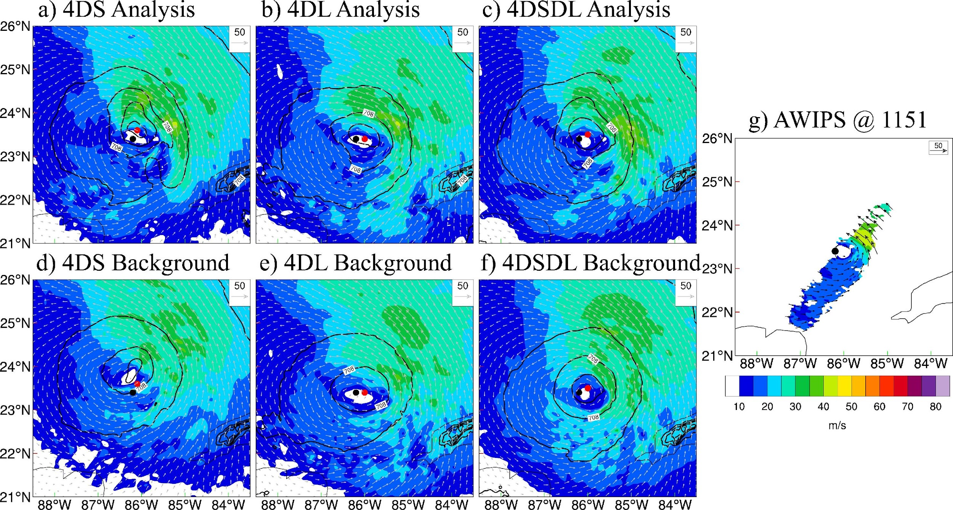
Impact of localization MDA
Single small scale localization issue
When inner-core observations are unavailable during the early cycles, small localization in 4DS are unable to leverage nearby observations for correction. The accumulated background has larger location error and therefore leads to worse analysis.
Such issue is alleviated by 4DL & 4DSDL, which result in better analyses and forecasts during the cycling.
Best Track
Analysis

Slide 9
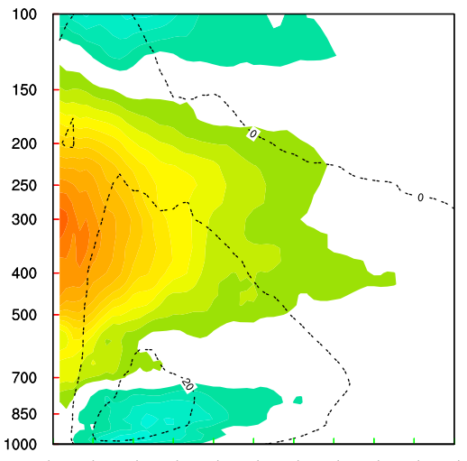
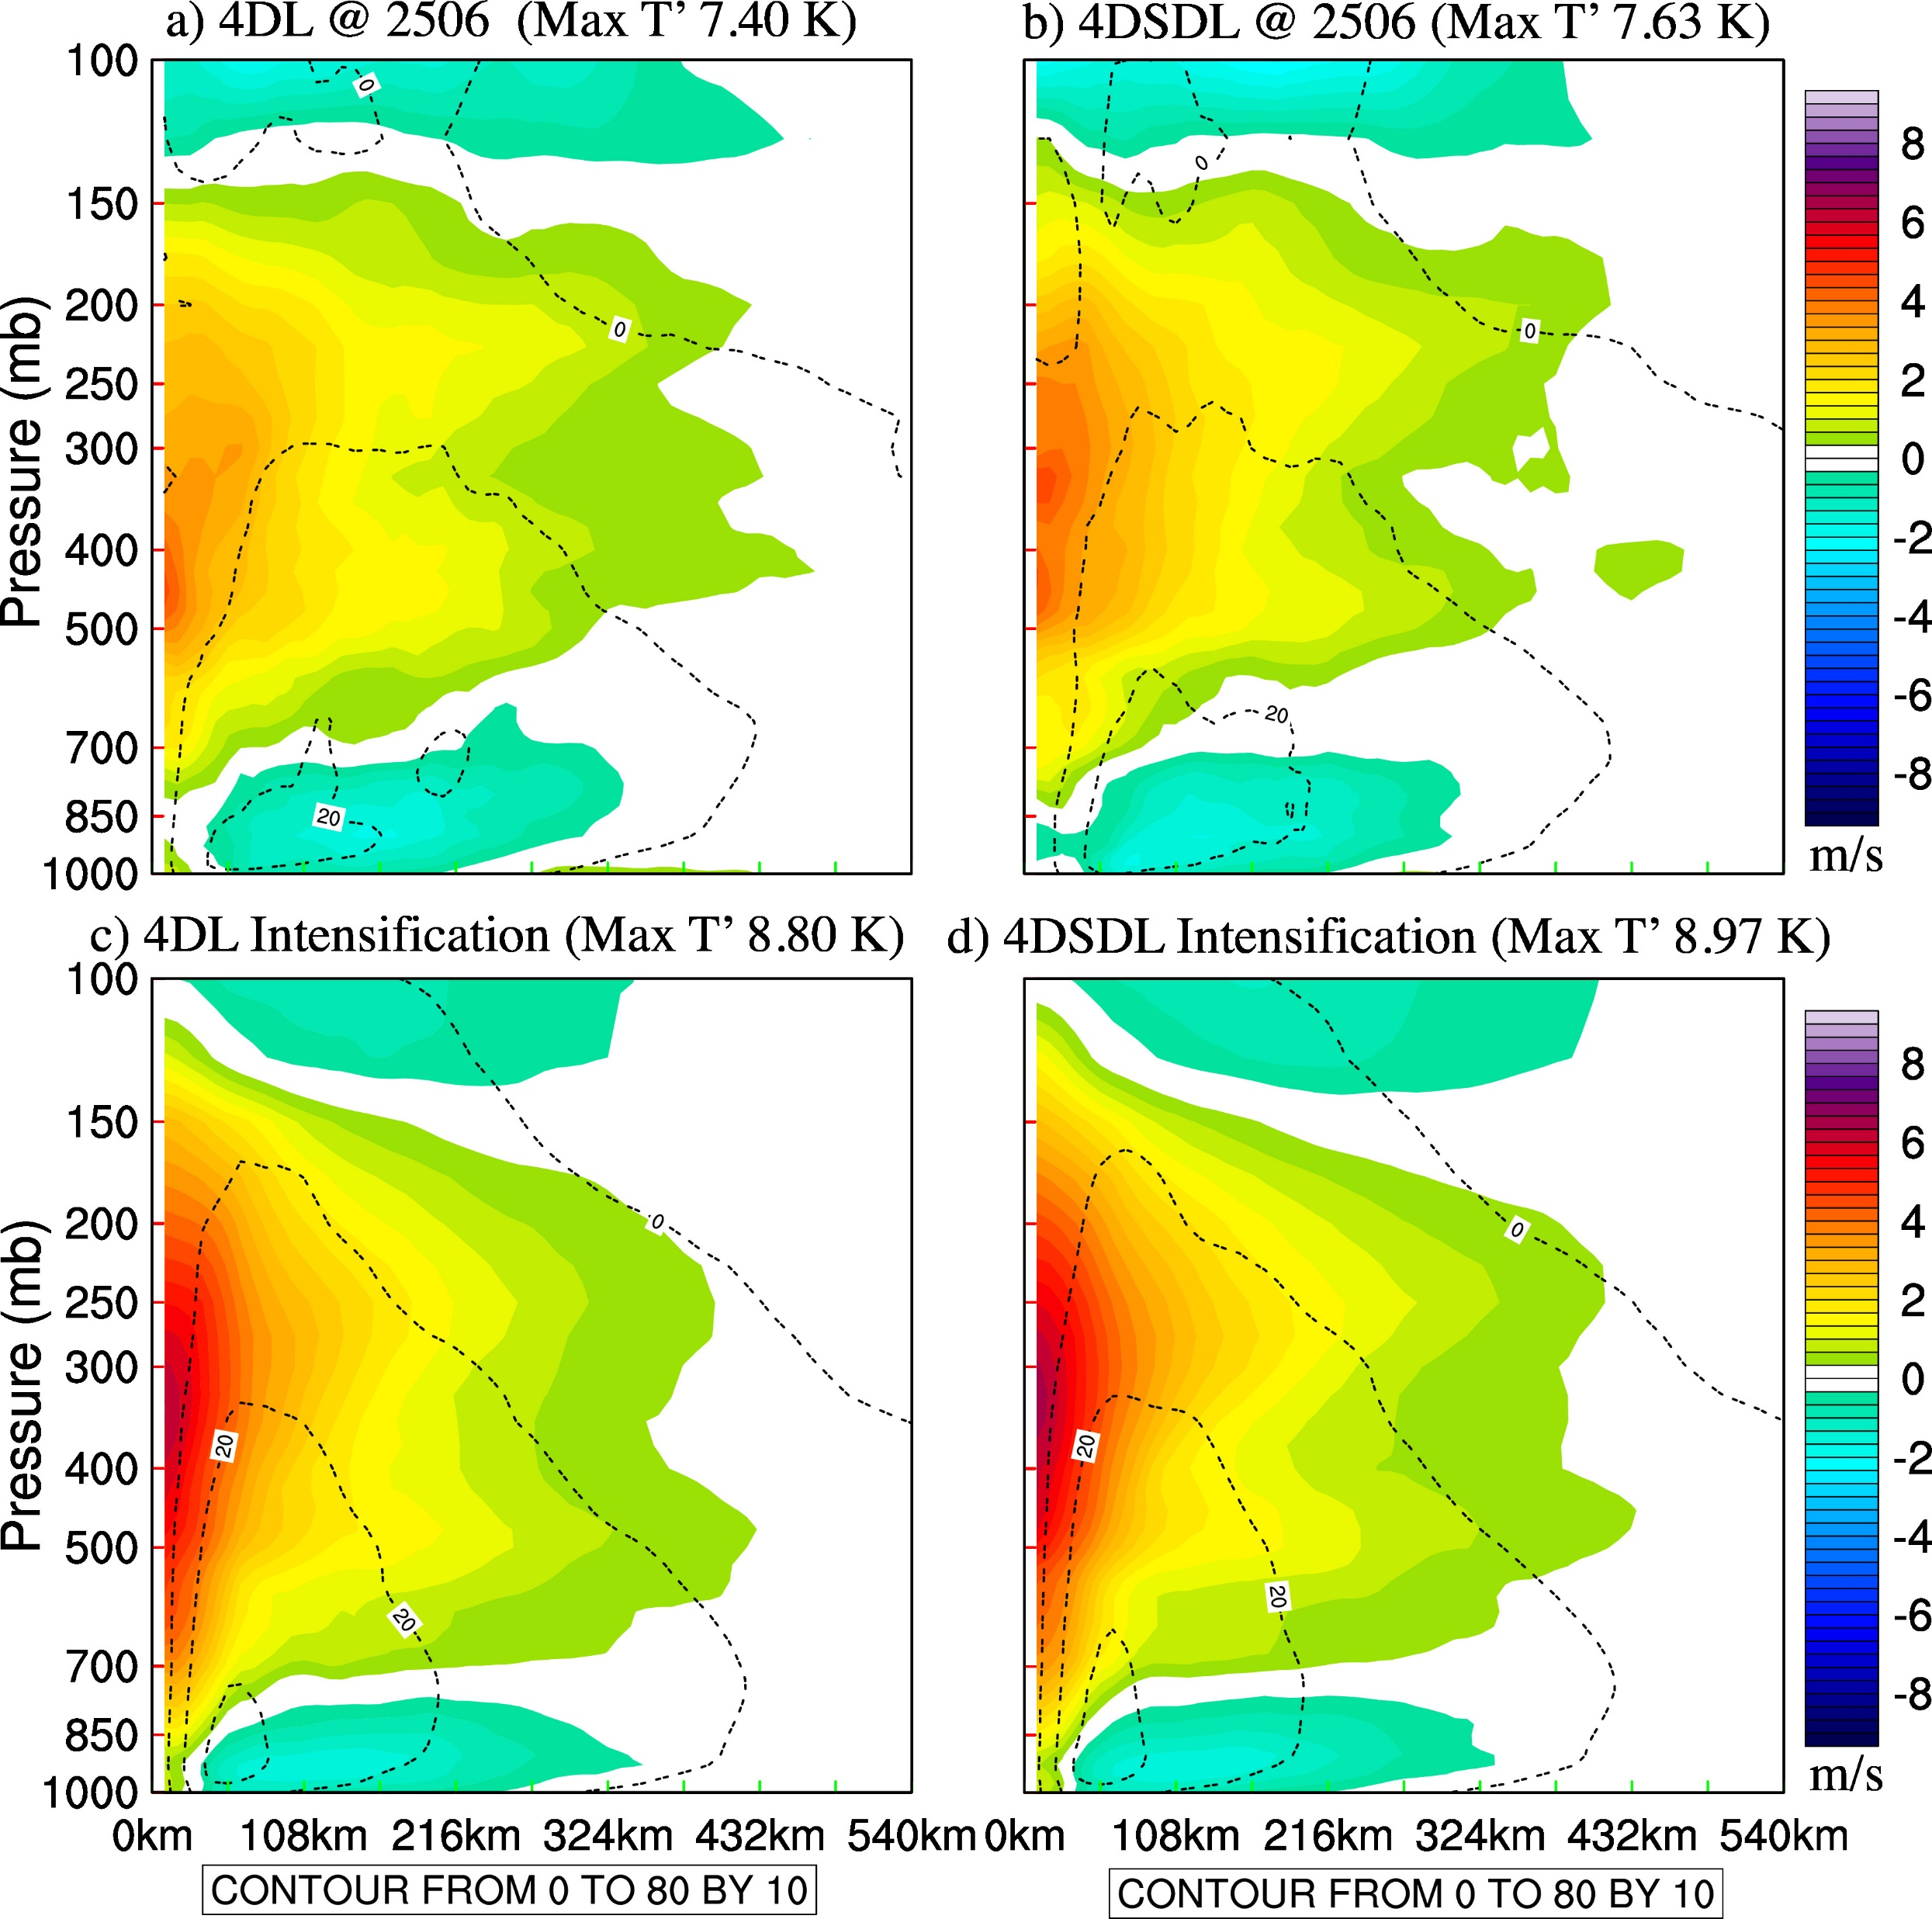
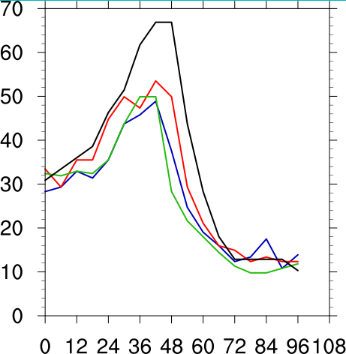
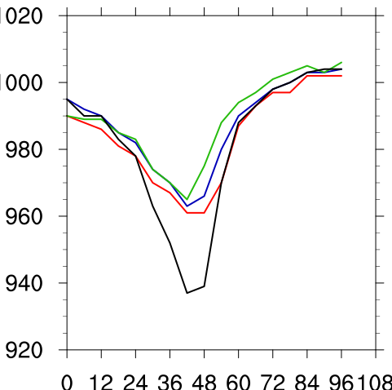
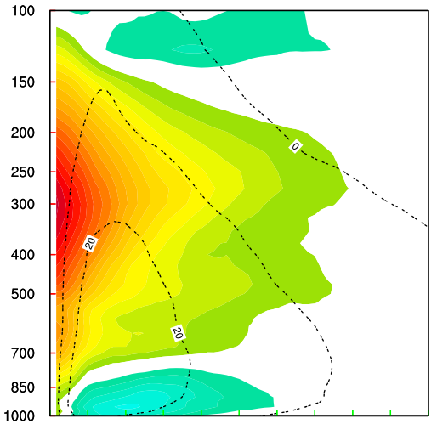
Why MDA improves intensity predictions?
Azimuthal mean temperature anomaly comparison at 2020082506 UTC
Max T’ 7.2 K
Max T’ 7.4 K
Max T’ 7.63 K
4DS
4DL
4DSDL
Vmax
MSLP
2506
2506
Max T’ 8.3 K
Max T’ 8.8 K
Max T’ 8.97 K
̶ ̶ 4DS
̶ ̶ 4DL
̶ ̶ 4DSDL
MDA improves the intensification predication due to a stronger warm-core analysis.
Intensification Period

Slide 10
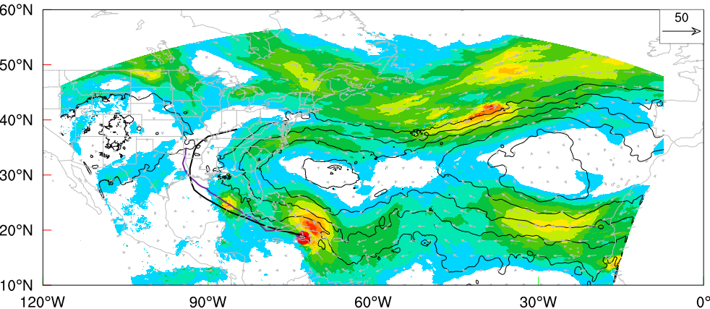
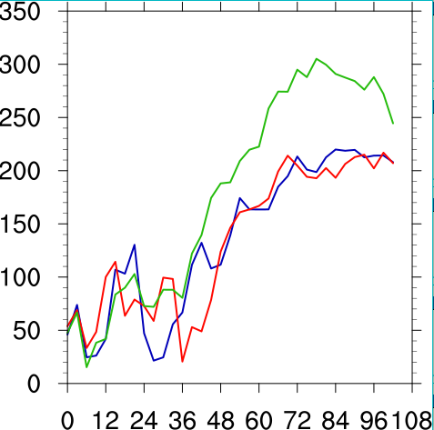
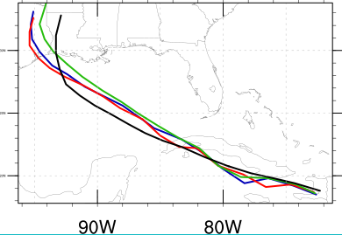
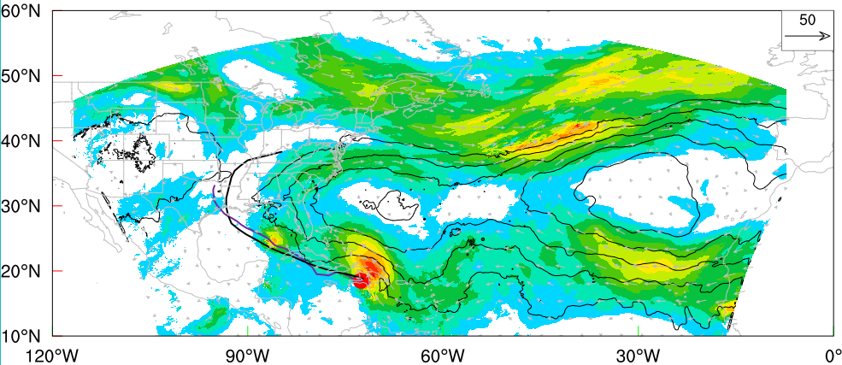
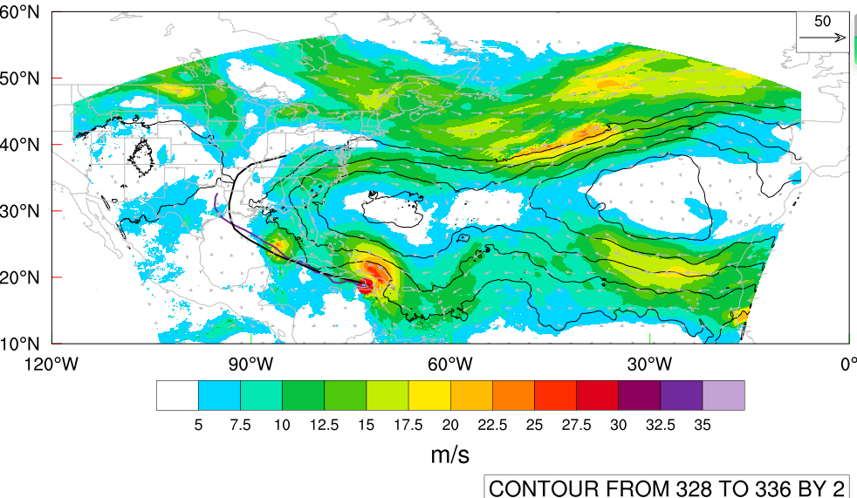
Why MDA improves track predictions?
Steering flow analysis comparison at 2020082100 UTC
4DS
Track Error
Track
4DL
2312
̶ ̶ 4DS
̶ ̶ 4DL
̶ ̶ 4DSDL
̶ ̶ Best
4DSDL
MDA improves track predications due to better environmental analysis (e.g. the extent of the southwest edge of the Atlantic Subtropical High)

Slide 11
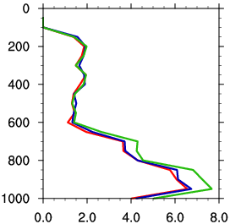
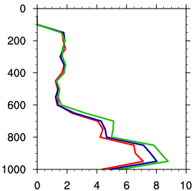
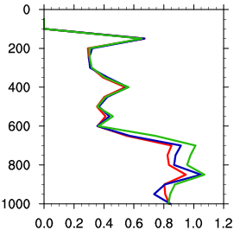
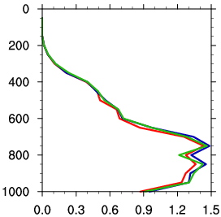
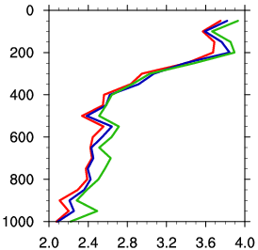
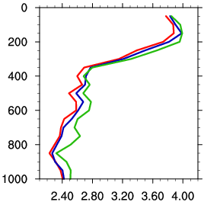
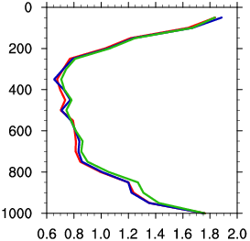
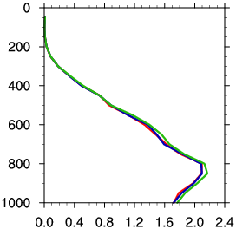
Impact of Simultaneous Multiscale DA
Background Verification against Dropsonde & Rawinsonde
Dropsonde
(Inner-core)
̶ ̶ 4DS
̶ ̶ 4DL
̶ ̶ 4DSDL
U
V
T
Q
Rawinsonde
(Environment)
MDA produces better background than SSL in both vortex scale and TC environment.

Slide 12
Summary
SSL using large localization outperforms SSL using small localization in almost all aspects;
MDA using SDL outperforms SSL using small localization for both intensity and track forecasts and outperforms SSL using large localization for intensity prediction;
Diagnostics suggest
MDA using SDL produces better inner-core warm-core analyses that improves the intensity predictions during the intensification period than both SSL
MDA using SDL produces better synoptic scale analyses that improves the track predictions during the early period than small-scale SSL
MDA using SDL produces both better forecast structures when compared to observations at almost all levels as compared both SSL

Slide 13
References
Lu, X.*, X. Wang*, M. Tong, and V. Tallapragada, 2017a: GSI-based, Continuously Cycled, Dual-Resolution Hybrid Ensemble-Variational Data Assimilation System for HWRF: System Description and Experiments with. Mon. Wea. Rev., 145, 4877–4898.
——, ——, Y. Li, M. Tong, and X. Ma, 2017b: GSI-based ensemble-variational hybrid data assimilation for HWRF for hurricane initialization and prediction: Impact of various error covariances for airborne radar observation assimilation. Quart. J. Roy. Meteor. Soc., 143, 223–239.
——, ——, 2020:Improving Hurricane Analyses and Predictions with IFEX, TCI Field Campaign Observations, and CIMSS AMVs Using the Advanced Hybrid Data Assimilation System for HWRF. Part II: Observation Impacts on the Analysis and Prediction of Patricia (2015). Mon. Wea. Rev., 148, 1407–1430.
——, ——, 2023: Simultaneous Multiscale 4DEnVar with scale-dependent localization (SDL) in HAFS to improve hurricane predictions. Mon. Wea. Rev., to be submitted.
Huang, B.*, Wang, X.*, Kleist, D. T., and Lei, T. (2021). A Simultaneous Multiscale Data Assimilation Using Scale-Dependent Localization in GSI-Based Hybrid 4DEnVar for NCEP FV3-Based GFS, Mon. Wea. Rev., 149(2), 479-501.
Wang, X.*, H. G. Chipilski*, C. H. Bishop, E. Satterfield, N. Baker, and J. S. Whitaker (2021). A Multiscale Local Gain Form Ensemble Transform Kalman Filter (MLGETKF), Mon. Wea. Rev., 149(3), 605-622.
Wang, Y.*, and X. Wang*, 2023. Simultaneous Multiscale Data Assimilation Using Scale‐and Variable‐Dependent Localization in EnVar for Convection Allowing Analyses and Forecasts: Methodology and Experiments for a Tornadic Supercell. Journal of Advances in Modeling Earth Systems, 15(5), p.e2022MS003430.
*MAP authors

