Slide 1
The Operational Use and Local Development of
UFS MRW-GSI System at Central Weather Bureau of Taiwan
Guo-Yuan Lien¹, Ling-Feng Hsiao¹, Chang-Hung Lin¹, Feng-Ju Wang¹, Yu-Han Chen¹,
Jen-Her Chen¹, Jing-Shan Hong¹, Daryl Kleist², Fanglin Yang², Vijay Tallapragada²
¹ Central Weather Bureau (CWB), Taipei, Taiwan
² Environmental Modeling Center, National Centers for Environmental Prediction, College Park, Maryland, USA

Slide 2
CWB Global NWP system
CWBGFS
TGFS v1
2002
T119L30
2003
SSI 3DVar
2004
T179L30
2007
T239L30
2010
GSI 3DVar
2011
T319L40
(~40 km)
2014
GSI hybrid
3DEnVar
2016
T511L60
(~25 km)
2020
TCo639L72
(~18 km)
2023
FV3 C384L64
(~25 km)
GSI hybrid
4DEnVar
In collaboration with NCEP/EMC since 2016,
CWB has adapted the NCEP GFS v15 as its new operational global NWP system
2019: Port GFS v15 (FV3GFS) model code
2020: Port GSI code (for GFS v15) and the complete data assimilation workflow
2021: Start semi-operational (near-real-time) run / research & performance tuning
2022: Research & performance tuning / Port to CWB’s 6th-generation HPC (Fujitsu FX1000; ARMv8.2-A)
2023: Research & performance tuning / Operation → Taiwan Global Forecast System (TGFS) v1
Continuous research & performance tuning

Slide 3
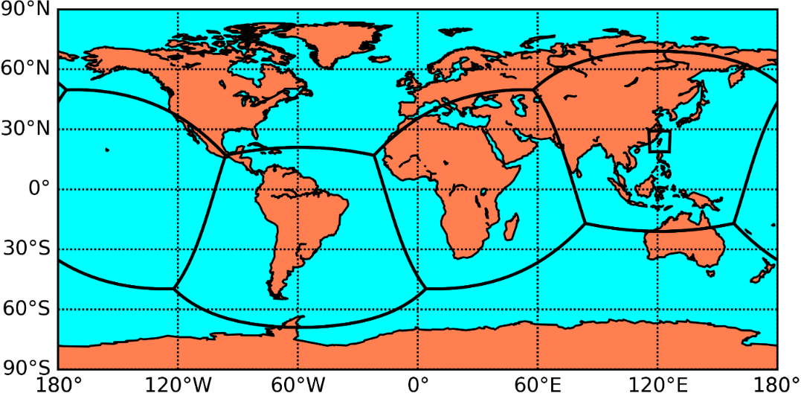
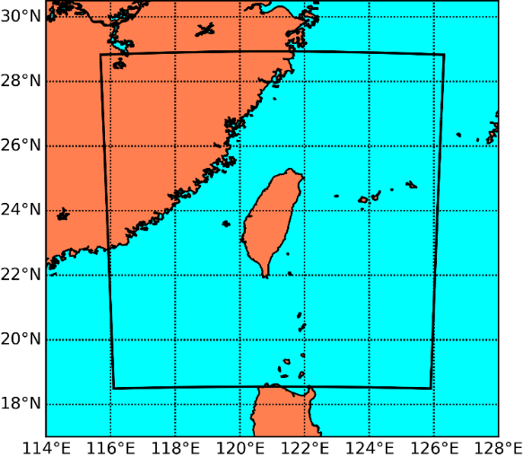
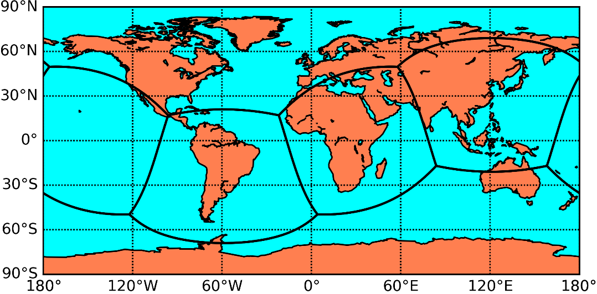
CWB TGFS v1 grid configuration
C384T (~ 25 KM)
(216 x 240)
cf. NCEP:
C768 (~13 km)
for deterministic
C384 (~25 km)
for ensemble
    Deterministic system hybrid 4DEnVar
    using time-lagged ensemble
    (global domains)
~ 4.8 KM
~ 25 KM
C192T (~ 50 KM)
    Forecast only
    Ensemble system
    EnKF
    (32 members)

Slide 4
NCEP GFS v15 vs. CWB TGFS v1
CWB TGFS v1 is largely based on NCEP GFS v15.1, with the following main differences:
 | NCEP GFS v15.1 | CWB TGFS v1
Global grid setting | Det: C768L64 (13km) / Ens: C384L64 (25km) (zonal tile arrangement) | Det: C384L64 (25km) / Ens: C192L64 (50km) (Taiwan-centric tile arrangement)
Nested tile | N/A | Taiwan-nested tile (4.8 km; forecast-only; initialized from global DA analysis)
Ensemble size | 80 | 32 + 32 (12-h time-lagged forecast)
Cumulus scheme | New SAS | Modified New SAS: Lin et al. (2022) [based on Kwon and Hong (2017)]
Cumulus scheme for the nested tile | N/A | New Tiedtke
Surface static data | NCEP fix data | Updated land-use, soil type (from WRF/MODIS), vegetation fraction (from EUMETSAT)
Gravity wave drag scheme |  | Fix a bug associated with air density
Planetary boundary layer scheme | K-EDMF | Fix a bug associated with Prandtl number
Assimilated observations | NCEP observation | NCEP observation – those not publicly available on NOAA NOMADS + CWB-processed conventional data (early run only) + CWB-processed COSMIC-2 RO + CWB-processed Himawari-8 AHI
Hybrid 4DEnVar time bin width | 1 h | 3 h
RO assimilation | Error specified using absolute values | Error specified using fractional values

Slide 5
NCEP GFS v15 vs. CWB TGFS v1
CWB TGFS v1 is largely based on NCEP GFS v15.1, with the following main differences:
 | NCEP GFS v15.1 | CWB TGFS v1
Global grid setting | Det: C768L64 (13km) / Ens: C384L64 (25km) (zonal tile arrangement) | Det: C384L64 (25km) / Ens: C192L64 (50km) (Taiwan-centric tile arrangement)
Nested tile | N/A | Taiwan-nested tile (4.8 km; forecast-only; initialized from global DA analysis)
Ensemble size | 80 | 32 + 32 (12-h time-lagged forecast)
Cumulus scheme | New SAS | Modified New SAS: Lin et al. (2022) [based on Kwon and Hong (2017)]
Cumulus scheme for the nested tile | N/A | New Tiedtke
Surface static data | NCEP fix data | Updated land-use, soil type (from WRF/MODIS), vegetation fraction (from EUMETSAT)
Gravity wave drag scheme |  | Fix a bug associated with air density
Planetary boundary layer scheme | K-EDMF | Fix a bug associated with Prandtl number
Assimilated observations | NCEP observation | NCEP observation – those not publicly available on NOAA NOMADS + CWB-processed conventional data (early run only) + CWB-processed COSMIC-2 RO + CWB-processed Himawari-8 AHI
Hybrid 4DEnVar time bin width | 1 h | 3 h
RO assimilation | Error specified using absolute values | Error specified using fractional values
Main inferiorities to NCEP GFS:
Lower resolution (25 vs. 13 km)
Fewer ensemble members (32(+32) vs. 80)
Fewer observations assimilated

Slide 6
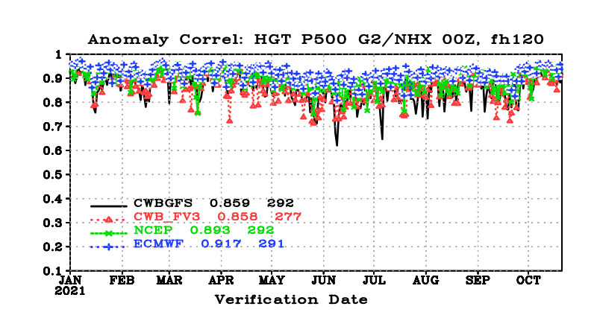
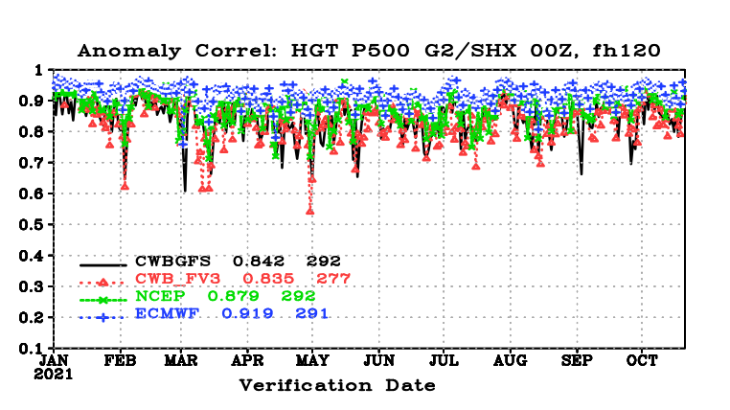
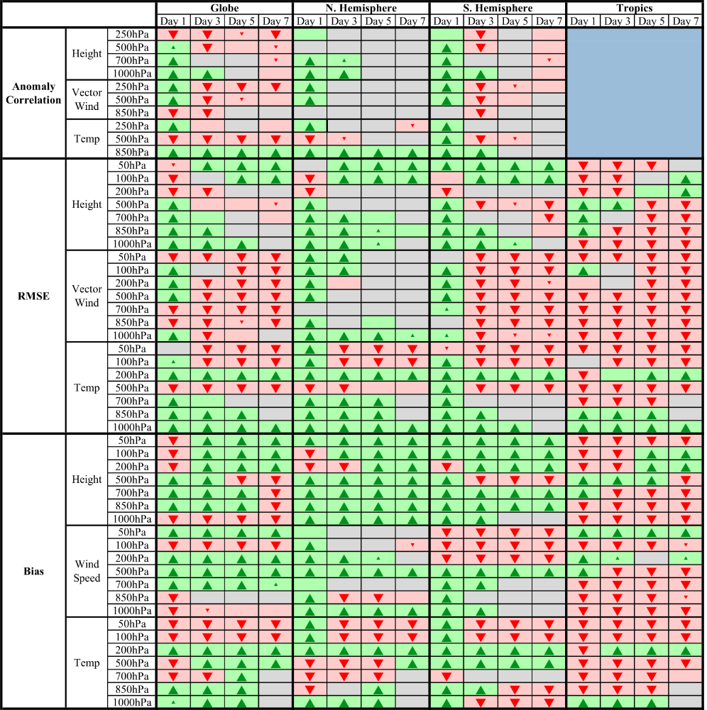
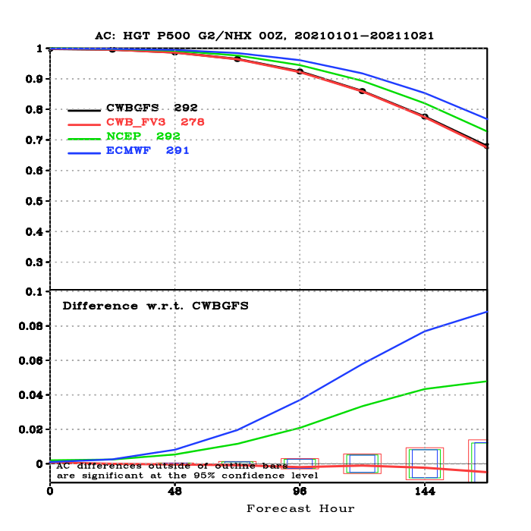
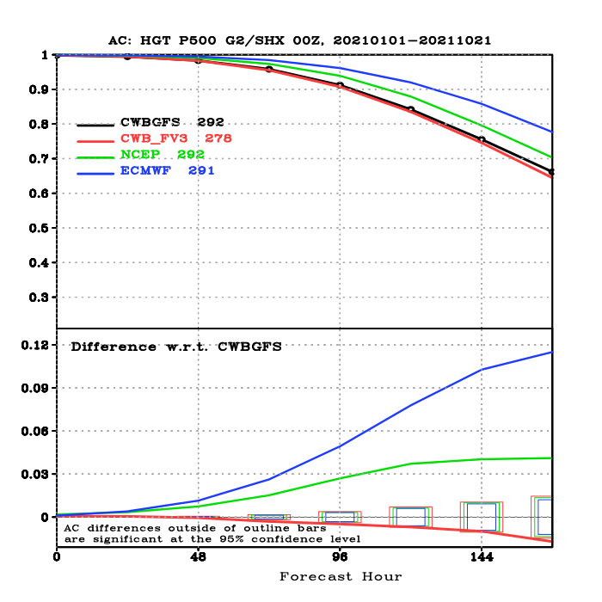
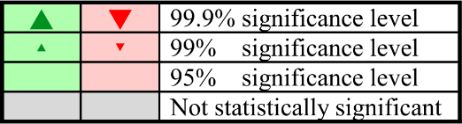
TGFS v1 semi-operational test: 2021
2021/01/01 ~ 2021/10/21
Scorecard – Green/Red :
TGFS is Better/Worse than CWBGFS
500-hPa Height ACC
NH (20-80N)
SH (20-80S)
ꟷꟷꟷꟷ CWBGFS (18 km; DA at 25 km with “EC bogus data”)
ꟷꟷꟷꟷ TGFS (C384; 25 km)
ꟷꟷꟷꟷ NCEP GFS (C768; 13 km)
ꟷꟷꟷꟷ ECMWF IFS (9 km)
Verified against NCEP analysis

Slide 7
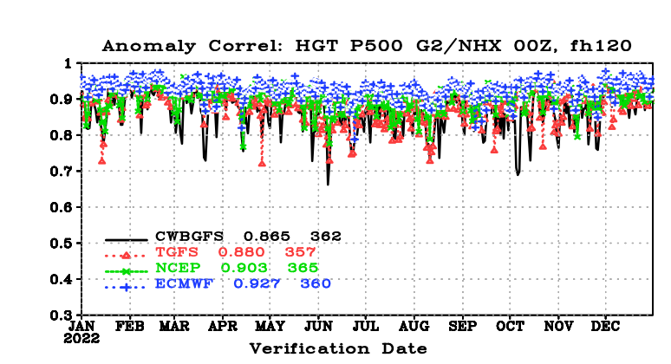
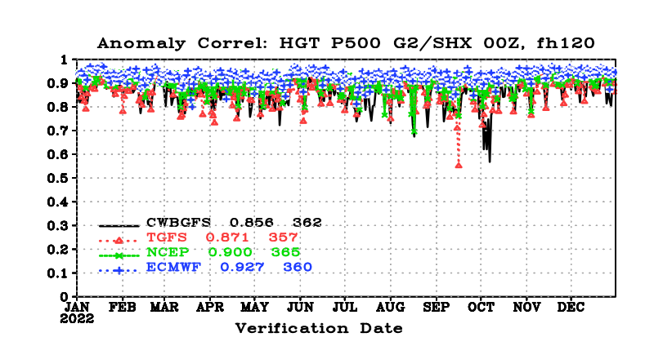
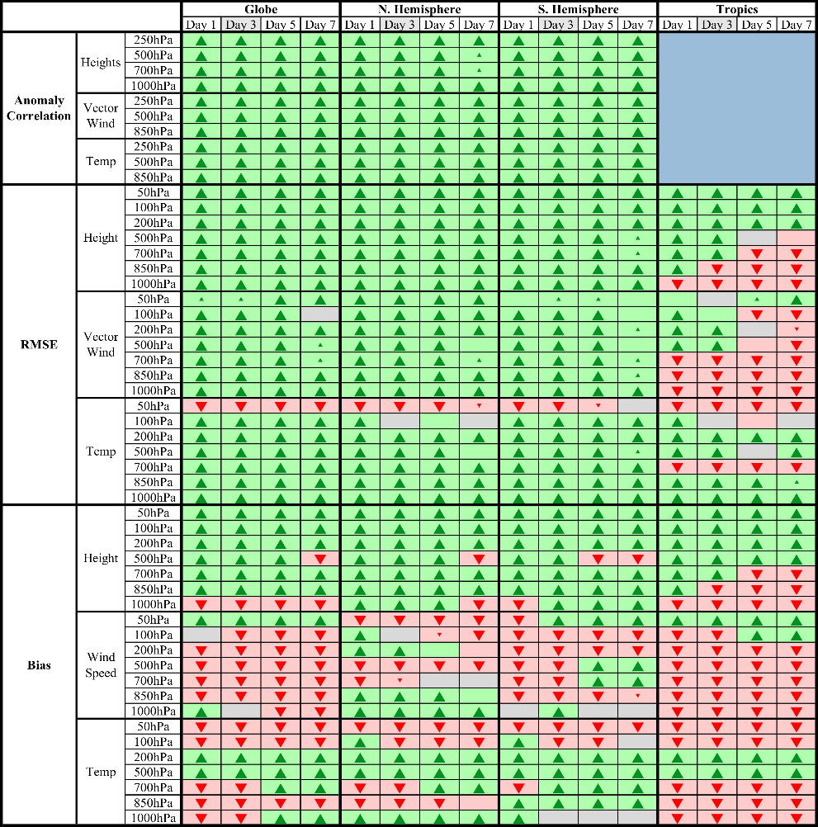
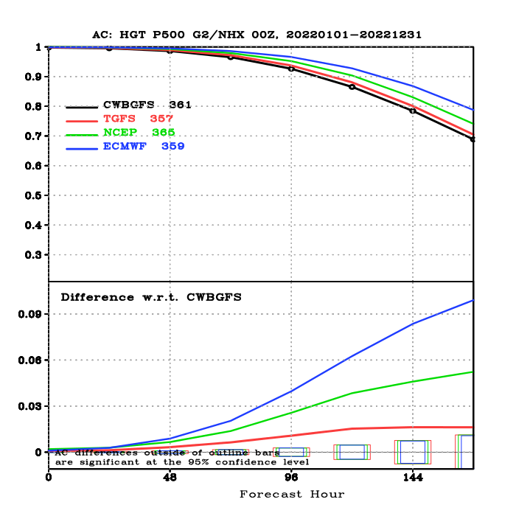
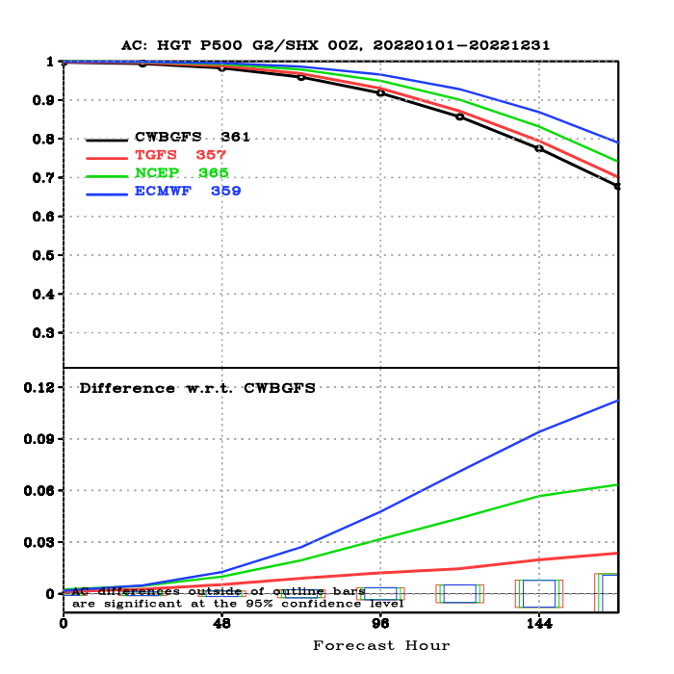
TGFS v1 semi-operational test: 2022
2022/01/01 ~ 2022/12/31
Scorecard – Green/Red :
TGFS is Better/Worse than CWBGFS
500-hPa Height ACC
NH (20-80N)
SH (20-80S)
ꟷꟷꟷꟷ CWBGFS (18 km; DA at 25 km with “EC bogus data”)
ꟷꟷꟷꟷ TGFS (C384; 25 km)
ꟷꟷꟷꟷ NCEP GFS (C768; 13 km)
ꟷꟷꟷꟷ ECMWF IFS (9 km)
Verified against NCEP analysis

Slide 8
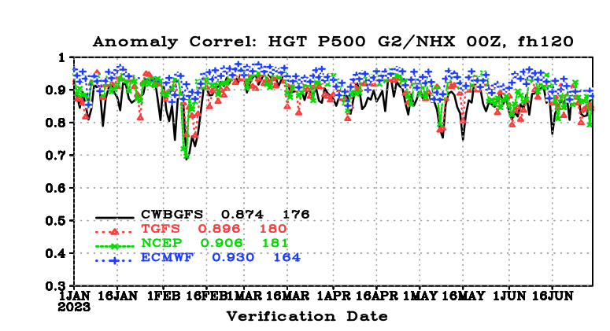
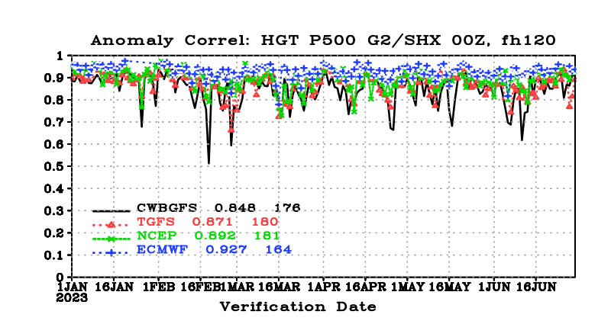
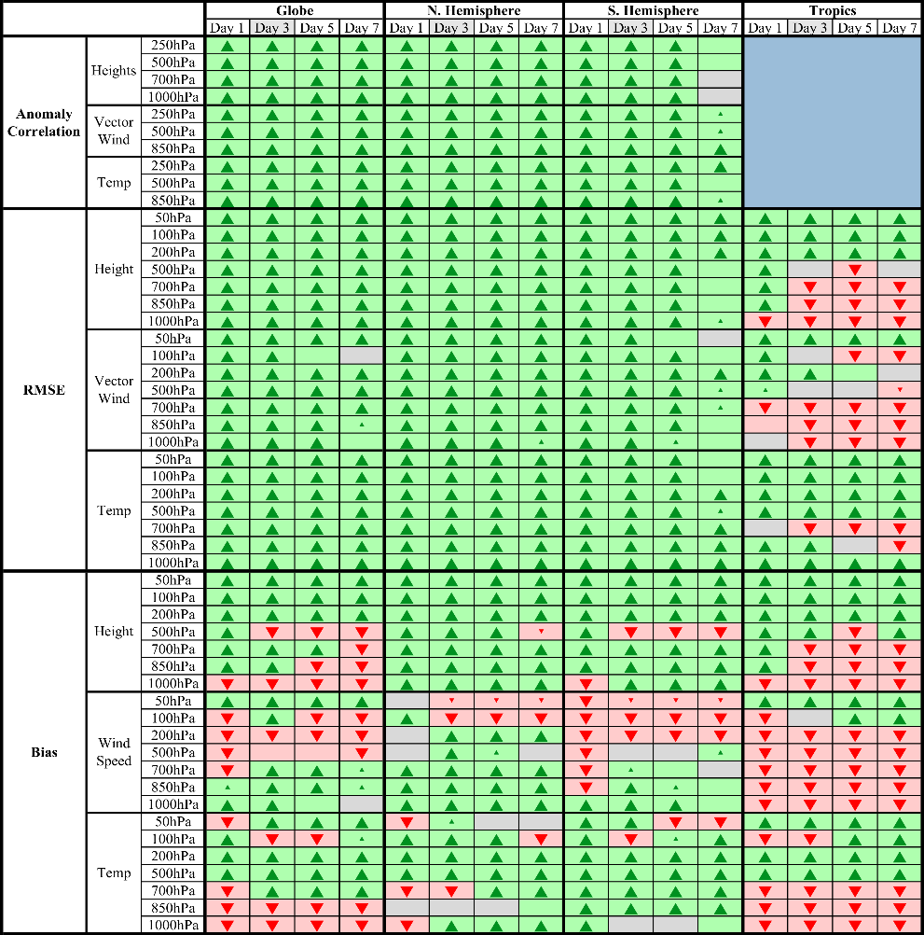
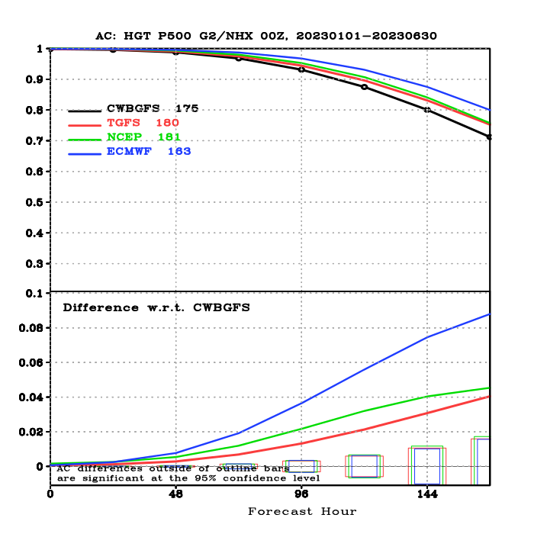
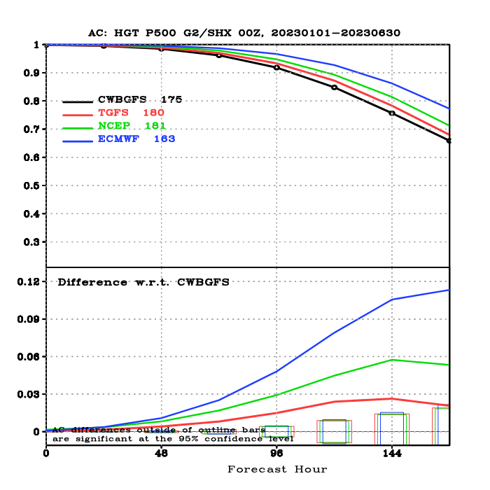
TGFS v1 semi-operational test: 2023H1
2023/01/01 ~ 2023/06/30
Scorecard – Green/Red :
TGFS is Better/Worse than CWBGFS
500-hPa Height ACC
NH (20-80N)
SH (20-80S)
ꟷꟷꟷꟷ CWBGFS (18 km; DA at 25 km with “EC bogus data”)
ꟷꟷꟷꟷ TGFS (C384; 25 km)
ꟷꟷꟷꟷ NCEP GFS (C768; 13 km)
ꟷꟷꟷꟷ ECMWF IFS (9 km)
Verified against NCEP analysis

Slide 9
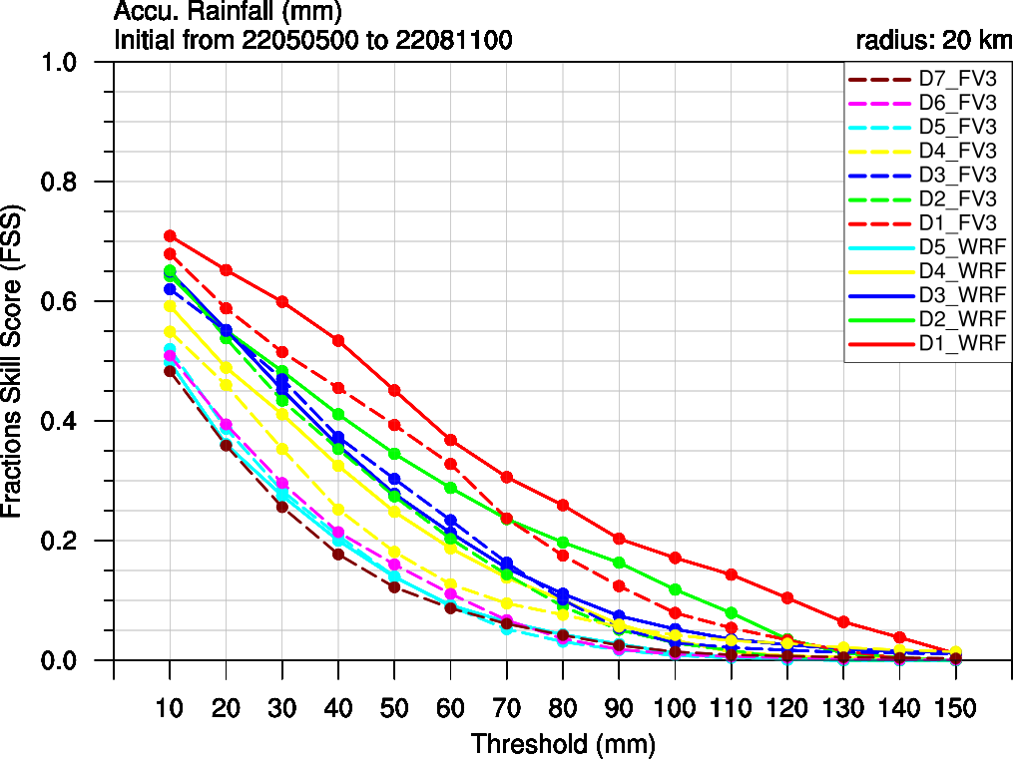
TGFS v1 semi-operational test: Taiwan nested tile
FSS
Solid lines: CWB WRF (3 km)
Dashed lines: TGFS (4.8 km)
Day 1
Day 2
Day 3
Day 5
Day 4
Day 6
Day 7

Slide 10
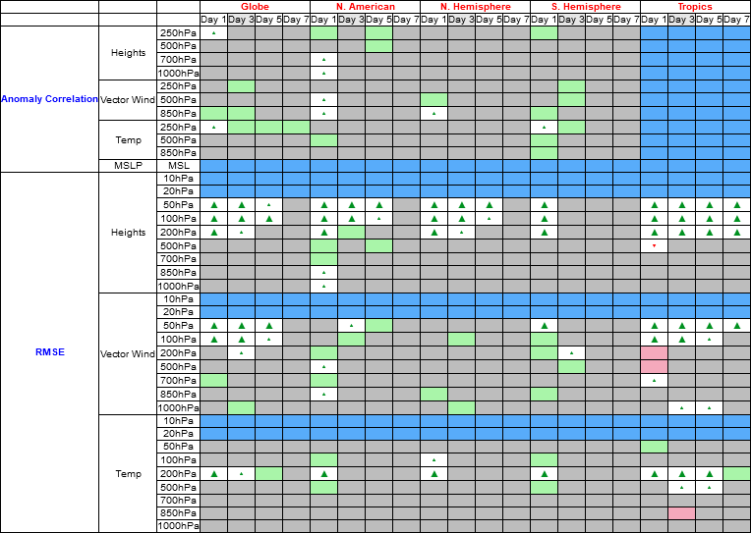
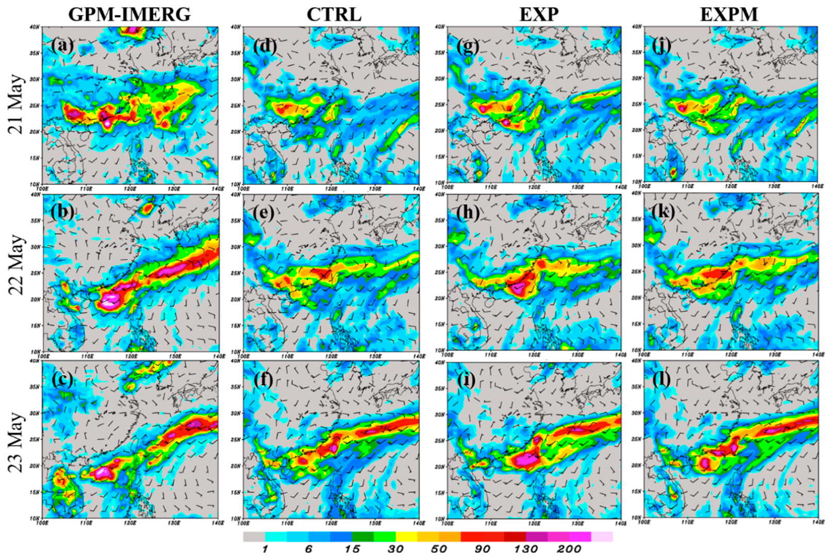
Improvement of NSAS cumulus scheme
[ Lin et al. (2022), based on Kwon and Hong (2017) ]
Scorecard – Green/Red :
EXP is better/worse than CTRL
Verification data: ERA5
Time period: 20210904~20211009

Slide 11
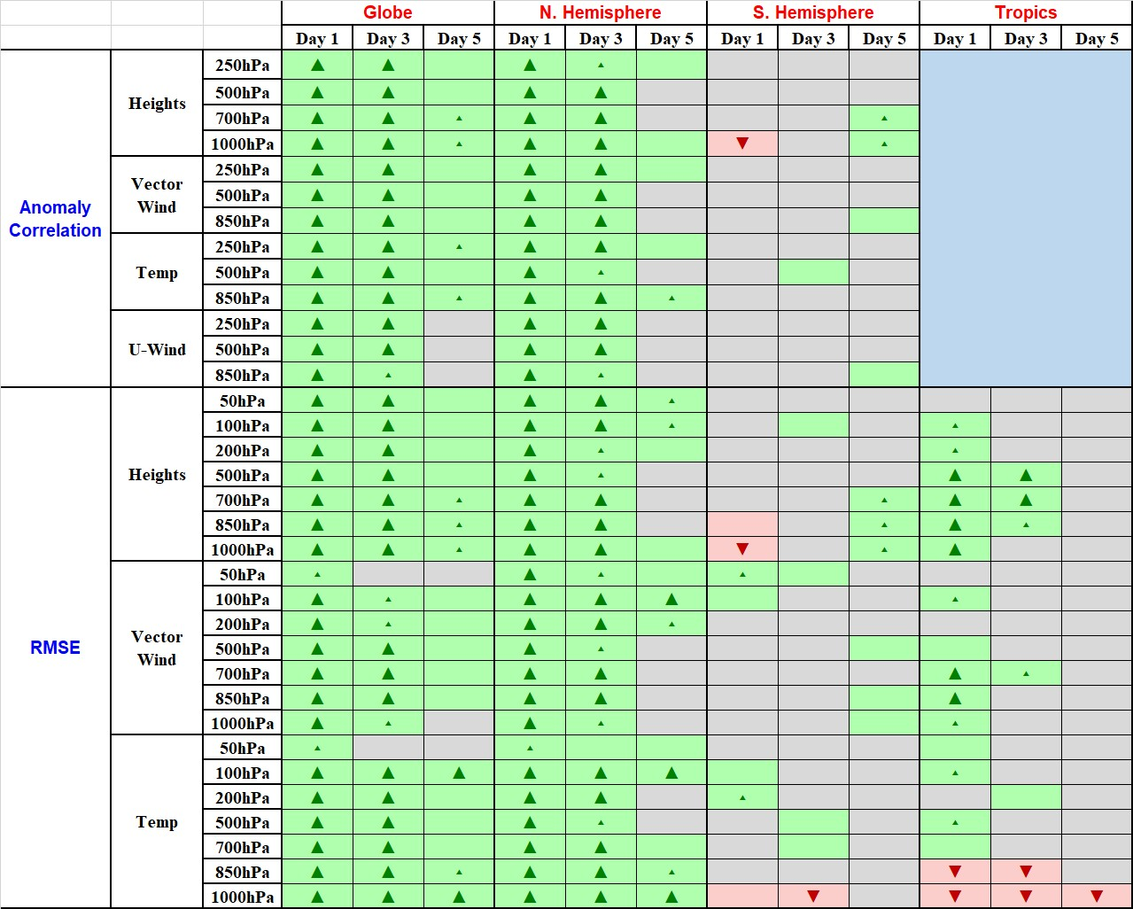
Improvement of land processes
Scorecard (RMSE) – Green/Red :
UPDATE is Better/Worse than CTRL
2022/12/01 ~ 2022/12/31
Update surface static data:
          Land-use & soil type: WRF/MODIS
        Vegetation fraction: EUMETSAT
        (much newer and higher-resolution than
        the GFS default static datasets)
Improve the land model:
(based on some revisions in GFS v16)
          Revise ground heat flux calculation
          over snow cover
          Introduce vegetation impact on surface energy budget over urban areas
Verification data: ERA5

Slide 12
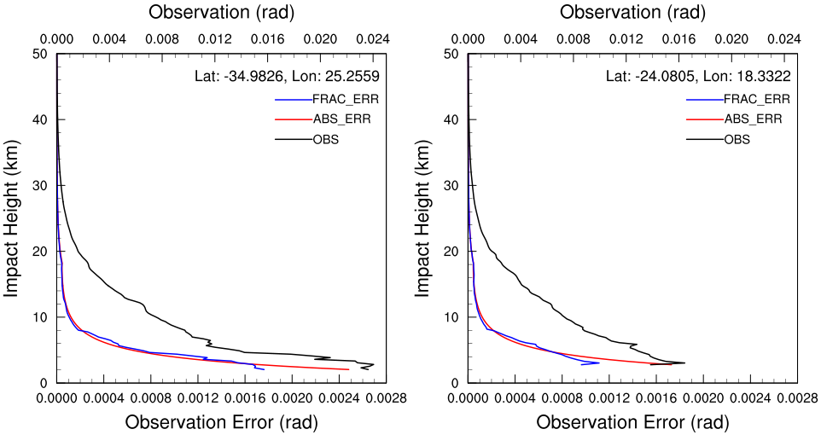
Improvement of GNSS RO observation error specification
Experiment | Observation error
CTRL | Absolute (GSI default)
FracErr | Fractional
RO absolute vs. fractional errors
Scorecard (RMSE) – Green/Red :
FracErr is Better/Worse than CTRL
(RO observation samples)
Observation
Absolute error
Fractional error
= OBS × a (%)
Verification data: self analysis

Slide 13
Relation between NCEP GFS and CWB TGFS
2019
2020
2021
2022
2023
2024
GFS V15
2019/06
GFS V16
2021/03
GFS V17
NCEP GFS
V17 based
V15 based
V16 based
TGFS develop
TGFS OP
TGFS V1
based on GFS V15
TGFS V2 ??
based on GFS V16
The base version of CWB TGFS will lag
behind the NCEP GFS by about 1 big version.

Slide 14
Summary & Discussion
In collaboration with NCEP/EMC since 2016, CWB has adapted the NCEP GFS v15 as its new operational global NWP system.
Since the model component of the system has later become part of the UFS Medium-Range Weather (MRW) Application, the CWB may be regarded as one of the UFS MRW’s early adopters for research and operations in the Western Hemisphere.
The CWB-localized GFS (TGFS) has achieved a good forecast performance.
Despite the thorough documentation of the GFS/UFS-related programs, to build the entire operational workflow of the system (including the hybrid EnVar data assimilation) in an environment outside NOAA computers (like CWB) is still not a trivial task, due to the complicated nature of the operational system.
  However, we worked based on EMC’s original operational code and did not watch closely the UFS community releases.
Based on this CWB-localized system, we have established several collaborations with Taiwanese universities/ research institutes, so a “sub-community” in Taiwan may emerge.
We greatly thank the UFS project and efforts spent by NOAA/NCEP to provide these great tools,
that allow us to build and use a start-of-the-art NWP system at CWB.

