Slide 1
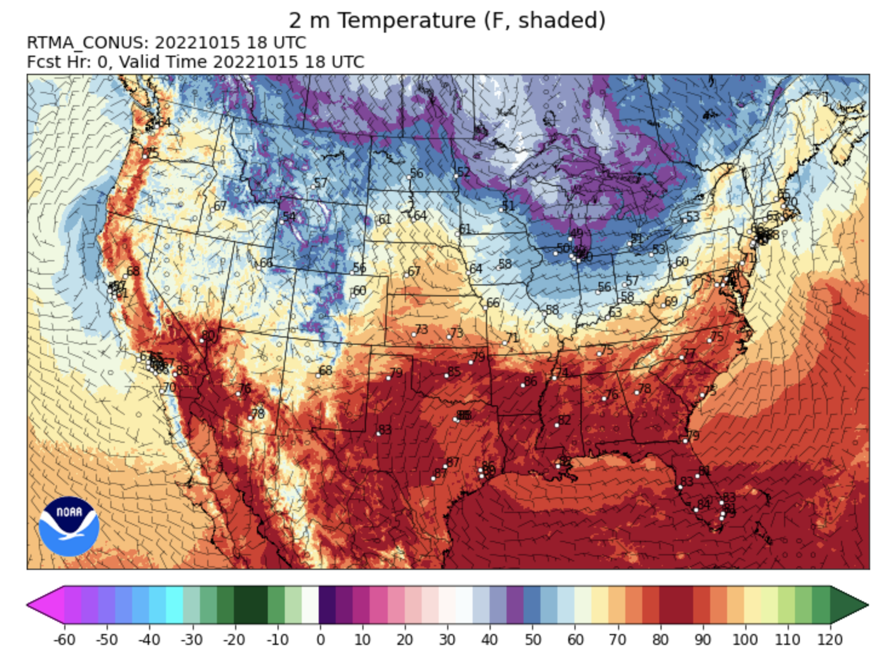
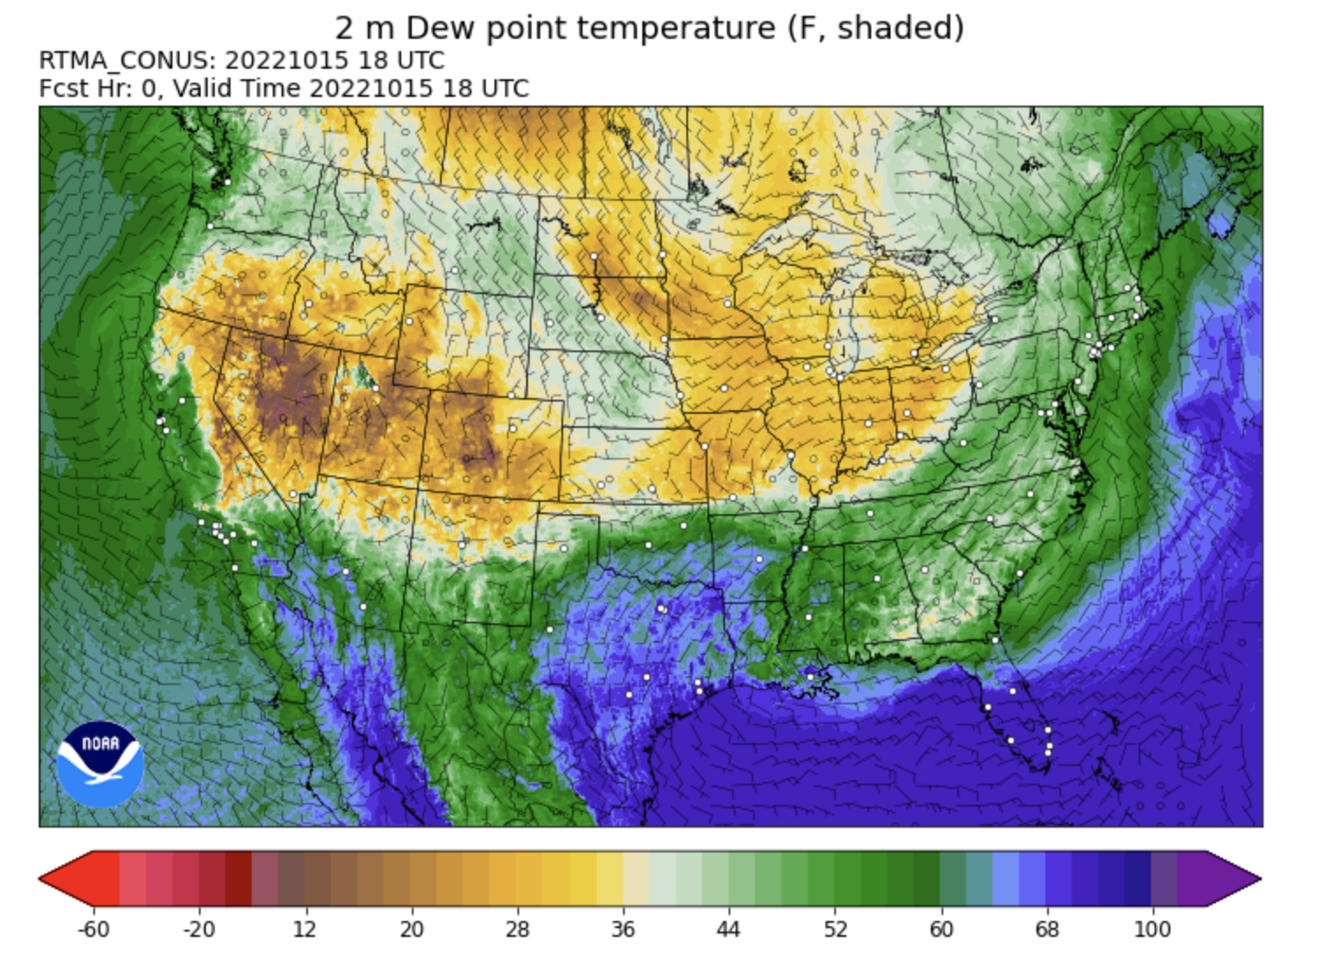
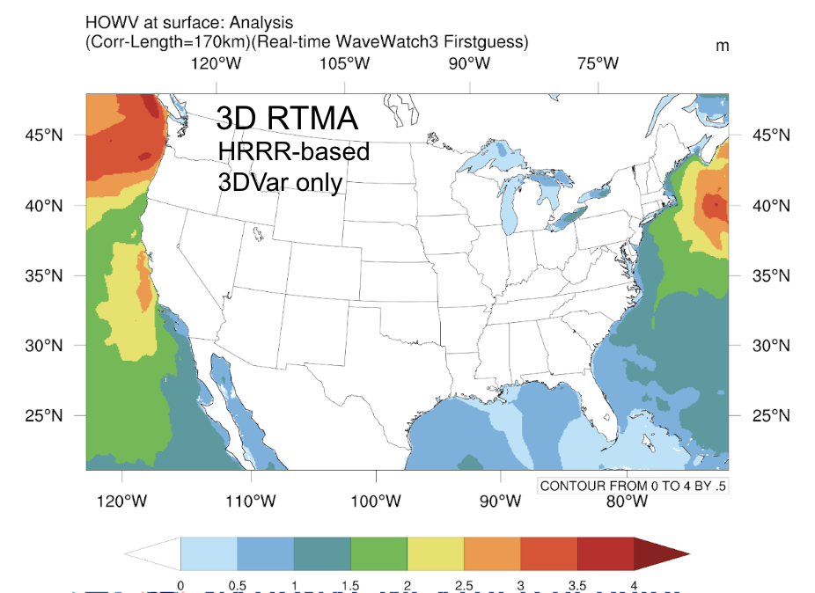
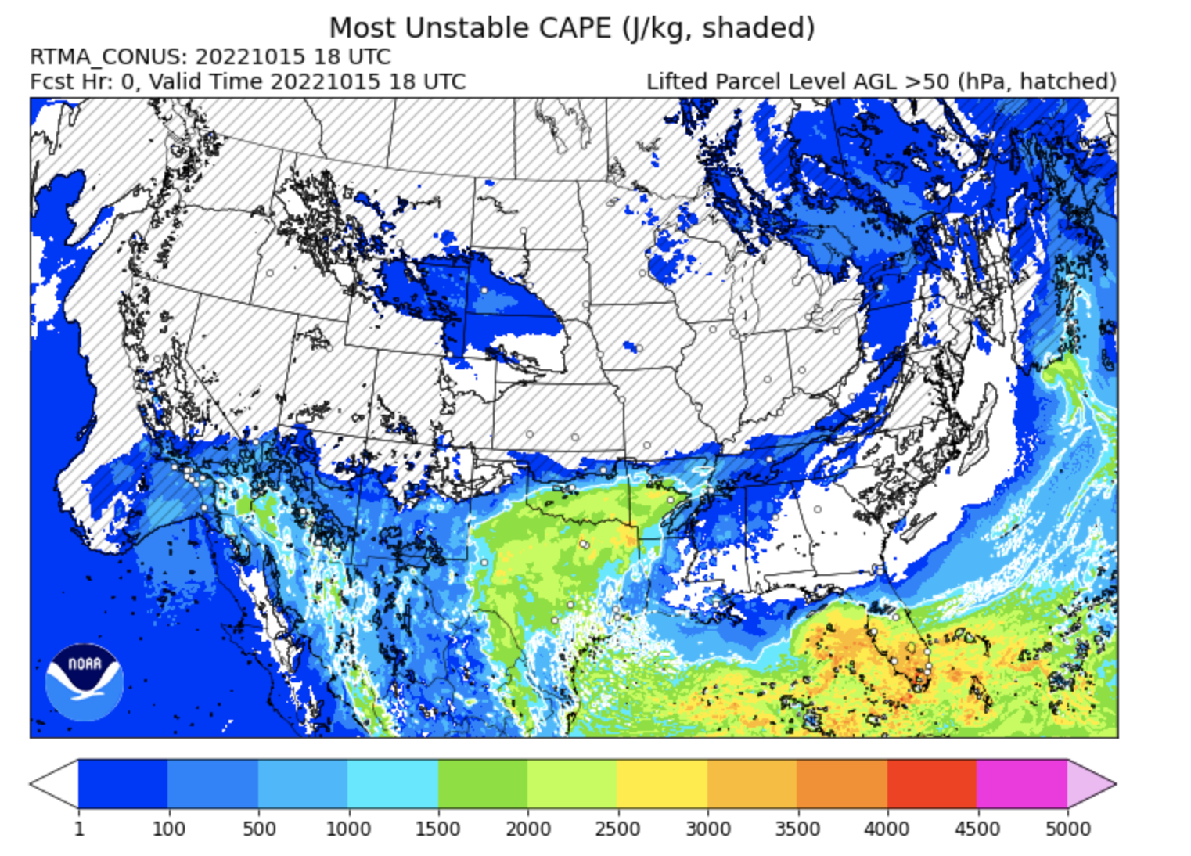
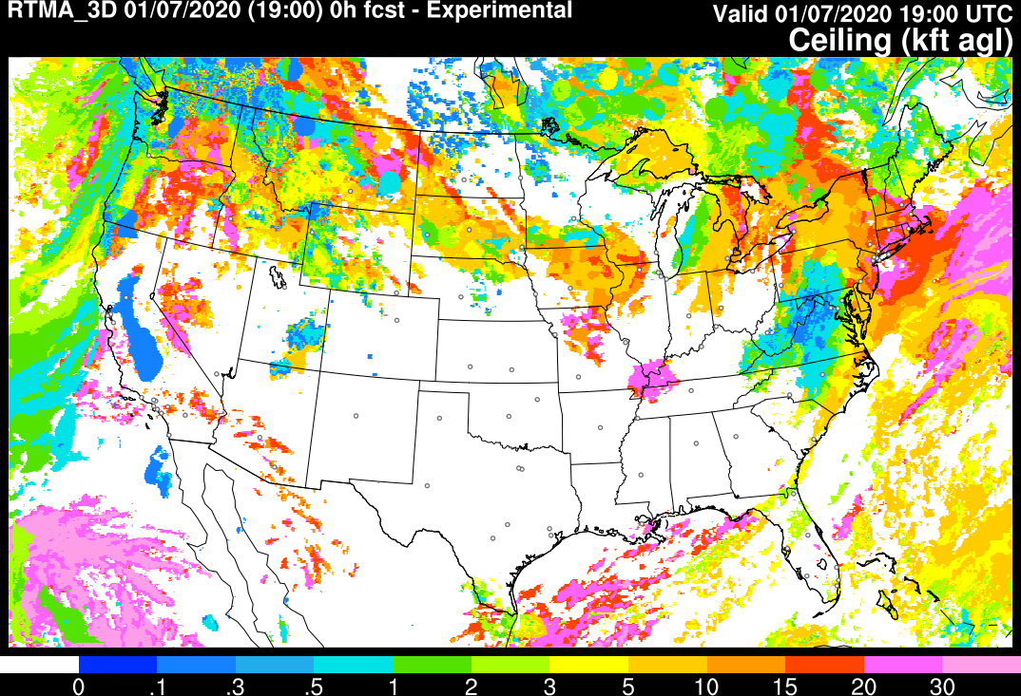
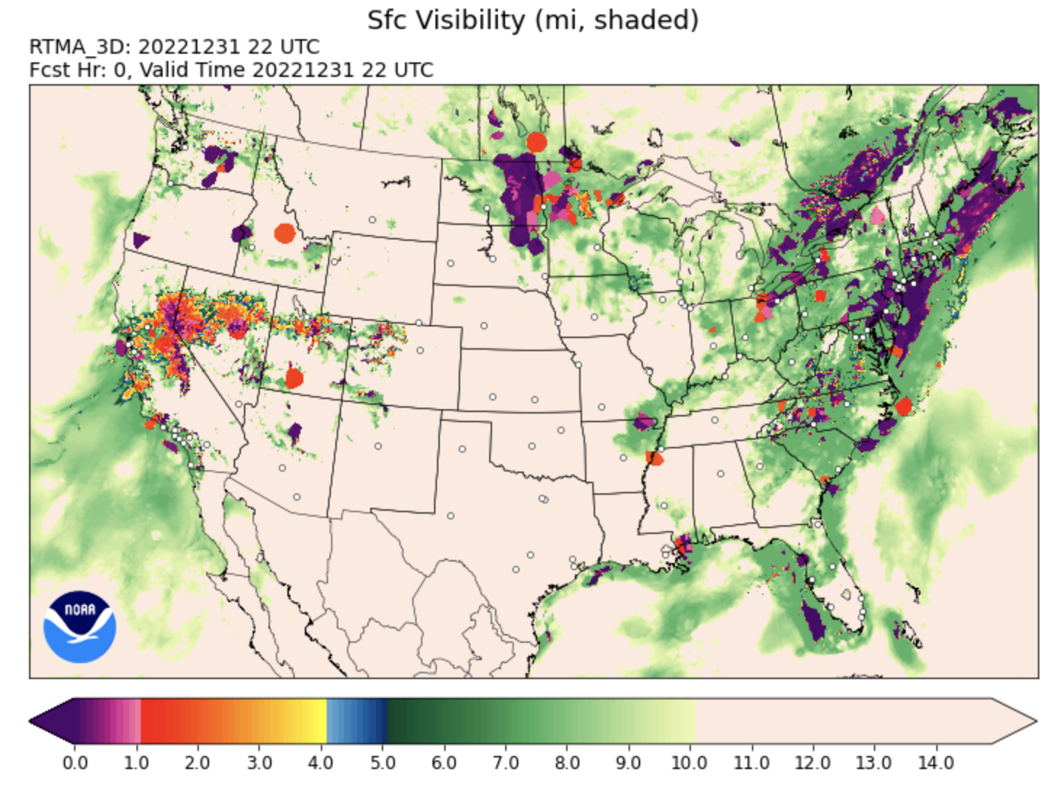
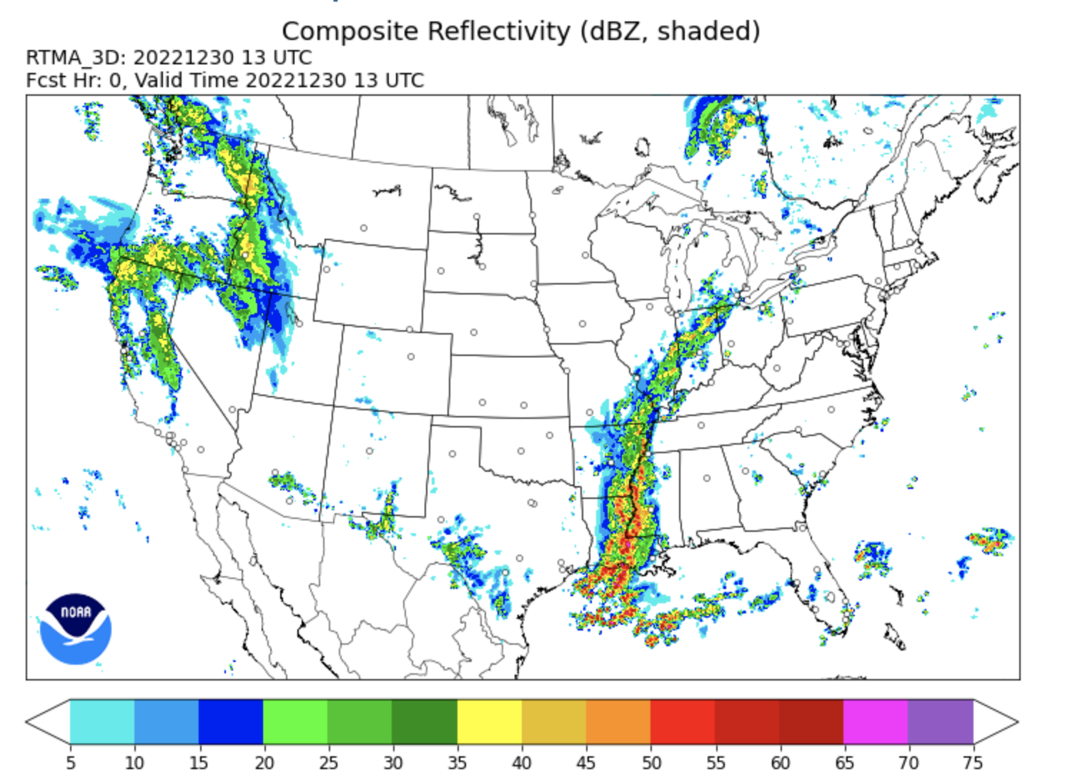
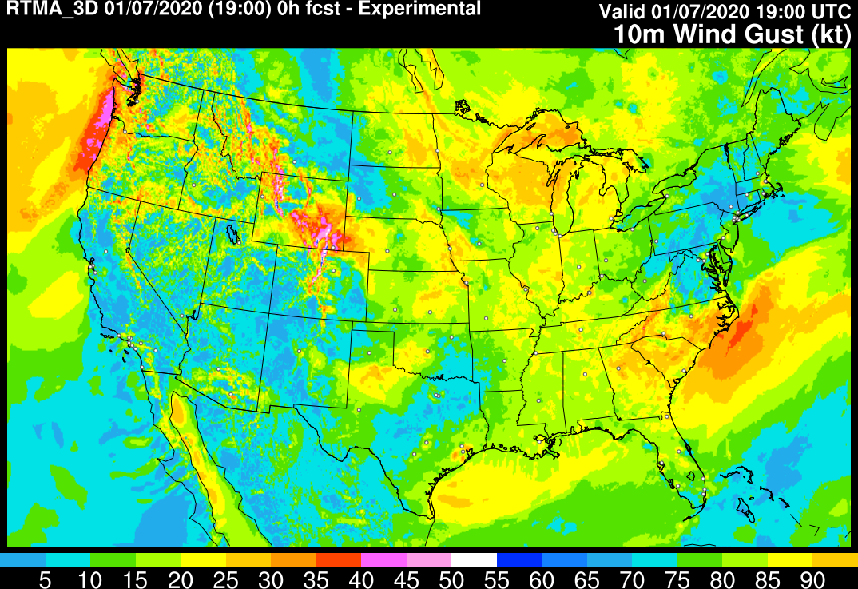
Collaborative Development of the 3DRTMA Using SRW-App
25 July 2023
Terra Ladwig
Manuel Pondeca, Israel Jirak, Guoqing Ge, Edward Colon, Nathan Dahl, Craig Hartsough, Matt Morris, Ming Hu, Annette Gibbs, Hongli Wang, Gang Zhao, Jim Purser, Ruifang Li, Miodrag Rancic, Curtis Alexander, Jacob Carley
NOAA/GLOBAL SYSTEMS LABORATORY
Unifying Innovations in Forecasting Capabilities Workshop

Slide 2
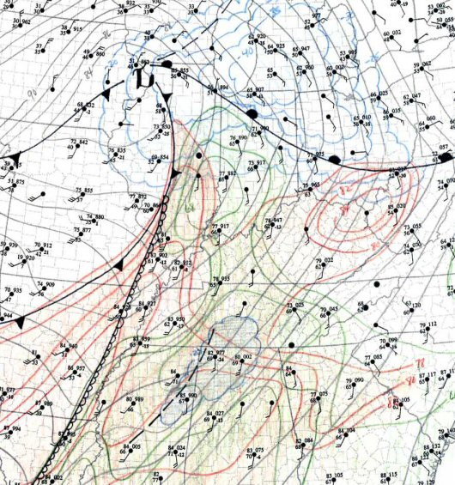
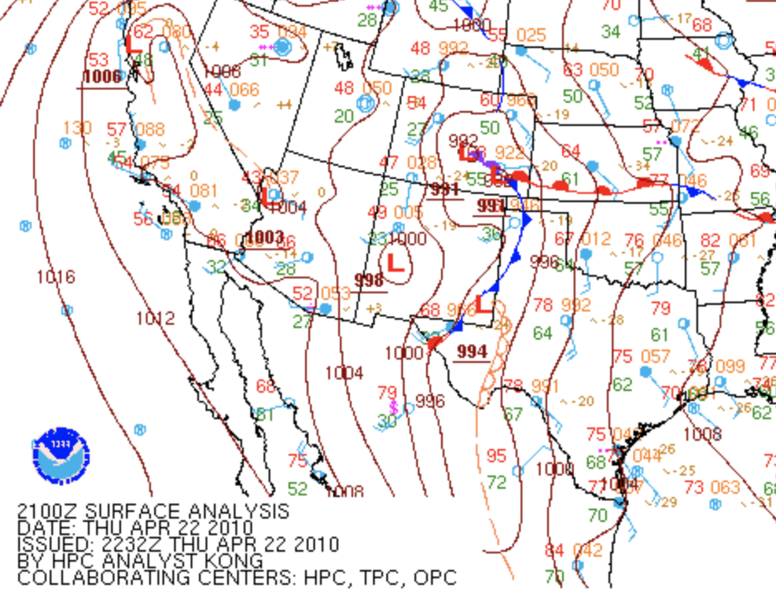
Real-Time Analysis Motivation
Forecasting, including nowcasting, requires a timely, accurate, and rapidly updating analysis of current conditions for situational awareness and to enable forecasters.
Hazardous wx can evolve on a time scale of minutes and is highly sensitive to subtle thermodynamic changes.
Analysis systems that are infrequent, coarse resolution, contain only a small set of 2D fields, and/or only leverage surface obs are inadequate.
SPC Hand Analysis Example

Slide 3
RTMA
Real-Time Mesoscale Analysis (RTMA)
Operational 2DRTMA (hourly) and 2DRTMA-RU (15 mins). Uses 2DVar.
Transition to 3D whole atmospheric analysis, and later an ‘on demand’ continuous analysis system. Use 3DEnVar.
Supports NWS National Digital Forecast Database (NDFD) operations, NWS national centers (e.g. SPC), and other user groups (e.g. aviation, fire wx, hydrology).
Used for situational awareness and nowcasting.

Slide 4
URMA
Companion system: UnRestricted Mesoscale Analysis (URMA)
Runs in delayed real-time to enable the use of late arriving obs.
Serves as NOAA’s analysis of record.
Used for verification and calibration in National Blend of Models (NBM).

Slide 5
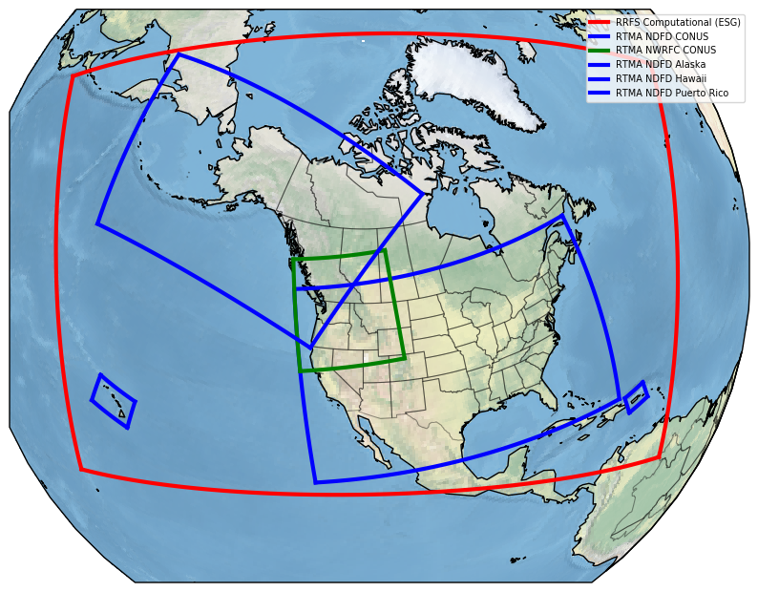
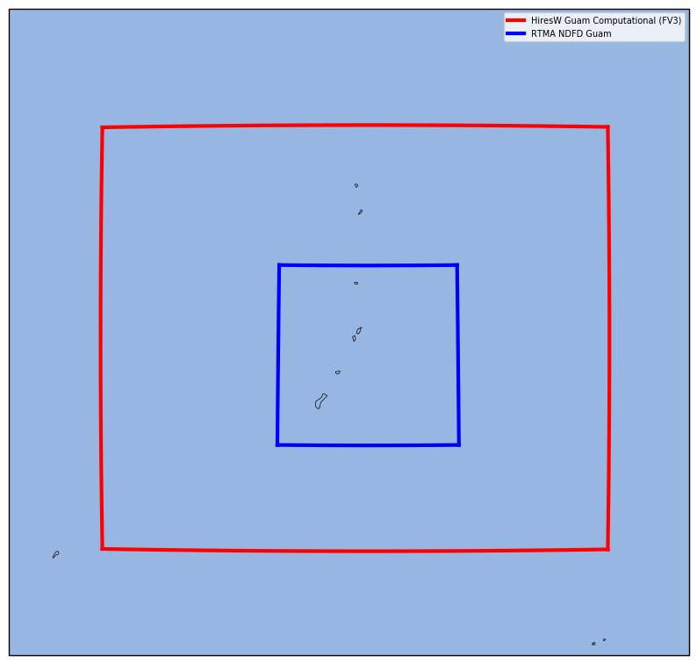
3DRTMA & 3DURMA
RTMA is a specific configuration of the Unified Forecast System (UFS) Short-Range Weather (SRW) Application.
RTMA depends on the Rapid Refresh Forecast System (RRFS) to provide background data.
3-km RRFS/RTMA
RTMA needs to provide products on the NDFD grids, which will be significantly more points than RRFS!
(2.5km grid for CONUS, Hawaii, and Guam,
1.25km for Puerto Rico, and 3 km for Alaska NDFD)
Separate domain
for Guam
RRFS 3-km
4881x2961x65
10GB / 3D native file
Rotated Lat-Lon
*925 million 3-D forecast grid points
and 2-3 times 13-km GFS

Slide 6
3DRTMA & 3DURMA
RTMA is a specific configuration of the Unified Forecast System (UFS) Short-Range Weather (SRW) Application.
RTMA specific configuration file; fixed files
Leverage innovations in SRW, especially those from RRFS
No RTMA specific testing in place, so upstream changes can break RTMA and manual intervention is required by GSL/EMC development team
RTMA is able to run reliably on the cloud to support prototype demonstration
Porting to the cloud requires expert staff time and depends on data transfers
Guoqing Ge poster on A Quick Interface for Nesting Gigantic-data within Git Repositories
Raj Panda poster on Cloud based Workflows for RRFS & RTMA

Slide 7
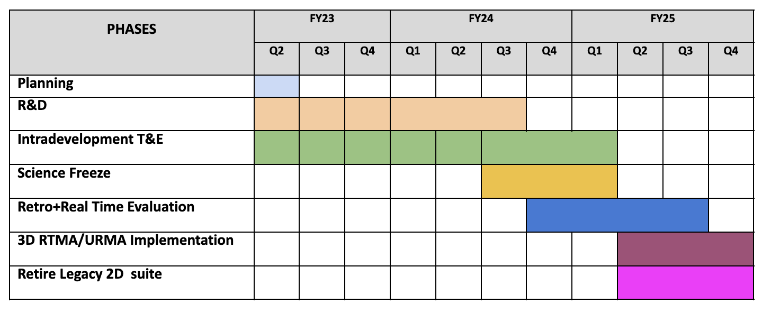
NOAA Model Operational Implementation Timeline
Potential RRFS Schedule Change (Q4FY24 → Q2FY25)
RTMA will follow RRFS
RTMAv1 Operational
Q2FY25 → Q4FY25

Slide 8
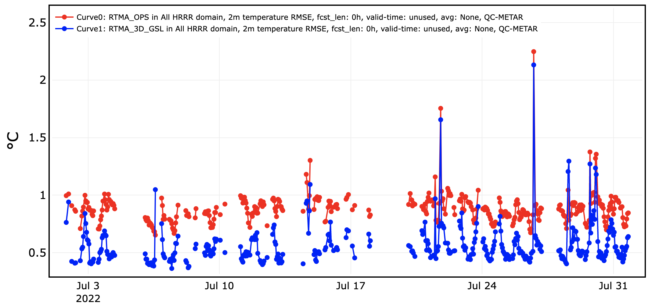
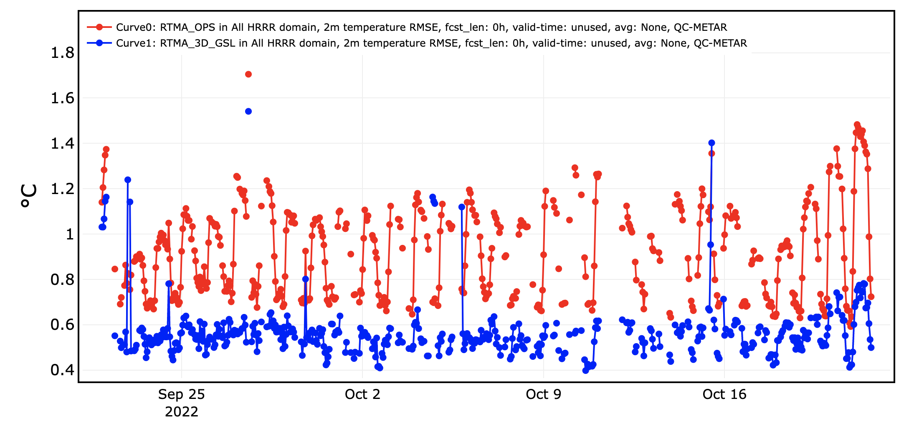
Comparisons to Operational 2D
Throughout 3DRTMA development we have been comparing to the operational 2DRTMA.
3DRTMA is able to fit surface observations more closely.
Example 2m Temp RMS:
July
Oct
3DRTMA
2DRTMA
3DRTMA
2DRTMA

Slide 9
RTMA Comparisons 2021
The FV3-based RTMA first guess was rated ‘much worse’ or ‘slightly worse’ than the HRRR first guess, especially for 2m dew point and reflectivity.
But the FV3-based RTMA did not have the hydrometeor analysis.
Upscaled to 40km FV3-based RTMA was rated ‘slightly worse’ than SPC Mesoanalysis.

Slide 10
RTMA Subhourly Comparisons 2021
The 15-min RTMA was rated “about the same” to “slightly better” than the hourly RTMA. It did leverage HRRRDAS BEC data instead of the GDAS data in the hourly version.
Participants noted the analyses at the top of the hour were similar, and the subhourly data was useful.
A discontinuity between the 45min and top of the hour analyses was prevalent, but the majority of participants thought the subhourly analyses provide useful info.

Slide 11
RTMA Comparisons 2022 & 2023
FV3-based RTMA was rated “slightly worse” to “about the same” as the HRRR-based version.
Analyses are very similar

Slide 12
RTMA Comparisons 2022 & 2023
FV3-based RTMA was rated “slightly worse” to “about the same” as the HRRR-based version.
Thunderstorm outflows too early/cold/expansive

Slide 13
RTMA Comparisons 2022 & 2023
FV3-based RTMA was rated “slightly worse” to “about the same” as the HRRR-based version.
Moist bias in RRFS version
RRFS version too moist in dry air/behind dryline

Slide 14
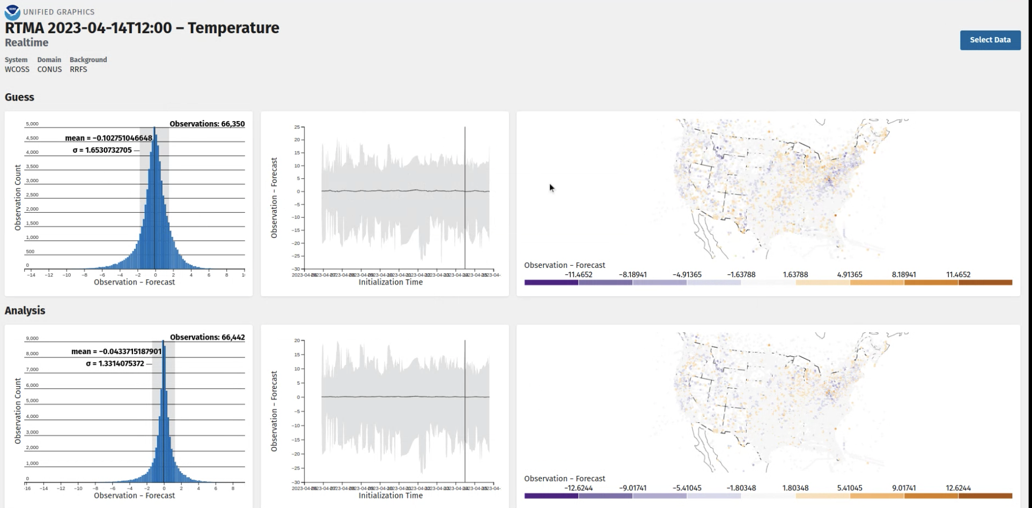
Analysis Visualization
Evaluating analysis fit to observations including spatial and temporal filtering

Slide 15
RTMA Summary & Future Direction
Strong dependence of RRFS; both technical and scientific innovations.
High resolution and low latency requirements are challenging.
Obs quality control is essential.
Uncertainty estimation is in development.
Transition to JEDI software for assimilation.
See: Jim Purser poster on Geometric Approaches for Adaptive Domain Decomposition With an Application to the Estimation of the Variance of Analysis Error

Slide 16
bit.ly/cudasp
CIRES/NOAA GSL has a job opening for a
Data Assimilation Scientific Programmer.
The Scientific Programmer will use and advance the JEDI software for RTMA and RRFS applications. In particular, work toward continuous assimilation approaches, analysis uncertainty estimation, and analysis of complex physical diagnostics will be prioritized. The development will take place in both NOAA High-Performance Computing environments and cloud computing environments. The candidate will have the opportunity to contribute to experimental and future operational RTMA prototypes including real-time experiments and the evaluation of RTMA by developers and interested parties. The candidate will work collaboratively with the GSL and EMC development teams, as well as the larger RRFS and UFS modeling community.

