Slide 1
Preliminary Analysis of Wintertime
Diabatic Heating Biases in UFS Prototype-P8
David Straus, Erik Swenson, Chul-Su Shin, Benjamin Cash
George Mason University
With grateful acknowledgement of support from NA22OAR4590506

Slide 2
Why Diabatic Heating?
Subseasonal to seasonal predictability is largely due to the influence of slowly-varying boundary conditions
  ENSO, other SST anomalies, soil moisture, etc.
Direct influence of these surface anomalies on the atmosphere is limited and local
Remote influence is communicated via the upper atmosphere through diabatic heating anomalies
  E.g. Teleconnections or ‘atmospheric bridge’
Diabatic heating is very difficult to observe directly
  E.g., satellite measurements of condensation
  Generally includes large observational uncertainties

Slide 3

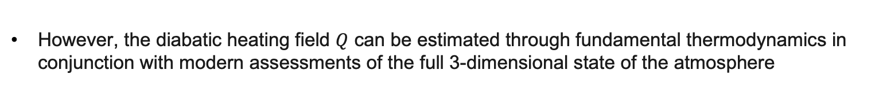
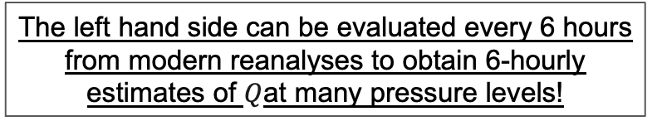
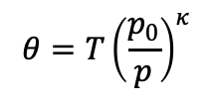
However, the diabatic heating field $Q$ can be estimated through fundamental thermodynamics in conjunction with modern assessments of the full 3-dimensional state of the atmosphere
$$\frac{∂Θ}{∂t}+\vec{u}∙\vec{∇}Θ+ω\frac{∂Θ}{∂p}=\frac{1}{C_{p}}{\left(\frac{p_{0}}{p}\right)}^{κ}Q$$
$$θ=T{\left(\frac{p_{0}}{p}\right)}^{κ}$$
Where
is the potential temperature and $ω$ = dp/dt (material derivative of pressure p)
The left hand side can be evaluated every 6 hours from modern reanalyses to obtain 6-hourly estimates of $Q$at many pressure levels!

Slide 4
Diabatic Heating Bias in UFS Prototype-P8
Monthly mean diabatic heating diagnosed from January 01 starts for 2012-2018
  Data obtained from https://registry.opendata.aws/noaa-ufs-s2s
Assessed relative to monthly mean diabatic heating diagnosed from ERA5 for same dates
Heating integrated over 9 layers
  1000-925; 925-850; 850-750; 750-650; 650-550; 550-450; 450-350; 350-200; 200-50
  All results in units of W/m**2
0

Slide 5
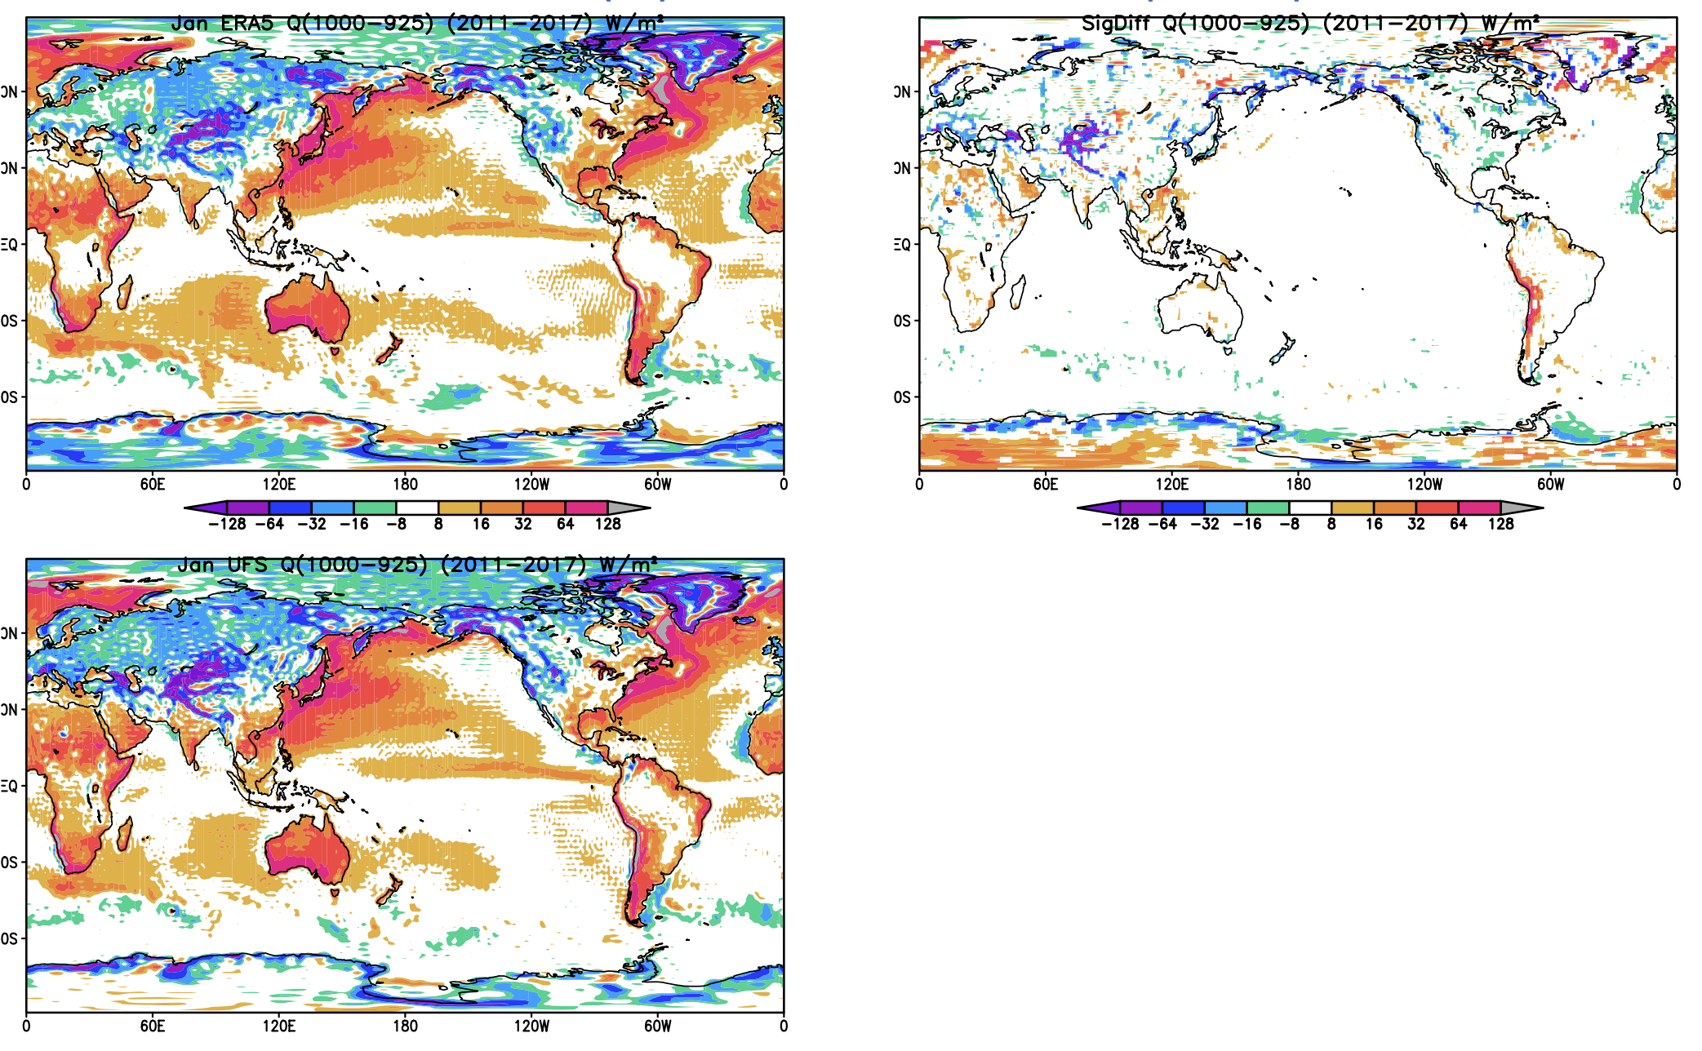
Diabatic Heating Comparison
ERA5: 1000-925 mb
ERA5
Difference
ERA5
UFS: 1000-925 mb
UFS
Close agreement at lowest levels
UFS

Slide 6
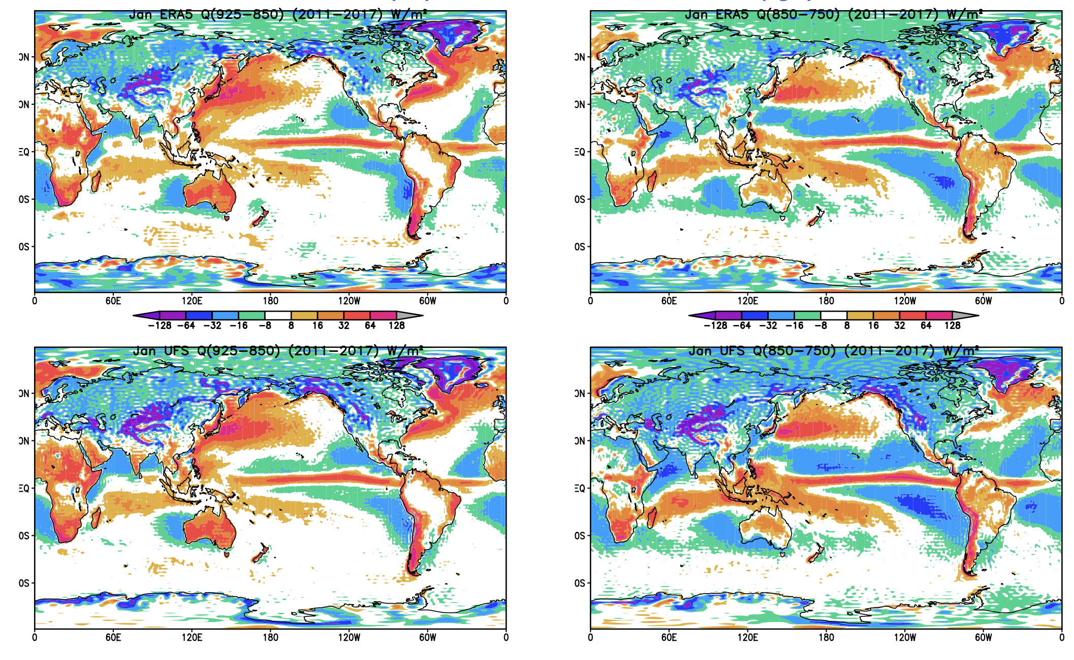
925-850 mb
850-750 mb
ERA5
ERA5
ERA5
ERA5
Close agreement maintained
UFS
UFS
UFS
UFS

Slide 7
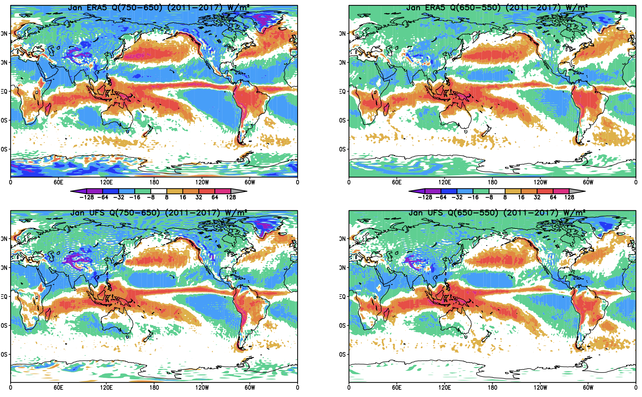
750-650 mb
650-550 mb
ERA5
ERA5
ERA5
ERA5
Close agreement maintained
UFS
UFS
UFS
UFS

Slide 8
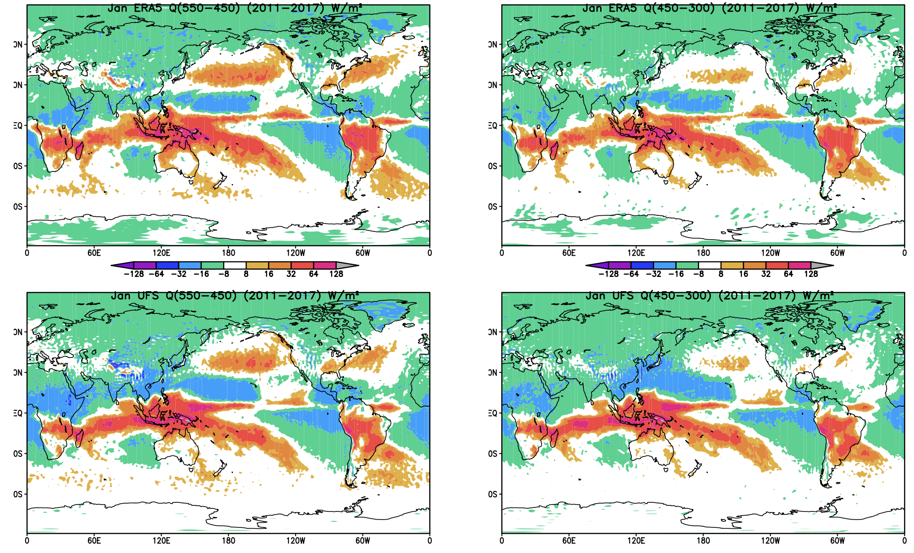
550-450 mb
450-300 mb
ERA5
ERA5
ERA5
ERA5
Close agreement maintained
UFS
UFS
UFS
UFS

Slide 9
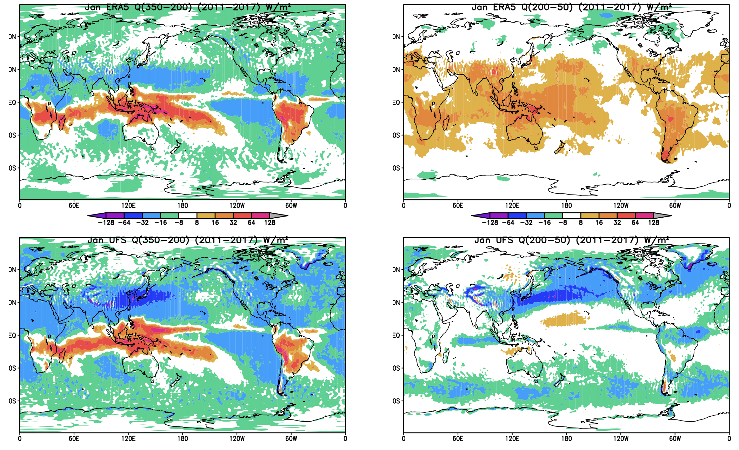
350-200 mb
200-50 mb
ERA5
ERA5
ERA5
ERA5
Large differences at upper levels
UFS
UFS
UFS
UFS

Slide 10

Horizontal Advection Component
Difference
ERA5
ERA5
UFS
Contribution from Horizontal Advection Only
$$Q=c_{p}{\left(\frac{p}{p_{0}}\right)}^{κ}\left(\frac{∂θ}{∂t}+\vec{u}∙\vec{∇}θ+ω\frac{∂θ}{∂p}\right)$$
Minimal differences
UFS

Slide 11

Vertical Advection Component
Difference
ERA5
ERA5
UFS
Contribution from Vertical Advection Only
$$Q=c_{p}{\left(\frac{p}{p_{0}}\right)}^{κ}\left(\frac{∂θ}{∂t}+\vec{u}∙\vec{∇}θ+ω\frac{∂θ}{∂p}\right)$$
Majority of the differences
UFS

Slide 12
Conclusions
Diagnosed diabatic heating closely matches ERA5 through most of the troposphere
  Significantly too negative in the Northern Hemisphere January storm-track regions
  Largest differences in the upper troposphere to lower stratosphere (200 – 50 hPa)
Time average vertical advection term is responsible for this difference
  Minimal differences in horizontal advection term
  Mean static stability in this region is too low?
  Dynamics of transients above the main storm track are faulty?
Ongoing work
  Further decomposition of vertical term
    Requires longer runs than the 35 day Prototype runs
    Analyzing seasonal runs performed on Frontera now
  Impact of correcting bias on model fidelity and skill

Slide 13
Additional Material

Slide 14
Example: Seasonal response to seasonal heating
Heating and divergence for the 1982/83 El Niño
DJF vertically integrated heating anomaly calculated from the residual method is collocated with the 200hPa divergence anomaly, as we would expect

Slide 20

$$Q=c_{p}{\left(\frac{p}{p_{0}}\right)}^{κ}\left(\frac{∂θ}{∂t}+\vec{u}∙\vec{∇}θ+ω\frac{∂θ}{∂p}\right)$$

Slide 21
With grateful acknowledgement of support from NA22OAR4590506

