Slide 1
Evaluation of High Resolution Prototypes for the Next Global Forecast System GFSv17
25 Jul 2023, UIFCW Workshop
Lydia Stefanova¹, Jongil Han², Wei Li³, Jessica Meixner², Jiayi Peng⁴, Sulagna Ray³, Mallory Row³, Catherine Thomas²
¹Lynker at NCEP/EMC, ²NCEP/EMC, ³SAIC at NCEP/EMC, ⁴Axiom at NCEP/EMC

Slide 2
Acknowledgements to GFS & UFS Active Developers
Atmospheric Physics NCEP/EMC: Jongil Han, Michael Barlage, Anning Cheng, Bing Fu, Hong Guang, Sanath Kumar, Xu Li, Wei Li, Qingfu Liu, Eric Sinsky, Ruiyu Sun, Kevin Viner, Helin Wei, Bo Yang, Fanglin Yang, Rongqian Yang, Weizhong Zheng, Xiaqiong Zhou ESRL/GSL: Ben Green, Joseph Olson, Tanya Smirnova, Shan Sun, Xia Sun, Michael Toy JCSDA/UCAR:Dom Heinzeller, ESRL/PSL: Lisa Bengtsson, Jian-Wen Bao, Clara Draper, Grant Firl, Songyou Hong, Philip Pegion, Dustin Swales DTC: Ligia Bernardet, Weiwei Li, Man Zhang | Data Assimilation NCEP/EMC: Catherine Thomas, Guillaume Vernieres, Daryl Kleist, Cory Martin, Andrew Collard, Jiarui Dong, Andy Eichmann, Travis Elless, Nick Esposito, Iliana Genkova, Azadeh Gholoubi, Brett Hoover, Xin Jin, Emily Liu, Haixia Liu, Hyun-Chul Lee, Xuanli Li, Ron McLaren, Dagmar Merkova, Sudhir Nadiga, Shastri Paturi, Ashley Stanfield, Steve Stegall, Andy Tangborn, Russ Treadon, Yaping Wang, Youlong Xia CIRES/GSL: Bo Huang, Mariusz Pagowski PSL: Clara Draper, Jeff Whitaker JCSDA/UCAR: Kriti Bhargava, Travis Sluka | Coupled Model Component Development NCEP/EMC: Jessica Meixner, Jiande Wang, Lydia Stefanova, Jun Wang, Yuejian Zhu, Neil Barton, Saeideh Banihashemi, Arun Chawla, Bing Fu, George Gayno, Robert Grumbine, Walter Kolczynski, Matthew Masarik, Avichal Mehra, Ali Salimi-Tarazouj, Denise Worthen ESRL/GSL: Ben Green, Shan Sun ESRL/PSL: Lisa Bengtsson, Phillip Pegion GFDL: Alistair Adcroft, Rusty Benson, Stephen Griffies, Robert Halberg, Matthew Harrison, Brandon Reichl, Marshall Ward NCAR: Alper Altuntas, Gokhan Danabasoglu, Keith Lindsay, Gustavo Marques NRL/ESMF: Gerhard Theurich GMU: Ben Cash, Jim Kinter, Lawrence Marx, Cristiana Stan FSU: Alexandra Bozec, Eric Chassignet, Alan Wallcraft NASA: Akella Santha Univ. Alaska: Katherine Hedstrom U. Mich.: Christiane Jablonowski Univ. Victoria: Andrew Shao
Field Evaluation NCEP/EMC: Geoff Manikin, Alicia Bentley, Mallory Row, Shannon Shields NWS Regional SSDs NCEP Centers | Products NCEP/EMC: Hui-Ya Chuang, Andrew Benjamin, L. Gwen Chen, Yali Mao, Wen Meng, Bo Cui
Atmospheric Composition NCEP/EMC: Partha Bhattacharjee, Jeff McQueen, Raffaele Montuoro, Li Pan, Ivanka Stajner ARL: Barry Baker, Patrick Campbell, Rick Saylor ESRL/GSL: Georg Grell, Shan Sun, Li (Kate) Zhang CSL: Gregory Frost, Jian He, Stuart McKeen, Siyuan Wang NESDIS/STAR: Ethan Hughes, Shobha Kondragunta, Xiaoyang Zhang | Infrastructure NCEP/EMC: Rahul Mahajan, Jun Wang, Arun Chawla, Kate Friedman, Lin Gan, George Gayno, Ed Hartnett, Dusan Jovic, Walter Kolczynski, Hang Lei, Terry McGuinness, Alex Reichert, Mallory Row, Edward Stafford, Henry, Winterbottom, Jack Wollen, Denise Worthen Redline Performance: David Huber | Coupled Model Evaluation NCEP/EMC: Lydia Stefanova, Jiande Wang, Michael Barlage, Neil Barton, Partha Bhattacharjee, Zhichang Guo, Robert Grumbine, Wei Li, Avichal Mehra, Jiayi Peng, Sulagna Ray, Huug van den Dool, Helin Wei, Youlong Xia, Weizhong Zheng CPC: Laura Ciasto, Yanyun Liu, Wanqiu Wang, Jieshun Zhu ESRL/PSL: Chris Cox, Maria Gehne, Juliana Dias, Zachary Lawrence, Amy Solomon GMU: V. Krishnamurthy, Eunkyo Seo, Cristiana Stan

Slide 3
Outline
High-resolution prototypes: HR1
Specification of HR1
Modeling system differences between GFSv16, HR1, and planned GFSv17
HR1 evaluation
Evaluation targets
Results
Summary

Slide 4
High Resolution Prototypes: HR1
Starting point: P8 (deterministic, lower resolution, all system components in)
High-Resolution Prototypes: HR1 (completed), HR2 (in progress), HR3 (planned), …
End point: GFSv17
Details of HR1
Model
Coupled Model: Atm (C768) - Ocean (¼ tripolar) - Ice (¼ tripolar) - Wave ( ¼ tripolar)
Time periods
Summer: June 1– Aug. 30, 2020, cold start forecasts at 00Z cycle every 3 days, 16 day forecast
Winter: Dec. 03, 2019 – Feb. 26, 2020, cold start forecasts at 00Z cycle every 3 days, 16 day forecast
Hurricane: July 20, 2020 – Nov 20th, 2020, cold start forecasts at 00Z cycle everyday, 7 day forecast
Initial conditions
Atm: GFSv16
Land: New spin up
Wave: New spin-up forced from GFSv16 (Winter), interpolated from GFSv16 for (Summer, Hurricane)
Ocn/Ice: Replay

Slide 5
Differences between GFSv16, HR1, and GFSv17
GFS v16
Atm: C364, L127
GFSv16 physics including
Land: NOAH
GFDL microphysics
NSST
Ocean: N/A
Ice: N/A
Wave: 9-25km
Aerosols: N/A
GDAS DA
HR1
Atm: C768, L127
Updated physics including
Land: NOAH-MP
Thompson microphysics
NSST
Ocean: ¼ tripolar
Ice: ¼ tripolar
Wave: ¼ tripolar
Aerosols: Not invoked
no DA
GFSv17
Atm: C768, L127
Updated physics including
Land: NOAH-MP
Thompson microphysics
NSST
Ocean: ¼ tripolar
Ice: ¼ tripolar
Wave: unstructured
Aerosols: In GDAS deterministic forecast only and no aerosol-radiation interaction
GDAS DA (Weakly Coupled)

Slide 6
Evaluation targets
Comparison between HR1 with GFSv16 for
Global distribution of biases
MJO
AC score card – geopotential heights, winds, temperature
CONUS 10-m wind biases
CONUS 2-m temperature biases
CAPE magnitude
TC track and intensity
Tools
Non-METplus-based scripts, as in prior prototype evaluations
METplus-based EMC_verif-global package (https://github.com/NOAA-EMC/EMC_verif-global.git)

Slide 7
Total Clouds, SFC Downward Shortwave, Upward longwave: Bias (DJF)
GFSv16 Bias
HR1 Bias
HR1 minus GFSv16
Total clouds generally reduced, but increased south of equator in the eastern tropical Pacific and Atlantic. The reduction is an improvement over Indian Ocean and high latitudes
SFC downward SW underestimation exacerbated in eastern tropical Pacific and Atlantic
SFC upward SW shows negative bias over deserts and sea ice. Result of lower desert albedoes and lower ice concentrations
Clouds
SW down
SW up

Slide 8
SW and SST bias in HR1 (DJF)
Spatial structure similar to low-res P8
Net SW bias is generally positive, except south of the equator in the eastern tropical Pacific and Atlantic, where HR1 has increased cloud amounts and exacerbated negative downward SW bias
Warm SST bias in the eastern equatorial Pacific and Atlantic. Cold bias south of there.
Close correspondence between net SW bias and SST bias; any discrepancies are largely from the ICs
Biases growing with lead time (not shown).
HR1 Bias
Net SW bias
SST

Slide 9
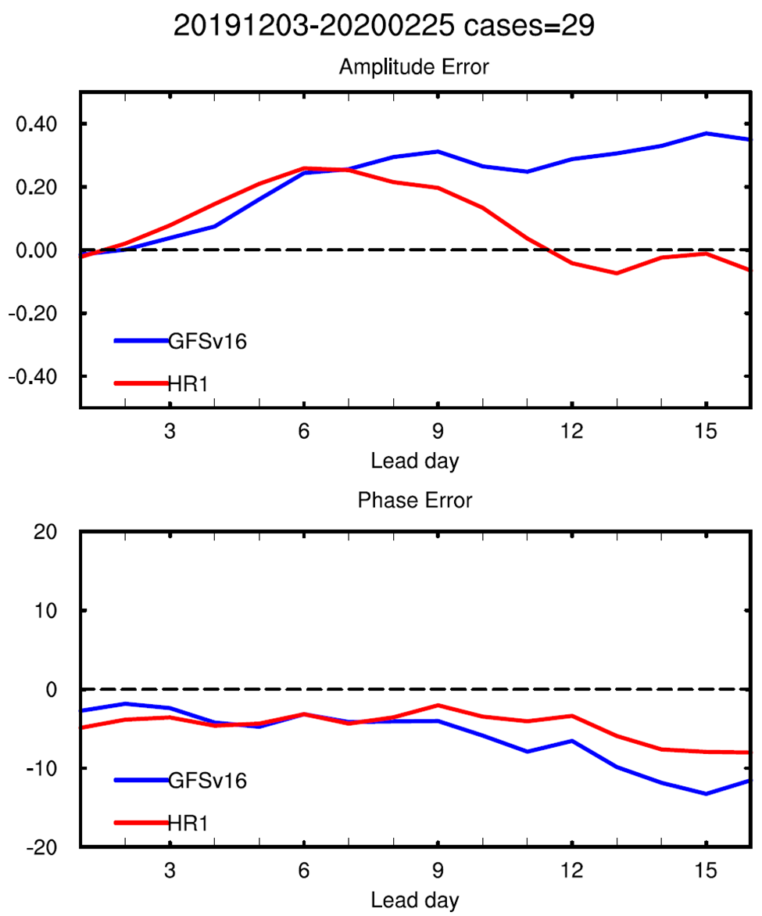
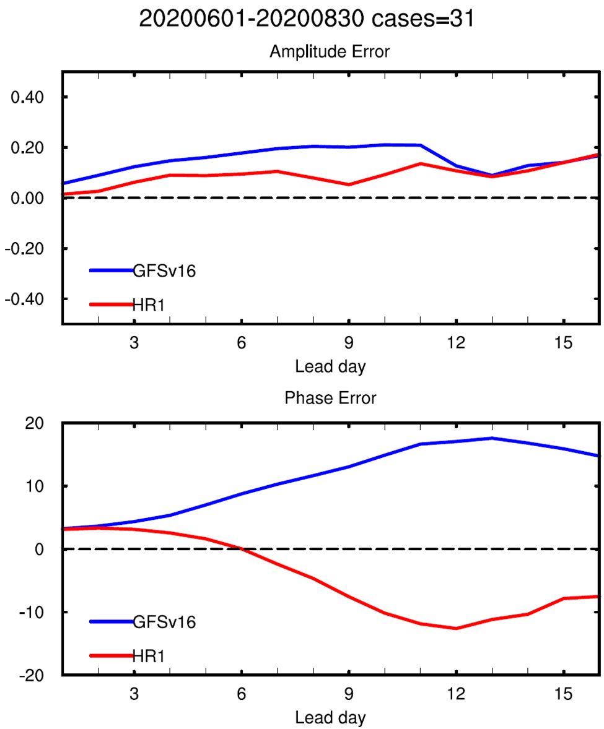
MJO
DJF
JJA
AC
Improved AC in HR1 for both seasons
Amplitude error
Reduced amplitude error in HR1 for both seasons.
Phase error
Reduced phase error
Still too slow in DJF
Switched from too fast to too slow in JJA.
For both GFSv16 and HR1, larger amplitude bias in strong MJOs; larger propagation bias in weak MJOs.
BivariateAC
Amplitude error
Phase error

Slide 10
ACC scorecard
Computed with EMC_verif-global package https://github.com/NOAA-EMC/EMC_verif-global.git
Day 1
ACC scores for HR1 worse than GFSv16 (initialization shock)
Days 3-10
Improvement: tropics and winter hemisphere – heights, wind speed, upper tropospheric temperature
Worsening: low level temperatures
DJF
JJA

Slide 11
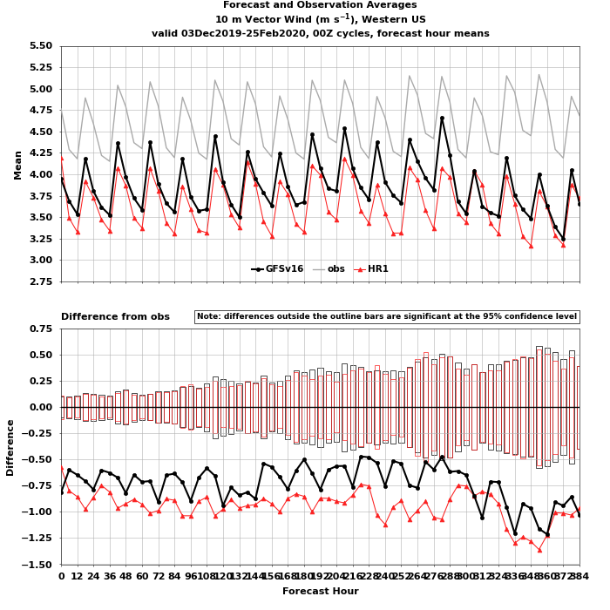
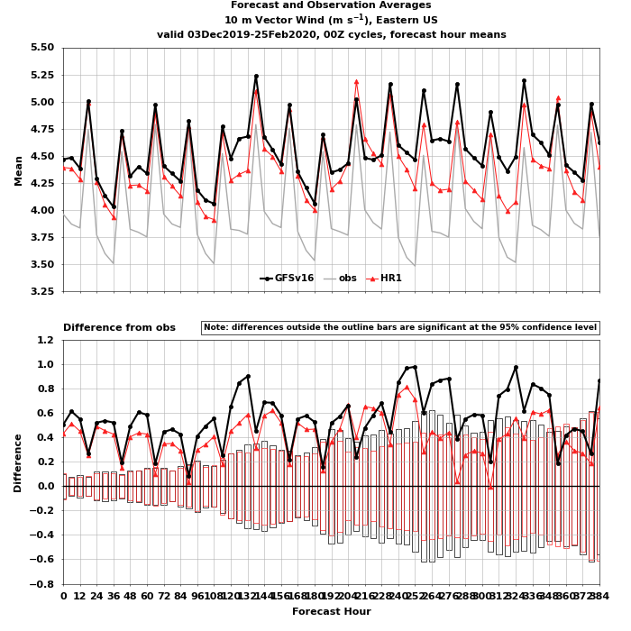
Mean Bias: 10m Wind Speed (DJF)
Sign of biases same as in GFSv16. Wind speeds on average lower in HR1 than GFSv16
Exacerbated underestimation in Western CONUS
Reduced overestimation in Eastern CONUS
(The shifts are in the same direction for JJA)
West CONUS
East CONUS
Mean
Error
GFSv16
HR1
OBS

Slide 12
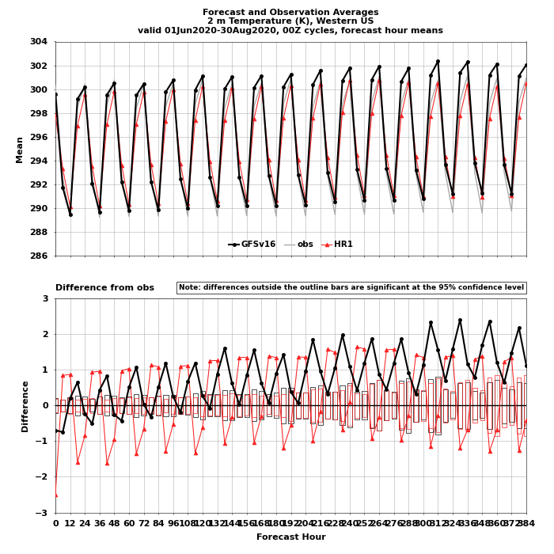
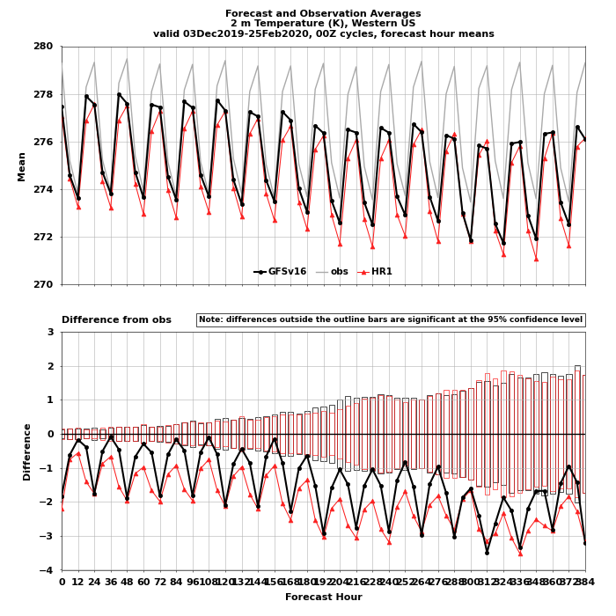
Mean Bias: T2m (West Conus)
JJA
DJF
JJA
Reduced daytime warm bias, improved diurnal cycle shape
Reduced diurnal range
DJF
Exacerbated nighttime cold bias
Improved diurnal cycle shape
Mean
Error
GFSv16
HR1
OBS

Slide 13
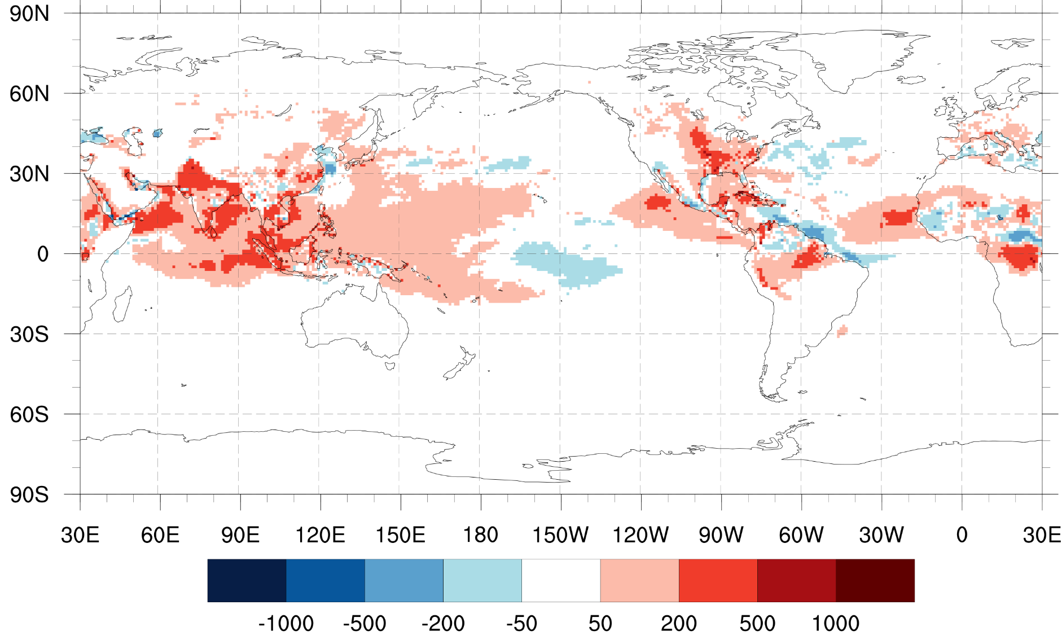
CAPE
HR1 minus GFSv16, JJA 2020
Larger CAPE in HR1 compared to in GFSv16
This is a move in the right direction but the magnitude of increase is insufficient.

Slide 14
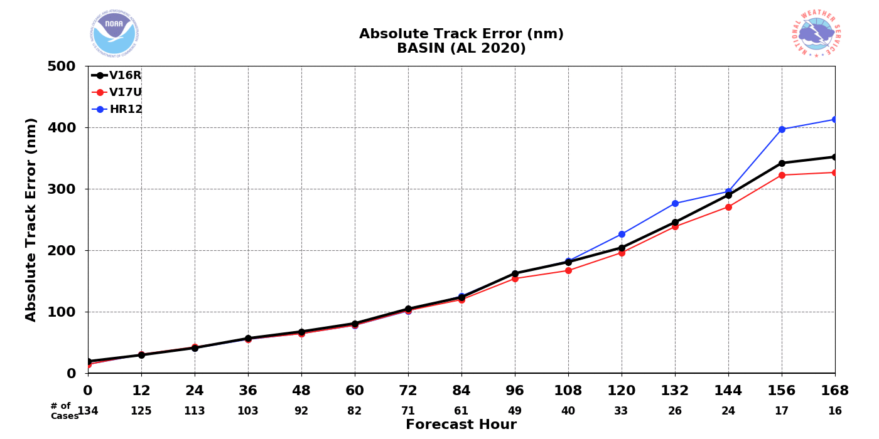
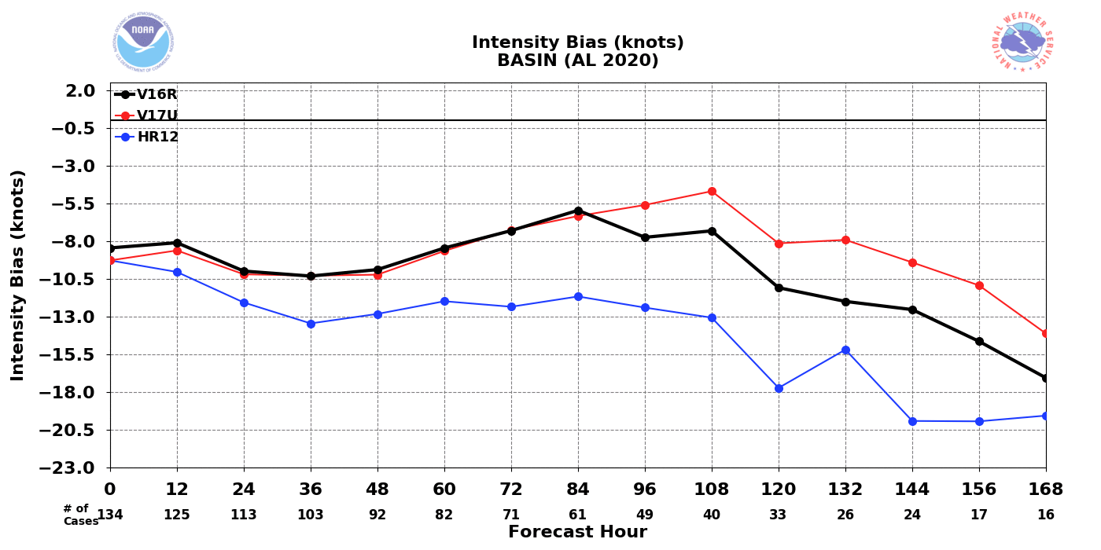
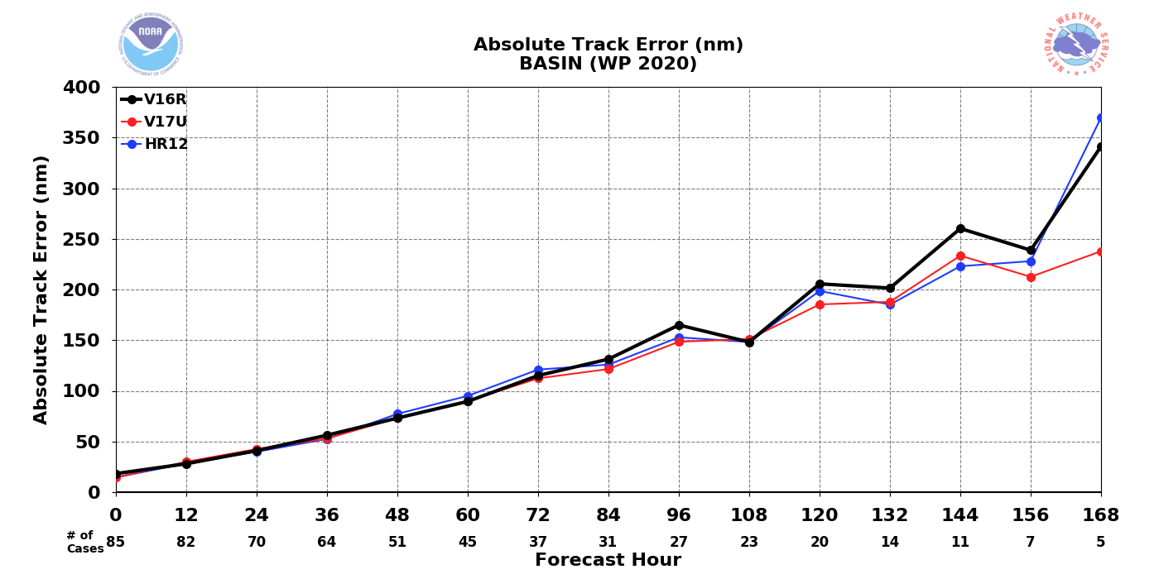
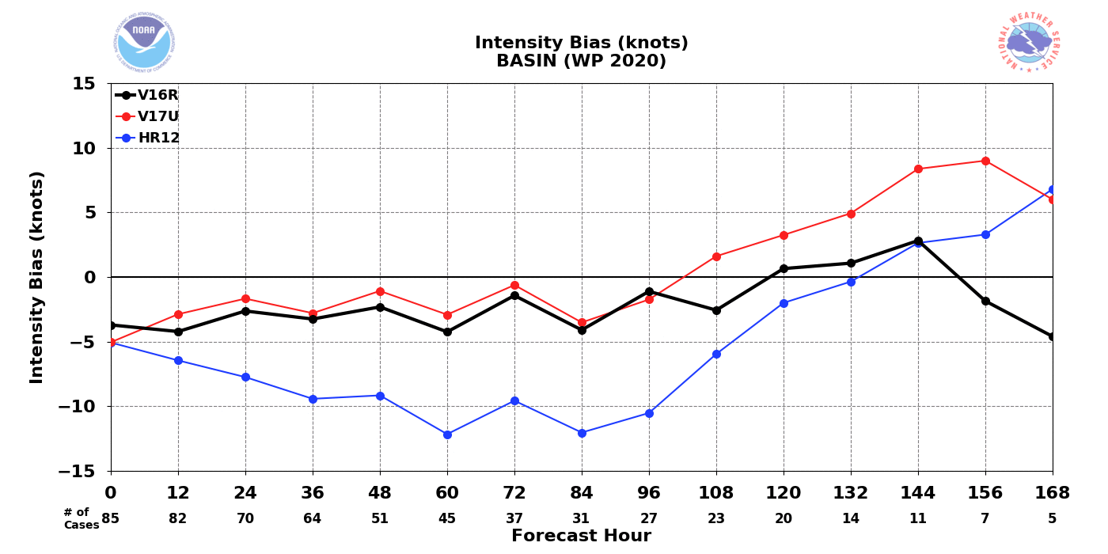
TC intensity and track error
TC track error
TC Intensity error
Track error
Slightly increased for N. Atl, little change for W. Pac
Intensity error
Both GFSv16 and HR1 underestimate intensity
The intensity underestimation is clearly exacerbated in HR1.
A not-surprising impact of coupling
Steps to improve for HR2
N. Atl
HR1
Uncoupled HR
GFSv16
W. Pac

Slide 15
Summary
Benefits of HR1
Improved MJO AC, amplitude, propagation speed (but propagation too slow)
Improved ACC for heights, winds, upper tropospheric temperature in winter hemisphere and tropics
Reduced West CONUS T2m warm bias in summer, improved diurnal cycle shape
Reduced East CONUS 10m wind speed overestimation (but still positive bias)
Increased CAPE (although insufficient)
Deficiencies of HR1
Overestimation of total cloud cover in eastern tropical Pacific/Atlantic south of the equator and consequent underestimation of downward shortwave, leading to cold SST biases
Warm SST biases along the equator in eastern Pacific/Atlantic
Reduced ACC for temperatures at low atmospheric levels
Exacerbated West CONUS 10m wind speed underestimation
Exacerbated West CONUS T2m nighttime cold bias
Exacerbated TC intensity underestimation
Steps to correct these deficiencies are planned for HR2
Contact: Lydia.B.Stefanova@noaa.gov

Slide 16
BACK-UP SLIDES

Slide 17
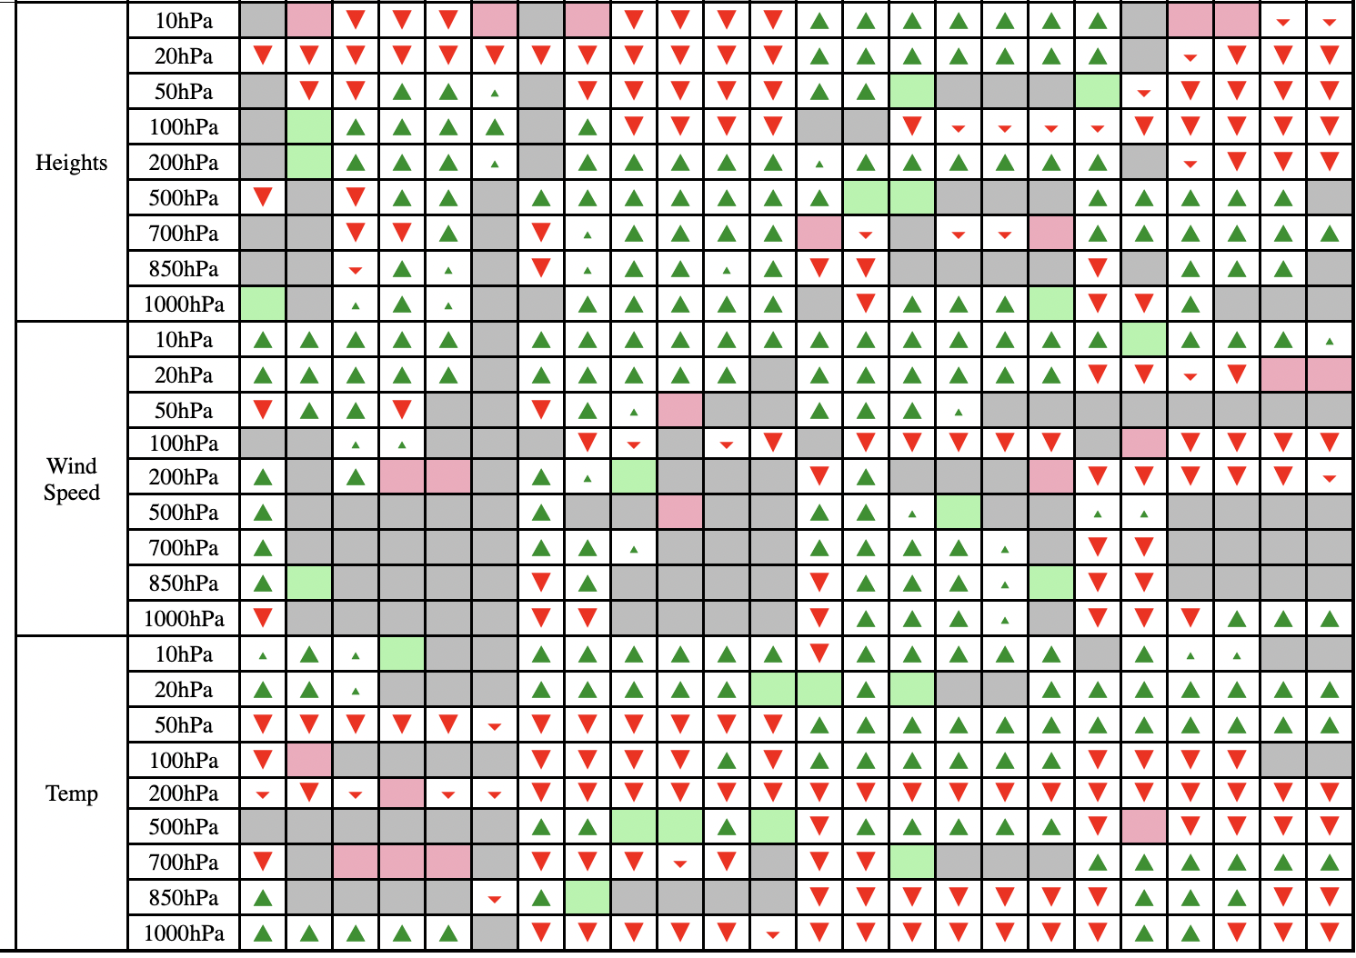
Bias scorecard: DJF
DJF

Slide 18
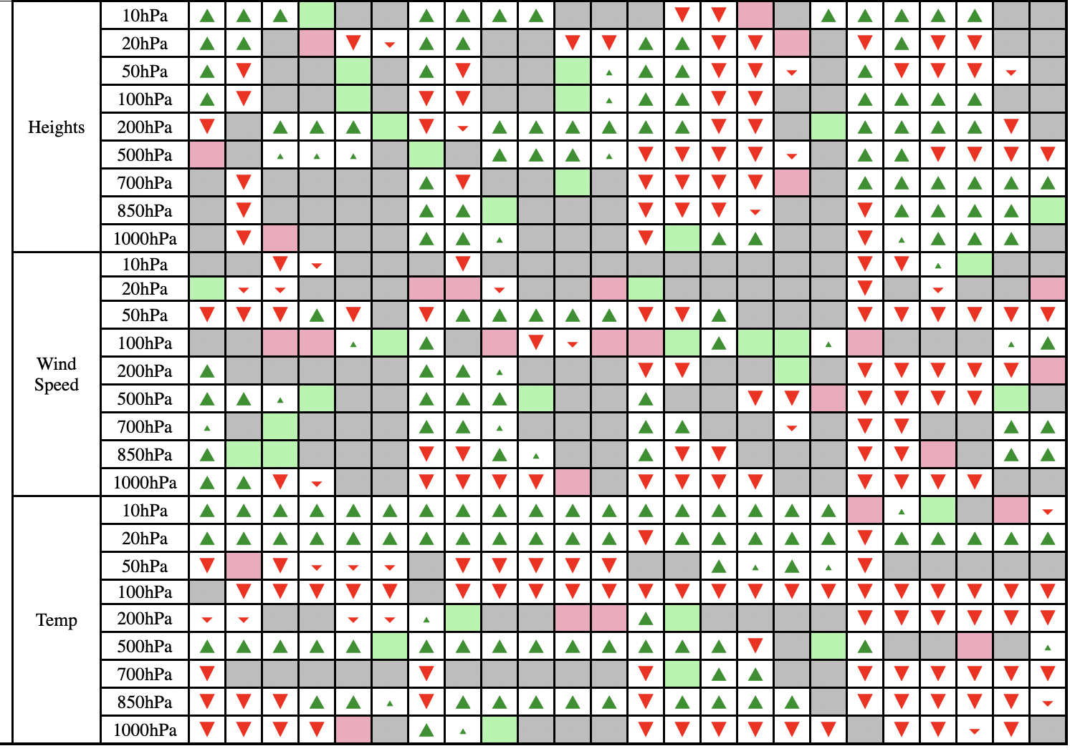
Bias scorecard: JJA
JJA

Slide 19
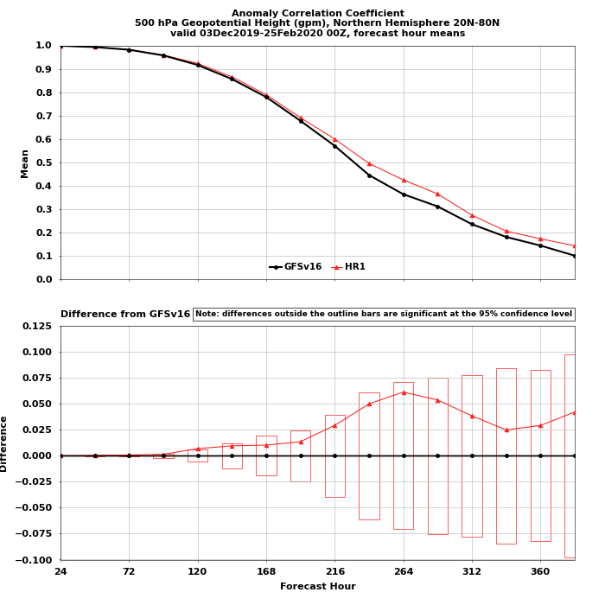
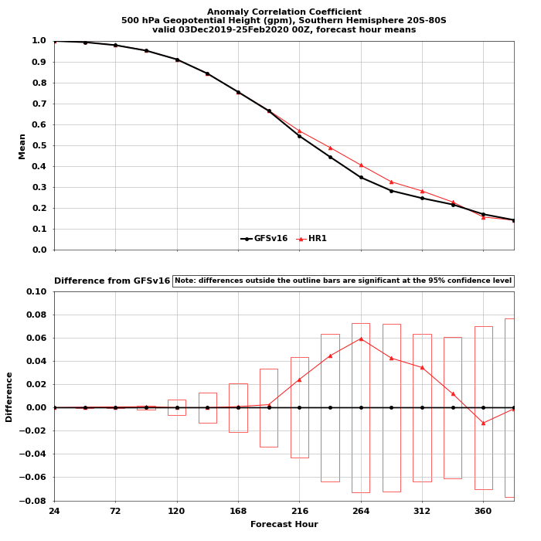
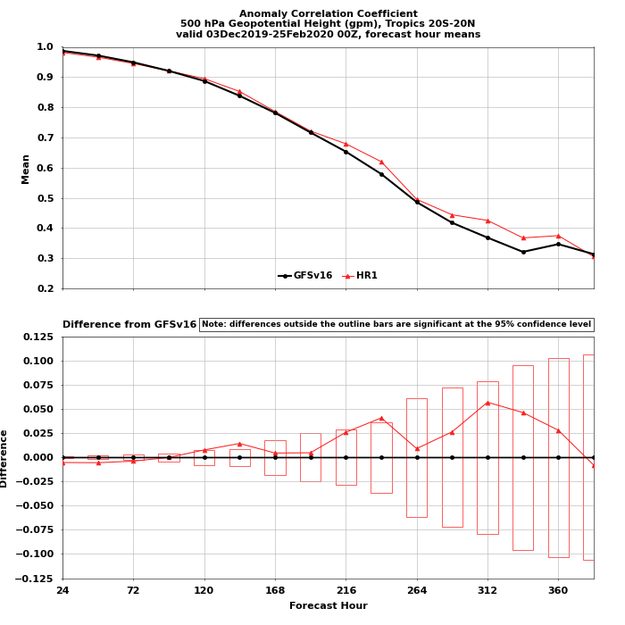
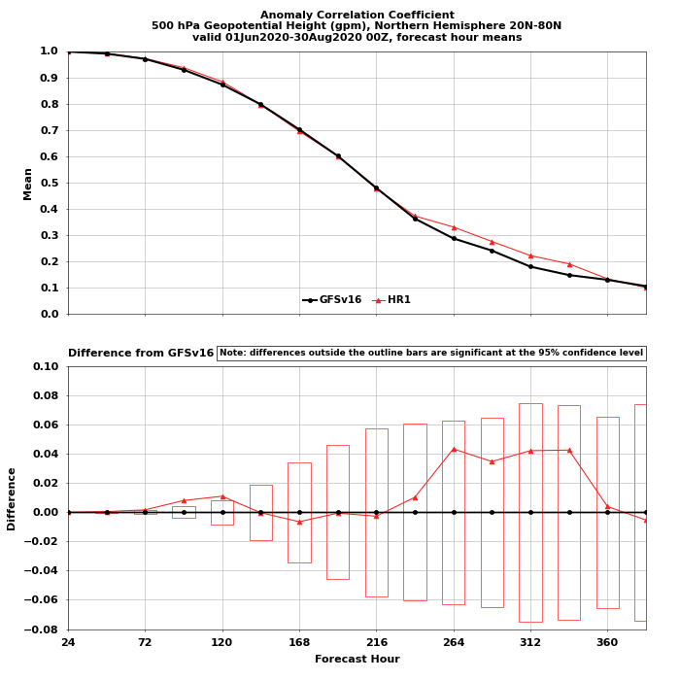
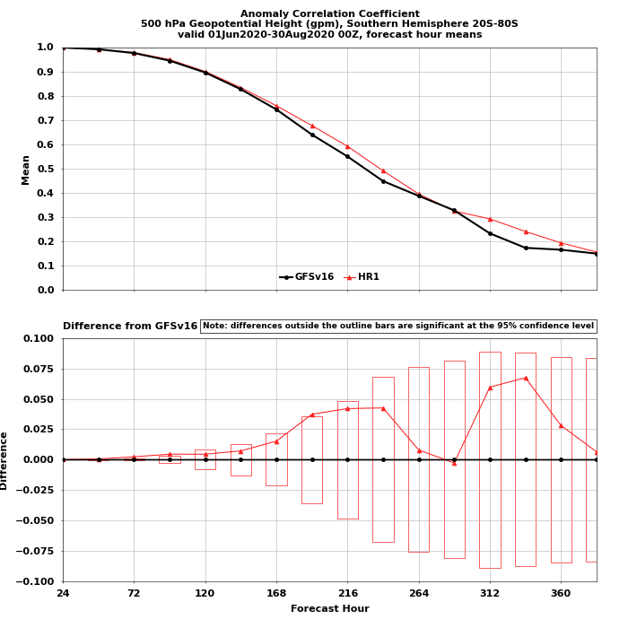
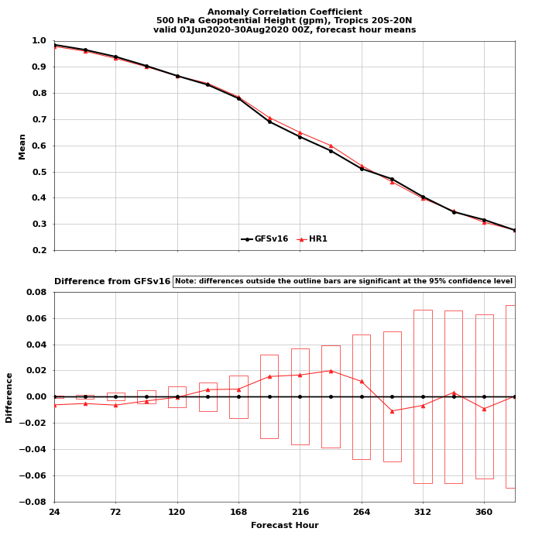
ACC: 500mb Geopotential Height
GFSv16
HR1
DJF
Apparent improvement in 500mb heights in NH/SH/Tropics, starting around day 3-5, although not consistently statistically significant
Northern Hemisphere
Southern Hemisphere
Tropics
JJA

Slide 20
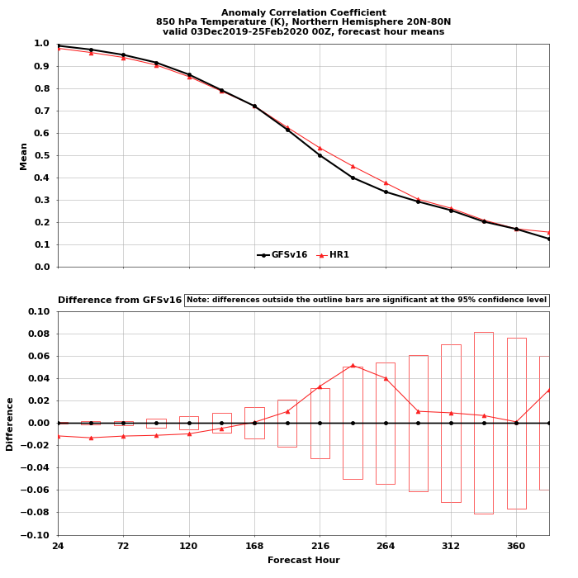
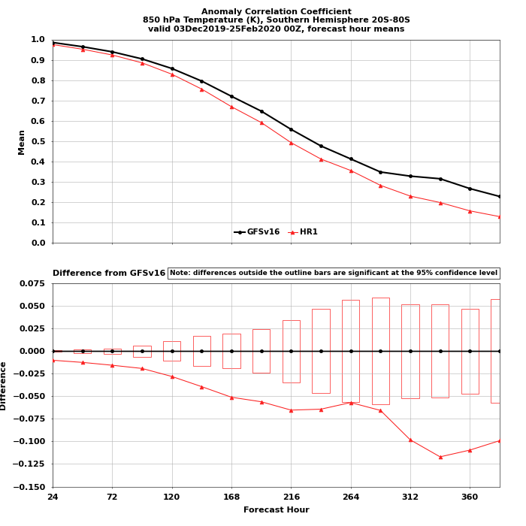
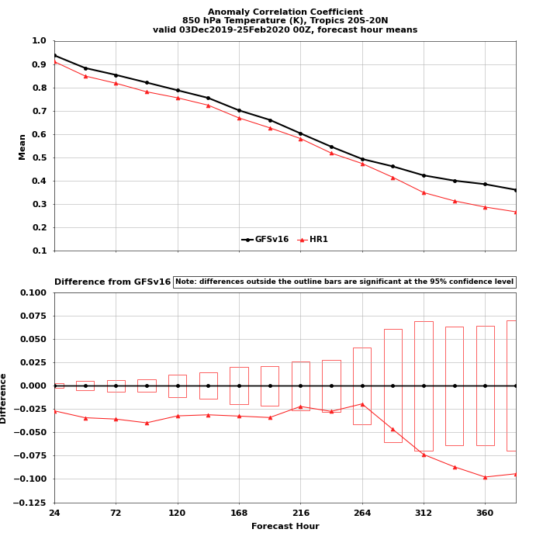
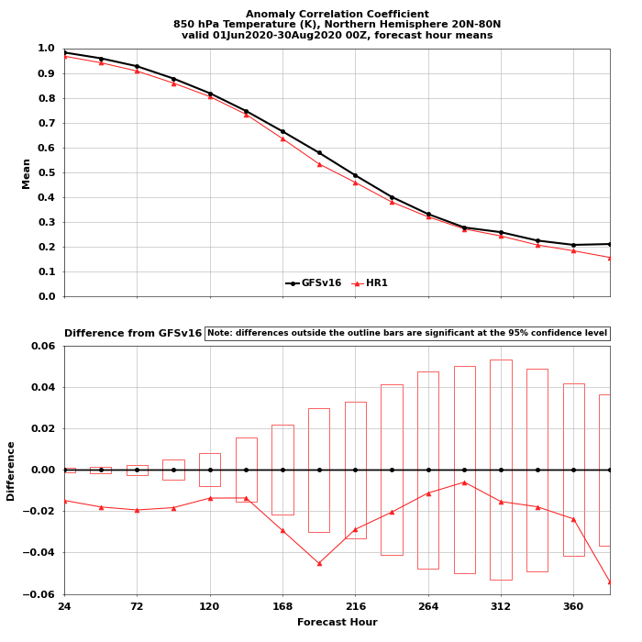
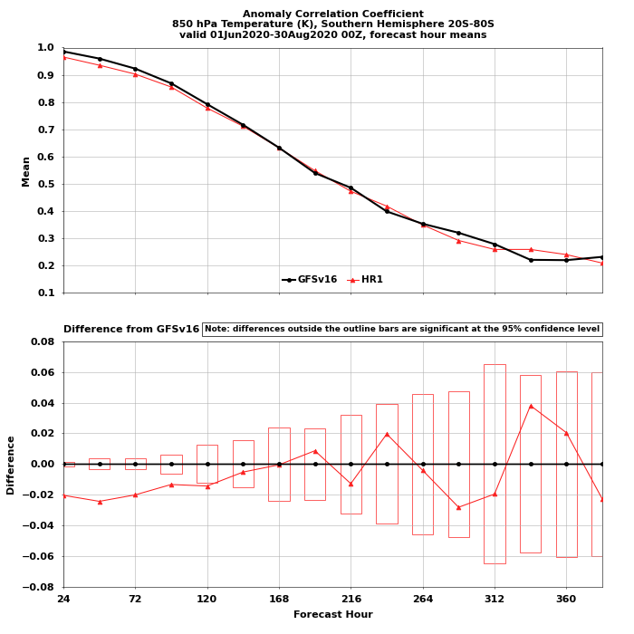
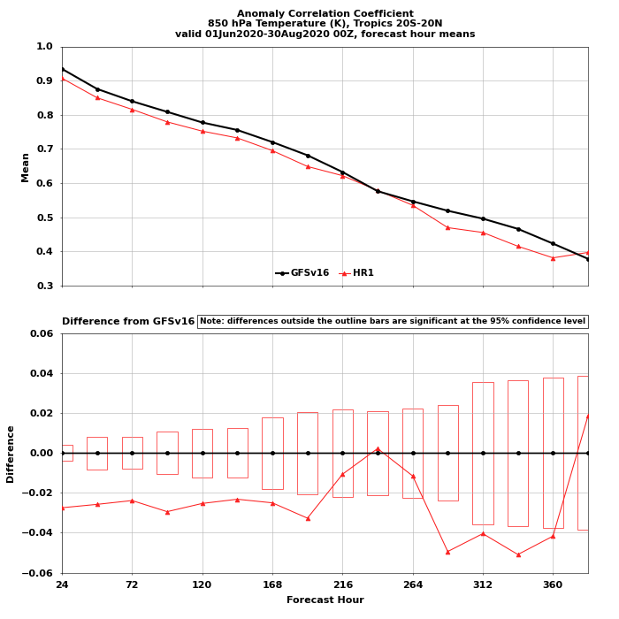
ACC: 850mb Temperature
GFSv16
HR1
DJF
Statistically significant degradation for 850 mb Temperature, particularly in the summer hemisphere (SH in DJF, NH in JJA), and in the Tropics
Northern Hemisphere
Southern Hemisphere
Tropics
JJA

Slide 21
T2max, T2min (JJA)
GFSv16 Bias
HR1 Bias
HR1 minus GFSv16
T2max
Mostly lower Tmax
Mostly higher Tmin
T2min

Slide 22
T2max, T2min (DJF)
GFSv16 Bias
HR1 Bias
HR1 minus GFSv16
T2max
Mostly higher Tmax
Mostly lower Tmin
T2min

Slide 23
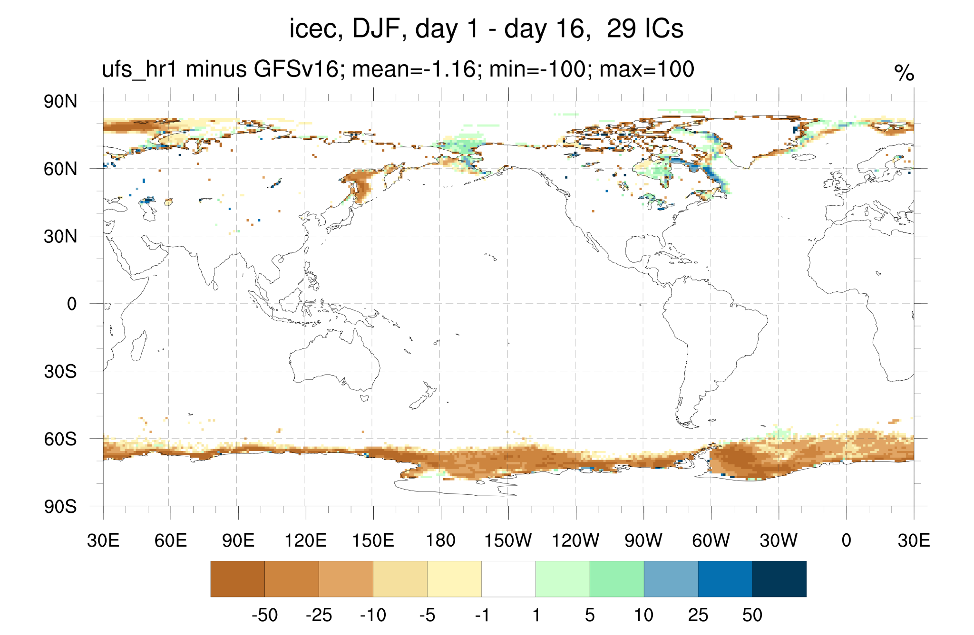
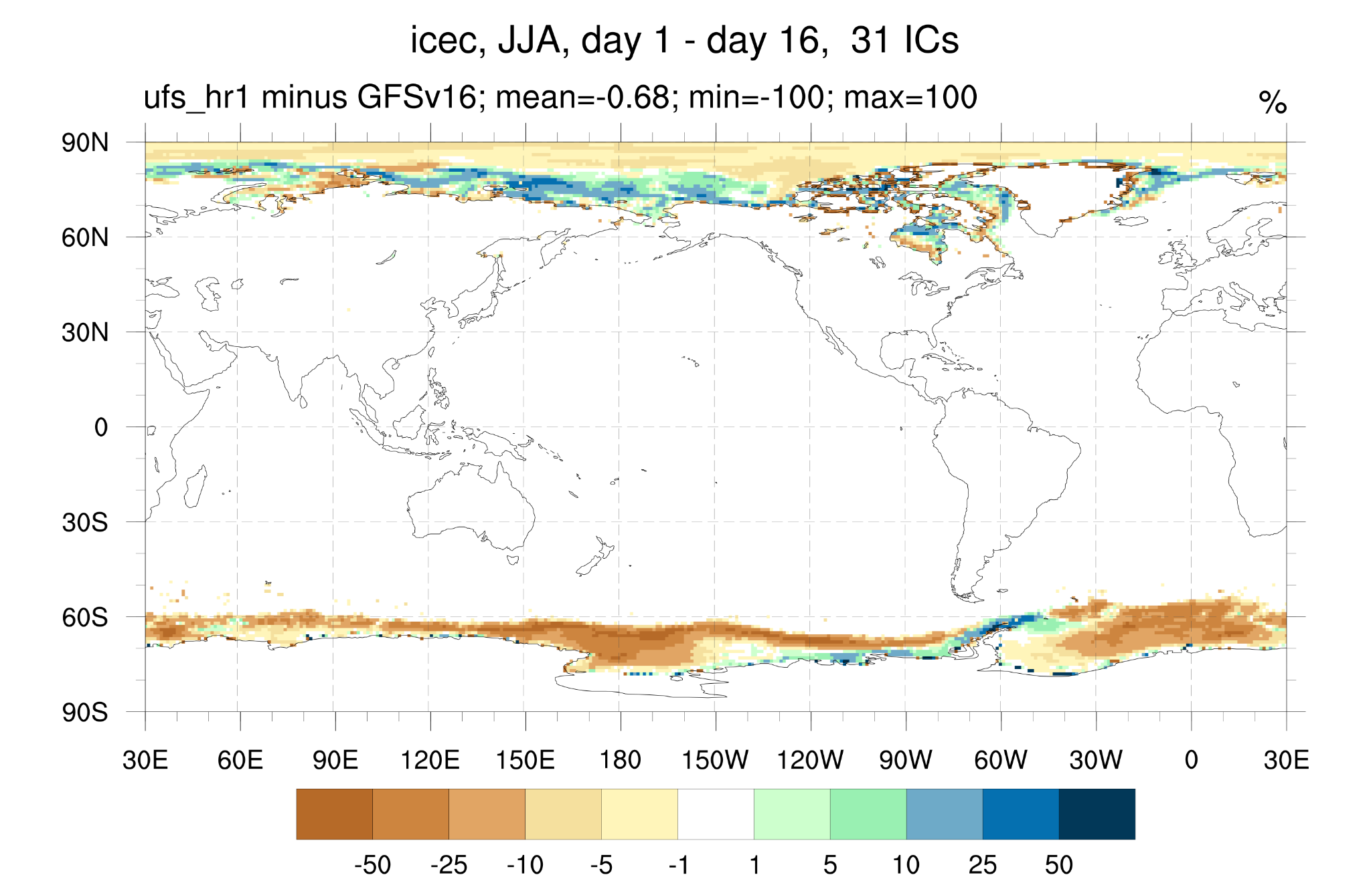
Ice Concentration, HR1 minus GFSv16
Ice concentration (and thickness) differences between HR1 and GFSv16 are notable in both SH and NH, but particularly prominent in SH.
This is a known issue from the Replay ICs for ice, its solution is being implemented by PSL

Slide 24
Total Clouds, bias wrt CERES
GFSv16 Bias
HR1 Bias
HR1 minus GFSv16
DJF
JJA
GFSv16 overestimates the total cloud cover over high latitudes, Indian ocean, Western equatorial Pacific, and south of the equator in the eastern tropical Pacific and Atlantic, as well as over Northern Africa. Cloud cover is underestimated over the remainder of oceans
HR1 has less clouds than GFSv16, except for the eastern tropical Pacific and Atlantic, where it is cloudier

Slide 25
OLR, bias wrt NOAA-CDR
GFSv16 Bias
HR1 Bias
HR1 minus GFSv16
DJF
JJA
OLR reduced (bias improved) along the equator (SH in DJF, NH in JJA). OLR increased (bias improved) in Indian Ocean

Slide 26
OLR, bias wrt NOAA CDR
GFSv16 Bias
HR1 Bias
HR1 minus GFSv16
DJF
JJA
Precip increased where OLR reduced, and vice versa

Slide 27
Surface upward shortwave radiation, bias wrt CERES
GFSv16 Bias
HR1 Bias
HR1 minus GFSv16
DJF
JJA
Most prominent differences between GFSv16 and HR1: Sahara, Arabian Peninsula (deserts) and Antarctic/Greenland (permanent ice/snow), suggesting lower albedoes in HR1
For the desert regions, this is an exacerbation of negative bias, while for the ice/snow regions it is an amelioration of positive bias

Slide 28
Surface upward longwave radiation, bias wrt CERES
GFSv16 Bias
HR1 Bias
HR1 minus GFSv16
DJF
JJA
Upward longwave radiation at the surface: increased positive bias notable over Sahara, Arabian Peninsula (deserts), and in the Southern ocean in JJA – reflecting warmer biases in these regions.
The warmer biases over the Southern ocean in JJA stem from reduced ice extent (attributed to Replay initialization)

Slide 29
2-m Tmax, bias wrt CPC
GFSv16 Bias
HR1 Bias
HR1 minus GFSv16
DJF
JJA
Deserts: Tmax is warmer (consistent with lower albedo)
CONUS
Winter : slight reduction of cold bias in the eastern US, but still cool bias
Summer: reduced warm bias in central US, cool bias elsewhere (and most of Eurasia)

Slide 30
2-m Tmin, bias wrt CPC
GFSv16 Bias
HR1 Bias
HR1 minus GFSv16
DJF
JJA
Deserts: Tmin is cooler (consistent with reduced cloudiness)
CONUS
Winter Tmin: slight reduction of the warm bias (increased cold bias to the north)
Summer Tmin: slight increase in warm bias, except for the west coast

Slide 31
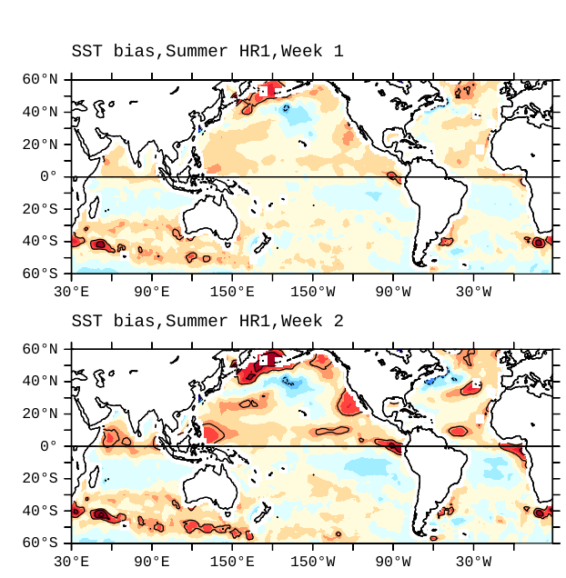
SST bias in weekly averaged forecasts of HR1
Winter case
Summer case
Week 1 bias
Week 2 bias
Warm bias enhanced in summer hemisphere. Bias increases from week 1 to 2
Warm bias (Kuroshio and south of Australia) and too cold bias in south tropical Atlantic in winter
Overall, spatial structure similar to low-res prototype 8; differences largely due to ICs

