Slide 1
Evaluation of the Rapid Refresh Forecast System during the 2023 HWT Spring Forecasting Experiment
Israel Jirak, NOAA/NWS/Storm Prediction Center
Adam Clark, NOAA/OAR/National Severe Storms Laboratory
David Harrison, CIWRO/SPC
Jake Vancil, CIWOR/SPC

Slide 2
RRFS Evaluation during the HWT SFE
RRFS was evaluated during the 2023 Hazardous Weather Testbed (HWT) Spring Forecasting Experiment (SFE) from May 1 - June 2, which was a below-average period climatologically for severe weather
Deterministic Evaluations:
00Z RRFS Control vs. HRRR DA (1-6 hours)
00/12Z RRFS Control vs. HRRR (Day 1)
00Z Flagship Models - Blinded (Day 1)
Ensemble Evaluations:
00Z RRFS vs. HREF (Day 1)
12Z RRFS vs. HREF (Days 1 & 2)
12Z Single-Physics RRFS vs. Multi-Physics RRFS (Days 1 & 2)
12Z Single-Time RRFS vs. Time-Lagged RRFS (Days 1 & 2)
The subjective evaluations from HWT SFE for severe weather forecasting are presented along with objective verification over daily mesoscale domains

Slide 3
RRFS
Deterministic Evaluations

Slide 4
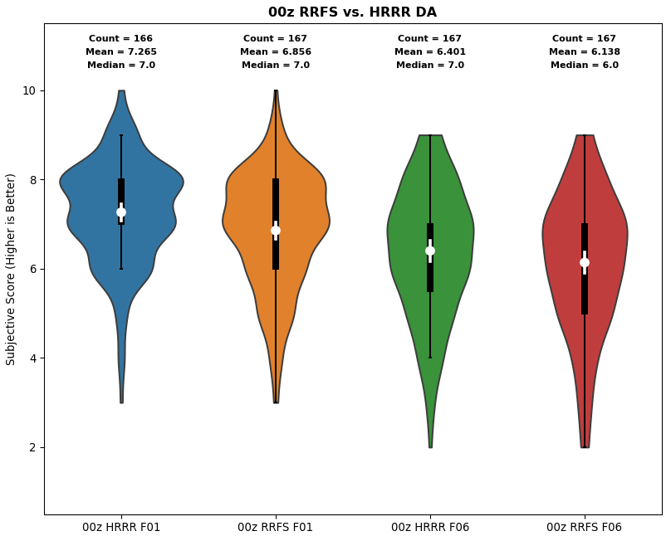
00Z RRFS Control vs. HRRR DA (1-6 hours)
HRRR short-term composite reflectivity forecasts (1-h & 6-h) had higher ratings than those from the RRFS
The 1-h forecasts from the RRFS had an especially high bias in intensity and coverage of reflectivity
HRRR
F01
RRFS
F01
HRRR
F06
RRFS
F06

Slide 5
00Z RRFS Control vs. HRRR DA (1-6 hours)
While neither HRRR nor RRFS are particularly accurate in depicting the derecho-producing MCS in this 1-h forecast, the overly intense reflectivity in the leading convective line and spurious storms in the RRFS are concerning
HRRR
F01
RRFS
F01
MRMS
OBS
Overly
Intense
Spurious
Storms

Slide 6
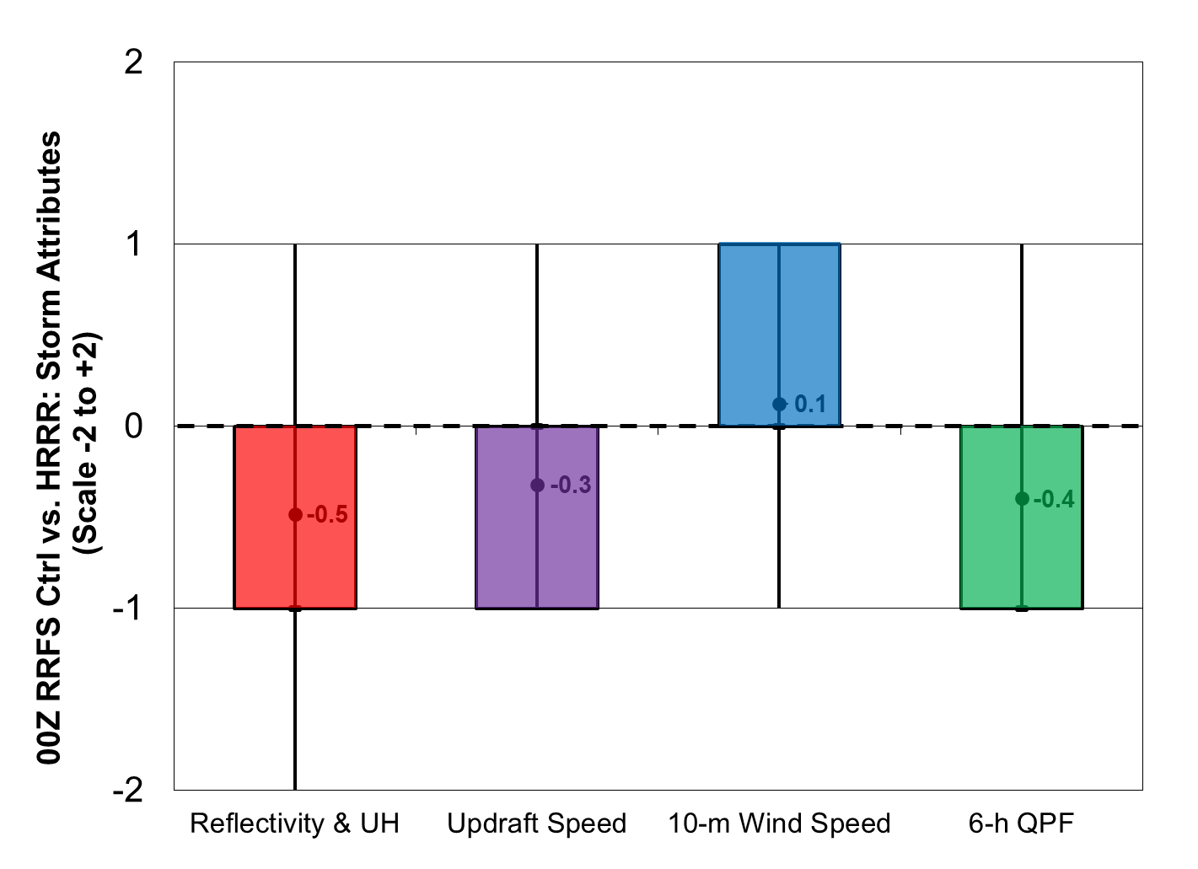
00Z RRFS Control vs. HRRR (Day 1): Storm Attributes
For 00Z storm-attribute fields, the HRRR was rated slightly better for simulated reflectivity/UH, updraft speed, and QPF
Meanwhile, the RRFS was very slightly favored for severe convective 10-m winds
Most common comments were that the RRFS developed storms that were too intense and numerous/widespread
RRFS Better
RRFS Worse

Slide 7
00Z RRFS Control vs. HRRR (Day 1): Storm Attributes
HRRR has a much better forecast than the RRFS control for the derecho-producing MCS across eastern Kansas from the 00Z-initialized run on 9 May 2023
HRRR
F20
RRFS
F20
MRMS
OBS

Slide 8
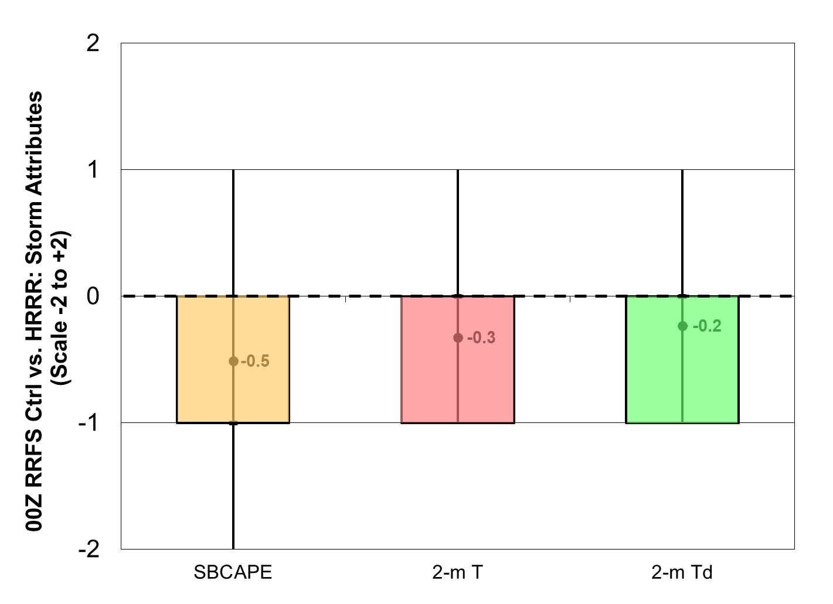
00Z RRFS Control vs. HRRR (Day 1): Environment
For 00Z environment fields, slight edge to the HRRR for SBCAPE, 2-m temperature, and 2-m dewpoint.
SBCAPE forecasts were the most common environmental field to be favored for the HRRR
RRFS Better
RRFS Worse

Slide 9
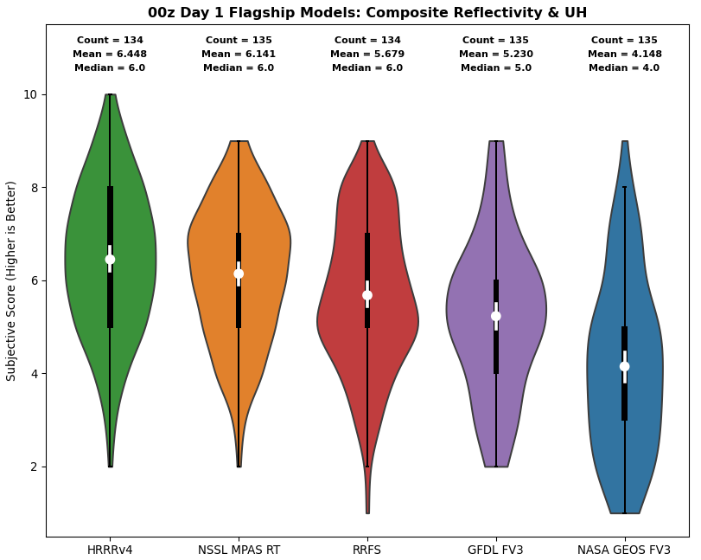
00Z Flagship Models - Blinded (Day 1): Reflectivity
Blinded Evaluation
HRRR had highest mean rating for reflectivity - statistically significantly higher than RRFS (90% CI)
NSSL MPAS actually slightly favored on average over the RRFS for these 00Z runs covering Day 1 (f12-f36)
HRRR
RRFS

Slide 10
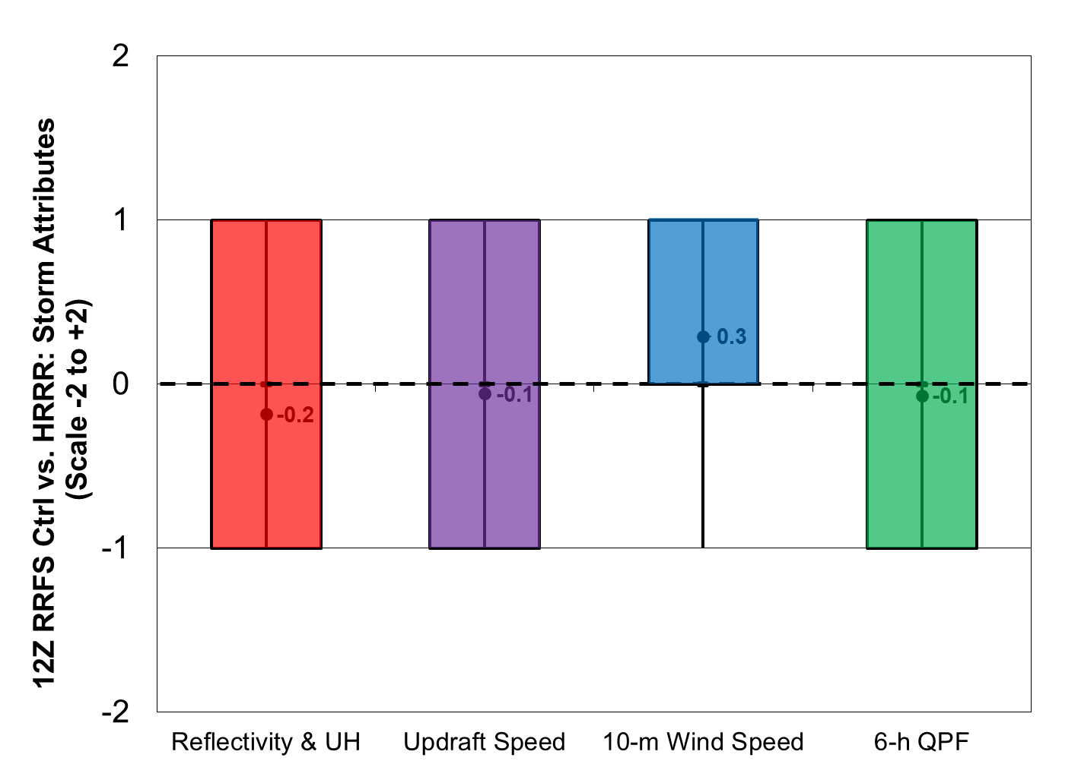
12Z RRFS Control vs. HRRR (Day 1): Storm Attributes
For 12Z storm-attribute fields, the distributions are shifted toward the middle where model performance is about the same
RRFS was slightly favored for severe convective 10-m winds
RRFS Better
RRFS Worse

Slide 11
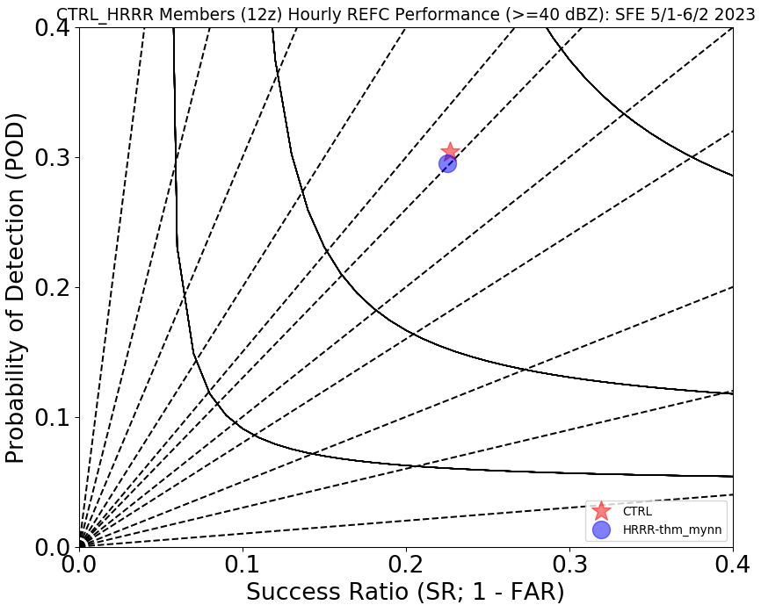
12Z RRFS Control vs. HRRR (Day 1): Reflectivity
Objective verification of ≥40 dBZ reflectivity over the SFE daily domains confirms subjective ratings for 12Z runs
Very similar Day 1 performance characteristics (CSI, POD, bias, etc.) for RRFS control and HRRR for 12Z cycle
* Planning to calculate objective statistics for 00Z runs for comparison
RRFS
HRRR
Credit: Jake Vancil (CIWRO)

Slide 12
12Z RRFS Control vs. HRRR (Day 1): Storm Attributes
RRFS control forecast is much improved from the 12Z cycle for the derecho-producing MCS across eastern Kansas compared to the 00Z run and better than the 12Z HRRR (though still slow)
HRRR
F08
RRFS
F08
MRMS
OBS

Slide 13
RRFS
Ensemble Evaluations

Slide 14
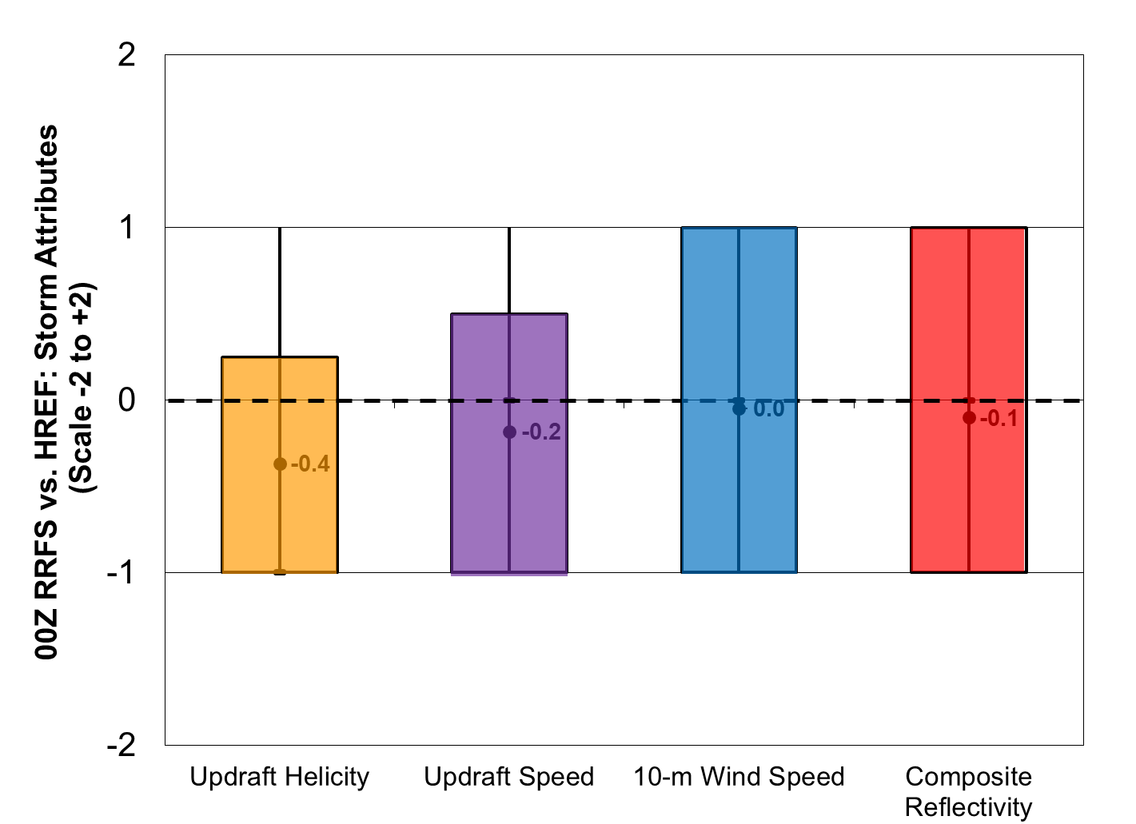
00Z RRFS Ens vs. HREF (Day 1): Storm Attributes
Directly compared the 00Z single-physics RRFS ensemble to the HREF
For the storm-attribute fields, the HREF has slightly higher ratings for updraft helicity & updraft speed
The rating distributions are more neutral (about the same) for 10-m wind speed and composite reflectivity.
RRFS Better
RRFS Worse

Slide 15
00Z RRFS Ens vs. HREF (Day 1): Storm Attributes
For the 9 May event, the RRFS was rated slightly worse than HREF, owing to better orientation of probabilities and centering of preliminary LSRs for the HREF forecast
24-h NMEP of Updraft Helicity >99.85%
HREF
F36
RRFS
F36

Slide 16
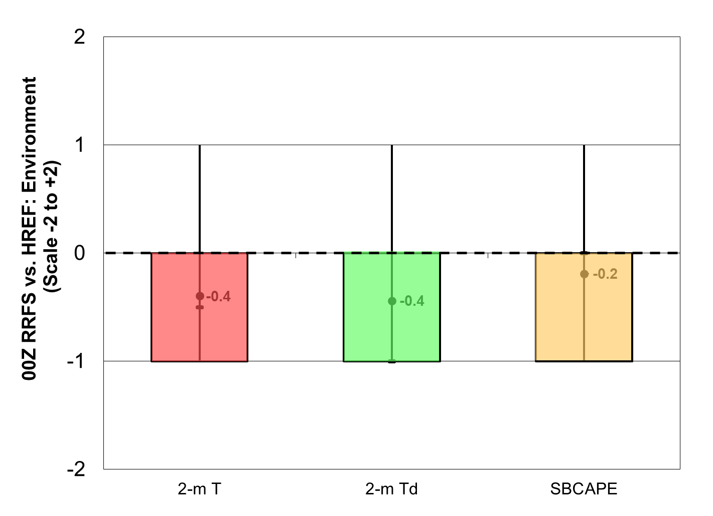
00Z RRFS Ens vs. HREF (Day 1): Environment
For the environment fields between 16-20Z, the rating distributions are shifted toward RRFS being slightly worse
SBCAPE forecasts were closer to “about the same”
Later times (not shown) are similar with a subtle shift toward being about the same
RRFS Better
RRFS Worse

Slide 17
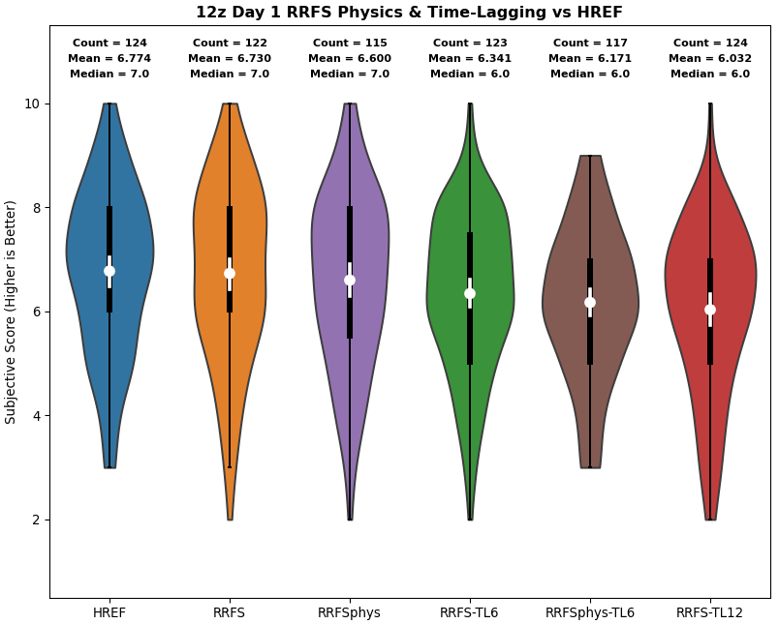
12Z RRFS Ens vs. HREF (Day 1): Storm Attributes
Similar rating distributions for the 12Z HREF and single-physics RRFS covering the Day 1 period
This is an encouraging result and evidence of the progress made
HREF
RRFS

Slide 18
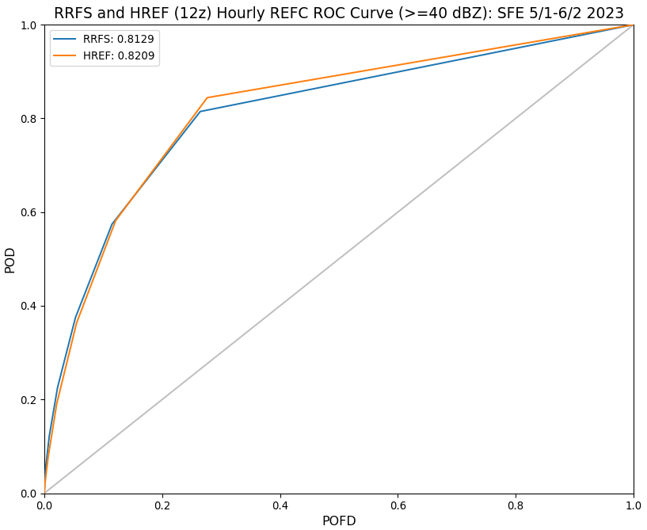
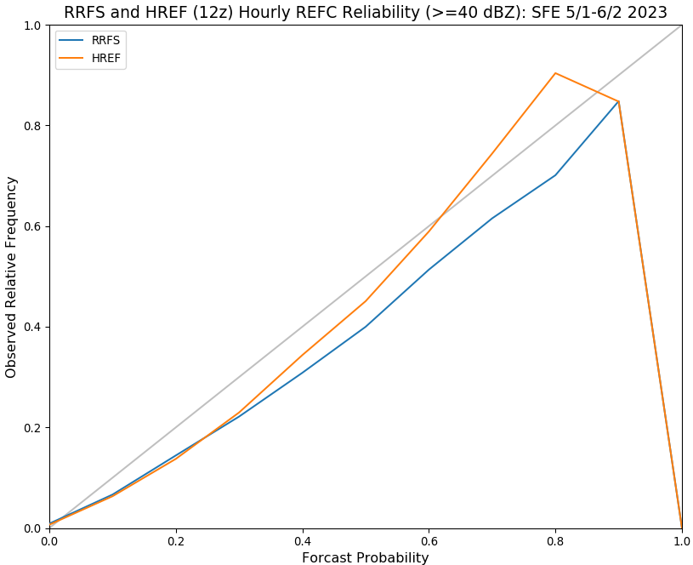
12Z RRFS Ens vs. HREF (Day 1): ROC & Reliability
HREF
RRFS
HREF
RRFS
Credit: Jake Vancil (CIWRO)
Objective verification statistics over the SFE domains confirm similar ensemble performance characteristics for deep convection (>40 dBZ reflectivity) with an edge to the HREF for POD @ 10% and reliability above 30%

Slide 19
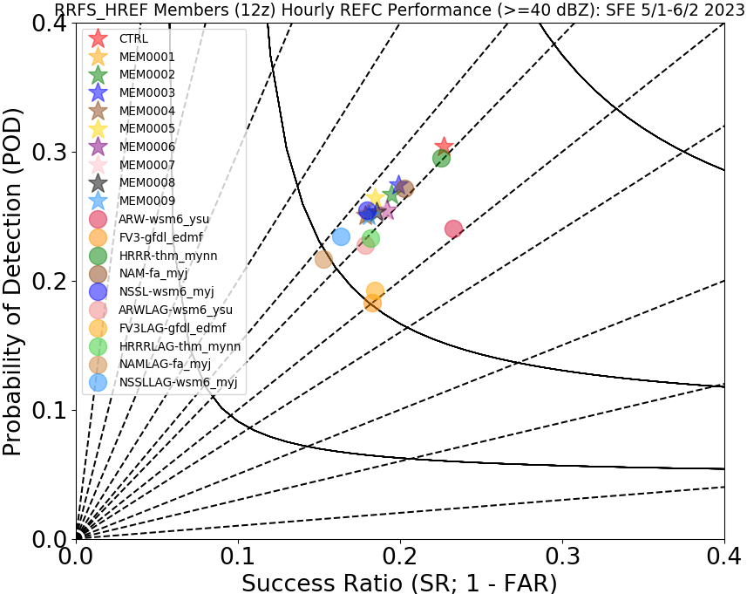
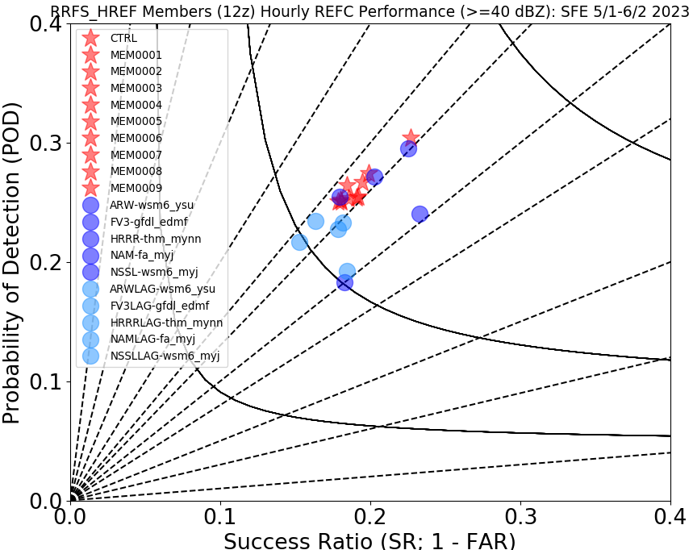
12Z RRFS Ens vs. HREF (Day 1): Member Perf.
First of all, it is worth acknowledging the significant development efforts and improvements to get the FV3 core to where it is today for convective-scale forecasting
This is a true worst-to-first story going from the HRW-FV3 to the current RRFS control member
RRFS Ctl
HRW-FV3
Stars: RRFS
Circles: HREF
Credit: Jake Vancil (CIWRO)

Slide 20
12Z RRFS Ens vs. HREF (Day 1): Member Perf.
The RRFS control member and HRRR clearly stand out as the best performers
The HRW-ARW stands alone as a next-tier performer with distinct performance characteristics
The NAM Nest, HRW-NSSL, and perturbed RRFS members have similar performance characteristics
The HRW-FV3 stands alone as the worst performer
RRFS Ctl
HRRR
NAM Nest
HRW-ARW
HRW-FV3
Stars: RRFS
Circles: HREF
Credit: Jake Vancil (CIWRO)

Slide 21
12Z RRFS Ens vs. HREF (Day 1): Member Perf.
The perturbed RRFS members are closely clustered in terms of performance (red stars)
The HREF members have widely varying performance characteristics (dark blue circles)
The time-lagged HREF members (light blue circles) are clustered as lower performers
Despite being comprised of worse-performing members, the HREF ensemble still provides more skillful & reliable probabilistic guidance
Red: RRFS
Blue: HREF
Credit: Jake Vancil (CIWRO)

Slide 22
12z RRFS Ensemble Physics (Day 1): Storm Attributes
Extremely similar rating distributions for the Day 1 12Z single-physics RRFS and multi-physics RRFSphys

Slide 23
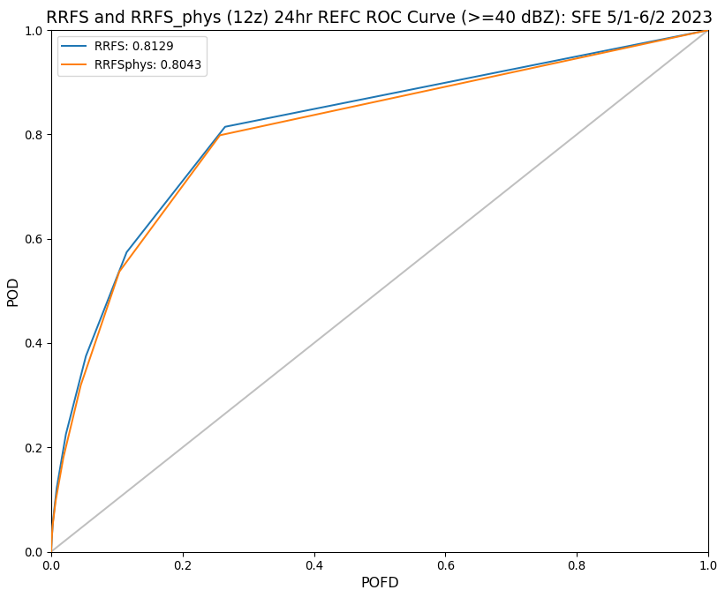
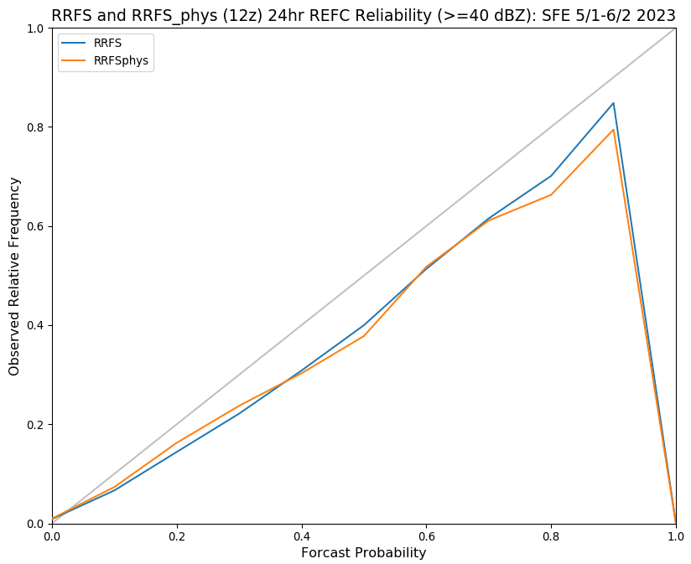
12z RRFS Ensemble Physics (Day 1): ROC & Reliability
RRFS
RRFSphys
RRFSphys
RRFS
Credit: Jake Vancil (CIWRO)
Objective verification statistics over the SFE domains confirm very similar RRFS ensemble performance characteristics for deep convection (>40 dBZ reflectivity).

Slide 24
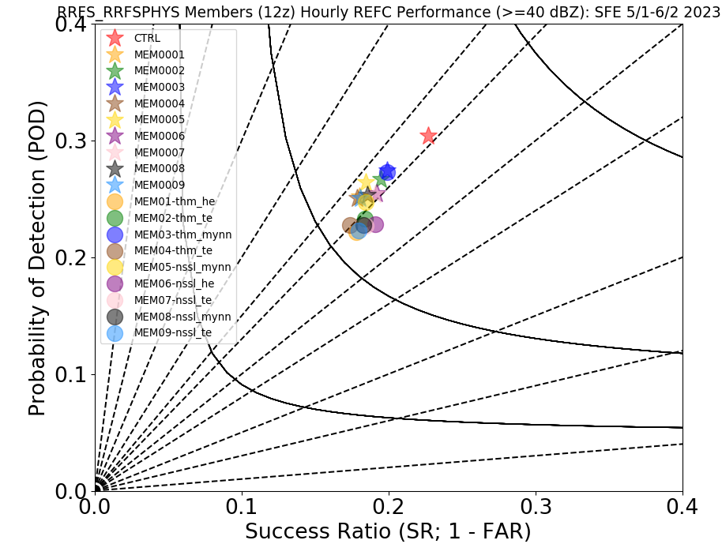
12z RRFS Ensemble Physics (Day 1): Member Perf.
The control member clearly stands out as the best performer
The perturbed single-physics members (MYNN-Thompson; stars) cluster fairly closely.
Perturbations in members 03 (blue), 02 (green), and 05 (yellow) perform slightly better than the others.
The MYNN physics members (03/blue and 05/yellow circles) perform the best from the mulit-physics ensemble
Stars: single-physics
Circles: multi-physics
Credit: Jake Vancil (CIWRO)

Slide 25
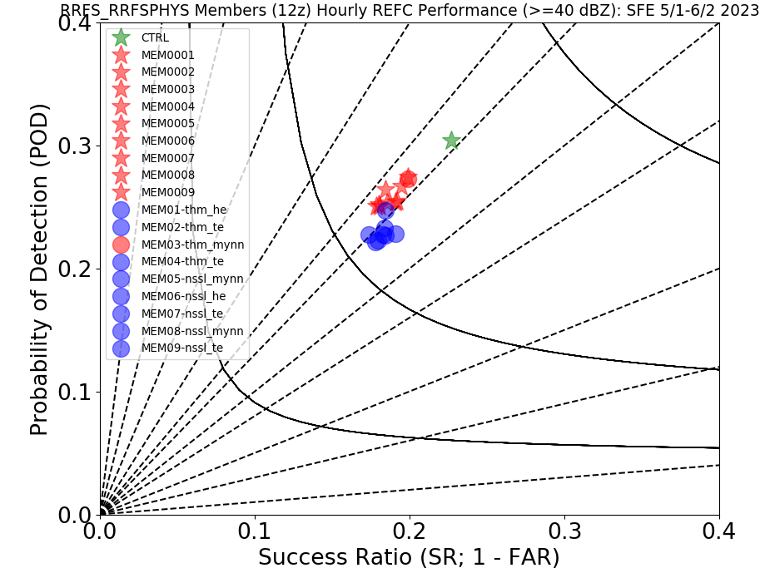
12z RRFS Ensemble Physics (Day 1): Member Perf.
Clearly, the perturbed physics members are closely clustered as the worst performers (blue circles)
Thus, using a poorer performing physics suite (especially GFS EDMF PBL scheme) in 6 of 10 members puts the multi-phsyics RRFS ensemble at a disadvantage
Red: single-physics
Blue: multi-physics
Credit: Jake Vancil (CIWRO)

Slide 26
12z RRFS Time Lagging (Day 1): Storm Attributes
The RRFS time-lagged ensembles had similar rating distributions to one another
However, the RRFS time-lagged ensembles had lower mean and median ratings than the HREF
With RRFS time-lagged ensembles being proposed to replace the HREF, this is concerning

Slide 27
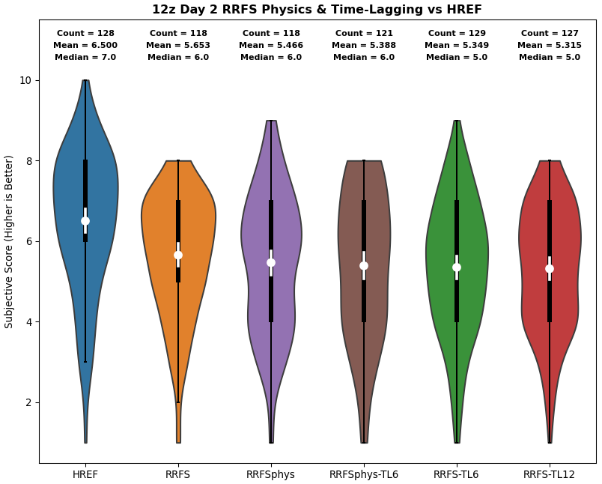
12Z RRFS Ens vs. HREF (Day 2): Storm Attributes
One of the more surprising and strongest results occurred with Day 2 forecasts
HREF has much higher rated Day 2 forecasts overall compared to RRFS
All of the RRFS configurations (physics, time-lagged) had a similar distribution of ratings for Day 2

Slide 28
Summary and Conclusions
There have been major strides in FV3 modeling at CAM scales
The 00Z HRRR was rated as performing better than the 00Z RRFS control member, but the 12Z runs were much closer in terms of performance
Despite poorer-performing members in the HREF, the probabilistic guidance is more skillful and reliable than the RRFS ensemble, which tends to be underdispersive and overconfident
The RRFS multi-physics ensemble is likely not optimally configured, owing to being comprised of a majority of poorer-performing members (w/ GFS PBL)
The time-lagged RRFS ensembles were rated lower on Day 1 than the ensembles initialized at a single time and the HREF
The HREF forecasts for Day 2 were rated much higher than all of the RRFS configurations for that period

Slide 29
Extra Slides

Slide 30
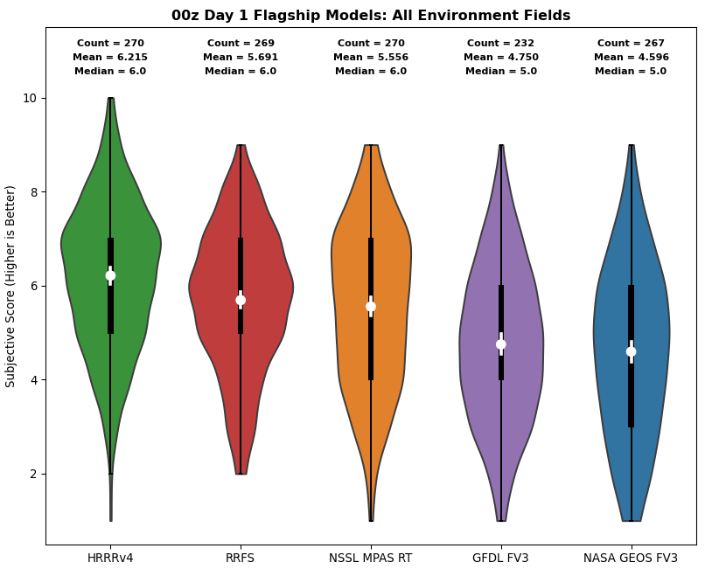
00Z Blinded Flagships (Day 1): Environment
Blinded Evaluation
HRRR also had highest mean rating for all environmental fields combined
RRFS had the second-highest mean rating for the environmental fields - SBCAPE was the lowest rated RRFS environmental field (not shown)

Slide 31
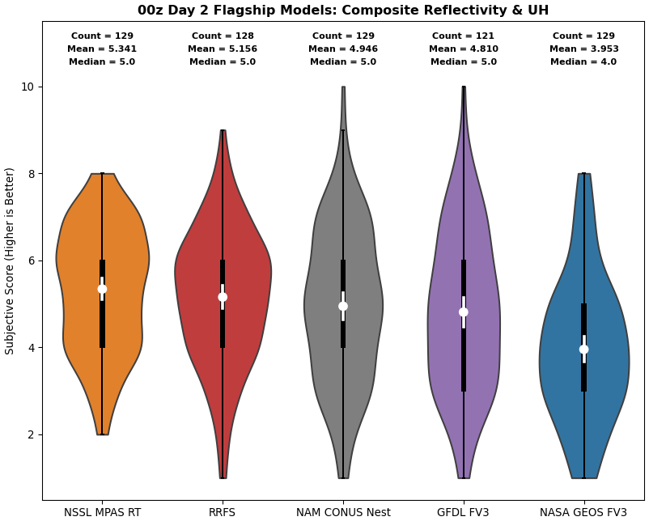
00Z Blinded Flagships (Day 2): Reflectivity
Blinded Evaluation
No HRRR for full Day 2, so replaced with NAM Nest
Rating distributions were more similar across the models
Very slight edge in the mean rating to NSSL MPAS actually over the RRFS

Slide 32
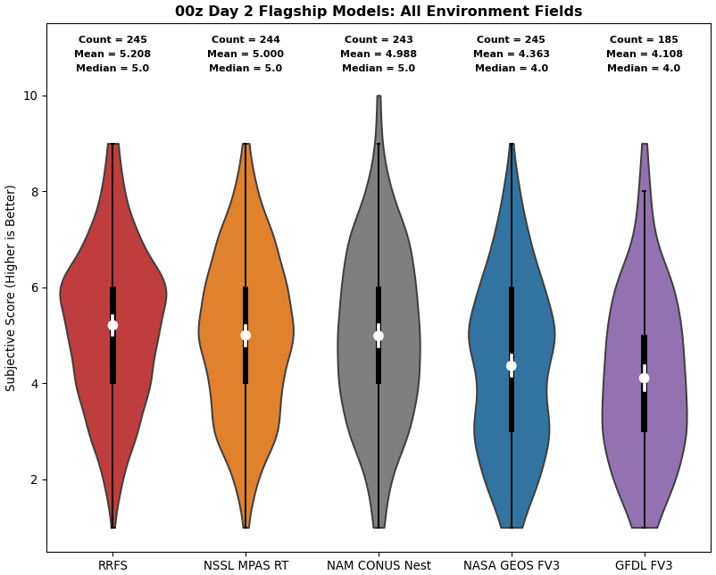
00Z Blinded Flagships (Day 2): Environment
Blinded Evaluation
RRFS had highest mean rating for all environmental fields combined, but there is strong overlap in the distributions with NSSL MPAS and NAM Nest

Slide 33
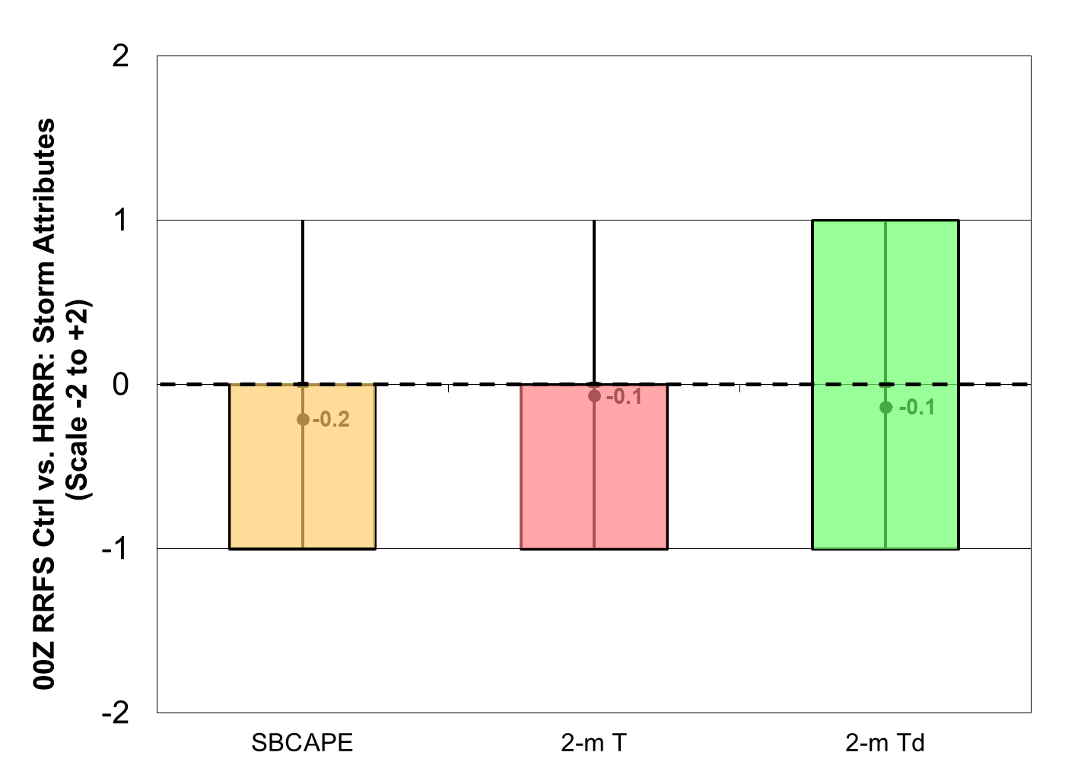
12Z RRFS Control vs. HRRR (Day 1): Environment
For 12Z environment fields, the distributions are also shifted toward the middle (“Models performed about the same”)
SBCAPE forecasts were the most common environmental field to be favored for the HRRR
RRFS Better
RRFS Worse

Slide 34
RRFS Ensemble Physics: Subjective Evaluation
Personal subjective comparison of RRFS single-physics to multi-physics for 38 forecasts between May 1 - June 17
Focused on 24-h updraft helicity and updraft speed probabilities for severe weather forecasting valid for the convective day from the 12Z cycle
Overall, the forecasts were very similar - often not different enough to result in a change to a severe weather outlook
Results using 5-Point Likert Scale shown by number of ratings:
0: Multi-Physics Much Worse
2: Multi-Physics Slightly Worse
30: Multi-Physics About the Same as Single-Physics
6: Multi-Physics Slightly Better
0: Multi-Physics Much Better

Slide 35
RRFS Ensemble Physics: Examples
Before May 12, multi-physics RRFS (RRFSphys; bottom row) commonly had higher peak neighborhood ensemble probabilities than the single-physics RRFS (RRFS; top row)
After May 12, the behavior seemed to change to the expected result - lower probs in the multi-physics RRFS
May 5 May 29 May 14
Higher Probs
Lower Probs
Much Lower Probs
24-h NMEP of Updraft Speed >20 m/s

Slide 36
2023 HWT SFE: 12z Day 2 RRFS Physics & TL vs. HREF
For Day 2 forecasts, the single-physics RRFS and multi-physics RRFSphys had similar mean ratings among SFE participants, but the multi-physics RRFSphys had a bi-modal distribution
HREF mean rating by SFE participants was statistically significantly higher than all of the RRFS configurations for Day 2

