Slide 1
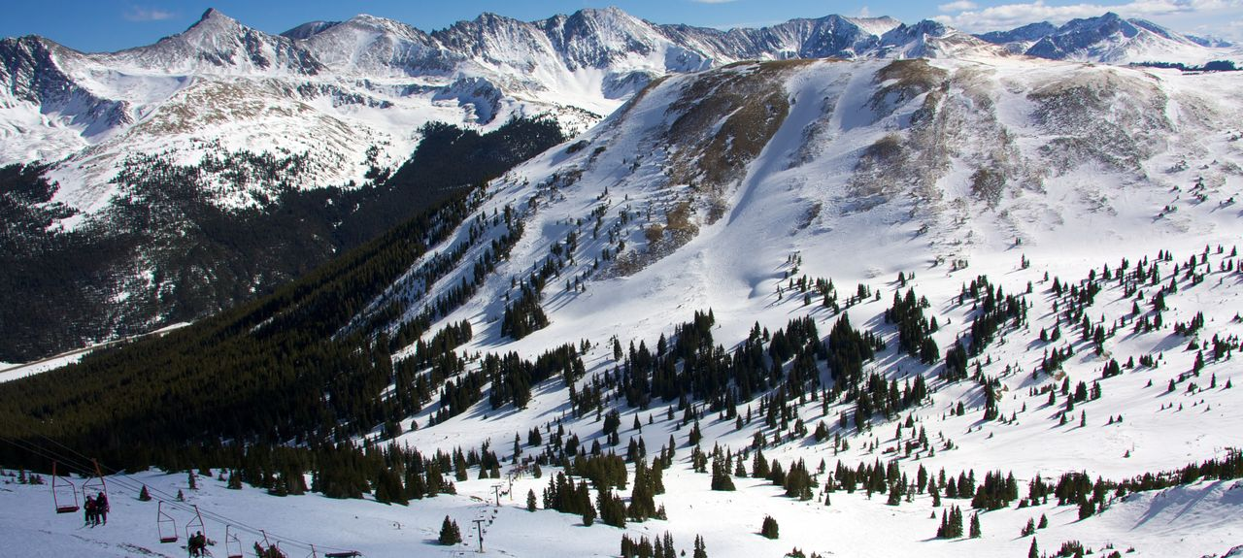


Improving snow cover modeling in UFS/Noah-MP land component
Cenlin He (NCAR)
Ronnie Abolafia-Rosenzweig (NCAR), Fei Chen (NCAR), Michael Barlage (NOAA/EMC)

Slide 2
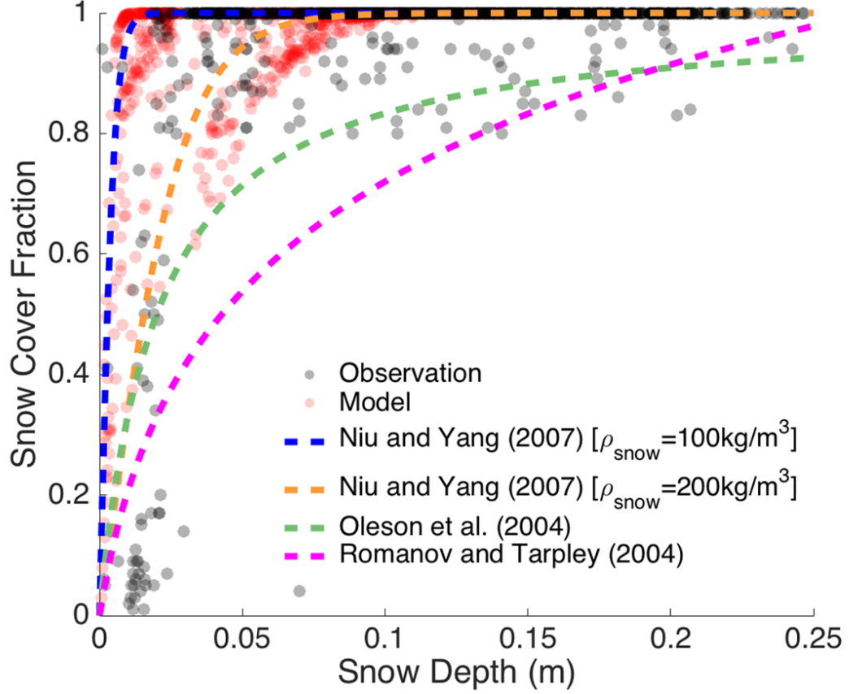
Snow cover bias in Noah-MP
Samples over bare ground (no vegetation)
Obs (MODIS SCF & SNODAS depth)
Noah-MP
Noah-MP formulation
Noah-MP formulation
He et al., 2019
2

Slide 3
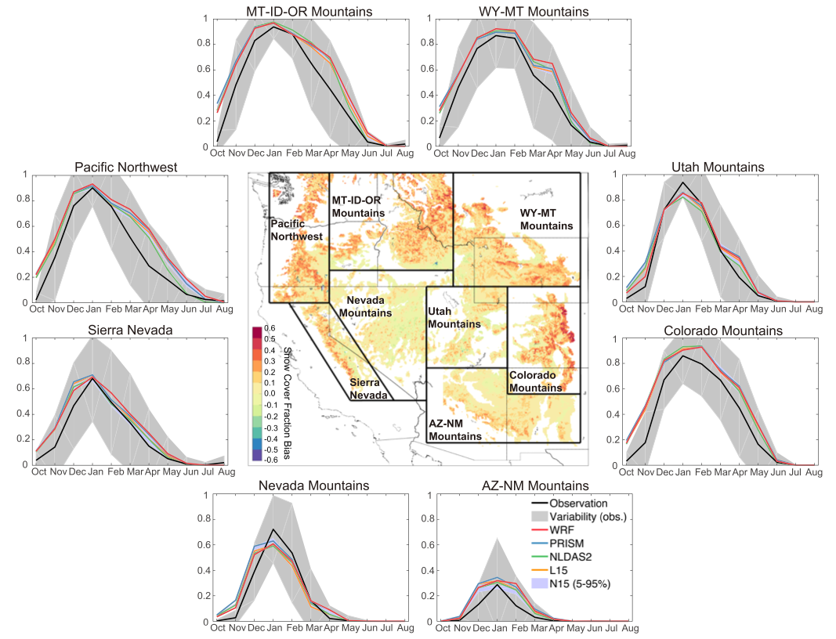
Snow cover bias in Noah-MP
He et al., 2019
3

Slide 4
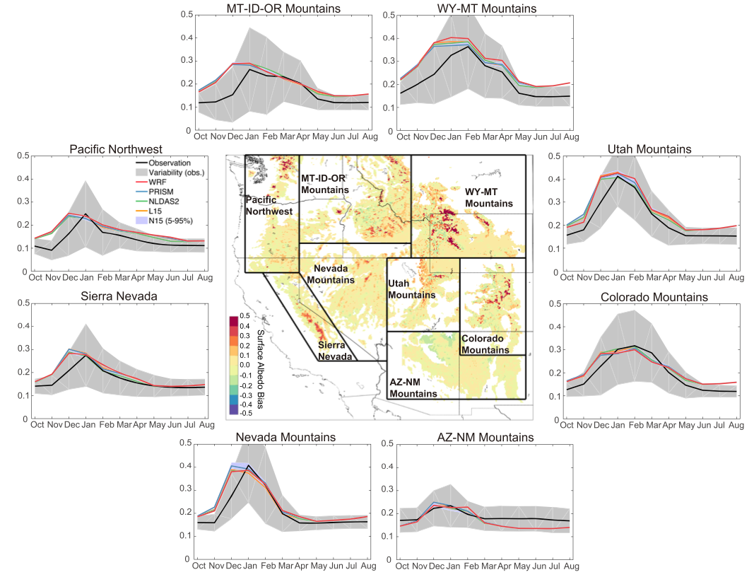
Surface albedo bias in Noah-MP
He et al., 2019
4

Slide 5
Snow albedo feedback connecting various model uncertainties
Abolafia-Rosenzweig et al., 2023 in review
5
Notes:
our analyses are systematically evaluating Noah-MP snowpack uncertainty sources one process at a time. We recently submitted a manuscript enhancing the compaction scheme. The on-going work I am presenting on here focuses on the SCF

Slide 6
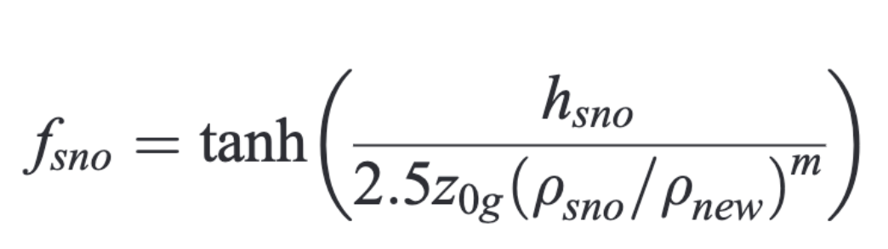
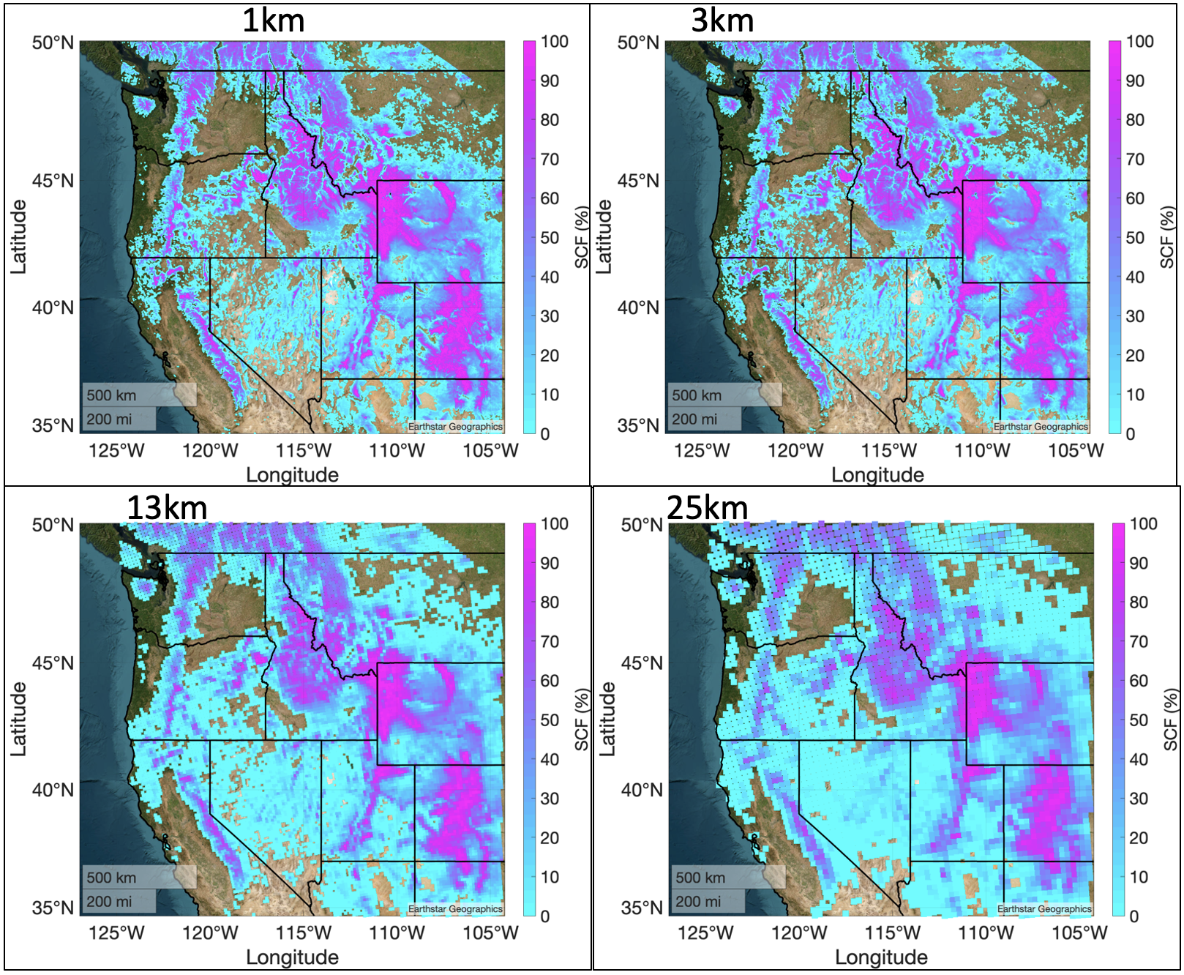
Enhancing snow cover parameterization across scales
MODSCAG: Mean Winter SCF (Jan-March, 2015)
1 km
3 km
Use observations to constrain and optimize the snow cover formulation parameters:
Snow melting factor: “m”
Snow cover prefactor: “2.5z_{0g}” = SCFFAC
Observations:
500-m MODSCAG snow cover data
1-km SNODAS snow depth and density data
13 km
25 km
6
Notes:
(i) find local minimum using Matlab's lsqcurvefit function (which uses the Levenberg-Marquardt algorithm)
(ii) re-find local minimum using the same guess of initial parameters but using Matlab's fminsearch function (which uses the Belder-Mead simplex algorithm)
(iii) re-do steps (i) and (ii) but with a very different initial guesses
Initial guess for step (i and ii)
MFSNO = 2.5, SCFAC = 0.2
Initial guess for step (iii)
MFSNO = 5, SCFAC = 2

Slide 7
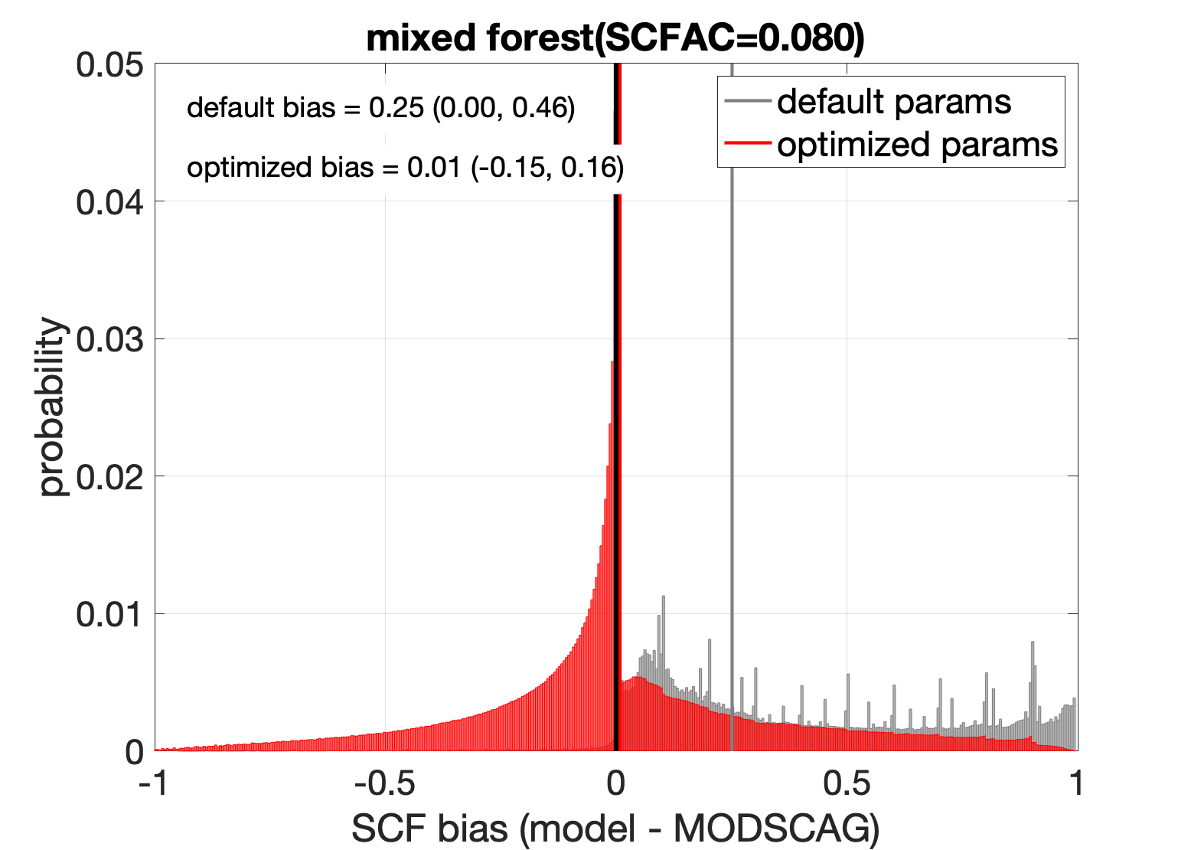
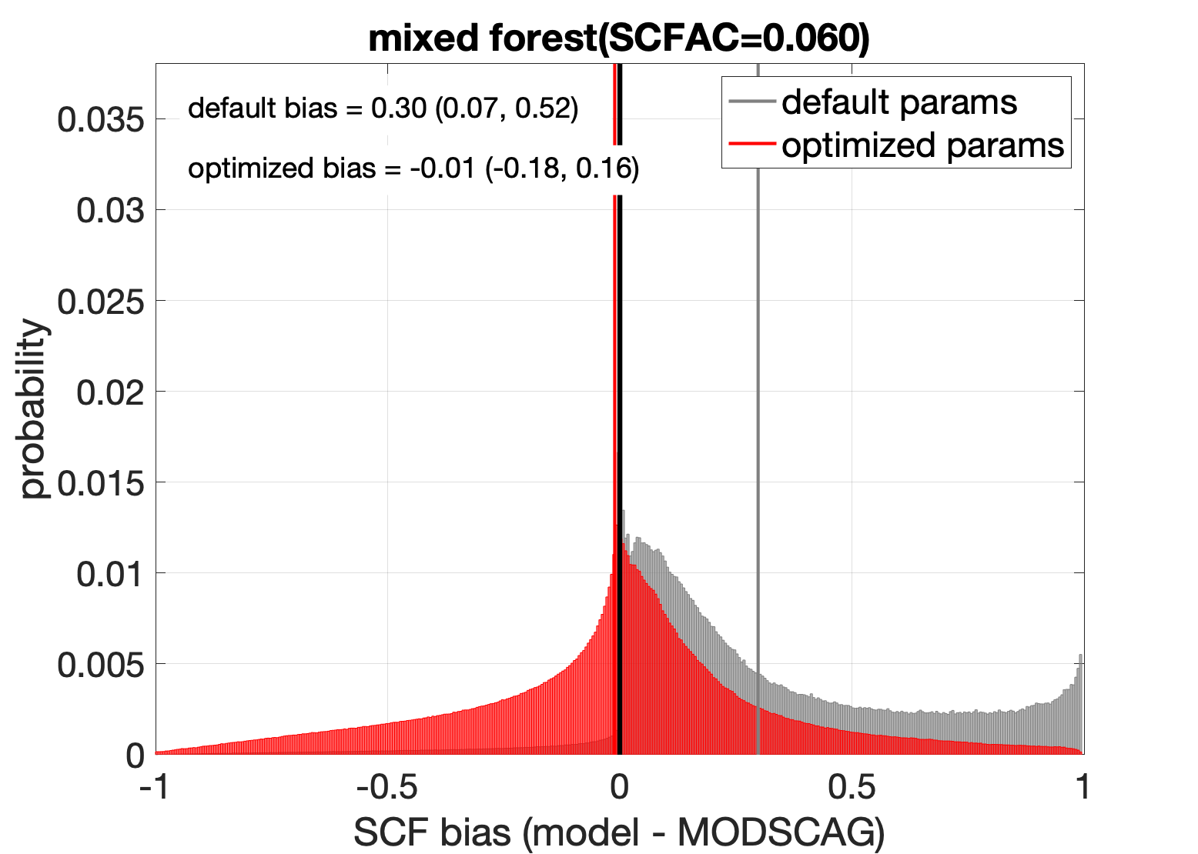
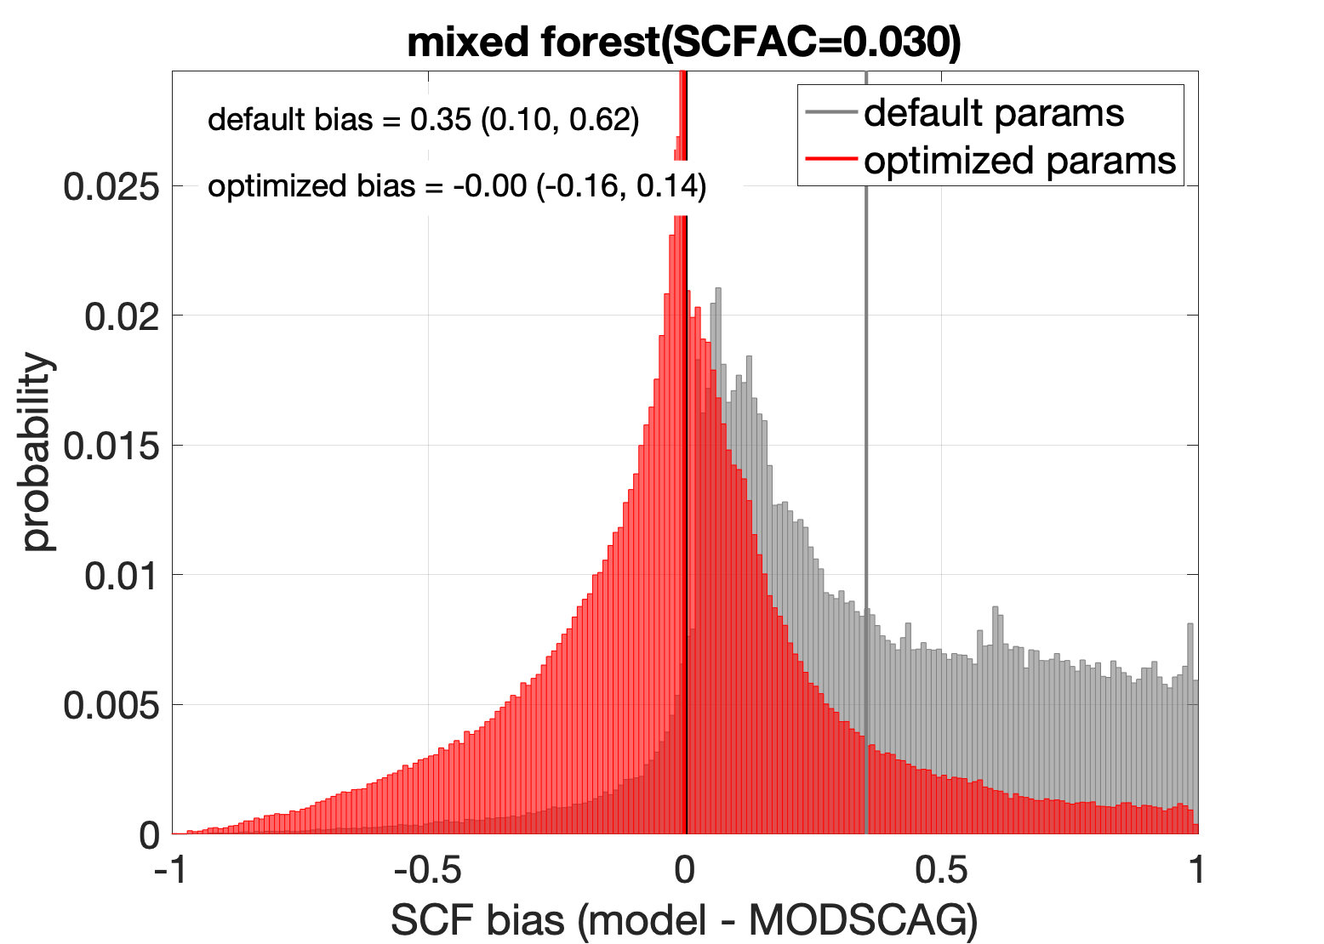
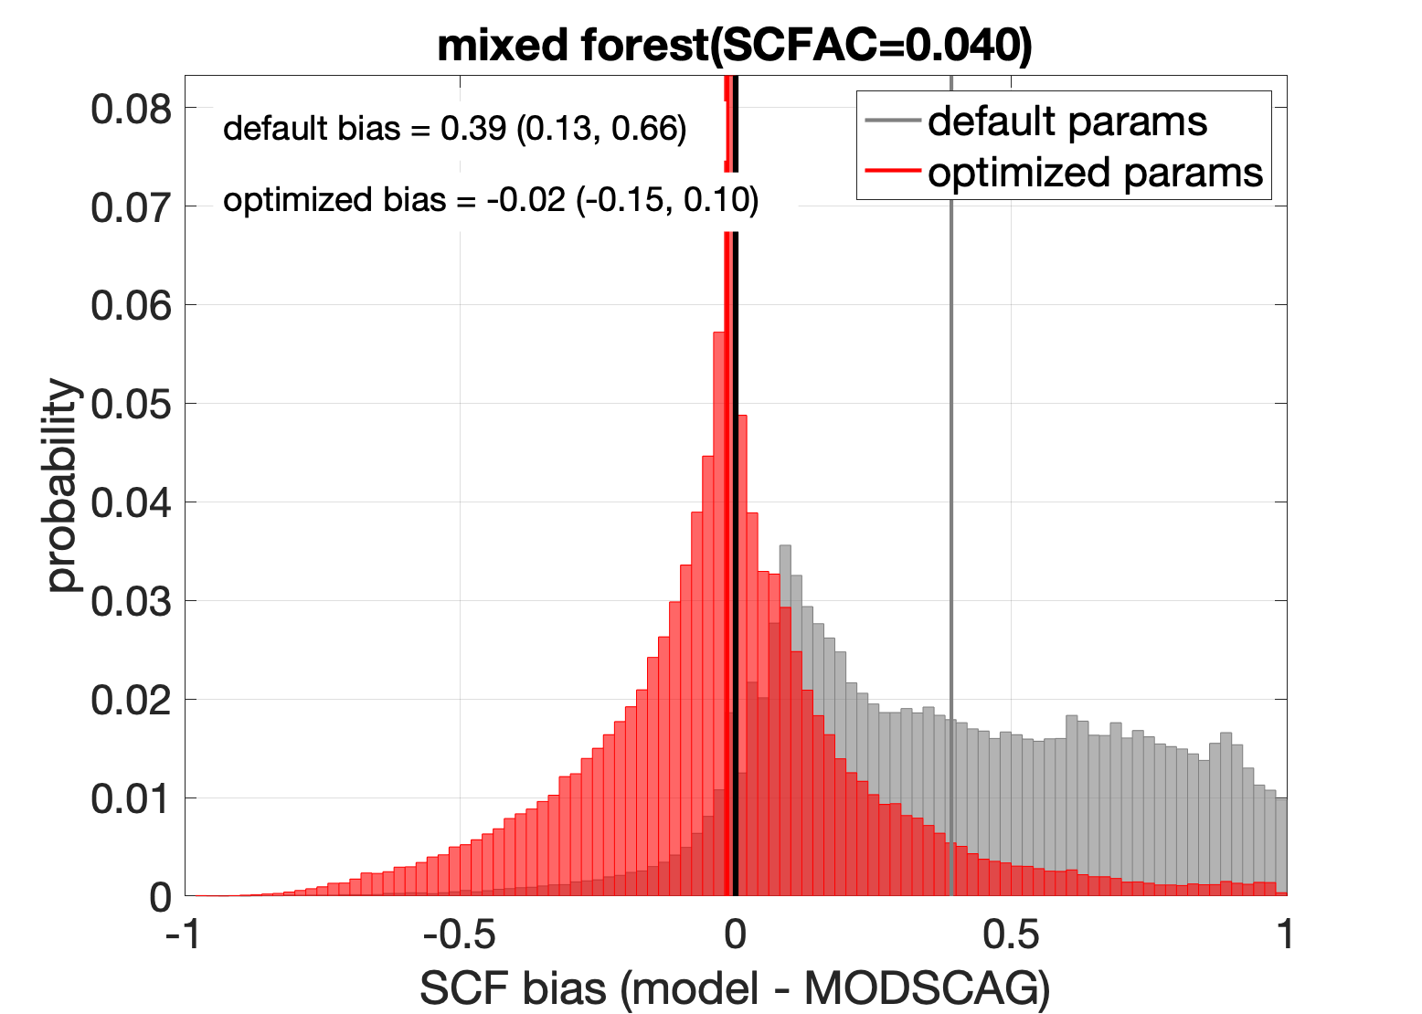
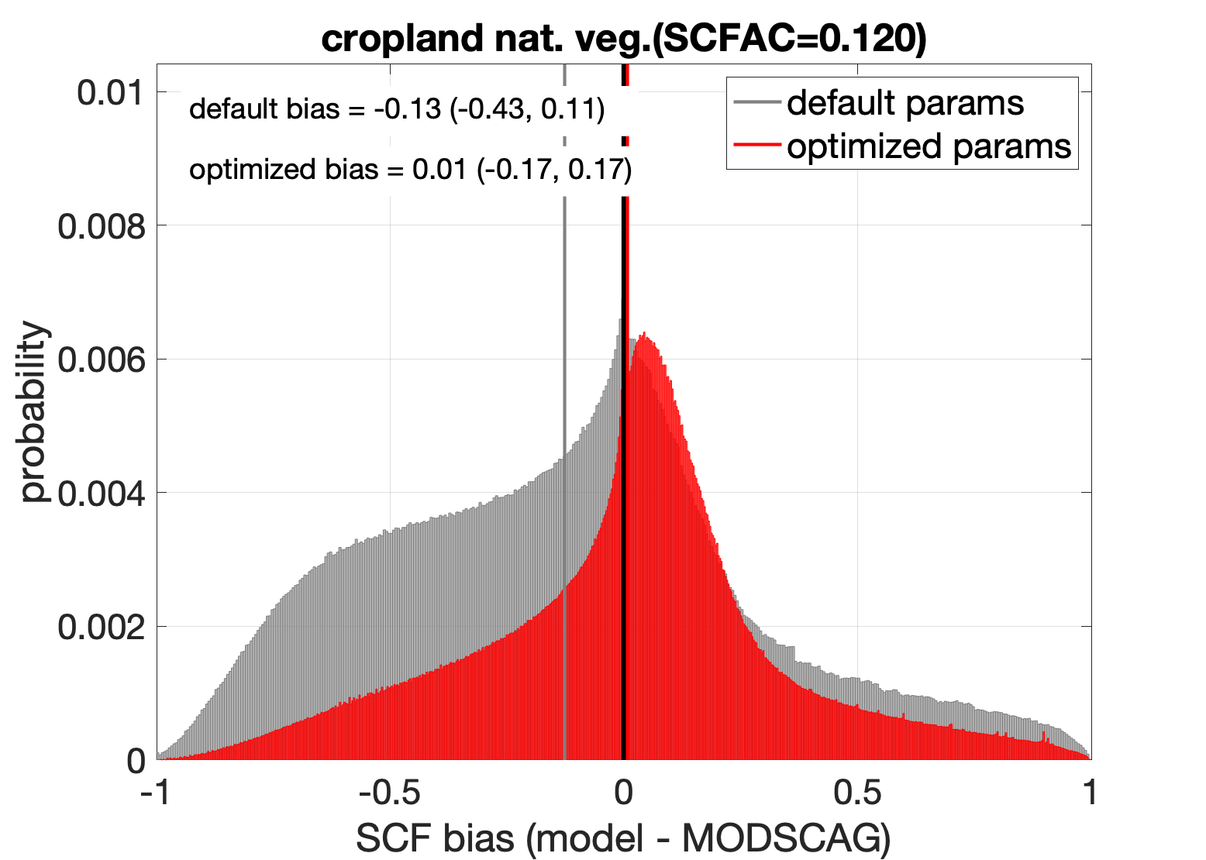
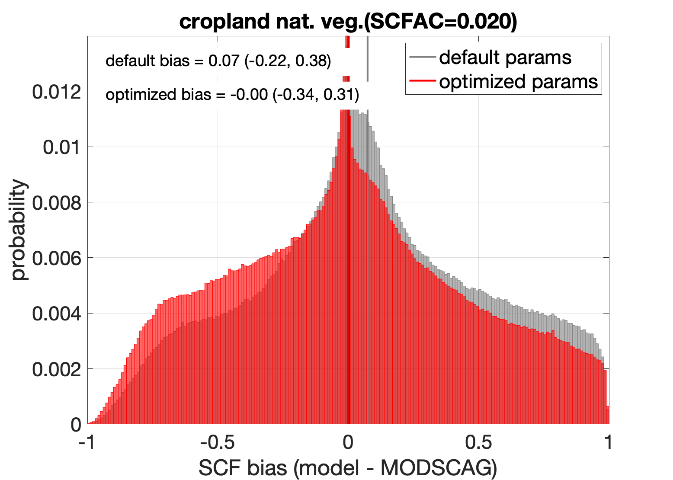
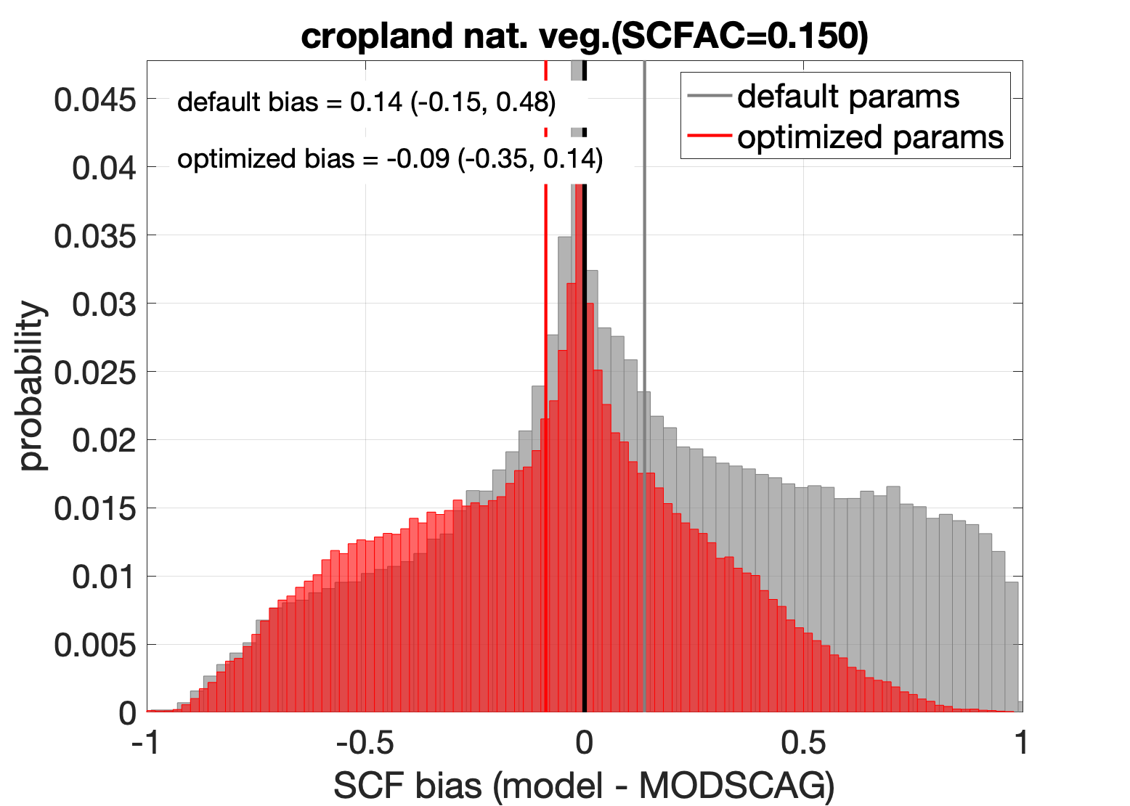
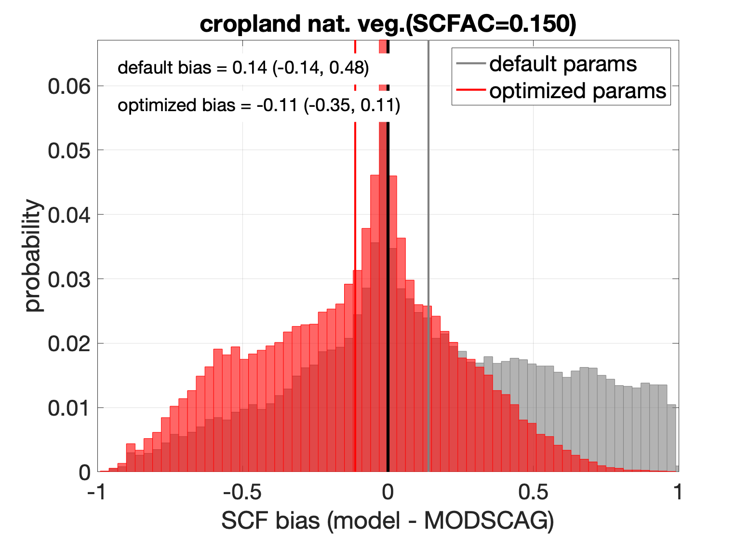
Reduced snow cover bias from optimized parameterization
1km
3km
13km
25km
Forest
Cropland
7

Slide 8
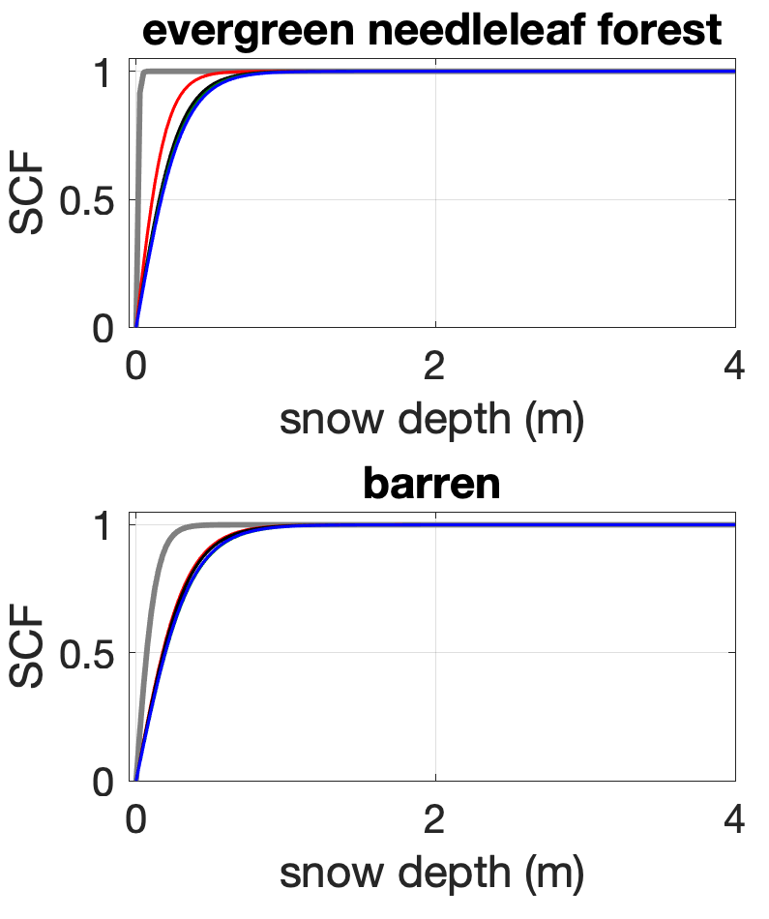
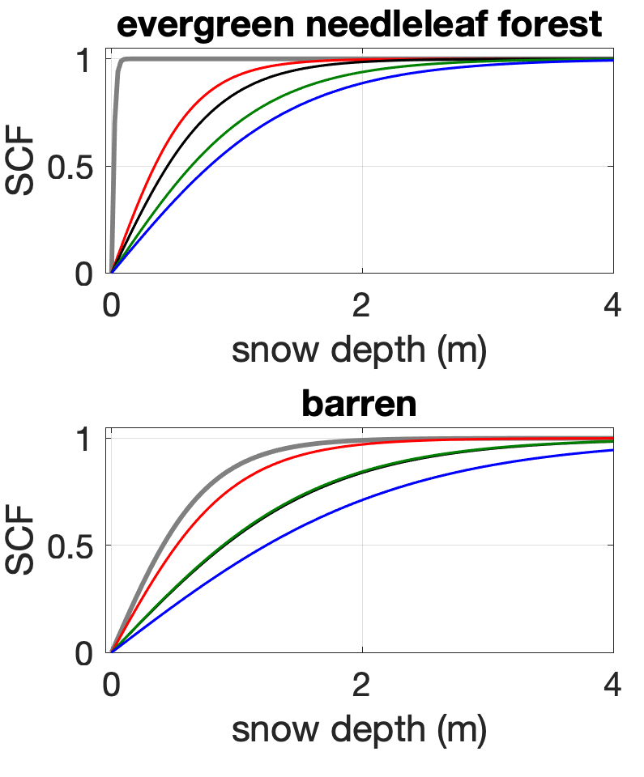

Scale dependence of snow cover parameterization
Low density example
(density = 200 kg/m3)
High density example
(density = 400 kg/m3)
8

Slide 9
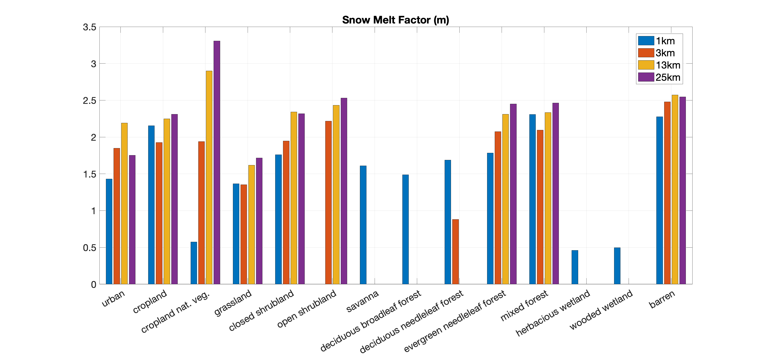
Remaining challenges
Discern a pattern between optimal parameters and spatial scale across vegetation classes
9
Notes:
Discern a pattern between optimal parameters and spatial scale such that results from the 1km res with more veg classes can be used to inform lower-res params where there are not veg classes represented at 3-25km

Slide 10
On-going work
Find a solution to allow the optimized snow cover parameters to be applied across scales
Assess the suitability of current SCF scheme is suitable for high-res modeling (the scheme was originally developed at a 1-degree resolution), and the need for a more complex parameterization to account for other land surface and met conditions (e.g., aspect, wind speed, radiation, topographic complexity).
Assessing regional offline Noah-MP simulations with the enhanced snow cover parameters
Testing coupled UFS/Noah-MP performance with the enhanced snow cover parameters
10
Notes:
Our future work will compare SCF errors with other land surface and meteorological conditions to determine if high-res modeling of SCF requires a more complex parameterization than a SWE/snow-density reliance (e.g., aspect, wind speed, radiation, topographic complexity).

Slide 11
Thank you!
If you are interested in our work, please email me: cenlinhe@ucar.edu

