Slide 1
The Current State of NOAA's Rapid Refresh Forecast System
Matthew E. Pyleª, Curtis R. Alexander^{b}, Jacob R. Carleyª, Stephen Weygandt^{b}
on behalf of the wider RRFS team
ª NOAA/Environmental Modeling Center, College Park, MD
^{b} NOAA/Global Systems Laboratory, Boulder, CO

Slide 2
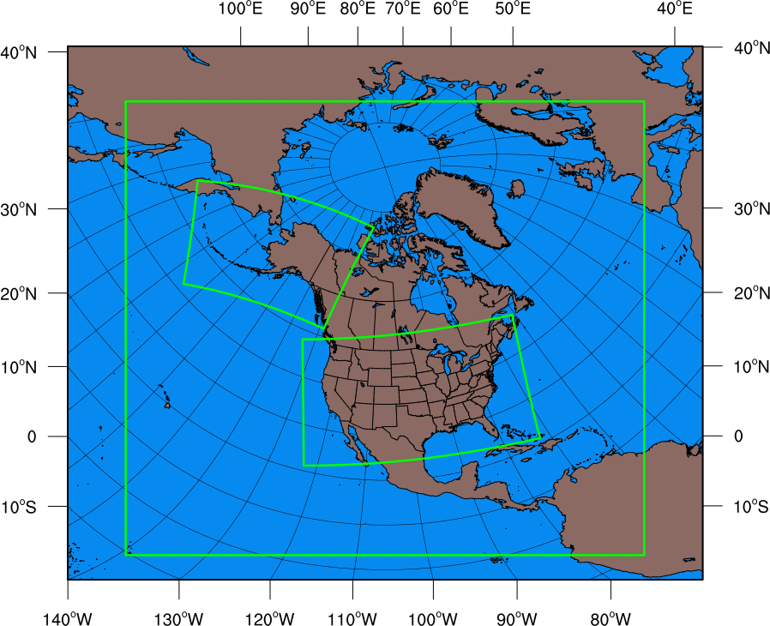
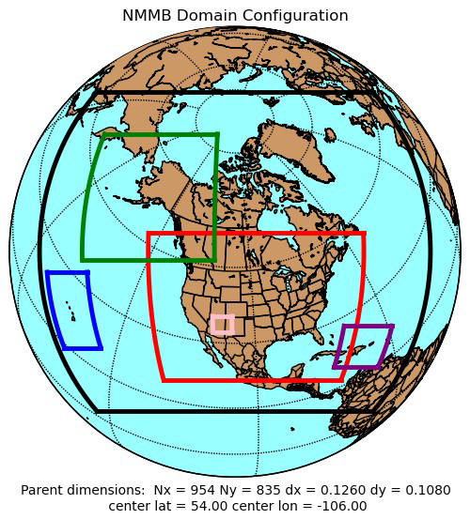
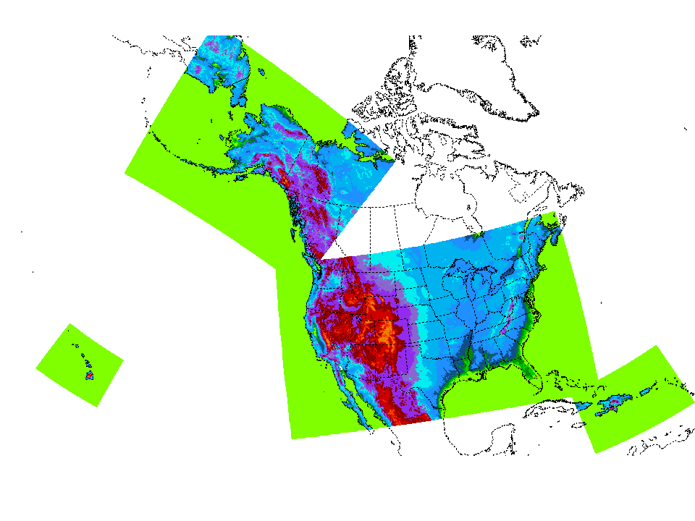
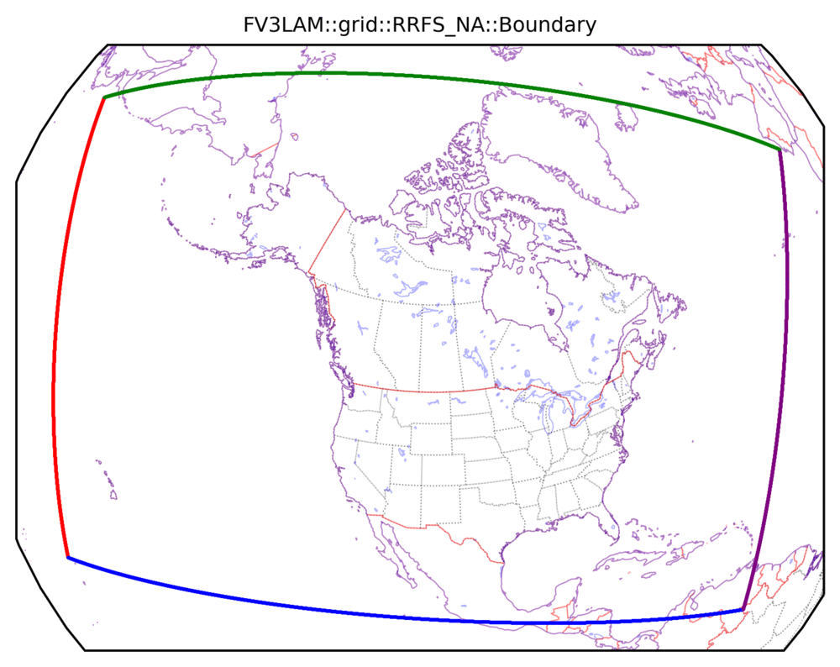
Planned NWS regional CAM unification
RAP/HRRR
NAM+Nests
HiResW/HREF
Current operational CAMs
ARW
NEMS-NMMB
ARW + FV3
Single UFS-based system for future operations (RRFS)
FV3

Slide 3
A move toward UFS: RRFS
A bold plan to replace all CAM guidance with a single North American domain forecast ensemble running at 3 km grid spacing
Hourly DA cycle, w/ a 3 km, ~30 mem ensemble for hybrid 3DEnVar
Forecasts to 60 h every 6 h (deterministic + forecast ensemble), with deterministic-only forecasts to 18 h for other cycles
Physics in deterministic RRFS broadly similar to those of the HRRR
65 vertical levels; 2 hPa model top
Subsumes all products and functionality from HRRR, NAM nest, HiresW, and HREF

Slide 4
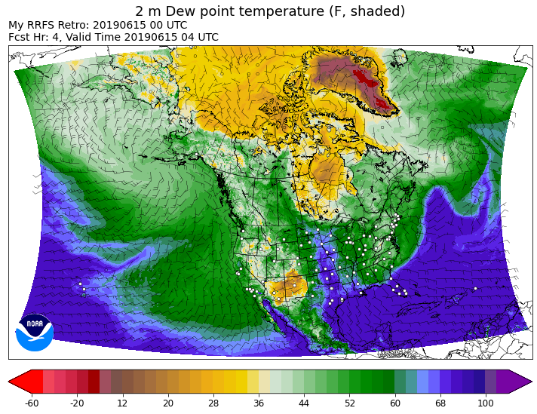
RRFSv1 Data Assimilation Cycling
ens
det
00
03
06
Land
09
12
15
18
Land
21
Land
Atmos
Land
Atmos
“partial cycle”
GFS Atmos
GFS Atmos
Two-way interaction between 30 member 3-km DA ensemble ( ) and 3-km deterministic RRFS hybrid 3DEnVar analysis( )
Partial cycle spin-up of atmosphere from GFS twice per day (RAP like), land states fully cyc’d
All ensemble members (in square) and deterministic/control (circle) on 3-km NA grid

Slide 5
Planned additions to RRFSv1
Multiscale DA
Inclusion of modeling small lakes (w/ CLM Lake Model) - matching the functionality contained in HRRR, but for larger RRFS domain.
32-bit physics (maybe) - efficiency gained from this change would ease the computational burden of running RRFS.

Slide 6
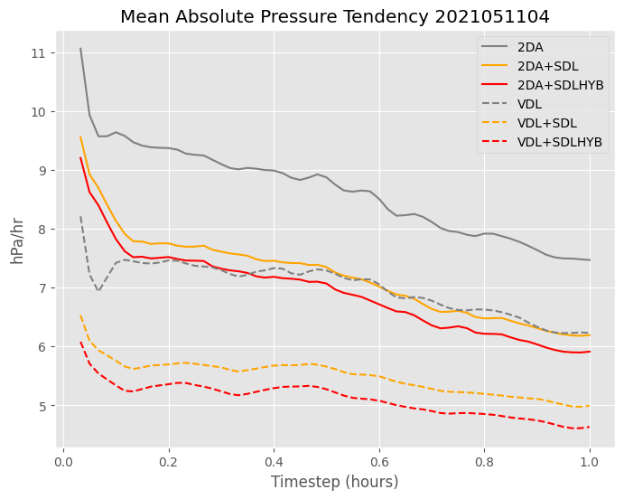
Multiscale DA Algorithm
Scale and variable dependent localization (SDL/VDL) employed in the EnVar DA algorithm
Ensemble covariances undergo scale-selective filtering (short & long waves)
Localization radii appropriate for each scale and variable group are used
Allows for all observations to be assimilated simultaneously
Eliminates 2 step implementations with ad-hoc separation of observations (sondes vs radar)
Imbalance (as measured by mean absolute pressure tendency) is ~40% lower over 1 h DA cycle forecast with proposed multiscale approach than with two step approach
Acknowledge JMA visiting scientist Sho Yokota (currently @ EMC), OU/MAP group, and Ting Lei (EMC)
proposed

Slide 7
Deterministic 12 h forecasts
Diurnal 2 m T/Td
May-June 2023
2 m T
00Z
12Z
23Z
RRFS
RMSE
HRRR
Bias
2 m Td
00Z
12Z
23 Z

Slide 8
24 h QPF
May-June 2023
ETS/GSS
RRFS
HRRR
bias
verif on 13 km grid

Slide 9
Heavy precipitation issue
A high bias in heavy precipitation is a long-standing RRFS/FV3 issue, particularly in the warm season. Also manifests as a high bias at higher reflectivity thresholds.
A more focused effort to solve it has been ongoing over the last year (including a coordinated effort between GFDL, GSL, and EMC), leading to exploration of a variety of approaches:
Less scientific (damping) approaches
Damping of condensational heating
Capping of MP heating tendency
Scientifically-based approaches
Revisions to physics-dynamics coupling
Inclusion of Grell-Freitas deep convection

Slide 10
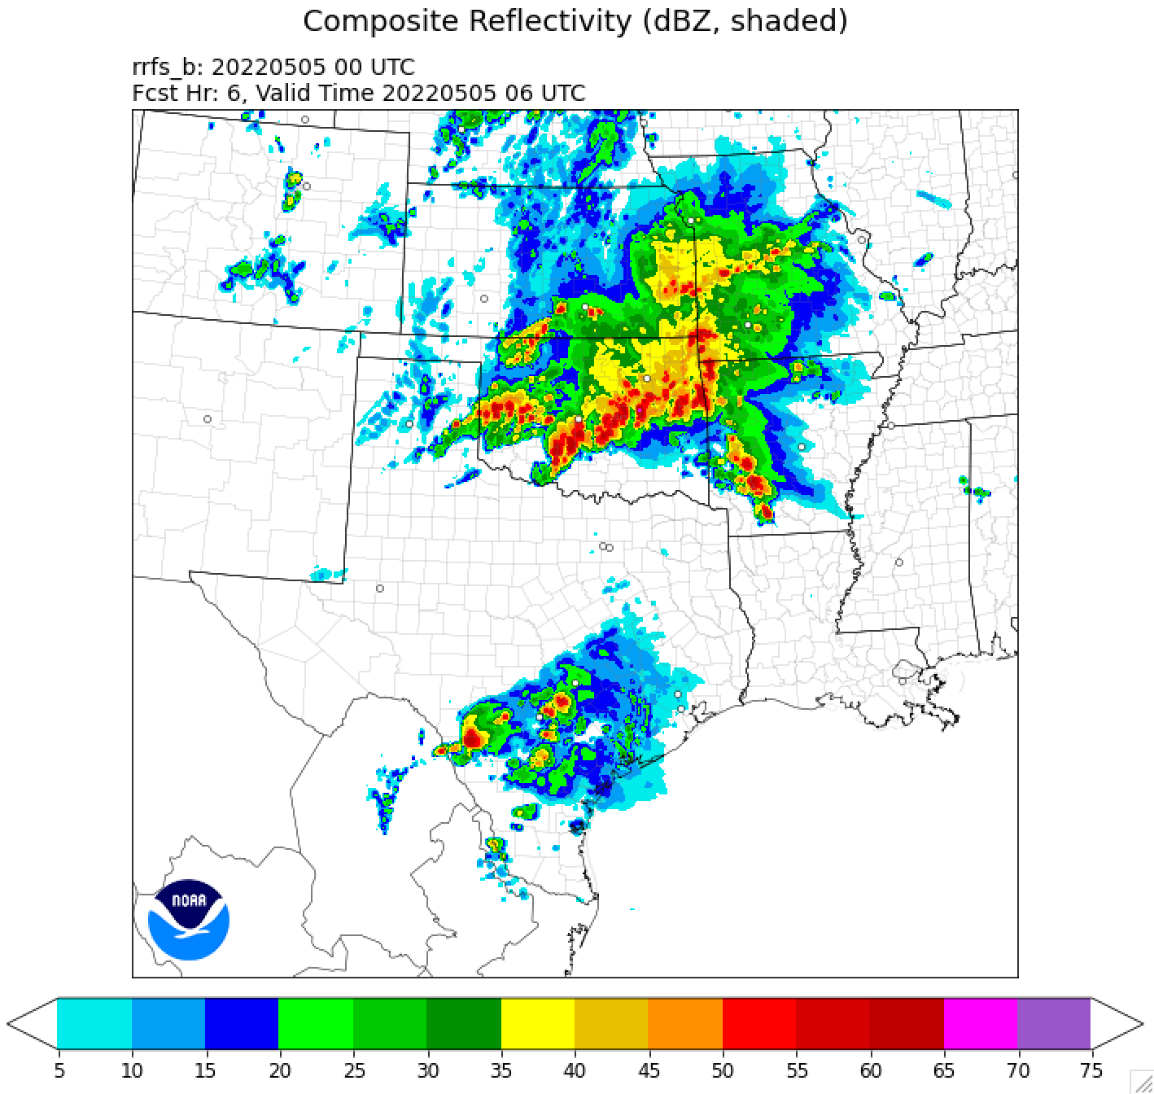
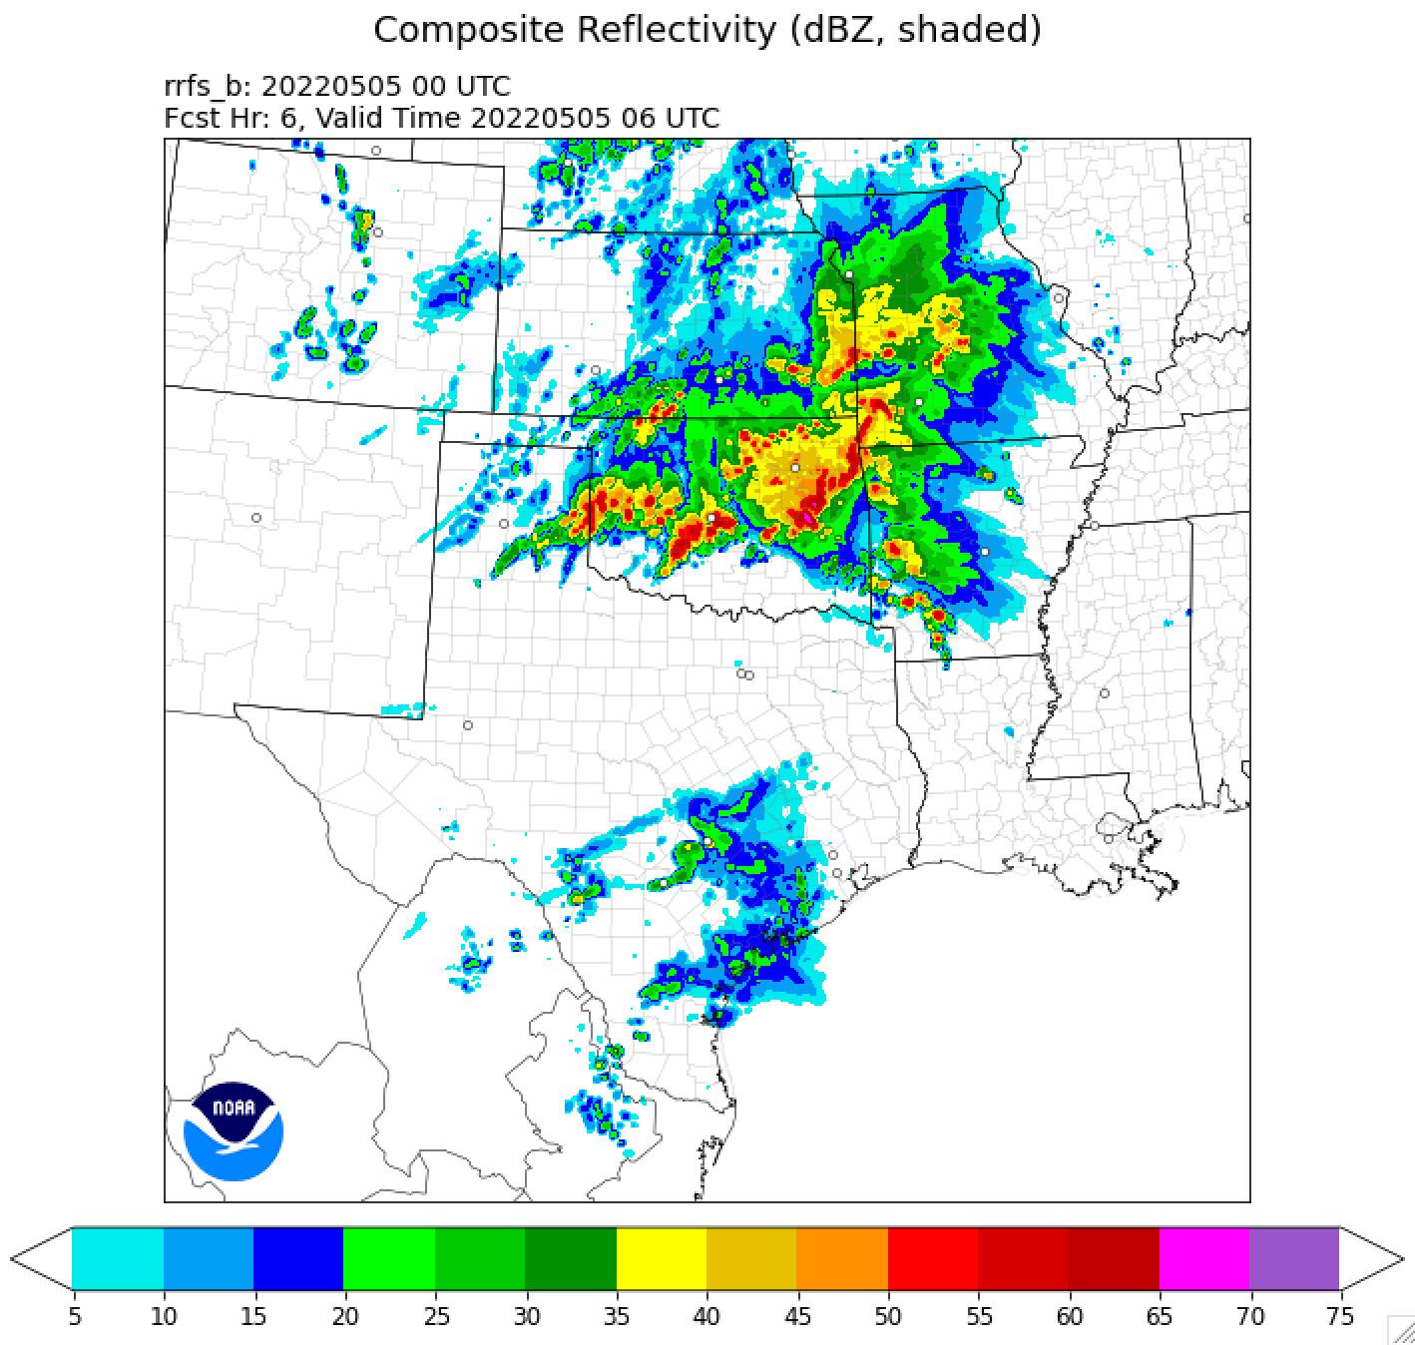
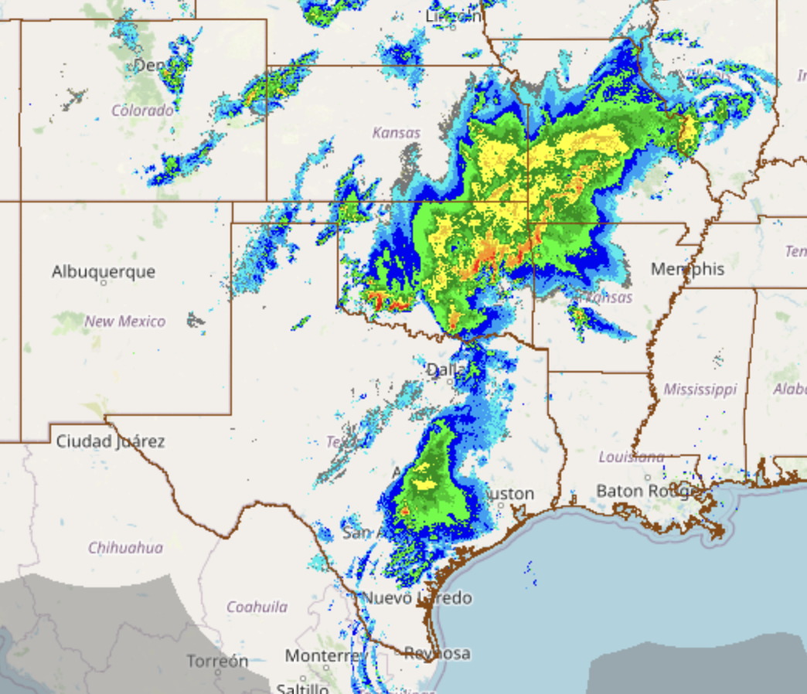
Parameterized Deep Convection w/ Grell-Freitas
[Not yet in official RRFS Prototype System]
No GF scheme
MRMS - observations
With GF scheme
Get better GSL example...stats?
figure courtesy of GSL

Slide 11
Forecast ensemble considerations
Computational constraints will limit RRFSv1 to generating 6 members (5 ens members + deterministic run) per cycle, so it will utilize members from previous cycle to generate a 12 member, time-lagged ensemble.
Single-physics or multi-physics configuration?
RRFS long term plan is to get to a single physics configuration, but possibly use multi physics for RRFSv1 to enhance ensemble spread.
Both options were run for evaluation during the 2023 HWT/SFE period.
Decision still to be made for RRFSv1 - options show differences in skill/spread/reliability space (and neither unambiguously better).

Slide 12
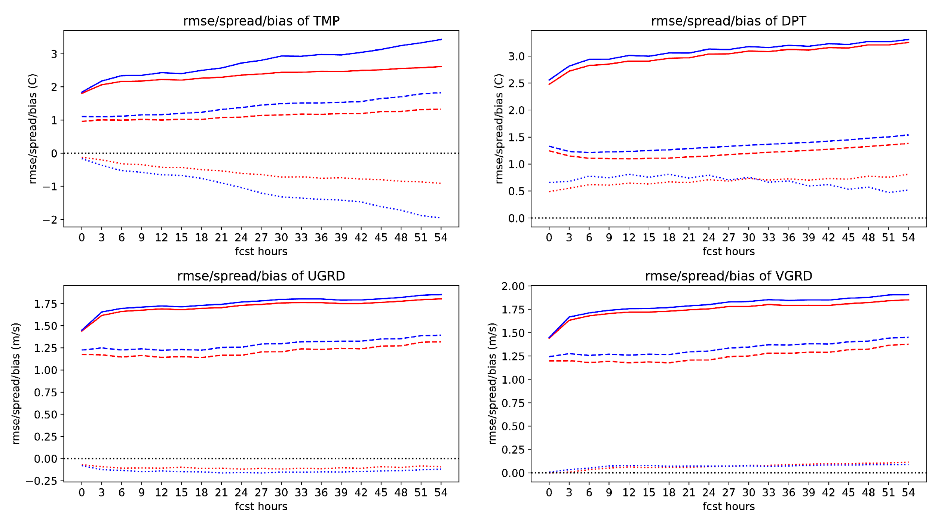
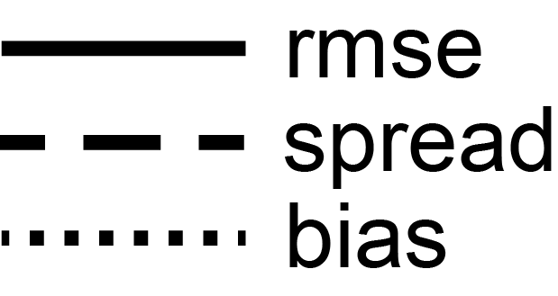
RRFS single/multi-physics ensemble comparison
(12 member TL) - sensible weather
May 10 - June 29 (133 cycles)
2 m T
2 m Td
10 m U
10 m V
Figure courtesy Jili Dong

Slide 13
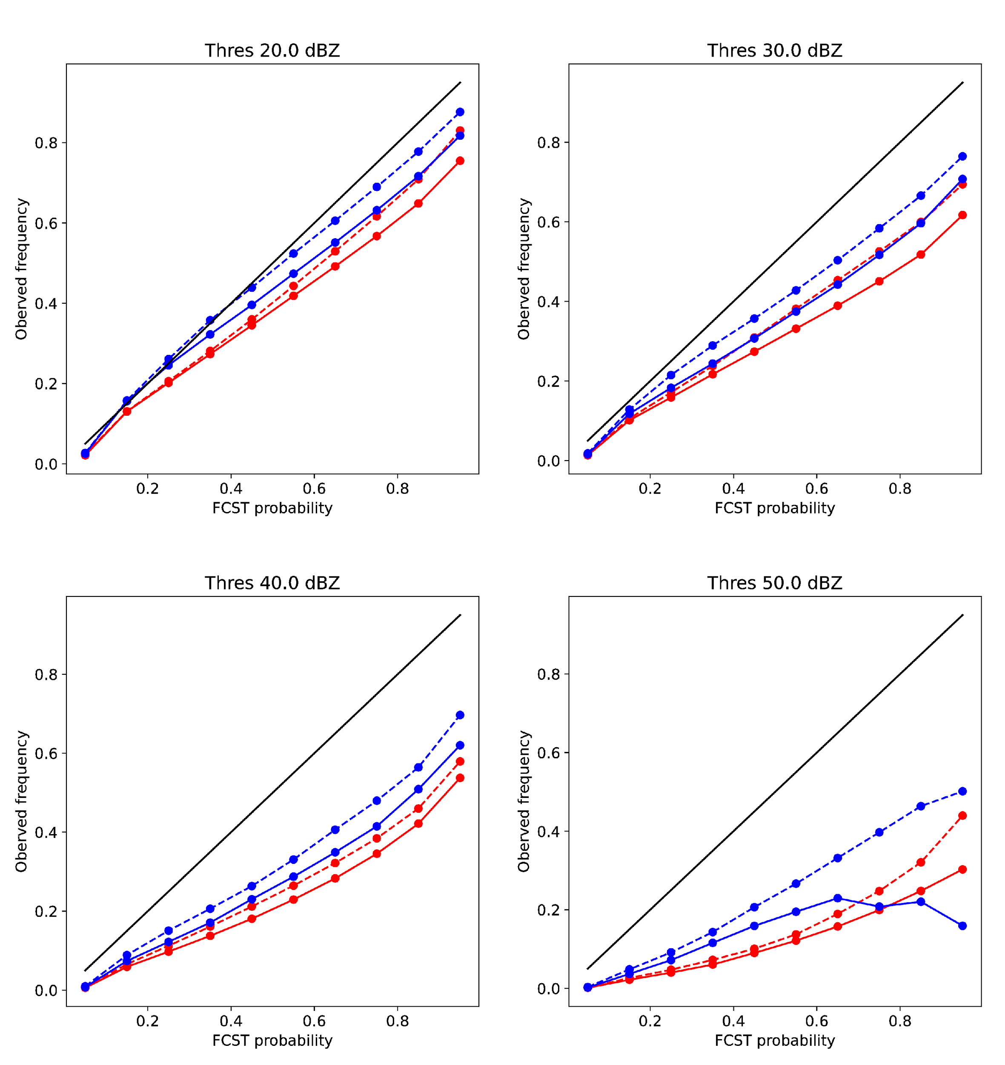
RRFS single/multi-physics ensemble comparison
(12 member TL) - simulated reflectivity reliability
May 10 - June 29 (133 cycles)
20 dBZ
30 dBZ
40 dBZ
50 dBZ
Results courtesy of Jili Dong
Figure courtesy Jili Dong

Slide 14
Summary
Tremendous progress has been made on the RRFS system, but work remains to get it to a place where stakeholders will be comfortable with it replacing HRRR and HREF (among other models) in NWS operations.
The high precipitation bias and deficient RRFS ensemble performance on day two (noted in HWT/SFE results) are two critical items that must be improved.
Have been targeting a late 2024 implementation for RRFSv1, but addressing the issues listed above is likely to push the implementation date back into 2025.
QUESTIONS??

Slide 15
Supplemental slides

Slide 16
Anticipated RRFSv1 Forecast Design
10 mbrs (w/ TL) 60 h
10 mbrs (w/ TL) 60 h
10 mbrs (w/ TL) 60 h
10 mbrs (w/ TL) 60 h
~30 mem, 3 km DA ensemble
00
06
12
18
Land
deterministic control analysis
Determ 60 h
Determ 60 h
Determ 60 h
Determ 18 h
Determ 18 h
Determ 18 h
Determ 18 h
Determ 60 h

Slide 17
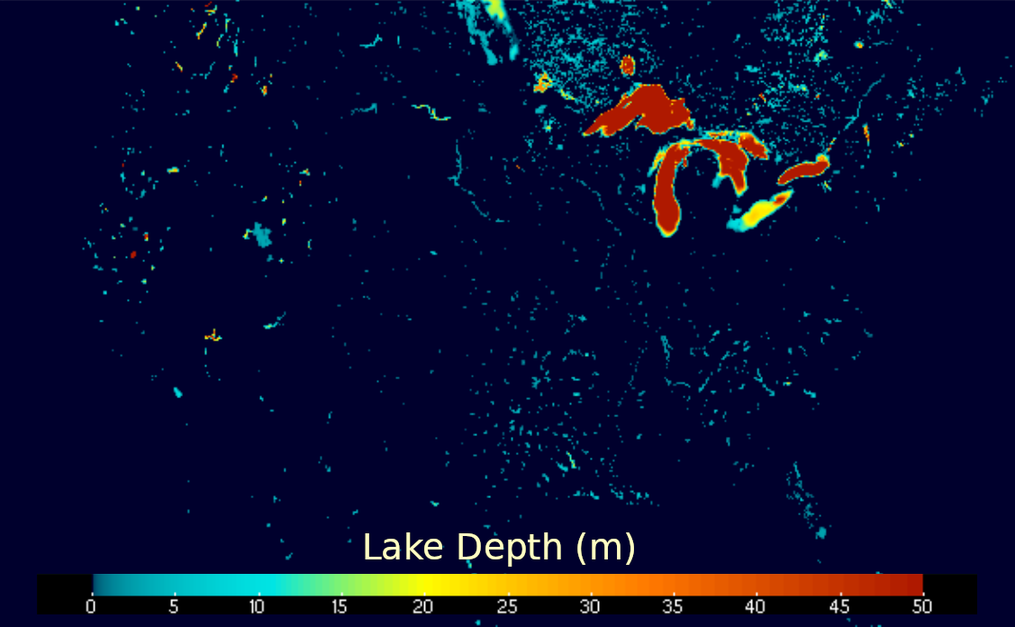
CLM Lake Model for the RRFS
The CLM code is committed to the UFS Repository, includes all modifications done for HRRR
The RRFS lake depth uses GLOBv3 data
Cycling of lake variables has to be enabled and tested in RRFS configuration.
To do: mask out the Great Lakes from the GLOBv3 lake mask (GLs are being handled by FVCOM in RRFS)
CLM Lake information courtesy of Tanya Smirnova

Slide 18
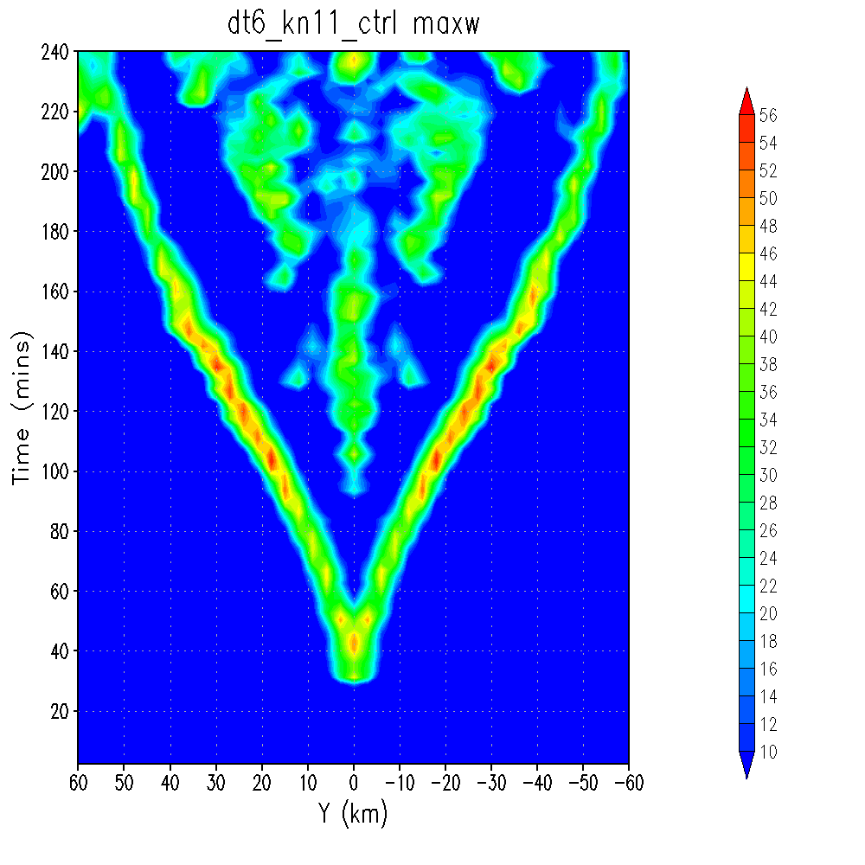
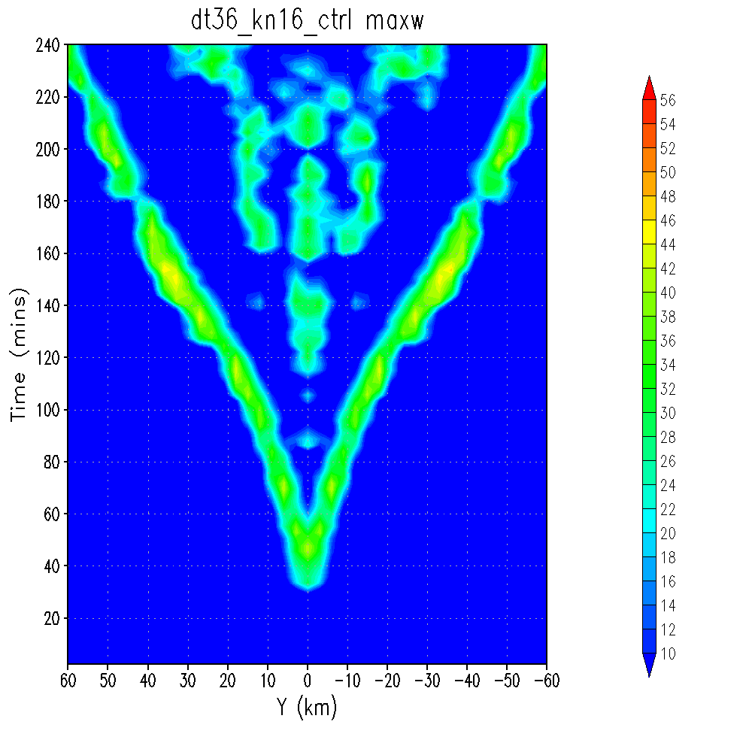
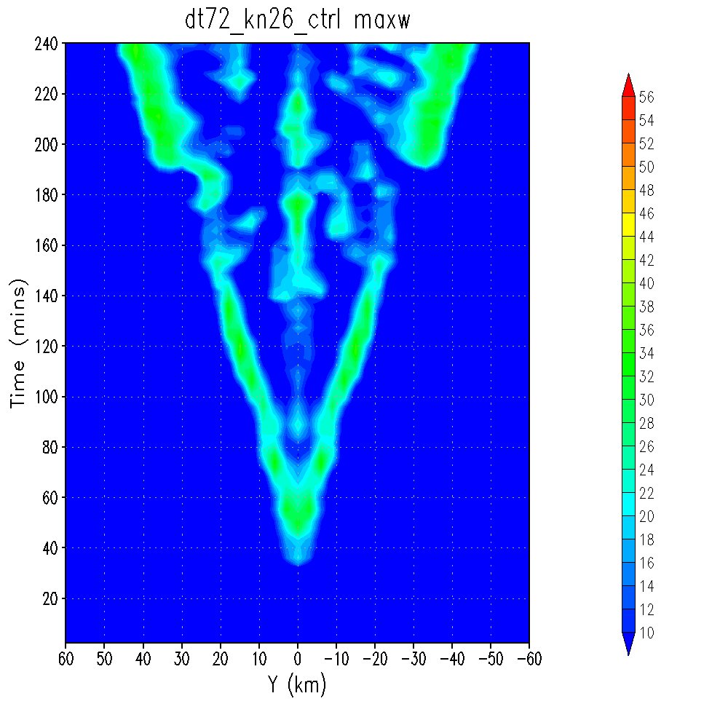
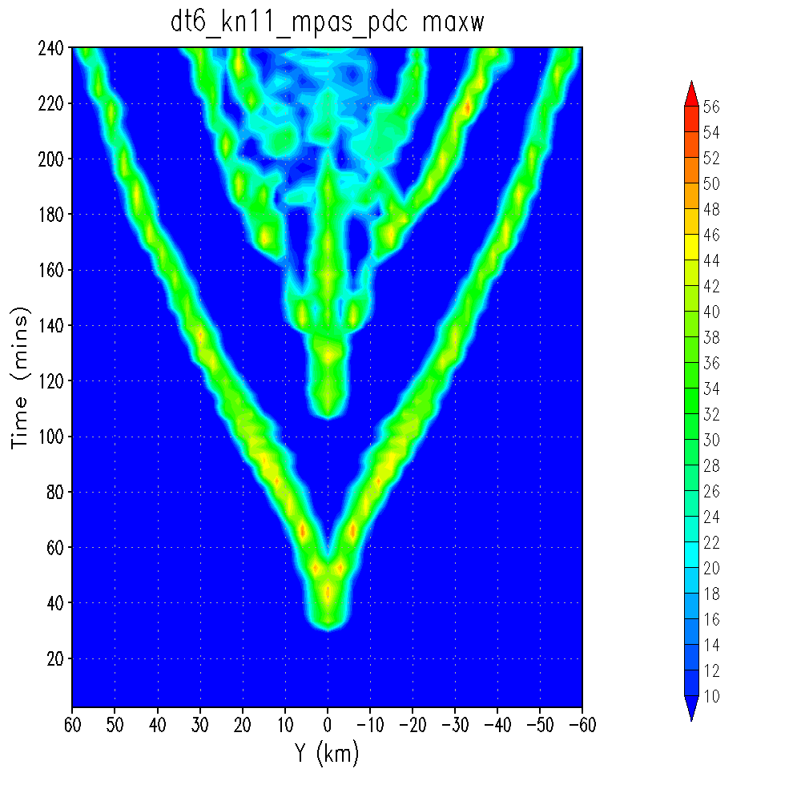
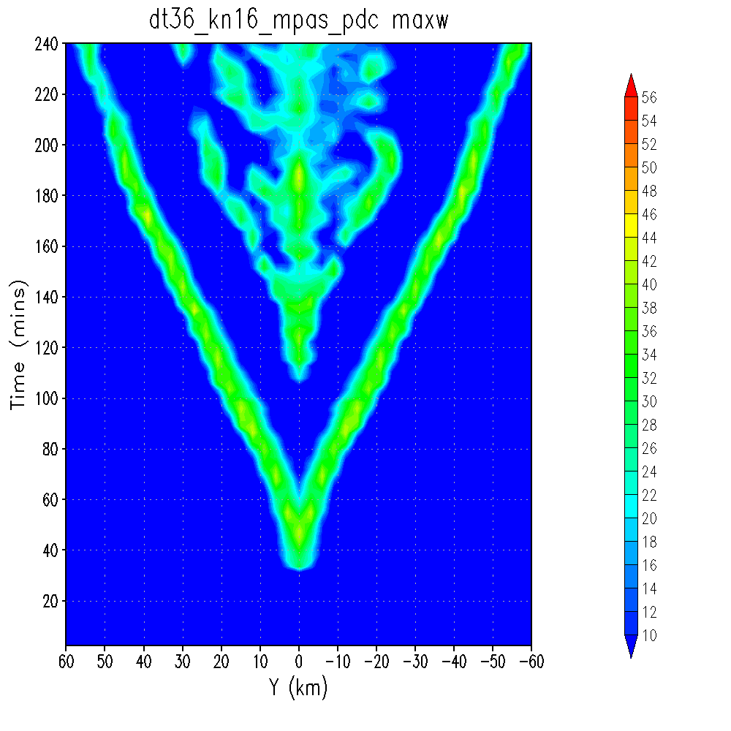
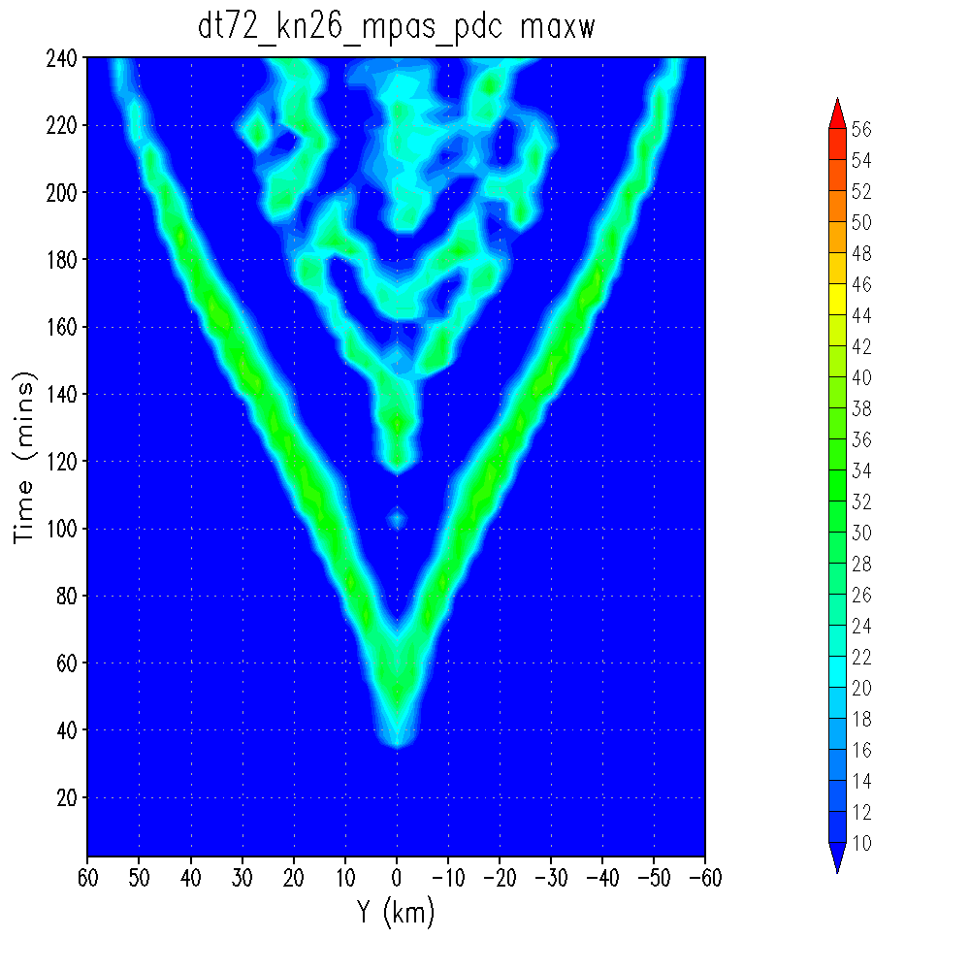
Updated Physics-Dynamics Coupling
Hovmoeller of maximum
vertical velocity over the convective region for
idealized splitting supercell
Current FV3 coupling leads to significant sensitivity of
solution to choice of
physics time-step
6 s coupling/phys
frequency
36 s coupling/phys
frequency
72 s coupling/phys
frequency
Modified FV3 coupling
greatly reduces sensitivity of solution to physics time-step
6 s coupling frequency,
6 s phys frequency
6 s coupling frequency,
36 s phys frequency
6 s coupling frequency,
72 s phys frequency
Acknowledge Kevin Viner (EMC) for this work

Slide 19
Possible introduction of Subgrid Vertical Transport Scheme
JMA and other centers have noticed challenges with excessive grid point storms in their modeling systems
To address this, they have introduced a scheme to account for unresolved vertical transport of heat and moisture in deep convection
Known as The Leonard Term
EMC is exploring the feasibility of including this term into the UFS
With Leonard term
Figure obtained from presentation by Hiroshi Kusabiraki et al. (2021) demonstrating impact at JMA
Acknowledge JMA visiting scientist Sho Yokota and his JMA colleagues

Slide 20
REFC 18 h fcst
18Z-00Z VTs
May-June 2023
ETS/GSS
RRFS
HRRR
bias
verif on 20 km grid
Notes:
could scrub this one (like Jacob did)

Slide 21
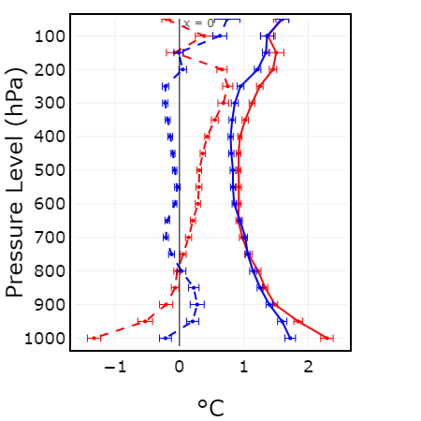
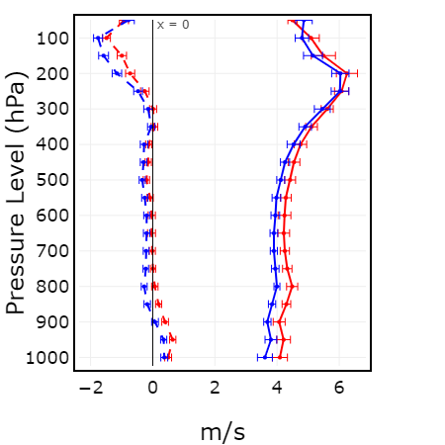
24 h forecasts
00Z valid
May-June 2023
Wind
Temp
RRFS
HRRR

Slide 22
RRFS time-lagged, multi-physics membership during HWT period
 | MP | PBL | sfc | lsm | Cu | IC/LBC
m1 (ctrl) | Thompson | MYNN | MYNN | RUC | N/A | RRFS hybrid/GFS
m2 | Thompson* | H-EDMF | GFS | RUC* | saSAS Shal | RRFS enkf1/GEFSm1
m3 | Thompson* | TKE-EDMF | GFS | RUC* | saSAS Shal | RRFS enkf2/GEFSm2
m4 | NSSL** | MYNN* | MYNN* | RUC* | N/A | RRFS enkf5/GEFSm5
m5 | NSSL** | H-EDMF | GFS | RUC* | saSAS Shal | RRFS enkf6/GEFSm6
m6 | NSSL** | TKE-EDMF | GFS | RUC* | saSAS Shal | RRFS enkf7/GEFSm7
*: Stochastic physics parameterization (SPP)
**: parameter perturbation using Latin hypercube sampling with multidimensional uniformity (lhs-mdu)
SPP also applied to GWD, radiation
sppt and skeb are applied to all perturbed members

