Slide 1
Song-You Hong^{1,2}, Haiqin Li^{1,3}, Jian-Wen Bao², and Jimy Dudhia⁴ ¹University of Colorado/CIRES ²NOAA/ESRL/PSL ³NOAA/ESRL/GSL ⁴NCAR/MMM Acknowledgements : Sara Michelson and Evelyn Grell (NOAA/ESRL/PSL)
A Double-Moment Parameterization with In-Cloud
Microphysical Processes for Use in Weather Forecasting

Slide 2
A history of the MPS scheme development
Hong, Juang, and Zhao (1998, MWR) : NCEP cloud 2, 3, 5
--- Prognostic clouds with inner loops at 120s for cloud 3 and 5
Hong, Dudhia, and Chen (2004, MWR) : WSM3, WSM5, WSM6
--- Revised ice microphysics. No temperature dependency in Ni
Juang and Hong (2010, MWR) : Semi-Lagrangian sedimentation
--- Rectified a problem of Eulerian advection
Lim and Hong (2010, MWR) : WDM5, WDM6
--- Prognostic CCN, Nc, Nr
Bae, Hong, and Tao (2018, APJAS) : WSM7, WDM7 ( + hail )
--- for sub-kilo meter resolutions
Kim and Hong (2018, JAS) : Introduction of partial-cloudiness on microphysics
--- In-cloud microphysics for production terms
* GFDL MP (GFSV16) : Some ice microphysics adapted from Hong et al. (2004)

Slide 3
New MPS ???
WSM MPs were written in 2003 summer, in 2009 summer for WDM MPs
Development strategy
-----Take all the advantages of previous developments….(e.g, MPS step = 180s)
-----Adopt the findings in the literature (e.g., Lei et al. 2019, Grasso et al. 2014)
-----Bug fixed (e.g., melting of snow and graupel, evaporation of rain drops)
===🡺 Code was re-written for readability and computational efficiency
Two major ingredients
1) In-cloud microphysics concept (Kim and Hong 2018, JAS)
2) Semi-Lagrangian sedimentation
Name of the scheme : WDM62, NOAA, ESRL, PSL, or something else ?
===🡺 tentatively, let us call “NEW or UFS MP”

Slide 4
Cloudiness in reality and in MPS schemes
Observation 33 % 98 %
Microphysics 100 % 100 %

Slide 5
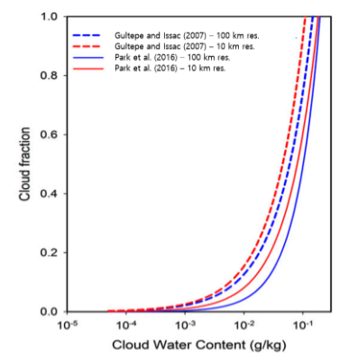
In-cloud microphysics : Kim and Hong
(2018, JAS) : Use the cloudiness in OBS
Microphysical processes | treated with in-cloud scales
Sedimentation Dynamical processes | treated with grid-mean scale
Cloudiness | Satellite observations Park et al. (2016, MWR)
Cloudiness ranges between 0 and 1 whereas it is 1 in conventional MPS

Slide 6
In-cloud microphysics : Kim and Hong (2018, JAS) – Analytic solution
Analytic solution
Accretion – increased
Autoconversion – increased
Sublimation - decreased
Snow melting - decreased
For example, autoconversion rate is about doubled in C=0.5 as compared to C=1
Our method is much simpler (no cloud overlapping), but yet applies to all the source/sink terms.
It also implicitly represents the scale aware behavior
=🡺 Issue in develop In-cloud physics algorithm for a double-moment cloud microphysics

Slide 7
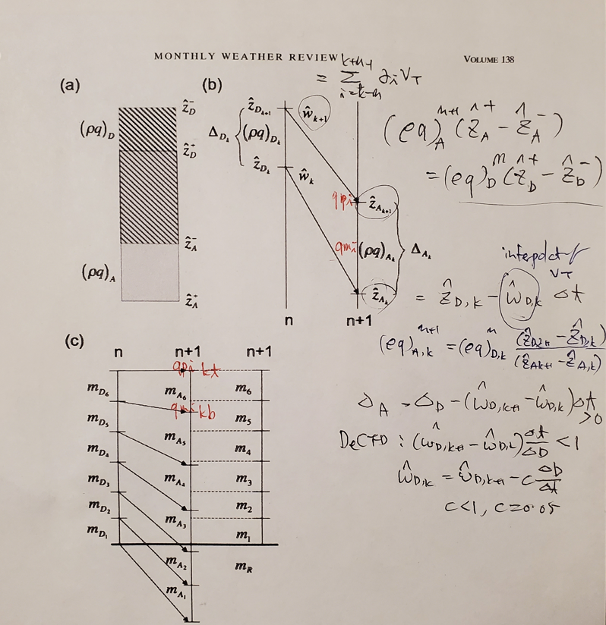
Juang and Hong (2010, MWR) sedimentation : Monotonic mass conserving scheme
JH2010 sedimentation determines the arrival point using velocity at the top and bottom of a cloud cell
With the Deformation CFL condition, this method is numerically absolutely stable

Slide 8
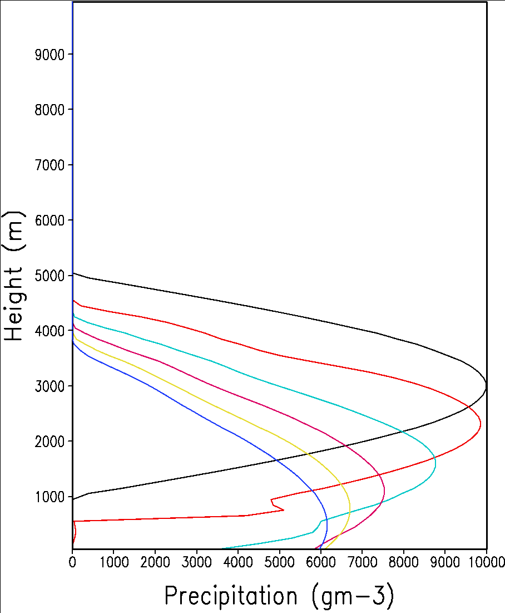
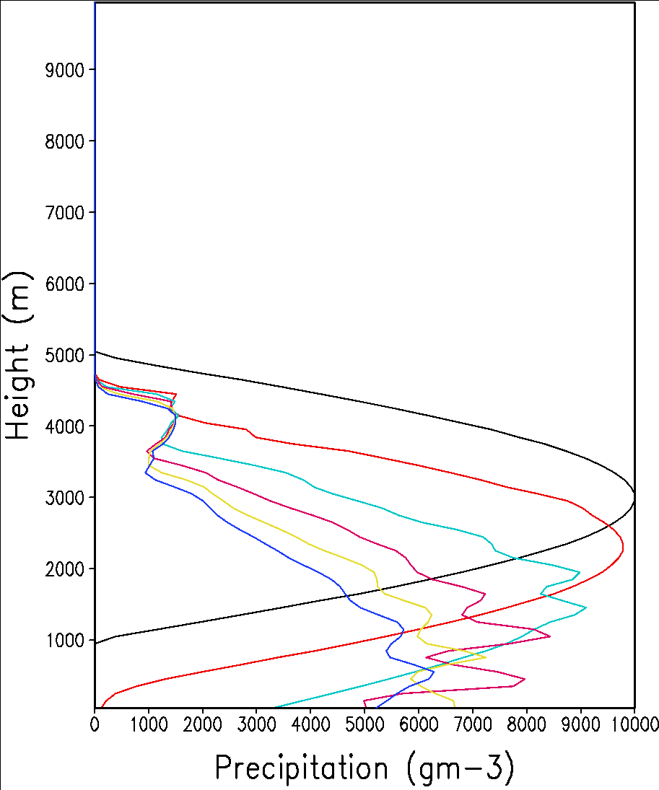
Application for double moment (WDM6) : Prof. Sunny Lim, 2009
Eulerian
Semi_Lagrangian
Nr
Semi-Lagrangian scheme (JH2010) is not appropriate for double moment schemes : qr and Nr are advected by Eulerian scheme in WDM MP

Slide 9
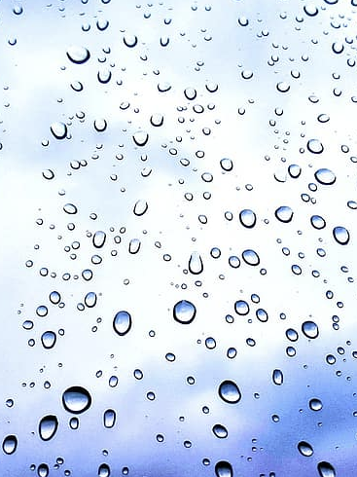
Major issues in sedimentation of two-moment MPS
1. Size sorting of precipitation drop
: Vn < Vr (Vn = 0.47Vr)
( n is # concentration of rain drop,
r = its mixing ratio )
: violates the CFL condition since Vt increases in sub-time steps
2. Depth of vertical layer decreases downward
: violates the CFL condition since nstep is computed before sedimentation
Eulerian advection could be unrealistic

Slide 10
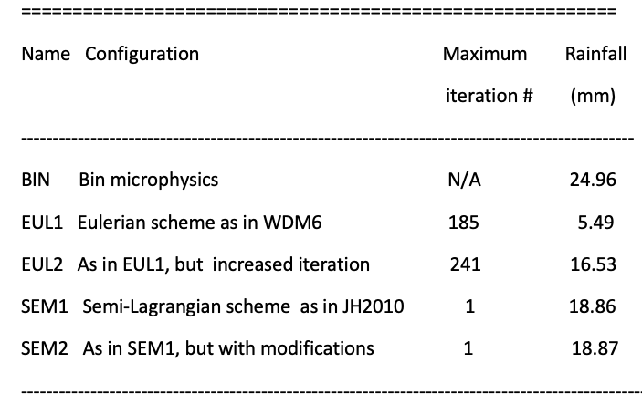
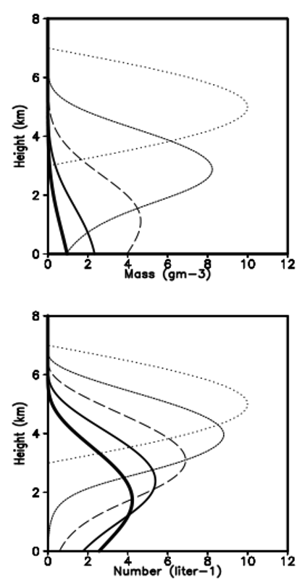
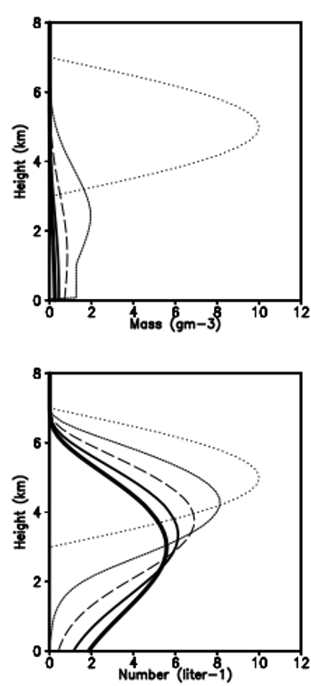
A semi-Lagrangian scheme for two moment MPS : One-D tests – sedimentation only
At t= 0, qr = 10 cos[ pi (Zc-Z)/Zd ] (g/kg)
At t = 0, Nr = the same to qr (#/liter)
dt = 180 sec, FH = 3600 sec,
DZ = 10 m at k =1, increasing upward
Contoured every 6 min
ç
qr
Eulerian advection in WDM6 (EUL1) suffers from a noticeable deficit of mass even if the Vt is updated during sub-stepping (EUL1), which was good enough in single-moment scheme
Nr
BIN
EUL1

Slide 11
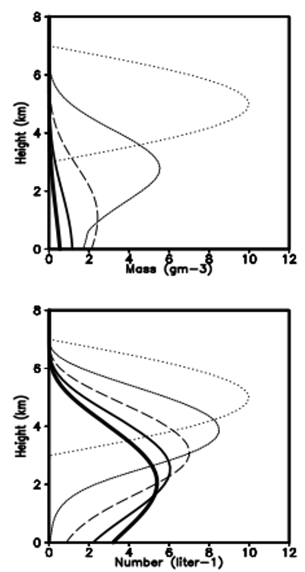
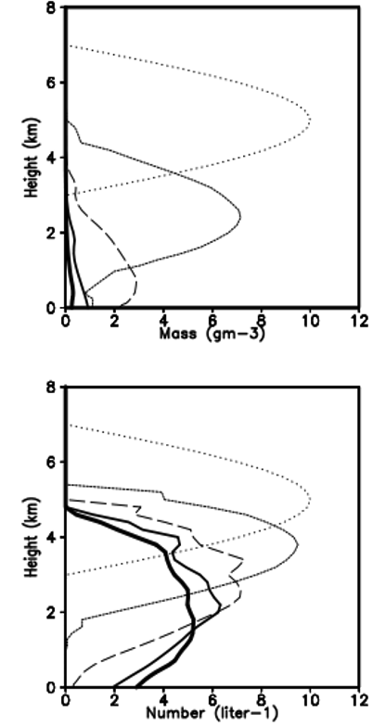
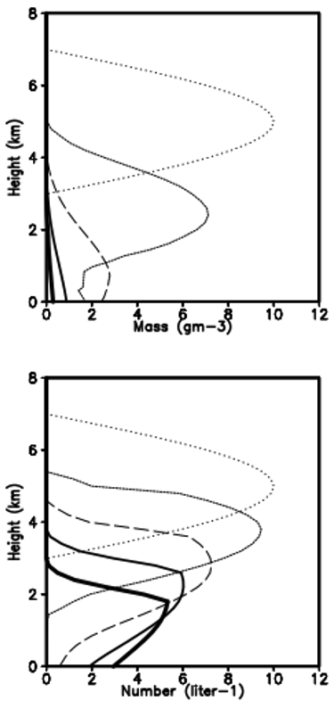
A semi-Lagrangian scheme for two moment MPS : One-D tests – sedimentation only
ç
qr
ç
Nr
BIN
EUL2
SEM1
SEM2
EUL2 : The number of iteration is computed at the depth in the lowest model level…
Iteration # =Max(Vt*delt/dz1). EUL2 with the maximum iteration at 241.
SEM2 : Considerations of constraints, radius constraints and smoothed Vt, produces realistic profiles of mass and number for falling precipitation…. (single loop)

Slide 12
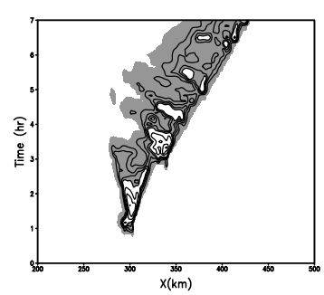
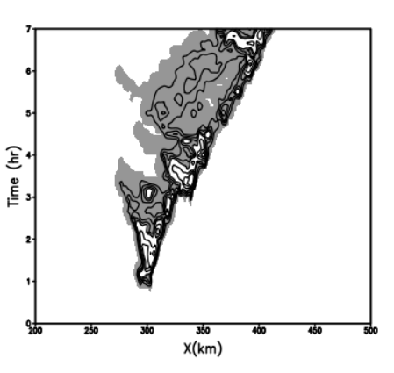
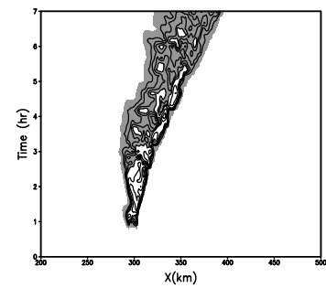
2D Idealized Squall line tests (WRF): MPS only
1 km 7hr forecast
SFC
Rain
WDM6
NEW1
NEW2
WDM6 : WRF version 4.2.1
NEW1 : All revisions other than In-cloud microphysics
NEW2 : NEW1 plus In-Cloud microphysics

Slide 13
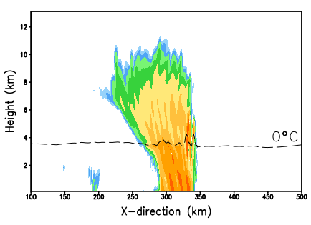
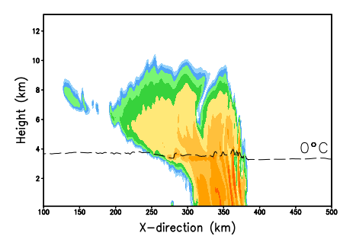
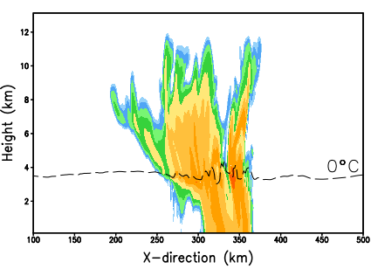
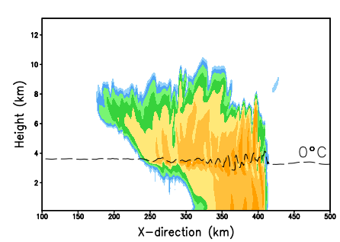
2D Idealized Squall line tests (WRF):
Reflectivity
At 4hr
At 6hr
NEW2
WD~70km
WDM6
WD~100km
NEW MPS produces stronger convective activities with smaller horizontal width

Slide 14
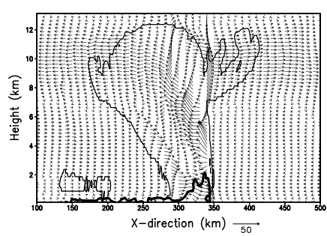
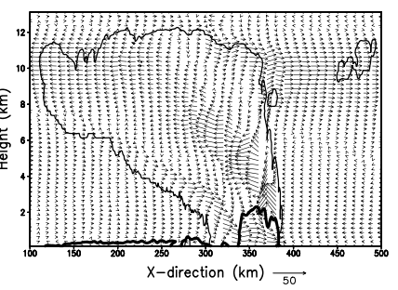
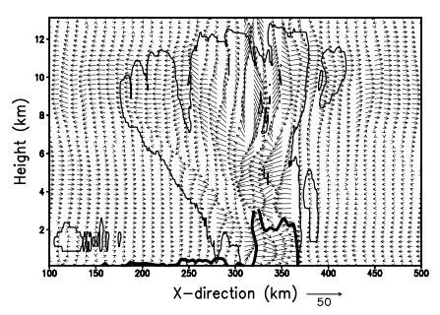
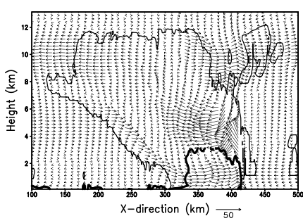
2D Idealized Squall line tests (WRF):
Storm structure
At 4hr
At 6hr
NEW2
WDM6
NEW MPS produces realistic FTR and RTF jets, along with cold pool near surface and outflow at the top

Slide 15
2D Idealized Squall line tests (WRF): MPS only
Aerosol effects (100, 500, 1000, 3000, 5000)
N_{C}
D_{C}
Aerosol effects (2nd indirect) are reasonably reproduced
As compared to WDM6 (Lim and Hong 2010), volume averaged
Nc increases (Dc decreases, 14 micro 🡪7 micro)
Nr decreases (Dr increases, 0.2 mm 🡪 0.7 mm)
==🡺 complies with airborne observation Lei et al. (2019)

Slide 16
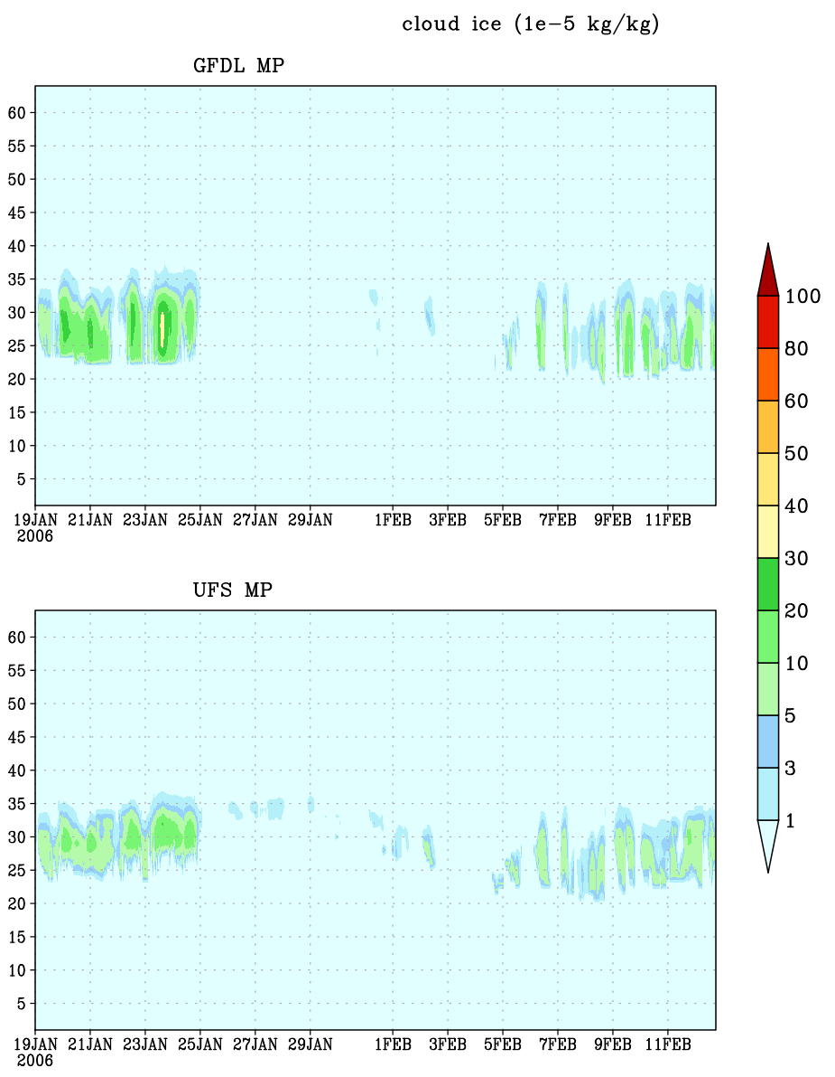
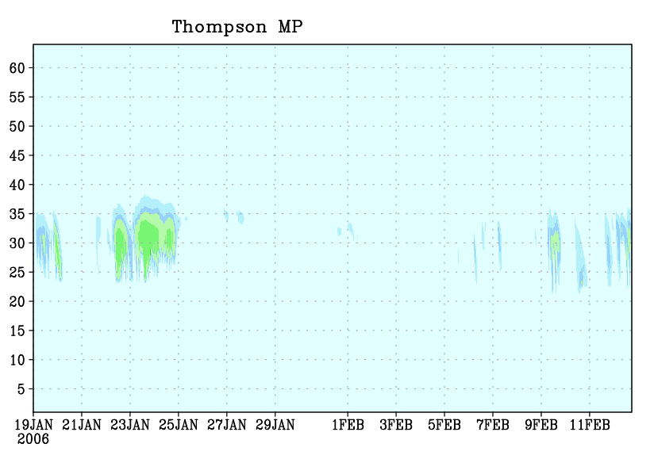
Single Column Tests : qi (ice)
GFDL
Thompson
NEW
Cloud ice is smaller than GFDL but greater than Thompson
Snow is smaller than Thompson but greater than GFDL

Slide 17
C768 (~13km) UFS run :
NEW MP : New Microphysics (v4.6.4) with other GFSv17 p8 physics
(CCN is initialized with 100 /cc) plus Aerosol-aware CCN
from Kang et al. 2019
(CCN is initialized with GOCART aerosol, by Haiqin Li)
IC=2020120100
Horizontal resolution: C768 (~13km)
Vertical resolution: 127 layers
Time step: 150s
Integration length: 120hrs

Slide 18
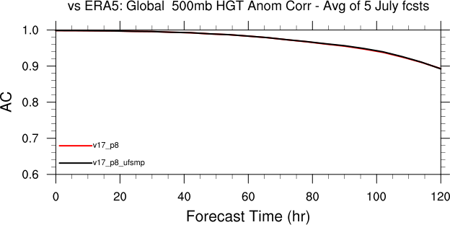
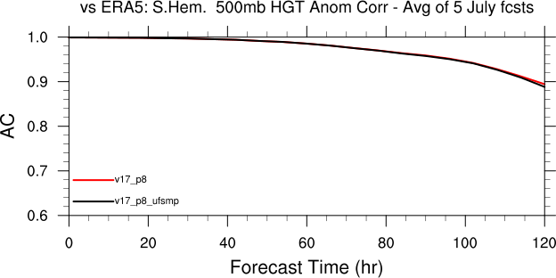
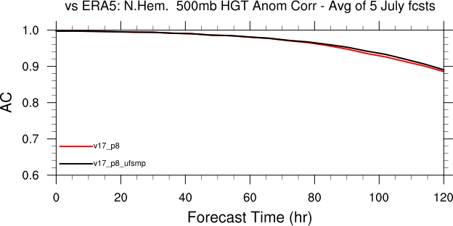
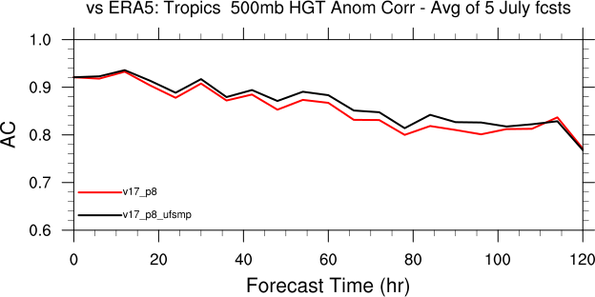
500 ACC : Red (p8) Black (NEW) - July 2021
Global
SH
NH
Tropics

Slide 19
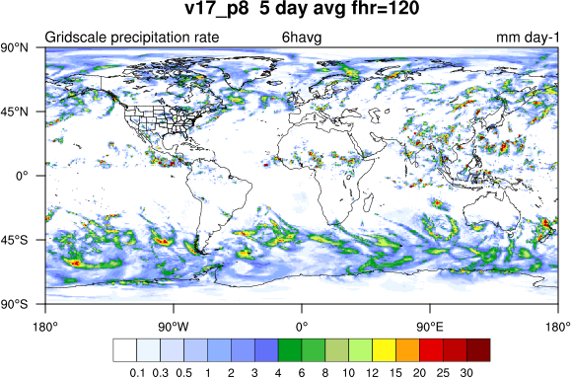
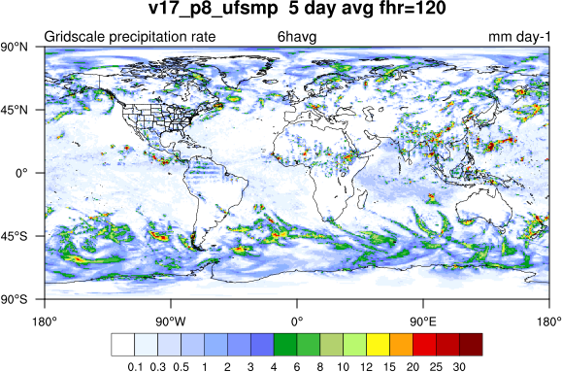
On-going issue : GRIDSCALE (MPS) PRECIP: July 2021
P8
NEW
ç
ç
Enhanced light precipitation over tropical ocean and un-realistic distribution of rainfall over tropical land
=🡺 Apparent deficiency of in-cloud MPS in NWP
resolutions with larger time step (dt = 150s in GFS, 13km)
=🡺 All production terms need to be examined…

Slide 20
C768 (~13km) UFS run : (wall clock time)
 | Number concentration variables (additional 3D prognostic variables) | Wall-clock time (s)
GFDL MP | N/A | 6628
Thompson MP | Ice number concentration (Ni) Rain water number concentration (Nr) | 7384 (11.4% more)
NEW MP | Cloud droplet number concentration (Nc) Rain water number concentration (Nr) Cloud Condensation Nuclei (CCN) | 6949 (4.8% more)
♥ NEW MP is under development …!!!

Slide 21
Remarks….
A new MPS scheme (presumably, UFS MP) is underdevelopment, along with promising preliminary evaluation results
The scheme is to be shared on UFS public domain in 2024, with the goal to be a candidate in UFSv18
Major to do list in 2023 :
Examine the source for instability ( one of 6 cases was crashed )
Re-examine the concept of in-cloud processes for NWP resolutions
Revise all the production terms accordingly
Add INP data input to improve ice-microphysics, in particular, mixed clouds
Modify ice-microphysics to improve clouds radiative forcing
Revise semi-Lagrangian advection to improve numerical accuracy
Prepare the codes to UFS protocol on public domain

Slide 22
Single Column Tests : CCPP
GFDL MP: GFDL Microphysics with other GFSv16 physics
Thompson MP: Thompson Microphysics with other GFSv16 physics
NEW MP: New Microphysics with other GFSv16 physics
Test Case: TWP-ICE
Vertical resolution: 64 layers
Time step: 600s

Slide 23
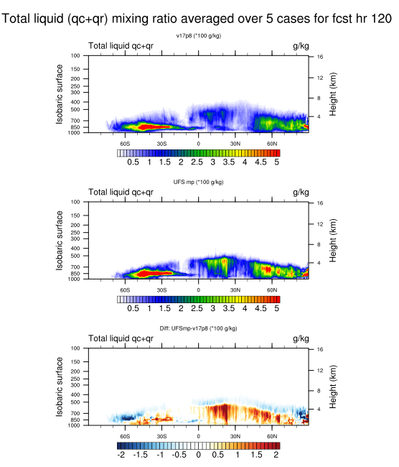
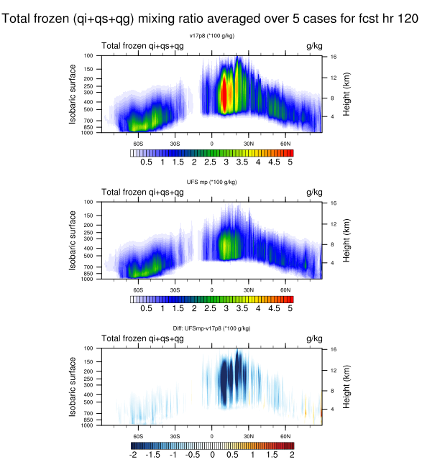
C768 (~13km) UFS run :
Liquid - increases
Ice - decreases
P8
NEW
NEW minus
P8

Slide 24
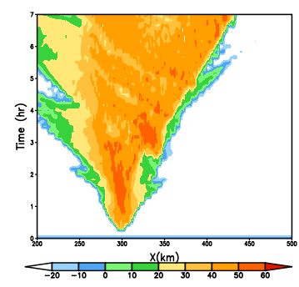
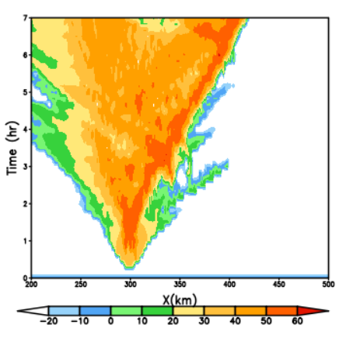
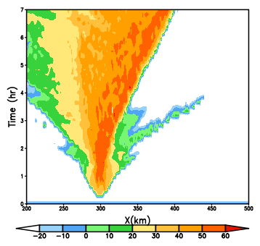
2D Idealized Squall line tests (WRF): MPS only
1 km 7hr forecast
Reflectivity
NEW1 - WDM6 : Convection at leading edge is enhanced
NEW2 - NEW1 : Squall width is narrowed
=🡺 Impact of in-cloud microphysics is dominant
Rain
WDM6
NEW1
NEW2

