Slide 1
DTC Contributions to the UFS Physics Development and Advanced Testing and Evaluation towards UFS Physics Unification
Cross-Cutting Concepts #1 - Physics, Verification, and Validation
25 July 2023
Weiwei Li^{1,2}, Man Zhang^{1,3,5}, Evelyn Grell^{1,4,5}, Tracy Hertneky^{1,2}, Brianne Nelson^{1,2}, and Kathryn Newman^{1,2}
DTC 2. NCAR 3. NOAA/OAR/GSL 4. NOAA/OAR/PSL 5. CU/CIRES
Internal Collaborators: Jimy Dudhia^{1,2} , Lulin Xue^{1,2}, and DTC CCPP & METplus teams
External Collaborators: UFS Physics leads: Lisa Bengtsson (PSL), Fanglin Yang (EMC); PBL and SGScld: Joe Olson (GSL), Jongil Han (EMC); Microphysics: Ruiyu Sun (EMC); Gravity wave physics: Mike Toy (GSL); Convection: Lisa Bengtsson (PSL); Radiation: Qingfu Liu (EMC); HAFS physics: Andrew Hazelton (AOML); RRFS configuration: Eric Aligo (EMC), Jili Dong (EMC); L-A LoCo: Dave Turner (GSL), Julia Simonson (GSL).

Slide 2
DTC UFS Physics Testing and Evaluation (T&E) activities & connection to UFS Stages and Gates
RL 1
RL 9
Objective #1 (UFS R2O) | Facilitate transitions of near-term, pre-operational physics improvements to operations.
Objective #2 (NOAA Base) | Support one of the longer-term, high-priority UFS objectives of realizing the unification of physics parameterizations across applications and scales towards a unified Earth System Modeling (ESM) system.

Slide 3
Real case studies - over both land and ocean
Capture processes of moist physics, atmospheric boundary layer, surface conditions, and their interplays.
Represent phenomena under various cloud/weather/climate regimes:
ARM LASSO non-precipitating shallow cumulus cases.
Atlantic tropical cyclones (TCs; Hurricanes Florence, Ian and Laura).
CONUS cases.
DYNAMO case with a transition from shallow to deep convection during the Madden-Julian Oscillation (MJO) initiation.
Marine ARM GPCI Investigation of Clouds (MAGIC) case featuring a transition from stratocumulus off the west coast to cumulus clouds in the trade wind regime.
TWP-ICE: Active and suppressed stages of Australian Monsoon case
Simulated and evaluated against benchmarks (observations or analysis)
CCPP single-column model (SCM) and/or UFS-SRW limited-area model (LAM)
13 km and/vs 3 km for most cases

Slide 4
DTC contributions to targeted physics for UFS
Worked more closely with physics developers to determine physics to work on:
Code base - 3 suites (suite definitely file only; exact code base described below)
GFS_v17_p8 (as in CCPP v6.0 or UFS-SRW v2.1; an experimental but not the final P8)
RRFS v1beta & HRRR (as in UFS-SRW v2.1)
Or, using the latest code base (top branch) when evaluation conducted
Several physics enhancements/innovations (“PR watchers”)
Prognostic and scale-adaptive cumulus convection closure (dubbed progsigma) (POC: Lisa Bengtsson@NOAA/PSL; ufs/dev PR18)
Updated Thompson microphysics (POC: Ruiyu Sun@NOAA/EMC; ufs/dev PR19)
Refactored RRTMGP (POC: Dustin Swale@NOAA/GSL; ufs/dev PR34)
Updated unified gravity wave physics (POC: Mike Toy@NOAA/GSL; ufs/dev PRs 22 & 40)
Updated MYNN-EDMF PBL & shallow cumulus (POC: Joe Olson@NOAA/PSL; ufs/dev PR43)
DTC visitor project by Andy Hazelton (NOAA/AOML/HRD)

Slide 5
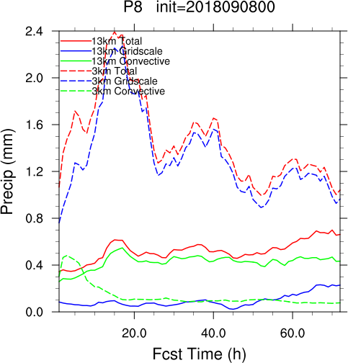
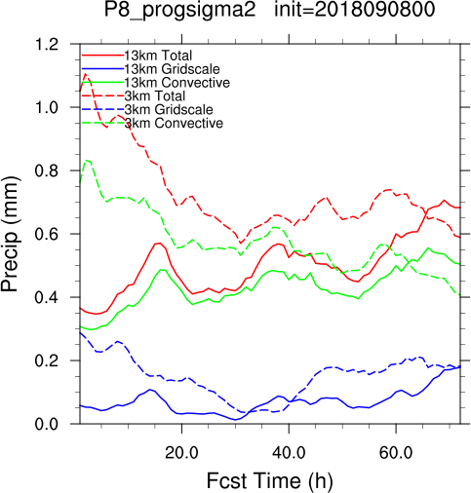
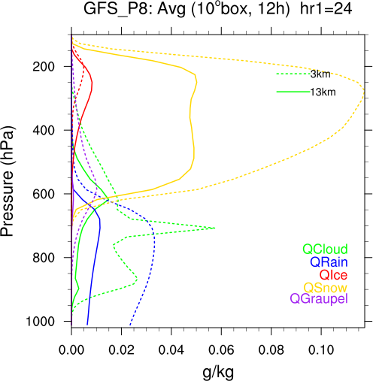
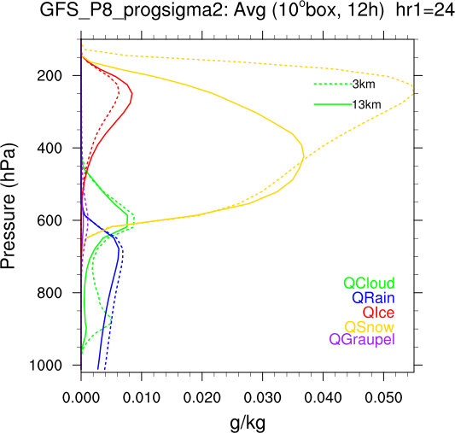
Prognostic & scale-adaptive cumulus convection closure (dubbed progsigma; PR18)
Total vs Grid-scale vs Parameterized precip [mm]
CTRL (P8 in CCPP v6)
CTRL + progsigma
Example - UFS LAM simulations of Hurricane Florence (2018)
CTRL@3 km produces more grid-scale precipitation, low clouds, and microphysics resolved hydrometeors.
Progsigma (Bengtsson et al. 2022): less scale sensitivity & tends to prevent microphysics from dominating rainfall production as grid spacing decreases.
Importance of interplays between moist physics components when considering scale awareness.
Hydrometeor Mixing Ratios [g kg⁻¹]
Pressure (hPa)
CTRL (P8 in CCPP v6)
CTRL + progsigma
Total
Grid-scale
Parameterized
13 km (solid)
3 km (dashed)

Slide 6
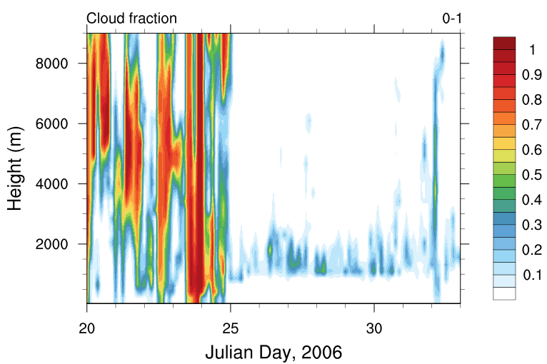
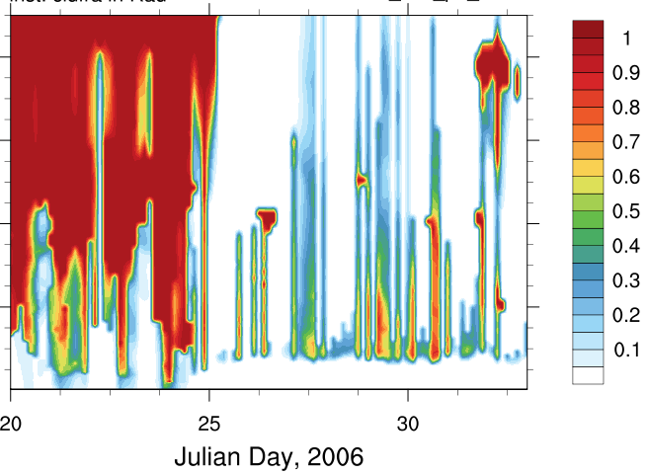
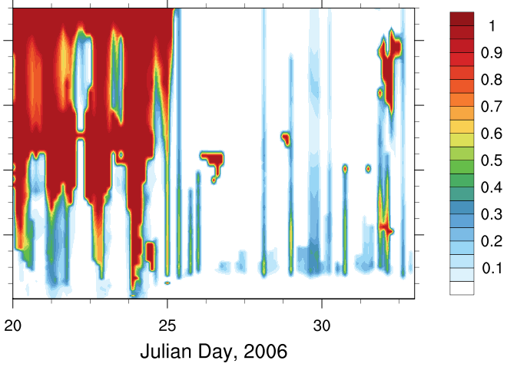
2. Updated Thompson microphysics (PR 19)
Time-height profiles of cloud fraction
Observation
CTRL (P8 in SRW v2.1)
CTRL + updated Thompson MP
ARM MAGIC
TWP-ICE
Example - CCPP SCM simulations of MAGIC & TWP-ICE
Updated Thompson microphysics → improved low cloud fraction, esp. stratocumulus

Slide 7
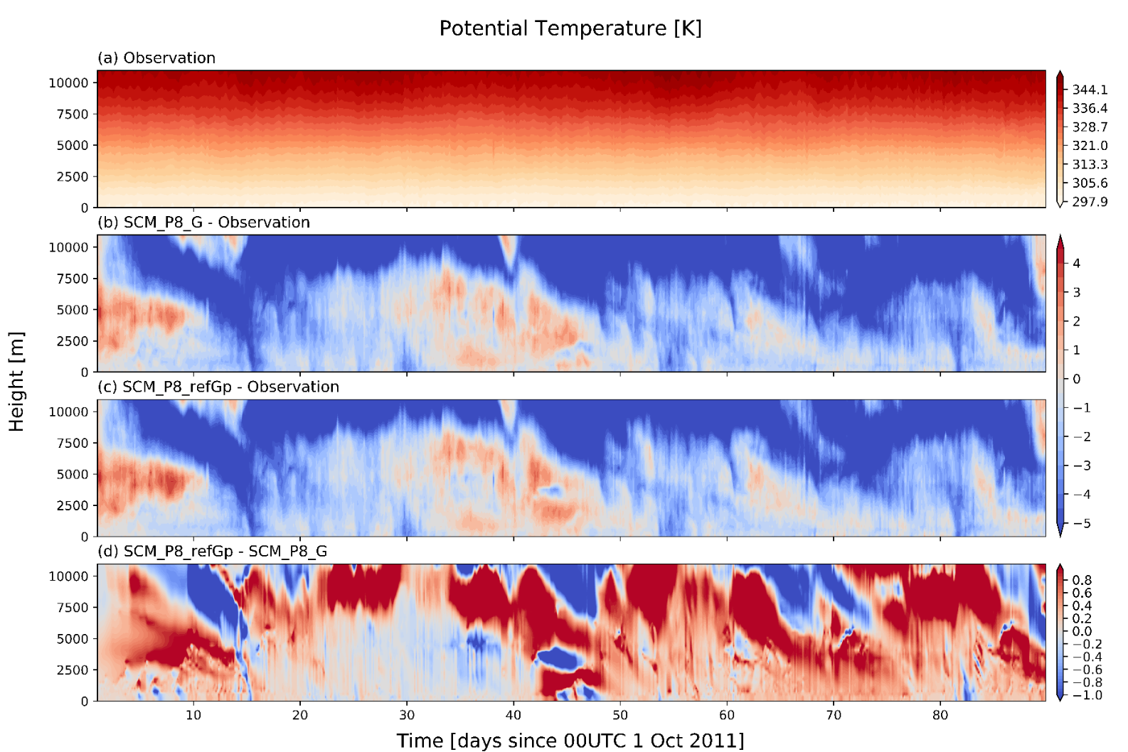
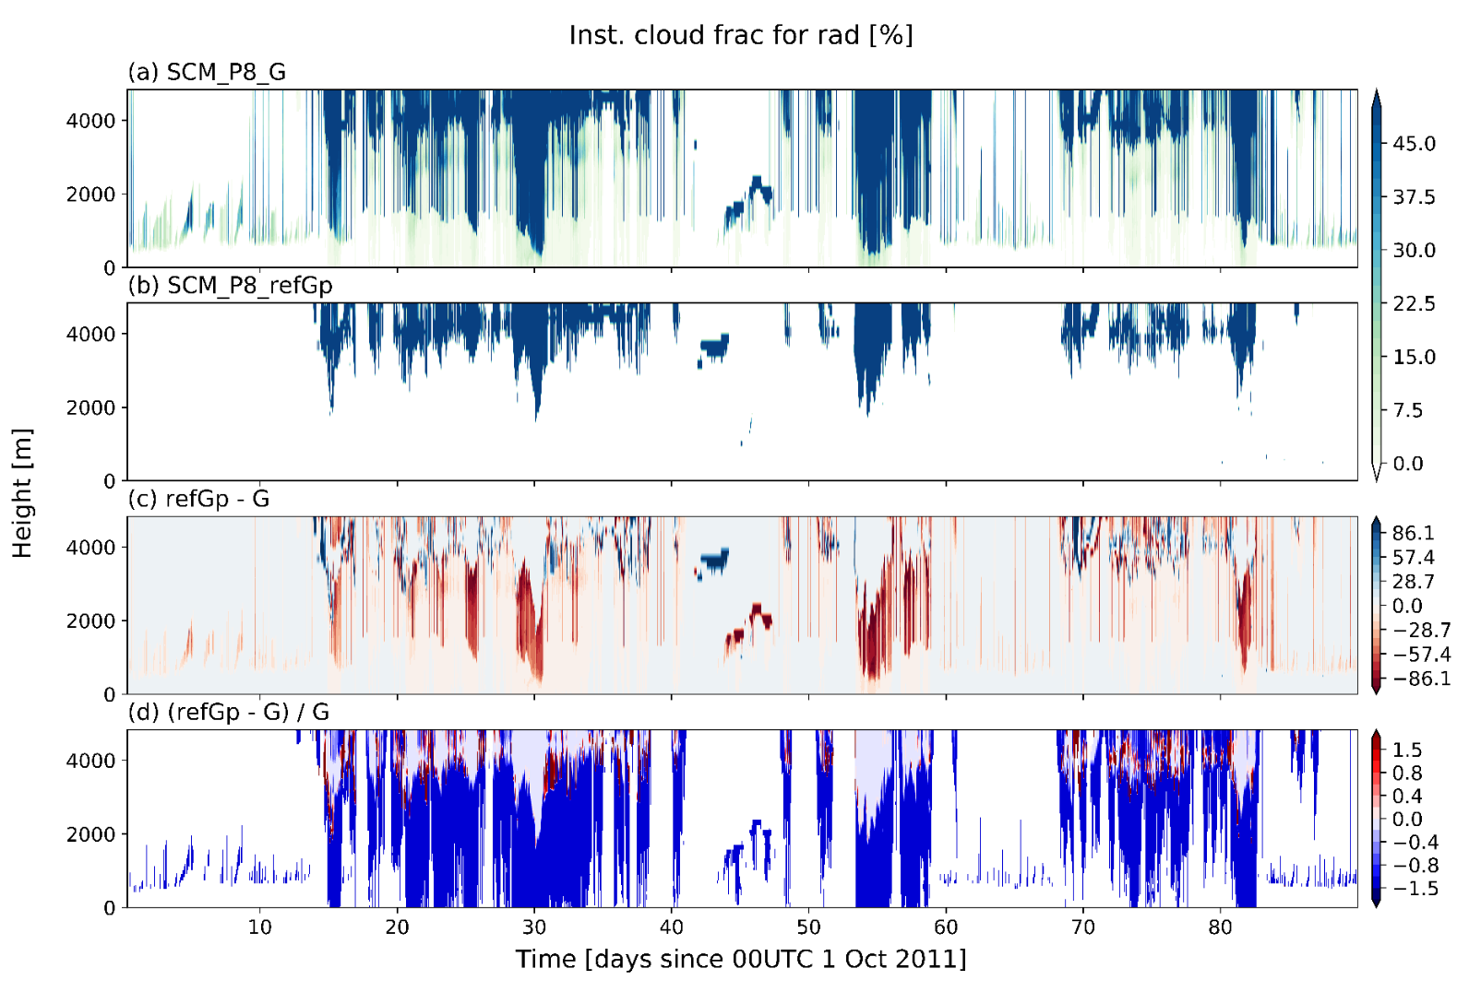
3. Refactored RRTMGP (PR 34)
Deficit in shallow cumulus clouds seen in all cases
Example - CCPP SCM simulations of DYNAMO
RRTMGp vs. RRTMG (top branch) - better wrt. upper tropo cold condition but still colder than obs (perhaps due to radiative cooling by high clouds)
Dearth of shallow cumulus clouds - an issue.

Slide 8
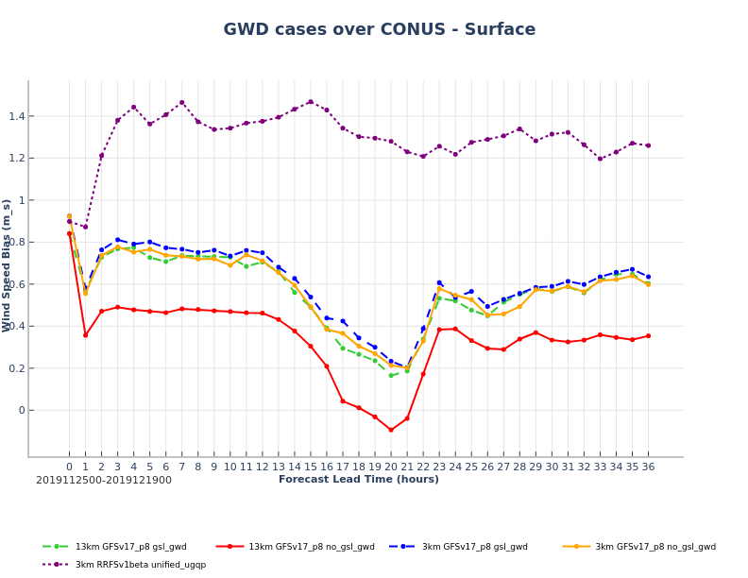
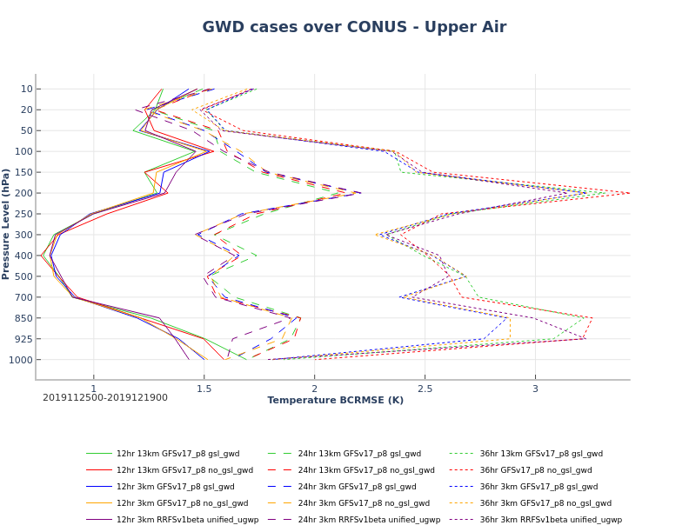
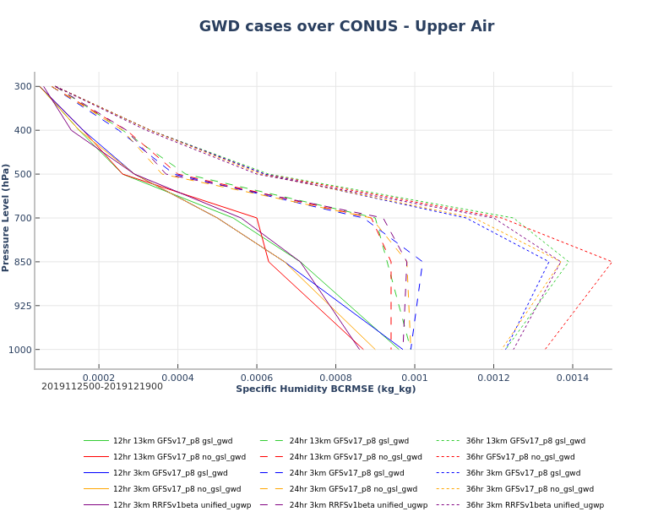
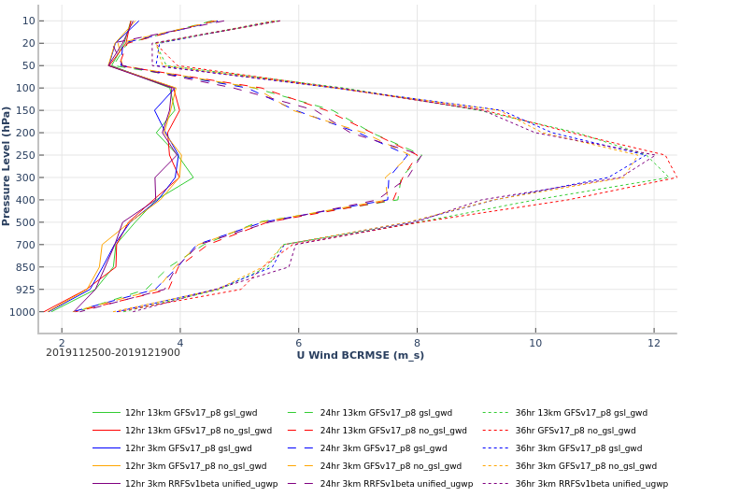
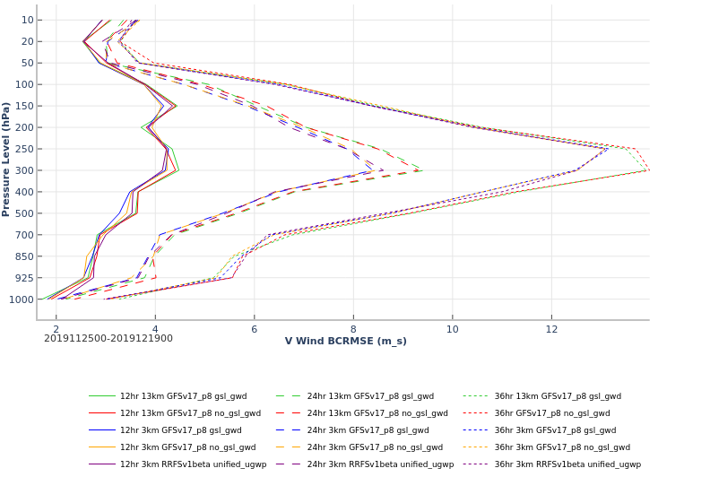
4. Updated unified gravity wave physics (PR 22 & 40)
Upper-air verification
Bias - surface wind speed
T
Qv
13-km P8 (SRW v2.1) w/ GSL GWD
13-km P8 (SRW v2.1) w/o GSL GWD
3-km P8 (SRW v2.1) w/ GSL GWD
3-km P8 (SRW v2.1) w/o GSL GWD
3-km RRFS (SRW v2.1) w/ Unified UGWD
U
V
Example – UFS-SRW LAM simulations w/ METplus for 9 CONUS cases
Using GSL gravity wave drag (GWD):
Overall higher skill in predicting upper-air variables
But, lower skill of surface temperature and winds (wrt both bias and RMSE).

Slide 9
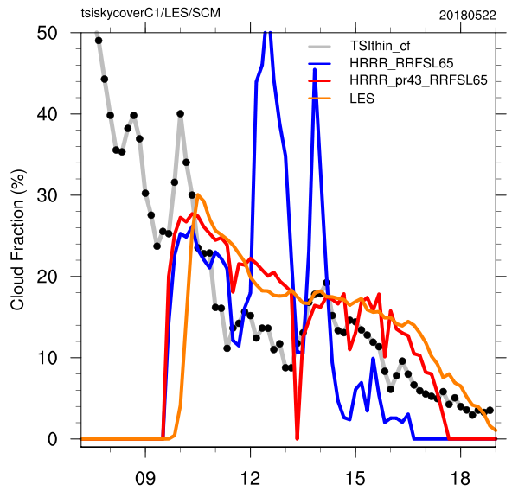
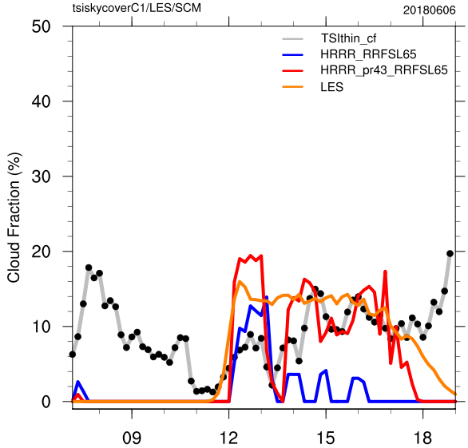
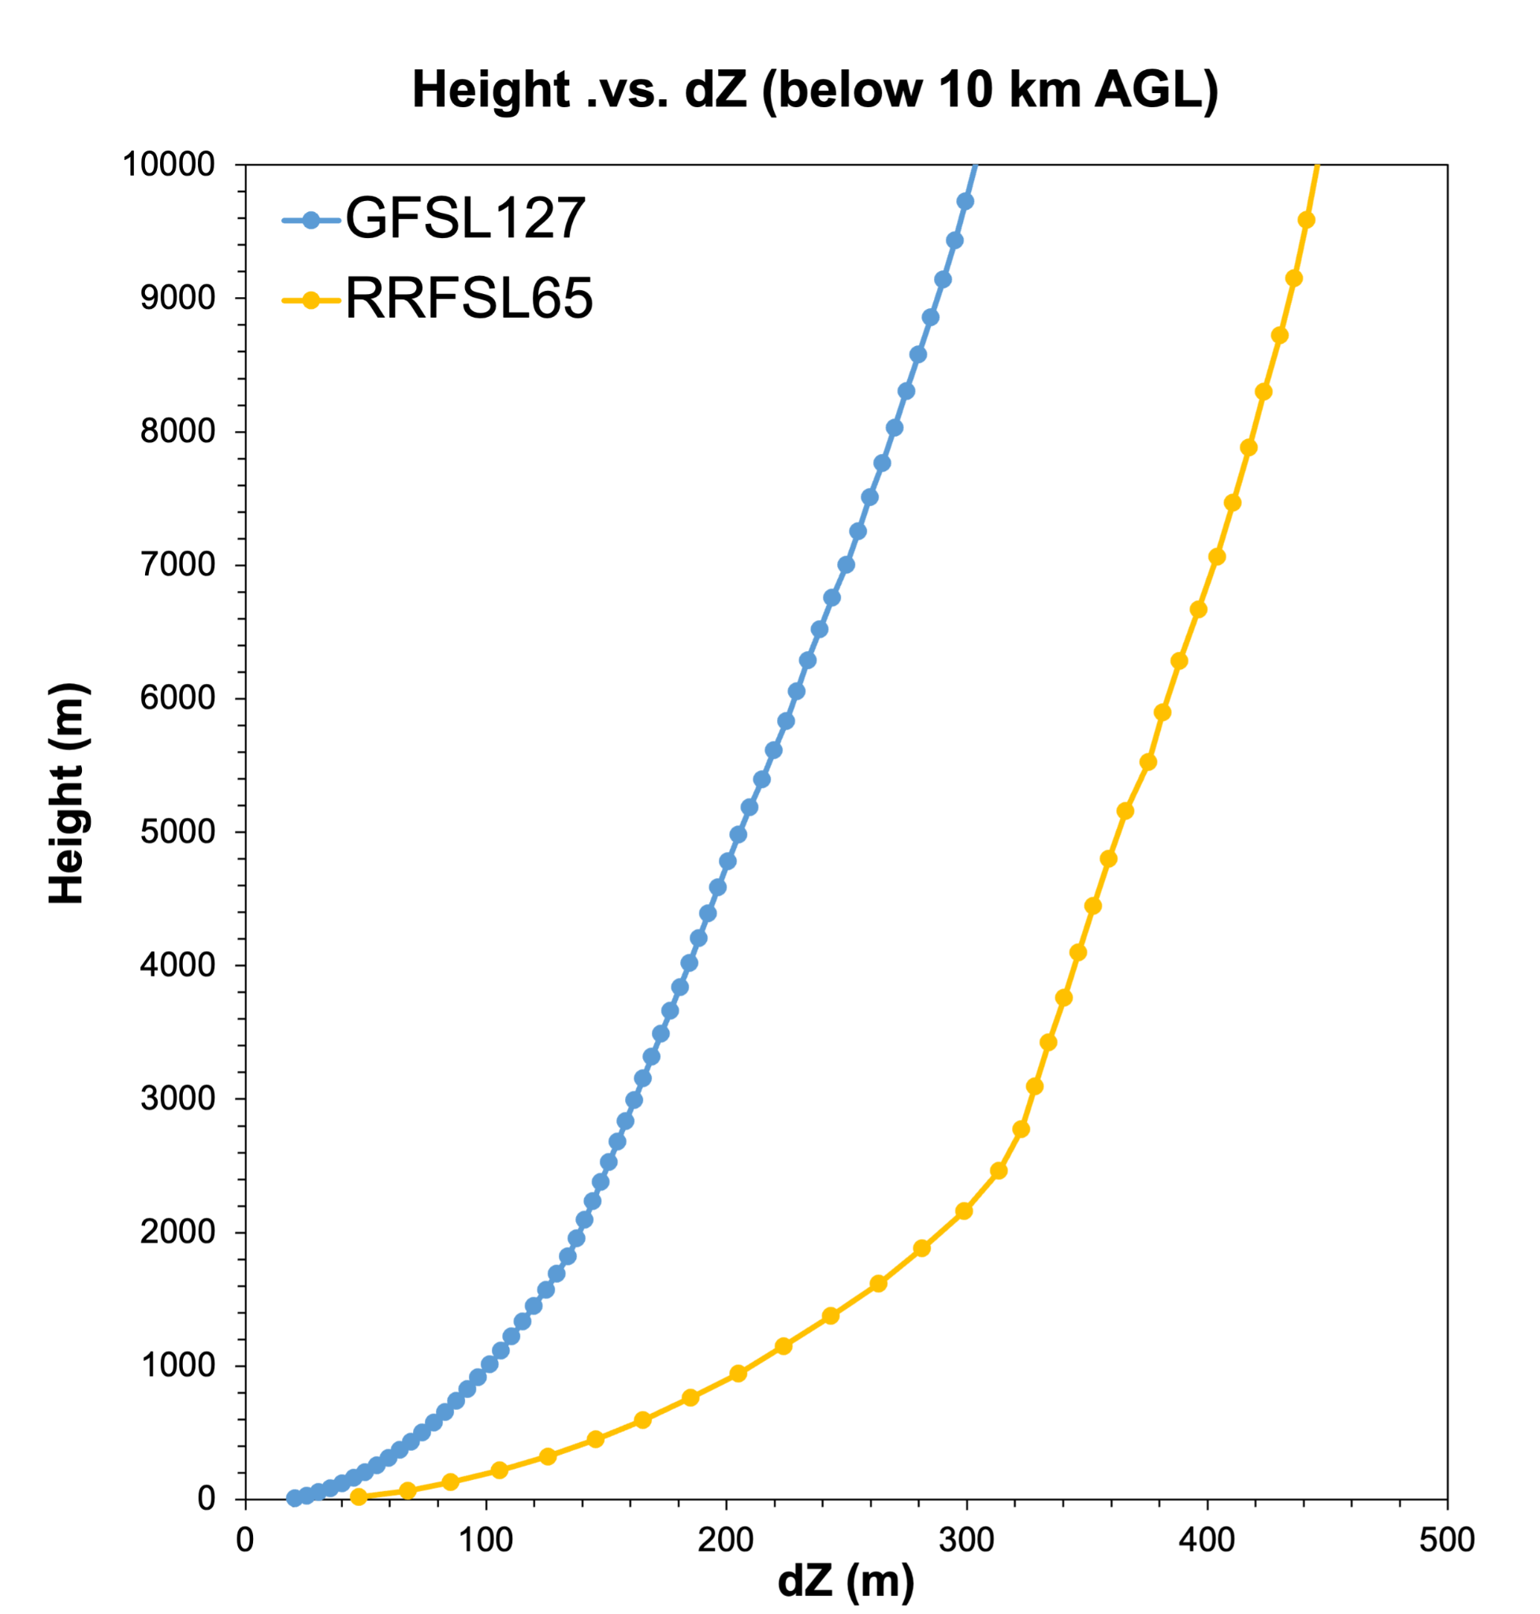
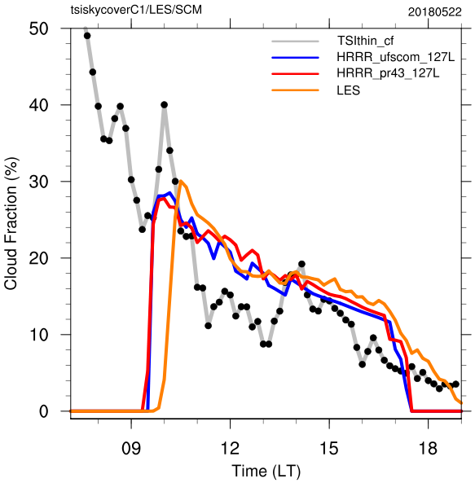
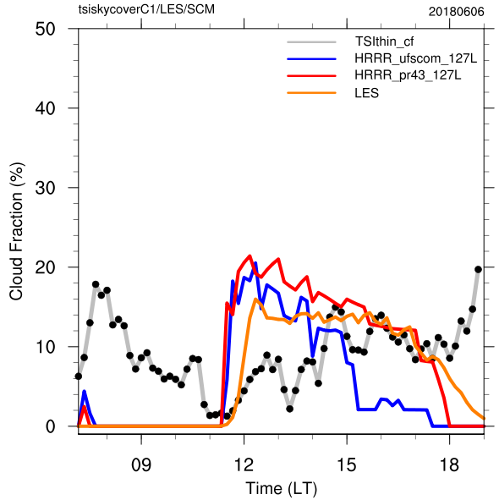
5. Updated MYNN-EDMF PBL & shallow cumulus (PR 43)
Time series of total cloud fraction [%] vs TSI & LES
20180522
20180606
Total Sky Imager (TSI)
LES
HRRR_RRFS (top branch)
HRRR_RRFS + PR43
Example - CCPP SCM simulations of LASSO
PR43 improves cloud fraction (wrt. amount and continuity) using both GFSL127 and RRFSL65, particularly in the afternoon.
Clouds are better represented at higher/finer vertical resolution, i.e., GFSL127
RRFSL65
GFSL127

Slide 10
Summary
DTC, working tightly with developers, tested and evaluated physics updates/innovations for the operations, across the spectrum of model physics.
Results inform both improvements or areas of attention in these physics, and stress the importance of
Interplays between physics components when considering scale awareness.
Appropriate vertical coordinate to work with particular physics.
Physics applicable to cases across different cloud/weather/regimes.
It is hopeful that our evaluations against relatively reliable benchmarks can help constrain parameterized processes and inform further physics development/improvement.

Slide 11
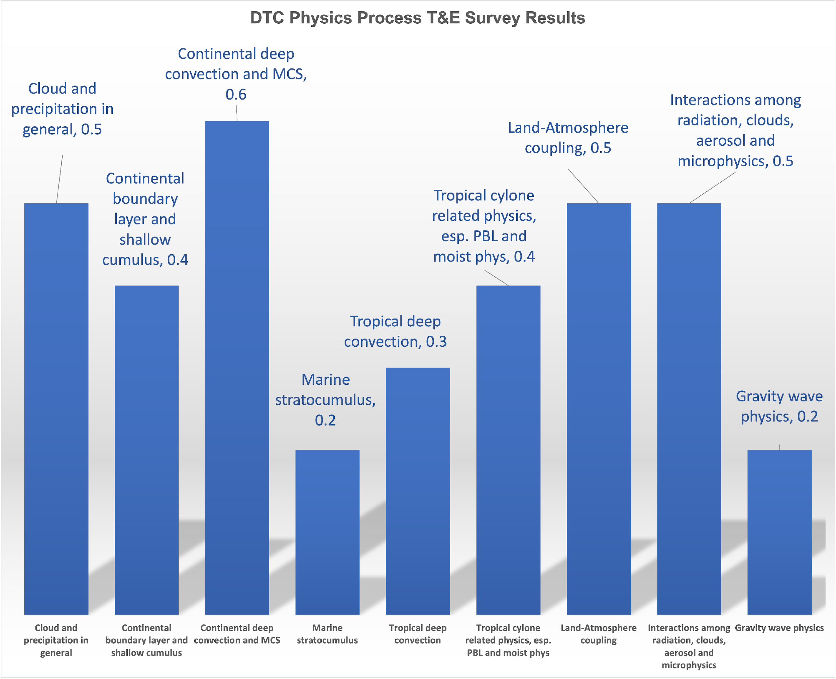
Activities for UFS-R2O Phase II
Top processes/phenomena for UFS physics development were identified, in combination with scalability investigations:
Interaction between land/ocean surface states, boundary layer, and shallow cumulus – also coordinated with SFS development
Interactions among microphysics, clouds, precipitation, radiation and aerosols.
(Year 5 beyond) Deep convection (oceanic and continental) (MCS, CAPE, convective initiation and cold pools).
DTC Advanced Phys T&E Interest Survey Results - Feedback from Physics Developers (as of Dec, 2022)

Slide 12
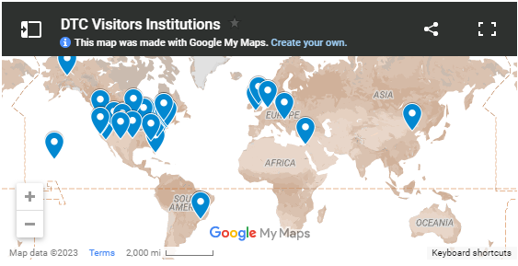
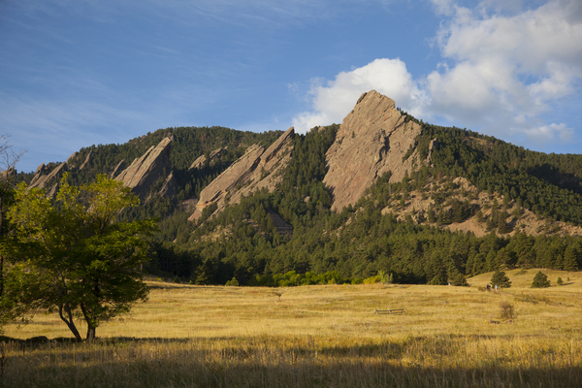
DTC Visitor Program
https://dtcenter.org/visitor-program
Propose a project to work on with us!
Two types of visitor projects:
PI - Up to 2 months salary, travel and per diem - can be split into multiple visits
Graduate Student - Up to 1 year of temporary living per diem and travel expenses for graduate student, plus support for advisor visits
See Announcement of Opportunity on DTC website for more information on how to apply and guidance on topics of interest

