Slide 1
Hierarchical Physics Development with the Common Community Physics Package and Single Column Model (CCPP SCM)
Dustin Swales^{1,3}, Grant Firl^{1,3,4}, Mike Ek^{1,2} , Lulin Xue^{1,2}, Ligia Bernardet^{1,3}
¹DTC
²NCAR/RAL
³NOAA/GSL
⁴CSU/CIRA

Slide 2
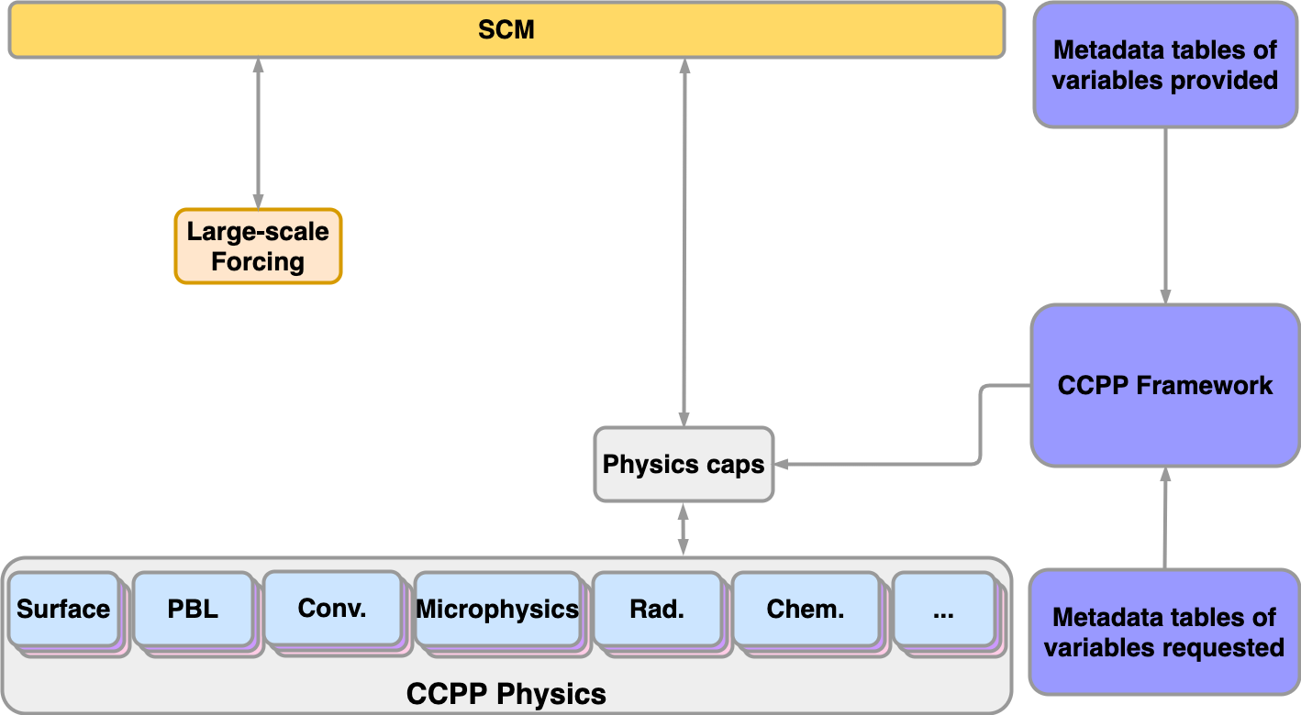
CCPP Single Column Model
The Common Community Physics Package, together with the CCPP Single Column Model, enables the incremental transition of physics development within Unified Forecast System (UFS/FV3).
The CCPP SCM uses the same physics configurations as the UFS, which facilitates development targeted for UFS applications.
*The DTC maintains the CCPP-SCM alongside the UFS.

Slide 3
CCPP Single Column Model
The CCPP-SCM provides much of the infrastructure to facilitate physics development from inception to operations. Which is great, but…
Data from field campaigns are used to derive forcing datasets that are then used to drive the CCPP-SCM. Excellent for model validation, but limited in coverage.
With the CCPP-SCM we removed the feedback between the physics and dynamical core, but we still have a gap in the hierarchy when it comes to understanding how changes to individual parameterizations behave in isolation, or interact with other parameterizations.

Slide 4
UFS replay
Using standard UFS output we can derive the large-scale forcing terms from the state variables to drive the CCPP-SCM.
This gives us a sense of how physics innovations will behave with the same forcings as in the three-dimensional FV3, without the computational burden.
UFS
S(T, qv, u, v) → dS(T, qv, u, v)/dt

Slide 5
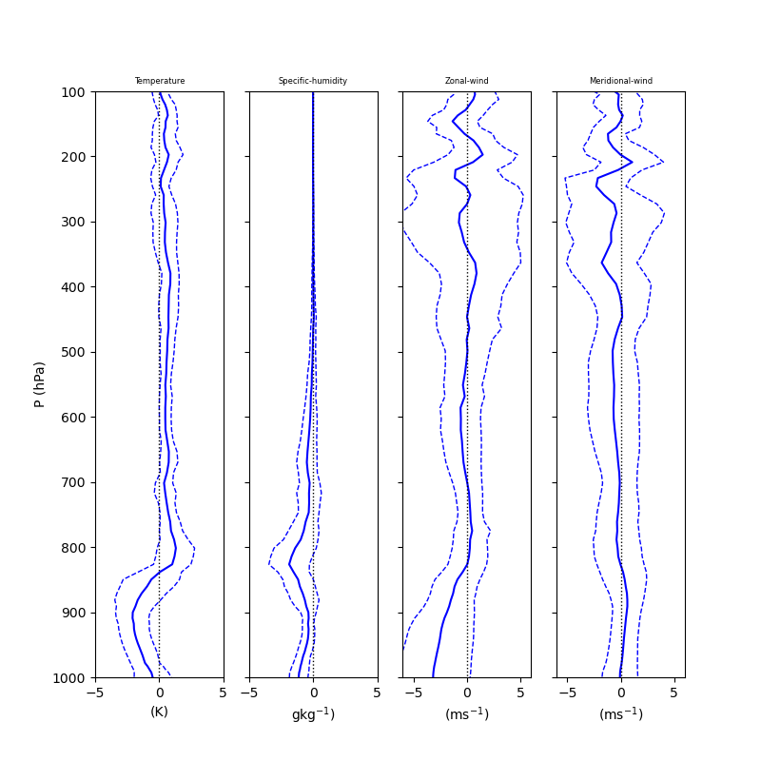
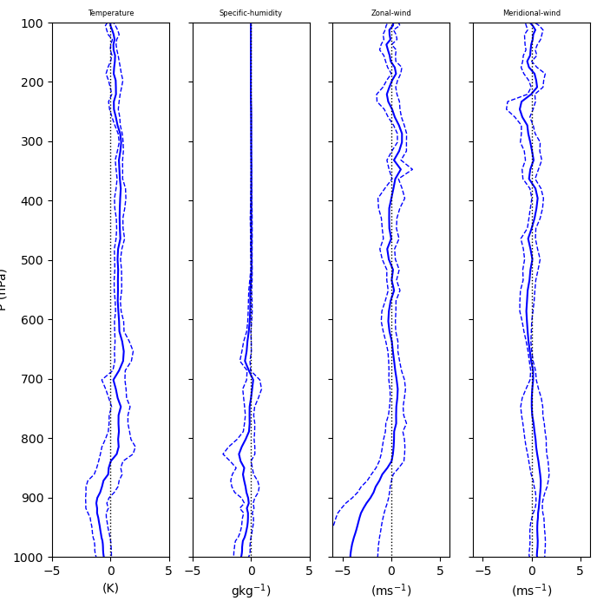
UFS replay
How well does SCM with UFS-replay reproduce the state of the UFS?
Mean differences (solid line) and variance (dashed lines) for an ensemble of SCM replay columns using 6-hourly UFS output (left) and using 1-hourly UFS output (right).
Ensemble of SCM points [300º - 320º , 30º - 40º]
UFS RT (c192) initialized @ 03/22/2021 dtp=dtf=360s

Slide 6
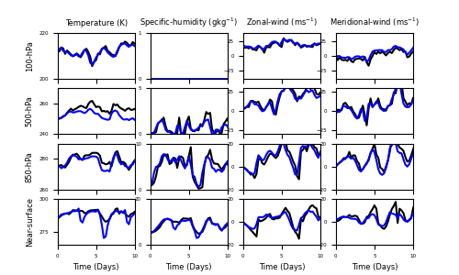
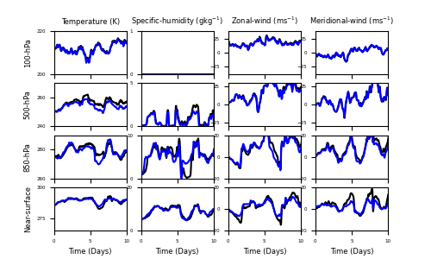
UFS replay
How well does SCM with UFS-replay reproduce the state of the UFS?
Ensemble of SCM replay columns (blue) and UFS output (black) for an ensemble of SCM replay columns using 6-hourly UFS output (left) and using 1-hourly UFS output (right)
Ensemble of SCM points [300º - 320º , 30º - 40º]
UFS RT (c192) initialized @ 03/22/2021 dtp=dtf=360s

Slide 7
UFS replay (example)
This tool can close a loop in the UFS modeling hierarchy, allowing developers to glean if their innovations behave as expected in the fully coupled model, but offline.
RRTMG has a known warm bias in the upper stratosphere lower-mesosphere.
RRTMGP uses more up-to-date spectroscopy, yielding lower errors in the upper-atmosphere shortwave heating-rate profiles.
The reference here are high spectral resolution line-by-line calculations for 52 RFMIP profiles.
Using an ensemble of UFS-replay SCM columns, we observe that the RRTMGP heating rates (red) in the upper atmosphere are considerably lower than RRTMG (blue).
RRTMG
RRTMGP
Ensemble of SCM points [300º - 320º , 30º - 40º]
Eli Mlawer @ AER
UFS RT (c192) initialized @ 03/22/2021 dtp=dtf=360s

Slide 8
UFS replay (summary)
Replaying UFS columns in the CCPP-SCM allows scientists/developers a quick an easy way to develop their parameterizations offline.
As always with the CCPP-SCM, we can test physics innovations without feedback to the dynamical core, but now we can extend that to “ with UFS-replay we can explore the physics response to the same dynamical large-scale forcing used in the 3D model, but without the physics coupling back to the dycore.”
UFS-replay closes some of the steps in the physics development hierarchy, but what about the coupling between physics parameterizations?

Slide 9
CCPP Suite Simulator
The CCPP Suite Simulator (CSS) emulates the evolution of the internal physics state outlined in the Suite Definition File (SDF).
For process-split physics, all schemes use same state from dynamical core:
so we can aggregate their tendencies to advance the state.
For time-split physics, each scheme uses an updated internal physics state modified by the upstream parameterizations

Slide 10
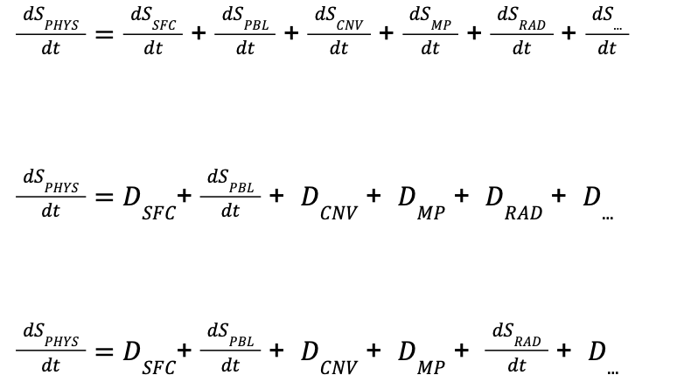
CCPP Suite Simulator
The CSS allows for schemes to be turned on and off, replacing “active schemes” with “simulated schemes”. For example, a process-split physics suite:
This is accomplished with a ccpp-compliant physics scheme that can be added to an existing SDF to modify the evolution of the internal physics state, via namelist control options.
For active PBL physics
For active PBL physics and radiation
OR…

Slide 11
CCPP Suite Simulator
For suites consisting process-split physics, the order of the schemes in the suite is not critical, making implementation of the CSS straightforward for process-split physics suites.
In this case the CSS could be added to the end of any existing SDF and configured using the physics namelist.
When using physics suites with time-split processes, the order in which the schemes are called is critical.
To emulate these suites we need to call the CSS at least twice in the SDF; once before, and once again after, the “active” scheme

Slide 12
CCPP Suite Simulator
CCPP Suite Definition Files (SDFs) for time-split and process-split suite simulation.
One caveat… Some schemes have upstream(downstream) dependencies on each other, and we don’t have data for these dependencies. For example, the PBL scheme may calculate a field needed by the convection. The CSS was designed with this is in mind and could be extended to account for additional simulated fields for each process.
Process-split SDF (All can be active)
<scheme>physics_radiation</scheme>
<scheme>physics_surface</scheme>
<scheme>physics_PBL</scheme>
<scheme>physics_SCNV</scheme>
<scheme>physics_DCNV</scheme>
<scheme>physics_MP</scheme>
<scheme>physics_…</scheme>
<scheme>ccpp_suite_simulator</scheme>
Time-split SDF (DCNV active)
<scheme>physics_radiation</scheme>
<scheme>physics_surface</scheme>
<scheme>physics_PBL</scheme>
<scheme>physics_SCNV</scheme>
<scheme>ccpp_suite_simulator</scheme>
<scheme>physics_DCNV</scheme>
<scheme>physics_MP</scheme>
<scheme>physics_…</scheme>
<scheme>ccpp_suite_simulator</scheme>
Time-split SDF (surface and DCNV active)
<scheme>physics_radiation</scheme>
<scheme>ccpp_suite_simulator</scheme>
<scheme>physics_surface</scheme>
<scheme>physics_PBL</scheme>
<scheme>physics_SCNV</scheme>
<scheme>ccpp_suite_simulator</scheme>
<scheme>physics_DCNV</scheme>
<scheme>physics_MP</scheme>
<scheme>physics_…</scheme>
<scheme>ccpp_suite_simulator</scheme>
Same SDF for ALL configurations!
Need to build a SDF with CSS calls between “active” schemes

Slide 13
CCPP Suite Simulator
One thing not discussed yet is the data for the CSS…
The spirit of the CSS is to help understand the behavior of the “active” scheme(s), but this is only useful if your simulated data is sensible for your application.
Provided with the CCPP SCM are scripts to create simulated tendencies for use in the CSS.
One to extract the physics tendencies from SCM output at a given time (constant 1D).
Another to create a temporally varying tendencies, which are interpolated by the CSS.
The CSS can be “extended” to accommodate data of any dimensionality.

Slide 14
CCPP Suite Simulator (summary)
This CSS provides users with the ability to turn off physics parameterizations and replace them with prescribed forcing. This allows developers to explore and understand how physics innovations impact individual physical processes.
One hurdle is creating data to use in the CSS.
Looking forward… in the future it may be possible for the CCPP framework, the infrastructure that connects the CCPP-physics to the CCPP-SCM, to handle the evolution of the internal physics state, which would greatly simplify this scheme.

Slide 15
Summary
We presented two new tools aimed at facilitating hierarchical physics development within the CCPP and the UFS.
UFS-replay in the CCPP-SCM allows users to explore physics schemes deeper, easier, and faster than before. Also, it allows developers the opportunity to get a sense of how there innovations will behave in the fully coupled three dimensional system.
The CCPP Suite Simulator provides a way for a greater process-level understanding by allowing developers to isolate inter-physics scheme coupling.
UFS-replay is currently available, and documented, in the authoritative CCPP-SCM repository
The CCPP Suite Simulator will be made available in the coming weeks. Stay tuned!

