Slide 1
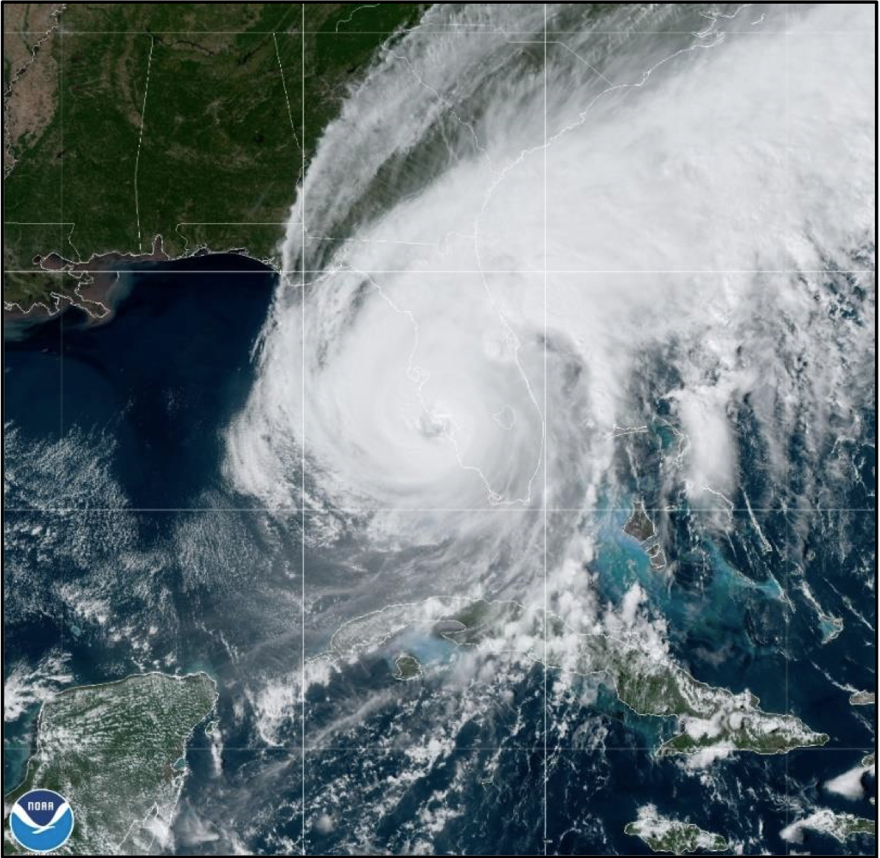
Moving Nest Features for HAFS
William Ramstrom^{1,2} , Xuejin Zhang² , Sundararaman G. Gopalakrishnan² ,
Bin Liu³ , Zhan Zhang⁴ , and Ghassan J. Alaka Jr.²
¹ CIMAS, University of Miami, Miami, Florida
² NOAA/AOML/HRD, Miami, Florida
³ Lynker at NOAA/NWS/NCEP/EMC
⁴ NOAA/NWS/NCEP/EMC

Slide 2
Moving Nest Overview
Limits in Global Forecast Systems
Current global GFS resolution of 13 km
To accurately model hurricanes, we need 1-4km resolution to capture strong gradients in the storm core
Not feasible to run large/global domain at that resolution in operational timeframes
High Resolution Nesting
Storm-following nest to provide high resolution of tropical cyclones
Storm-centered regional, basin-scale regional, and global configurations supported
Storm-centric regional configuration for operational system

Slide 3
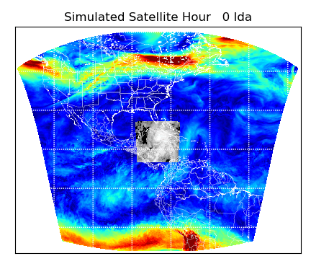
Moving Nest Implementation
Development Accomplishments
Began running operationally for NOAA June 27
6km regional parent
2km moving nest
Two configurations in operations
Culmination of 4 years of development work

Slide 4
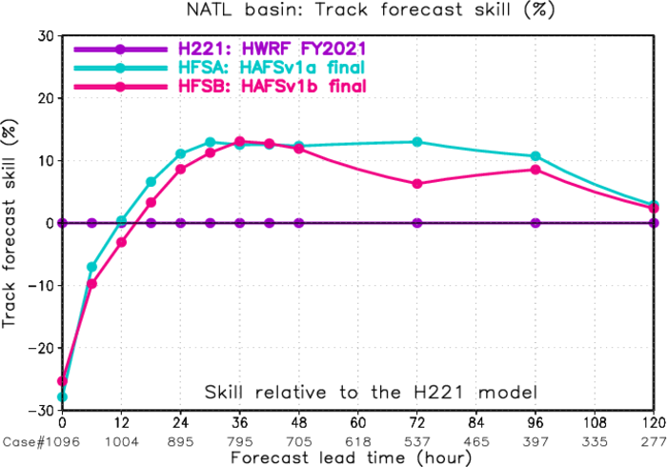
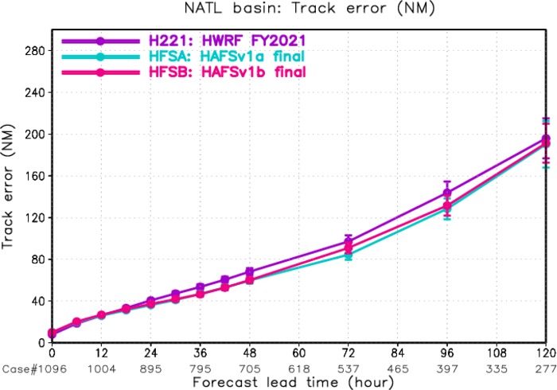
Moving Nest Features
Accurate
Track 5-10% more accurate than HWRF
Max Wind Speed also 5-10% more accurate
Fast
Runtime Overhead 3%-7% compared to static nest
Scales with forward motion of storm
HWRF overhead is ~15-20%
Robust
2020-2022 retrospective testing, stress tests
Configurable
Enabled via namelist options
Verification diagrams courtesy of Bin Liu/EMC

Slide 5
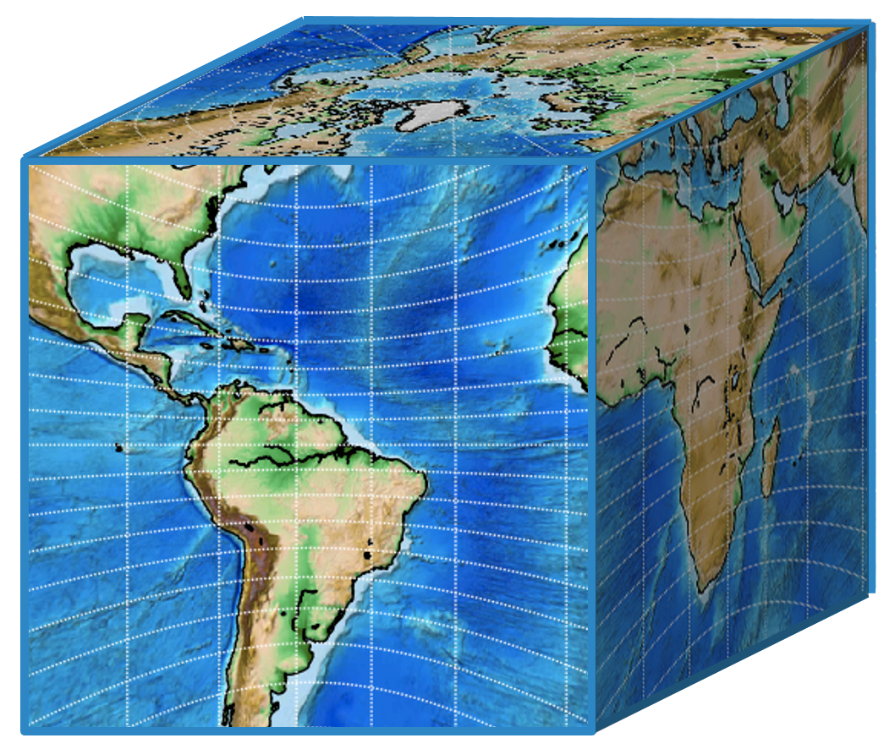
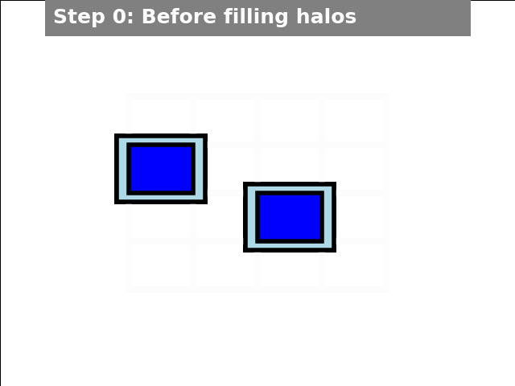
Implementation
Nesting Design
Nest halo code used for downscaling and transmitting coarse resolution data
Prognostic variables must all be moved
Nest points are aligned with parent points
Enhanced efficiency
Prognostic Variable Staggering
Mass and tracers are cell volume averages on A-grid
Winds are staggered on D-grid
Model Variables
Prognostic
T, delz, delp, u,v,w wind, humidity, tracers
Physics
56 separate variables in 1D vectors
Static surface fields
High resolution
Nest resolution from files
Grid distances, areas, Coriolis, etc.
Calculated at 64 bit precision from lat/lons

Slide 6
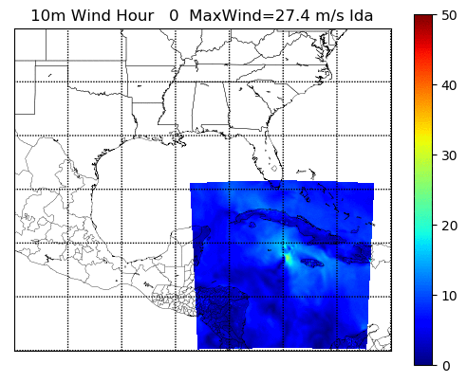
Internal Tracker
Internal tracker ported from HWRF based on GFDL tracker
Center evaluated using 9 different variables
Sea level pressure, 10m winds, vorticity
850mb wind, vorticity, geopotential
700mb wind, vorticity, geopotential

Slide 7
Multiple Moving Nest Design
Multiple Moving Nests
Regional, Basin, Global configurations
Same parallelism as single moving nest
Nests timestep concurrently with parent
Nests aligned with parent grid
Consider merging feedback when nest points overlap

Slide 8
Multiple Moving Nests
Dual nest cases now running
Coarse and high resolution
Validation underway
Nest Tests:
3 moving nests
Overlapping nests
Mix Static & moving nests
Sally and Teddy, Sept. 2020

Slide 9
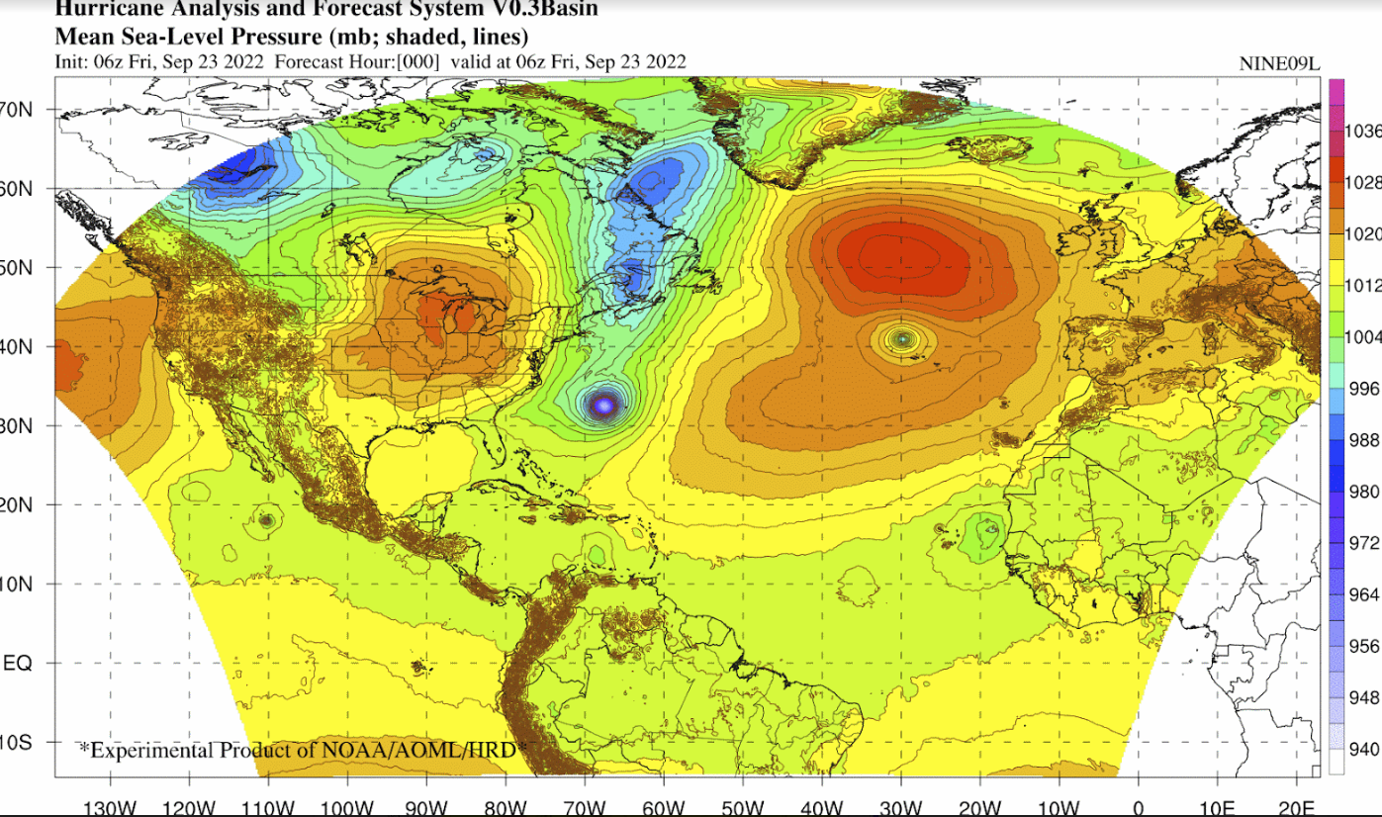
HAFS-Basin
Successor to Basin-Scale HWRF
Multiple nested domains
Permits cycled data assimilation
Goal is to cover NHC AOR
Better capture storm-storm interactions
HAFS-Basin diagram courtesy of Gus Alaka, NOAA/HRD

Slide 10
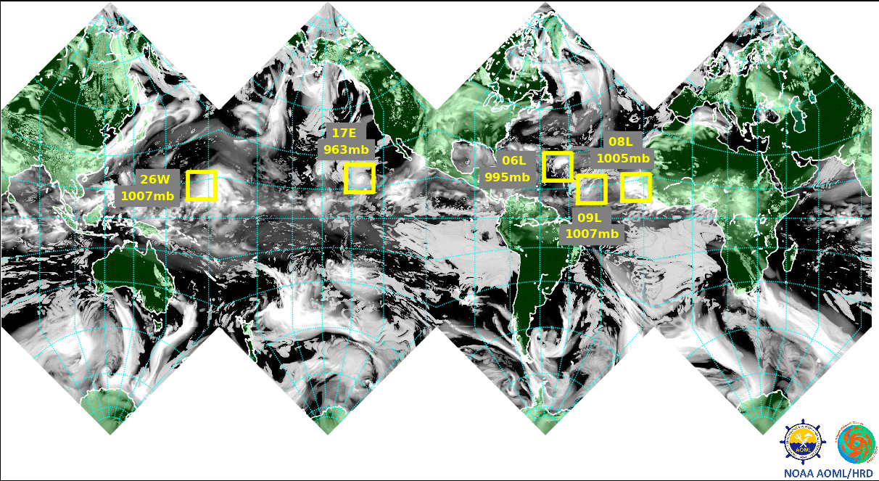
HAFS Roadmap – 2023 Season and Future
Accomplished
Storm-centered
Operational 2023
Two configurations
Long Term
Basin-scale
Multi Storm
Refinement Ratios
Global

Slide 11
Questions?
AOML Hurricane Model Viewer
https://storm.aoml.noaa.gov
AOML’s Hurricane Modeling and Prediction Program
https://www.aoml.noaa.gov/hurricane-modeling-prediction/

Slide 12
Extra Slides

Slide 13
