Slide 1
Evaluation and Process-oriented Diagnosis of the GEFSv12 Reforecasts
Zhuo Wang
University of Illinois at Urbana-Champaign
Acknowledgements: Jiacheng Ye, Fanglin Yang, Lucas Harris, Tara Jensen, Douglas E. Miller, Christina Kalb, Daniel Adriaansen, Weiwei Li
Supported by NOAA Round 3 R2O Initiative and MAPP Program
JCLI 2023: https://doi.org/10.1175/JCLI-D-22-0772.1

Slide 2
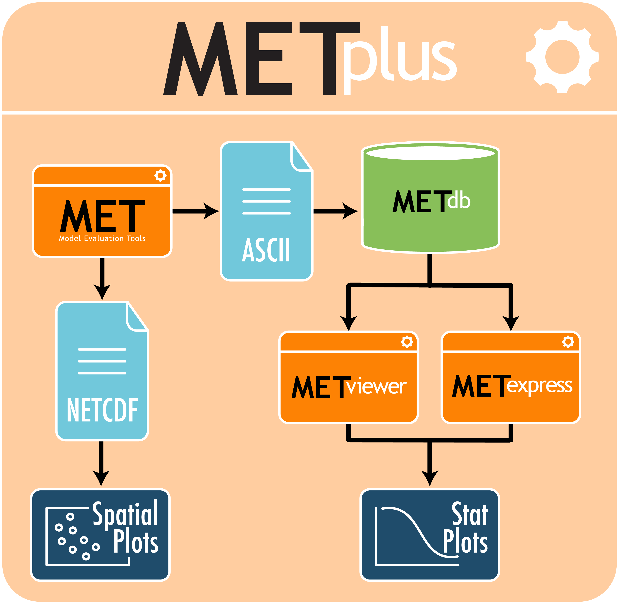

Three-level Diagnostics
Integration into METplus
Level 1: Evaluation of Model Systematic Errors
  Moisture-Precipitation
  Cloud microphysics
Level 2: Evaluation of the Sources of Predictability for Extended-range Forecasts
MJO
NAO
weather regimes
MDTF Github
Level 3: Evaluation of High-Impact Weather and Climate Phenomena
Blocking
Tropical cyclones

Slide 3
Data
Model data:
The GEFSv12 retrospective forecasts span from 1 Jan 2000 to 31 Dec 2019
Only the control run is evaluated
Evaluation datasets
ERA5 reanalysis
Global Precipitation Climatology Project (GPCP)
Outgoing longwave radiation (OLR) from the Clouds and the Earth’s Radiant Energy System (CERES)
International Best Track Archive for Climate Stewardship (IBTrACS) dataset Version 4

Slide 4
Level 1: Model Systematic Errors

Slide 5
Moisture-Precipitation Relationships
A single prominent peak of PW over WPac corresponding to deep convection and a high precipitation rate – dry biases in the GEFS
a bimodal distribution over EPac not well represented in the GEFS
Early onset of precipitation
Deep conv.
congestus

Slide 6
Column Water Vapor and Precipitation
Column Water Vapor Precipitation
ERA5
GEFS
Biases
Dry biases over the Maritime Continent
ITCZ too strong in the GEFS

Slide 7
Level 2: Sources of Predictability for Extended-range Forecasts

Slide 8
MJO Skill in the GEFS
The bivariate correlation remains above 0.6 up to 16 days.
Increasing ensemble size is expected to improve the model prediction skill.
The skill is higher for strong MJO days.

Slide 9
Hovmöller diagrams of band-pass filtered precip
The eastward propagation of enhanced precipitation across the maritime continent remains robust even in the Day-16 reforecasts, although the signals weaken with increasing forecast lead time

Slide 10
Probability distributions of the MJO phase speed and daily change of RMM magnitude
(a) MJO Prop Speed
8° day⁻¹ ~ 45 days
(b) MJO Amplitude Change
The MJO propagation slows down progressively with increasing forecast lead time.
The model has difficulty maintaining the steady state of the MJO with increasing forecast lead time.
The weakened and less coherent MJO signals with increasing forecast lead-times may be attributed to humidity biases over the Indo-Pacific warm pool region.

Slide 11
North American Weather Regimes
The ACC remains above 0.6 up to 12 days, which is comparable to the performance of the ECMWF S2S reforecasts.
The persistence probability is well reproduced for all regimes and for all pentads in the GEFS

Slide 12
Level 3: High-Impact Weather and Climate Phenomena

Slide 13
Tropical Cyclone Genesis Density Function
Obs
TCG in the WPac is improved substantially compared to an earlier version.
The positive biases over the EPac can be attributed to the overestimated ITCZ.
GEFS
Biases

Slide 14
Blocking
The long-term mean longitudinal distribution of blocking frequency is well represented in the GEFSv12 from Day 1 to Day 15.
Positive blocking frequency biases prevail over the subpolar North Atlantic, and negative biases downstream of the Ural Mountain, which increase with the forecast leadtime.

Slide 15
Summary
Three levels of model diagnostics are applied to evaluate the GEFSv12 reforecasts.
The level-1 diagnostics reveal that precipitation onset over tropical oceans occurs too early in terms of CWV accumulation, leading to prevailing dry biases in the tropics.
The level-2 diagnostics show that the GEFSv12 can skillfully forecast the MJO up to 16 days ahead and can reasonably represent the MJO propagation across the MC.
It is also found that the weather regimes can be skillfully predicted up to 12 days ahead with persistence comparable to the observation.
The GEFSv12 shows reduced mean biases in TC genesis distribution, and blocking climatology in the GEFSv12 also shows an overall good agreement with the observations.

