Slide 1
A Scale-Aware Three-Dimensional TKE Turbulent Mixing Parameterization for the Hurricane Analysis and Forecast System (HAFS)
UIFCW 2023
Ping Zhu¹, Jun Zhang^{2,3}, Xuejing Zhang³, Jianwen Bao⁴, Zhan Zhang⁵
¹Florida International University (FIU)
²Cooperative Institute for Marine & Atmospheric Studies (CIMAS), University of Miami (UM)
³AOML/Hurricane Research Division (HRD), NOAA
⁴Physical Sciences Laboratory (PSL), NOAA
⁵Environmental Modeling Center (EMC), NOAA
07/25/2023

Slide 2
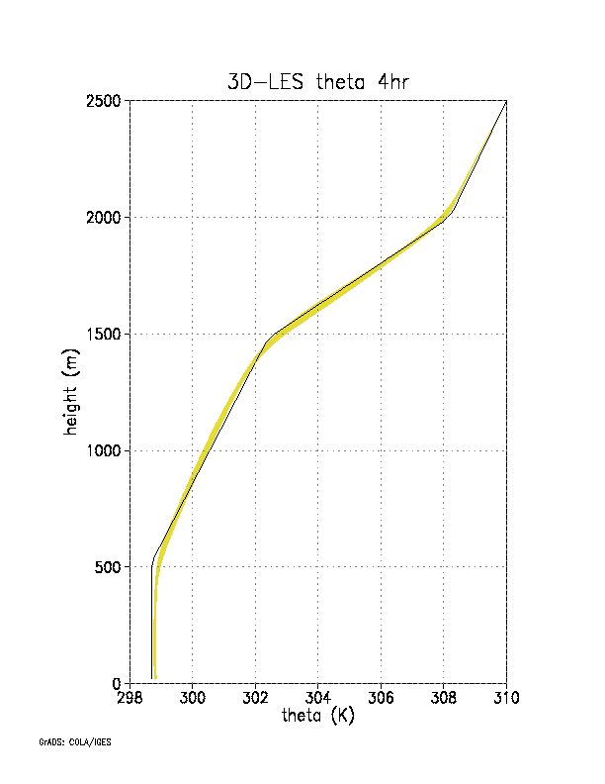
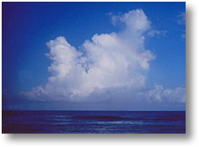
Background
Boundary layer and turbulence parameterization
15:30 LST
12:30 LST
09:30 LST
06:30 LST
BOMEX
DYCOMS
Southern Great Plains
Typical CBL
Subtropical trade-wind MBL
Stratocumulus-topped MBL
Typical SBL
The turbulent BL is cleanly separated from the free atmosphere above by a capping inversion.
Vertical turbulent mixing is much stronger than the horizontal turbulent mixing.
In MS and LS models, horizontal and vertical turbulent mixing is treated separately. The former is handled in a model’s dynamic solver, whereas the latter is treated as a standalone one-dimensional module in a model’s physics package.

Slide 3
Background
Observed thermodynamic and turbulence structure in the eyewalls of tropical cyclones (TCs)
(Lorsolo et al. 2010)
(Zhu et al. 2019)
No inversion exists to separate the BL from the free atmosphere above in the eyewall.
Large Turbulent kinetic energy (TKE) is seen in the eyewall throughout troposphere.
Traditional PBL concept does not apply to the eyewall.

Slide 4
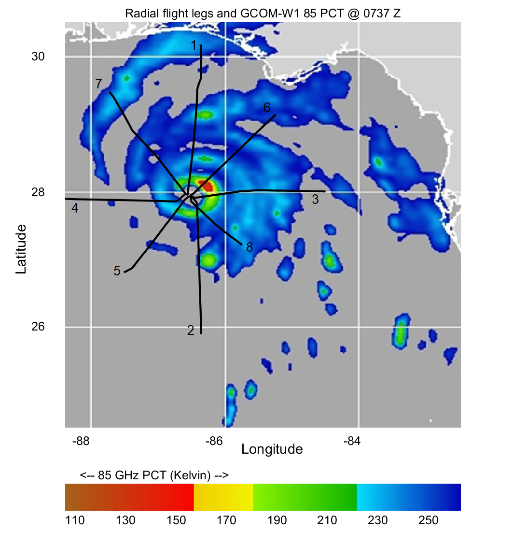
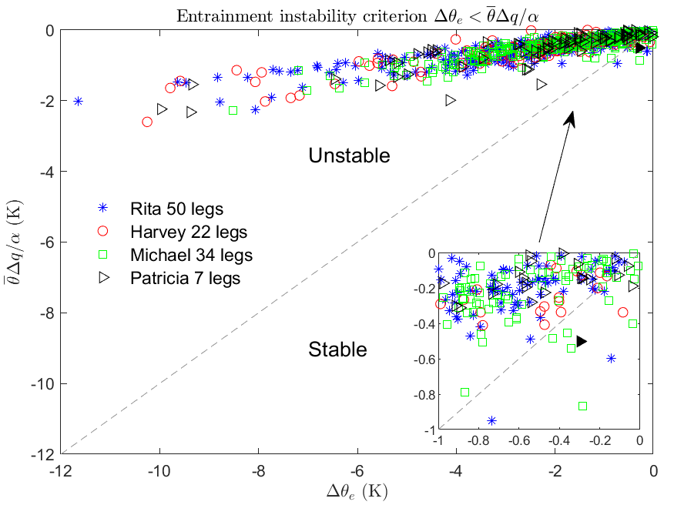
Background
Horizontal turbulent mixing and lateral entrainment instability in the inner core of TCs
(Zhu et al. 2023)
Entrain moat air laterally into the eyewall

Slide 5
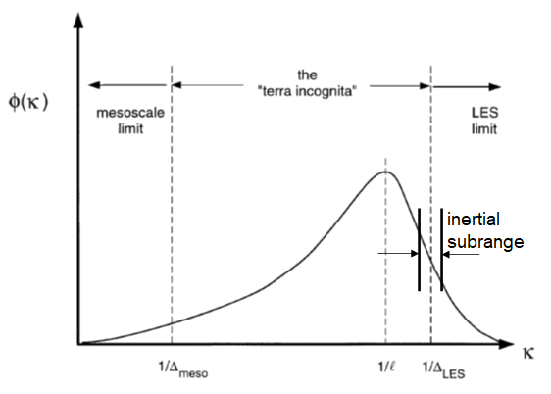
Background
Parameterization of turbulent mixing in the gray zone
after Wyngaard (2004)
Large eddies are generated by the instabilities of the mean flow and fundamentally anisotropic.
Eddies smaller than inertial subrange are isotropic.
In large-eddy simulations (LES), the unresolved small-scale turbulence needs to be treated three dimensionally under the isotropic assumption.
In mesoscale simulations (MS), the large anisotropic turbulence is currently handled by the separated vertical and horizontal turbulence schemes.
Turbulent eddy energy spectrum
Anisotropic large eddies
Isotropic eddies
Eddy scale
What about turbulent mixing when model grid resolution falls in the gray zone? The purely 1D column parameterization framework becomes a problem.
The physics-dynamics coupling becomes important as model resolution falls in the gray zone. The “separation” between physics and model dynamics becomes an obstacle to model development.

Slide 6
A scale-aware (SA) 3D TKE turbulence scheme bridging the gap between the LES and MS limits
(a) 3D TKE budget equation
Shear production
Buoyancy production
3D TKE trans. & Press. Corr.
TKE dissipation
In 1D PBL scheme,
(b) Turbulence closure in a TKE scheme
NL: nonlocal mixing
V:
H:

Slide 9
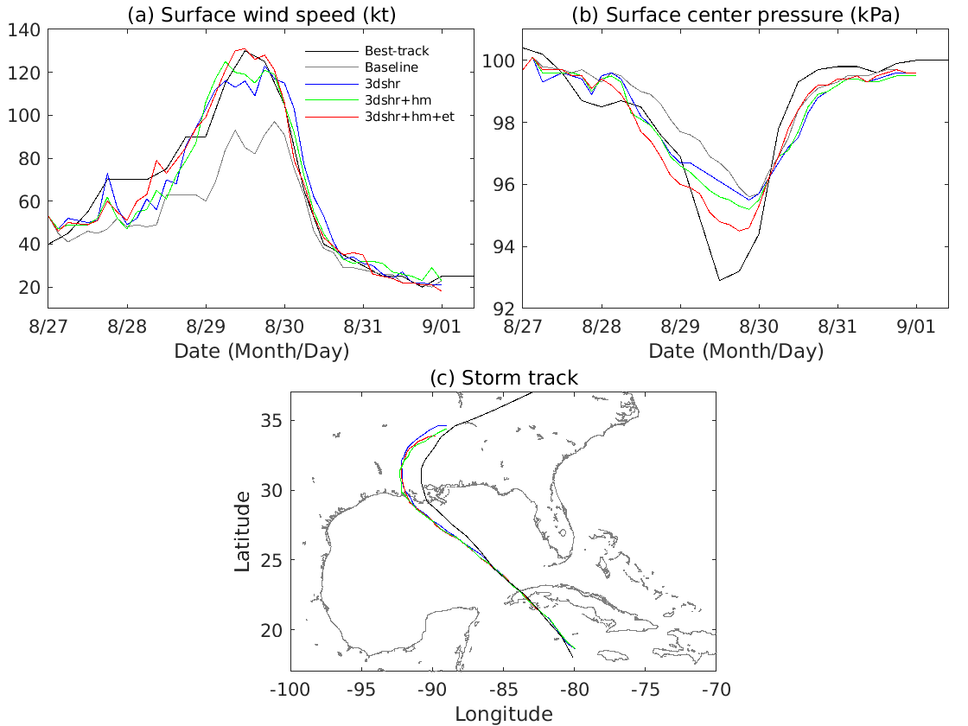
Initial results
HAFS’s simulated track and intensity of Hurricane Ida (2021) compared with observations
Black line: the best-track; Gray line: baseline HAFS simulation; Blue line: HAFS simulation that considers 3D TKE shear production only; Green line: HAFS simulation that considers 3D TKE shear production and horizontal mixing parameterized using the predicted TKE;
Red line: HAFS simulation that considers 3D TKE shear production, TKE based horizontal mixing, and 3D TKE transport and pressure correlation.

Slide 10
Summary
The purely one-dimensional vertical column framework for parameterizing vertical turbulent mixing and the separated inconsistent horizontal and vertical turbulence parameterization pose an obstacle for a realistic representation of the three-dimensional turbulent transport in the TC inner core.
A scale-aware 3D TKE scheme shows a promising result to improve HAFS’s skill in predicting TC intensity.
Future Work
Conducting sensitivity tests to evaluate the scale-aware 3D turbulence scheme for various resolution settings, and further refining and tuning the scheme.
Validating the HAFS simulations of historical hurricane cases against observations.
Performing real-time TC forecasts during the Atlantic hurricane seasons.

