Slide 1

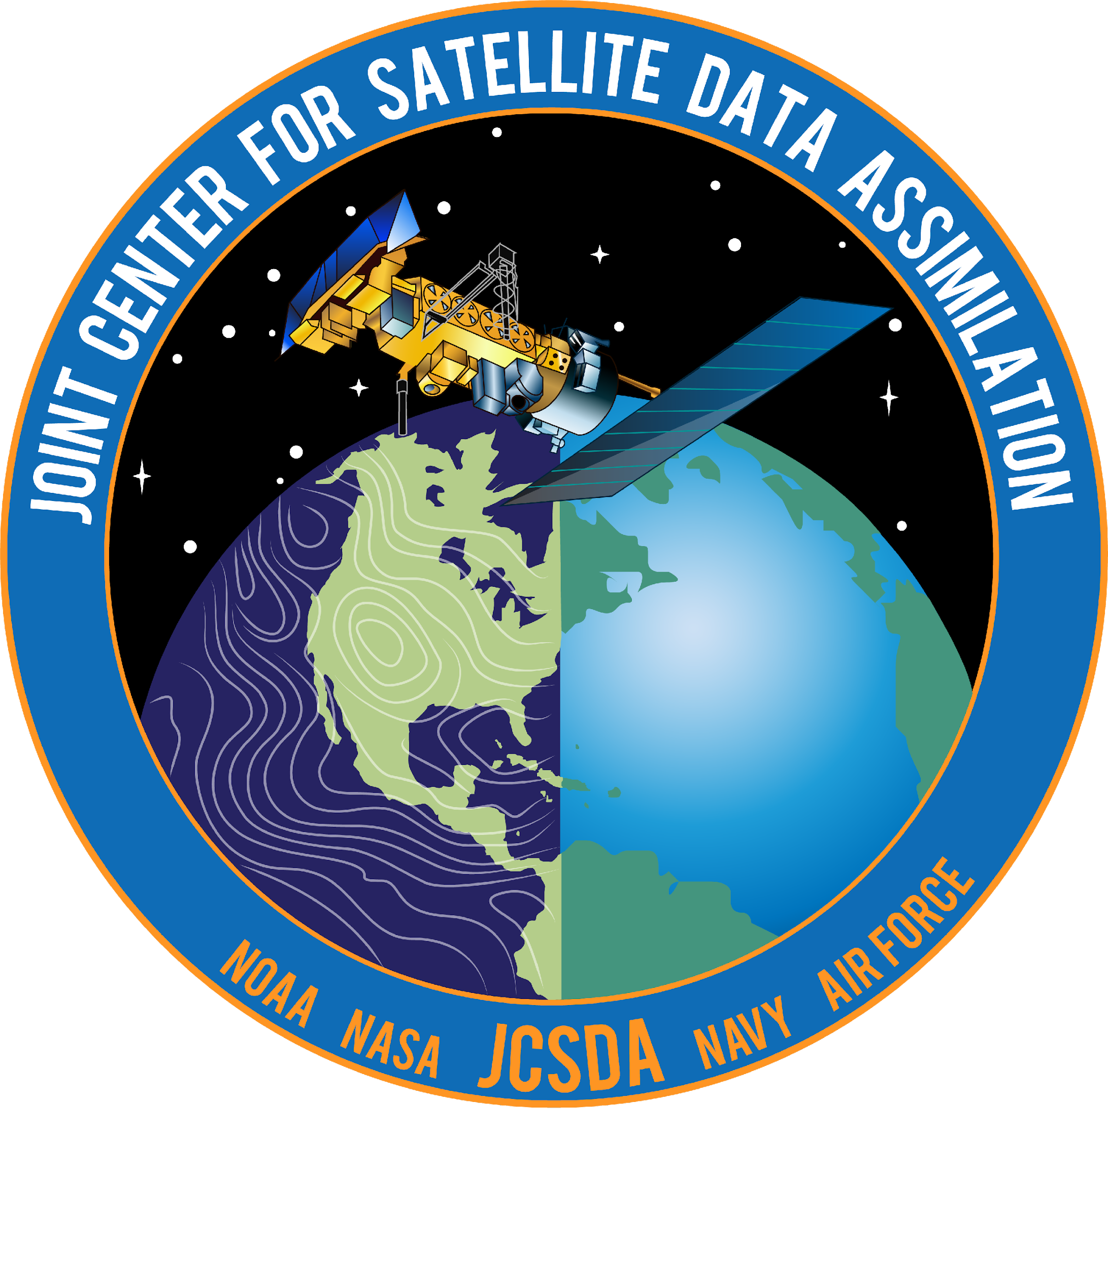
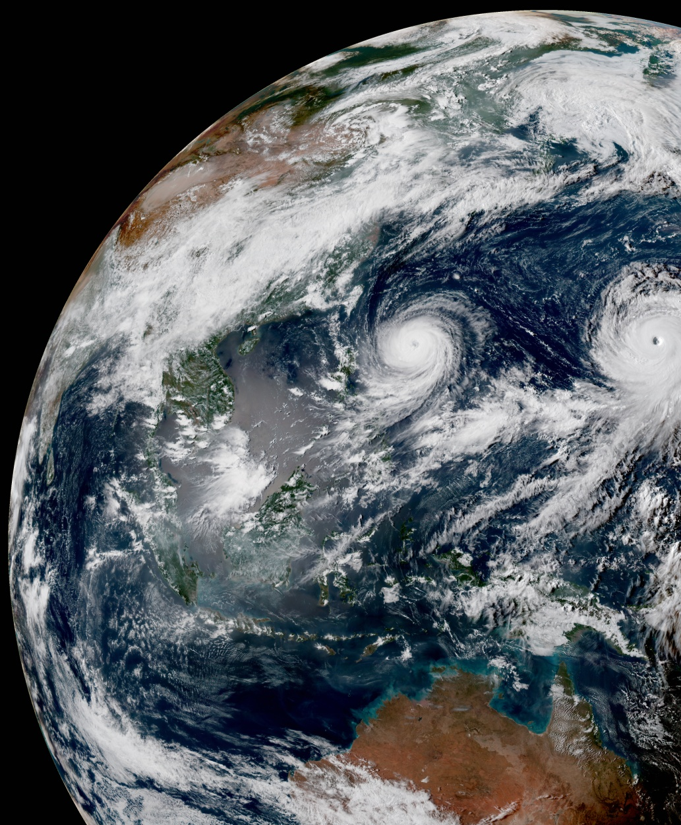
Next Generation Earth System Data Assimilation for the UFS
Tom Auligné, Joint Center for Satellite Data Assimilation (JCSDA)
UIFCW:: July 25, 2023:: Boulder, CO.

Slide 2

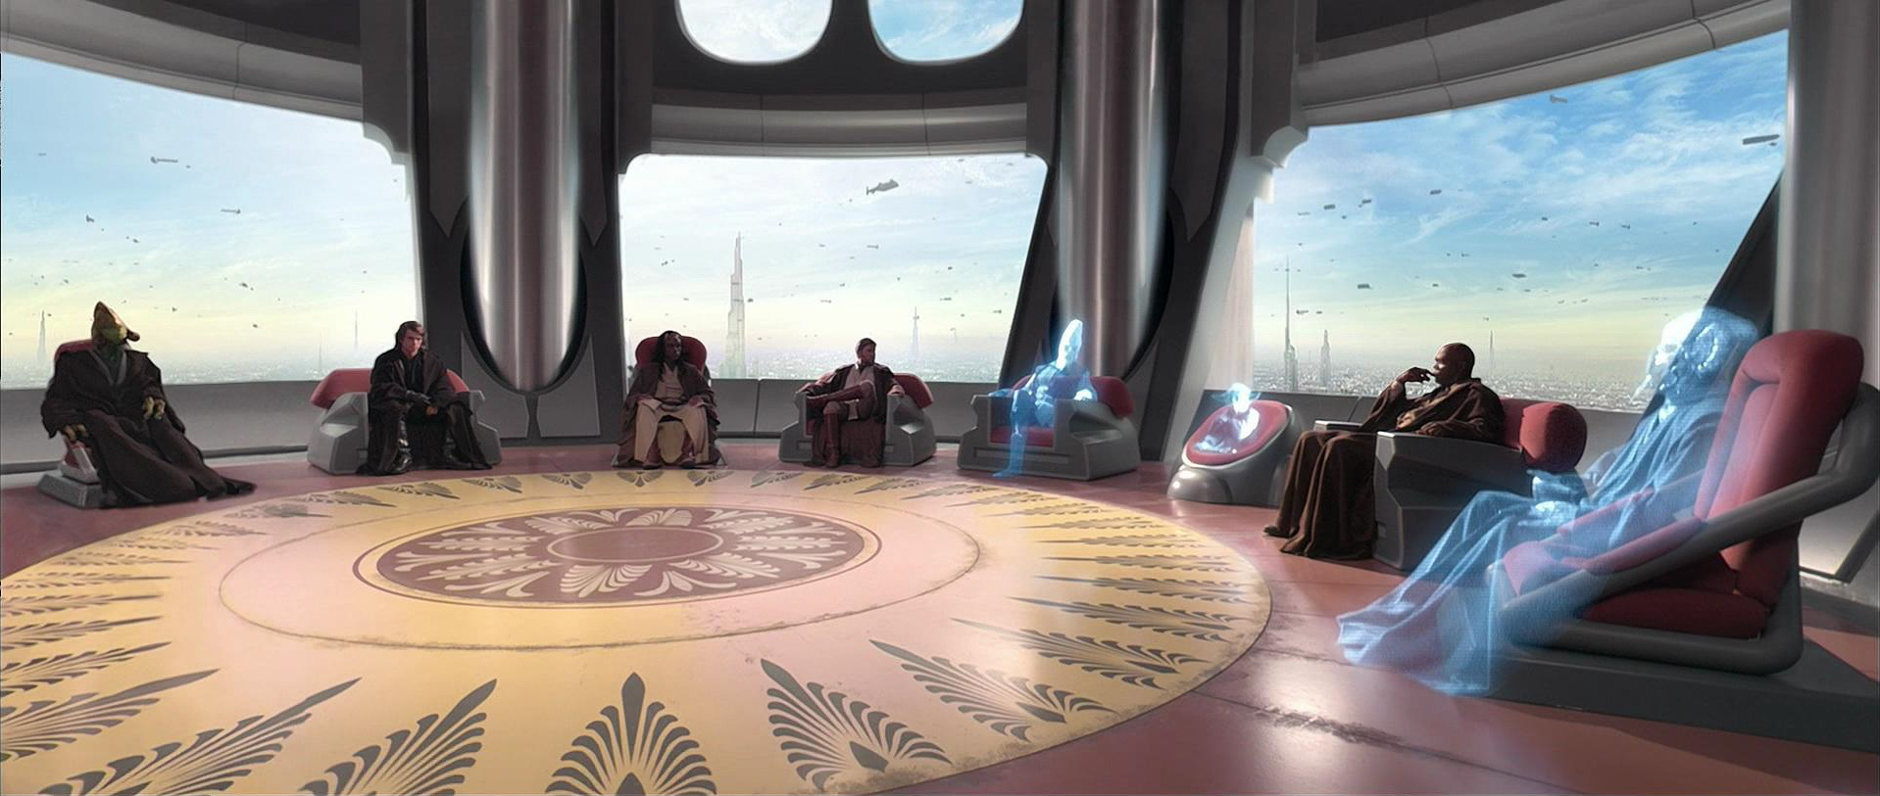




Joint Center for Satellite Data Assimilation (JCSDA)
Vision: An interagency partnership working to become a world leader in applying satellite data and research to operational goals in environmental analysis and prediction.
NOAA
NESDIS
NASA
GMAO
NCAR
UCAR
NOAA
OAR
JCSDA
Team
Air Force
Academia, private sector &
international
partners
NOAA
NWS
Navy
WHO Distributed staff
HOW Joint operating plan
WHAT Critical path to operations

Slide 3





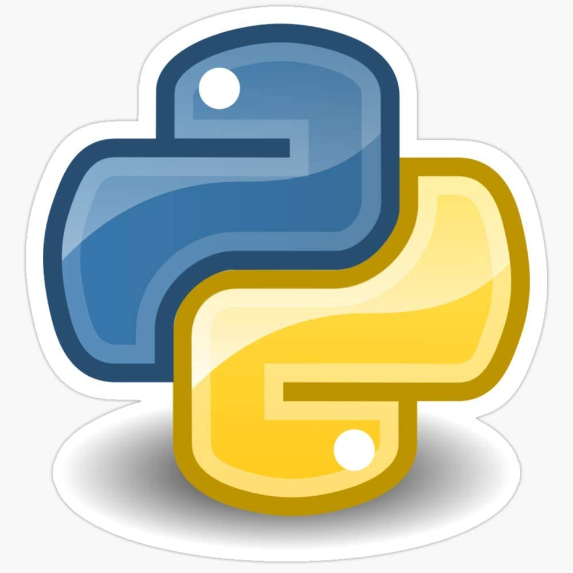



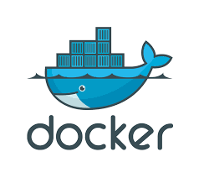


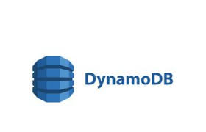

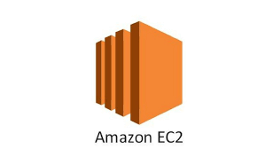

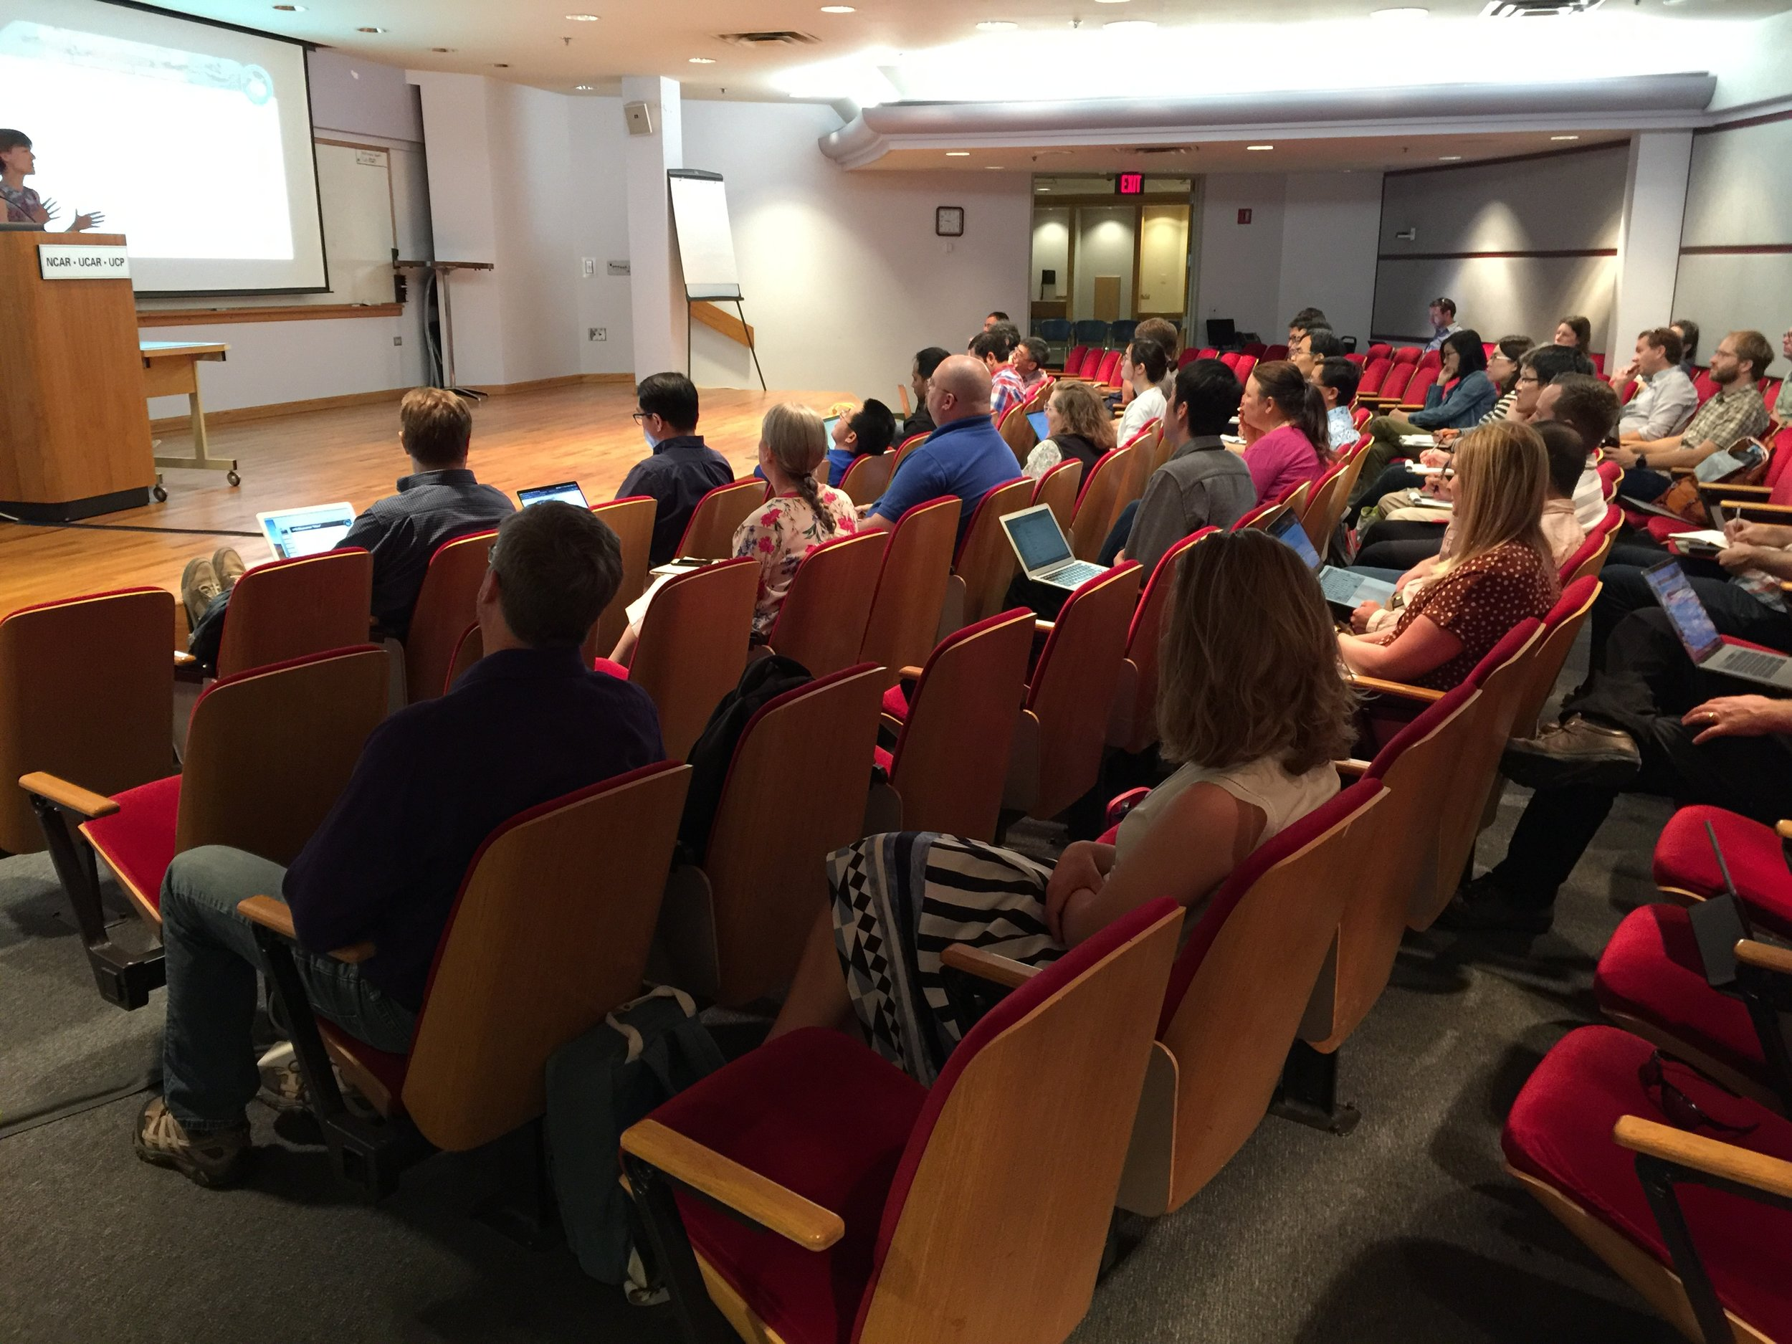
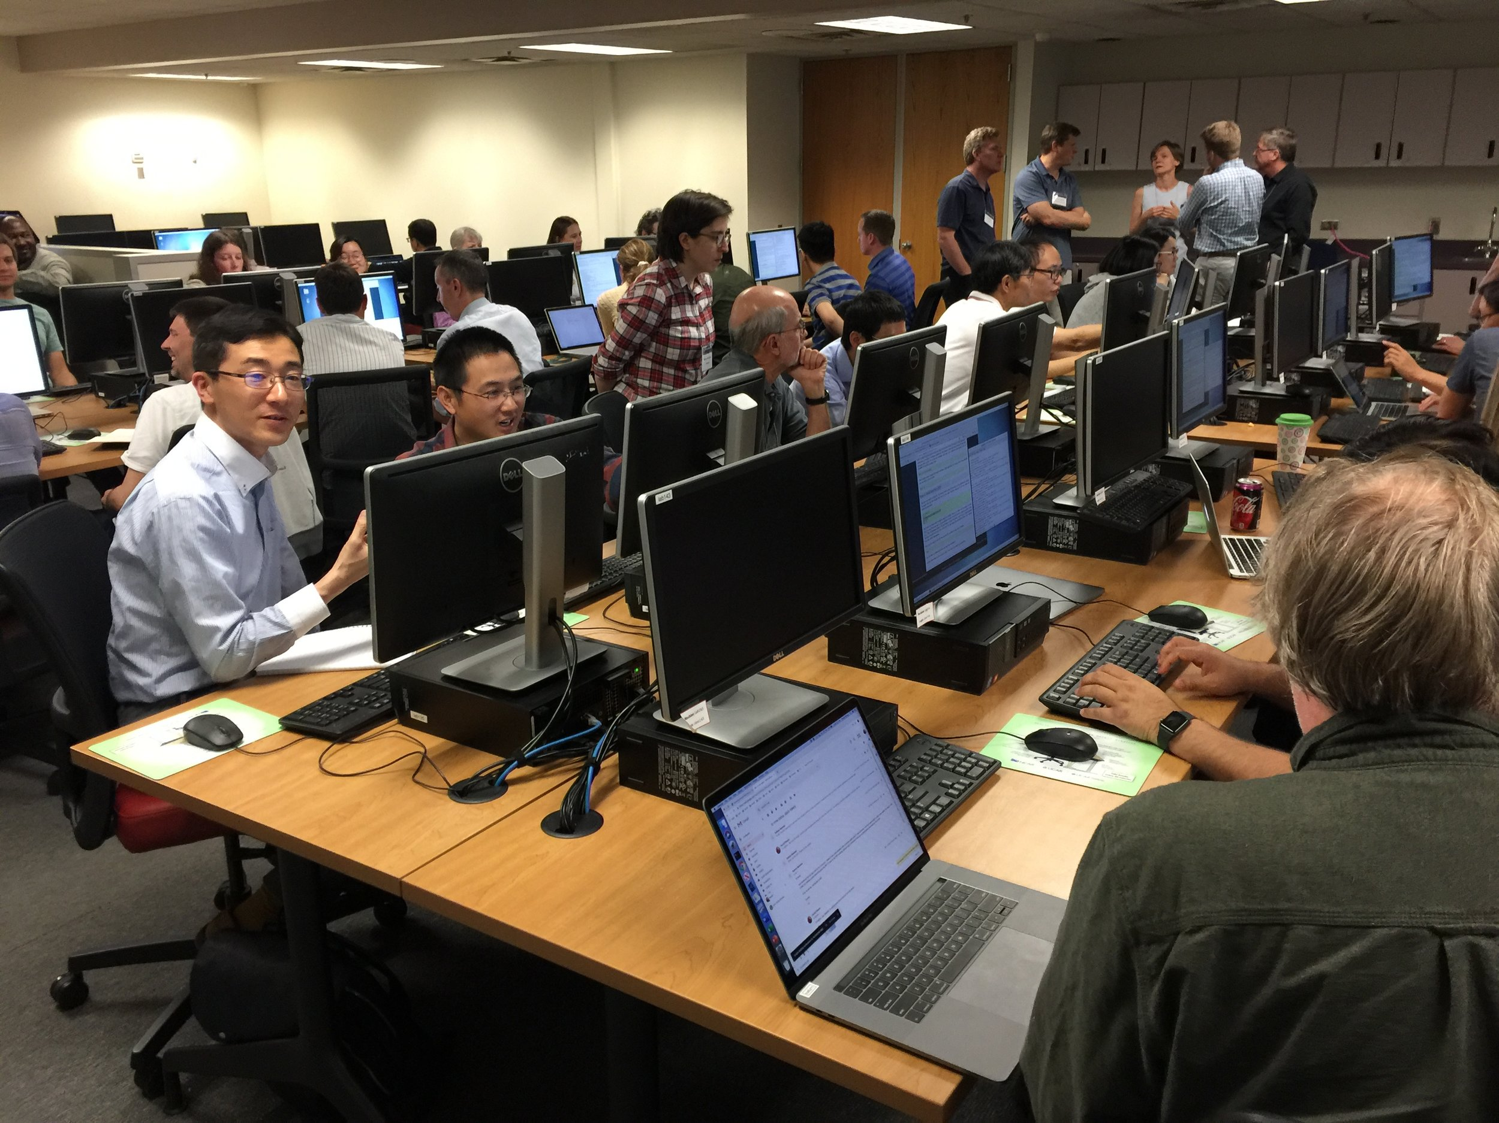

JCSDA - Trailblazer in Community Development
Public Releases
2022-07-18 JEDI-SKYLAB v1
2022-10-11 JEDI-SKYLAB v2
2023-01-09 JEDI-SKYLAB v3
2023-04-17 JEDI-SKYLAB v4
2023-07-17 JEDI-SKYLAB v5
Collaborative working practices Success Metrics
Lean project management 176 current contributors (60+ FTEs)
Agile/SCRUM methodology 1,000+ PRs/commits/comments per week
Champion of Open Science 1,000,000+ lines of open-source code (github.com/jcsda)
Quarterly roll-up releases (24 repositories + 479 packages)
Leader in automated testing, CI/CD 1,800+ automated unit, function, integration tests
Pathfinder in cloud HPC and containers 1st to port FV3-GFS pre-operational model to AWS (2018)
1st to demonstrate value of super-containers
Shift in software portability 12 different HPC configurations supported (23 tested)
Porting time from several months to few days
Community training 500+ padawans (7 JEDI Academies, online tutorials)

Slide 4

Joint Effort for Data assimilation Integration (JEDI)
Consortium of Jointness: Scientific diversity without reinventing the wheel
Goals
Next-generation unified DA for Earth system science
Increase R2O/O2R transition rate
Improve science productivity and code performance
Community
Specific
WRF
MPAS
ROMS
GFS
MIT GCM
Air Force
Met Office
UM
RRFS
LFRic
Navy
HAFS
Generic
NEPTUNE
MOM6
MERRA
GOCART
CICE6
NOAA
WW3
GEOS-Chem
GEOS-FP
# lines of code
NWM
RTMA
NASA

Slide 5
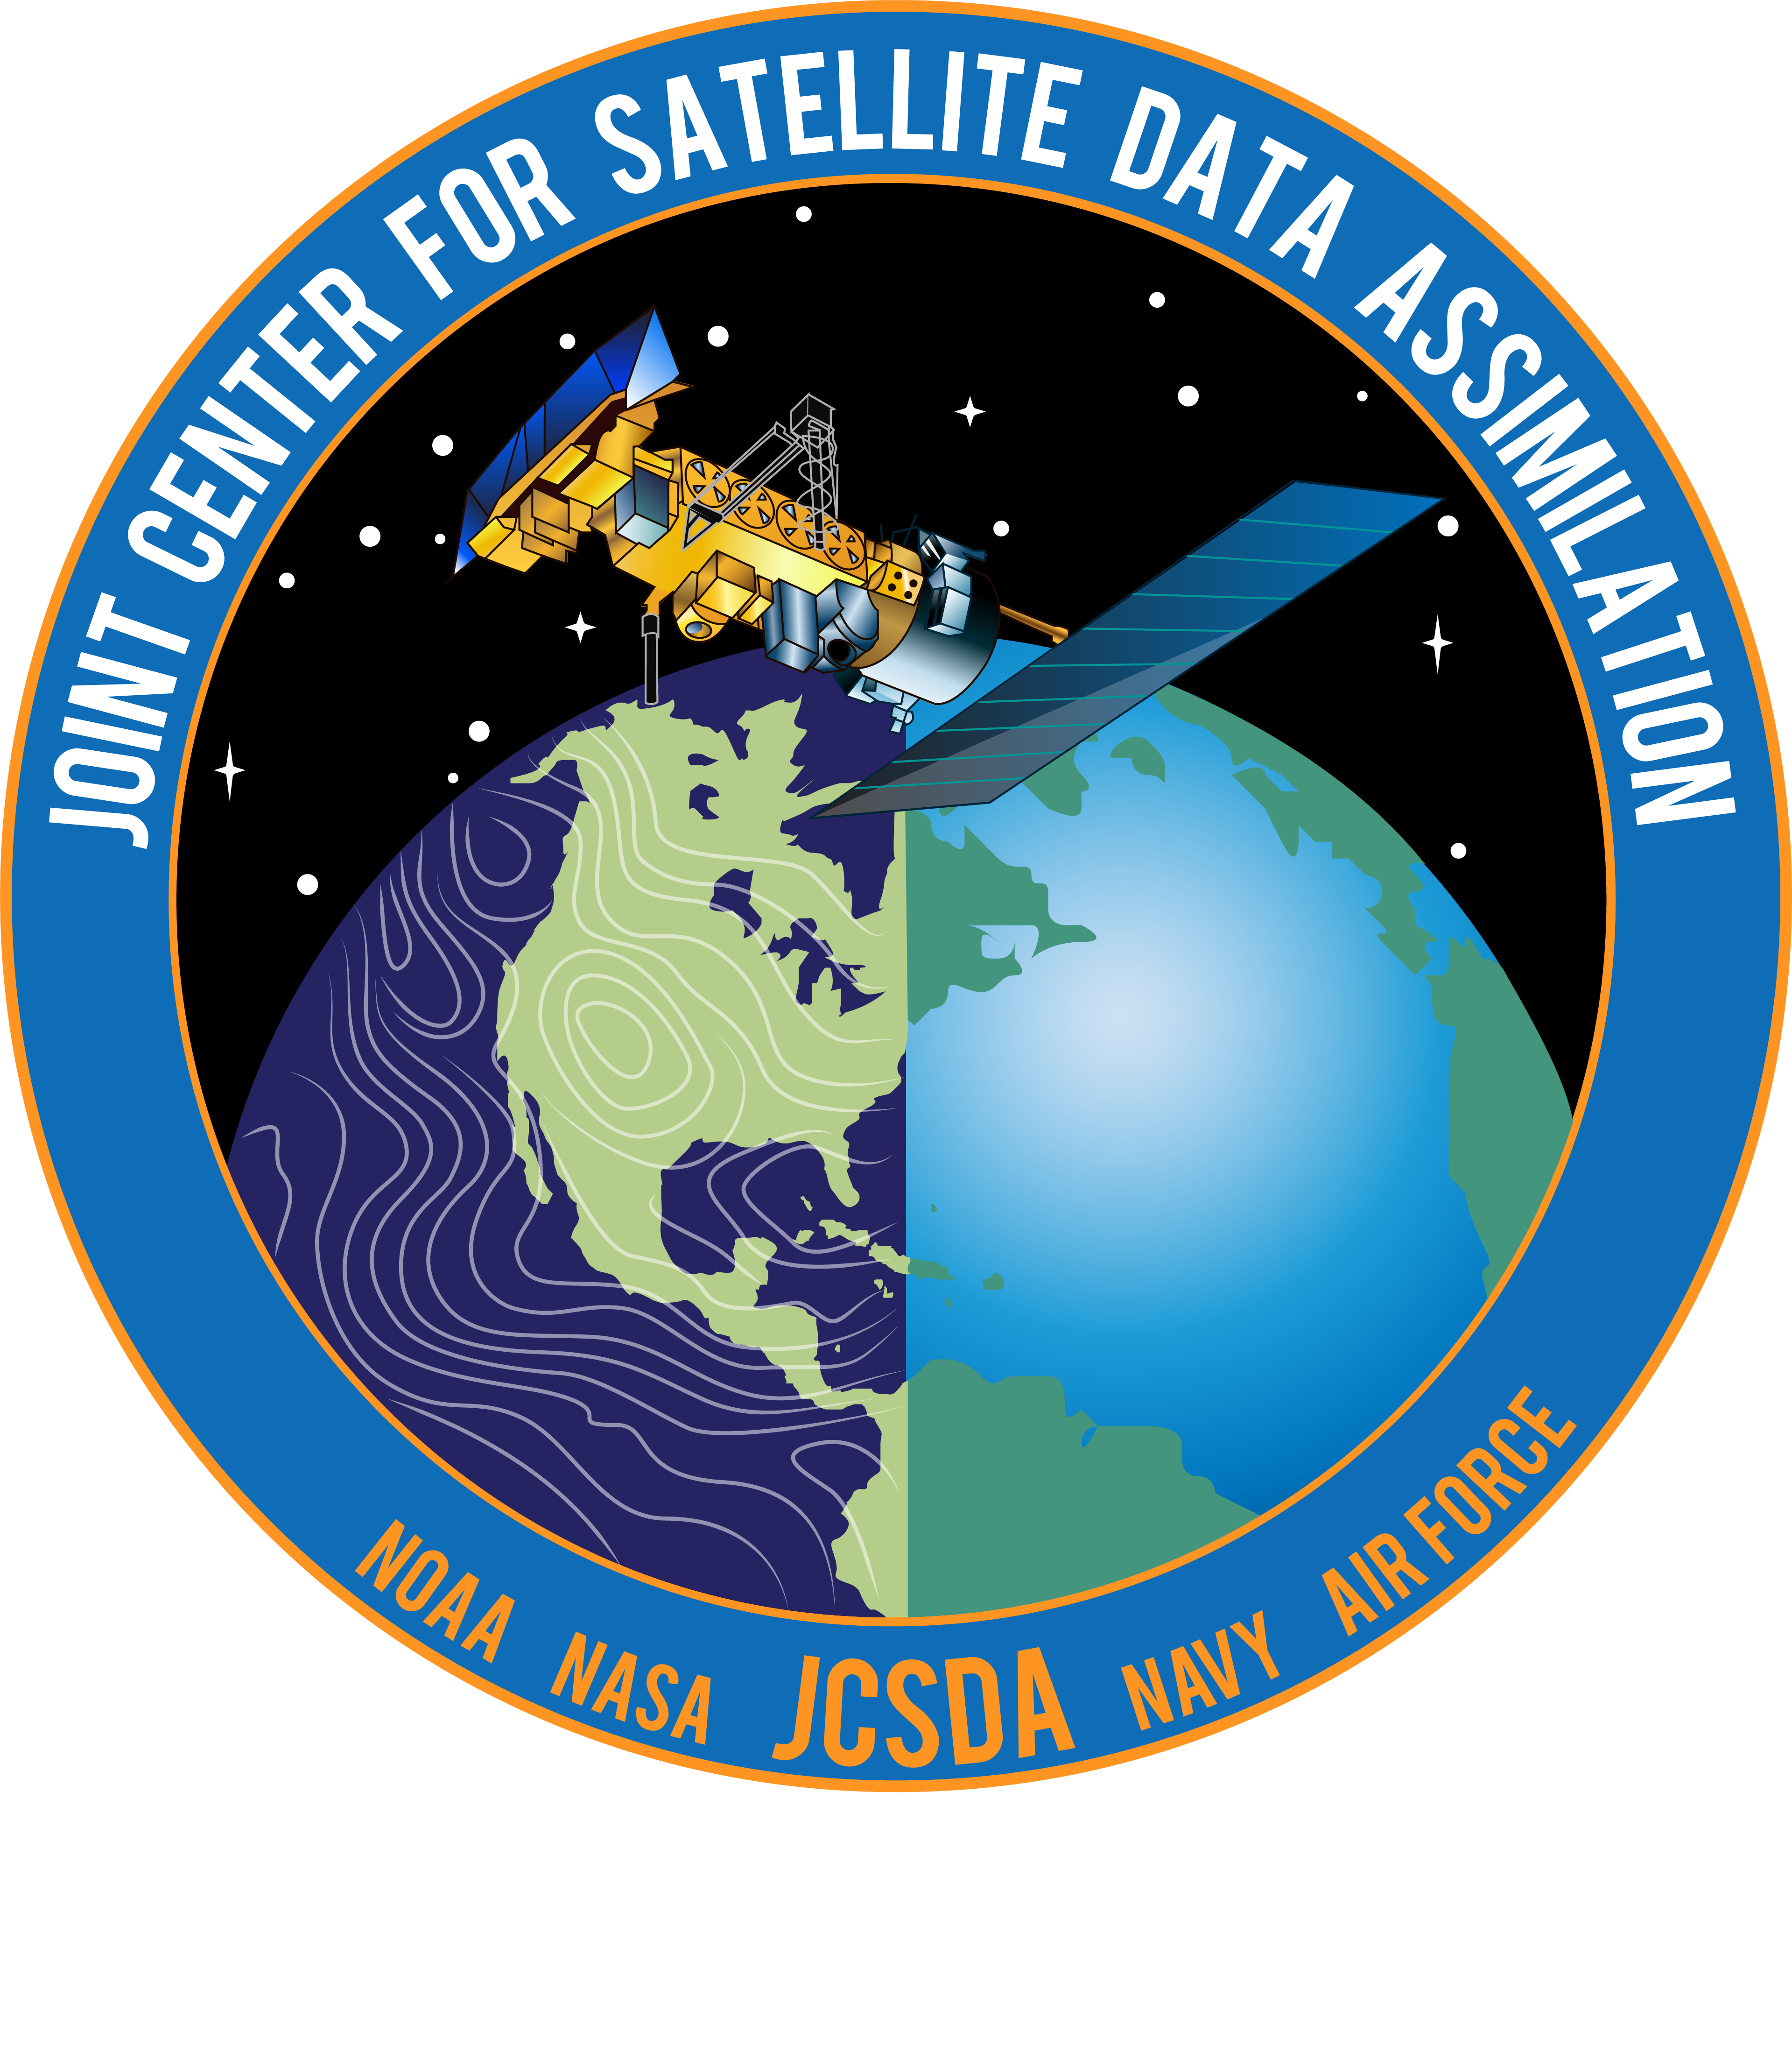











JEDI - A New Dawn (for Earth System DA)
Phase 1: match skills of operational systems
GEOS-FP
NEPTUNE
GFSv18
HAFSv3
RRFSv2
GFSv17
GEFSv13
LFRic
GALWEM
MERRA-3
Notional T2O timeline (systems freeze)
2023
2024
2025
Phase 2: foster
scientific innovation
Atmosphere
Hybrid
4DEnVar
Aerosol
3DVar
Aerosols
Atmosphere
Constituents
Land
EnKF
Constituents
3DVar
JEDI
Ocean
Land
Sea ice
LETKF
Ocean
LETKF
Waves
Snow
Sea ice

Slide 6
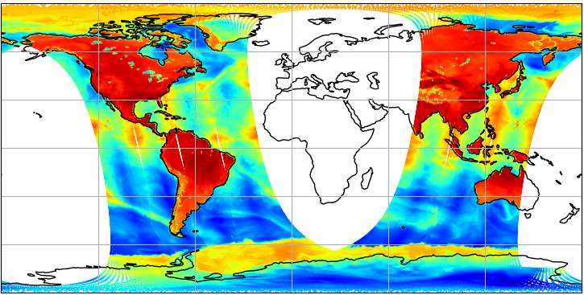
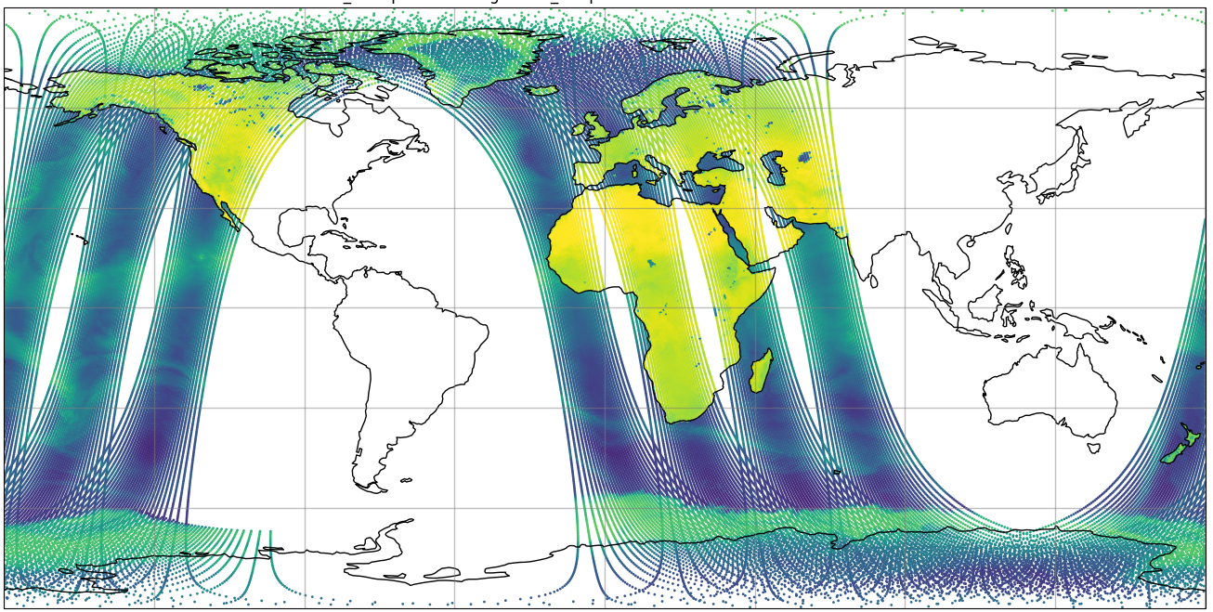
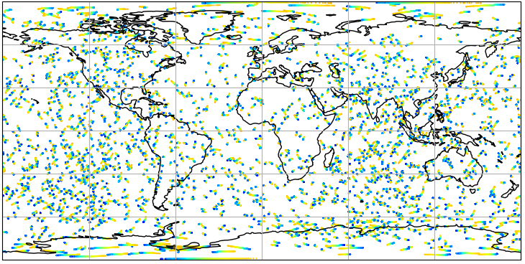
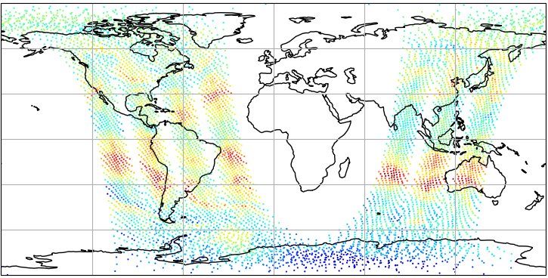
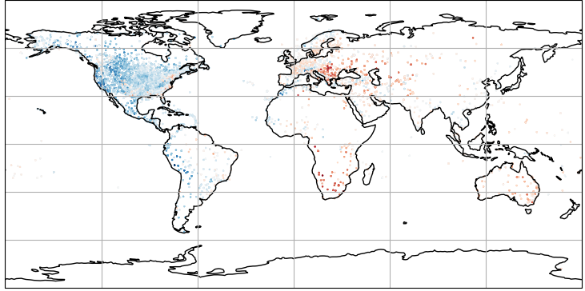
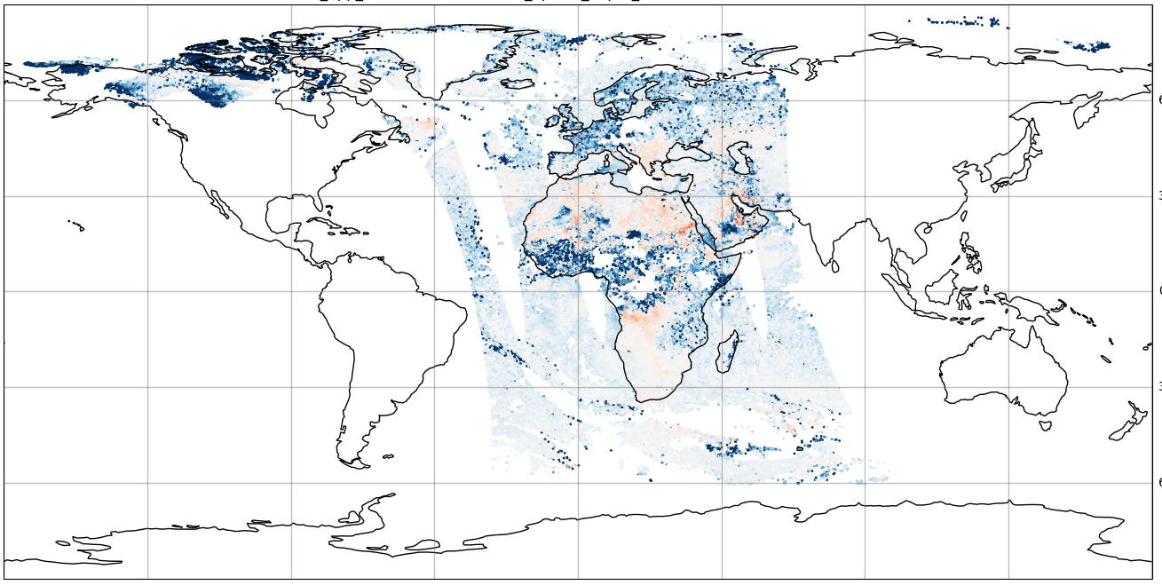
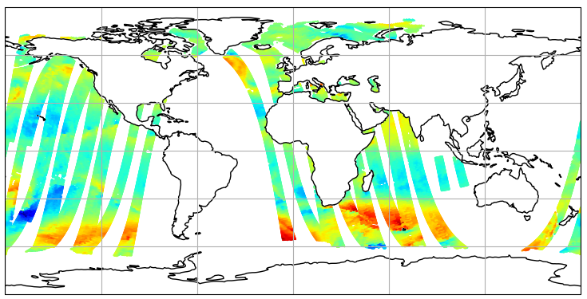
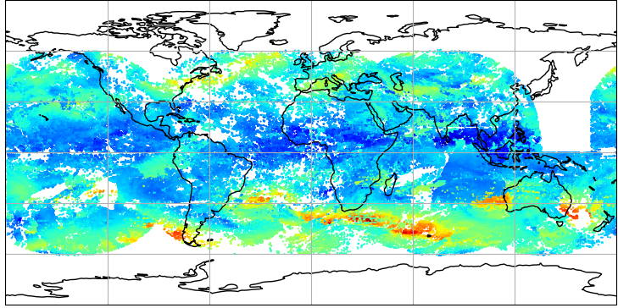
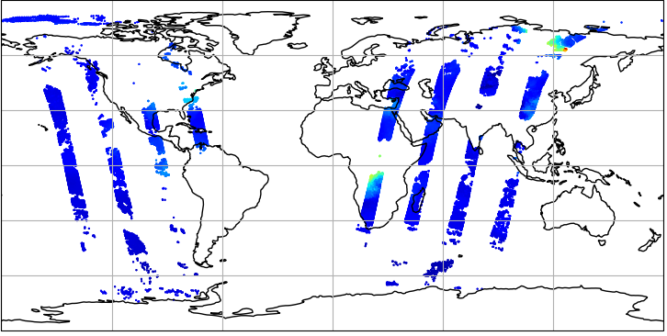
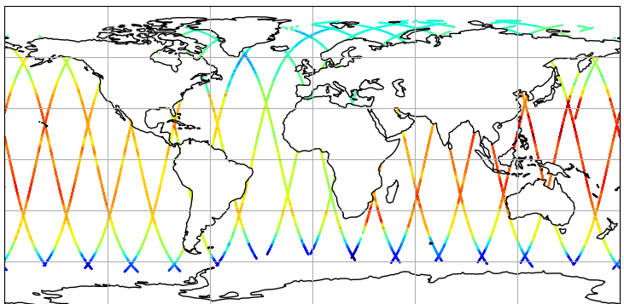
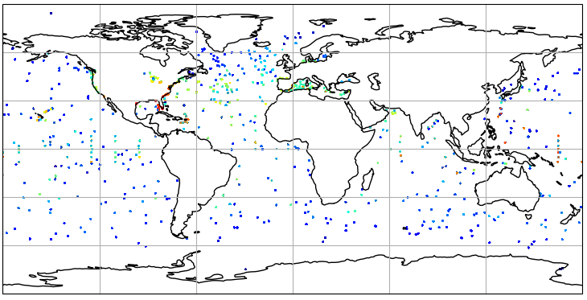
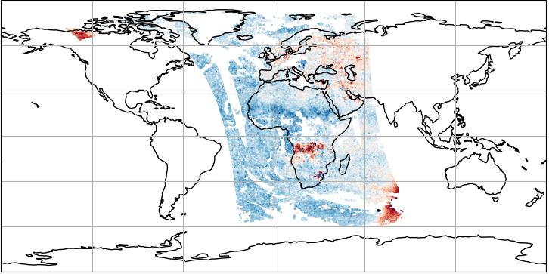
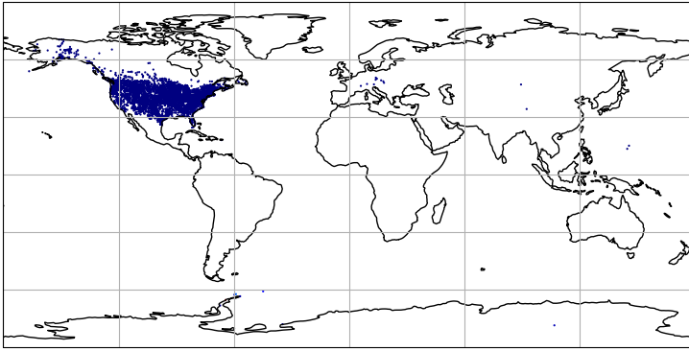
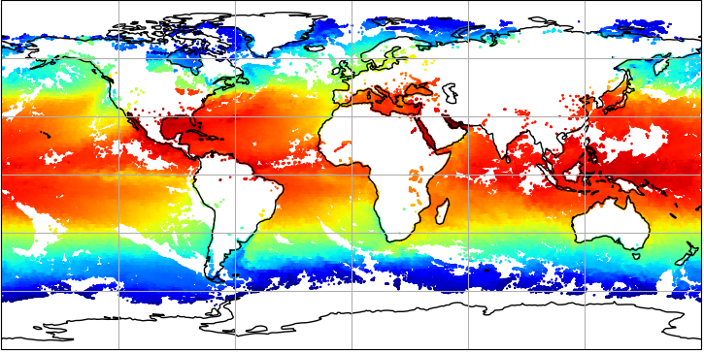
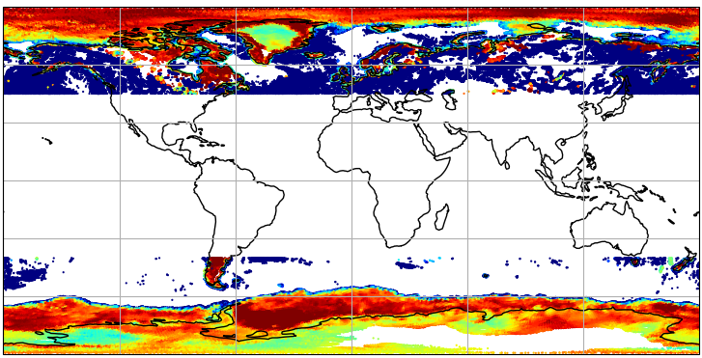
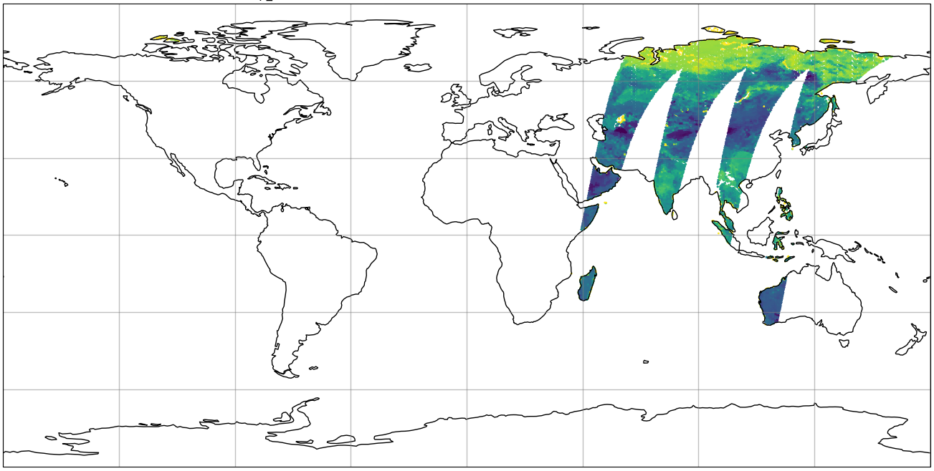
JEDI - A New Dawn (for Earth System DA)
https://skylab.jcsda.org
ATMS (N20)
AMSUA (N18/19/20, METOP-A/B/C)
GNSS-RO
CrIS (N20/NPP)
IASI (METOP-A/B)
METAR
SYNOP
RAOB
SATWIND
Aerosols
AOD (VIIRS NPP)
Atmosphere
Constituents
Wind (SCAT)
JEDI
CO (MOPITT)
Altimeters (3A/3B/C2/J3/SA)
Ocean
Land
Snow
NO2 (TROPOMI)
Waves
Ocean Profile
Sea ice
Snow Depth
SST (AVHRR METOP-B/METOP-C)
Soil Moisture (SMAP)
Ice (SSMI/S F17-F18)

Slide 7
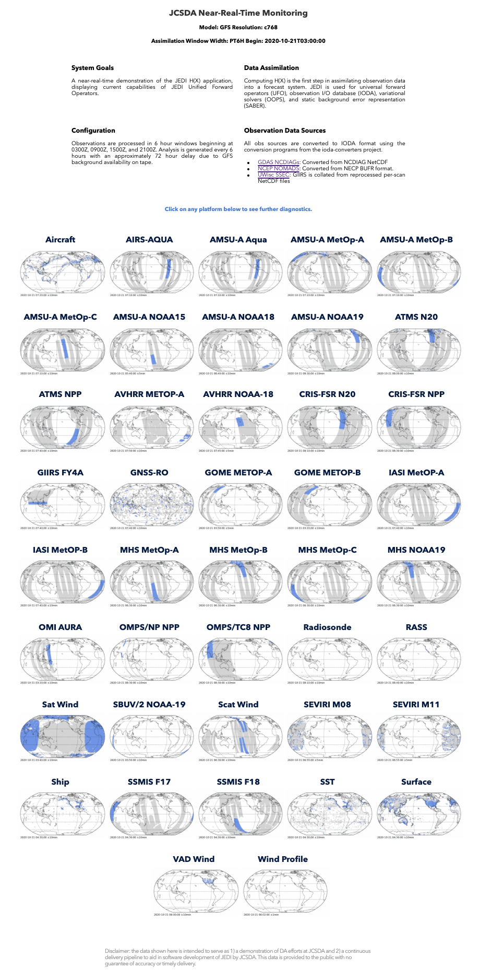








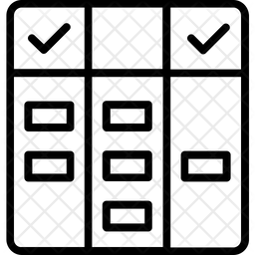


JCSDA SkyLab Testbed
Ingest Use Evaluate
Observations
SKYLAB TESTBED
BUFR Tanks
Data Lake
Interface for
Observation
Data Access
(IODA)
Research Repository
for Data and Diagnostics
(R2D2)
Diagnostics
CDAAC
ODB
FTP
SkyLab-Atmos
LDM
SkyLab-Land
Agile
SkyLab-Marine
Experiment Workflow
and Orchestration Kit
(EWOK)
SkyLab-Aerosols
Config
SkyLab-TraceGas
+
Config
Code
Notes:
Application = end-to-end system instantiated with specific partner configuration
Continuously test all components in pseudo-operational environment
Leverages JCSDA open-source and agile working practices, and generic infrastructure
Continuously evolves, yet continuously functional (CI/CD)
Testbed = focusing vehicle for collaborative development
Turn-key ecosystem to spin-up research experiments
Rapid testing with near-instantaneous feedback, multi-tier to optimize HPC resources
Joint = effort spent in developing the application benefits everyone
Co-owned, co-developed and co-branded between JCSDA and partner agency
Results are transparent to everyone and can be replicated & compared by everyone

Slide 8
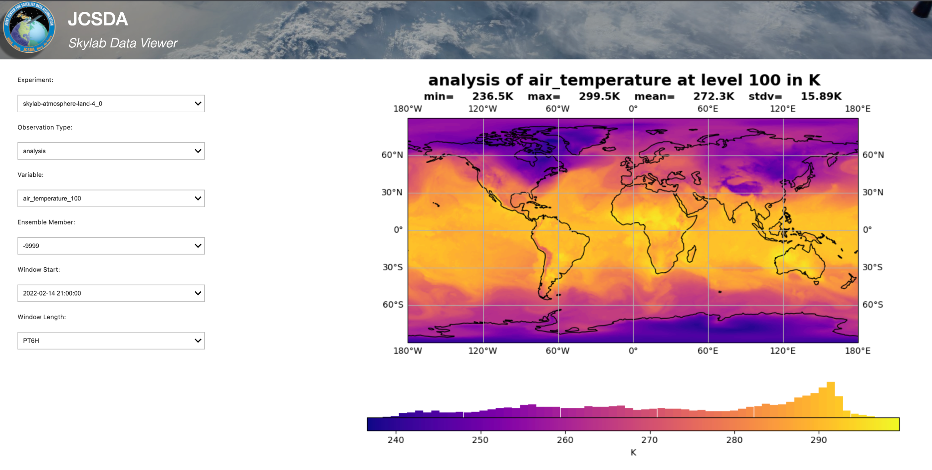
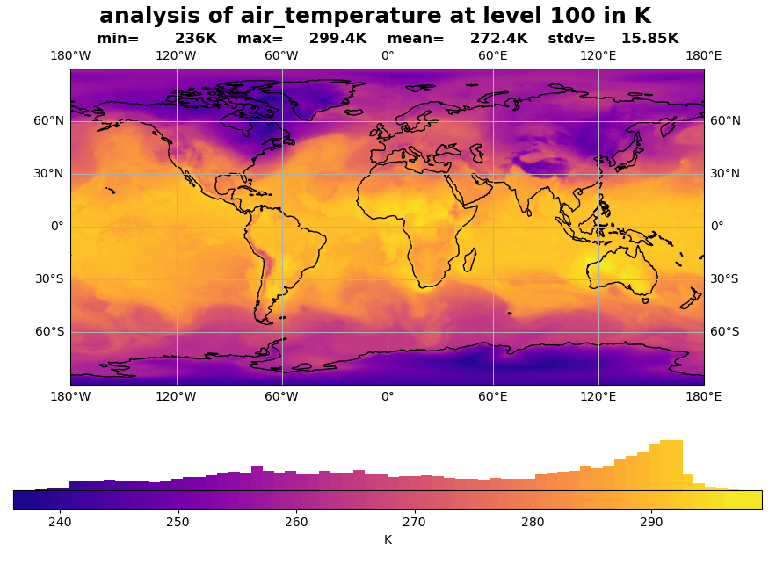
JCSDA SkyLab Testbed
https://skylab.jcsda.org
UFS DA experiments:
Aerosols (GOCART)
Marine (MOM6/CICE6)
Atmosphere / land (FV3ATM, NOAH-MP)

Slide 9




Three Major Goals
Support agencies
transition to operations
Real-world system hardening
Coarse scientific quality assurance
JCSDA Product Management
SKYLAB
Workforce training & community engagement
Continuous innovation
enabled by JEDI
Training staff & community
Open source, agile, CI/CD
Rapid integration of innovation
Pathway to next-generation DA
Notes:
Earth system observations
Aggressive approach to increase the use of observations available for Earth system DA. Improve how we address volume (increase spectral and geographic resolution), variety (commercial data, smallsats, new instruments), and velocity (on-the-fly processing without traditional cut-off).
Earth system coupled DA
Prototype for atmosphere, ocean, and sea ice, land surface, atmospheric composition, whole atmosphere; the approach is to start from multi-component DA under a unified infrastructure and to gradually evolve into coupled DA; development and evaluation of ensemble DA and enhancement with multi-resolution ensembles.
Convection permitting DA
Assimilation of all-sky and all-surface radiances; hourly cycling DA with overlapping windows; continuous DA; DA across scales over stretched grids.
Advanced DA algorithms at scale, including AI/ML integration
DA algorithm optimization (e.g. on accelerators), and hybridization with AI/ML for observation simulation & processing, fast adjoint physics, forecast model error inference & correction, and evaluation/scoring
Continuous ingest of innovation
Agile development and delivery; hierarchical system development; continuous integration and continuous delivery (CI/CD); community engagement & training on open-source code; comprehensive readiness for new satellites & sensors.

Slide 10
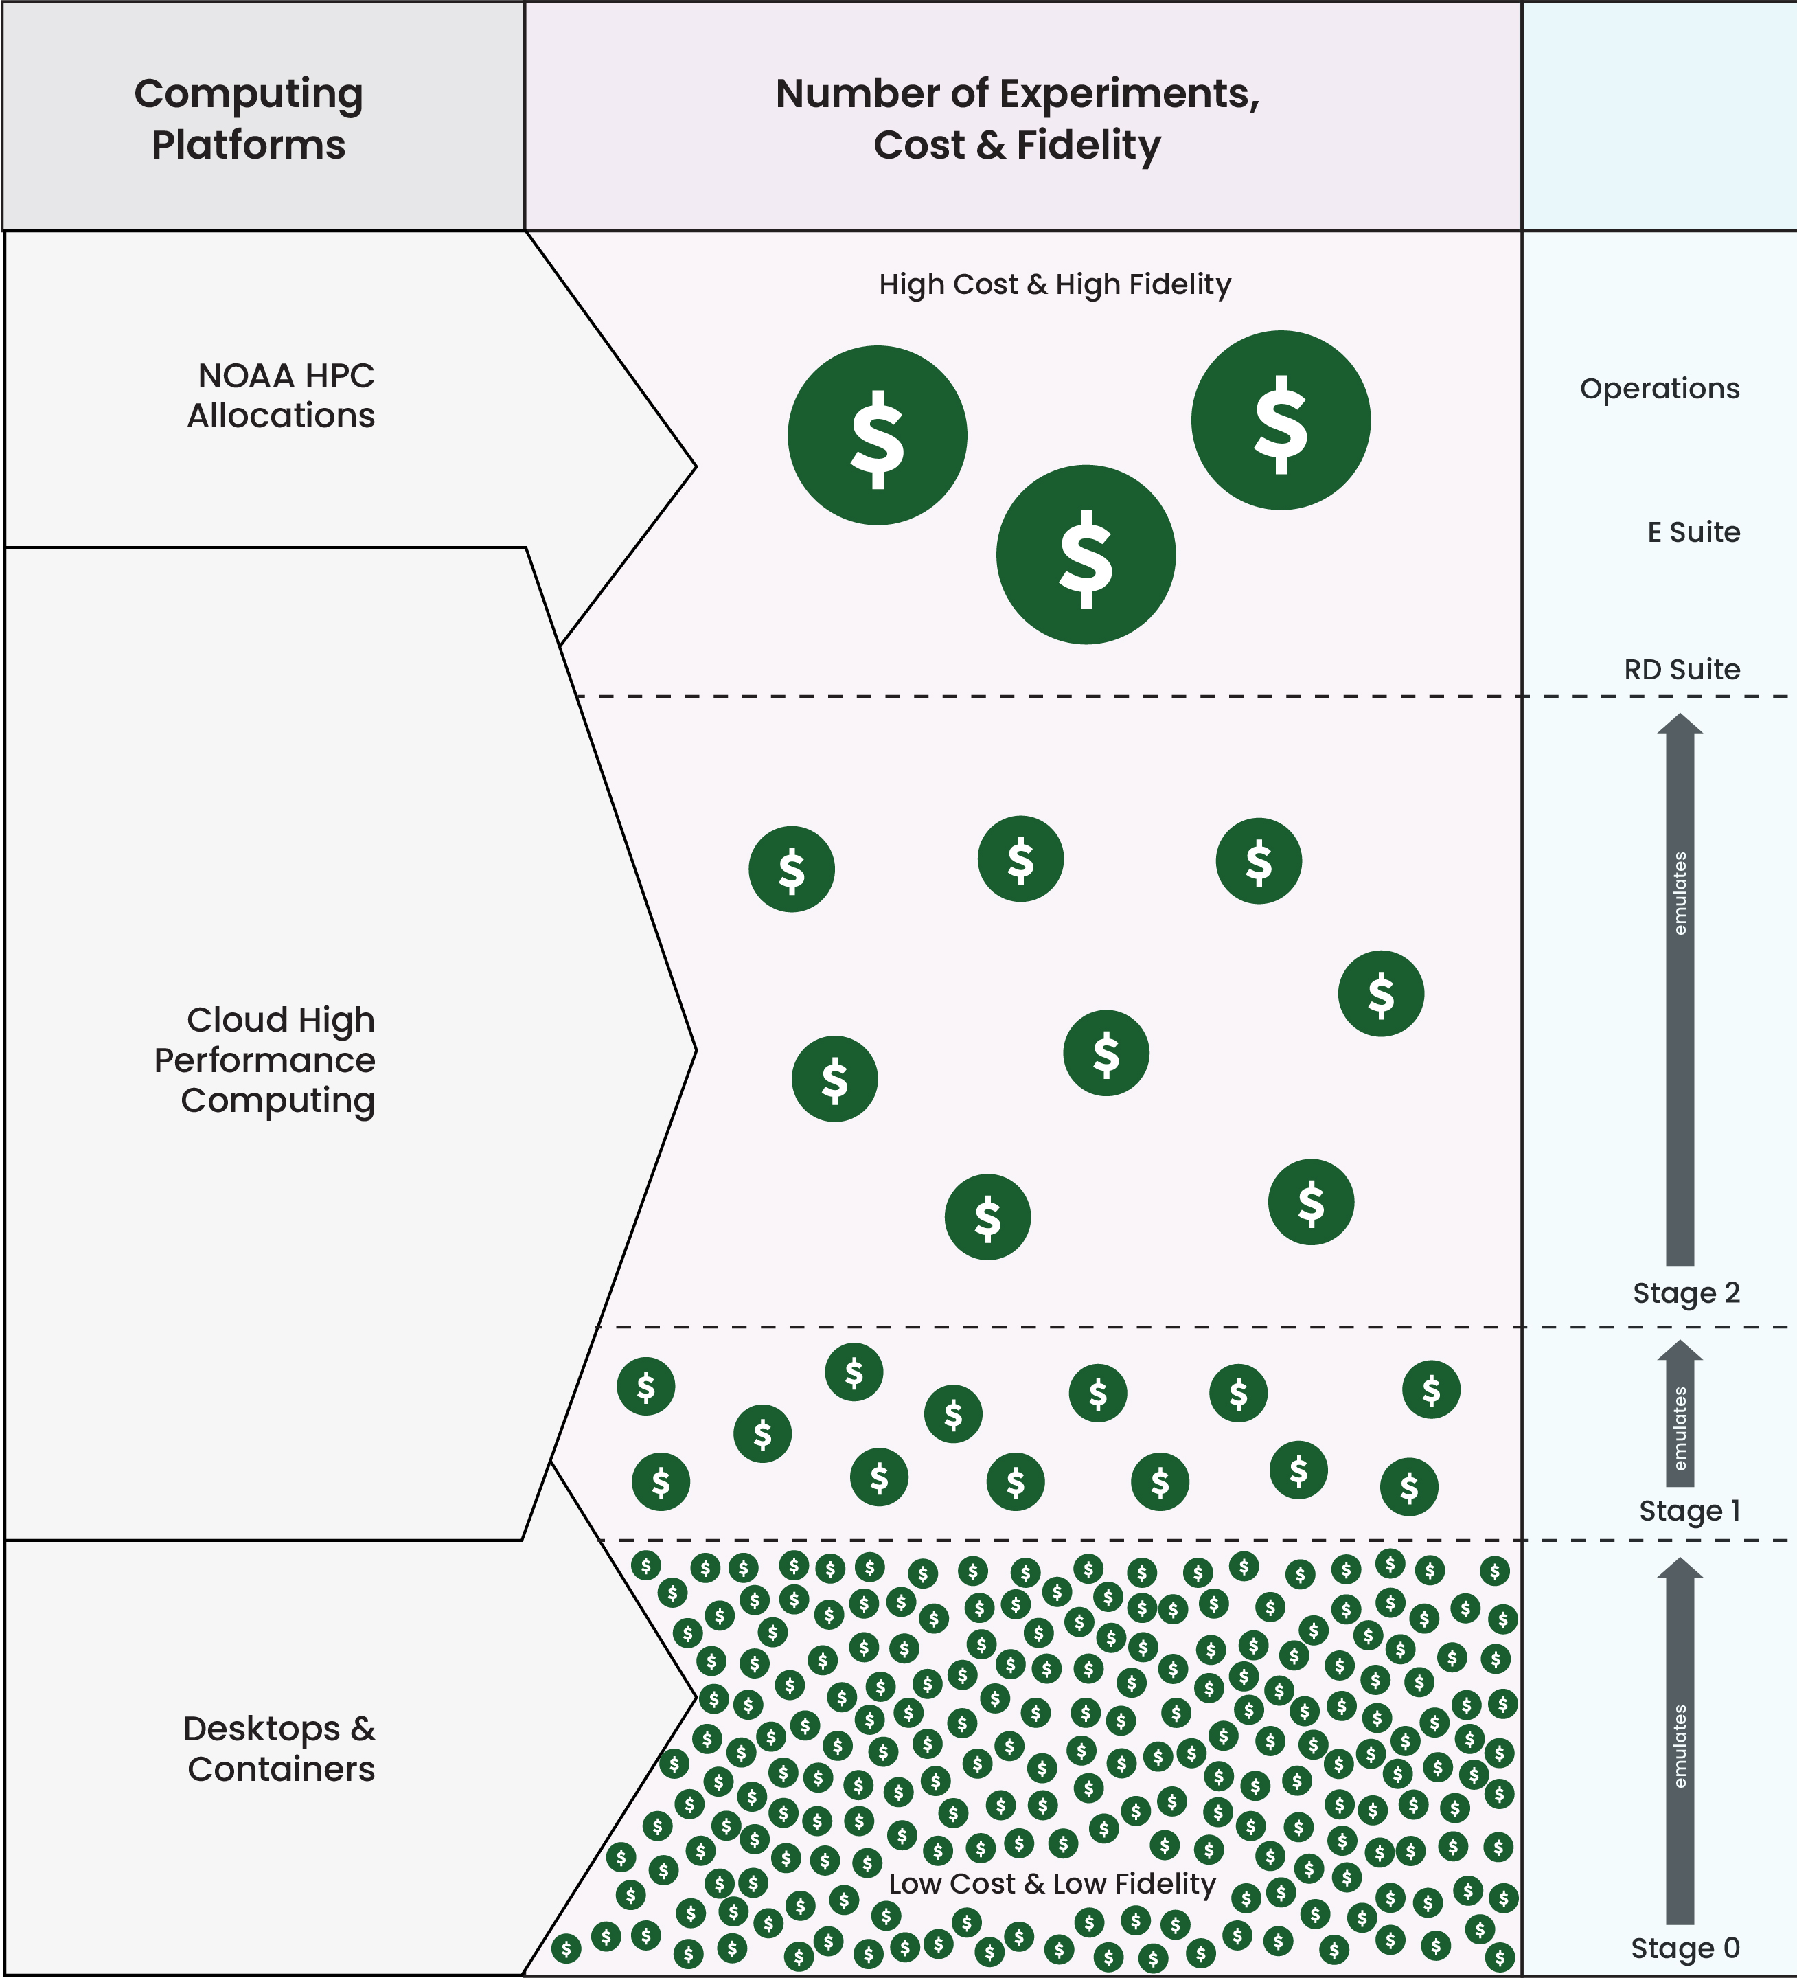
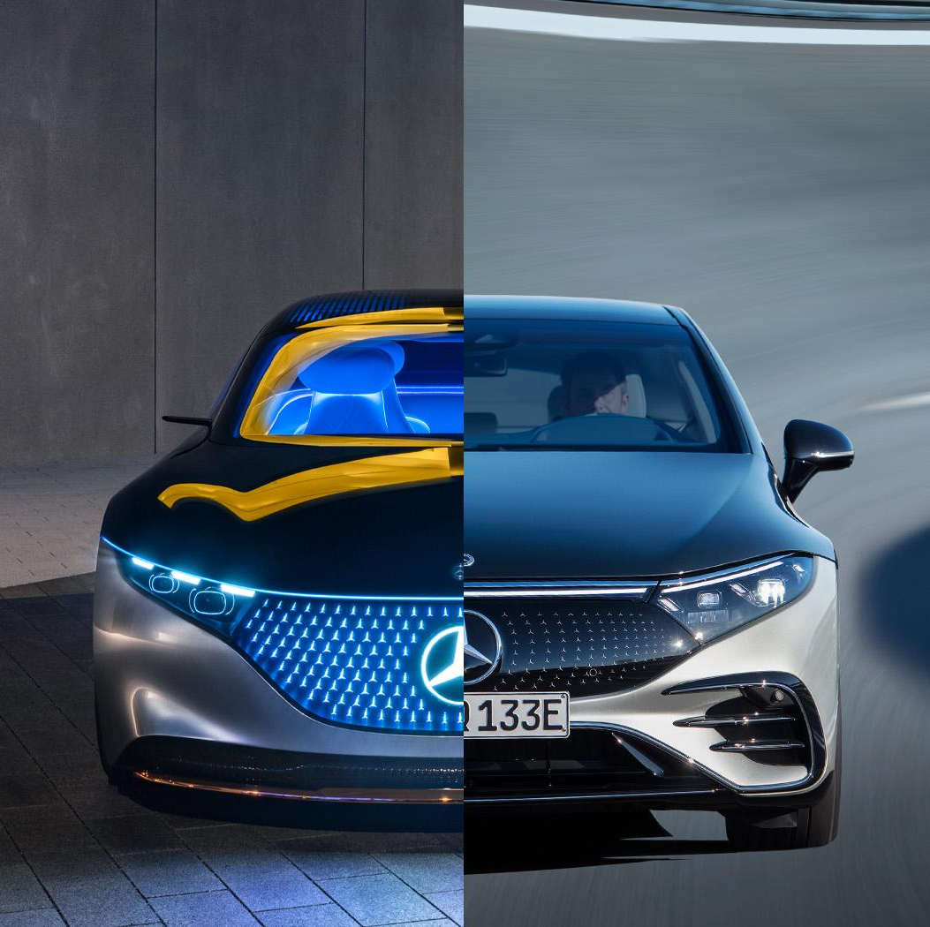
Open-Science Connecting Research and Operations
SkyLab (Large)
Point of convergence for rapid prototyping & validation with quarterly releases (soft + expt)
Continuous delivery of functional system for downstream operations
Support agencies
transition to operations
Workforce training & community engagement
Continuous innovation
enabled by JEDI

Slide 11
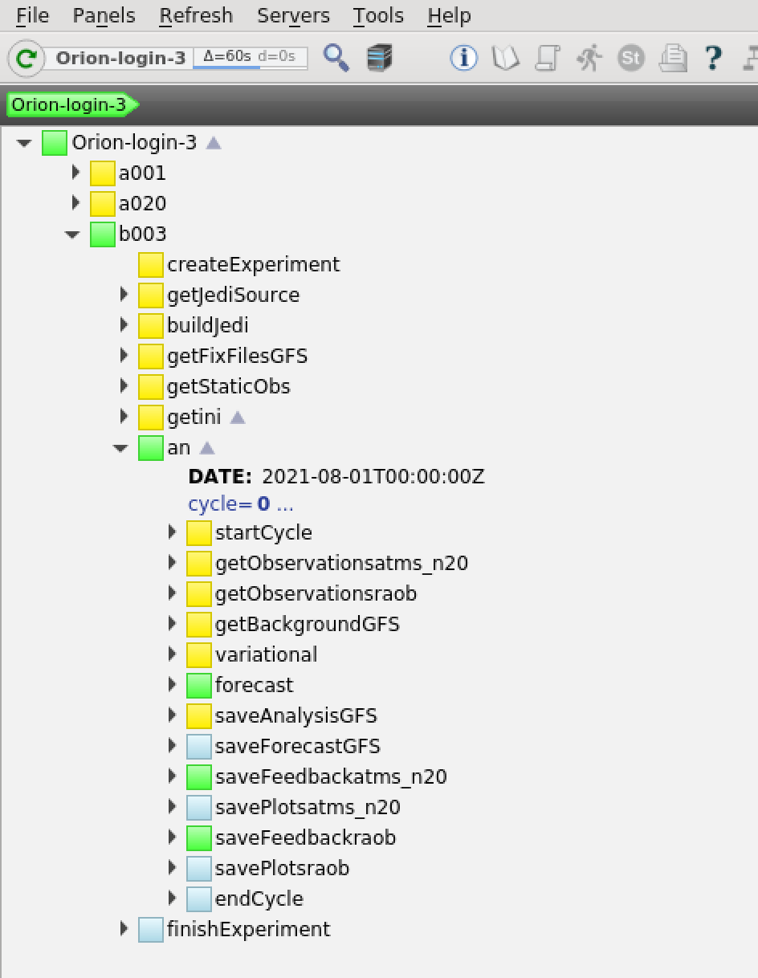
Open-Science Connecting Research and Operations
Support agencies
transition to operations
Support agencies
transition to operations
Workforce training & community engagement
Workforce training & community engagement
Continuous innovation
enabled by JEDI
Continuous innovation
enabled by JEDI
Testbed (SkyLab-Medium)
Turnkey solution for real-world community experimental testbed
Experiment as a Service
  Data Store (ingest pipelines)
  Generic build & workflow
  Configuration management
  Diagnostics dashboard
  Multi-platform

Slide 12
Open-Science Connecting Research and Operations
Online tutorials
7 JEDI Academies
500+ padawans
(35 univ. + 11 private + 9 interna.)
Support agencies
transition to operations
Support agencies
transition to operations
Support agencies
transition to operations
Workforce training & community engagement
Workforce training & community engagement
Workforce training & community engagement
Continuous innovation
enabled by JEDI
Continuous innovation
enabled by JEDI
Continuous innovation
enabled by JEDI
JEDI-EDU (SkyLab-Small)
End-to-end package to download + learn + experiment + evaluate within minutes on laptop
Integrate in university curriculum

Slide 13
Final Remarks
JCSDA has found a unique and efficient way to manage jointness
and provide demonstrable value to partner agencies.
NOAA, NASA, USAF, Navy, NCAR, Met Office critically dependent on JEDI. Operational implementation within grasp; will unlock transformative technologies.
Vision of success
  World-class use of Earth observations
  Coupled multiscale Earth system data assimilation
  Advanced algorithms (hybrid AI/ML) scaling on future HPCs
  Continuous innovation with rapid transition to operations
  Community engagement and collective resilience

Slide 14

Discussion

