Slide 1
Pace: A GPU-enabled implementation of FV3GFS Using GT4Py
Oliver Elbert, NOAA GFDL
Johann Dahm, Eddie Davis, Florian Deconinck, Rhea George, Jeremy McGibbon, Tobias Wicky, Elynn Wu, Christopher Kung, Tal Ben-Nun, Lucas Harris, Linus Groner, and Oliver Fuhrer

Slide 2
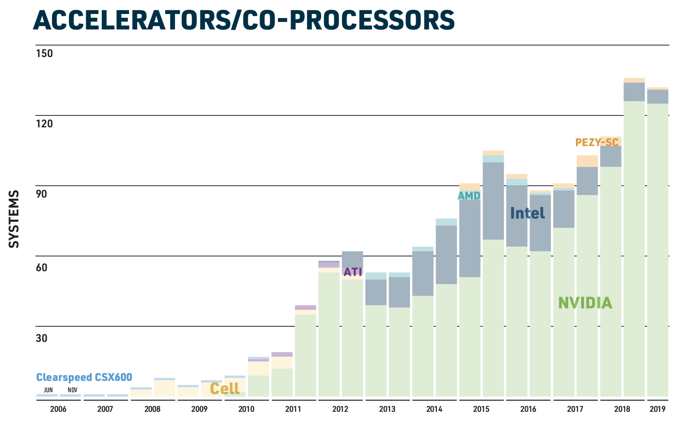
The Future of HPC
# | System | Nodes | Power [MW] | Rmax [PFlop/s] | Chip Technology
1 | Frontier | 9,472 | 21.1 | 1,102.0 | 1 x AMD, 4 x 250X
2 | Fugaku | 158,976 | 29.9 | 442.0 | 1 x A64FX
3 | Lumi | 2,650* | 6.02 | 309.1 | 1 x AMD, 4 x 250X*
4 | Leonardo | 3,456 | 7.4 | 238.7 | 1 x Xeon, 4 x A100
5 | Summit | 4,608 | 10.1 | 148.6 | 2 x Power9, 6 x V100
6 | Sierra | 4,474 | 7.4 | 94.6 | 2 x Power9, 4 x V100
7 | TaihuLight | 40,960 | 15.4 | 93.0 | 1 x SW26010
8 | Perlmutter | 1,536 | 2.6 | 70.9 | 1 x AMD, 4 x A100
9 | Selene | 560 | 2.6 | 63.5 | 2 x AMD, 8 x A100
10 | Tianhe-2A | 16,000 | 18.5 | 61.4 | 2 x Xeon, 3 x Xeon Phi

Slide 3
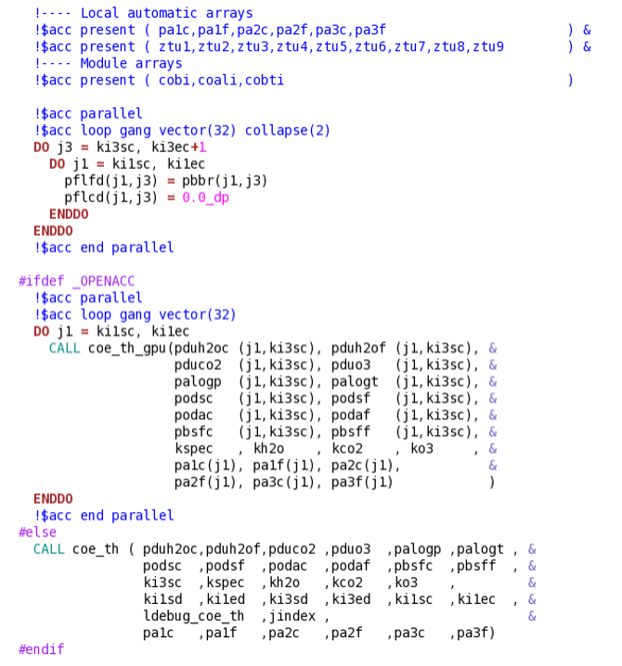
Approaches
Rewrite model for hardware backend
Adapt code with compiler directives
Write model in a DSL

Slide 4
GridTools for Python
Write model code in Python using GT4Py library
Have access to Python environment for infrastructure, development, testing, etc…
DSL compiler translates code to C++/CUDA and optimizes code for hardware target
github.com/GridTools/gt4py
User code
DSL Frontend (GT4Py)
DSL Compiler
Checkers
Optimizers
Code Generators
Python
CPU Compiler
GPU Compiler

Slide 5
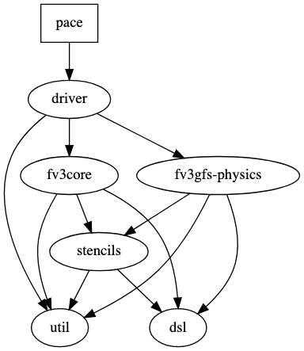
The Pace Model
GT4Py port of FV3 + v2 of GFDL cloud microphysics
Rest of physics routines ported, not optimized or integrated yet
Contains infrastructure and utilities needed to run simulations, test code, profile performance…
https://github.com/NOAA-GFDL/pace
Dahm et al. 2023:
https://gmd.copernicus.org/articles/16/2719/2023/

Slide 6
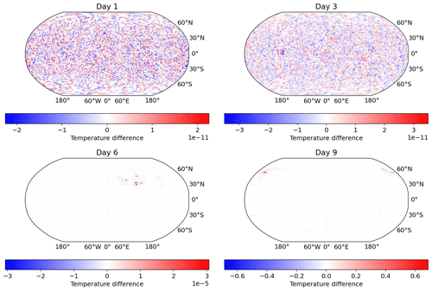
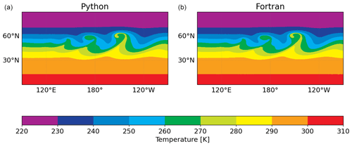
Comparing to Fortran
Moist baroclinic instability integrated for 9 days
Results match fairly well given arithmetic changes
Plotted: 850 mbar temperature

Slide 7
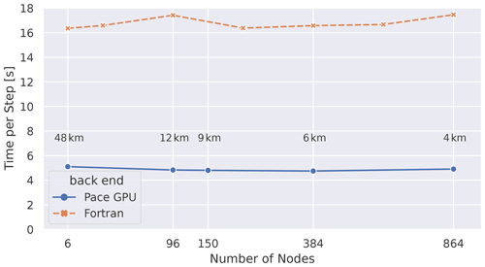
Performance
~3.6x speedup over Fortran on P100 GPUs, ~8.6x on A100 GPUs
CPU performance tuning coming soon, currently ~25% of Fortran speed
Ben-Nun et al. 2022:
https://dl.acm.org/doi/abs/10.5555/3571885.3571982
(https://arxiv.org/pdf/2205.04148.pdf)

Slide 8
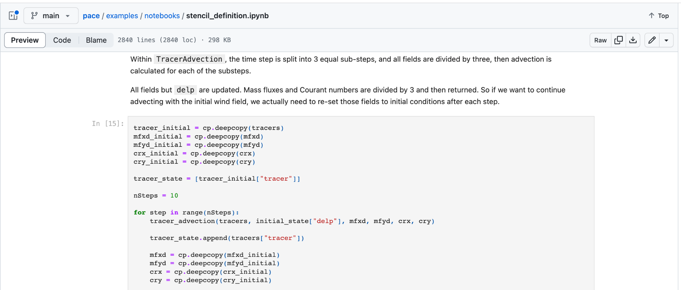
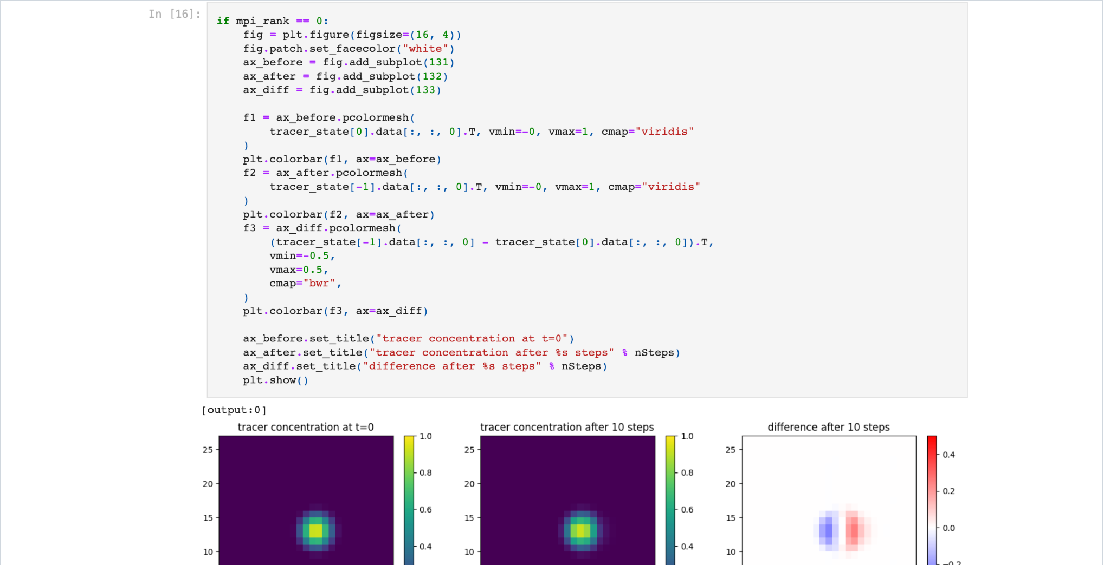
Take Advantage of Python
Python ecosystem available for model development
Can use Jupyter notebooks to run the model, or individual model components
Ex: run tracer advection for 10 steps and plot the results

Slide 9
Ongoing Development
Latest GFDL Cloud Microphysics
Integrate and optimize more physics parameterizations
CPU performance
Additional Capabilities
Put Pace to work!

Slide 10
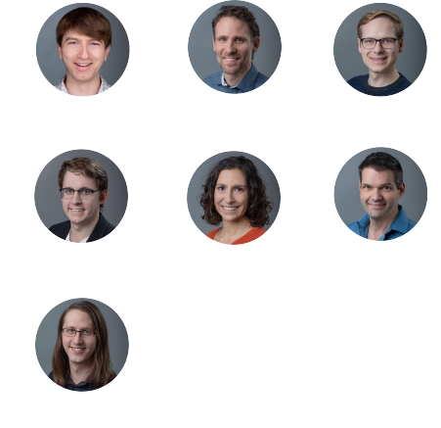
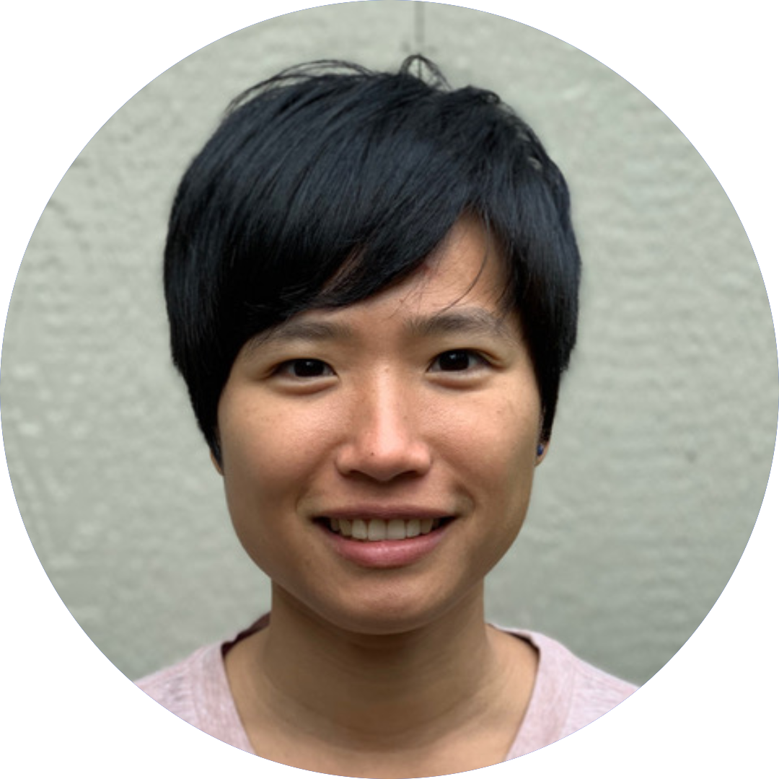
Thank You!
Former AI2 DSL Team
Collaborators
Oliver Elbert
Oli Fuhrer
Johann Dahm
Tobias Wicky
Rhea George
Eddie Davis
Jeremy McGibbon
Elynn Wu
Florian Deconinck

Slide 11
This slide intentionally left blank

Slide 12
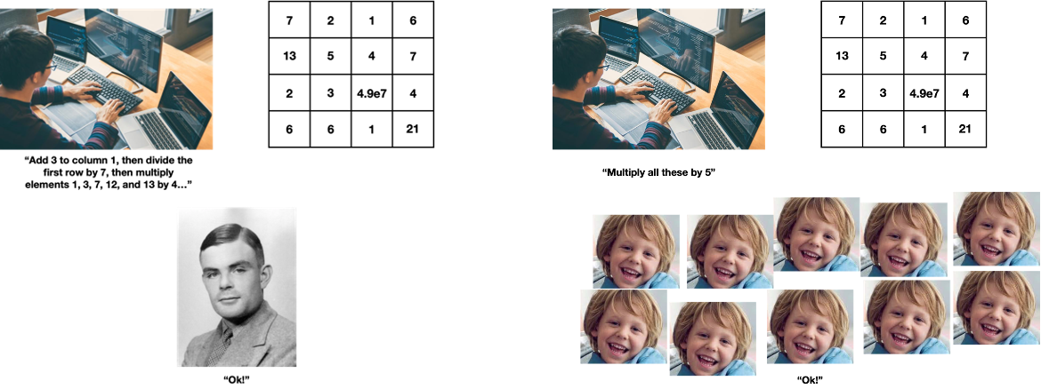
GPUs vs CPUs
CPU:
Complex instructions done in serial
GPU:
Simple instructions done in parallel

Slide 13
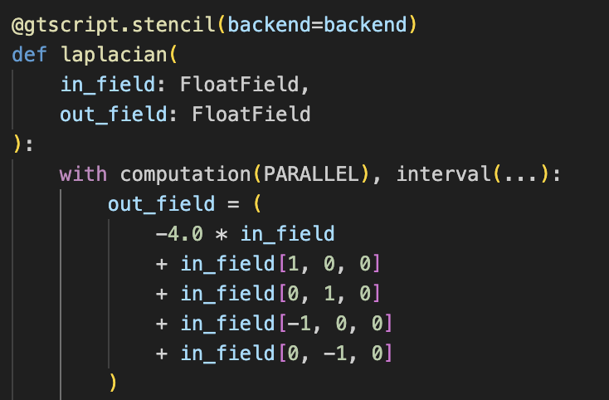
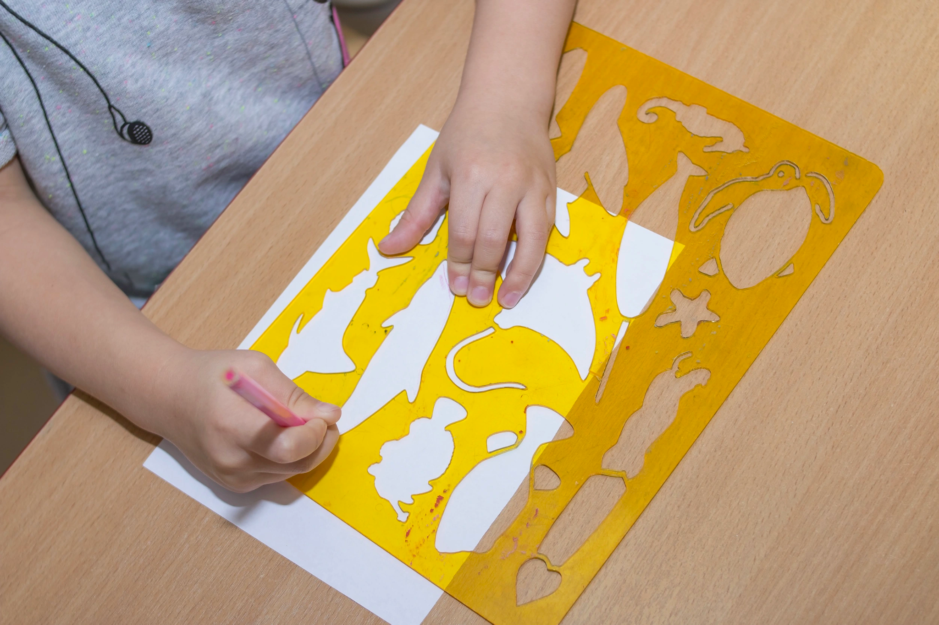
GT4Py Stencils
Instead of looping through x, y, z define a function that gets moved around the grid and applied to all the points you want
Pass 3D fields as arguments

Slide 14
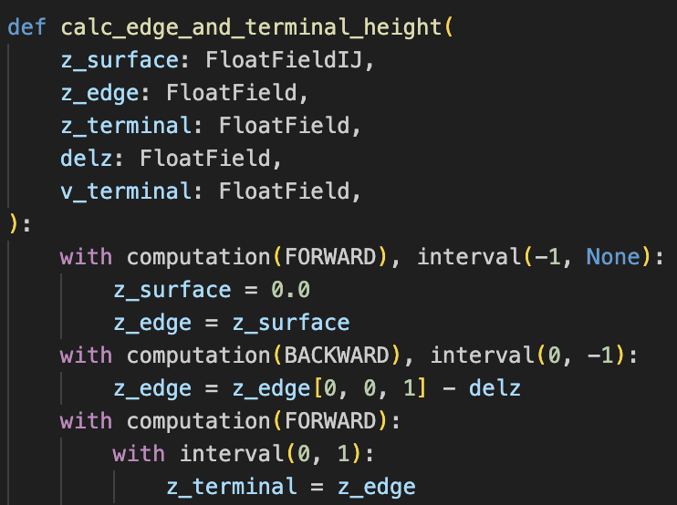
More on Stencils
Stencils run on all horizontal indices in parallel
Can set vertical order and boundaries within stencil through computation and interval
FORWARD to go from k=0 to kend, BACKWARD to go in reverse
Interval slices like numpy
Use offsets instead of absolute indices i-1 instead of i=13
Can’t write with offsets

Slide 15
Comparing Code
Fortran
GT4Py
subroutine del2_cubed(q, cd, del6_v, del6_u, rarea, grid)
real :: fx(is:ie+1, js,je), fy(is:ie, js:je+1)
!$OMP parallel do default(none) shared(km, q,&
!$OMP is,ie,js,je, & cd) &
!$OMP private(fx, fy)
do k = 1, km
do j = js, je
do i = is, ie + 1
fx(i,j) = del6_v(i,j) * ( q(i-1,j,k) - q(i,j,k) )
enddo
enddo
do j = js, je + 1
do i = is, ie
fy(i,j) = del6_u(i,j) * ( q(i,j-1,k) - q(i,j,k) )
enddo
enddo
do j = js, je
do i = is, ie
q(i,j,k) = q(i,j,k) + cd * rarea(i,j) * (
fx(i,j) - fx(i+1,j) + fy(i,j) - fy(i,j+1) )
enddo
enddo
enddo
...
end subroutine del2_cubed
call del2_cubed(q, cd, del6_v, del6_u, rarea, grid)
@gtscript.function
def delx(q, weight):
return weight * (q[-1, 0, 0] – q)
@gtscript.function
def dely(q, weight)
return weight * (q[0, -1, 0] – q)
@gtscript.stencil(backend=‘numpy’)
def del2_cubed(q:field, rarea:field, del6_v:field, del6_u:field, cd:float):
with computation(PARALLEL), interval(...):
fx = delx(q, del6_v)
fy = dely(q, del6_u)
q = q + cd * rarea * (fx - fx[1, 0, 0] + fy - fy[0, 1, 0])
del2_cubed(q, del6_u, del6_v rarea, cd, origin=grid.compute_origin(), domain=grid.compute_domain())
Horizontal loops removed, OMP removed
Index offsets instead of absolute indices
No explicit storage statements for temporary variables
Overhead-free, reusable functions -- inlining
Less code
No explicit parallelism or data storage layout
Escaping into straight Python is possible

Slide 16
DaCe
User Code
Compilation​ Toolchain
Generated Code
GT4Py Pipeline
NumPy
GT4Py Stencil
General Analysis
GT4Py Stencils
Per-target Optimization
C++
CUDA
‹#›

Slide 17
DaCe
User Code
Compilation​ Toolchain
Generated Code
GT4Py Pipeline
GT4Py Stencil
General Analysis
GT4Py Stencils
Per-target Optimization
C++
CUDA
aCe
‹#›

Slide 18
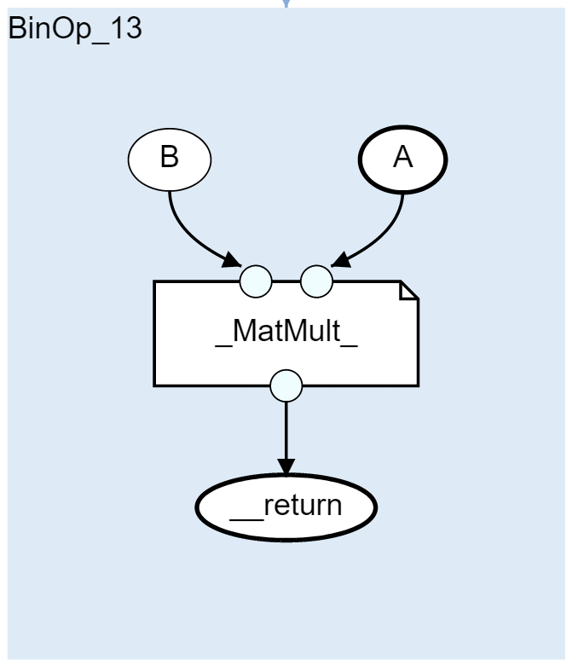
DaCe
ace
import dace
@dace.program
def somethingelse(x):
return x * 5
@dace.program
def example(A: dace.float64[20, 20]):
B = somethingelse(A)
C = A + A
B += C
return np.dot(B, A)
parametric dataflow representation
‹#›
imperative code
‹#›

Slide 19
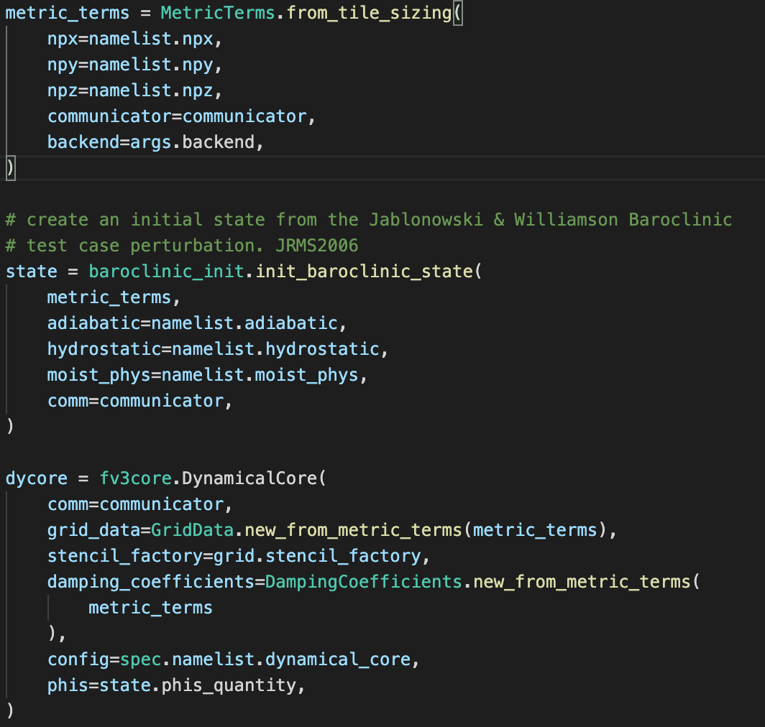
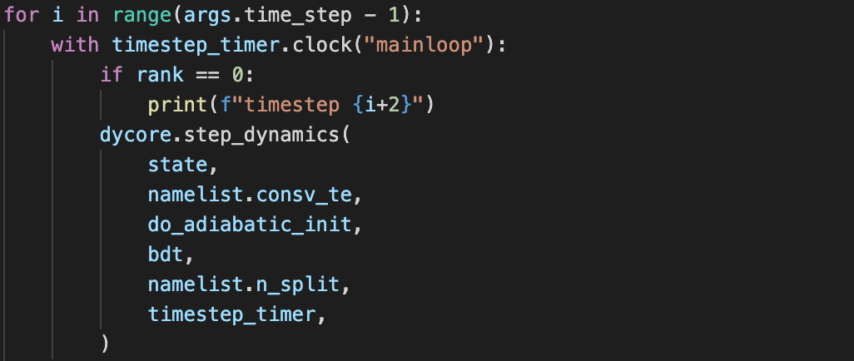
Running the Dycore
Python runfile.py
Import dynamical core, state setup modules
Load namelist from file, initialize grid, state, and dycore
Then simple loop over timesteps.
Full access to Python ecosystem for performance monitoring, postprocessing, etc.

Slide 20
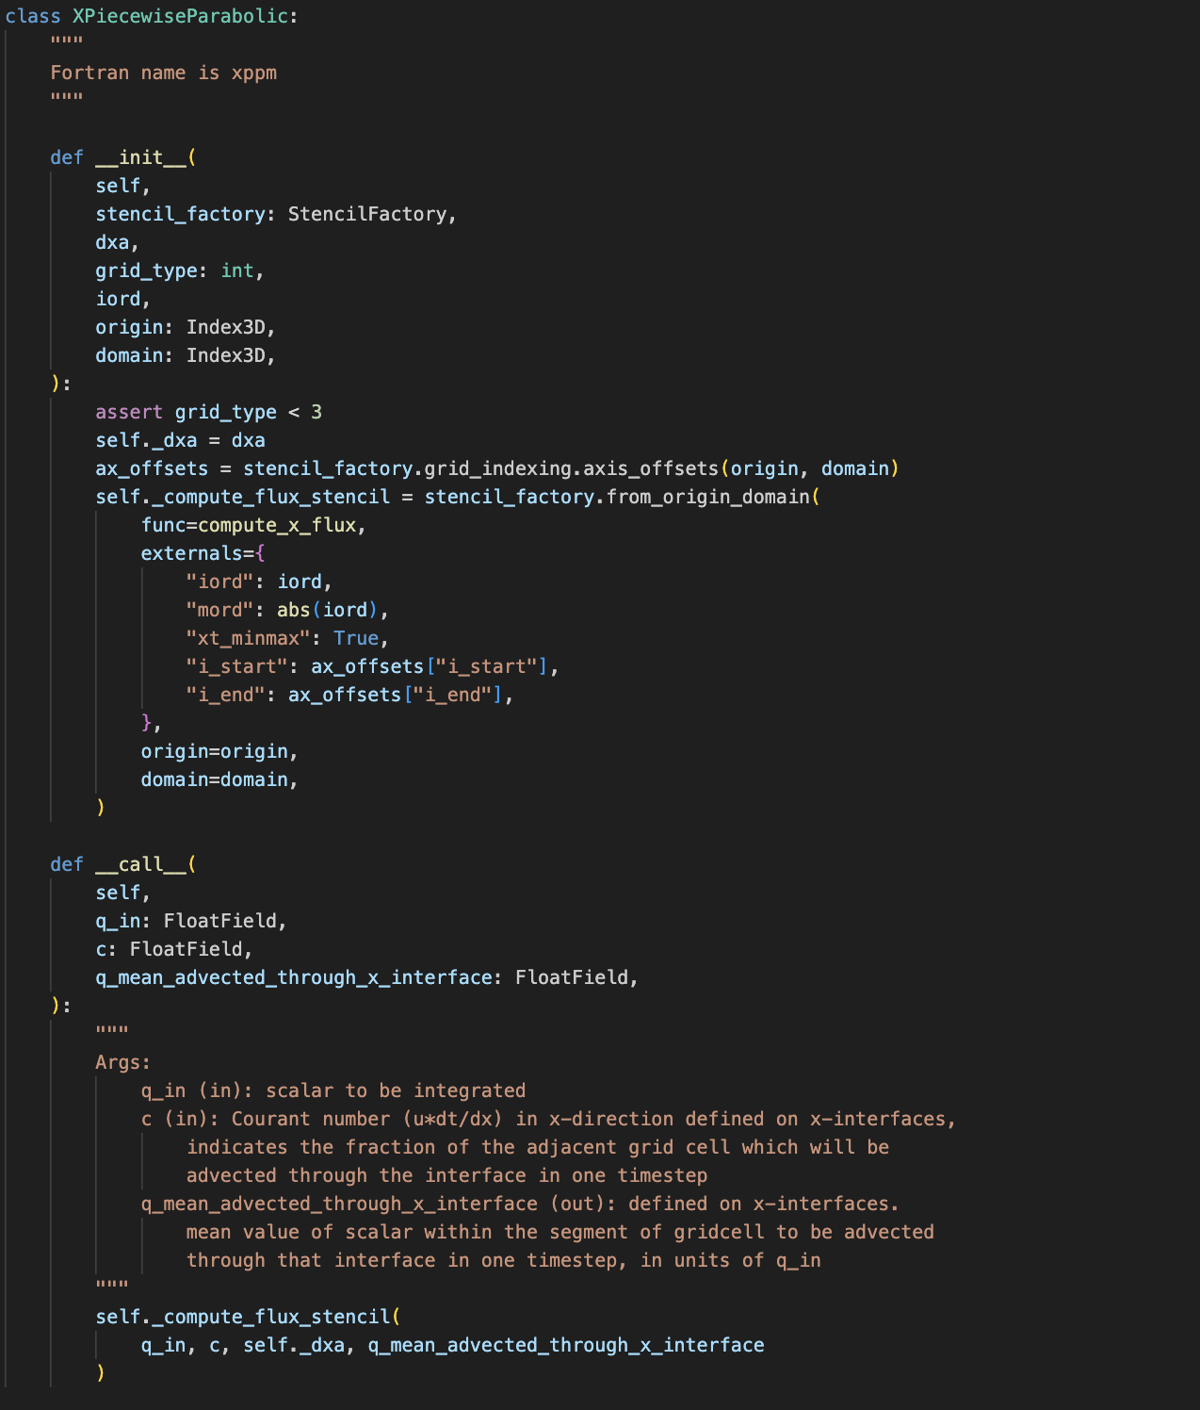
Object Orientation
Most stencils live inside classes
Preserves temporary storages
Stencils compile at init-time
Simple organization
__init__ creates an object of the class, handles stencil compilation, etc.
__call__ means objects are called like functions

Slide 21
Object Orientation
init:
Objects create objects inside their constructors
Ex: fvtp2d uses xppm
self.x_piecewise_parabolic_inner = XPiecewiseParabolic(
stencil_factory=stencil_factory,
dxa=grid_data.dxa,
grid_type=grid_type,
iord=ord_inner,
origin=idx.origin_compute(add=(0, -idx.n_halo, 0)),
domain=idx.domain_compute(add=(1, 1 + 2 * idx.n_halo, 1)),
)
call:
self.x_piecewise_parabolic_inner(q, crx, self._q_x_advected_mean)

Slide 22
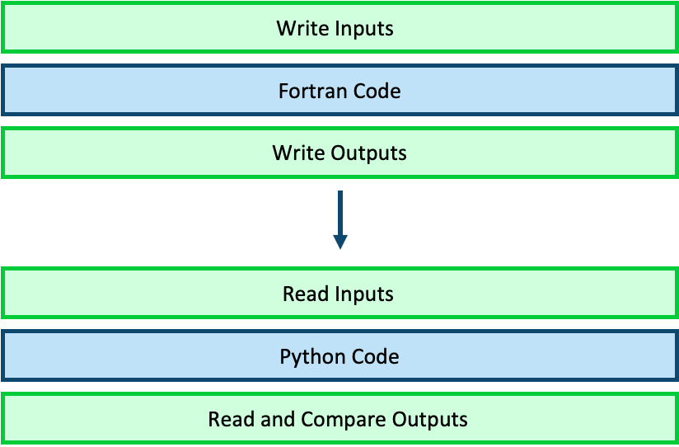
Porting

Slide 23
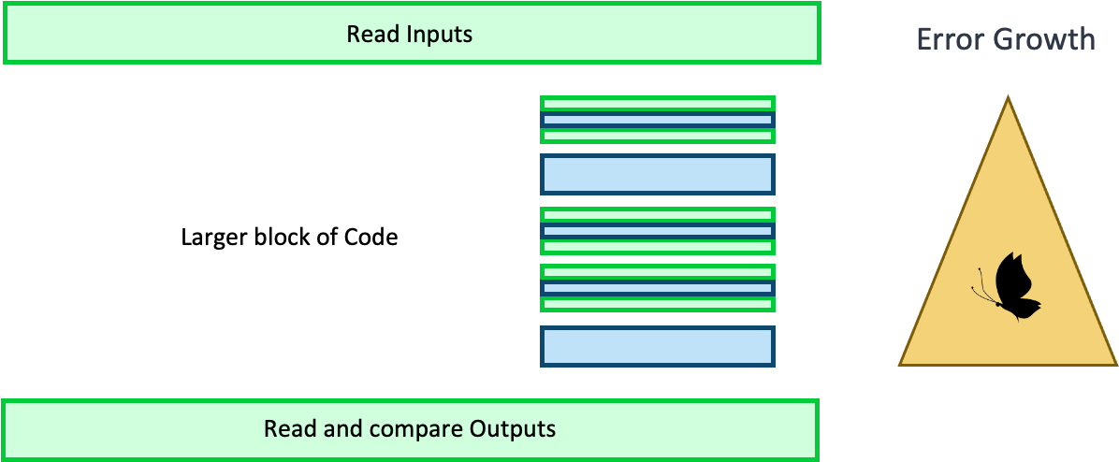
Porting
Suite of tests to make sure code matches Fortran as Pace builds up

Slide 24
Serialbox
Handy tool from GridTools team
Extracts data from C++, Python, Fortran codes
For Fortran: !$ser statements
Save data or execute code
Python preprocessor replaces !$ser with #ifdef SERIALIZE
Compile Fortran with -DSERIALIZE and run
!$ser verbatim bdt=dt_atmos/real(abs(p_split))

