Slide 1
The Worldwide, Federated FV3 Community
Lucas Harris
For the GFDL FV3 Team
25 July 2023
FV3 and SHiELD development are principally funded by the NOAA Global-Nest Initiative
https://www.gfdl.noaa.gov/noaa-research-global-nest-initiative/

Slide 2
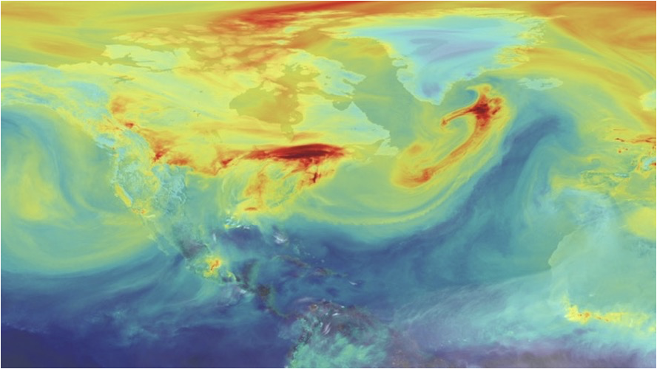
FV3 is the fluid solver (“engine”) for a community of atmosphere models
Accurate, physical numerics
Computationally efficient
Flexible solver and interface
Timely forecasts
Accelerated development
Ultra high-resolution models
Many applications Weather, climate, DA, atmospheric chemistry, reanalysis, planetary atmospheres, and more
FV3
The GFDL Finite-Volume Cubed-Sphere Dynamical Core
Carbon dioxide in FV3-based NASA GEOS
https://svs.gsfc.nasa.gov/11719

Slide 3
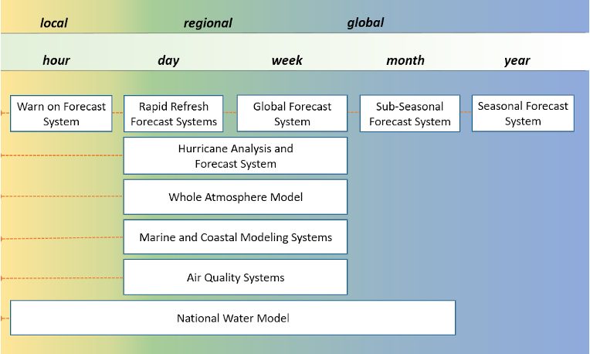
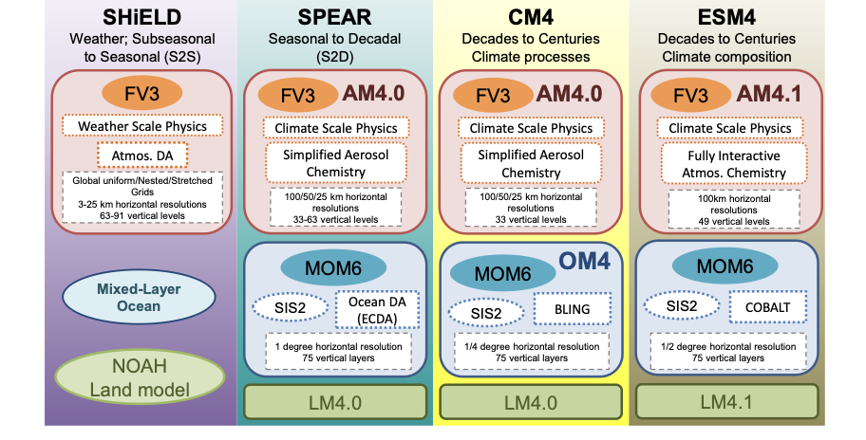
The Worldwide FV3 Community
Many missions, many models, one dynamical core
NOAA Minutes-to-Millennia Unified Modeling
GEOS, MERRA
Ames Mars GCM
GEOS-Chem
GEOS-Chem High Performance
CAM-FV
CAM-FV3
Unified Forecast System
LASG FAMIL, F-GOALS
Taiwan Central Weather Bureau
CWBGFS
GFDL Seamless Modeling Suite
Chinese Academy of Sciences

Slide 4
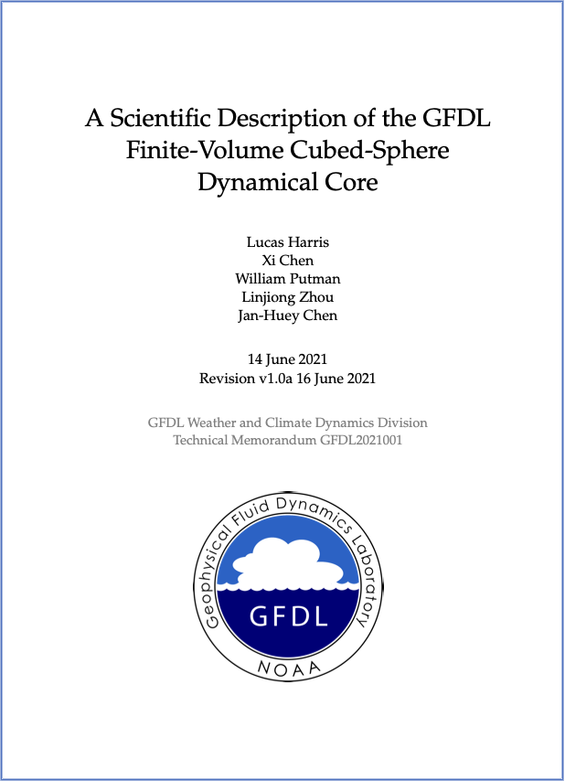
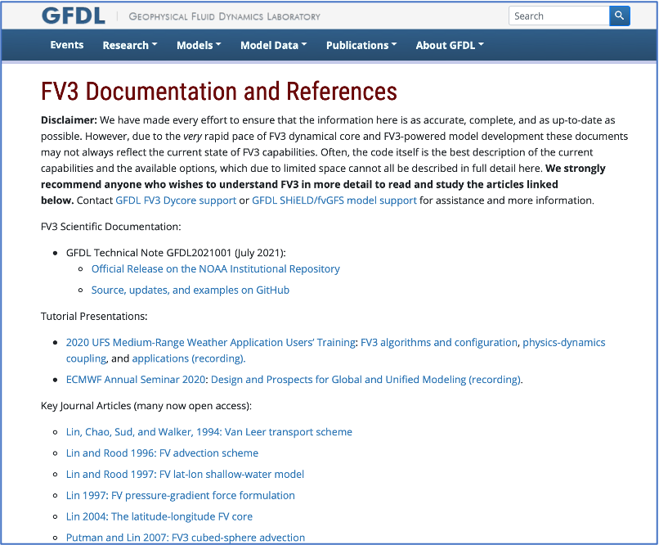
FV3 Reference Information
Harris et al. (2021)
109-page FV3 Scientific Documentation
on GitHub and NOAA Institutional Repository
Documentation on FV3 Portal:
www.gfdl.noaa.gov/fv3/fv3-documentation-and-references/

Slide 5
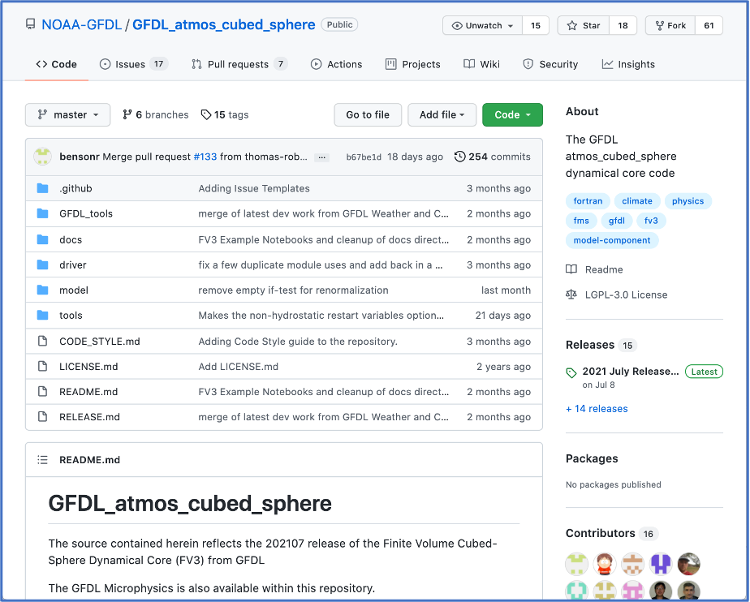
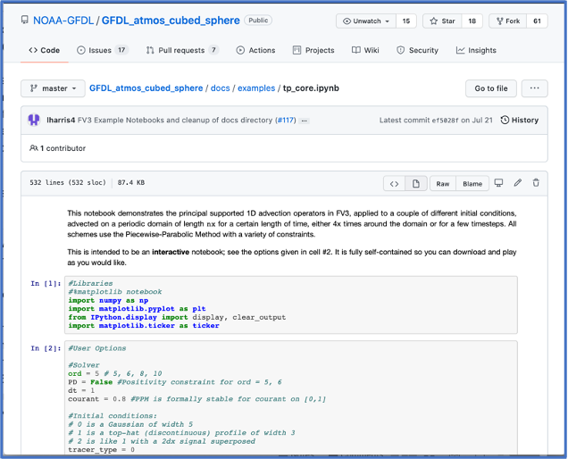
FV3 Community GitHub
Official site for FV3 releases, examples, issue tracking, code submissions, documentation, and more
github.com/NOAA-GFDL/GFDL_atmos_cubed_sphere
Examples directory: Jupyter notebooks
demonstrating FV3 capabilities.
Updates released regularly.

Slide 6
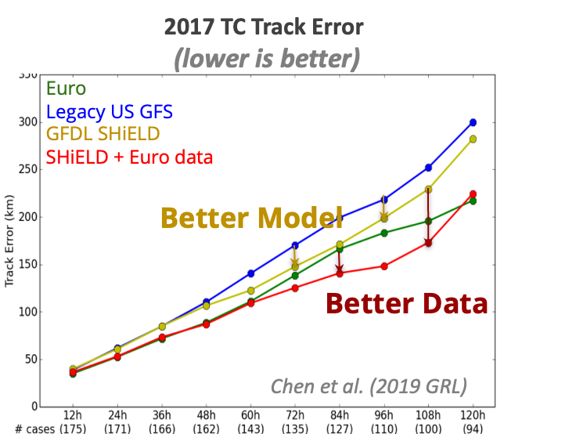
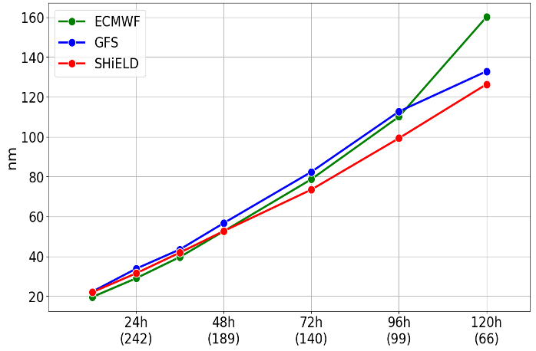
R2O: Improving Hurricane Forecasts
2021-2022
Mean Atlantic TC Track Error
Operational Transition
+
Improved DA
Courtesy Kun Gao and Jan-Huey Chen
See also J-H Chen et al (2023, Earth Space Sci) for DIMOSIC intercomparison

Slide 7
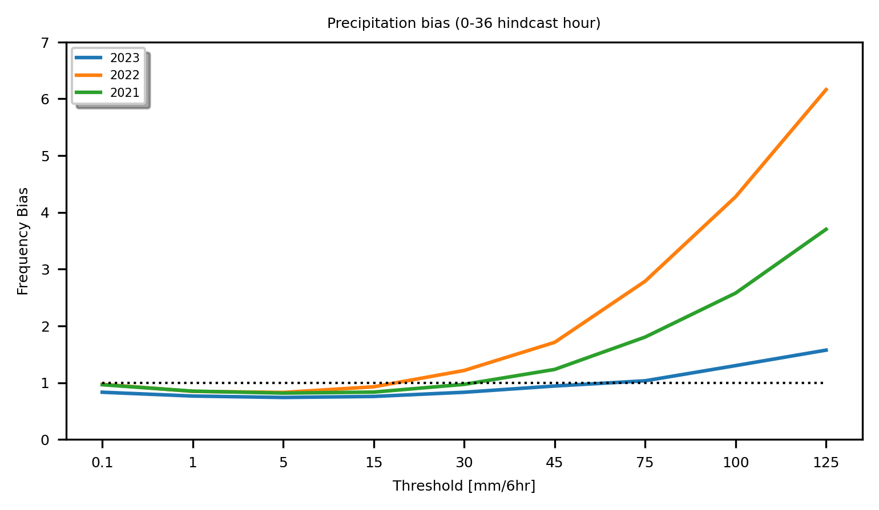
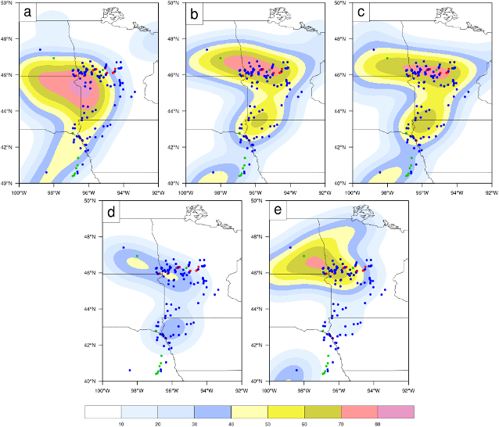
Advances in continental convection prediction
No DA
GSI DA
JEDI DA
May 2022 CONUS Forecasts & Hindcasts
C-SHiELD 2021
C-SHiELD 2022
C-SHiELD 2023
13 May 2022 predicted
UH > 75 vs. SPC storm reports
Ops HRRR
RRFS p2
OBS Radar
23Z 1 May 2019
C-SHiELD 2023
00 1 May 2019 + 23h
Revised advection (hord=5) and new GFDL MP v3 greatly reduce heavy precipitation biases and improve storm structure
Courtesy Kai Cheng and Linjiong Zhou, Princeton CIMES
CAPS Radar DA in UFS SRW significantly improves convective-scale hazard prediction OU CAPS w/ EMC & GSL—courtesy Chengsi Liu and Ming Xue
See Jun Park’s poster on Thursday

Slide 8
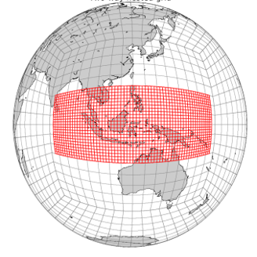
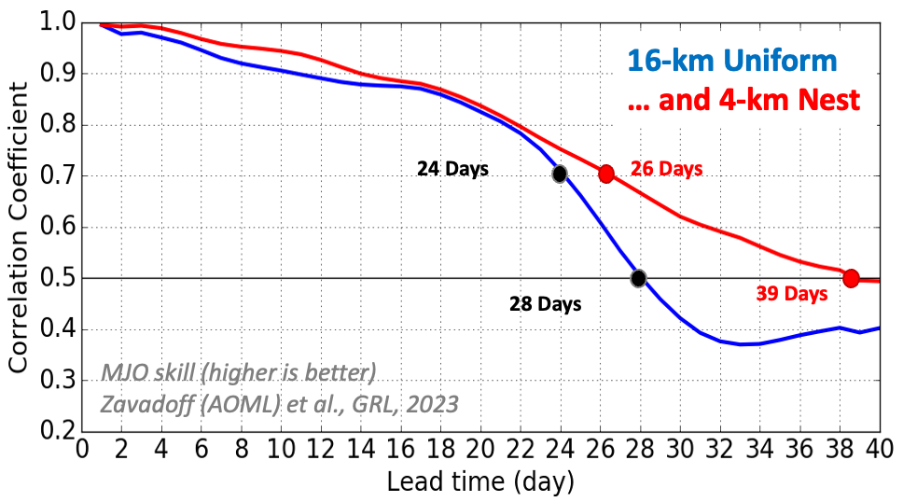
Improved MJO Forecasts with FV3’s Grid Nesting
GFDL SPEAR and SHiELD get 25+ days of MJO at 100-50-25 km resolution. Higher resolution gives better forecasts.
AOML & GFDL Collaboration: 40-day runs during DYNAMO
Maritime Continent nest gives a full 39 days of useful predictability!
Enhanced resolution improves precipitation and diurnal cycle over Maritime Continent
SHiELD global 16-km grid
4-km Maritime Continent nest
40-days in 8 hours with 4K Gaea cores

Slide 9
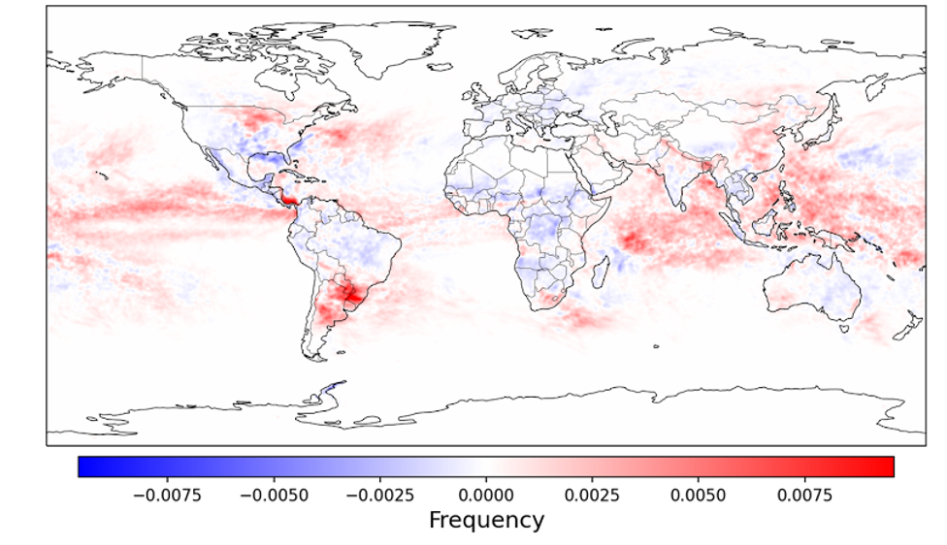
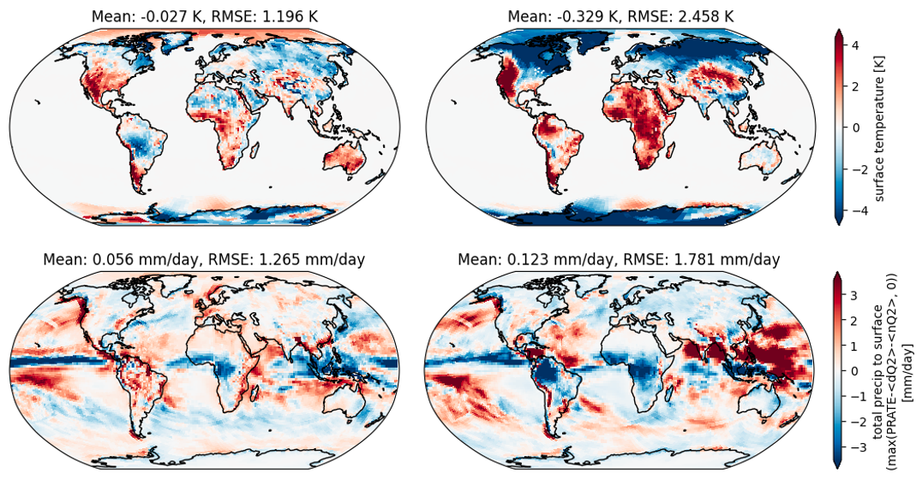
Global Storm-Resolving Modeling
Shift in intense convection under warming in year-long X-SHiELD simulations
(O(10⁸) updrafts)
Cheng et al. 2022, GRL
3.25-km GFDL X-SHiELD and NASA GEOS latest FV3-based GSRMs—big wins with FV3 accuracy and efficiency.
Unprecedented years-long simulations in current & warmed climates for effect on convection, water resources, clouds, etc.
Allen Institute for AI trains ML with X-SHiELD output to correct 200-km FV3GFS ⇒ Much improved precipitation, land diurnal cycle, and Tsfc—at 10000x less cost.
ML-Corrected
200-km FV3GFS Baseline
Courtesy Chris Bretherton (AI2 & UWashington)
Bretherton et al. (2022, JAMES) and Kwa et al. (2023, JAMES)

Slide 10
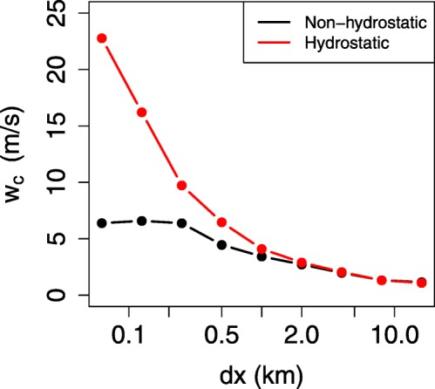
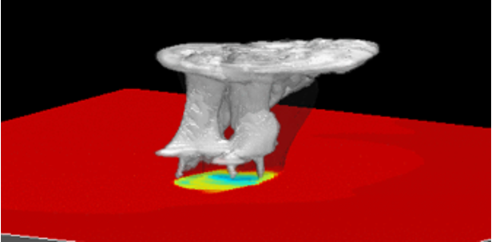
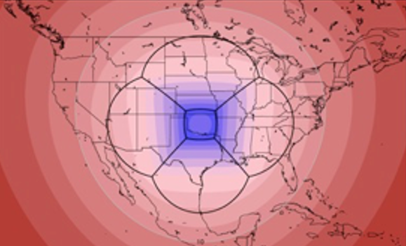
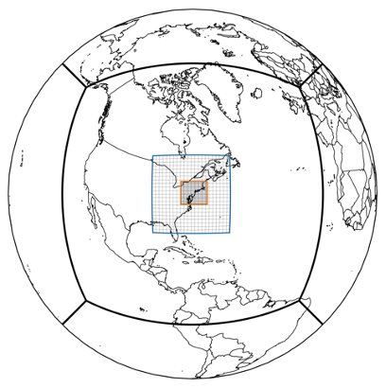
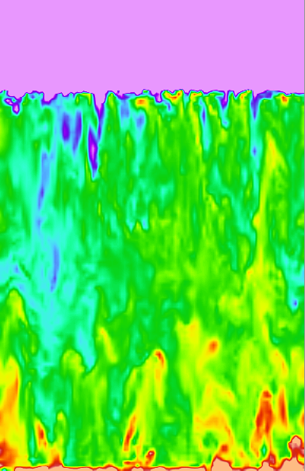
“There’s plenty of room at the bottom”: towards sub-k-scale
Convection is fully resolved at ∆x = 250 m as per G. Bryan, NCAR
Weakly-forced convection in Radiative-Convective Equilibrium 100s of updrafts: Jeevanjee (2017, JAMES); Jeevanjee and Zhou (2022, JAMES)
Tornado-like vortices in super-stretched 1-km domain.
Cheng & Harris, 2022 SLS Conference
1.4 km Tele-SHiELD for hyper-local impacts
Courtesy Jan-Huey Chen
LES experiments:
35-m forced shallow convection
Notes:
2022 paper principally about precipitation and clouds

Slide 11
FV3 Ongoing Development
Advanced telescoping, moving, and vertical nesting (GFDL, AOML & EMC)
See Bill Ramstrom’s talk this session
New numerics: Duo-Grid & LMARS (GFDL) and numerics upgrades (GFDL & EMC)
See Joseph Mouallem’s talk this session
Saw Kun Gao’s talk in HAFS session
Super-regular regional domain (EMC)
See Jim Purser’s talk this session
OpenACC (UWyoming) and GT4Py for performance portability (GFDL, GMAO, et al.)
See Oliver Elbert’s talk in System Architecture session
Whole & Deep Atmospheres (EMC & SWPC)
FV3 Integrated Physics (GFDL, AOML, EMC)
Subgrid turbulence (GFDL, Clemson, FIU, AOML)
See Ping Zhu’s talk this session
GitHub CI/CD (GFDL)
FV3 Adjoint (GMAO & JSCDA)
FV3net ML + Python Wrapper (AI2)
…

Slide 12
On Community and Cooperation
The worldwide FV3 community has been a great opportunity to bring together some of the best model developers in the world.
FV3’s flexibility, accuracy, and efficiency enable many different applications.
Portable nature of FV3 enable development of models tailored for each mission.
FV3 crosses all scales, allowing exchange of innovations and accelerating development.
There is a lot to learn from cooperation with other modeling efforts
ECMWF, UKMO, SCREAM (see Paul Ullrich’s talk next)
Community is a two-way street
“A key element that makes collaborations successful is having individuals who enjoy working together and are able to do so.”—Morris Bender, BAMS 2019

Slide 13
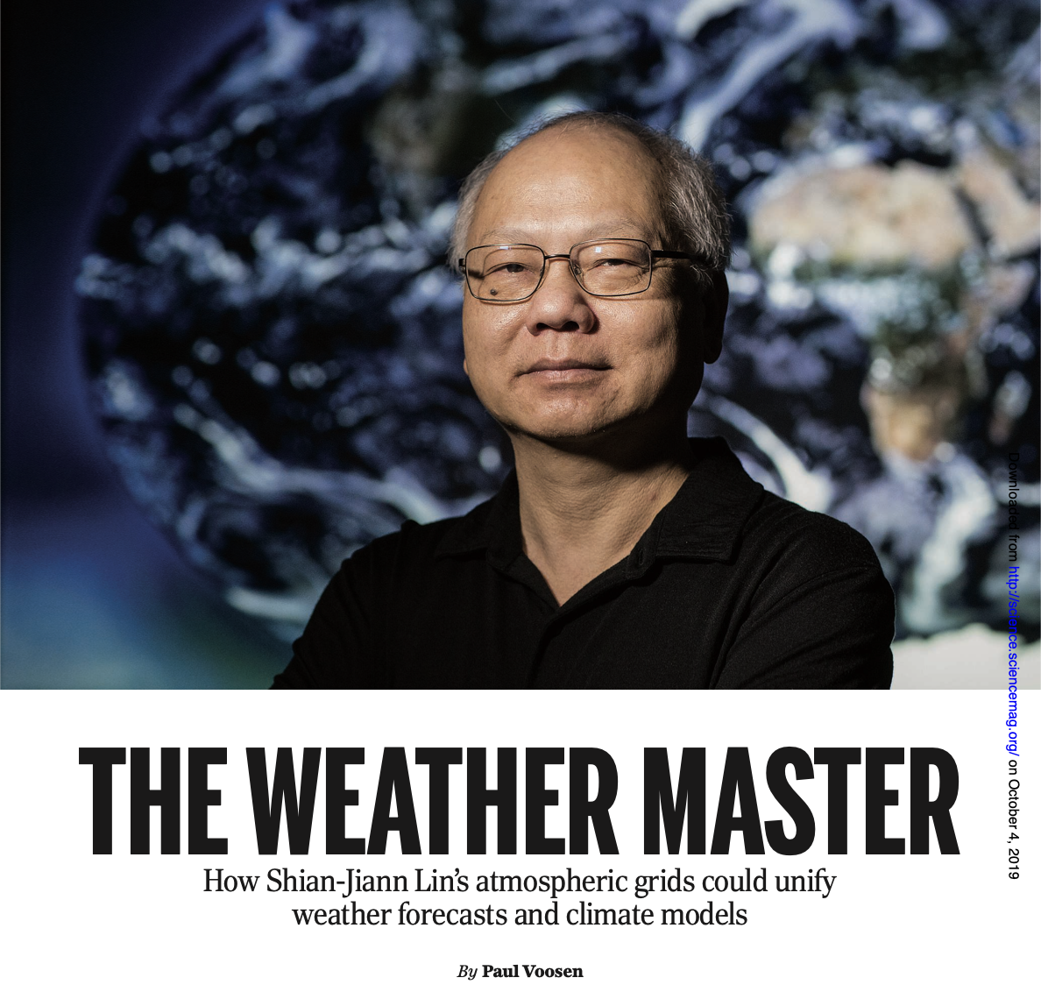
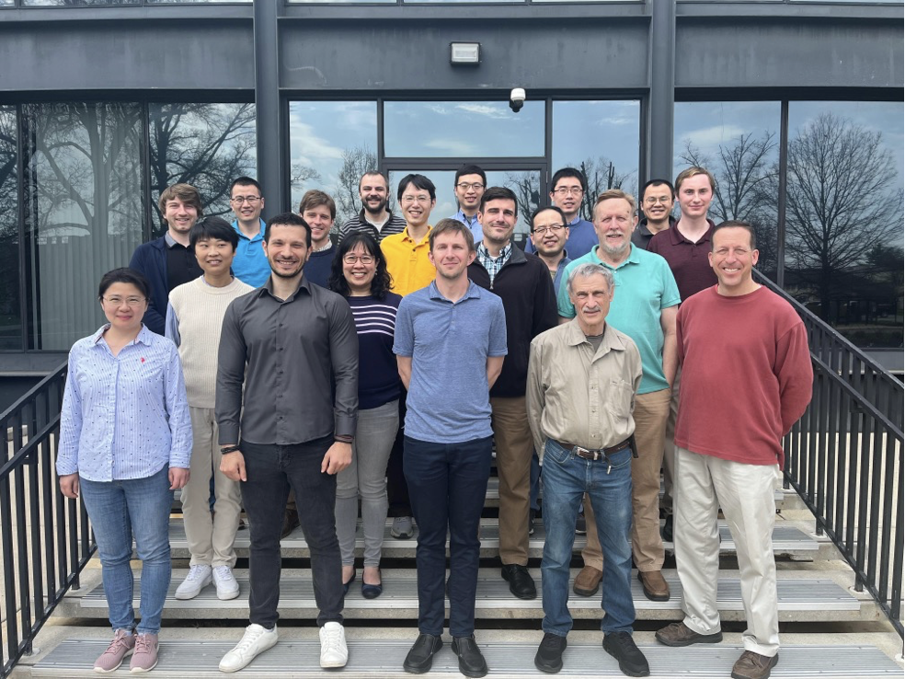
“There are no shortcuts around quality, and quality starts with people” — Steve Jobs
Thanks to GFDL Modeling Systems and collaborators at EMC, AOML, Princeton CIMES, OU CAPS, and the Allen Institute for AI

