Slide 1
Better Use of Ensembles in Operations Through Clustering and Ensemble Sensitivity Analysis
Austin Coleman, Brian Colle, Jim Nelson, and Travis Wilson

Slide 2
Motivation
As technology improves and NWS responsibilities expand
Forecasters have access to more data with simultaneously less time to interrogate those data
The National Blend of Models (NBM) is frequently used as a first-guess for said forecasts
Blends a large amount of forecast data, but can be seen as a black box
Forecasters desire more information about what makes up the NBM
Ensemble mean of NBM’s sub-ensemble systems (CMCE, GEFS, and ECMWF) is one way to quickly summarize solutions
Problem: it often washes out important nuance amongst ensemble membership

Slide 3
Motivation
Solution? Develop a clustering approach to break down an ensemble forecast into its most prevalent scenarios!
Inspired by and in collaboration with fuzzy clustering work conducted at Stony Brook
As technology improves and NWS responsibilities expand
Forecasters have access to more data with simultaneously less time to interrogate those data
The National Blend of Models (NBM) is frequently used as a first-guess for said forecasts
Blends a large amount of forecast data, but can be seen as a black box
Forecasters desire more information about what makes up the NBM
Ensemble mean of NBM’s sub-ensemble systems (CMCE, GEFS, and ECMWF) is one way to quickly summarize solutions
Problem: it often washes out important nuance amongst ensemble membership
This isn’t a viable answer either!

Slide 4
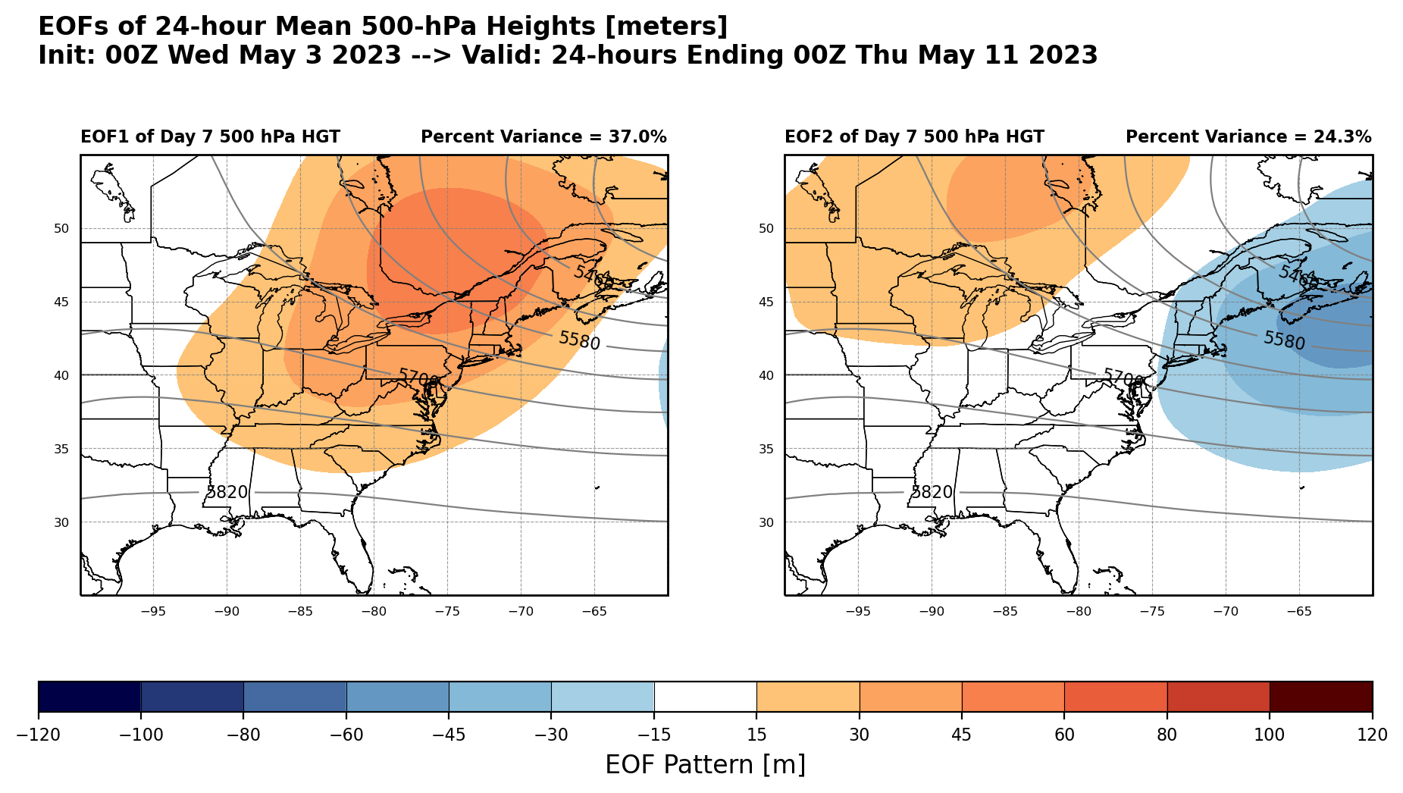
How does it work? First, we break down the forecast (super-ensemble of CMCE, GEFS, & ECMWF) into its leading modes of variability via EOF Analysis (traditionally known as PCA)
Leading mode of uncertainty:
Amplitude of trough
Secondary mode of uncertainty:
NW-SE positioning of trough

Slide 5
How does it work? Next, we use k-means clustering to assign members to cluster scenarios
Cluster 4
Deeper trough shifted SE
Trough Shifted SE
Cluster 1
Shallower trough likely shifted SE
First two EOFs for reference
Principal component (PC) phase space shows us the forecast scenario for each ensemble member (and system)
EOF 1
Deeper Trough
Shallower Trough
Leading uncertainty mode:
Amplitude of trough
Members with positive PC1 will look more like EOF1 whereas members with negative PC1 will look opposite EOF1
EOF 2
Cluster 2
Deeper trough with little shift in position
Cluster 3
Trough shifted NW
K-means clustering groups members with similar scenarios
(WPC pg keeps # clusters fixed at 4)
Secondary uncertainty mode:
NW-SE trough position
Trough Shifted NW
Notes:
Now that we know how the leading modes of ensemble forecast uncertainty look spatially, we can analyze each ensemble member in the context of those uncertainty modes by displaying them in principal component space. Basically, members with a positive PC1 will look more like EOF1 and members with a negative EOF1 will look opposite EOF1. The same goes for the secondary leading mode EOF2, and PC2. And the fact that we can summarize all of this information into 2 dimensions is pretty incredible! After plotting members in PC1-PC2 phase space, we see that some of them cluster together. To create the clusters, we use k-means clustering to assign each member to a group of similar forecasts. These are denoted by the number shown for each ensemble member.

Slide 6
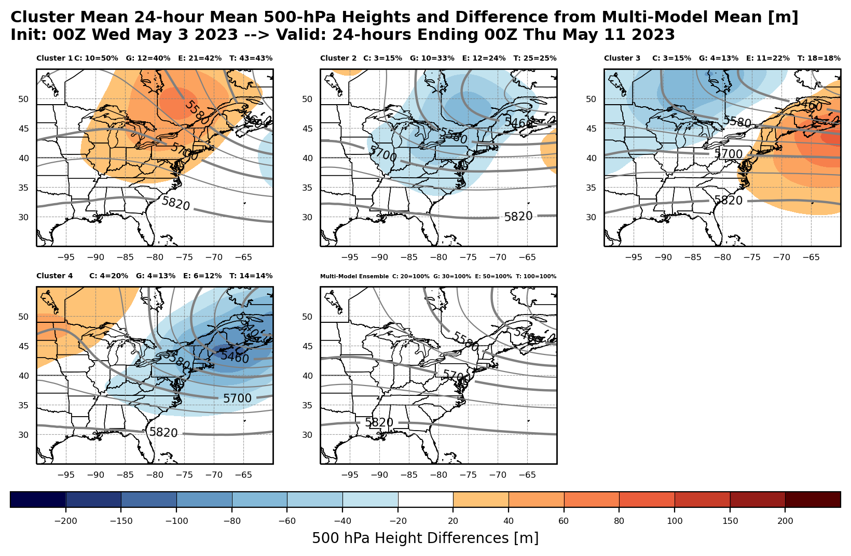
Don’t even need to look at EOFs or PCs to use! Can skip straight to the cluster forecasts (of 500-hPa heights in this case)
Shallower Trough shifted SE
Deeper Trough
Trough shifted NW
Color-filled contours show differences from multi-model ensemble mean
Deeper Trough shifted slightly SE
Multi-model Mean

Slide 7
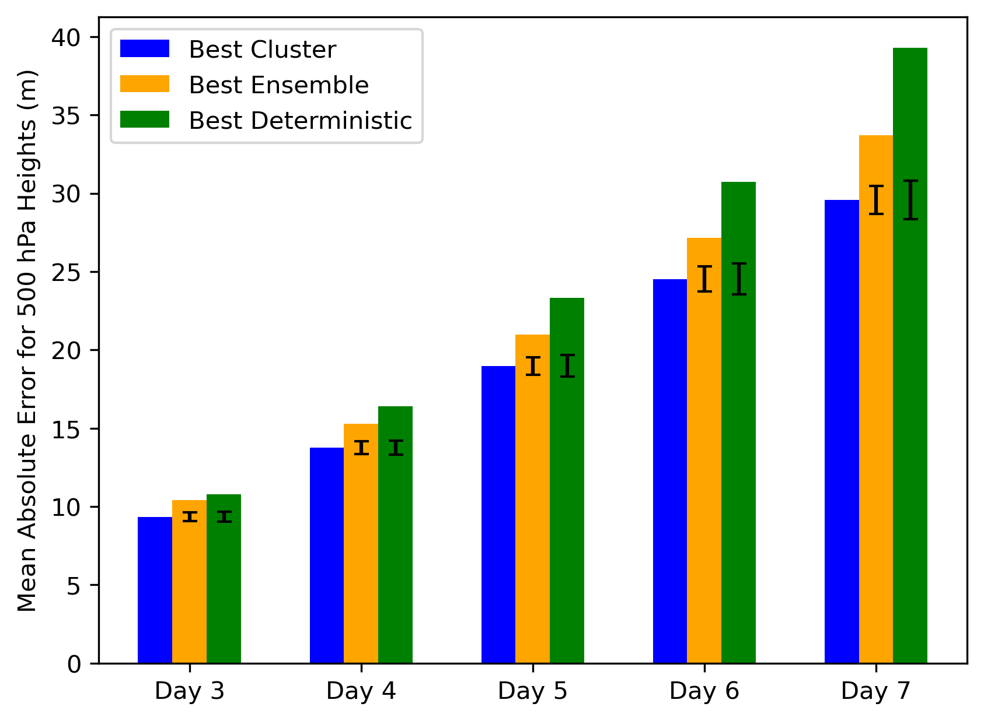
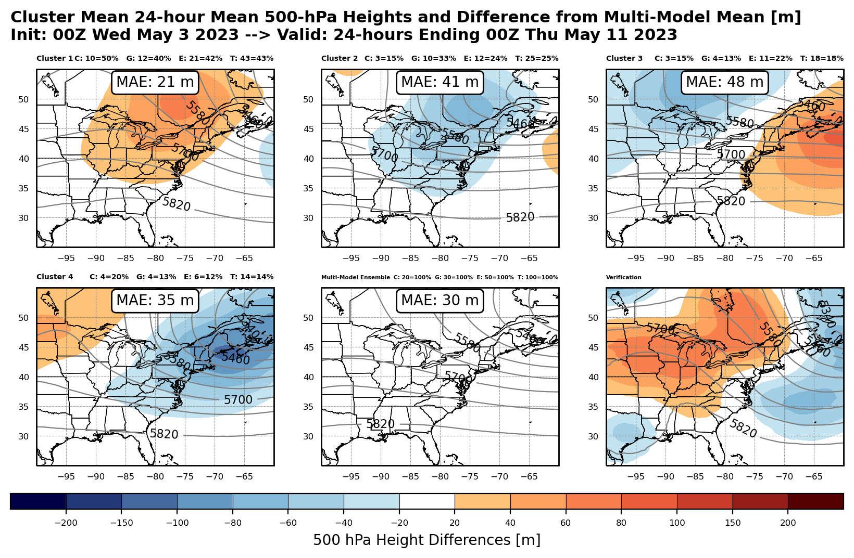
Don’t even need to look at EOFs or PCs to use! Can skip straight to the cluster forecasts (of 500-hPa heights in this case)
Best cluster forecast verifies better than best ensemble or deterministic forecast!**
(Lamberson et al. 2023)
**Doesn’t mean we should be trying to identify the best cluster ahead of time
Shallower Trough shifted SE
Deeper Trough
Trough shifted NW
Deeper Trough shifted slightly SE
Multi-model Mean
Notes:
- We can’t say the highest membership cluster is always the best cluster or performs better than the ensemble mean. That’s an open research question we’re exploring, but anecdotally forecasters have told me that oftentimes they see near-outlier clusters, or clusters with less membership but a more extreme scenario, verifying pretty well. I’ll pause here for questions or if anyone has any experiences with clusters/cluster verification they’d like to share!

Slide 8
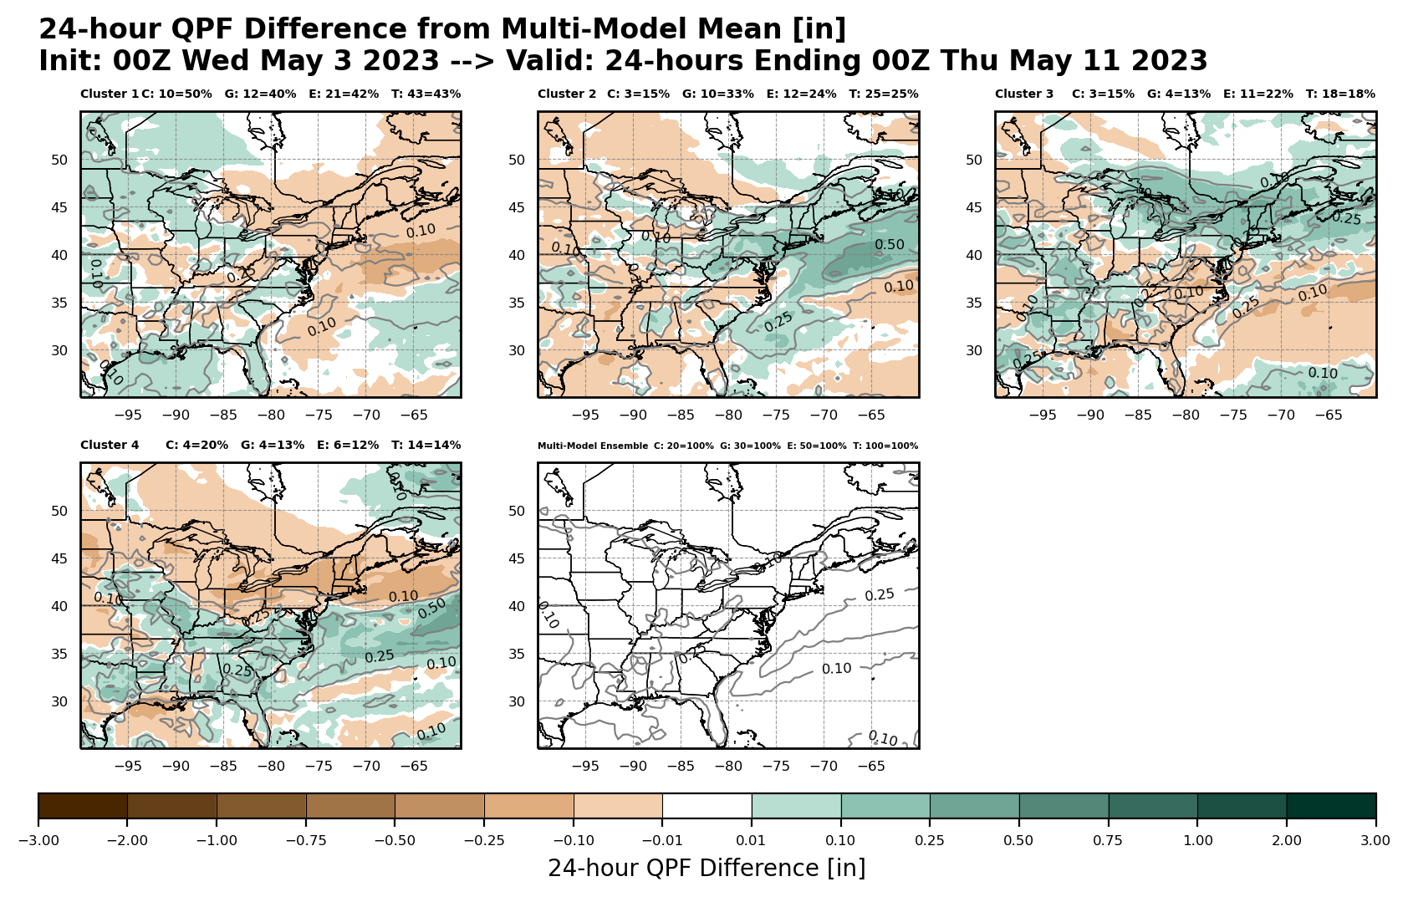
Can use 500-hPa height clusters to predict other fields 24-hr QPF
Cluster 1
Cluster 2
Cluster 3
Cluster 4
Multi-model Mean

Slide 9
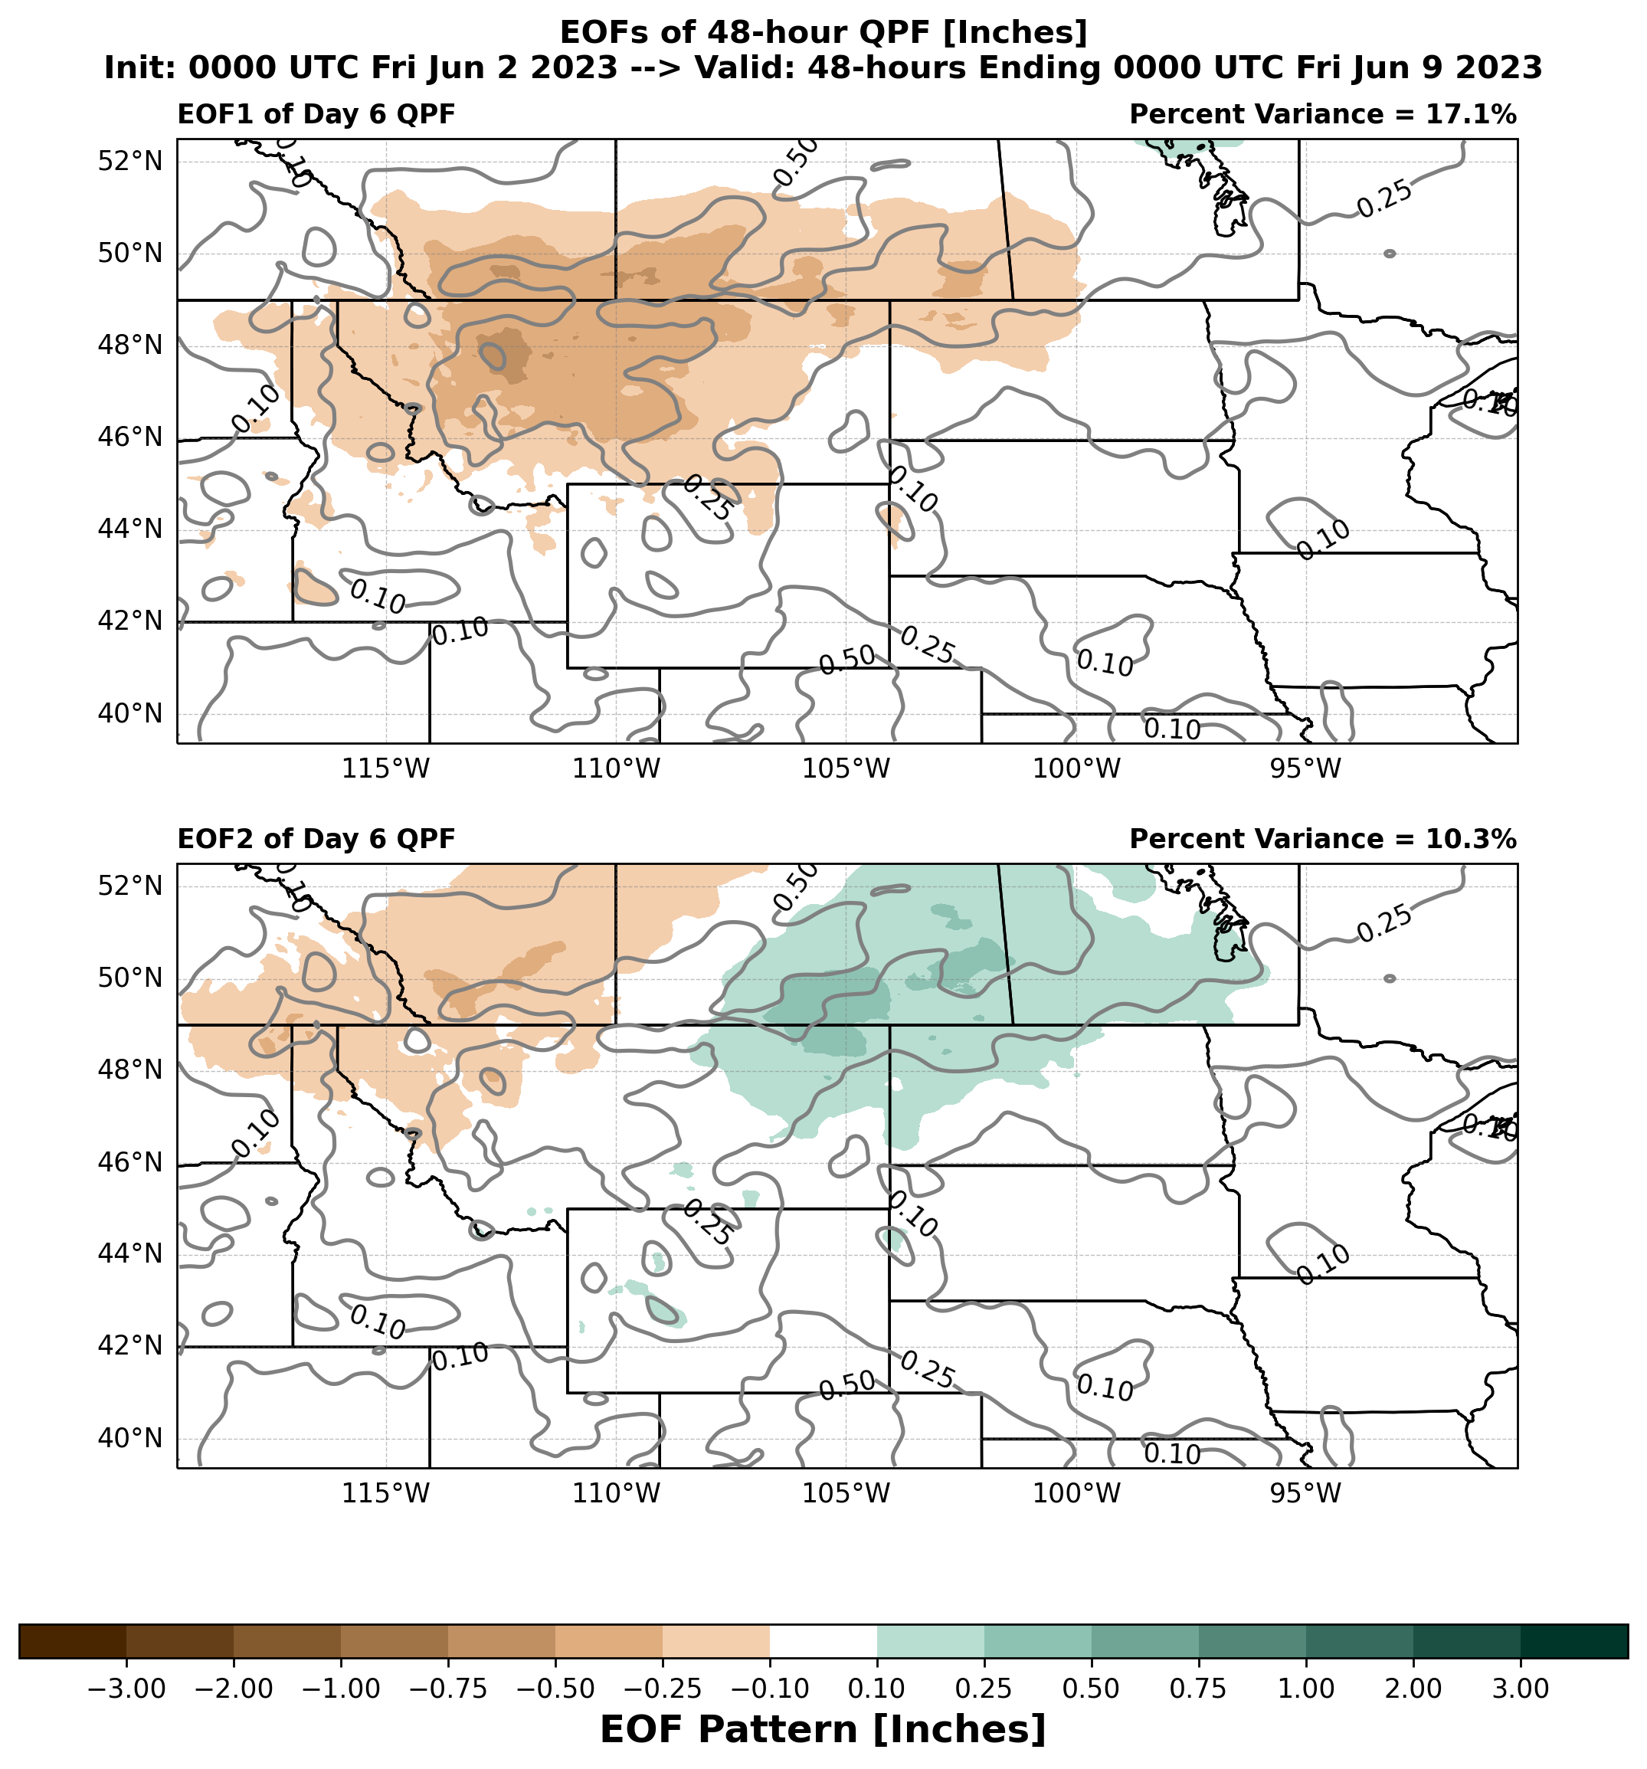
We also have a page that clusters on QPF uncertainty! Based on NBM QMDs (100 members)
Leading mode of 48hr QPF uncertainty is precipitation amounts
Secondary mode of 48hr QPF uncertainty is position of precipitation max

Slide 10
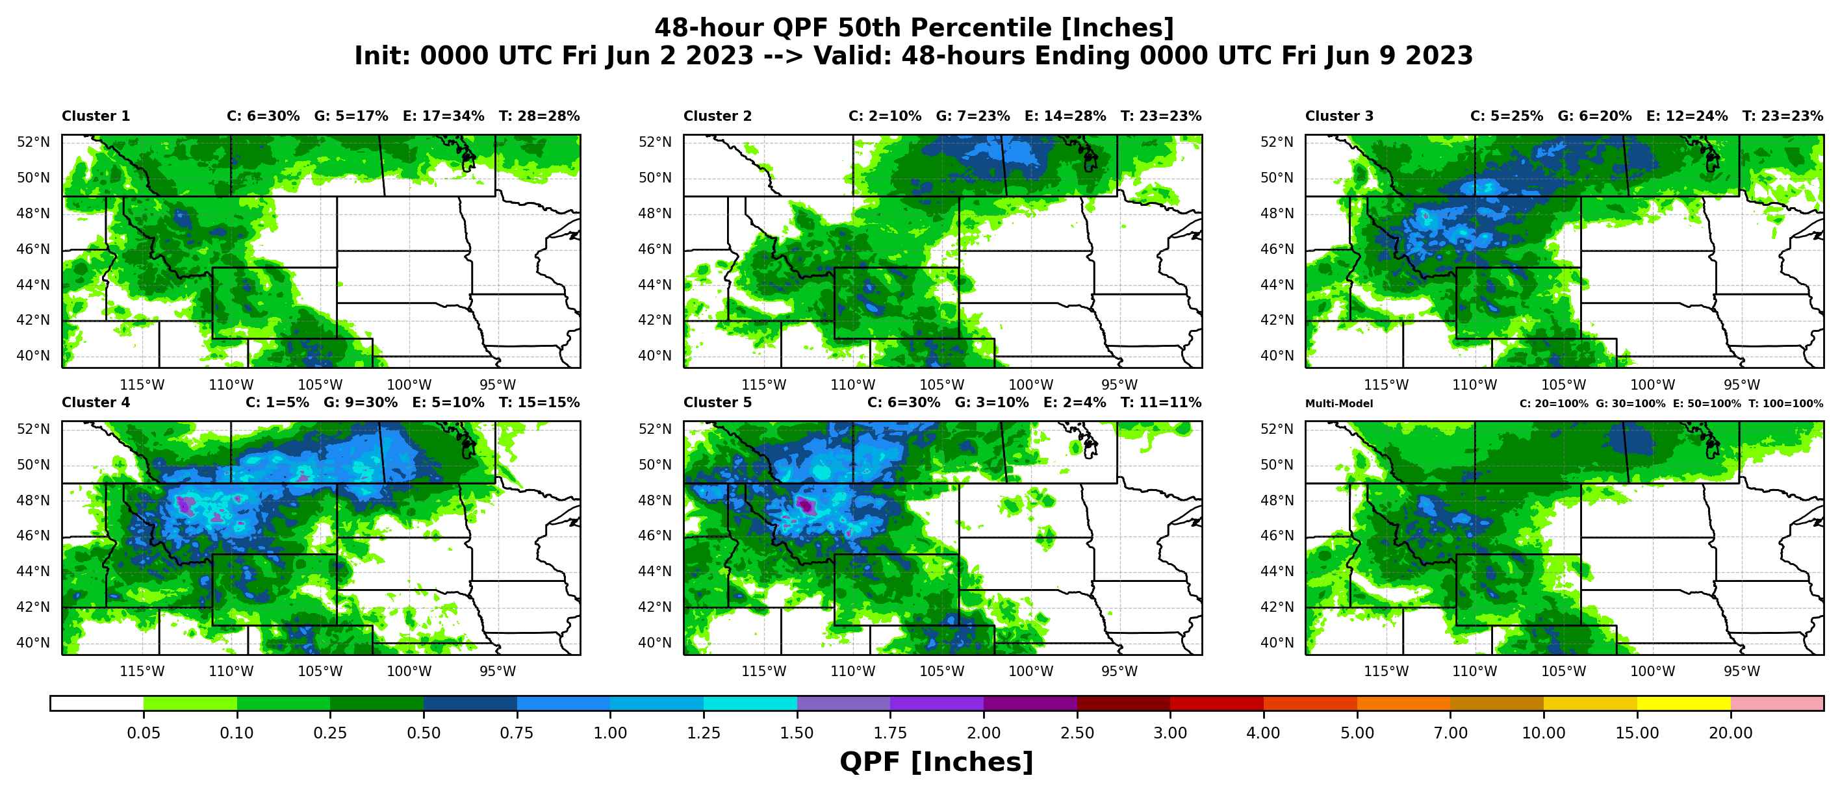
We also have a page that clusters on QPF uncertainty! 48-hr QPF 50th Percentile by Cluster

Slide 11
Forecasters regularly use this guidance!
Clustering technique has quickly gained popularity within the NWS (largely due to Western & Central Region championing it!)
In 2019, ensemble clustering tool was mentioned 38x in NWS AFDs
By 2021, it was referenced over 3,600x in AFDs
Clustering also used as a centerpiece of the experimental ensemble visualization platform known as the Dynamic Ensemble-based Scenarios for IDSS (DESI)
As part of DESI, the clustering technique is used as both a scientific forecasting tool and a communication tool

Slide 12
But they want more context about how the different clusters came to be… …Cue ensemble sensitivity analysis (ESA)!
Clusters tell you the different prevalent forecast outcomes, but don’t provide any context on what leads to those outcomes
Forecasters can look at the forecast evolution of each cluster and infer which early forecast differences lead to different outcomes, but takes a lot of time/energy and can be tricky
Ensemble sensitivity analysis relates the possible forecast outcomes back to the early forecast state – quantifies which early features are most relevant to scenario
Clustering describes the “what”, and ensemble sensitivity explains the “why”
Forecasters often ask for the “why” in DESI feedback surveys
Actively developing this product as a web-based tool (should be available on the main WPC cluster page in the next few weeks)
Also in collaboration with Brian Colle at Stony Brook

Slide 13
ESA tells us how the atmosphere needs to evolve early on in order to look like a given EOF! Response Function: PC Values (in this case, positioning of the cut-off low)
Primary Uncertainty:
Position of Cutoff Low & Amplitude of Pattern over Pacific NW
Positive PC1 means cut-off low shifted West and higher heights for Pacific NW
Notes:
Mention 4 pre-defined response domains corresponding with cluster domains, and 1 potential floater domain we’re trying to figure out how to implement

Slide 14
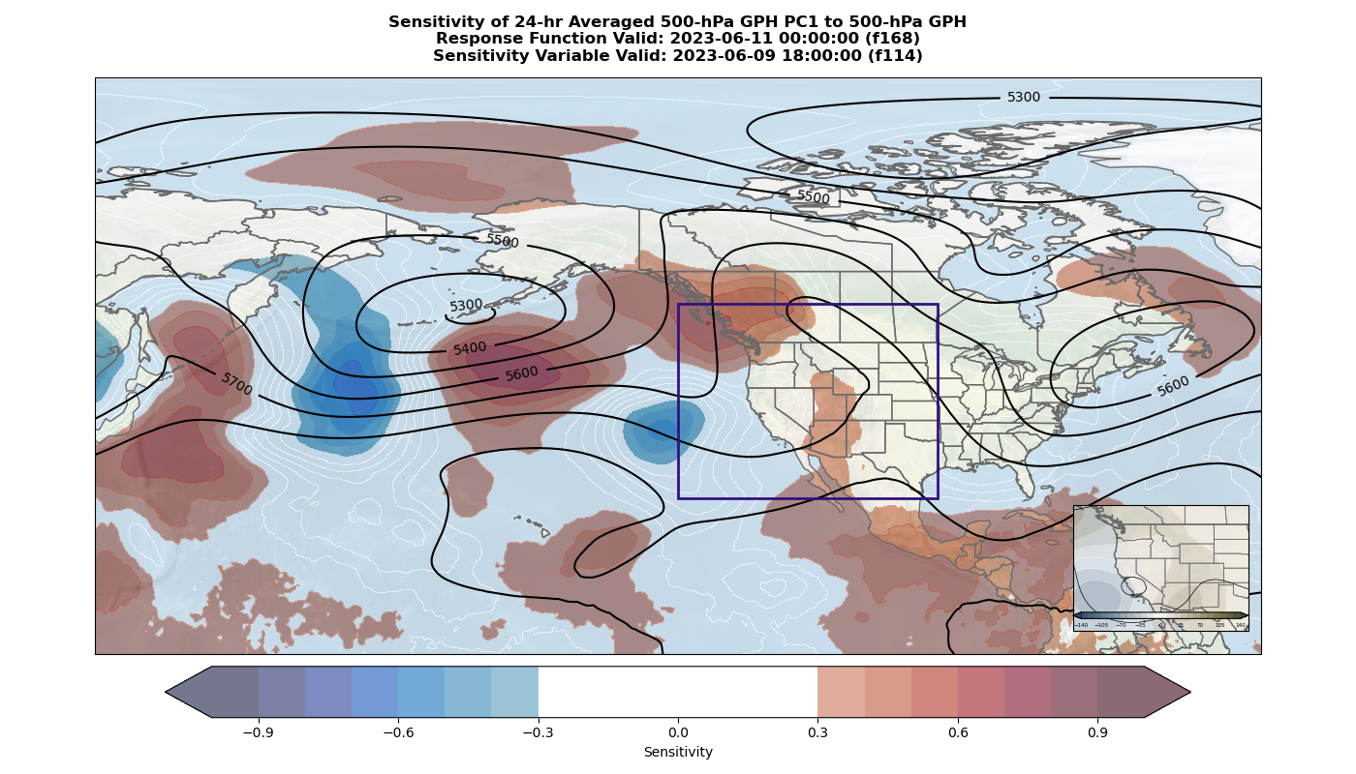
ESA tells us how the atmosphere needs to evolve early on in order to look like a given EOF!
Positive PC1 means cut-off low shifted West and higher heights for Pacific NW
EOF1 for reference
Notes:
If the atmosphere evolves a particular way, you could use the sensitivity fields and “truth” at early forecast times to hedge your bets towards a particular cluster. For instance, if at 18Z today (the time for which this sensitivity is valid), the shortwave ridge just east of Japan ends up being very amplified & the broad cut-off low in the Pacific is regressed, you might expect the cutoff low early next week to be shifted further west than expected.

Slide 15
Take-Home Points
Ensemble clustering is a quick way to distill an ensemble forecast down to its prevalent scenarios
Lots of potential as a scientific tool (best cluster verifies better than best deterministic or best ensemble mean forecast)
Feedback suggests utility as a communication tool as well
Ensemble sensitivity analysis (ESA) provides context on how the atmosphere must evolve to lead to different cluster scenarios
Testament to the potential of data mining ensemble systems
As we continue to build techniques that extract information from these datasets, need to keep forecaster needs at the forefront (lots of room for O2R/R2O in these spaces)!

Slide 16
Bonus Slides

Slide 17
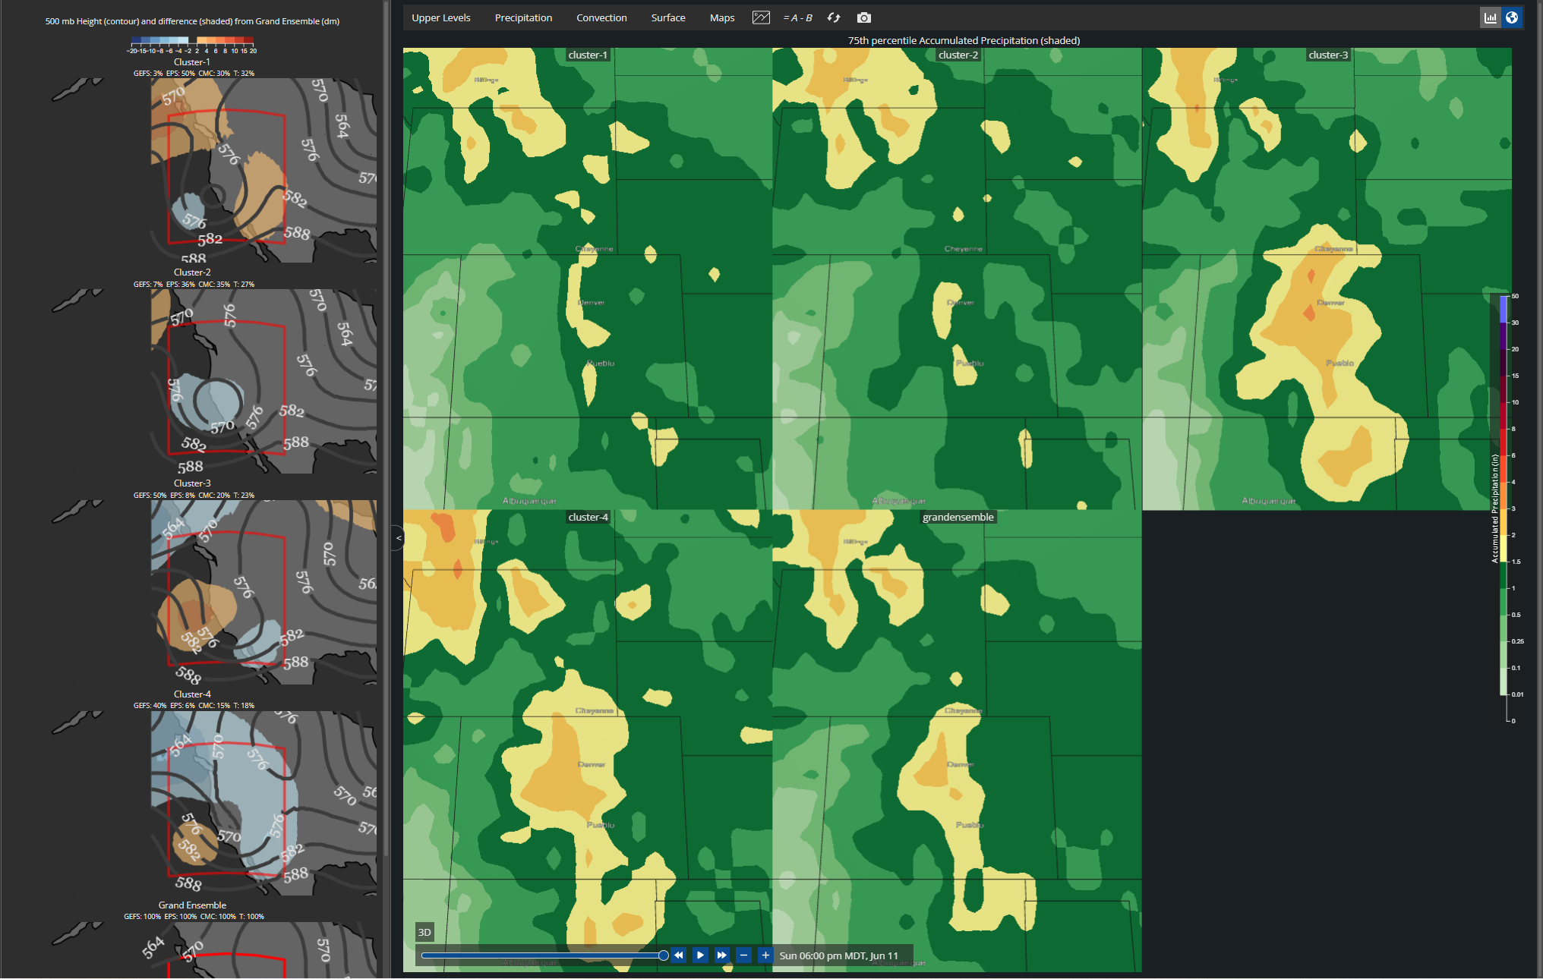
75th percentile QPF from each Cluster

Slide 18
Forecaster Feedback on Clustering in DESI as a Communication Tool
“Helps the forecaster determine why uncertainty exists which can be passed along to the core partner which helps build trust.”
“Aids in communicating with our partners and the public. Cluster information gives me a better idea of where there is lots of uncertainty, and in those cases I avoid speaking in terms of absolutes.”

Slide 19
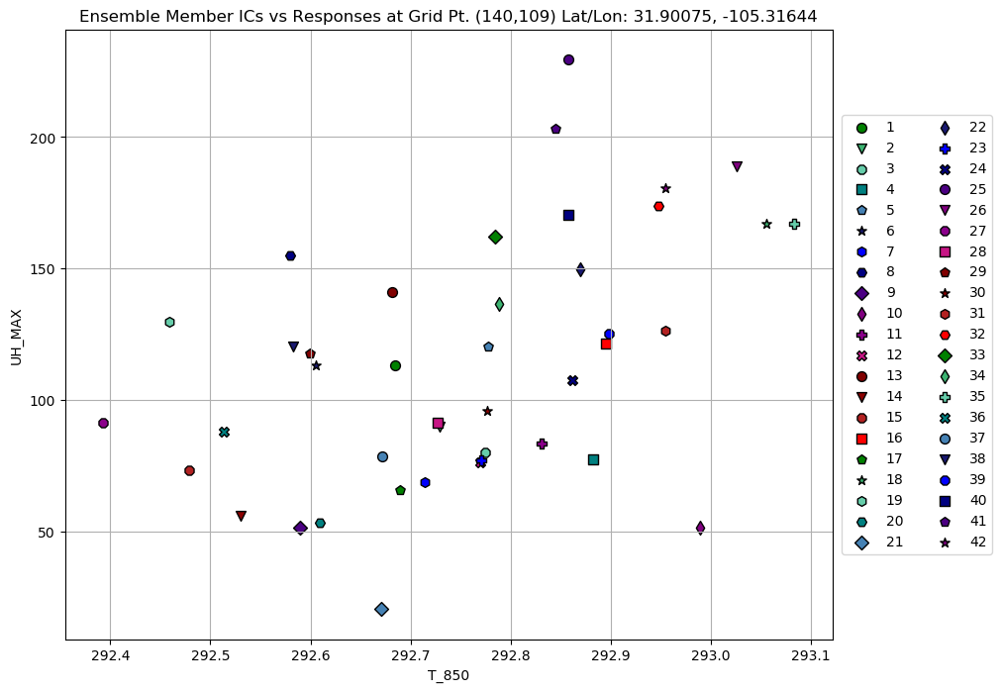
How does Ensemble Sensitivity Analysis work?
Reveals how meteorological conditions early in the forecast (sensitivity variable) are linked to the evolution of a chosen high-impact forecast feature (response function)
(Hakim and Torn 2008, Ancell and Hakim 2007, Torn and Hakim 2008)
Simply the slope of a linear regression line:
$$\frac{∂J}{∂x_{0}}$$
$$J≡response function$$
$$x_{0}≡sensitivity variable$$
Ensemble Sensitivity $≡$ Slope of the Linear Regression
Member 1-hour UH Max at f25
(Response Function = J)
Member 850 hPa Temperature at f6
(Sensitivity Variable = x₀)

Slide 20
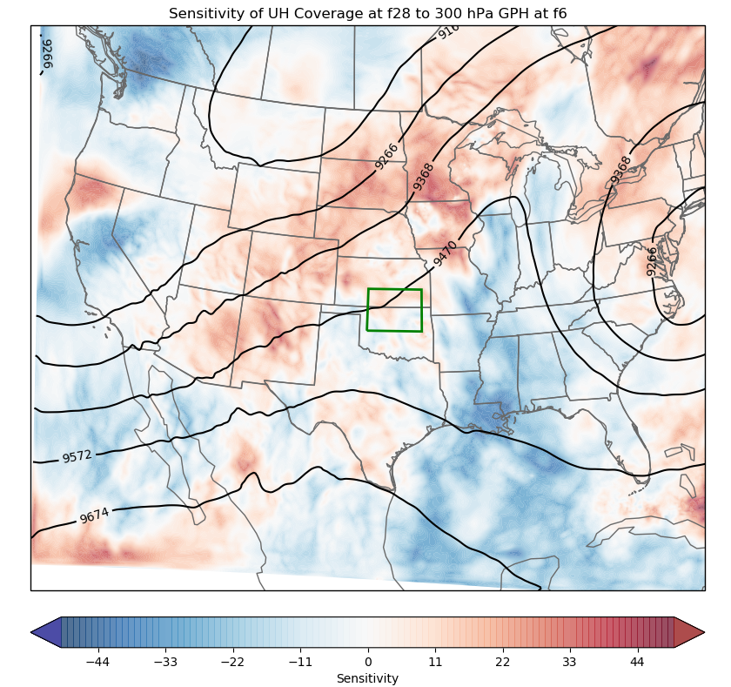
Ensemble Sensitivity Fields
Powerful tool: Sensitivity fields show us which early forecast features the ensemble “cares” most about in predicting high-impact weather!
More Examples of (Traditional) Sensitivity Variables and Response Functions:
Sensitivity Variables
(Predictors)
500 hPa GPH
2m Temperature
700 hPa Temperature
SLP
300 hPa U, V
850 hPa Temperature
850 hPa Moisture
High 10m Wind Speed (>40 mph) Coverage
High UH (>25 m2/s2) Coverage
Coverage Responses
Max Precipitation Accumulation
Max Updraft Helicity
Magnitude Responses
Response Functions
(High-Impact Forecast Features)
Min Sea Level Pressure
Max 2m Temperature
Max 10m Wind Speed
Response Box
Sensitivity time (early)
Response time (later)
(# high UH points / meter geopotential height)

Slide 21
Can use ESA and truth at early forecast times to hedge your bets on a particular cluster verifying
Positive PC1 means cut-off low shifted West and higher heights for Pacific NW
EOF1 for reference
Notes:
If the atmosphere evolves a particular way, you could use the sensitivity fields and “truth” at early forecast times to hedge your bets towards a particular cluster. For instance, if at 18Z today (the time for which this sensitivity is valid), the shortwave ridge just east of Japan ends up being very amplified & the broad cut-off low in the Pacific is regressed, you might expect the cutoff low early next week to be shifted further west than the ensemble mean would suggest.

