Slide 1
JEDI-based data assimilation for the UFS marine components
Travis Sluka (tsluka@ucar.edu) SOCA (Sea-ice, Ocean, and Coupled Assimilation) Project Lead, JCSDA/UCAR
(With help from numerous JCSDA, NOAA, and NASA in-kinds)

Slide 2
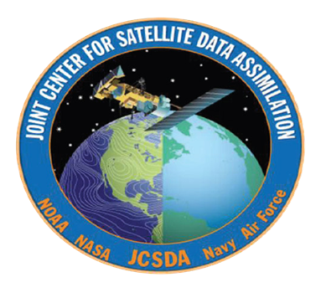
Who is JCSDA?
Joint Center for Satellite Data Assimilation (JCSDA): Interagency partnership dedicated to improving and accelerating use of research and operational satellite data in weather, ocean, climate and environmental analysis and prediction systems
Marine DA in-kinds and collaborators

Slide 3
What is SOCA: Sea-ice, Ocean, and Coupled Assimilation
Overall Goals:
Provide a “menu of marine DA options” based on JEDI for operational DA implementation at NOAA / NASA, and use by the community, focusing on the marine UFS components.
Consolidate DA development efforts and code sharing share components across models (i.e. steal from the atmosphere people!)
Accelerate marine DA R2O and innovation Advance “coupled assimilation” methods. Engage community development

Slide 4
What is SOCA: Sea-ice, Ocean, and Coupled Assimilation
FV3
The components of SOCA we are developing data assimilation for:
ocean (MOM6)
sea ice (CICE6)
ocean biogeochemistry (BLING)
air-sea interactions
waves (Wavewatch3) (insufficient resources to focus on waves at this time, any volunteers??)
atmo
SOCA
MOM6
CICE6
ocean
sea ice
waves
biogeochem
BLING
WW3

Slide 5
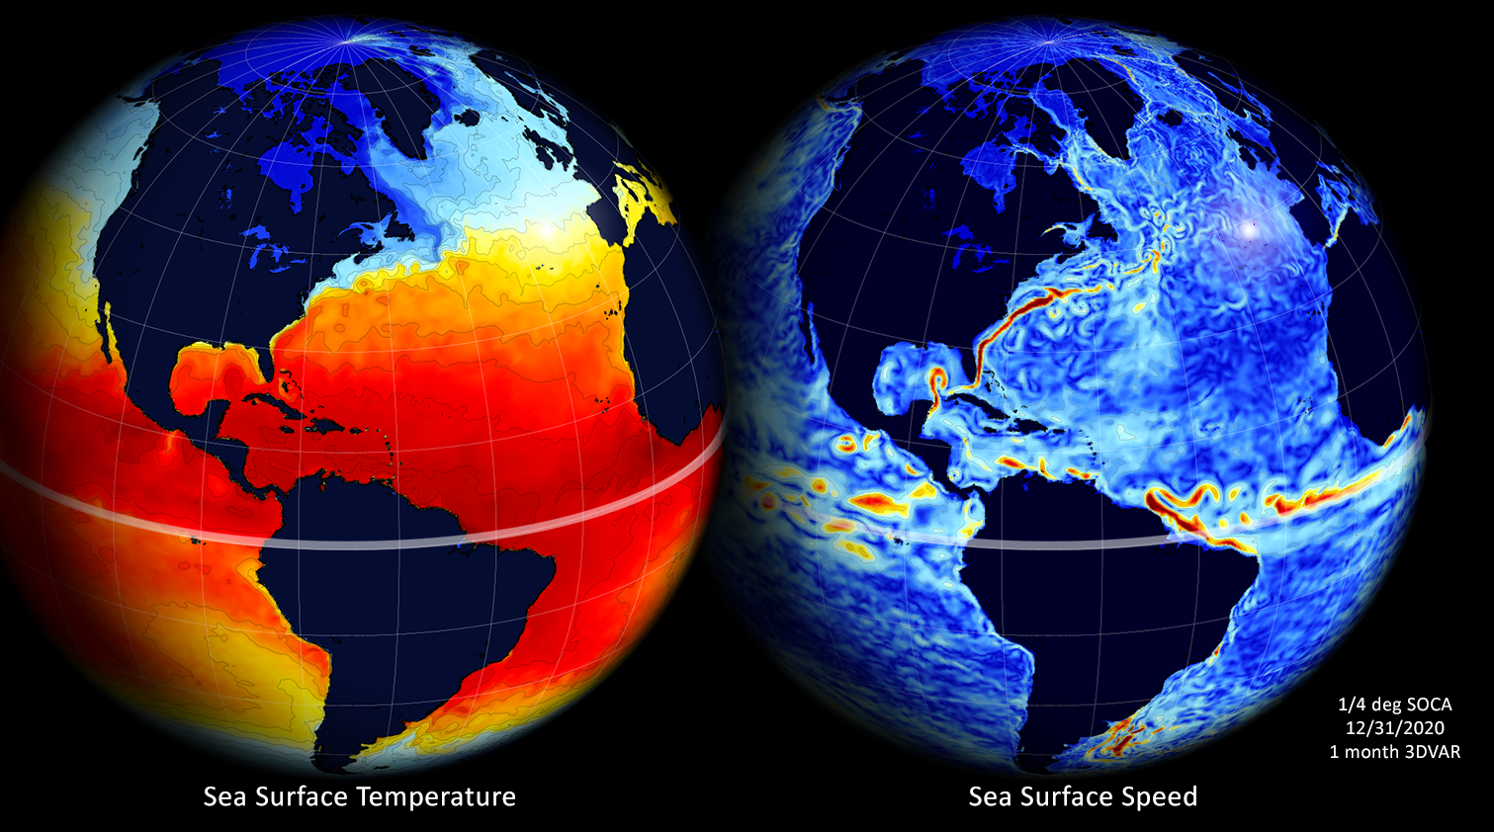
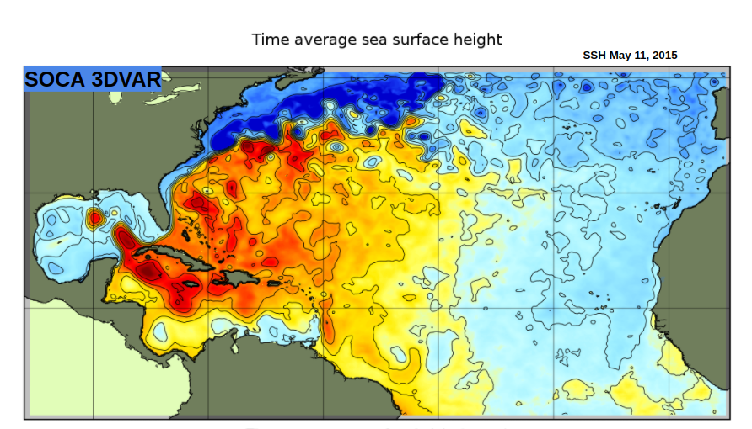
SOCA: targets for NOAA/NASA
Global DA ¼ degree ocean/ice initialization
NOAA NG-GODAS ✅ (40 year 3DVAR reanalysis on AWS)
NOAA GFSv17 / GEFSv13 (initialized using Hybrid LETKF-EnVAR)
NASA GEOS In development for next GEOS system
Regional DA
NOAA 1/12 deg HAT10 regional with eventual benefits for HAFS initialization

Slide 6
SOCA: developing a “menu” of ocean/ice DA options
3DVAR
3DVAR-FGAT
LETKF
Hybrid LETKF-EnVAR ⭐ (target for NOAA operations)
Hybrid EDA-EnVAR
Working now
4DLETKF / 4DEnVAR
SOCA/UFS supported in JCSDA Skylab
2023
4DVAR
coupled multi-component covariance
future JEDI methods (e.g. particle filter)
in progress
2024

Slide 7
SOCA: Built on JEDI
Models
JEDI
JEDI: Joint Effort for Data assimilation Integration
A model and component agnostic toolkit
The ocean DA community is small, any common JEDI parts we use that were developed by other groups (i.e. atmosphere DA) is a win!
A common DA system for all UFS components will accelerate coupled DA science
OOPS generic DA
SOCA (MOM6/CICE6)
SABER B-matrix tools
ROMS
UFO obs operators / obs QC
CRTM radiative transfer model
FV3
OASIM ocean color model
IODA obs IO / database
…
VADER variable transforms
…
continuing to move specific code into generic layers

Slide 8
JEDI: example of common components used by SOCA
SABER - emulating a diffusion operator
Examples of generic JEDI components used (with no, or minimal, coding on our part!)
SABER - static B model. Able to simulate a diffusion operator (normally ocean specific, and difficult to implement correctly), but faster!

Slide 9
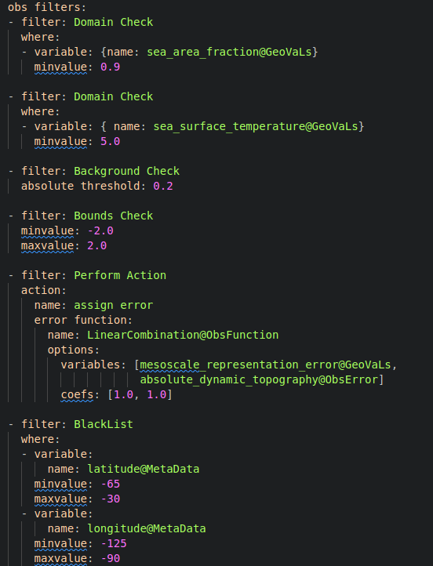
JEDI: example of common components used by SOCA
SOCA - use of generic JEDI components
land mask
Examples of generic JEDI components used (with no, or minimal, coding on our part!)
UFO- Forward operators and QC filters
remove if bkg too cold
O-B check
gross bounds check
obs error inflation
remove troublesome regions

Slide 10
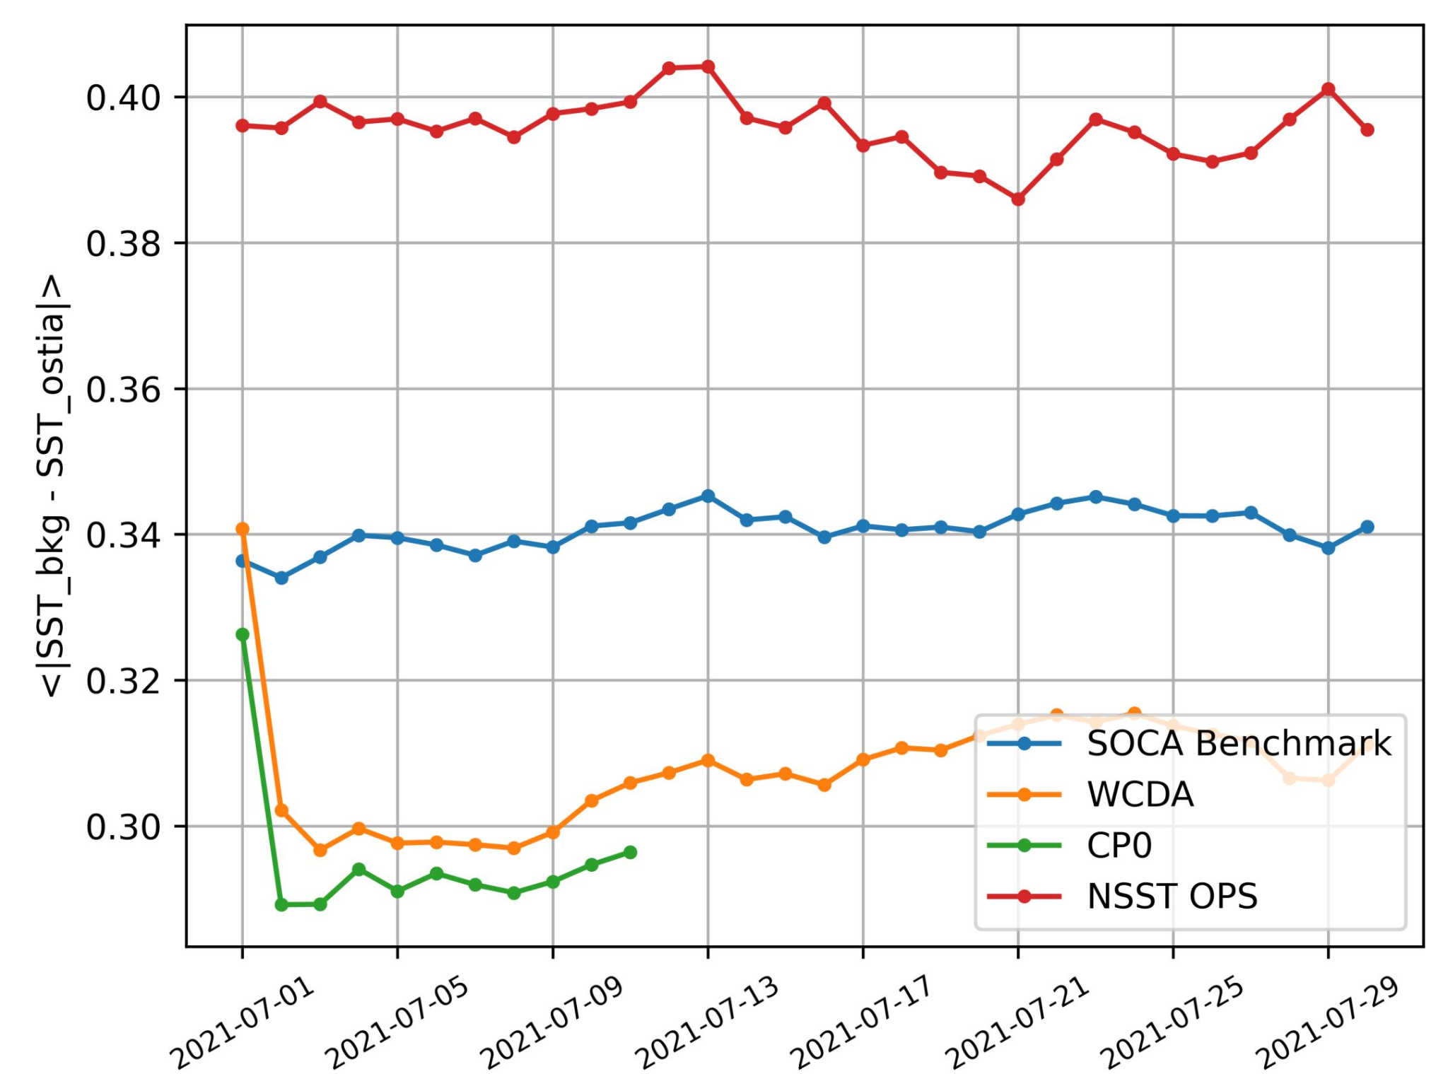
SOCA: Highlight on adoption at NOAA/EMC
SST compared with OSTIA
NOAA/EMC using SOCA for GFSv17/GEFSv13
ocean/ice DA is SOCA Hybrid LETKF-EnVAR
atmo DA is existing GSI (i.e. not JEDI)
The current weakly coupled EMC testbed results so far are very encouraging
Foundation temperature is increasingly better
GSI’s AVHRR radiance O-B improves when SST foundation improves
Ocean current slightly better defined
current operations
ocean only 3DVAR
coupled UFS w/ 3DVAR
Hybrid EnVAR w/ static ens: Status as of 07-11-2023.
Hybrid EnVAR with 30 offline members
(G. Vernieres, NOAA/EMC)

Slide 11
SOCA: Highlight on adoption at NOAA/EMC
AVHRR NOAA-18, channel 3 <|Obs-Bkg|> from GSI/CRTM
NOAA/EMC using SOCA for GFSv17/GEFSv13
ocean/ice DA is SOCA Hybrid LETKF-EnVAR
atmo DA is existing GSI (i.e. not JEDI)
The current weakly coupled EMC testbed results so far are very encouraging
Foundation temperature is increasingly better
GSI’s AVHRR radiance O-B improves when SST foundation improves
Ocean current slightly better defined
GFS
WCDA test (GSI+JEDI/SOCA)
cp0: Status as of 07-11-2023.
Hybrid EnVAR with 30 offline members
More obs passed the GSI QC
Smaller O-B almost everywhere
(G. Vernieres, NOAA/EMC)

Slide 12
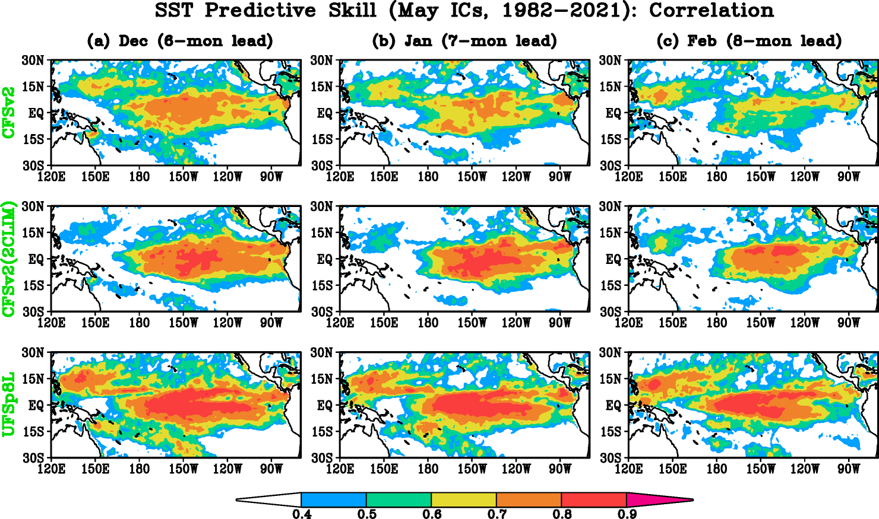
SOCA: Highlight on adoption at NOAA/CPC
NOAA/CPC performing experiments with UFSp8
ENSO hindcast experiments with UFSp8
initialized with SOCA ocean/ice DA (called GLORe here)
The UFSp8 initialized with GLORe has better ENSO forecast than the current operational system (CFSv2)
 | ATM. model | ATM. resolution | OCN./ICE model | OCN./ICE resolution | ATM. IC | OCN. IC | ICE IC
CFSv2 | Spectral GFS | T126 (~100km) L64 | MOM4 +SIS | 1/2deg | CFSR | CFSR | CFSR
UFSp8L | FV3+Thompson microphysics+… | C96 (~100km) L64 | MOM6 +CICE6 | 1deg | CFSR | GLORe | GLORe
(J. Zhu, NOAA/CPC)

Slide 13
SOCA: The future: coupled DA!
By having all earth system component DA under JEDI, we can make progress on coupled DA. Plan to focus heavily on this in 2023/2024
2023: Coupled hofx (surface sensitive radiances)
CRTM - infrared (AVHRR), microwave (GMI),
OASIM - ocean color (PACE/VIIRS/MODIS)
2024: Coupled covariances (observation impacts across components)
via explicit balances (e.g. sea-ice/SST)
via ensemble (LETKF/EnVAR)
FV3
atmo
SOCA
MOM6
CICE6
ocean
sea ice
waves
biogeochem
BLING
WW3

Slide 14
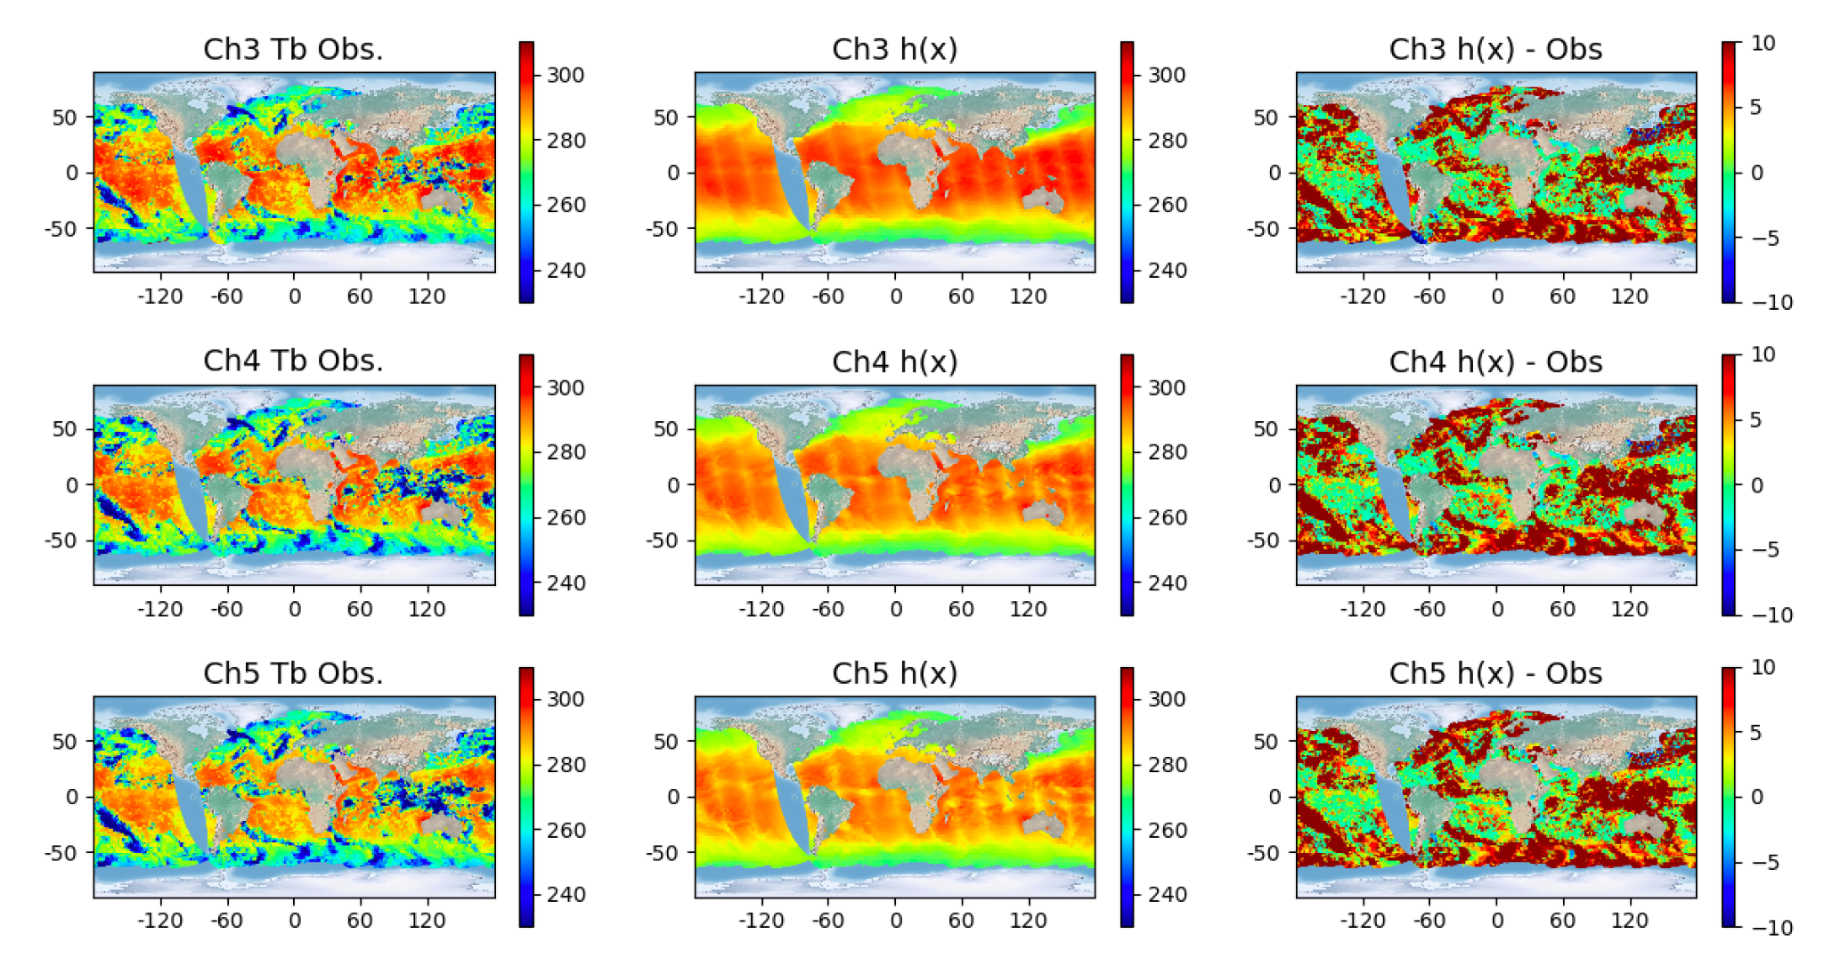
SOCA: The future: coupled DA!
CRTM: SST sensitive IR channels
By having all earth system component DA under JEDI, we can make progress on coupled DA. Plan to focus heavily on this in 2023/2024
2023: Coupled hofx (surface sensitive radiances)
CRTM - infrared (AVHRR), microwave (GMI),
OASIM - ocean color (PACE/VIIRS/MODIS)
2024: Coupled covariances (observation impacts across components)
via explicit balances (e.g. sea-ice/SST)
via ensemble (LETKF/EnVAR)
AVHRR METOP-A (Dec 15, 2020), 24 hour window, GEOS (C360 atmosphere, ¼ degree ocean),
(H. Ebrahimi)

Slide 15
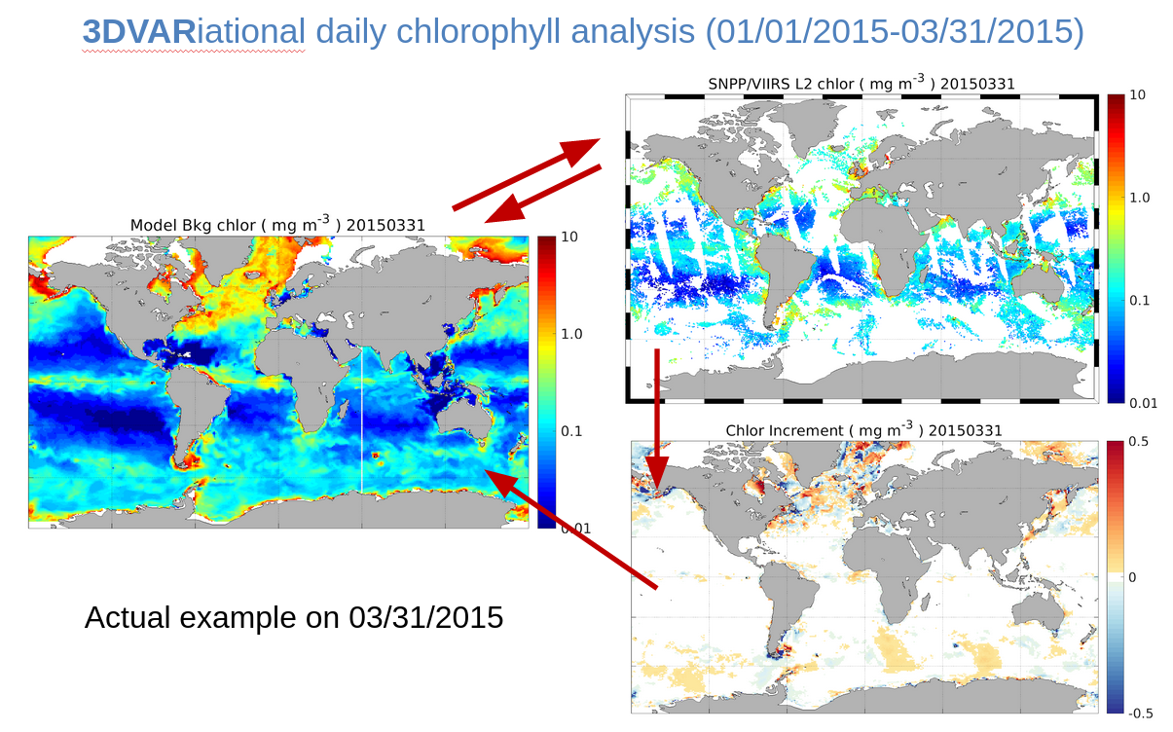
SOCA: The future: coupled DA!
OASIM: Ocean Color DA
By having all earth system component DA under JEDI, we can make progress on coupled DA. Plan to focus heavily on this in 2023/2024
2023: Coupled hofx (surface sensitive radiances)
CRTM - infrared (AVHRR), microwave (GMI),
OASIM - ocean color (PACE/VIIRS/MODIS)
2024: Coupled covariances (observation impacts across components)
via explicit balances (e.g. sea-ice/SST)
via ensemble (LETKF/EnVAR)
(H. Ebrahimi, X. Liu NOAA/EMC)

Slide 16
JEDI-based data assimilation for the UFS marine components
Travis Sluka (tsluka@ucar.edu) SOCA Project Lead (Sea-ice, Ocean, and Coupled Assimilation) JCSDA/UCAR
SOCA: https://github.com/jcsda/soca

