Slide 1



Towards a State-of-the-Art Greenhouse Gas Data Assimilation/ Flux Inversion Modeling System
Lori M Bruhwiler and Andrew Schuh
NOAA Global Monitoring Laboratory & Cooperative Institute for Research in the Atmosphere, Colorado State U.

Slide 2
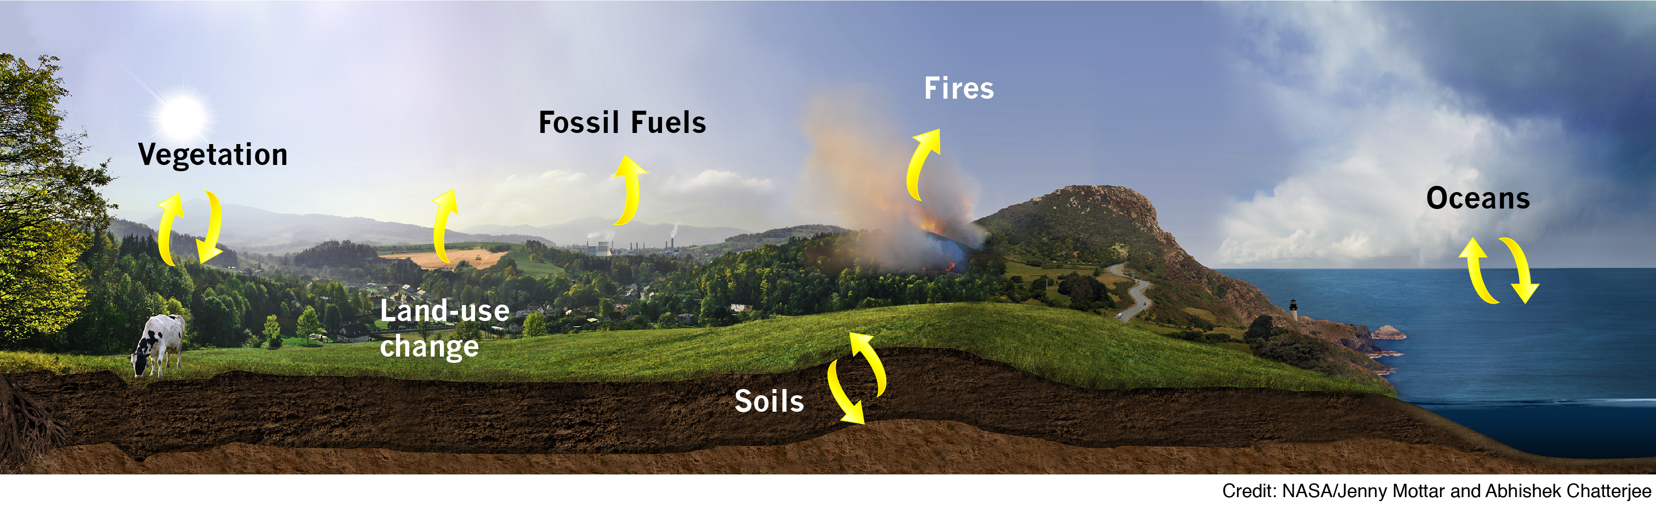
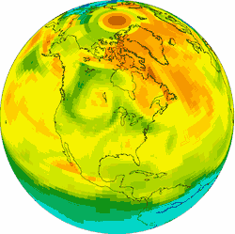
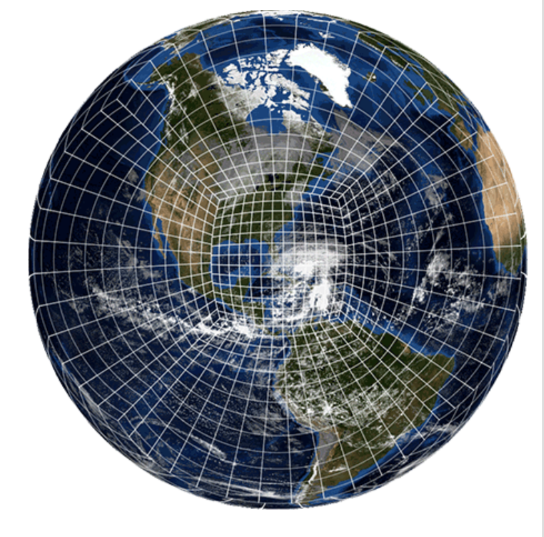
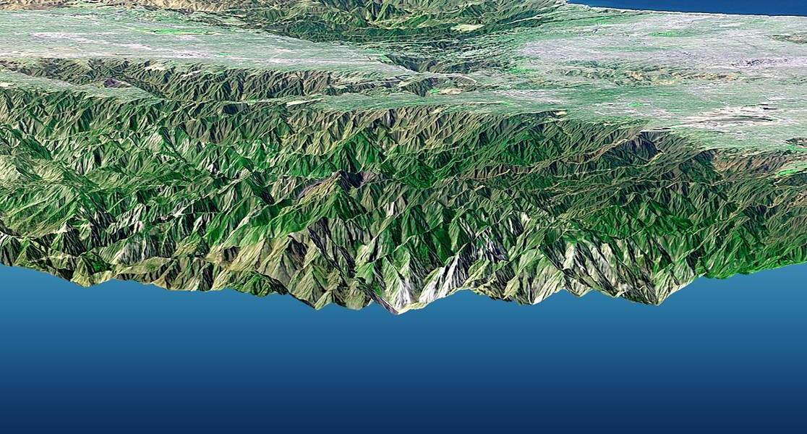

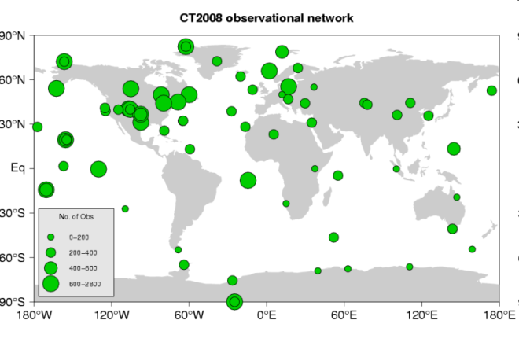
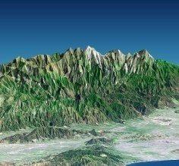
Atmospheric Carbon Data Assimilation/ Flux Inversion
Carbon Flux Models (inventories , wetland models)
Carbon Analyses
Atmospheric Transport Model+ DA/Inversion Techniques (FV3 Development!)
Remotely- Sensed Column Data
In Situ Surface Network Data
Estimated Fluxes
Profiles from aircraft
www.esrl.noaa.gov/gmd/ccgg/carbontracker/
www.esrl.noaa.gov/gmd/ccgg/carbontracker-ch4/
Notes:
1) What we’d like to do:
We a combination of surface and profile in situ observations and column data from remote sensing platforms
Our data are sparse, so we need to also use prior information about sources and sinks
We use the prior sources and sinks along with a transport model to forecast the atmospheric composition state
Finally we use data assimilation/flux inversion methods to retrieve the analyzed atmospheric state and the surface fluxes (e.g. the forcing)
2) What we need:
Adequate observational coverage
Good prior information and atmospheric transport
Uncertainty estimates for the forecast (both the priors and the atmospheric transport)

Slide 3
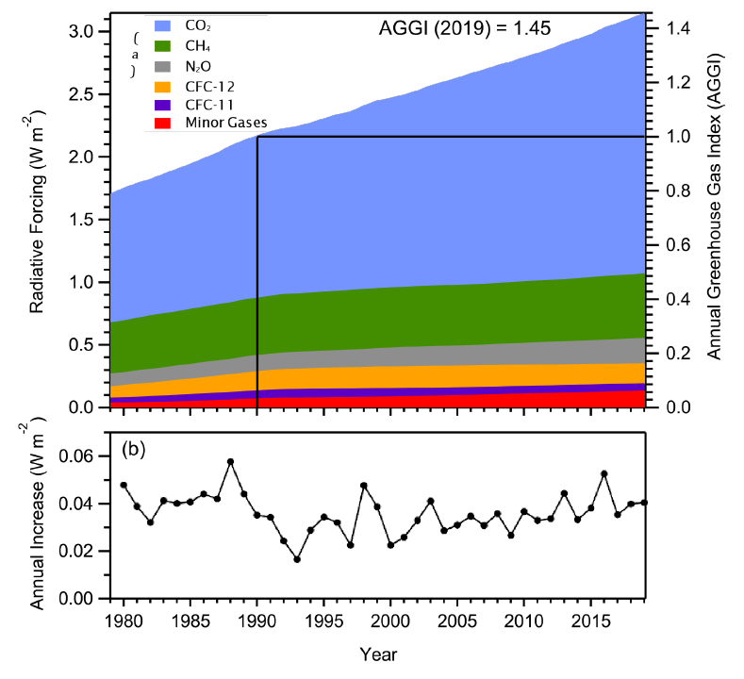
The Role of Anthropogenic Emissions in the Earth’s Energy Budget: Radiative Forcing
The CO₂ contribution is rapidly increasing.
The GWP-100 of CH₄ is 28-36, but there is less of it in the atmosphere.
Using Climate-Chemistry Models (IPCC):
ΔT (CO₂) = 0.75 ( 0.25 – 1.25) ^{º}C
ΔT (CH₄) = 0.5 (0.25 – 0.8) ^{º}C **
**Includes chemical effects on other radiative forcers. CH₄ has an atmospheric lifetime of ~9-10 yrs.
66%
16%
Radiative Forcing = human impact on Earth’s energy budget since pre-industrial times. Units are Watts/meter². Based on NOAA network measurements.
www.esrl.noaa.gov/gmd/aggi
Notes:
Why do we need GHG assimilation/flux inversion systems?
Humans have significantly perturbed the Earth’s energy budget
CO2 and CH₄ dominate radiative forcing and its growth over time.
There are large uncertainties on the contributions of these radiative forcers to the increase in global avg. T due to uncertainties in carbon cycle feedbacks and chemistry
We use the observational record to try to understand chemical and climate feedbacks.

Slide 4

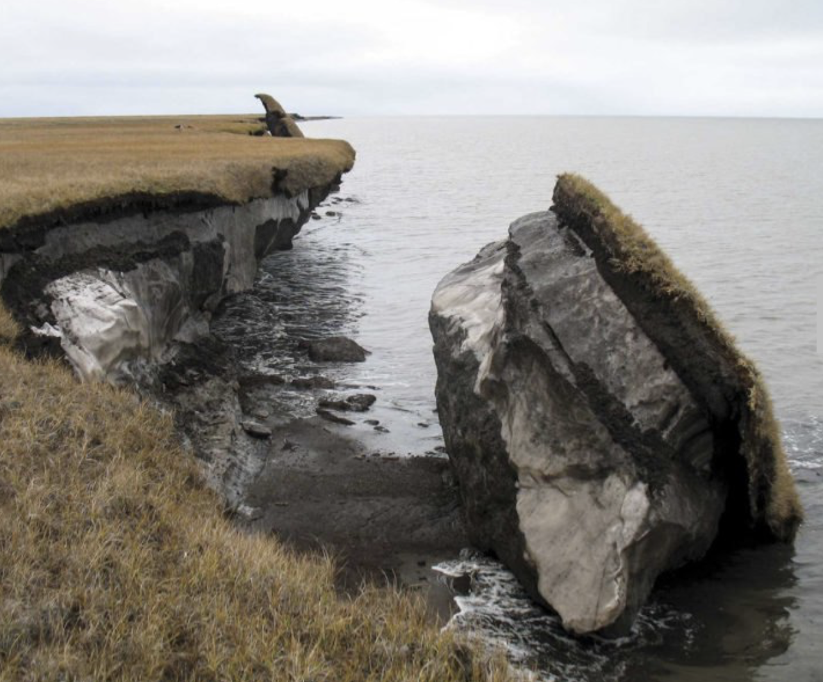
Carbon-Climate Feedbacks
The amount of carbon in Arctic permafrost soils is ~4x what humans have already emitted since preindustrial times.
Arctic CH₄ emissions could double over this century with accelerating increases next century.
Monitoring observations suggest large emission increases are not happening……yet.
Are tropical wetlands drying up or expanding?
Inhabit.com
Notes:
We also need to be aware of possible feedbacks between climate and greenhouse gas budgets. Can we detect them? If so are they captured by models?
Examples of feedbacks between CH4 and climate – Arctic permafrost, tropical wetlands
Some of the vast stores of carbon in Arctic permafrost soils will be mobilized to the atmosphere as CO2 and CH4
How much depends on how warm we let the Arctic get.
Changes in tropical wetlands could also result in changing CH4 emissions.
We need to understand these processes in order to improve our ability to make projections of future climate change, and craft policies that are consistent with climate goals.

Slide 5

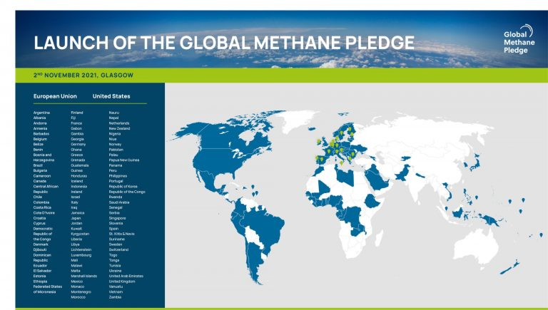
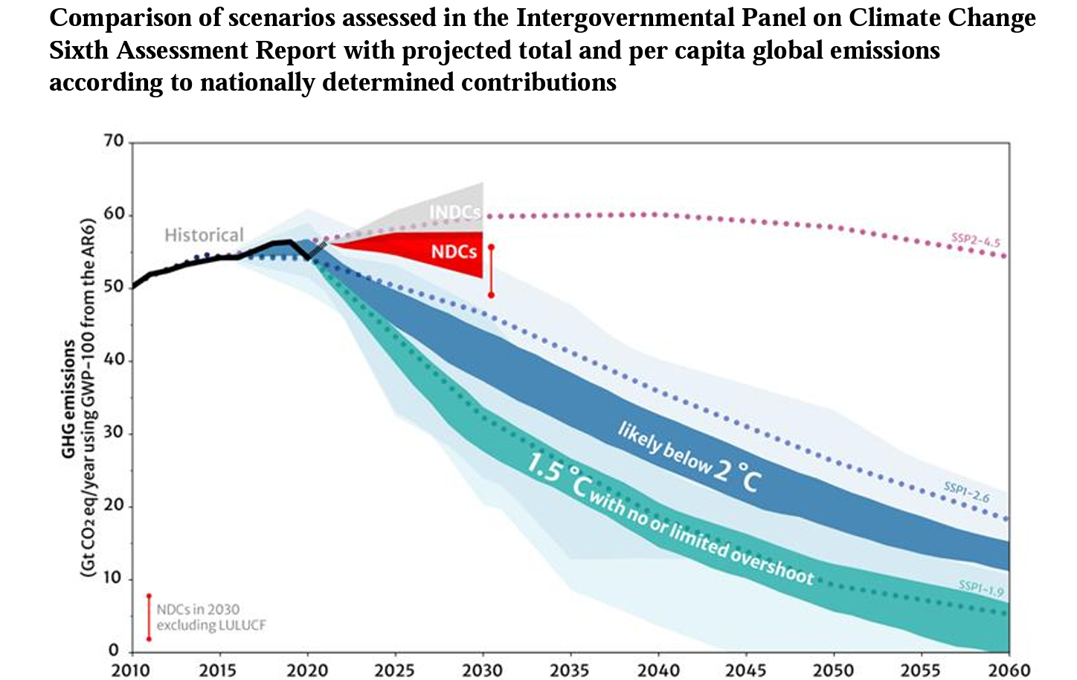
The Need for MMRV (Measuring, Monitoring, Reporting and Verification) of Emissions
Reduce Anthropogenic Emissions of CH₄ by 30% below 2020 levels by 2030
Notes:
Finally, policy considerations: can we verify that plans to reduce emissions are on track?
Can we detect and quantify potential climate-carbon feedbacks? Possibly we have to adjust emission reduction strategies if there are large positive feedbacks.

Slide 6
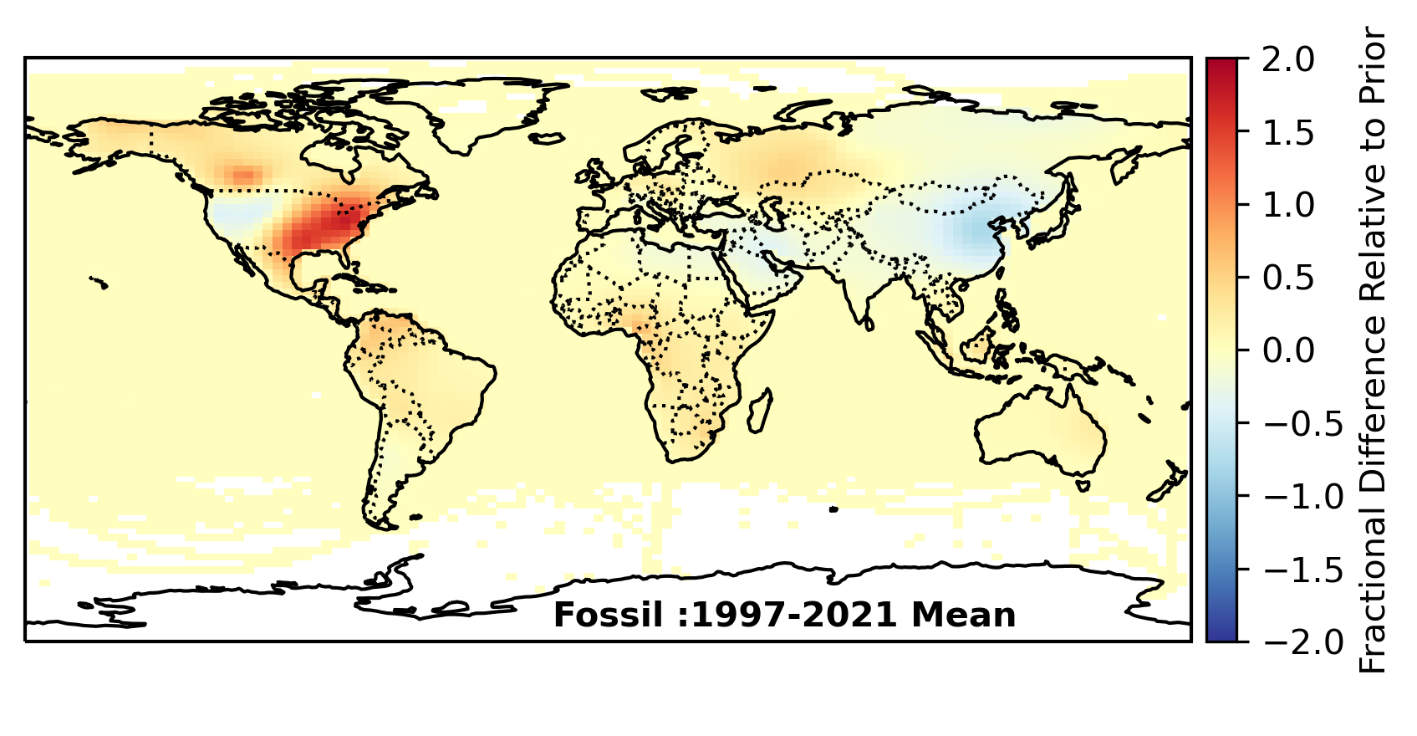
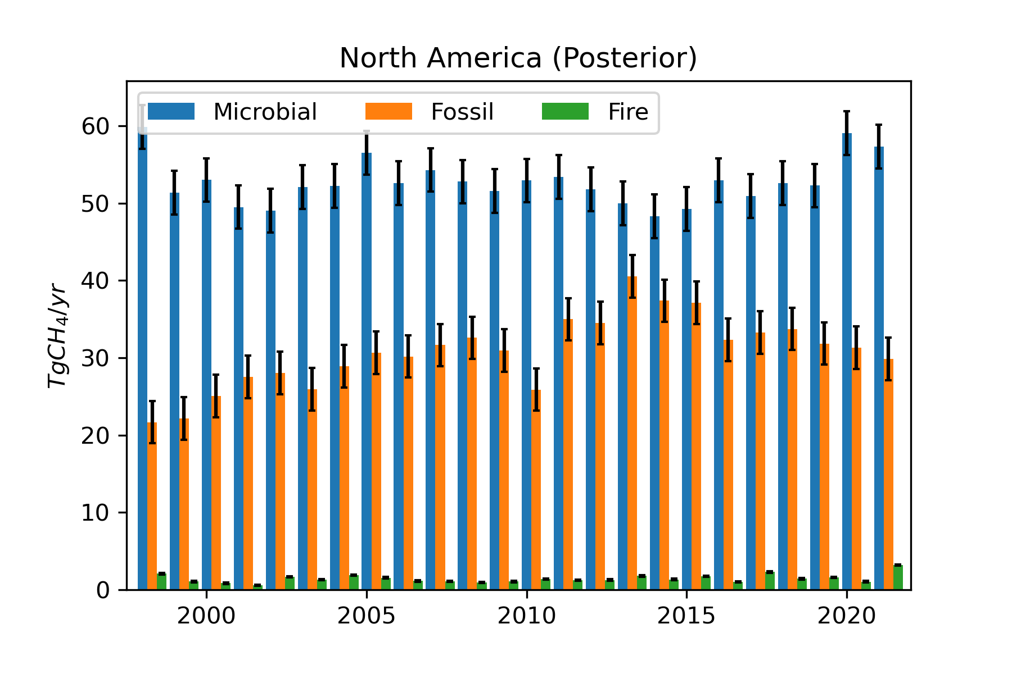
Carbon Tracker-CH₄ :North America
Microbial emissions are the largest contribution.
Fossil fuel emissions are revised upwards from priors due to the isotopic constraint.
Peak fossil fuel emissions occurred between 2010-2015 (note that prior is relatively flat).
Notes:
An example – CarbonTracker-CH4
Inversion wants to adjust US fossil fuel emissions, particularly in the East
The prior is flat but there are trends recovered by the inversion.

Slide 7
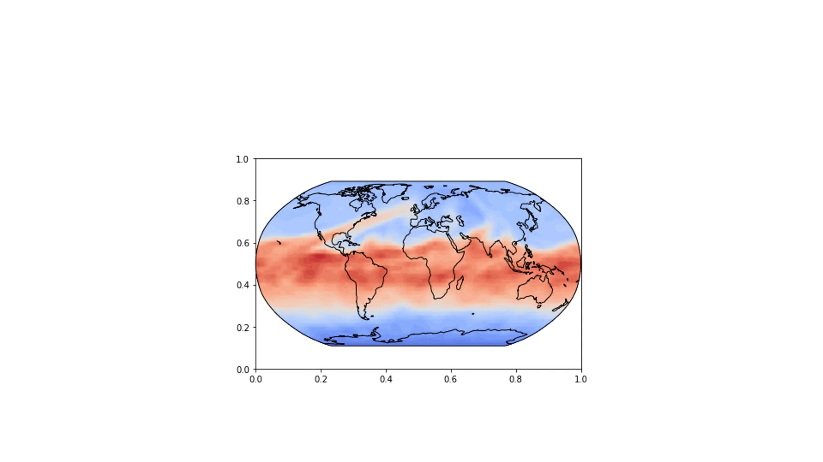
Why Should We Consider Using UFS-Chem?
To better simulate observations, we need higher spatial and temporal resolution than is currently possible in our existing CarbonTrackers. We could resolve emissions at finer spatial scales.
We are currently dependent on our European colleagues for our global transport model and driving fields.
Can we use the GEFS reanalysis ensemble to independently estimate model transport error?
Carbon and moisture exchanges are fundamentally linked – what could we learn from including a detailed treatment of the carbon cycle in the LSM?
Forecast CH₄ 050120
Notes:
Why do we want to consider using the UFS?

Slide 8
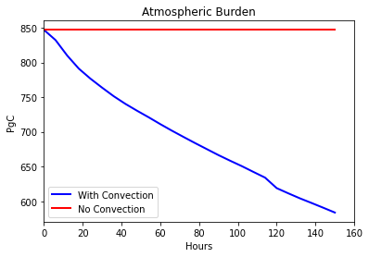
Mass Conservation and Dry Airmass:
We measure dry, not specific mole fractions
Dry air mass can be calculated using UFS model pressure level thickness, specific humidity and condensates. But formulation of parameterizations affecting moisture variables can adversely impact tracer mixing ratio.
Successive reinitialization of the simulation can introduce analysis shocks that can also lead to non-conservation of tracer mass.
The Experiment:
Constant CO₂ field (400 ppm)
No sources/sinks/deposition

Slide 9
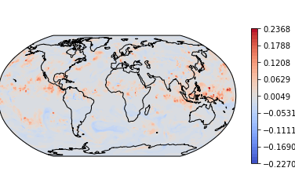
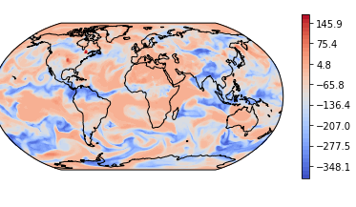
Mass Conservation and Dry Airmass: Tracer Gradients 500hPa, 6 Days
No Convection
Colorbar: Departure from 400 ppm
The Experiment:
Constant CO₂ field (400 ppm)
No sources/sinks/deposition
20160715-20160721

Slide 10
Progress is Possible: The OLAM Model
Total global tracer mass is conserved
A “uniform” tracer field, e.g. 400ppm dry mix ratio, remains well mixed and doesn’t “unmix”
Results from 7 day forecast of full model showing errors ~ 0.00002%
surface
2000 meters
Notes:
There are two very desirable qualities for trace gas modeling in GCMs or CTMs that can be summarized quite nicely in two requirements, of which most people will be shocked are rarely satisfied. First, in a free running global simulation, one needs global tracer mass to be conserved. Secondly, and much more difficult, is that a uniform dry mixing ratio field stays well mixed. Results from the latest OLAM model are shown at the bottom of this slide. They show maximum errors on the order of 2-e04 against a 400 ppm background for a 1 week simulation. They come completely from the convective parameterization, and disappear when trace gas mixing is turned off in the Grell/GF convection scheme. While this requirement is often baked into CTMs via dry mass transport, this is extremely rare to be able to show in a GCM, GEOS can’t do it, the developing NOAA forecast model can’t do it, and although MPAS should be able to do it, I haven’t seen results yet..

Slide 11
Conclusions
Conservation of tracer mass and local gradients must be addressed before UFS-Chem can be used for greenhouse gas data assimilation/flux inversion
Convective parameterizations appear to be the largest source of error in tracer mass conservation.
It is certain that this problem will exist for other long-lived trace species and is likely to exist for shorter- lived trace species
It is possible to fix these problems, but will like require accurate tracking of the water budget.
Fixing the problems could potentially lead to better predictions.
Notes:
There are two very desirable qualities for trace gas modeling in GCMs or CTMs that can be summarized quite nicely in two requirements, of which most people will be shocked are rarely satisfied. First, in a free running global simulation, one needs tracer mass to be conserved. Secondly, and much more difficult, is that a uniform dry mixing ratio field stays well mixed. Results from the latest OLAM model, from yesterday, are shown at the bottom of this slide. They show maximum errors on the order of 2-e04 against a 400 ppm background for a 1 week simulation. They come completely from the convective parameterization, and disappear when trace gas mixing is turned off in the Grell convection scheme. While this requirement is often baked into CTMs, this is extremely rare to be able to show in a GCM, GEOS can’t do it, the developing NOAA forecast model can’t do it, and although MPAS should be able to do it, I haven’t seen it yet from it.

