Slide 1
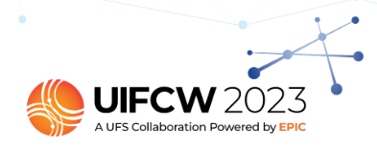
Unifying Innovations in Forecasting Capabilities Workshop
Emerging Applications 2 - Space Weather
Going Beyond the Terrestrial
Space Weather Verification Using METplus
JONATHAN L. VIGH
PROJECT SCIENTIST I
Joint Numerical Testbed - Research Applications Laboratory – National Center for Atmospheric Research
3:00 PM Thursday, 27 JULY 2023
Notes:
NOTE: Background image can be used as is or changed for a particular presentation in the “Slide Master” button found under the “View” tab.

Slide 2
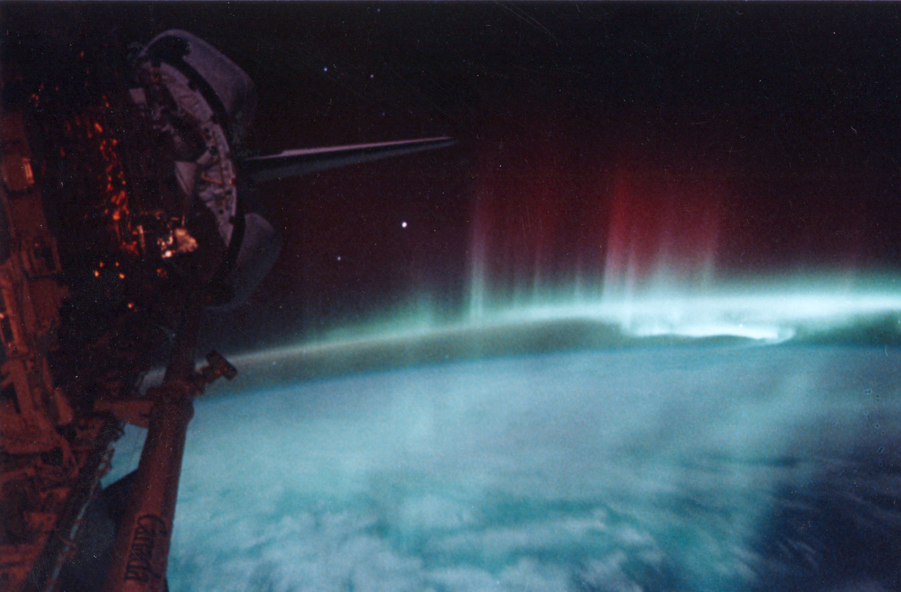
NCAR and SWPC Team
Jonathan L. Vigh¹, Terrance G. Onsager², Tara L. Jensen¹, Dominic J. Fuller-Rowell³, Jun Wang³, Mihail Codrescu², Tibor Durgonics³, Charlotte Martinkus³, Naomi Maruyama⁴, Frank Centinello², Timothy J. Fuller-Rowell², Robert Steenburgh²
(1) National Center for Atmospheric Research, Boulder, CO, United States
(2) NOAA Space Weather Prediction Center, Boulder, CO, United States
(3) University of Colorado/CIRES, Boulder, CO, United States
(4) University of Colorado/LASP, Boulder, CO, United States
NASA (Crew of STS-39)

Slide 3
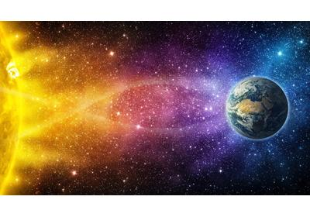
Overview
The Space Weather Prediction Center Real-time Evaluation System (SWPC-RT) is a platform-independent, container-based verification system whose purpose is to apply advanced methods and techniques to space weather verification
SWPC-RT provides:
Ability to bring the capabilities of METplus to bear on space weather evaluation
The capability to read analyses, model output, and forecasts in their native data formats
Embedded support to conduct interactive interrogations of verification sets using METViewer
The ability to use other Python packages to do complex calculations on geophysical datasets

Slide 4
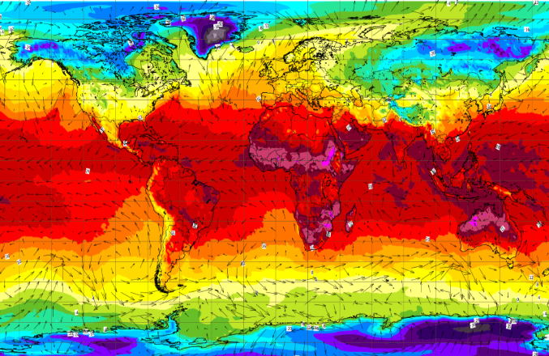
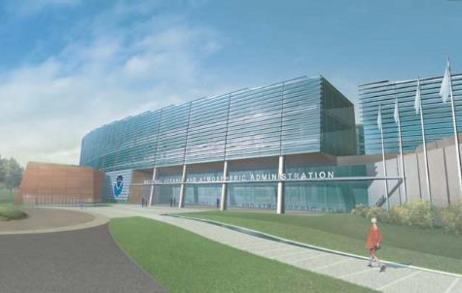
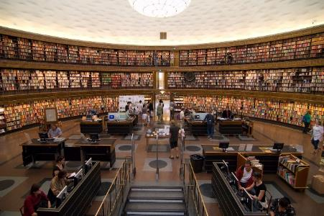
Why METplus?
Highly-configurable, state-of-the-art suite of verification tools, a suite of python wrappers, and other supporting capabilities allow for complex real-time and retrospective verification workflows to be simplified and codified for
robustness and reproducibility.
Forecasters Operational Centers Universities & national labs
Comprehensive and Unified Verification Tools *Make R2O more efficient *Provide a consistent set of metrics
Allows researchers and operational scientists to speak a “common verification” language
User support of unified package provides greater opportunity to train all on verification best practices
Highly-configurable, state-of-the-art suite of verification tools, a suite of python wrappers, and other supporting capabilities allow for complex real-time and retrospective verification workflows to be simplified and codified for robustness and reproducibility.

Slide 5
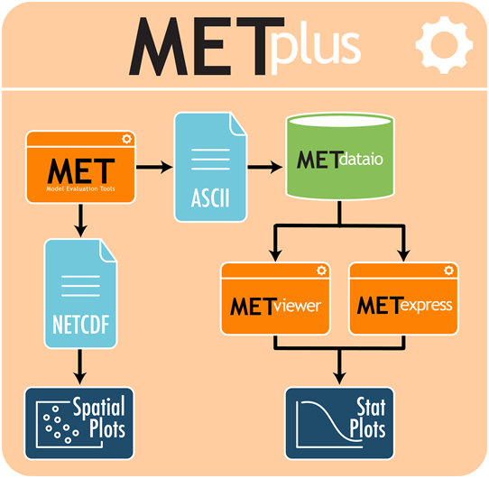
What is METplus?
Over 100 traditional statistics and diagnostic methods for both point and gridded datasets
15 interpolation methods
Applied to many spatial and temporal scales
Developed to allow for easy sharing of config files for reproducible results
3500+ users; US and International
At the core of EMC Verification System for UFS

Slide 6
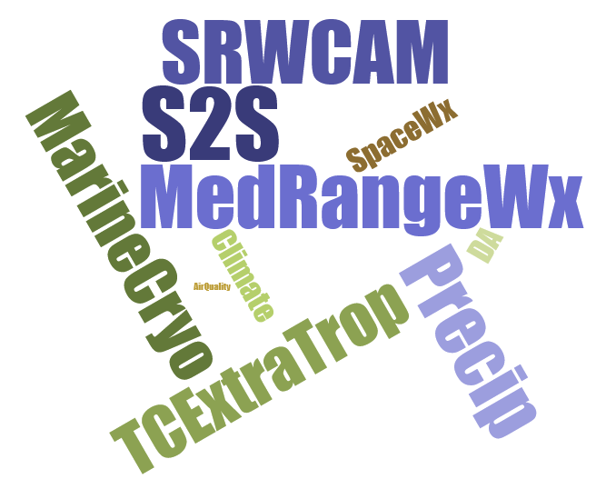
What is METplus?, cont’d
Suite of Python wrappers around:
MET tools (core)
Traditional statistics
Spatial methods
Additional diagnostics
Database and display systems
METviewer for deep dive data interrogation
METexpress for quick analysis
Analysis and plotting tools
Python tools support database and display systems
Developing command line option to run on HPCs and in containers

Slide 7
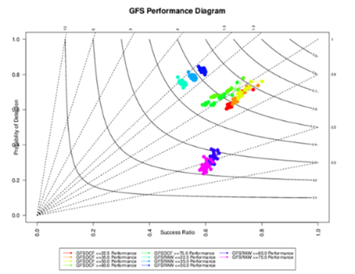
Design of real-time system
Datasets
GloTEC
WAM-IPE
CTIPe (coming soon)
COSMIC-II
MIT gnss
Supported platforms:
Linux
MacOSX
WSL-2
Configuration: Define use cases / dates to run
Gridded comparisons
Object-oriented comparisons
Verification of human forecasts
Gradient comparisons
Python driver +
METplus
MetPy
Python Embedding Reads non-standard data and format to pass to MET Tools
One main configuration file
MET: Grid-Stat
MET: MODE
MET: Point-Obs (coming soon)
Graphical Products
& Scorecards
MET: Stat-Analysis
Statistics
METdataio
METviewer
Notes:
The real-time evaluation system uses a containerized workflow of discretized tasks facilitated by the METplus tools.
The python-based driver can be run regularly by cron or a workflow manager.
It defines the high-level analysis, which kick off METplus use cases and the associated tool wrappers.
These pull in the data either directly from the datasets (via NetCDF) or using python embedding.
METplus wrappers mediate the interactions between the data and MET tools, resulting in statistics output.
These will be loaded into METdb.
Then METviewer will undertake the generation of products such as plots and scorecards.
All use cases are specified from one main configuration file
Allows for stacked or chained workflows across multiple models/products
System is containerized, so there is no need for complicated installs

Slide 8
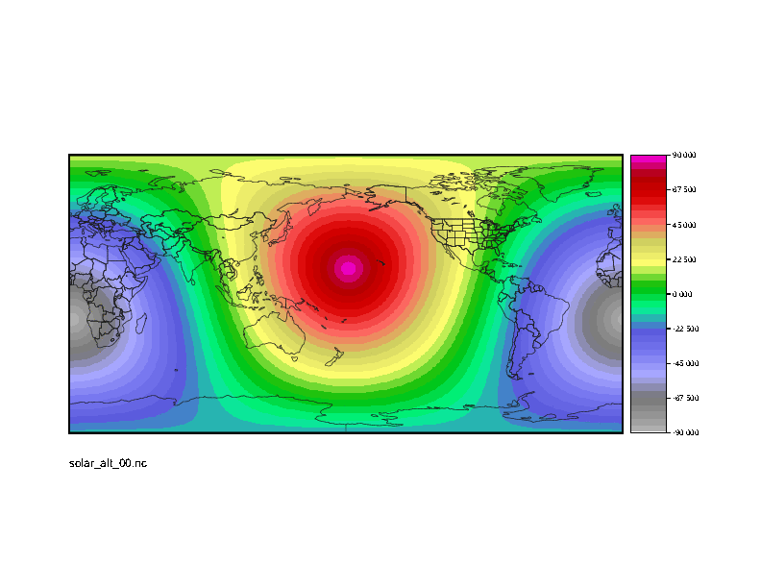
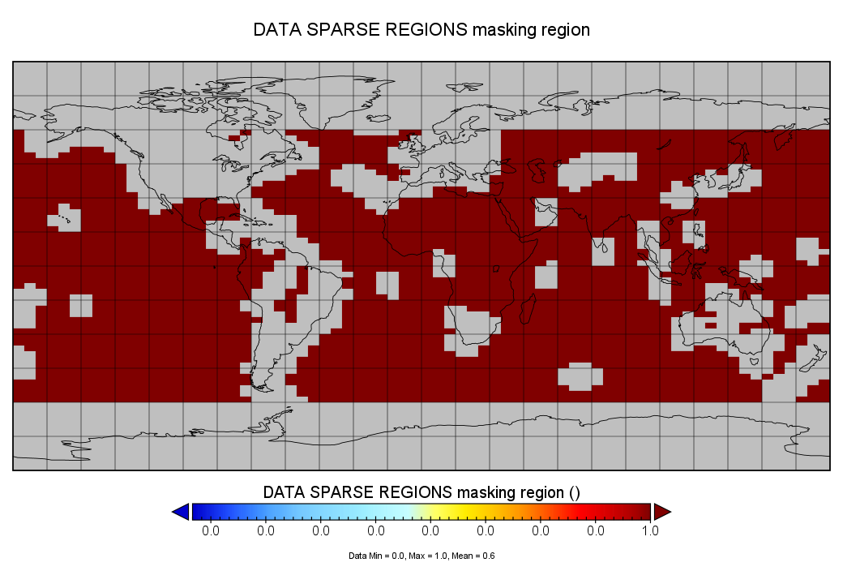
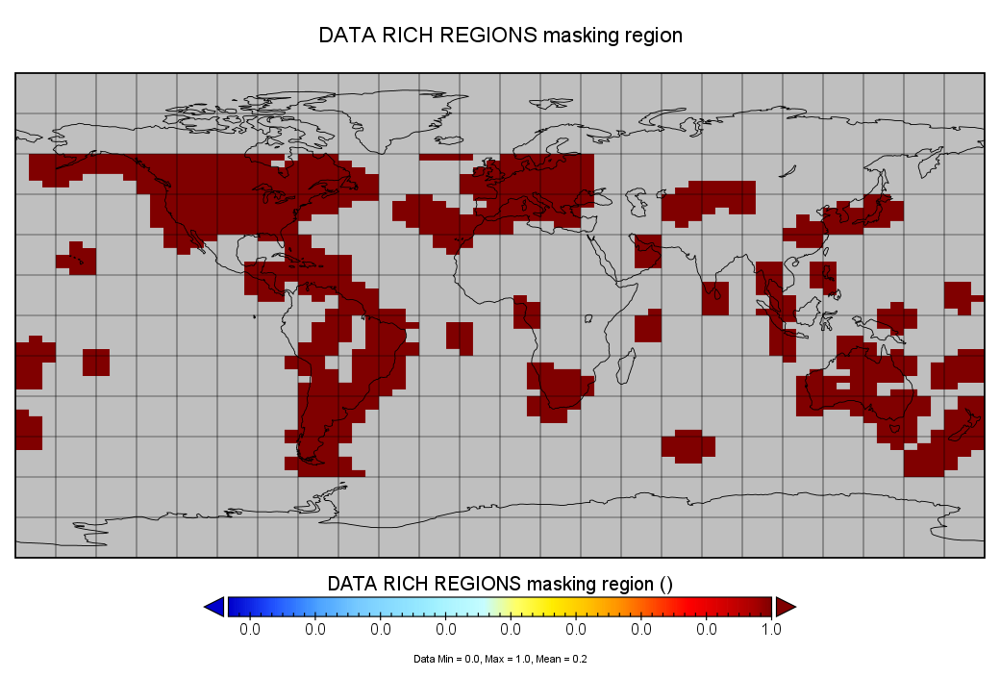
Gridded Comparisons
SWPC-RT uses METplus’ GridStat tool to undertake gridded comparisons of models with analyses.
Key adaptations for the space-weather domain include:
Adaptation for space weather variables like Total Electron Content (TEC)
Custom masks, e.g., distance from ionospheric ground stations
Time-dependent masking by
azimuthal solar angle
quality flag based on the # of Radio Occultation (RO) rays
Python embedding scripts to read data in its native format

Slide 9
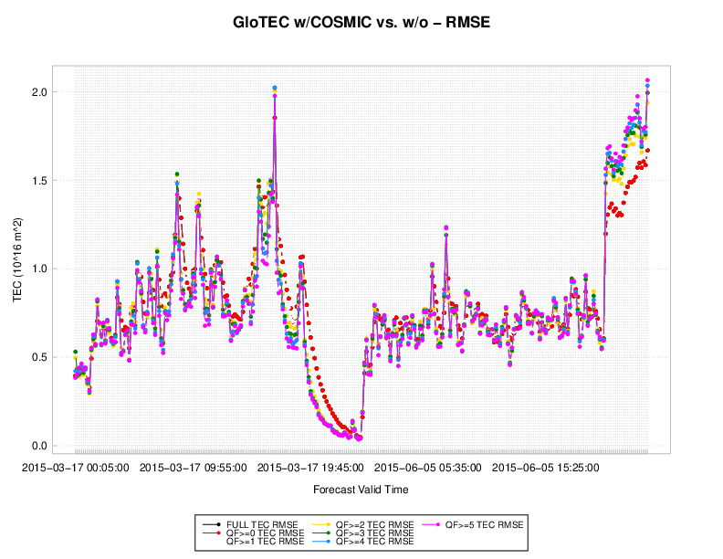
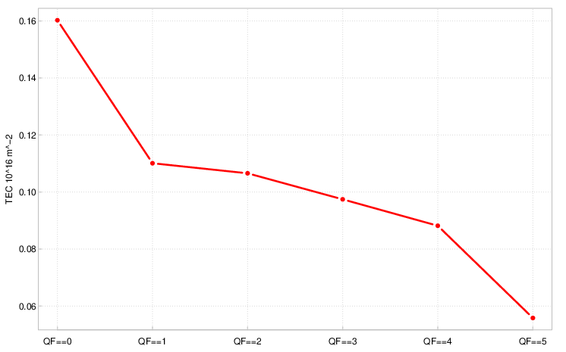
Examples of Gridded Comparisons
Evaluation of impact of Radio Occultation (RO) data on GloTEC analyses
More difference
in data sparse
regions
Less difference
when ground-based observations
available
SWPC has been using these capabilities to evaluate real-time RO data from vendors for the Commercial Weather Data Program (CWDP)
Notes:
Global Total Electron Content (GloTEC)
Combines ground-based and space-based (COSMIC) GPS/GNSS observations to create a 3D assimilative map of the ionosphere
Provides specification to many users including GPS/GNSS and satellite communications

Slide 10
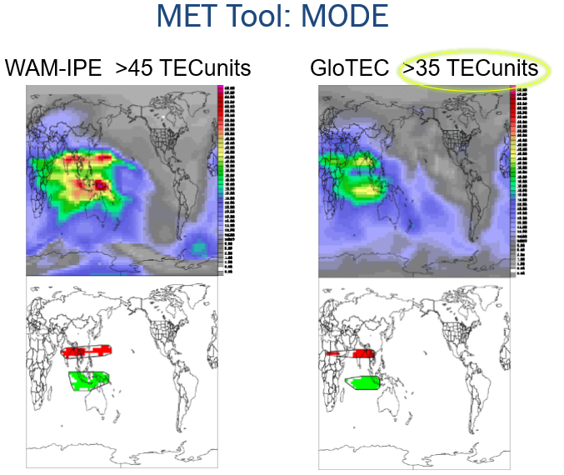
Object-Oriented Comparisons
METplus’ MODE tool allows object-oriented comparisons of gridded the physical models (e.g., WAM-IPE) with an empirical model analysis (GloTEC)
This allows examination of object attributes such as:
centroid distance
area ratio
axis angle
intensity ratio
Object-oriented comparisons helped SWPC identify a bias in WAM-IPE in which TEC in high regions was ~10 TEC units greater than GloTEC

Slide 11
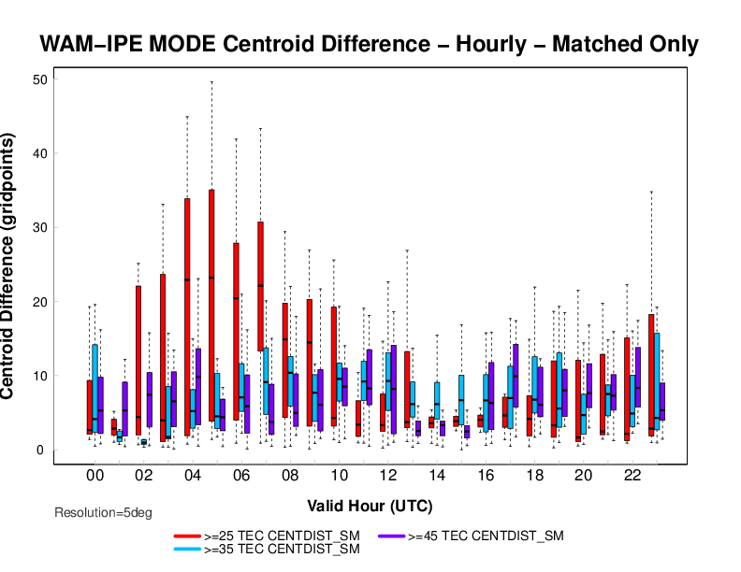
MODE Example
Distribution of differences in centroid difference between objects in the two models by valid hour for different object thresholds
Differences are relatively small for the high-value TEC objects. There is quite a bit of diurnal variation at the lower TEC thresholds

Slide 12
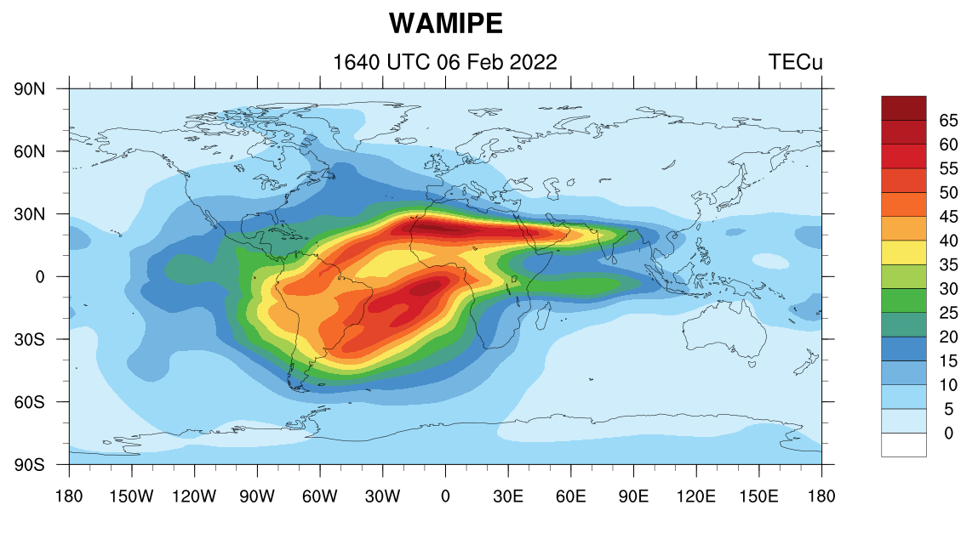
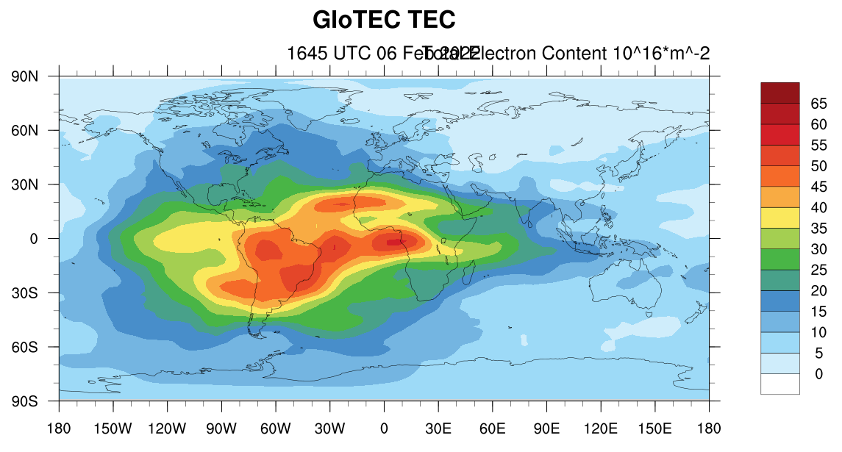
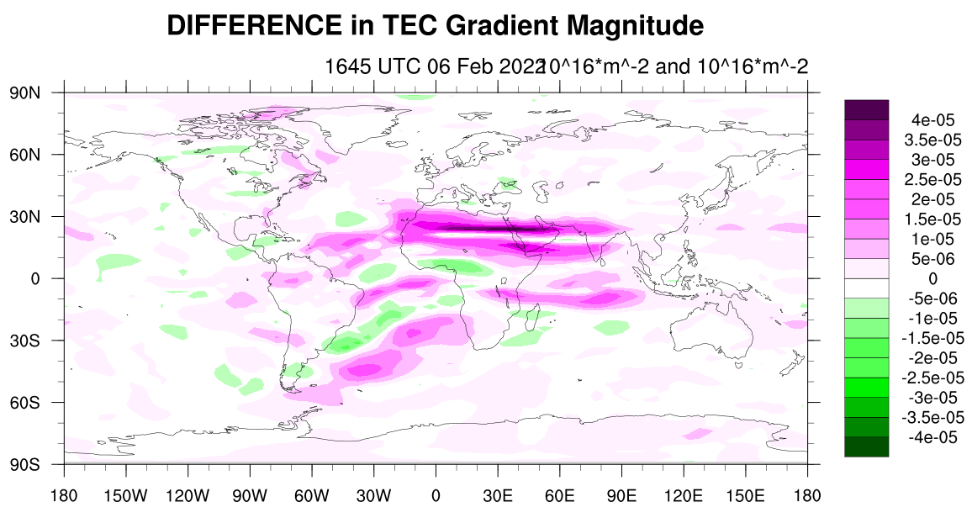
TEC gradient comparisons
TEC gradients lead to instability which can cause ionospheric irregularities
The resulting undulations can lead to scintillation, which can significantly impact radio communications
A new use case allows SWPC-RT to compute the gradient magnitude of TEC and compare these between model and analysis

Slide 13
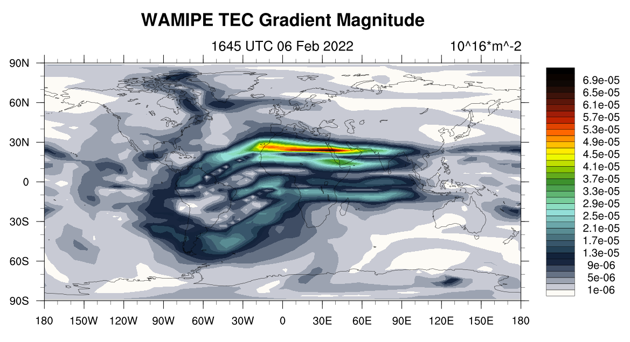
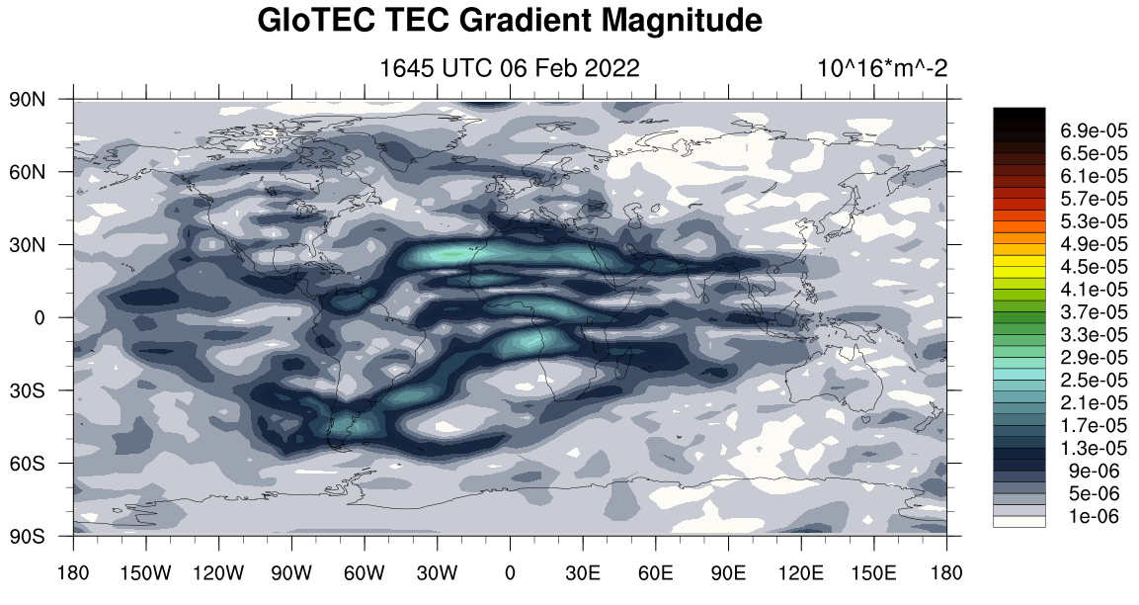
TEC gradients
MetPy’s geospatial_gradient function used to calculate the gradient magnitude for each field
Computation is done at the time it is read into the system using python embedding
This function computes the gradient accurately on the sphere using map factors.

Slide 14
Scintillation
Scintillation is likely near areas of high TEC gradients
Goal of future development is to explore the relationship between TEC gradients and point observations of scintillations

Slide 15
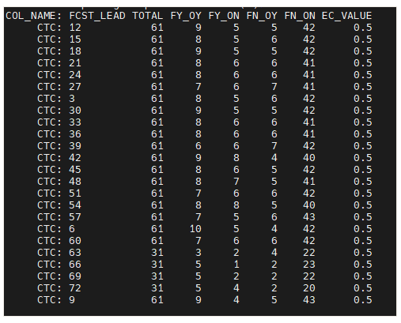
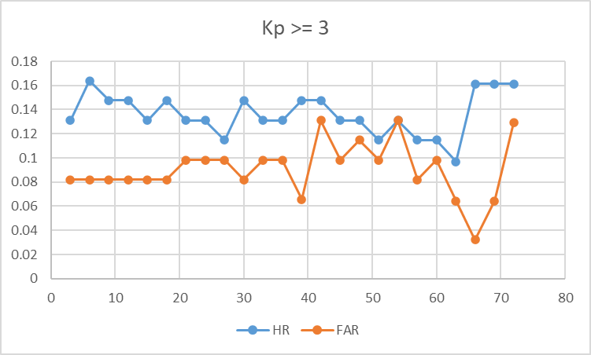
Verification of human forecasts
Event: Kp >=3
SWPC’s human forecasters provide forecast the Kp index
The input data are in Json format
This use case computes contingency tables by forecast lead time
Event being forecast is a threshold of Kp >= 3
Each line is a separate contingency table for the respective forecast lead time
FY_OY means the event was forecast and it was also observed (a “hit”)
FY_ON gives the number of times that the event was forecast but not observed (a “false alarm”), etc.

Slide 16
Thank you for your attention
Jonathan Vigh, jvigh@ucar.edu
Tara Jensen, jensen@ucar.edu
Terry Onsager, terry.onsager@noaa.gov
METplus Resources
METplus home page: https://dtcenter.org/community-code/metplus
METplus discussions support: https://github.com/dtcenter/METplus/discussions
METplus documentation: https://metplus.readthedocs.io/en/latest/Users_Guide/

